Slide 1
Introduction to Relational Databases with MySQL
Trip Ottinger

Slide 2
DAY 2
Basic SQL Statements
SELECT
JOINS
GROUP BY
HAVING

Slide 3
Git Hub Exercise: Syncing your Local Fork with the Instructor’s new files. In this exercise we will sync your Fork to the changes made in the instructor’s chscodecamp/mysql101 repository’s master branch.

Slide 4
Create a DB from a script
Create a new database named RockStarDay2
Create tables within the database and populate the tables with data.
.sql script file that contains a series of SQL commands.
We will pipe the instructions stored within a file named rockstar.sql.
$ mysql < C:\Users\tripot\Dropbox\CharlestonCodes\MySQL\SQLScripts\RockStar\rockstar.sql -u root –p

Slide 5
Exercise 1: Creating a Database from a .SQL Script FILE
Page 26

Slide 6
Select Statements
Using SQL you can retrieve data and even change data
Data Manipulation Language statements (DML)
Ex: SELECT * FROM CUSTOMER
define the data structures i.e. create tables
Data Definition Language (DDL)

Slide 7
The SELECT Clause
Use the SELECT clause to retrieve data
Use * to grab all the columns. Not usually a good idea.
Specify columns in SELECT
SELECT ID, FirstName, LastName, BirthDate FROM Individual;
Use only use the least amount of columns in your SELECT statement
SHOW COLUMNS FROM Band

Slide 8
Exercise 2: Building a SELECT Statement
USE RockStarDay2;
SELECT * FROM INDIVIDUAL;
The exercise begins on page 27 and end on page 29

Slide 9
Restricting the Rows Returned
SELECT identified the columns to return
WHERE clause determines the rows to return

Slide 10
Exercise 3: Taking the WHERE clause for a spin
Exercise 4: Translating Requirements to SQL statements
Page 34

Slide 11
SQL Wildcards
Use Wildcards with the LIKE operator within a WHERE clause
Wildcards enable pattern matching
Select * from Individual WHERE FirstName LIKE ‘L%’;
SELECT * FROM Band WHERE Name LIKE ‘%Stones’;
Select * from Individual WHERE FirstName Like ‘_ob’;

Slide 12
Exercise: Using Wildcards in a WHERE
Try out some wildcard characters in your WHERE clauses
Try your hand at deciphering the requirements into your own SQL statements

Slide 13
JOIN
An INNER JOIN is the most common type of join.
Only output rows that match between tables
An INNER JOIN clause is used to join two or more tables together based on a common field to produce a result set.
Product
Product options

Slide 14
Base and Derived Relations (Tables)
Tables are called "base relations" because they store data.
You can create a derived relation by relating one or more relations together.
Derived relations do not store data.
Derived relations are implemented in the database as a View. A view can be created with a SQL SELECT query.
Derived relations are convenient in that they act as a single relation, even though they may grab information from several relations (tables).

Slide 15
Demo: JOIN two tables together
Using the CreateOutdoorOutfitters.sql
Open the script and executue piece of the script
Let’s create a new table named ProductOption that displays product options for a product like a bicycle.
Create a Foreign Key back to Product
Let’s use the JOIN statement within a SELECT to JOIN two tables together
Let’s take the SELECT statement as the basis for a VIEW

Slide 16
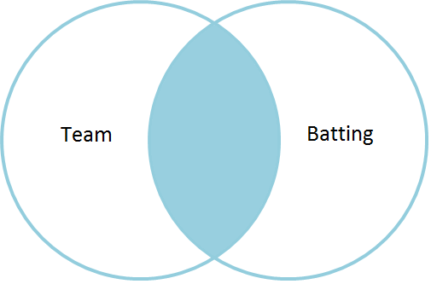
INNER JOIN
Demo: Joining the Team table to the Batting table via the Team ID.
SELECT <Column List>
FROM <Table_A> INNER JOIN <TABLE_B> ON <Table_A>.<Column_Name> = <TableB>.<Column_Name>

Slide 17
Exercise: Using an INNER JOIN
Let’s create and populate a new database named ‘baseball’ via a sql script file named ‘baseball.sql’.
Explore some tables in the database
Try some joins.
Learn about Views

Slide 18
LEFT JOIN
Produces a complete set of records from the table on the LEFT side of the JOIN
LEFT JOIN is the same as LEFT OUTER JOIN
In the following statement which table will have all rows returned? Which one is on the LEFT side of the JOIN?
Answer on the next slide.

Slide 19
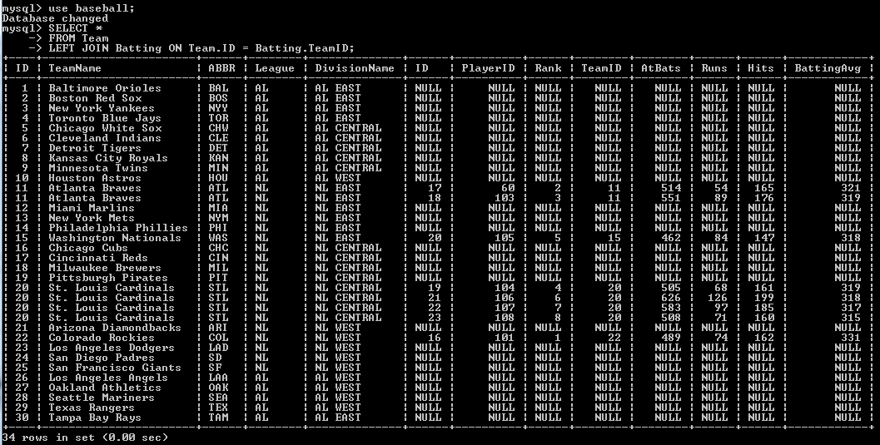
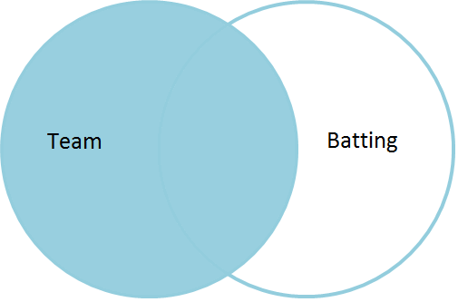
Which table will have all rows returned?
SELECT *
FROM team
left join batting on team.ID = batting.TeamID;

Slide 20
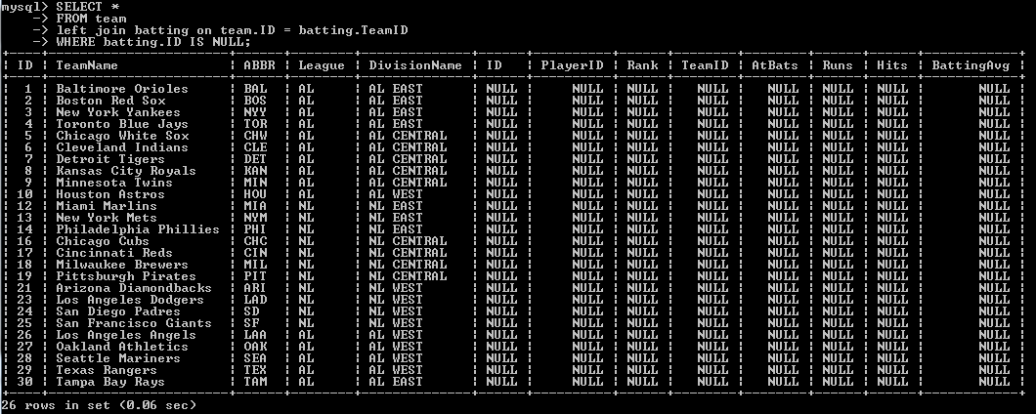
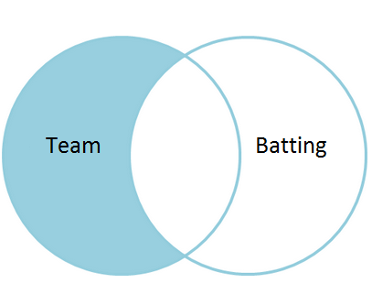
Consider this query…
What if we wanted to produce a listing of teams that did NOT have any batting leaders?
We could use a where clause to only show NULL rows from the batting table:
SELECT *
FROM team
left join batting on
team.ID = batting.TeamID
WHERE batting.ID IS NULL;

Slide 21
Exercise: LEFT JOIN
Create a SELECT statement that joins the player table and the batting table.
The query should show all the players and any matching players that exist within the batting table.
You should see NULL when there are no matches in the batting table.

Slide 22
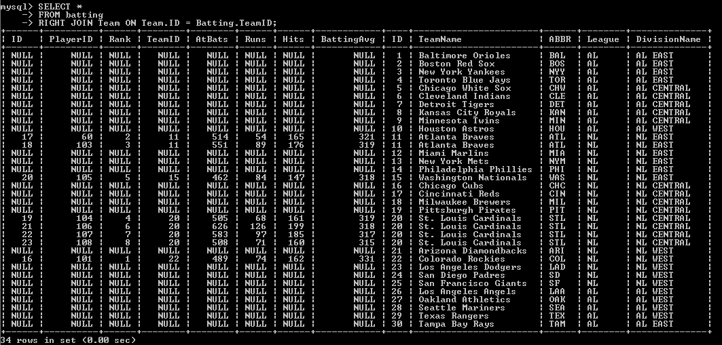
Right Join
With a Right Join, the Right hand side table is dominant and all its rows will be returned.
These two queries are basically the same:
SELECT *
FROM Team
left join Batting on Team.ID = Batting.TeamID;
SELECT *
FROM batting
RIGHT JOIN Team ON Team.ID = Batting.TeamID;

Slide 23
Order By Clause
order the results of a query using a listing of columns
Ascending order is the default
To sort in descending order use DESC
Demo:
Let’s order some baseball info
Ascending
Descending
Both!
vTeamRoster
League, DivisionName, and TeamName are ordered in ASCENDING order AND the HeightInches column is ordered in DESCENDING order

Slide 24
Exercise: Trying out the ORDER BY clause

Slide 25
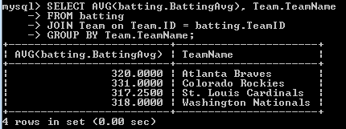
GROUP BY
Used to aggregate (Max, Min, Avg, Count…) rows together by one or more columns.
Use after WHERE
Average the batting averages to calculate a team batting average. GROUP the data BY TeamName.

Slide 26
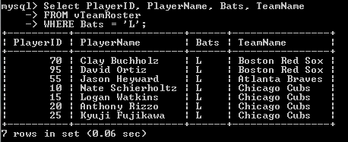
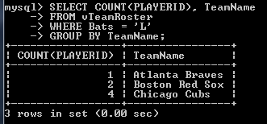
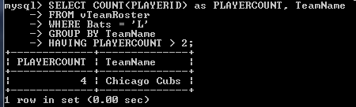
HAVING
Use WHERE to filter the rows before they are grouped.
Use HAVING to FILTER the results after having been grouped.
list all the players from the vTeamRoster view who bat left handed
Determine which team has the most lefties.
limiting the grouped rows to those HAVING a PLAYERCOUNT greater than 2

Slide 27
HOMEWORK
Any remaining exercises or homework for Day 2.
Be sure submit a pull request for the items marked as ‘homework’.

Slide 28
DAY 3
INSERT
DELETE
UPDATE
VIEWS
DISTINCT ROWS
COLUMN ALIASES
OPERATORS AND FUNCTIONS

Slide 29
INSERT INTO
INSERT INTO tablename (Col1, Col2, Col3, ...) VALUES (Value1, Value2, Value3, …)
The order of the values should correspond to the column names.

Slide 30
INSERT Statements Add Rows to a Table
Use SQL to add rows to a table
INSERT statement
With this syntax, values must contain a value for each column.
Values should be in the order in which you created the table:
INSERT INTO table_name VALUES (value1, value2,…);
An example would be:
INSERT INTO Individual Values (’Hendrix’,’Jimi’,’1942-11-27’);

Slide 31
Another INSERT Syntax
INSERT INTO table_name (Column1, Column2, Column3,…) Values (value1, value2, value3,…);
An example would be:
INSERT INTO Individual (LastName, FirstName, BirthDate) VALUES (‘Jagger’, ‘Mick’, ‘1943-07-26’);

Slide 32
Third way to INSERT
INSERT INTO table_name VALUES (,,,),(,,,),(,,,),…;
And an example would be:
INSERT INTO Individual VALUES
(‘Jagger’, ‘Mick’, ‘1943-07-26’)
, (‘Zimmerman’, ‘Robert’, ‘1942-05-25’)
, (‘Cobain’, ‘Kurt’, ‘1967-02-20’);

Slide 33
Exercise: Add an Individual to a Band

Slide 34
Add multiple records at once
Each data set is wrapped in parenthesis and separated by a comma
INSERT INTO Band
(Name,YearFormed,IsTogether,Genre)
VALUES
('Rolling Stones', '1962', 1, 'Rock')
, ('Beatles', '1960', 0, 'Rock')
, ('Traveling Wilburys', '1988', 0, 'Rock')
, ('Nirvana', '1987', 0, 'Grunge');
, ('REM', '1980', 0, 'Alternative');

Slide 35
Exercise: More than one way to INSERT INTO
Exercise: INSERT INTO SELECT
Exercise: inserting a row and discovering the value for the last inserted ID

Slide 36
DELETE Statement
DELETE removes row from a table.
DANGER, YOU REALLY NEED A WHERE CLAUSE!
Try SELECT before DELETE to verify rows affected
Dangerous:
DELETE FROM <table_name>;
Much, much better
DELETE FROM <table_name> WHERE ID = 234;

Slide 37
I get nervous
Whenever I use delete without a WHERE clause that identifies rows by the primary key

Slide 38
Using the IN Operator
The IN operation is used to test whether or not a value is ‘in’ the list.
SELECT ID, FirstName, LastName
FROM Individual
WHERE LastName IN (‘Ramone’, ‘Jennings’,’Presley’);
same as:
SELECT ID, FirstName, LastName FROM Individual
WHERE LastName = 'Ramone' OR LastName = 'Presley' OR LastName = 'Jennings';

Slide 39
NOT IN
Use NOT IN to exclude the rows in your list
SELECT ID, LASTNAME FROM Individual WHERE ID NOT IN ('50','51','52','53');

Slide 40
Exercise: Using the DELETE statement
Exercise: Using the IN operator to delete multiple records

Slide 41
UPDATE
UPDATE statement used to update existing records in a table
The SET clause indicates which columns to modify and the values they should be given
The WHERE clause specifies which record or records are updates
UPDATE <table_name>
SET <column_name> = {expression}
WHERE <where_condition>

Slide 42
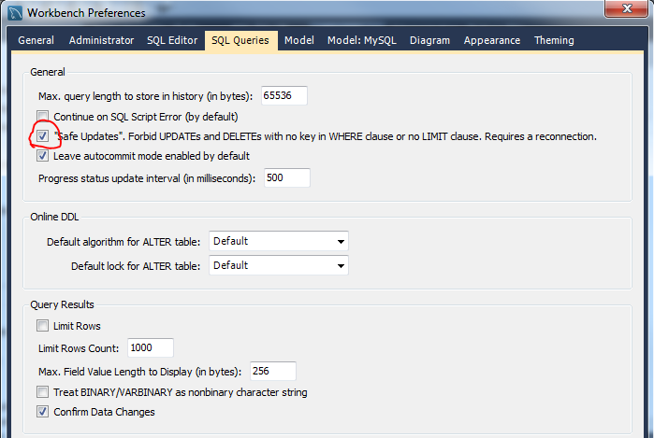
SQL Safe Updates
You may get the following error when attempting to update a column without using the a KEY (primary key) column within the WHERE clause:
“Safe Updates” forbids updates and delete with no key in the WHERE clause or no LIMIT clause.
SET SQL_SAFE_UPDATES = 0;
Edit -> Preferences -> SQL Editor -> SQL Queries

Slide 43
Day 4

Slide 44
Day 4
Operators and Functions
Stored Functions
Stored Procedures
Also know as Stored Routines

Slide 45
GitHub: Fetch
There are two steps required to sync your repository with the upstream:
Fetch from the remote repository
Merge the desired branch into your local branch.
Fetching from the remote (the instructor’s chscodecamp/mysql101) repository will bring in its branches and their respective commits (new, changed, deleted files). So, this will bring down the latest docs, presentations, sql script files, text files, etc. These will be stored in your local repository under special branches.
Enter the following command to fetch the instructor’s remote repository.
$ git fetch upstream
We now have the upstream (instructor’s master branch) stored in a local branch, upstream/master

Slide 46
GitHub: Merge
Merging
Now that we have fetched the upstream repository, we want to merge its changes into your local branch. This will bring your local branch into sync with the upstream, without losing our local changes.
Enter the following commands:
$ git checkout master
# Check out our local master branch
# Switched to branch 'master'
$ git merge upstream/master
# Merge upstream's master into our own

Slide 47
Using MySQL OPERATORS AND Functions
Comparison operators will result in a value of True , False, or Null.
SELECT 5 <> 3; -- this will evaluate to True (1).
SELECT 5 = 3; -- this will evaluate to False (0).

Slide 48
Basic Comparison Operators
Comparison operators can work on numbers and strings.
Below is a listing of some basic comparison operators:
greater than (>)
less than (<)
equals to (=)
not equal to (<>) (!=)
greater than or equal to (>=)
less than or equal to (<=)

Slide 49
USING THE IS NULL and IS NOT NULL Comparison Operators
IS NULL tests whether a value is null. It’s really useful to discover columns are values that are NULL. If something is null then a 1 (true) is returned. For example, the following will return a value of 1:
mysql> SELECT NULL IS NULL;
Use IS NULL in WHERE clause to determine a missing value.
mysql> SELECT * FROM Individual WHERE BIRTHDATE IS NULL;

Slide 50
USING THE BETWEEN COMPARISON Operator
Use BETWEEN to evaluate the value of something to see if its greater than or equal to a minimum value AND less than or equal to a maximum value.
If the value is BETWEEN then a 1 is returned, otherwise a 0 is returned.
BETWEEN is equivalent to the expression
(minimum value >= expr AND expr <= maximum value)
mysql> SELECT ‘y’ BETWEEN ‘x’ and ‘z’;
mysql> SELECT ‘ABC’ BETWEEN ‘AAA’ and ‘BBB’;
mysql> SELECT 7 BETWEEN 7 and 10;
mysql> SELECT 1 BETWEEN .5 and 10;
mysql> SELECT * FROM Individual WHERE LASTNAME BETWEEN ‘A’ AND ‘Cobain’ ORDER BY LASTNAME;

Slide 51
EXERCISE 1: TRY SOME BASIC COMPARISON OPERATORS AND WATCH THE AUTOMATIC CONVERSION OF STRINGS TO NUMBERS
Exercise 2: Try out the BETWEEN, IS NULL, and IS NOT NULL comparison OPERATORs

Slide 52
USING the IFNULL() Function
IFNULL takes two expressions and if the first expression is NOT NULL, it will return the first expression.
If the first expression is NULL then it will return the second expression.
mysql> SELECT IFNULL(NULL, 89);
mysql> SELECT ID, LASTNAME, IFNULL(DECEASEDDATE, 'Still Alive') as Alive FROM INDIVIDUAL;

Slide 53
USING THE COALESCE() FUNCTION
COALESCE will return the first non-null value in a list of values.
It will return NULL if there are no non-null values.
mysql>SELECT COALESCE(NULL, NULL, ‘Stuff’);
mysql>SELECT COALESCE(NULL, 5, ‘Stuff);
mysql> SELECT ID, LASTNAME, COALESCE(DECEASEDDATE, 'Still Alive') as Alive FROM INDIVIDUAL;

Slide 54
What is a stored routine?
A stored routine contains SQL statements that are stored on the MySQL server and given a name.
When you create a save a stored routine, it is saved within the database server system tables.
You can execute either on demand.
Doing so causes the SQL statements defined within the stored routine to be run on the server.
When a stored routine is run, it runs within the memory address of the server process.

Slide 55
EXERCISE 3: USING THE IFNULL() FUNCTION

Slide 56
Stored Routines: stored functions and stored procedures

Slide 57
What are stored routines?
Stored procedures and functions can be referred together as stored routines.
A stored routine contains SQL statements that are stored on the MySQL server and given a name.
When you create a save a stored routine, it is saved within the database server system tables.
You can execute these on demand.
Causes the SQL statements defined within the stored routine to be run on the server.
When a stored routine is run, it runs within the memory address of the server process.

Slide 58
Differences
A stored procedure is a computer program that can be run on request and accept input and output parameters.
A stored function is similar to a stored procedure.
But a function results in a single value.
Functions allow you to write your own calculations and extend the SQL language.
Functions can be executed from within a SQL statement.

Slide 59
STORED FUNCTIONS VERSUS STORED PROCEDURES
Stored Function
Calculates a single value.
Functions are used to as a general purpose way to return a result from a calculation.
You could create a function to convert units of measure, such as Fahrenheit to Celsius.
You could create a function to return a person’s complete mailing address using Street, City, State, and postal code as inputs into the function.
Used within expressions such as SELECT fnCalculateAgeInDays(‘2001-12-12’);
Use the CREATE FUNCTION statement to create a function
Uses a RETURNS clause to indicate the data type to return.
Stored Procedure
Can be used to calculate a single value, return a set of data, return multiple sets of data, return multiple values, perform an action and return no value.
Not used in expressions. Executed as standalone operations using CALL statement.
Use the CREATE PROCEDURE statement to create a procedure
A stored procedure doesn’t have a RETURNS clause. You can get data out of a stored procedure in different ways. First, a stored procedure can return an integer value. The default is zero (0). Second, you can use output parameters to return zero, one or more values back to the calling application. Third, stored procedure can return a row or multiple rows as the result of a SQL SELECT statement.
Stored Function | Stored Procedure
Calculates a single value. Functions are used to as a general purpose way to return a result from a calculation. You could create a function to convert units of measure, such as Fahrenheit to Celsius. You could create a function to return a person’s complete mailing address using Street, City, State, and postal code as inputs into the function. | Can be used to calculate a single value, return a set of data, return multiple sets of data, return multiple values, perform an action and return no value. A stored procedure is written to perform a specific task and implement business logic.
Used within expressions such as SELECT fnCalculateAgeInDays(‘2001-12-12’); | Not used in expressions. Executed as standalone operations using CALL statement.
Use the CREATE FUNCTION statement to create a function | Use the CREATE PROCEDURE statement to create a procedure
Uses a RETURNS clause to indicate the data type to return. | A stored procedure doesn’t have a RETURNS clause. . You can get data out of a stored procedure in different ways. First, a stored procedure can return an integer value. The default is zero (0). Second, you can use output parameters to return zero, one or more values back to the calling application. Third, stored procedure can return a row or multiple rows as the result of a SQL SELECT statement.
Must include a RETURN statement to return a value. | Instead it can return the result as a row or rows of data. Or, it can return a result by assigning the value using an OUT parameter.
A stored function belongs to a database. | A stored procedure belongs to a database.
A stored function does not have an IN parameter type. | A stored procedure uses an IN parameter to accept in a parameter value from the caller. The caller cannot see any changes to the parameter value.
A stored function does not have an OUT parameter type. | With an OUT parameter, the stored procedure sets the value of the parameter. The parameter value can be utilized by the caller of the procedure.
A stored function does not have an INOUT parameter type. | With an INOUT parameter the caller can pass in a value into the procedure. The caller can receive a value from the procedure.
A function does not have a pre-compiled execution plan. | Stored procedure’s execution plan is pre-compiled for performance.

Slide 60
Stored Function Syntax
To create a function you supply the following syntax:
CREATE FUNCTION db_name.sp_name
([param1 type][,param2 type][,param2 type][…]}
RETURNS Type
[characteristic ...]
routine_body

Slide 61
Stored Function Example
Here’s a function that tells you how comfortable the air temperature is:
delimiter $$
CREATE FUNCTION fnHotColdWarm (Tempc int) RETURNS varchar(5)
DETERMINISTIC
COMMENT 'Converts Celcius to Fahrenheit and returns the forecast'
BEGIN
DECLARE TempFResult int;
DECLARE TheResult varchar(5);
SET TempFResult = fnCelsiusToFahrenheit(TempC);
IF TempFResult < 60 THEN SET TheResult = 'Cold';
ELSEIF TempFResult >= 60 and empFResult < 76 THEN SET TheResult = 'Warm';
ELSEIF TempFResult >= 76 THEN SET TheResult = 'Hot';
END IF;
RETURN TheResult;
END$$

Slide 62
Exercise 4: Building a Simple Deterministic Stored Function

Slide 63
Naming your stored routine
By default, a routine is associated with the default database
To associate the routine explicitly with a given database, specify the name as db_name.sp_name when you create it.

Slide 64
Stored Procedure Example
DROP PROCEDURE IF EXISTS baseball.usp_insert_team;
DELIMITER $$
CREATE PROCEDURE baseball.usp_insert_team (
IN p_teamname varchar(75)
, IN p_abbreviation char(3)
, IN p_league enum('AL','NL')
, IN p_divisionname enum('AL EAST','AL CENTRAL','AL WEST','NL EAST','NL CENTRAL','NL WEST')
, OUT p_teamid INT
)
BEGIN
/* The logic goes in between the BEGIN and END . The logic below takes the parameters from the procedure and inserts a row into the team table. */
INSERT INTO baseball.team
(TeamName, ABBR, League, DivisionName)
VALUES (p_teamname, p_abbreviation, p_league, p_divisionname);
SET p_teamid = LAST_INSERT_ID();
END$$
DELIMITER ;

Slide 65
BEGIN and END blocks
Stored programs contain one or more blocks which contain one or multiple statements.
A block is enclosed by the BEGIN and END keywords.
A block allows you to group related individual statements together.
A block allows you to control the scope of variables.
you can declare a variable within a block and that is not visible outside of the block.

Slide 66
More about BEGIN and END blocks
Each statement within the BEGIN and END code block should terminated by a semicolon (;) statement delimiter.
You can label a block to ease code readability:
MYLABEL: BEGIN
<YOU CODE GOES HERE>
END MYLABEL;

Slide 67
Nesting blocks
You can declare a variable within a block and that is not visible outside of the block.
You can nest blocks within blocks like this:
Do you see the error?
CREATE PROCEDURE multipleblocks( )
# This is the outer block
BEGIN
DECLARE variableA VARCHAR(25);
# This is the inner block
BEGIN
DECLARE variableB VARCHAR(25);
SET variableB ='cannot be seen outside the inner block';
END;
SELECT variableB;
END;
$$

Slide 68
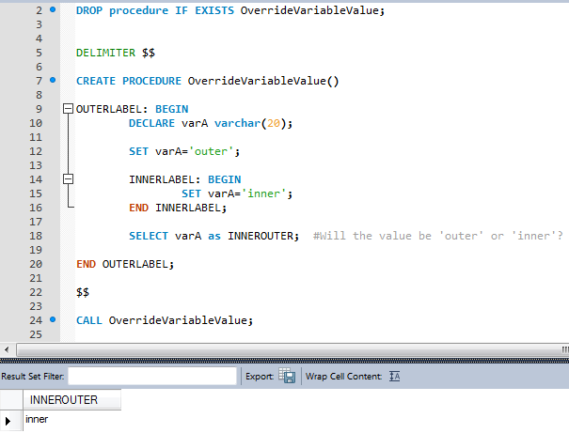
Overriding Variable Values within a Block

Slide 69
DELIMETER statement
A way to tell mysql that we are through defining the script.
normally use a semi colon (;) to end a statement.
Within a script you use several statements that end with a semi colon.
When you use Workbench to create a stored routine, the system will suggest using $$.

Slide 70
Stored Procedure Parameters
Parameters to make the program more flexible
Parameters come in 3 different modes:
IN (Default)
OUT
INOUT

Slide 71
Parameter: IN
IN: client passes IN the parameter to the SP
The value of the parameter can be changed INside the stored routine
The calling client will NOT have visibility to any change in the parameter’s value inside of the stored routine.
USE rockstarday2;
DROP procedure IF EXISTS usp_search_individualbylast;
DELIMITER //
CREATE PROCEDURE usp_search_individualbylast(IN plastname VARCHAR(50))
BEGIN
SELECT *
FROM Individual
WHERE LastName = plastname;
END //
DELIMITER ;
CALL usp_search_individualbylast('Ramone');

Slide 72
Parameter: OUT
The value of an OUT parameter can be changed inside the stored procedure and its new value is passed back OUT to the calling program.
USE rockstarday2;
DROP PROCEDURE IF EXISTS simpleproc;
delimiter //
CREATE PROCEDURE simpleproc (OUT param1 INT)
BEGIN
SELECT COUNT(*) INTO param1 FROM individual;
END//
delimiter ;
CALL simpleproc(@a);
SELECT @a;

Slide 73
Parameter: INOUT
An INOUT parameter is the combination of IN parameter and OUT parameter
Calling program may pass the argument, and the stored procedure can modify the INOUT parameter and pass the new value back to the calling program.

Slide 74
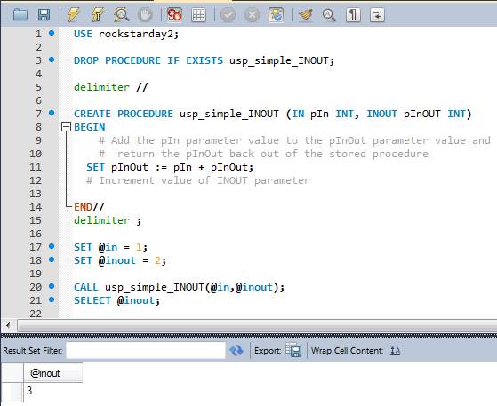
INOUT Example

Slide 75
Variables
A variable is like a box that holds a value.
A variable sets aside a piece of memory in the computer and gives it a name.
Declare the variable before you work with the variable.
Option of setting an initial value to the variable

Slide 76
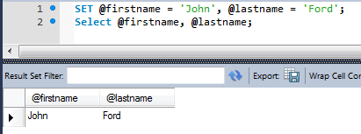
Using SET within a script
SET @var_name = expr [, @var_name = expr] ...
When you use SET, you can use either = or := as the assignment operator.
Ex: SET @firstname := ‘John’;

Slide 77
Local Variable DECLARE Syntax within a stored program/routine
Use the DECLARE statement to declare local variables within stored routines.
Define the data type. ex: INT or VARCHAR(25)
DECLARE var_name type [DEFAULT value];
To provide a default value for a variable, include a DEFAULT clause. The value can be specified as an expression; it need not be a constant. If the DEFAULT clause is missing, the initial value is NULL.
The scope of a local variable is the BEGIN ... END block within which it is declared.
Let’s check out: usp_teamcountbyleague
Within the SQLSCRIPTS\BASEBALL folder

Slide 78
EXERCISE 7: CREATE A SIMPLE STORED PROCEDURE WITH AN IN PARAMETER
Exercise 8: Create a Stored Procedure with an IN and OUT parameters
Exercise 9: Rewrite using INOUT parameter

Slide 79
Using the IF Statement
Conditionally branch your execution logic
Evaluate a condition, if True then perform SQL statements
IF <some condition> THEN
<Perform Some Statements>
END IF

Slide 80
ELSEIF
ELSEIF statement to create another branch in your logic
mutually exclusive clauses
IF condition1 THEN
...
ELSEIF condition2 THEN
...
ELSEIF condition3 THEN
...
ELSE
...
END IF;

Slide 81
Exercise 10: Using IF, ELSEIF and ELSE

Slide 82
Using the CASE Statement
CASE statement and IF statements are interchangeable
CASE is more readable when you have a lot of conditions

Slide 83
Simple CASE
Check the value of an expression against a set of unique values
CASE p_region
WHEN 'Southeast' THEN
SET p_surcharge = '20';
WHEN 'Northeast' THEN
SET p_surcharge = '30';
WHEN 'Lower Midwest' THEN
SET p_surcharge = '30';
WHEN 'Upper Midwest' THEN
SET p_surcharge = '40';
WHEN 'SouthWest' THEN
SET p_surcharge = '40';
WHEN 'Mountain West' THEN
SET p_surcharge = '50';
ELSE
SET p_surcharge = '70';
END CASE;

Slide 84
Complex CASE
In the complex syntax each search_condition expression is evaluated until one is true.
DECLARE returnrisklevel varchar(10);
DECLARE ratio float;
SET ratio = ploan_amt / phousehold_income;
CASE
WHEN ratio < .10 THEN
SET returnrisklevel = 'Low';
WHEN ratio <= .25 and ratio >= .10 THEN
SET returnrisklevel = 'Moderate';
WHEN ratio <= .35 and ratio >= .26 THEN
SET returnrisklevel = 'High';
WHEN ratio > .35 THEN
SET returnrisklevel = 'No Loan';
END CASE;

Slide 85
EXERCISE 11: USING CASE TO CONTROL EXECUTION FLOW

Slide 86
Pros of using stored routines
One place for code
Code is available to different types of client applications (PHP, JAVA, .NET, etc.)
simplify security, administration, and maintenance.
Security
Use stored routines to help secure the underlying data in MySQL databases
abstract others away from your tables
secure access to the underlying base tables
use security to grant access to just the view and stored procedures and not the underlying tables
affords changing the underlying tables and minimizing the impact to other developers accessing the data within the tables
Maintainability of the code improves as your underlying data structures changes over time

Slide 87
Pros of using stored routines
Performance
reduced network usage
The stored procedure performs intermediate processing on the database server, without transmitting unnecessary data across the network
SQL statements that you group together in a stored procedure, the more you reduce network usage and the time that database locks are held
Reducing network usage and the length of database locks improves overall network performance and reduces lock contention problems

Slide 89
Cons of using stored routines
Performance
Having the code in one place can put a large burden on the database
more client applications and users depend on the database and the hardware
Lots of I/O pressure on the server and underlying disk subsystems
Transferring processing to the middle tier (PHP, Java, C#, etc.) can also enhance load balancing and scalability.

Slide 90
Cons of using stored routines
Limited Programming Power
C#, Ruby, Java, JavaScript, etc. These languages provide greater capabilities than the SQL language enabling you to elegantly and flexibly solve tougher problems.
Code in the database deepens your dependency on the database platform
What if you need to switch database platforms? You will need to rewrite a major chunk of our application logic…ouch!

Slide 91
Naming Conventions
Variables
Instead of using capitalization of letters to separate names within a variable, consider using an _ (ex: min_level)
Avoid naming variables or parameters the same as a column name
Consider using anaming convention that states the data type of the variable (ex: imin_level)
Use a unique name, regardless of scoping
Establish a set of naming convention within your group. Be consistent.

Slide 92
Compound Statements
A simple stored procedure containing a single statement does not need a compound statement.

Slide 93
Stored Procedures (SP)
Executed as standalone operations
Use the CALL statement to execute
Use to do something in the db or if you need to return result set(s).
Use CREATE PROCEDURE statement to build a SP
Define the parameters when you define the SP
Pass parameter values into the SP
Pass parameters values OUT of the SP
Hands-On Exercise: Building and CALLing a Simple Stored Procedure

Slide 94
Stored Function
Use a stored function to calculate a value
Use in expressions
Cant use if you want to return more than one value (use SP instead)
Use CREATE FUNCTION statement to build a function

Slide 95
Resources
MySQL Developer’s Library – Paul DuBois
http://en.wikipedia.org/wiki/MySQL
http://www.w3schools.com/sql/
https://dev.mysql.com/doc/index.html
NoSQL Distilled: A Brief Guide to the Emerging World of Polygot Persistence - Sadalage, Fowler
http://blog.teamtreehouse.com/introduction-to-the-mac-os-x-command-line

Slide 96
END

