Slide 1
Subset Selection
CS60021 · Scalable Data Mining
Submodular coresets and sparse approximation
Sourangshu Bhattacharya

Slide 2
Contents
Problem definitions subset selection and coresets
Part 1 Submodular Optimization for Coreset Finding
1.1 Submodular functions
1.2 Submodular maximization
1.3 Data subset selection & coresets
Part 2 Sparse Approximation for Subset Selection
2.1 Gradient matching with OMP
2.2 Convex subset selection
References

Slide 3
Subset Selection: General Definition
Ground set V = {1, …, n}: data points, features, sensors, video frames
Utility function f : 2^{V} → ℝ that scores every candidate subset
Feasible family 𝒞 ⊆ 2^{V}: cardinality |S| ≤ k, budget c(S) ≤ B, or a matroid
Find S* ∈ argmax_{S ∈ 𝒞} f(S)
NP-hard for an arbitrary f; tractable when f has structure:
Submodular f (Part 1): greedy achieves (1 − 1/e) · OPT under |S| ≤ k [Nemhauser, Wolsey & Fisher 1978]
Sparse approximation (Part 2): min ‖Ax − b‖² s.t. ‖x‖₀ ≤ k; solved by OMP or convex relaxation [Natarajan 1995; Das & Kempe 2018]
Krause & Golovin, Submodular Function Maximization (2014); Bilmes, Submodularity in Machine Learning and AI (2022)

Slide 4
Coresets vs. General Subset Selection
ε-coreset. A weighted subset (C, w), C ⊆ D, |C| ≪ |D|, such that for every model θ:
| Σ_{i∈C} w_{i} ℓ(x_{i}; θ) − Σ_{i∈D} ℓ(x_{i}; θ) | ≤ ε · Σ_{i∈D} ℓ(x_{i}; θ)
Gradient coreset (for training): ‖ Σ_{i∈C} w_{i} ∇ℓ_{i}(θ) − Σ_{i∈D} ∇ℓ_{i}(θ) ‖ ≤ ε
 | General subset selection | Coreset
Goal | Maximize a chosen utility f(S) (diversity, coverage, value) | Approximate the full-data objective
Output | Unweighted subset S | Weighted subset (C, w)
Guarantee | f(S) ≥ α · OPT | Error ≤ ε for all θ (or along training)
Size | Fixed budget k | Set by the target accuracy ε
In this lecture
Coresets: CRAIG (facility-location bound on gradient error), GradMatch (OMP on gradients)
General subset selection: submodular summarization, Convex DSS, TMCOSS, data valuation (appendix)
Feldman, Core-sets: Updated Survey (2020); Mirzasoleiman, Bilmes & Leskovec, ICML 2020; Killamsetty et al., ICML 2021

Slide 5
Submodular Optimization for Coreset Finding
Part 1
1.1 Submodular functions
1.2 Submodular maximization
1.3 Data subset selection & coresets
Slides adapted from the IJCAI 2020 tutorial by Rishabh Iyer and Ganesh Ramakrishnan

Slide 6
Submodular Functions
Part 1 · Section 1.1
Definitions, modular and monotone functions, and the main families: representation, diversity, coverage, information

Slide 7

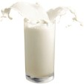


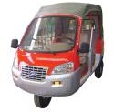


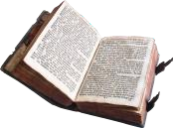

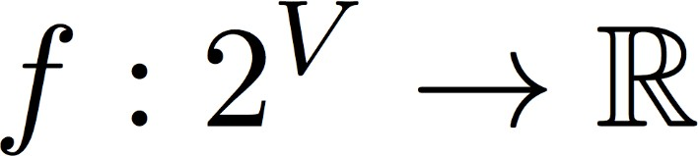
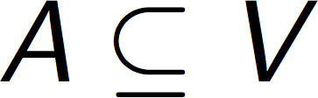

V = {
Combinatorial Subset Selection Problems
A = {
Choose Subset
}
}
$f(A)$ is maximum
General Set function Optimization: very hard!
What if there is some special structure?

Slide 8
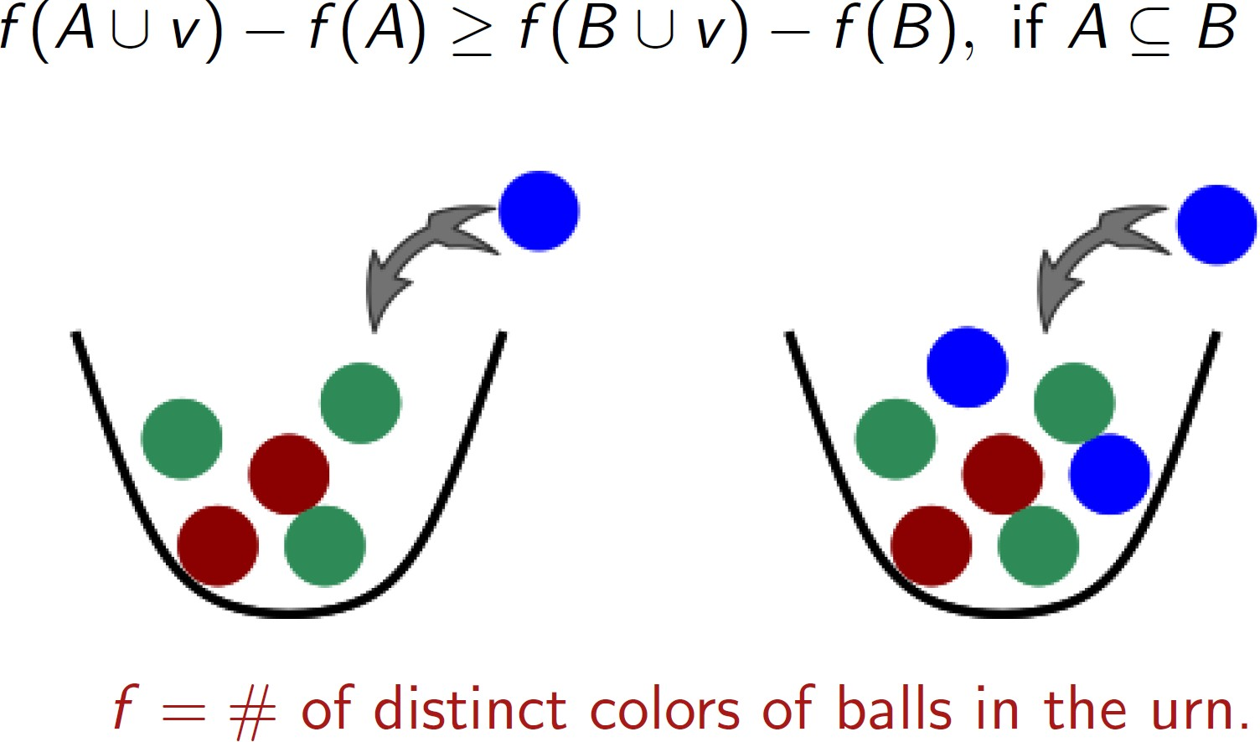
Submodular Functions
Negative of a Submodular Function is a Supermodular Function!

Slide 9

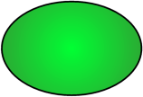


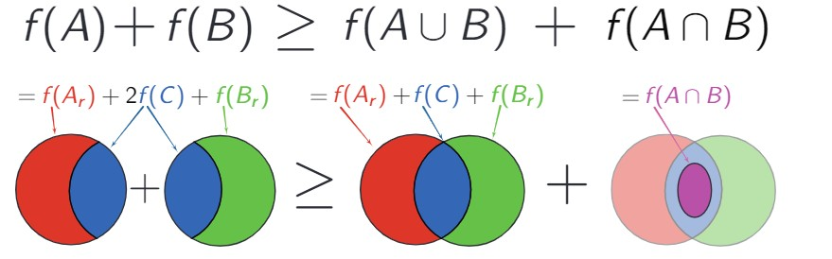



Equivalent Definitions of Submodularity
Diminishing gains: for all
A
+ s
B
+ s
Union-Intersection: for all

Slide 10
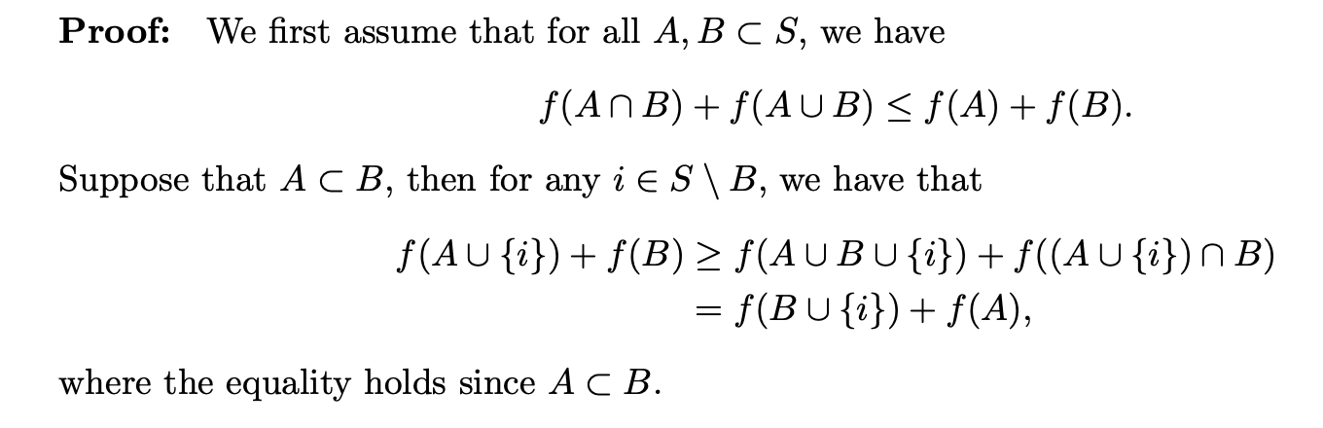
Equivalent Definitions of Submodularity
Lemma: The above definitions for submodularity are equivalent.

Slide 11
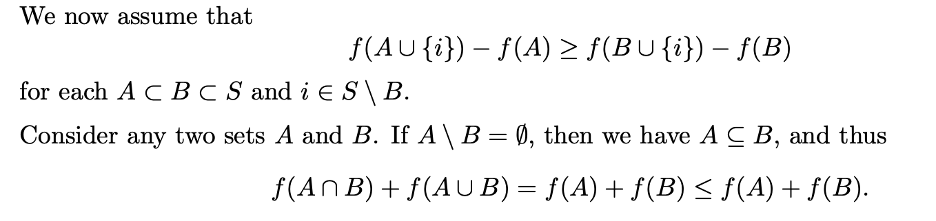
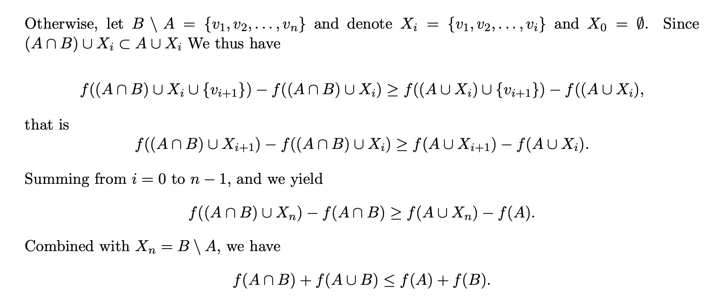
Equivalent Definitions of Submodularity

Slide 12
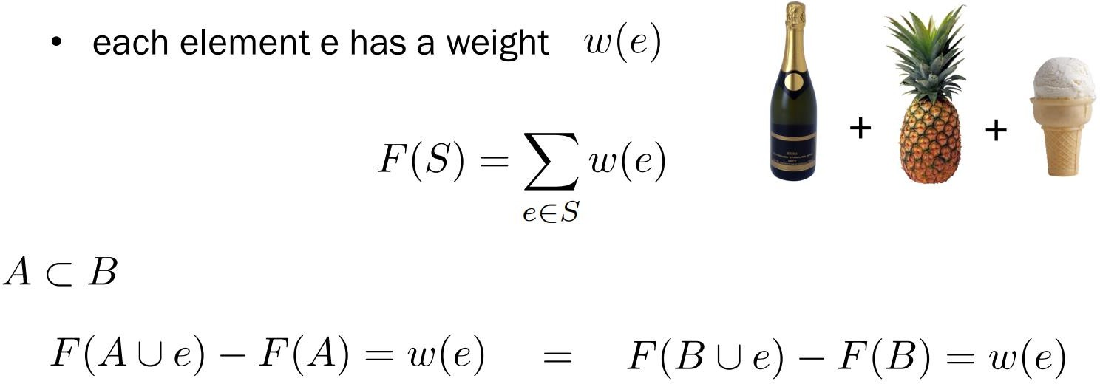
Modular Functions
Modular Functions are both submodular and supermodular!

Slide 13
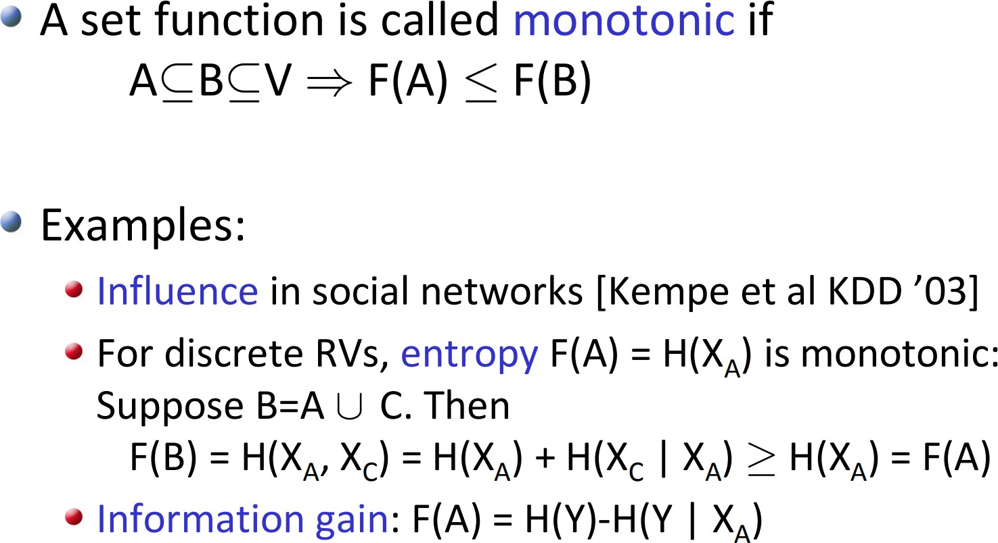
Monotone Submodular Functions

Slide 14
Instantiations of Submodular Functions
Representation Functions
  Facility Location Function (k-mediods
clustering)
  Graph Cut Family, Saturated Coverage
Diversity Functions
  Dispersion Functions (Min, Sum, Min- Sum)
  Determinantal Point Processes
Coverage Functions
  Set Cover Function
  Probabilistic Set Cover Function
  Feature Based Functions
Importance Functions
  Modular Functions
Information Functions
  Mutual Information
  Entropy
Discounted Cost Functions
  Clustered Concave over Modular Functions
  Cooperative Costs and Saturations
Complexity Functions
  Bipartite Neighborhood Functions

Slide 15
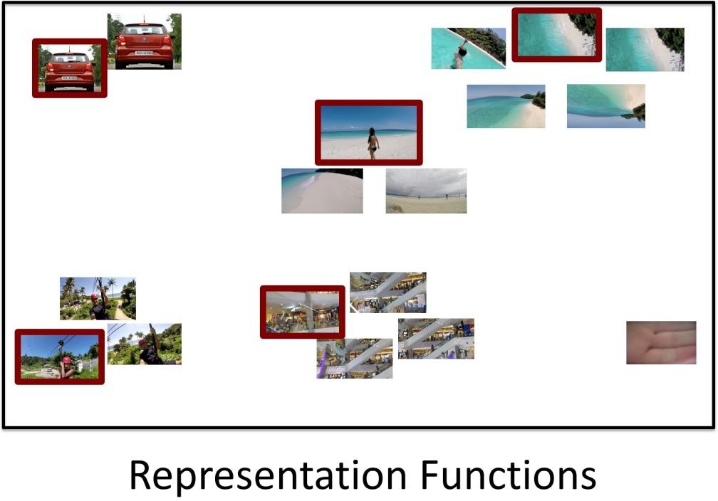
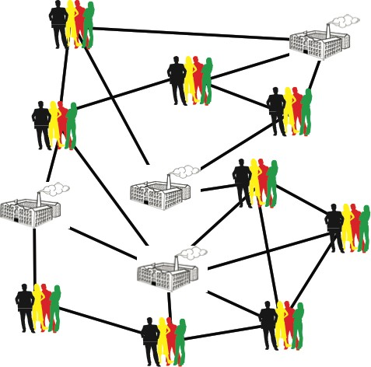
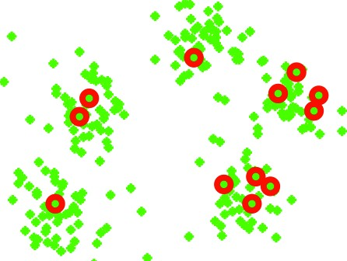
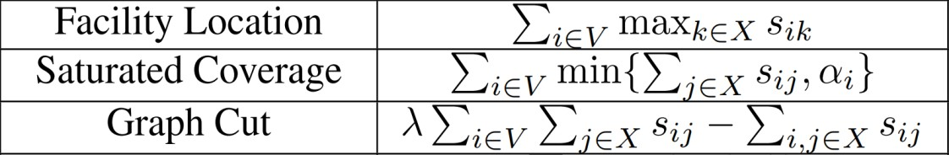
Representation Functions
Picks Centroids
Iyer 2015, Kaushal et al 2019, Tschiatchek et al 2014, …
Similarity Kernel

Slide 16
Facility Location is Submodular (1/2): Setup
Ground set V of n items; similarity s_{ij} ≥ 0 for all i, j ∈ V (e.g. a similarity kernel)
Each item i is "served" by its most similar selected representative
f(S) = Σ_{i∈V} max_{j∈S} s_{ij}, with max_{j∈∅} s_{ij} = 0
Step 1 — Decompose. f(S) = Σ_{i∈V} g_{i}(S), where g_{i}(S) = max_{j∈S} s_{ij} is the value item i receives.
Step 2 — Lemma. If g₁, …, g_{n} are submodular and α_{i} ≥ 0, then Σ_{i} α_{i} g_{i} is submodular.
Proof: for A ⊆ B, v ∉ B, each g_{i} satisfies the diminishing-gains inequality; multiplying by α_{i} ≥ 0 and adding keeps it.
So it is enough to show that every single-item function g_{i} is monotone submodular.
Krause & Golovin, Submodular Function Maximization (2014); Iyer & Ramakrishnan, IJCAI 2020 tutorial

Slide 17
Facility Location is Submodular (2/2): Diminishing Gains
Fix an item i, sets A ⊆ B ⊆ V and a new element v ∈ V ∖ B. Let a = g_{i}(A) and b = g_{i}(B).
Monotone. A maximum over a larger set is no smaller: A ⊆ B ⇒ a ≤ b.
Marginal gain. Adding v helps only if s_{iv} beats the current best:
g_{i}(A ∪ {v}) − g_{i}(A) = max(a, s_{iv}) − a = (s_{iv} − a)⁺ where (x)⁺ = max(x, 0)
Compare. x ↦ (s_{iv} − x)⁺ is non-increasing and a ≤ b, so
g_{i}(A ∪ {v}) − g_{i}(A) = (s_{iv} − a)⁺ ≥ (s_{iv} − b)⁺ = g_{i}(B ∪ {v}) − g_{i}(B)
Summing over i ∈ V: f(A ∪ {v}) − f(A) ≥ f(B ∪ {v}) − f(B) so f is monotone submodular. ∎
Intuition: a new representative helps an item only if it is more similar than the item's current best, and a larger set already has a better best. Greedy therefore gives a (1 − 1/e) guarantee for the facility location objective used by CRAIG.

Slide 18
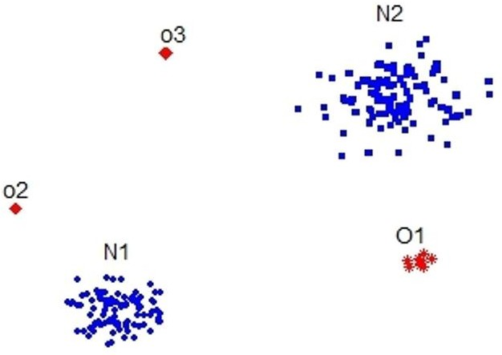
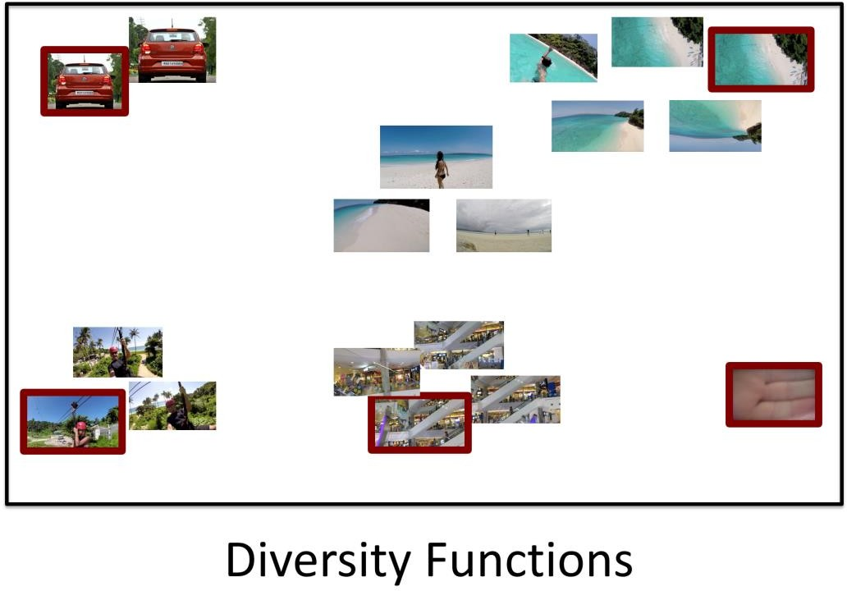
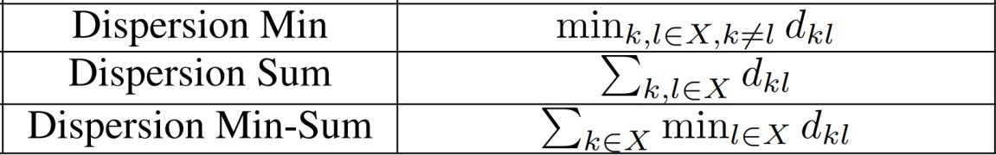
Diversity Functions: Dispersion
Outliers
Clusters
Picks items as different as possible!
Dasgupta et al 2013, Chakraborty et al 2015
Dispersion Sum and Dispersion Min Not Submodular!
Application: Diverse text summaries and search results
Dasgupta et al. (2013) add a dispersion term to a submodular coverage objective for extractive document summarization, so selected sentences are not redundant. The same idea diversifies web-search results and recommendations.
Application: Image collection and video summarization
Pick photos or keyframes that differ as much as possible from one another. Chakraborty et al. (2015) use this for keyframe selection in video summarization.

Slide 19
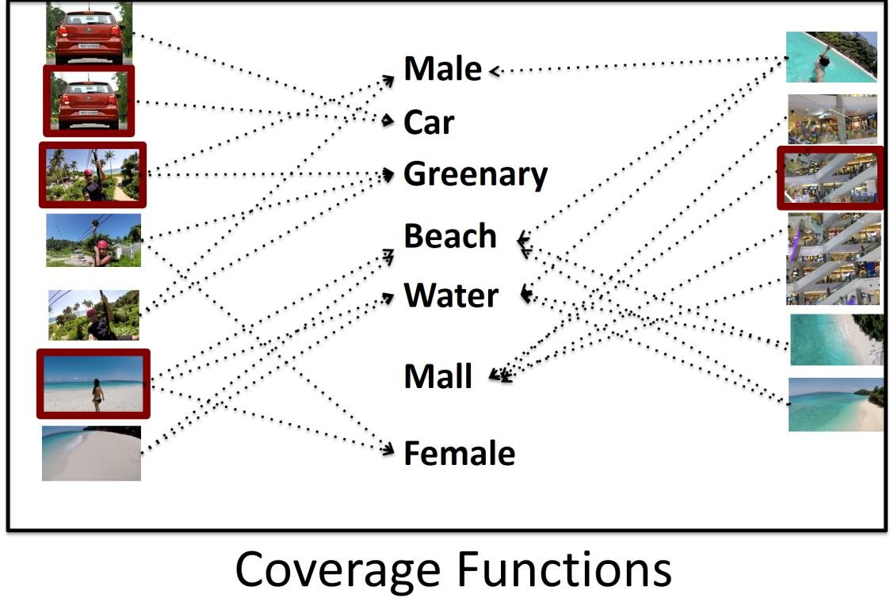






Coverage Functions
Cat Dog Bird Man Beach …..
…
…
Set Cover Function
Concepts Covered by Instance i
Select instances which “cover” all concepts
Wolsey et al 1982, …
Application: Concept and topic coverage
Choose a few items so that every concept (tag, topic, keyword) is represented at least once. The same set-cover model underlies sensor and camera placement and test-suite minimization.
Application: Photo album summarization
Each image covers the visual concepts detected in it (person, car, beach, ...); a small summary should cover all concepts present in the collection.

Slide 20
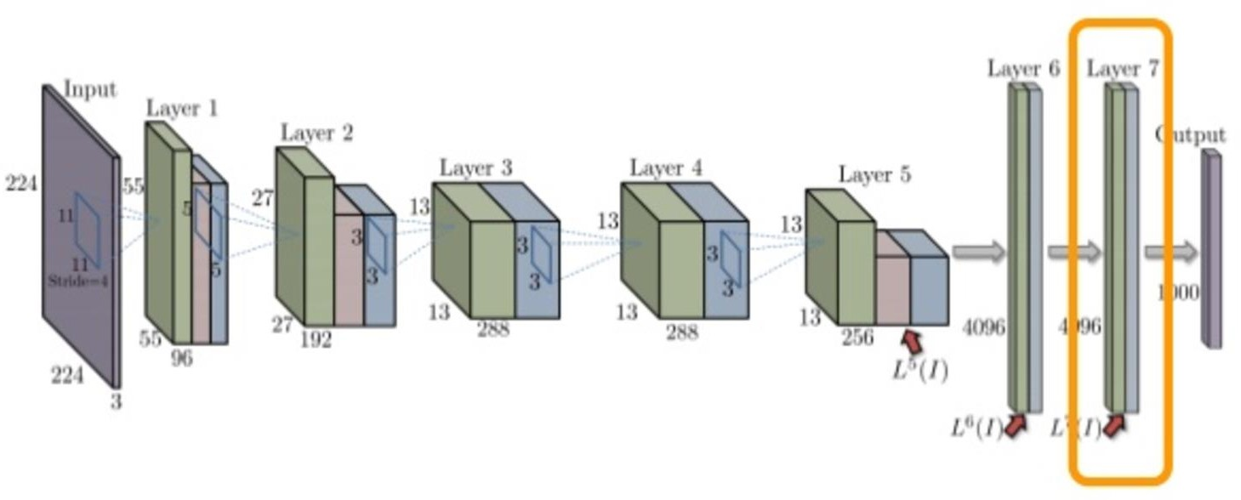
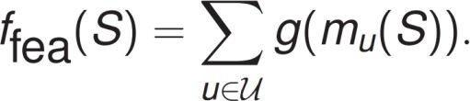
Feature Based Functions
Achieve Uniformity in Feature Coverage
Feature Based Functions
Wei-Iyer et al 2014 …
Total Contribution of Feature u in the Set of Images S
g is concave function
Application: Training-data subset selection
Wei, Iyer et al. use feature-based functions to pick small, representative training sets for speech recognition and image classification; features can be CNN activations (shown), n-grams or acoustic units.

Slide 21
Diversity Functions: Dispersion
Outliers
Clusters
Picks items as different as possible!
Dasgupta et al 2013, Chakraborty et al 2015
Dispersion Sum and Dispersion Min Not Submodular!

Slide 22
Coverage Functions
Cat Dog Bird Man Beach …..
…
…
Set Cover Function
Concepts Covered by Instance i
Select instances which “cover” all concepts
Wolsey et al 1982, …

Slide 23
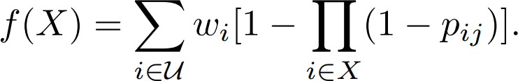
Coverage Functions
Cat Dog Bird Man Beach …..
…
…
Probabilistic Set Cover Function
Probability that Image i covers concept j
Allow for Probability of covering concepts
El-Arini & Guestrin 2013, …

Slide 24
Feature Based Functions
Achieve Uniformity in Feature Coverage
Feature Based Functions
Wei-Iyer et al 2014 …
Total Contribution of Feature u in the Set of Images S
g is concave function

Slide 25
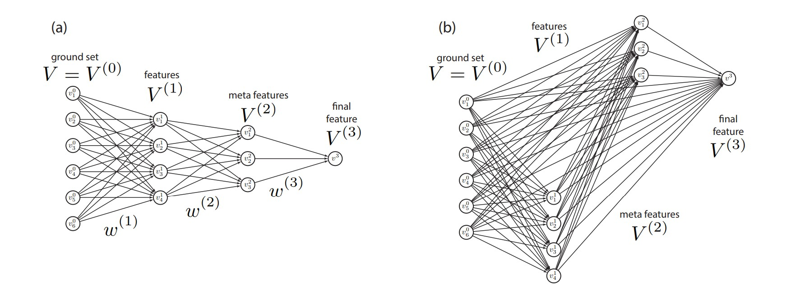
Deep Submodular Functions
Bilmes-Bai 2015…

Slide 26
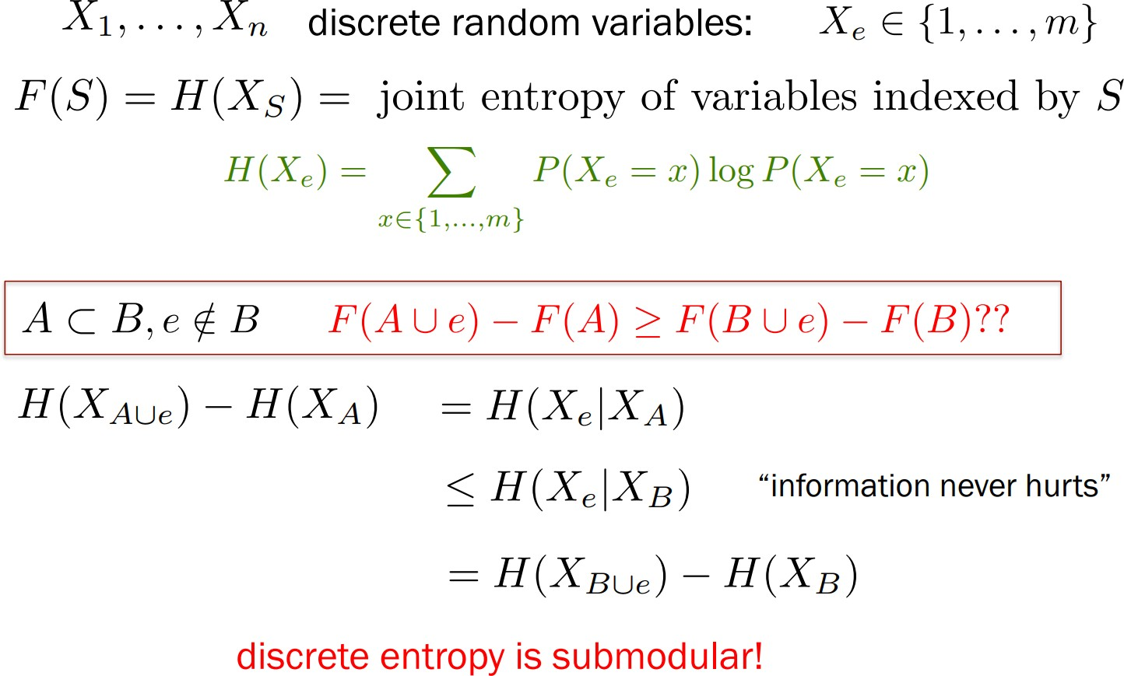
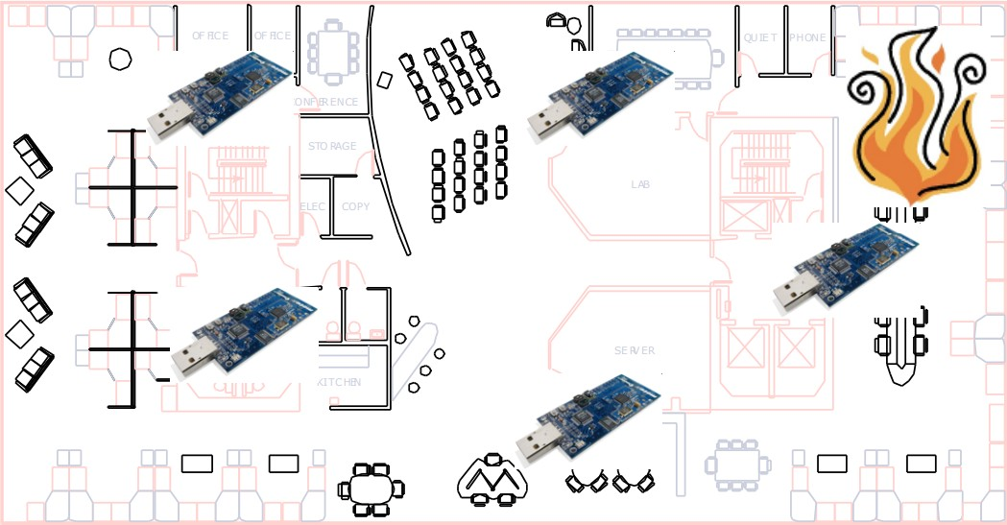
Information Functions
Entropy
Mutual Information Information Gain
…
Krause et al 2008, …

Slide 27
Submodular Maximization
Part 1 · Section 1.2
Greedy algorithms and their guarantees, budget and matroid constraints, non-monotone objectives, faster greedy

Slide 28
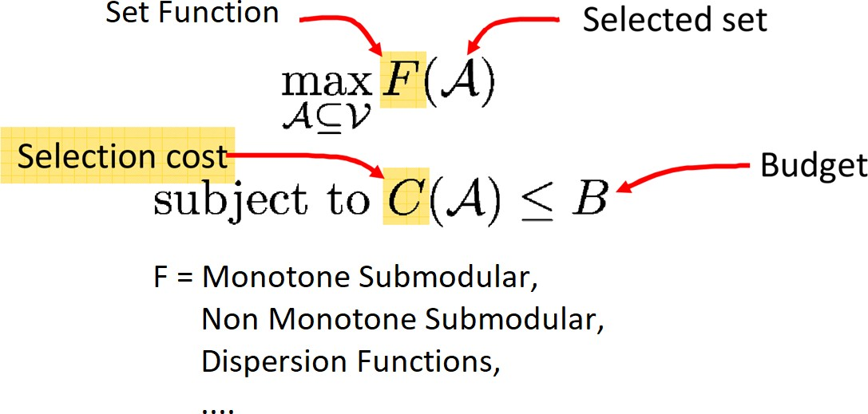
Master Optimization Problem
F Models:
Diversity
Representation
Coverage
Information
Importance
…
We shall study this and variants of this Master Optimization Problem!

Slide 29
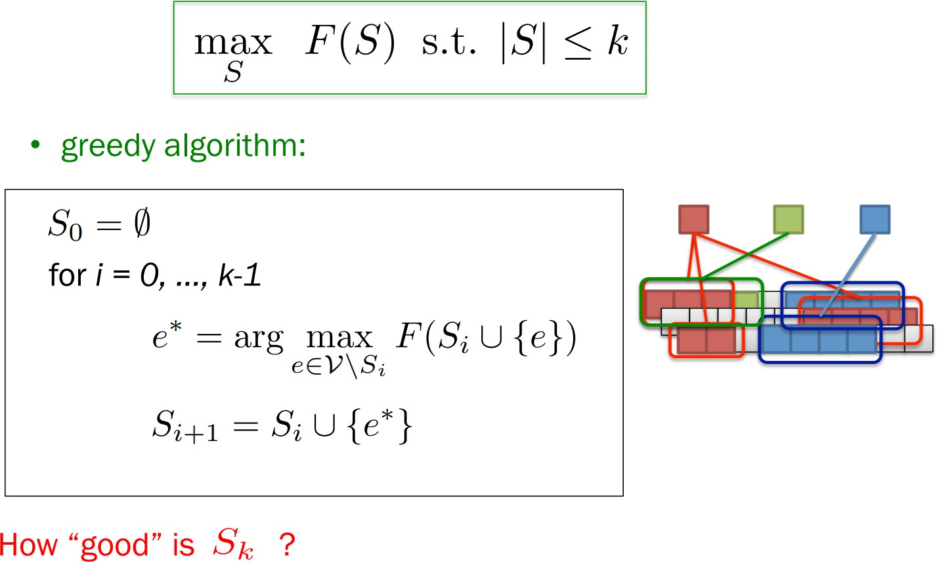
Monotone Submodular Maximization
What is the Constraint? C(S) = |S|
Approximation Guarantee!

Slide 30
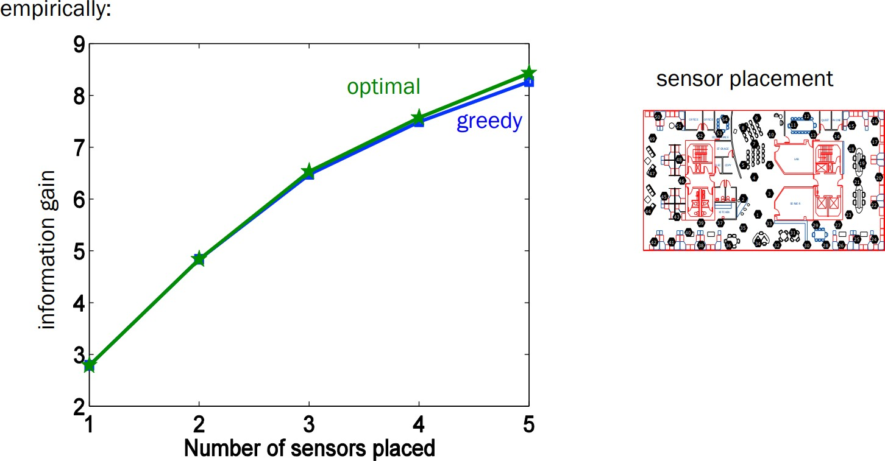
How good is Greedy in Practice?

Slide 31
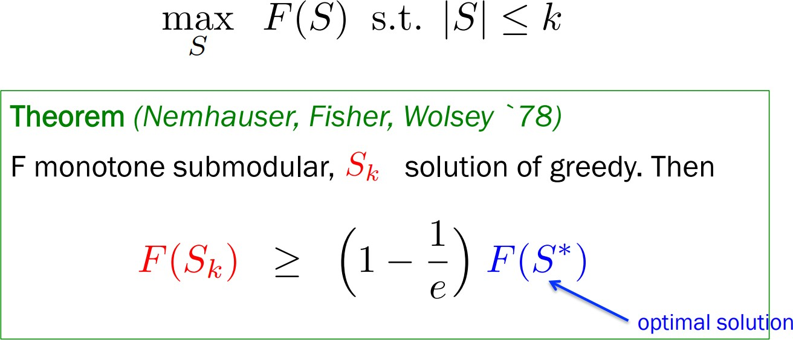
How good is Greedy in Theory?
No Poly-time algorithm can do better than this in the worst case!

Slide 32
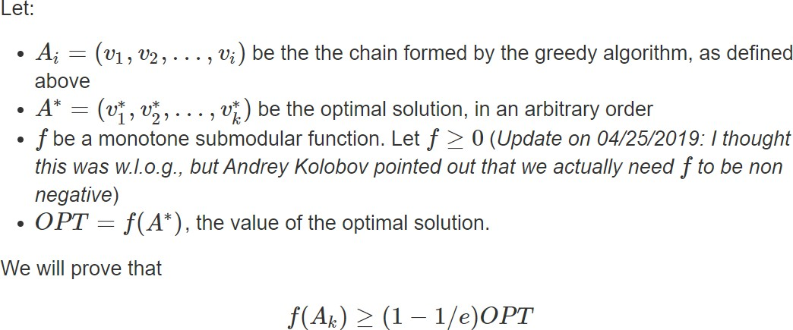
Proof (Nemhauser et al 1978)
Source: https://homes.cs.washington.edu/~marcotcr/blog/greedy-submodular/

Slide 33
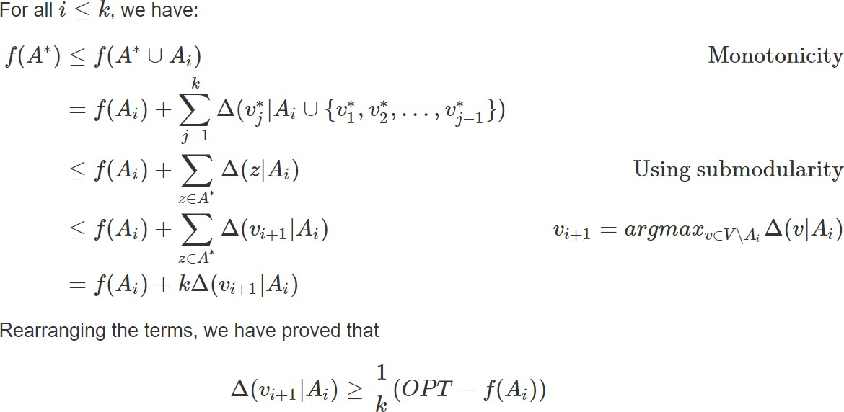
Proof (Nemhauser et al 1978)
Source: https://homes.cs.washington.edu/~marcotcr/blog/greedy-submodular/

Slide 34


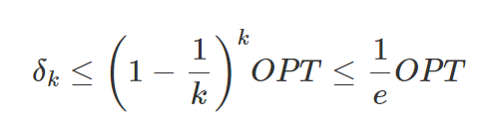
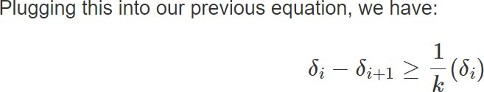
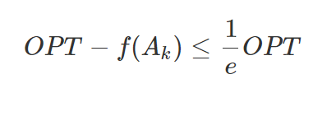

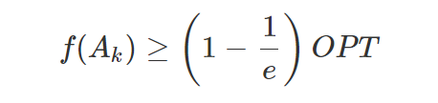
Proof (Nemhauser et al 1978)
Part I Part II
t I
Source: https://homes.cs.washington.edu/~marcotcr/blog/greedy-submodular/

Slide 35
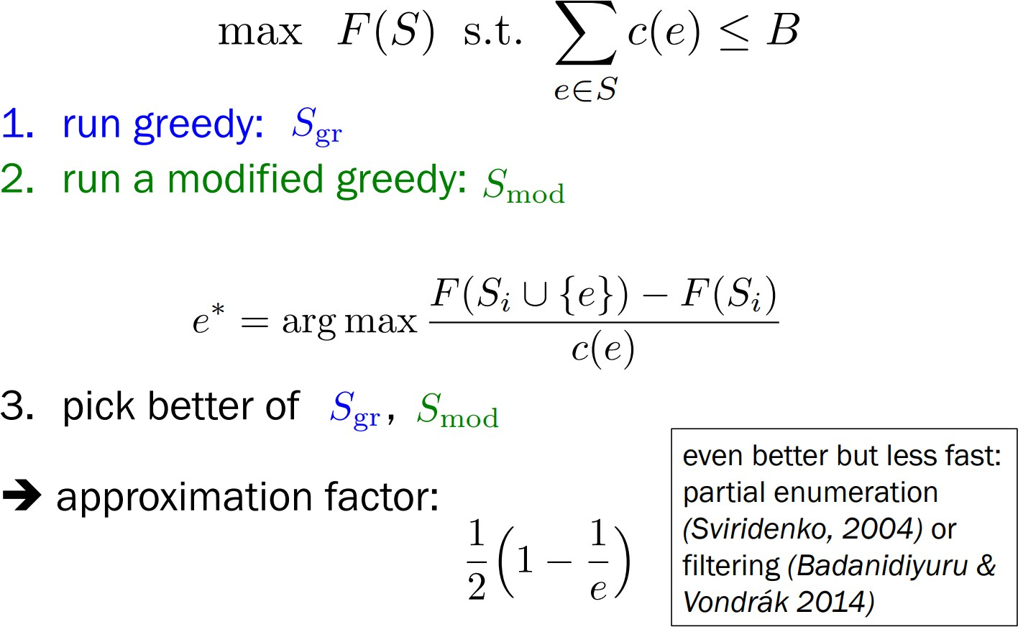
Monotone Submodular – Budget Constraints
Sviridenko 2004:
Run the cost-sensitive greedy algorithm starting with all possible initial sets
{i,j,k}
𝑂(𝑛³) initial complexity
(1 – 1/e) approximation!
Sviridenko 2004, Leskovec et al 2007

Slide 36
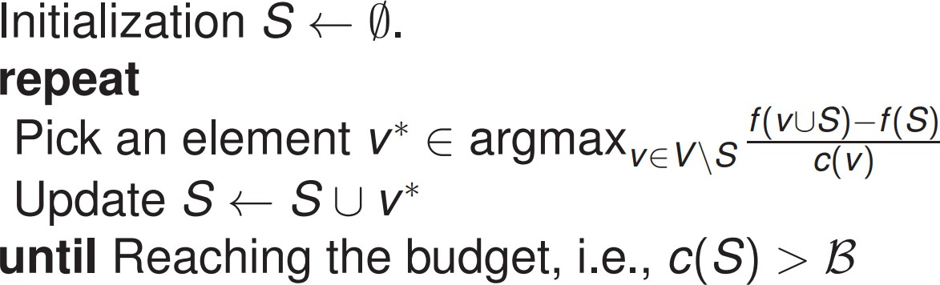
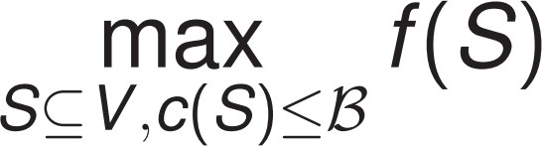
Summary: Greedy Algorithm Framework
Monotone Submodular Function
Cost of Summary Subset S (e.g. size)
Problem Formulation
Greedy Algorithm

Slide 37
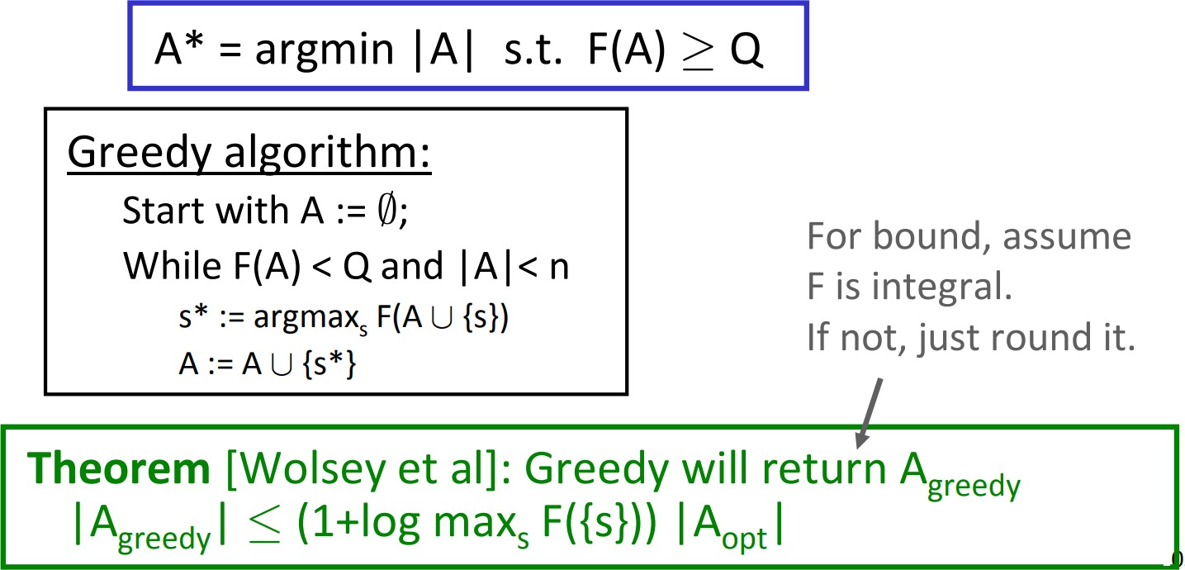
Dual Problem: Monotone Submodular Cover
Wolsey 1982

Slide 38
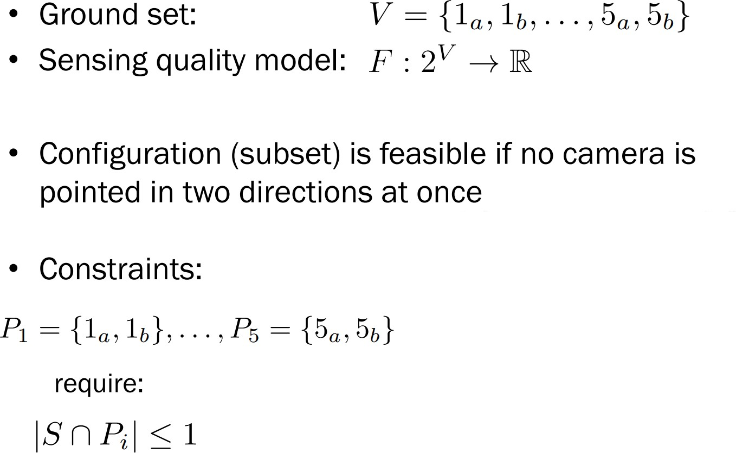
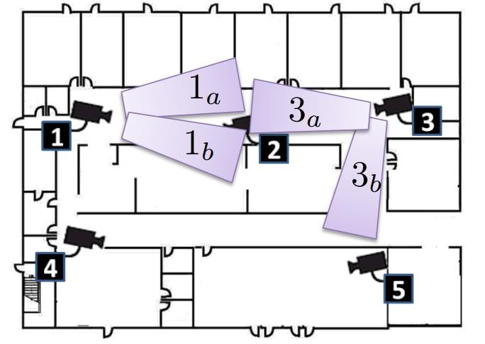
More Complex Constraints: Matroid Constraints

Slide 39
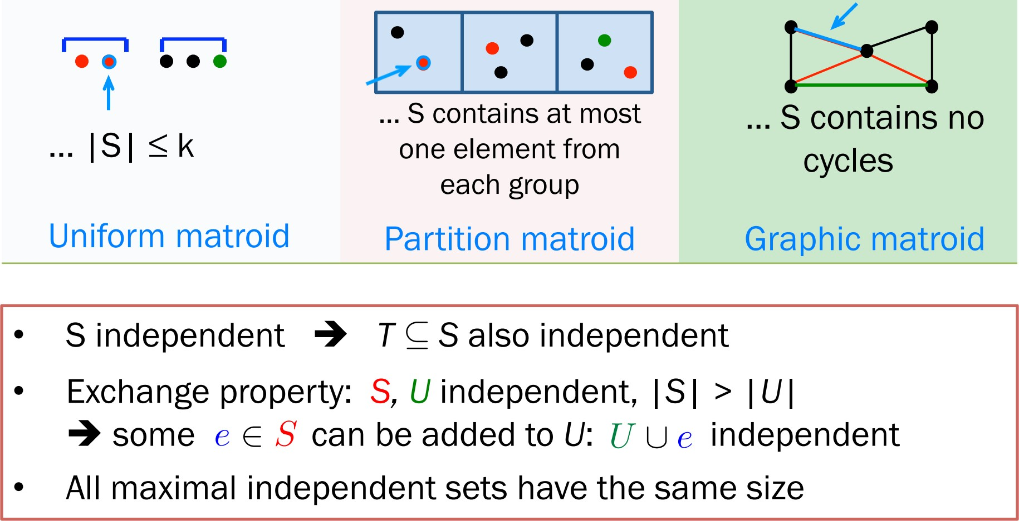
Matroid Constraints?

Slide 40
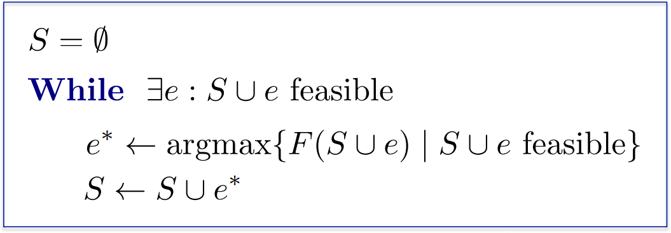
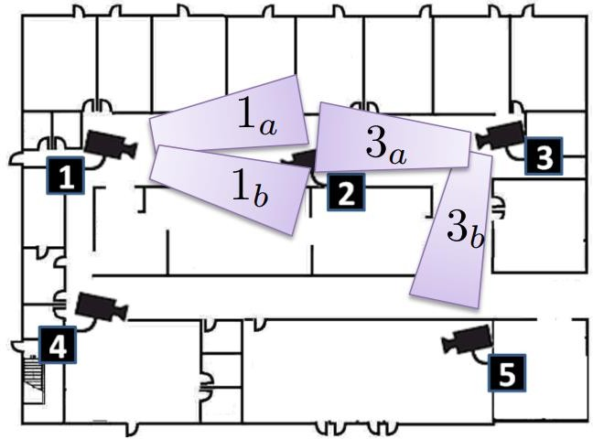
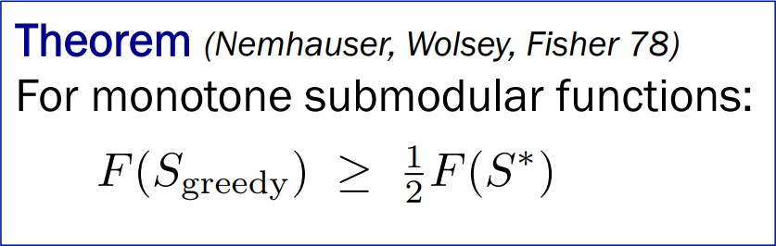
Monotone Submodular Maximization subject to Matroid Constraints
Nemhauser, Wolsey, Fisher 78

Slide 41
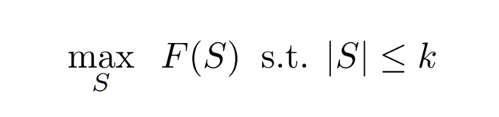
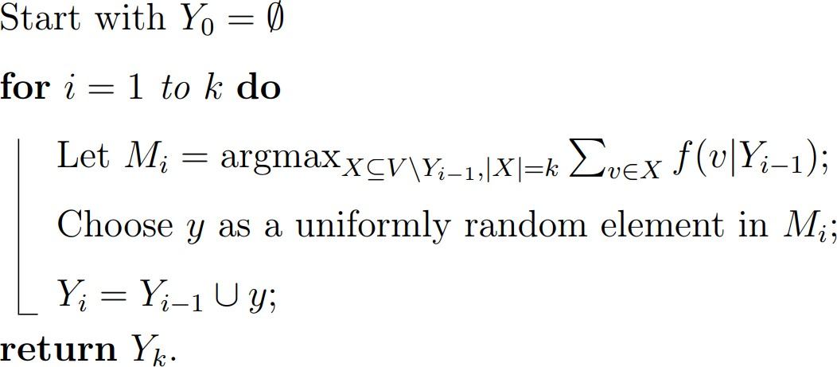
Non-Monotone Submodular Functions
Theorem (Buchbinder et al 2014): The Randomized Greedy Algorithm achieves a 1/e approximation
guarantee for Non-Monotone Submodular Maximization subject to cardinality constraints!

Slide 42
Submodular + Dispersion Functions
Submodular + Dispersion
Cost of Summary Subset S (e.g. size)
Problem Formulation
Greedy Algorithm
Theorem (Dasgupta et al 2013): The greedy algorithm achieves a ½ and ¼ approximation
For the Submodular + Disparity Sum and Submodular + Disparity Min Optimization Problems
Subject to cardinality constraints

Slide 43
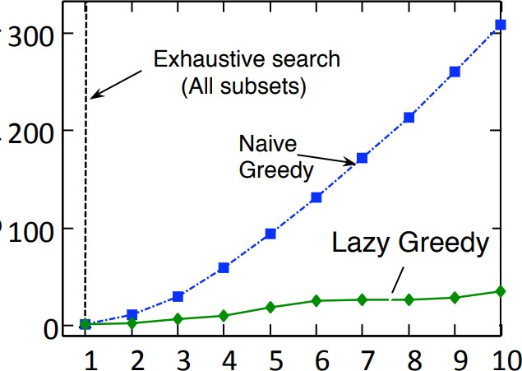
Implementational Tricks: Lazy greedy
(Minoux 1982) that the greedy algorithm can be efficiently implemented via a lazy
greedy algorithm.
Idea is to accelerate the algorithm via priority queues and maintains upper bounds on the marginal gains
In practice this brings the complexity to linear time
Complexity still 𝑂 𝑛𝑘𝐹 in worst case, where
𝐹 = Function Eval Complexity.
Can we do better?

Slide 44


Making Lazy Greedy Faster: Stochastic Greedy
Mirzasoleiman et al 2014, …

Slide 45
Data Subset Selection & Coresets
Part 1 · Section 1.3
Training on a subset: setup, requirements, and gradient-matching coresets (CRAIG)

Slide 46
Make ML Data Efficient and Robust
Data Preparation
Data Labeling
Feature Engineering
Model Training
Model Selection
Training Budget
Batch sizes, Partitions
Model Validation
Model Deployment
Deployment Infra
Latency & Memory
Often repeated for hyper-parameter tuning
Production Systems Constraints
Data Labeling => Time Consuming, Expensive, Noisy
Feature Selection => Latency & Memory
Model Training => Compute Intensive and Time Consuming
Hyper-Parameter Tuning/NAS => Very Time Consuming
Distribution Shift => Deployment vs Training
Can we train Models under these constraints without sacrificing
on accuracy?

Slide 47





Data Subset Selection Setup
A Machine Learning model characterized by model parameters
Training Data: Training log-likelihood function:
Training a machine learning model often reduces to finding the parameters that maximizes a log-likelihood function for given training data empirically.
Validation Data:
Validation log-likelihood function:
Goal: Select a subset
such that the resulting model performs the best!

Slide 48

Requirements for optimal subset selection
The subset selection algorithm needs to be as fast as possible.
  Subset Selection time <<<< Full training time
Example: Subset selection algorithm with negligible time complexity
Training on 10 % Subset
Faster training
Theoretical guarantees of subset selection algorithm.
  Can we show theoretical guarantees for subset selection algorithms?

Slide 49
Approaches for Data Subset Selection
Several different kinds of approaches studied in literature:
  Approach 1: Use Submodular Functions as proxy functions for data subset selection
  Approach 2: Choose data subset which approximates the gradient of the entire dataset
  Approach 3: Choose data subset which approximates the performance on full training
dataset (or validation set) as a bi-level optimization!
  Approach 4: Choose data subset which minimizes a suitable divergence (e.g. KL divergence) between the distribution induced by the subset and full data!
Types of Data Selection
  Supervised (Using the labels)
  Unsupervised (No access to labels)
  Validation based (Access to a validation set for focusing on generalization)

Slide 50
Approaches for Data Subset Selection
Several different kinds of approaches studied in literature:
  Approach 1: Use Submodular Functions as proxy functions for data subset selection
  Approach 2: Choose data subset which approximates the gradient of the entire dataset
  Approach 3: Choose data subset which approximates the performance on full training
dataset (or validation set) as a bi-level optimization!
  Approach 4: Choose data subset which minimizes a suitable divergence (e.g. KL divergence) between the distribution induced by the subset and full data!
Types of Data Selection
  Supervised (Using the labels)
  Unsupervised (No access to labels)
  Validation based (Access to a validation set for focusing on generalization)

Slide 51

Idea: Gradient Matching/ CoreSets
Can we obtain a weighted gradient of a subset of points that approximates the full gradient?
Sivasubramaniam & Killamsetty et. al. 2021, Mirzasoleiman et al 2020

Slide 52

Gradient Matching/ CoreSets Convergence
Sivasubramaniam & Killamsetty et. al. 2021

Slide 53

Gradient Matching: Main Idea
Sivasubramaniam & Killamsetty et. al. 2021

Slide 54



CRAIG as an upper bound
Sivasubramaniam & Killamsetty et. al. 2021, Mirzasoleiman et al 2020

Slide 55
Sparse Approximation for Subset Selection
Part 2
2.1 Gradient matching with OMP
2.2 Convex subset selection

Slide 56
Gradient Matching with OMP
Part 2 · Section 2.1
GradMatch: minimizing the gradient error directly with orthogonal matching pursuit

Slide 57

Directly Optimizing Gradient Error: GradMatch
Sivasubramaniam & Killamsetty et. al. 2021

Slide 58

Orthogonal Matching Pursuit

Slide 59
Convex Subset Selection
Part 2 · Section 2.2
Convex relaxations for offline and online subset selection: Convex DSS and TMCOSS

Slide 60






Aim
We study the problem of data efficient training of autonomous driving systems.
Training using many frames on straight road sections may not be necessary. Frames at the turns turn out to be useful.
REDUNDANT
INFORMATIVE
Method | Train One-Turn | Test One-Turn
Uniform Skip | 3/10 | 5/10
In the context of edge device deployment, multi-criteria online subset selection (OSS) framework can be useful in selecting informative frames, essential for an end-task.

Slide 61




Subset selection on Edge devices
Adding to existing data

Slide 62
High Level Idea
Given a compression ratio, find out representatives which have the least dissimilarity with the left-out elements besides having the highest task-specific loss.

Slide 63

Problem Setup
$X_{t}$: the set of incoming datapoints at time t (Size m)
D: set of all data points (Size N)
$R_{t}$: Reduced set of data at time t
$d_{ij}$: Distance between data points I and j.
$z_{ij}$: Indicator variable indicating that datapoint i is a representative for datapoint j.

Slide 64



Convex Subset Selection
Original formulation in set notation:
Formulation using indicator random variables $z_{ij}$:
Convex relaxation:
$0≤z_{ij}≤1$
Size regularizer

Slide 65




Online Subset Selection
At time t:
$R_{t−1}$: old set (denoted by superscript o)
$X_{t}$: in the new set (denoted by superscript n)
$R_{t}$: the new reduced set that we are trying to compute using $z_{ij}$
${R_{t}=R}_{t−1}∪\{i∈X_{t}|Z_{ij}=1\}$
Revised formulation:
$$ε_{o}=R_{t−1}$$
$$D_{n}=X_{t}$$

Slide 66
High Level Idea
Given a compression ratio, find out representatives which have the least dissimilarity with the left-out elements besides having the highest task-specific loss.
Highest task-specific loss ensures having situational tasks needed to be learnt more by the model.

Slide 67




TMCOSS
Adopts a facility location objective involving multiple criteria
Objective function
Constraint 1
Constraint 2
Compression Ratio
Denotes j from existing set o is a representative of element i from incoming set n
Denotes j from incoming set n is a representative of element i from incoming set n
Dissimilarity
Representative power of element j thresholded by
Task specific Loss

Slide 68





Justification for thresholding
Multi-criteria OSS (MCOSS)¹
Soumi Das, Sayan Mondal, Ashwin Bhoyar, Madhumita Bharde, Niloy Ganguly, Suparna Bhattacharya, Sourangshu Bhattacharya, "Multi-criteria onlineframe-subset selection for autonomous vehicle videos." Pattern Recognition Letters 133 (2020): 349-355.

Slide 69
References
Submodular Optimization
Andreas Krause and Daniel Golovin. Submodular Function Maximization. 2012.
IJCAI 2021 tutorial by Rishabh Iyer and Ganesh Ramakrishnan
Buchbinder, Niv, et al. Submodular maximization with cardinality constraints. SODA 2014.
Mirzasoleiman, Baharan, Jeff Bilmes, and Jure Leskovec. Coresets for data-efficient training of machine learning models. ICML 2020.
Orthogonal Matching Pursuit
Killamsetty, Krishnateja, S. Durga, Ganesh Ramakrishnan, Abir De, and Rishabh Iyer. Grad-match: Gradient matching based data subset selection for efficient deep model training. ICML 2021.
Tropp, Joel A., and Anna C. Gilbert. Signal recovery from random measurements via orthogonal matching pursuit. IEEE Transactions on information theory, (2007).
Cai, T. Tony, and Lie Wang. "Orthogonal matching pursuit for sparse signal recovery with noise." IEEE Transactions on Information theory, (2011).
Convex Optimization
Elhamifar, Ehsan, and M. Clara De Paolis Kaluza. Online summarization via submodular and convex optimization. CVPR 2017.
Das, Soumi, Harikrishna Patibandla, Suparna Bhattacharya, Kshounis Bera, Niloy Ganguly, and Sourangshu Bhattacharya. "TMCOSS: Thresholded Multi-Criteria Online Subset Selection for Data-Efficient Autonomous Driving." CVPR 2021.

Slide 70
Data Valuation and Subset Selection
Appendix
Influence functions, Data Shapley, DVRL and HOST-CP

Slide 71


Problem Definition
What is data valuation?
  How much does each data contribute to the trained model
Amirata Ghorbani, James Y. Zou, Data Shapley: Equitable Valuation of Data for Machine Learning, ICML, 2019

Slide 72

Objective & Use-cases
- Learn in reliable way
Data valuation
  Fair valuation for the labelers and data provider
  Insights about the dataset
Ruoxi Jia et al., Towards Eﬃcient Data Valuation Based on the Shapley Value, AISTATS, 2019

Slide 73





Objective & Use-cases
- Learn in reliable way
High-value samples
Corrupted sample discovery
Low-value samples

Slide 74


Objective & Use-cases
- Learn in reliable way
Robust learning with noisy (or cheaply-acquired) datasets
  Augmented learning
Cheaply-acquired samples High valued samples
Amirata Ghorbani, James Y. Zou, Data Shapley: Equitable Valuation of Data for Machine Learning, ICML, 2019

Slide 75
Objective & Use-cases
- Learn in reliable way
Domain adaptation
  Assigns higher values on the samples from the target distribution
Training Set
Target Set
Type
D
Type
A
Type
B
Type
C
Type
D
High valued samples

Slide 76
Use - cases
We study the problem of data efficient training of autonomous driving systems.
Training using many frames on straight road sections may not be necessary. Frames at the turns turn out to be useful.
REDUNDANT
INFORMATIVE
Method | Train One-Turn | Test One-Turn
Uniform Skip | 3/10 | 5/10
In the context of edge device deployment, multi-criteria online subset selection (OSS) framework can be useful in selecting informative frames, essential for an end-task.

Slide 77







Subset Selection
Subset Selection
Algorithm
Research Question: How to select the most informative items?
NP-Hard Problem

Slide 78

Notion of Importance in Machine Learning Setup
How much does each data point contribute towards the test set performance?
Machine Learning Model
Training Data
Test Data performance
Applications: Explainability ; Debugging domain mismatch ; Fixing mislabelled examples

Slide 79
Influence Functions
Appendix · Data Valuation
Koh, Pang Wei, and Percy Liang. "Understanding black-box predictions via influence functions." ICML 2017, pp. 1885-1894.

Slide 80


Influence Functions
Which training data points have the most influence on the test loss?

Slide 81
Influence Functions
Let z_{i} = (x_{i}, y_{i}) ∈ X x Y.
Let z be a training sample point and z_{test} be the test point.
What will be the effect in model parameters if z is removed from the training set?
Koh et al. ICML 2017

Slide 82



Influence Functions
Let z_{i} = (x_{i}, y_{i}) ∈ X x Y.
Let z be a training sample point and z_{test} be the test point.
Loss function:
Updated θ:
Formally, if θ is the set of parameters, (θ_{-z} - θ) is the change, where
θ_{-z} =

Slide 83
Influence Functions
Let z_{i} = (x_{i}, y_{i}) ∈ X x Y.
Let z be a training sample point and z_{test} be the test point.
Loss function:
Updated θ:
Formally, if θ is the set of parameters, (θ_{-z} - θ) is the change, where
θ_{-z} =
Retraining the model with each removed z is prohibitively slow!!!

Slide 84

Influence Functions
Let z_{i} = (x_{i}, y_{i}) ∈ X x Y.
Let z be a training sample point and z_{test} be the test point.
Loss function:
Updated θ:
Upweighting z by ∊:
Influence of upweighting training point z on updated θ: [Cook and Weisberg,1982]

Slide 85
Influence Functions
Let z_{i} = (x_{i}, y_{i}) ∈ X x Y.
Let z be a training sample point and z_{test} be the test point.
Loss function:
Updated θ:
Upweighting z by ∊:
Influence of upweighting training point z on updated θ:
-/n

Slide 86
Influence Functions
Let z_{i} = (x_{i}, y_{i}) ∈ X x Y.
Let z be a training sample point and z_{test} be the test point.
Loss function:
Updated θ:
Upweighting z by ∊:
Influence of upweighting training point z on updated θ:
Same as removing z
-1/n

Slide 87


Influence Functions
Let z_{i} = (x_{i}, y_{i}) ∈ X x Y.
Let z be a training sample point and z_{test} be the test point.
Loss function:
Updated θ:
Upweighting z by ∊:
Influence of upweighting training point z on updated θ:
Same as removing z
-1/n

Slide 88


Influence Functions
Let z_{i} = (x_{i}, y_{i}) ∈ X x Y.
Let z be a training sample point and z_{test} be the test point.
Loss function:
Updated θ:
Upweighting z by ∊:
Influence of upweighting training point z on loss of z_{test}:

Slide 89
Data Shapley
Appendix · Data Valuation
Ghorbani, Amirata, and James Zou. "Data Shapley: Equitable valuation of data for machine learning." ICML 2019, pp. 2242-2251.

Slide 90
Shapley Values
A prediction can be explained by assuming that each feature value of the instance is a "player" in a game where the prediction is the payout.
Shapley values, a term originally used in game theory tells us how to fairly distribute the "payout" among the features.

Slide 91
Shapley Values
Intuition:
The feature values enter a room in random order.
All feature values in the room participate in the game which is contributing to the prediction.
The Shapley value of a feature value is the average change in the prediction that the coalition already in the room receives when the feature value joins them.

Slide 92

Data Shapley
Ingredients of Machine Learning
Ghorbani et al.

Slide 93

Data Shapley

Slide 94

Desirable properties
Null Element: If adding to the subset of training data does no change the learned model’s performance, value( ) = 0.
Symmetry: If adding or to the subset results in the same change in performance, value( ) = value( ).
Linearity: Performance metric is measured as the sum of performances of individual test points.
Adding or removing the test point is similar to adding or removing value ( or ) to the task.

Slide 95

Data Shapley Value

Slide 96
DVRL
Appendix · Data Valuation
Yoon, Jinsung, Sercan Arik, and Tomas Pfister. "Data valuation using reinforcement learning." ICML 2020, pp. 10842-10851.

Slide 97
Challenges & Motivation
The search space is extremely large.
  Impossible to explore the entire space.
Training processes can be non-differentiable
  Selection operation (i.e. sampler block) is non-differentiable.
  Performance metrics can be non-differentiable (accuracy, AUC).
  End-to-end back-propagation may not be possible.
Reinforcement learning is an eﬃcient way to explore large search space and to handle non-differentiable process.

Slide 98

High-level figure for DVRL
Jointly train selector and predictor in an end-to-end way.

Slide 99





Problem formulation
To minimize the validation loss
Components
  Training set:
  Validation set:
  Predictor model:
  Data valuation model:
Weighted optimization for predictor

Slide 100

Block diagram

Slide 101
HOST-CP
Appendix · Data Valuation
Das, Soumi, Arshdeep Singh, Saptarshi Chatterjee, Suparna Bhattacharya, and Sourangshu Bhattacharya. "Finding High-Value Training Data Subset Through Differentiable Convex Programming." ECML PKDD 2021, pp. 666-681.

Slide 102
High-Level Idea
Learnable subset selection formulation.
Jointly learn the selection parameters along with the model parameters for optimizing the value function.

Slide 103


Problem Statement
Value function
Fraction of incoming instances
Other value functions exist like test set accuracy, or expected return in the context of Reinforcement Learning

Slide 104
Solution Framework
Challenge: Update Φ through optimisation framework
Training Loss used to update Ө
D
Φ
u(Φ)
Ө
ML model
Convex Optimisation
Framework parameterized by Φ
Selected
Instances
Ө(Ө,Φ)
D_{t}
ML model
Value function used to update Φ

Slide 105
Experimental Results
Appendix · Data Valuation
HOST-CP on image, biomedical, text and synthetic datasets

Slide 106



Datasets
Image domain - CIFAR10
Biomedical domain - Protein
Text domain - 20 Newsgroups
Synthetic dataset

Slide 107
Applications
Explainability : Which set of examples best explains the test set predictions?
2. Diagnosing mislabelled examples : How early can the mislabelled examples be detected?

Slide 108

Experimental Results : Addition
Notes:
Mark the 5% of HOST-CP and 20% of DS reaching same accuracy at different fractions.

Slide 109
Experimental Results : Addition
Data Shapley(DS) reaches the same accuracy level at a fraction of 20% that HOST-CP attained at a fraction of 5%
Denotes presence of redundant elements in selection using baselines.
Notes:
Mark the 5% of HOST-CP and 20% of DS reaching same accuracy at different fractions.

