Slide 1

Alpha Income Estimation Model For Shop Installment Loans & Cash Loans

Slide 2
Alpha Income Estimation Model Details
Objective: Develop a machine learning regression model to accurately estimate the monthly income of "good" customers, defined as those with no loan payments greater than or equal to 10 days past due.
Background: Accurate income estimation is crucial for various financial applications, including credit scoring, loan approval, and targeted marketing. However, obtaining reliable income information can be challenging. This project aims to leverage available customer data to build a robust income estimation model specifically for customers with a history of timely payments.
Data: The model will be trained on a dataset of "good" customers, featuring a range of attributes such as demographics and credit bureau data.
Features | Data Type | Description | Feature Engineered
ib_encoded_company_name_grouped | Numerical Feature | Company names are target encoded using frequency smoothing with a threshold of 15. If a company's frequency is below 15, its target encoding is pulled closer to the global mean. If its frequency is 15 or above, it's pulled towards the company-specific mean. | Yes
inc_alpha_ln_loan_prod_type | Categorical Feature | categorical feature that describes the type of product customer purchased. | No
inc_alpha_ln_education_level | Categorical Feature | categorical feature that captures the highest level of education attained by a loan applicant | No
inc_alpha_ln_industry_new | Categorical Feature | categorical feature that provides information about the industry sector in which a loan applicant is employed or operates a business. | Yes
inc_alpha_ln_employment_type_new | Categorical Feature | categorical feature that classifies the employment status of loan applicants | Yes
inc_alpha_ln_age | Numerical Feature | numerical feature representing the age of the customer in years | No
inc_alpha_cic_max_active_contracts_amt | Numerical Feature | Maximum amount of all active contract for the customer from credit bureau data at the time of loan application | Yes
inc_alpha_ln_city | Categorical Feature | the city information that customer provided during the loan application process | No
inc_alpha_ln_brand | Categorical Feature | categorical feature that identifies the brand of a device | No
inc_alpha_ln_purpose | Categorical Feature | a categorical feature that describes the intended purpose of the loan | No
inc_alpha_ln_source_of_funds_new | Categorical Feature | categorical feature that describes the primary source of income for a loan applicant | Yes
inc_alpha_ln_osversion_bin | Categorical Feature | 1-Nomad: This likely represents users with the oldest OS versions. They might be less tech-savvy or less frequent smartphone users. | Yes
 |  | 2-Voyager: This category likely represents users with slightly newer OS versions than Nomads. They might be more comfortable exploring new features and apps.
 |  | 3-ComfortSeeker: These users likely have mid-range OS versions. They value stability and familiarity, sticking to apps and features they know well.
 |  | 4-Innovator: This category likely represents users with relatively up-to-date OS versions. They are more likely to be early adopters of new technologies and features.
 |  | 5-Pioneer: These users likely have the latest OS versions and are at the forefront of technology adoption. They are often the first to try new apps and features.
 |  | This feature was engineered by combining the OS type and version. This combination was driven by an analysis of how first-payment default rates (FSPD30) vary across different OS versions.
inc_alpha_ln_gender | Categorical Feature | a categorical feature that describes the gender of customer | No
inc_alpha_cic_credit_avg_credit_limit | Numerical Feature | Average credit limit alloted to customer in credit bureau data at the time of loan application | Yes
inc_alpha_doc_type_rolled | Categorical Feature | A frequency-based rollup was applied to this categorical feature. Categories with a frequency below 50 were consolidated into 'others'. | Yes
inc_alpha_ln_cnt_dependents | Categorical Feature | Number of dependents customer declared at the time of loan application | No
inc_alpha_ln_marital_status_new | Categorical Feature | Marital status declared by customer at the time of loan application | No
inc_alpha_ln_nature_of_work_new | Categorical Feature | The type of work customer declard at the time of loan application | Yes
Assumption: When customer applies for loan what will be the monthly income, he/she will declare if he/she is a good customer.
The Alpha model is combination of demographic data from Beta and features created from the credit bureau (CIC) data for all good customer who never reached greater than or equal to 10 dpd and have at least 3 months on book with tonik.
The model was trained from data where the loan submit date ranges from June 2023 to July 2024 and was tested on data from August 2024 and out of time samples of September 2024 and October 2024. The breakdown of sample size is mentioned below:
Data Set | Count of Loans Applied | Date Range
Train | 60841 | 2023-06 - 2024-07
Test | 12010 | 2024-08
OOT_SEP_24 | 12850 | 2024-09
OOT_OCT_24 | 13354 | 2024-10

Slide 3
Model Comparison
We have run the model starting from 20 features to 8 features. The results are as below:
Mean Absolute Error (MAE):
What it measures: The average absolute difference between predicted and actual values.
Interpretation: Lower MAE indicates better model performance. It's easy to understand as it's in the same units as the target variable.
Sensitivity to outliers: Less sensitive to outliers than MSE or RMSE.
Mean Squared Error (MSE):
What it measures: The average squared difference between predicted and actual values.
Interpretation: Lower MSE indicates better model performance. Squaring the errors penalizes larger errors more heavily.
Sensitivity to outliers: Highly sensitive to outliers.
Root Mean Squared Error (RMSE):
What it measures: The square root of the MSE.
Interpretation: Lower RMSE indicates better model performance. It's in the same units as the target variable, making it easier to interpret than MSE.
Sensitivity to outliers: Sensitive to outliers, like MSE.
R-squared (R²):
What it measures: The proportion of the variance in the dependent variable that is predictable from the independent variables.
Interpretation:1 Ranges from 0 to 1. Higher R² indicates a better fit.
1: Perfect fit.
0: The model doesn't explain any variance.
Limitations: Can be misleading if used alone, especially with complex models. Doesn't indicate if the model is biased.
Mean Absolute Percentage Error (MAPE):
What it measures: The average absolute percentage difference between predicted and actual values.
Interpretation: Lower MAPE indicates better model performance. Expresses error as a percentage, making it easy to understand and compare across different datasets.
Limitations: Can be undefined if actual values are zero. Can be skewed if actual values are very small.
Model | feature_count | mae | mse | rmse | r2 | mape
Alpha | 20 | 4365.972259 | 165525627.1 | 12865.67632 | 0.702766327 | 0.118358427
 | 19 | 4392.206934 | 171056118.9 | 13078.84242 | 0.692835246 | 0.117603671
 | 18 | 4323.542387 | 163105412.5 | 12771.27294 | 0.707112296 | 0.117059195
 | 17 | 4383.388941 | 168740815.5 | 12990.02754 | 0.696992827 | 0.118690474
 | 16 | 4368.086543 | 166532153.4 | 12904.73376 | 0.700958912 | 0.118633065
 | 15 | 4325.907626 | 165528927.5 | 12865.80458 | 0.702760401 | 0.116557322
 | 14 | 4375.107194 | 167922438.6 | 12958.48905 | 0.698462383 | 0.11789081
 | 13 | 4342.171317 | 167217459.5 | 12931.25901 | 0.699728311 | 0.117305473
 | 12 | 4417.284329 | 169838460.8 | 13032.20859 | 0.69502179 | 0.120111214
 | 11 | 4397.077883 | 172064575.7 | 13117.33874 | 0.691024365 | 0.118081293
 | 10 | 4443.571389 | 174824979.8 | 13222.13976 | 0.686067519 | 0.118913132
 | 9 | 4442.117269 | 173907056.1 | 13187.38246 | 0.68771583 | 0.120652541
 | 8 | 4533.403459 | 184933701.3 | 13599.0331 | 0.66791533 | 0.120951546
The model with 18 features delivers the best overall performance, achieving the highest R² score of 0.7071 and the second-best MAPE of 0.1170

Slide 4
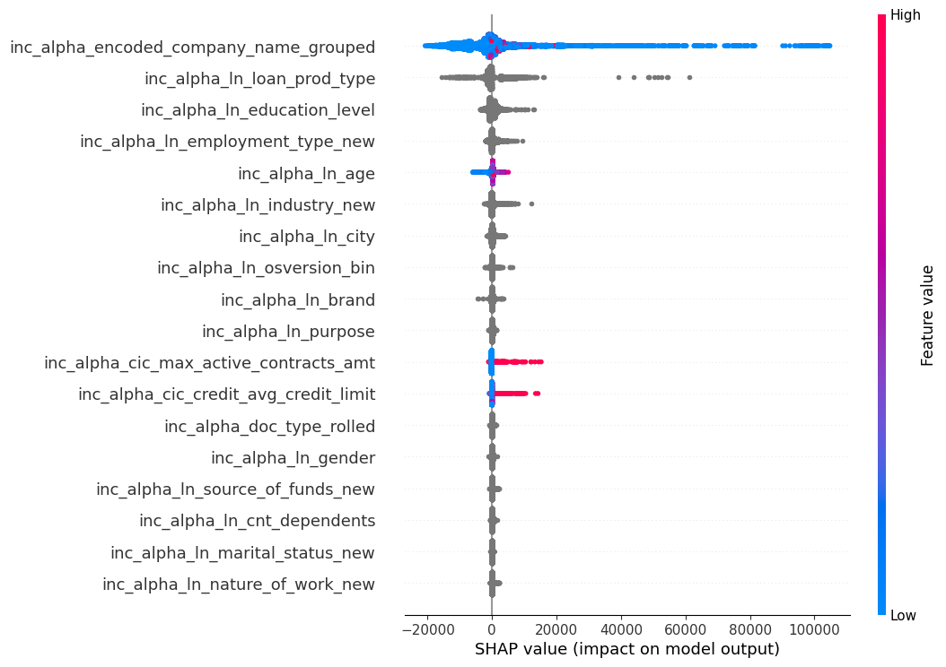
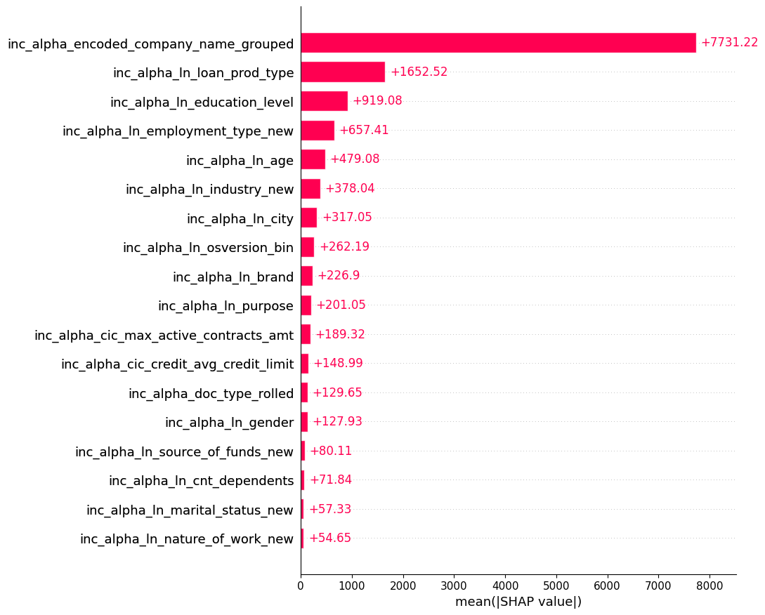
Statistical model to estimate income by predicting how much income the customer would declare if s/he were a good customer
Test Results | Mean Absolute Error (MAE) | Mean Squared Error (MSE) | Root Mean Squared Error (RMSE) | R-squared (R2) | Mean Absolute Percentage Error (MAPE)
Alpha Model | 4323.54 | 163105412.5 | 12771.27 | 0.7071 | 0.1171
September 24 OOT | 4612.87 | 148210965.8 | 12174.19 | 0.6879 | 0.141
October 24 OOT | 5365.51 | 234012229.9 | 15297.46 | 0.6497 | 0.1498
The "inc_alpha_encoded_company_name_grouped" is by far the most important factor in this prediction. Knowing the company someone is associated with gives us the biggest clue about the customer’s income.
The type of loan ("inc_alpha_In_loan_prod_type") also plays a significant role, though not as much as the company name.
Many other factors, like age, gender, or education level, have relatively little influence on the prediction compared to company name and loan type.

Slide 5
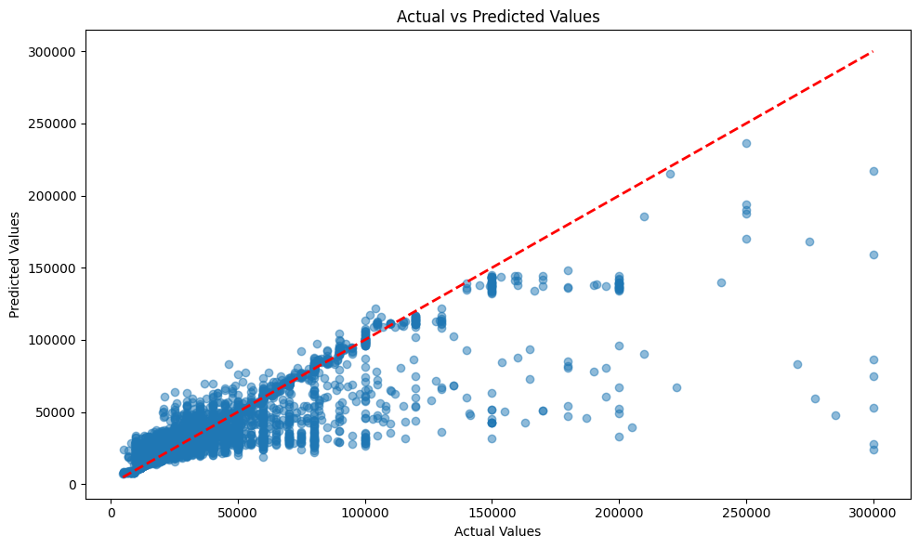
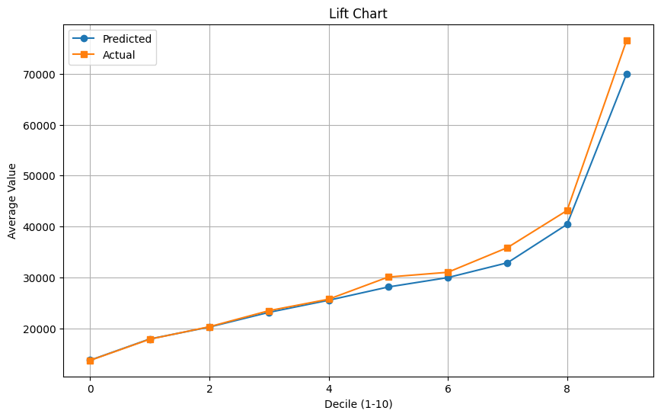
Residual and Lift
There's a clear positive correlation. As the actual values increase, the predicted values generally increase as well.
Many data points are clustered relatively close to the red line, especially for lower values. This indicates that the model is performing reasonably well in this range.
As the actual values increase, the spread of data points around the red line also increases. This suggests that the model's predictions become less accurate for higher values.
Overall, the model shows a decent performance, especially for lower values. The clustering of data points around the red line indicates a good fit in this range.
The model's performance deteriorates for higher values, as indicated by the increased spread and the presence of outliers.
We see a clear upward trend for both the "Predicted" and "Actual" lines, suggesting the model is performing well.
The "Actual" line is consistently above the "Predicted" line, meaning the model is slightly underestimating the average value in each decile. However, the lines are relatively close, indicating good overall agreement.
The closer the "Predicted" and "Actual" lines are, the more accurate the model's predictions are. In this chart, the lines are relatively close, indicating good accuracy.

Slide 6
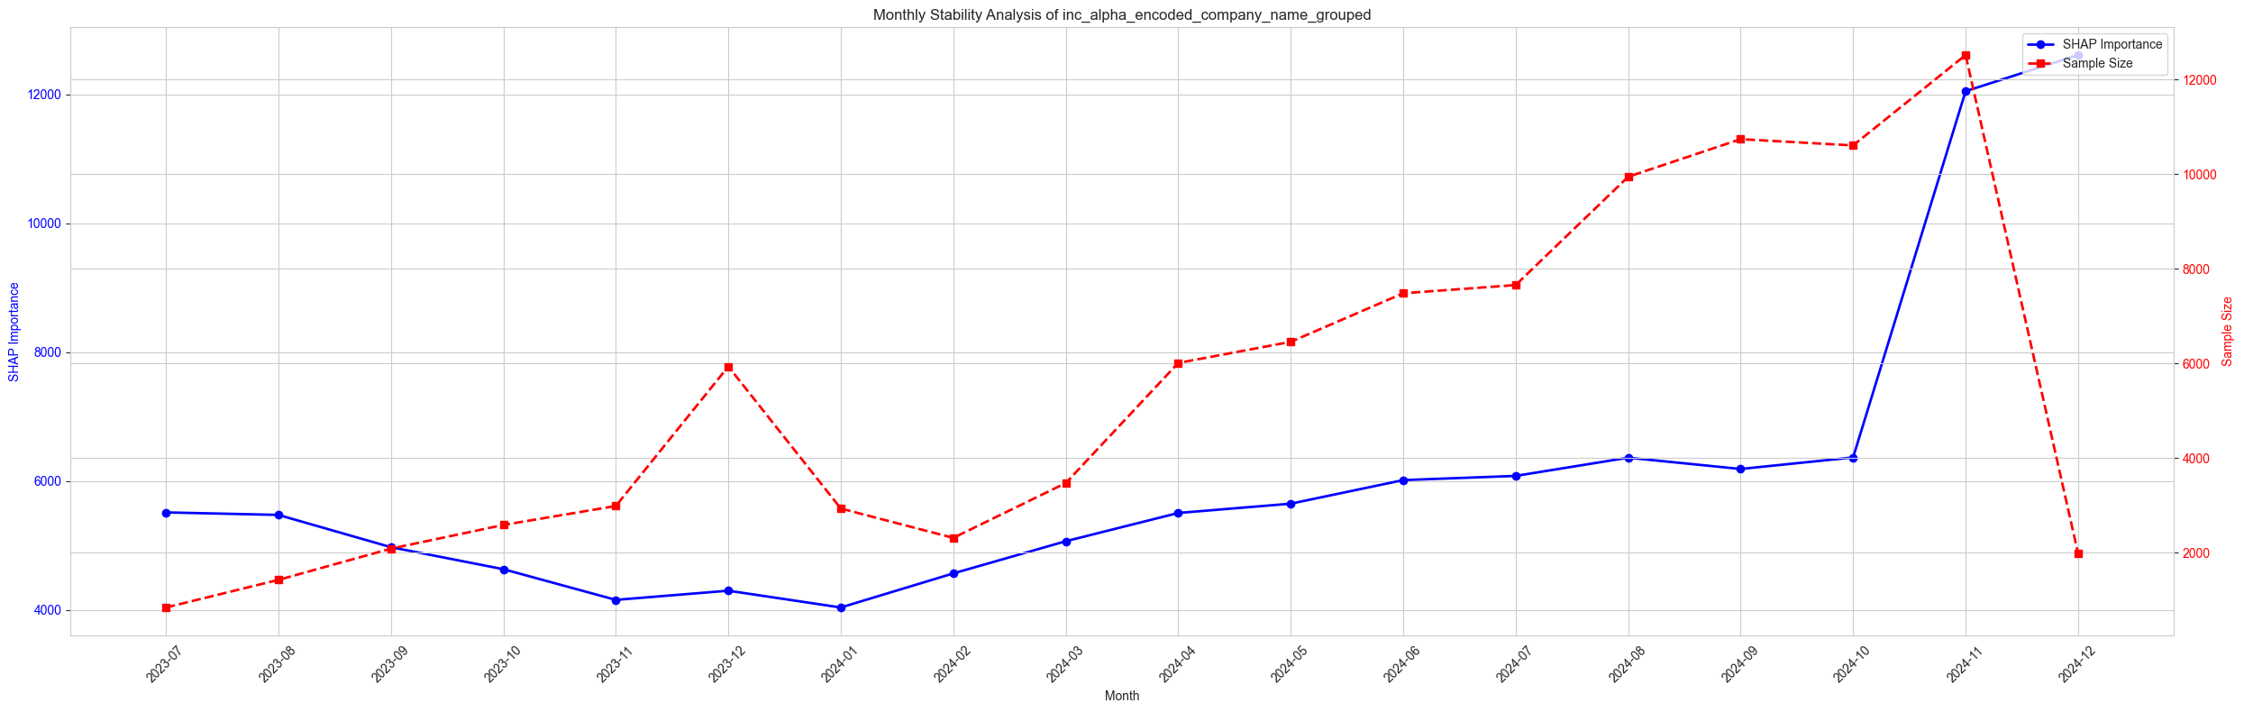
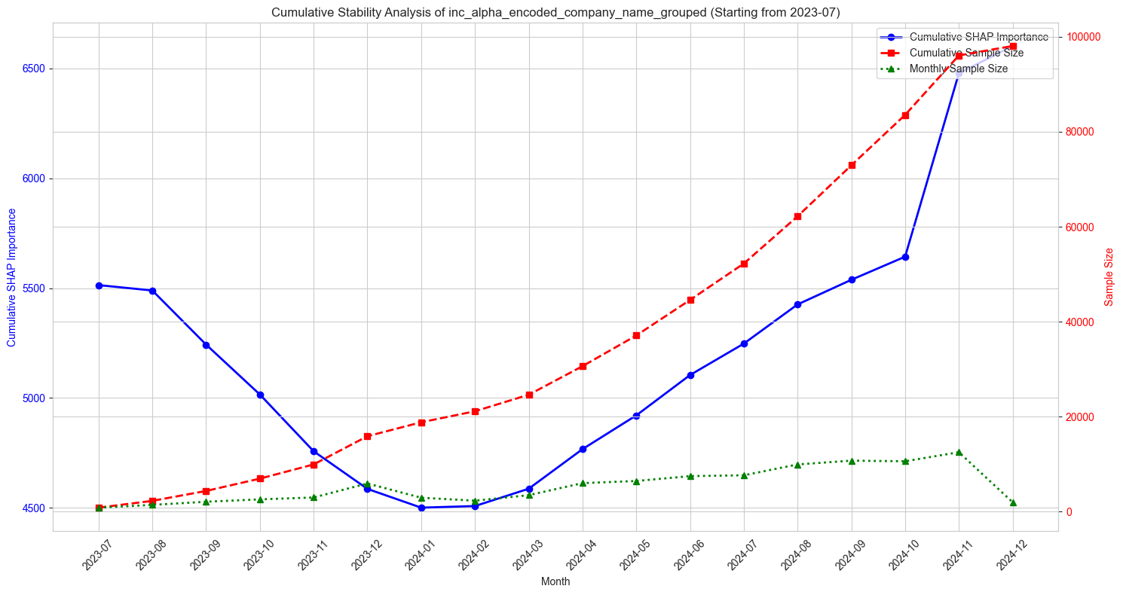
Company Encoder Feature Stability
Monthly Stability Metrics
mean_importance | 6085.8124
std_importance | 2392.676
coefficient_of_variation | 0.3932
min_importance | 4038.4394
max_importance | 12610.095
range | 8571.6553
Cumulative Stability Metrics
final_importance | 6602.4635
importance_change | 1088.808
std_importance | 612.1093
coefficient_of_variation | 0.1173
max_monthly_change | 834.8832
total_samples | 98063
The cumulative stability analysis of the “inc_alpha_encoded_company_name_grouped” column reveals a more stable trend compared to the monthly fluctuations. The cumulative SHAP importance shows an overall decreasing trend in the initial months followed by an increasing trend in the later months. The lower coefficient of variation suggests higher stability in the cumulative values. This analysis provides a more robust understanding of the feature's importance over time.

Slide 7
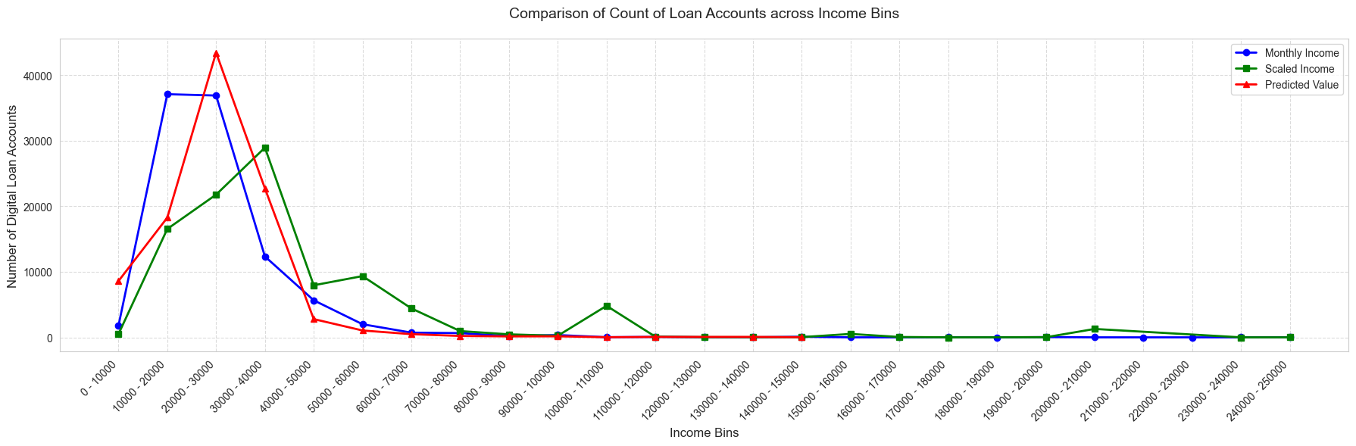
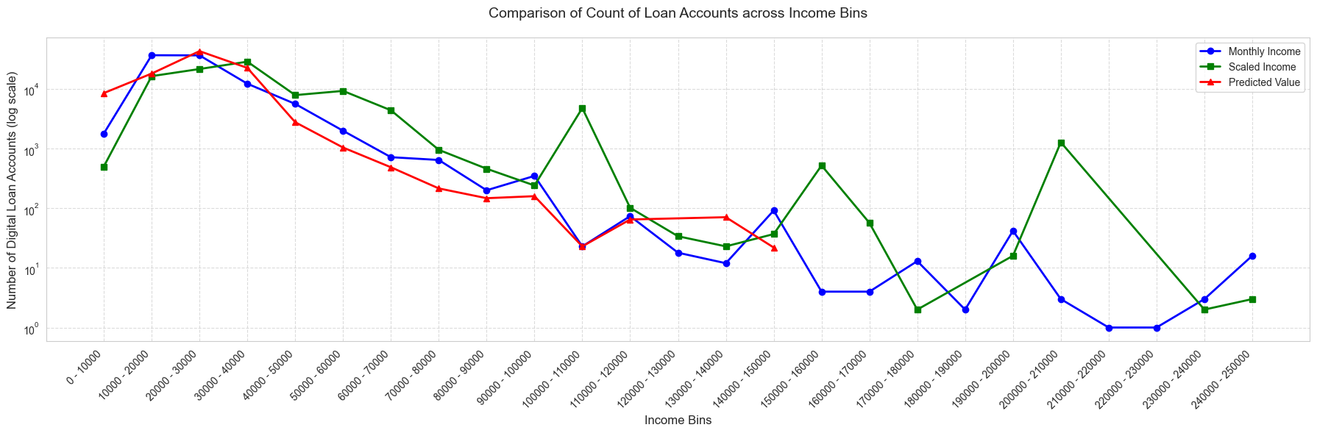
Distribution of Loans Across Income Types
The graph shows that the predicted values for the number of digital loan accounts are generally close to the actual values, indicating that the model used to predict the number of digital loan accounts is accurate.
With Log Scale

Slide 8
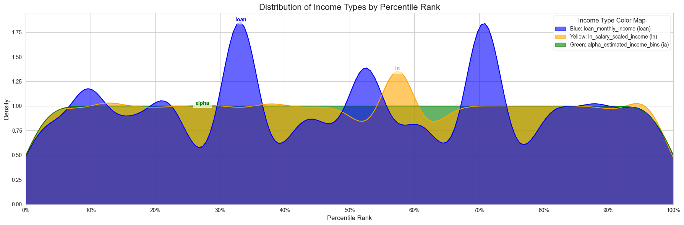
Comparing Model Performance:
"In" (Yellow) vs. "loan" (Blue): The "in salary scaled_income" is a poor representation of the actual "loan" income distribution. It overestimates the income at lower percentiles and underestimates it at higher percentiles.
"la" (Green) vs. "loan" (Blue): The "la estimated_income" shows a more even distribution compared to the "loan" income. While it captures the general presence of income across all percentiles, it doesn't accurately reflect the peaks and valleys of the "loan" income distribution.
"In" (Yellow) vs. "la" (Green): These two income types have very different distribution patterns. "In" is heavily concentrated at lower percentiles, while "la" is more evenly spread.
The "in salary scaled_income" is not a reliable predictor of the actual "loan" income, especially across the entire income spectrum.
The "la estimated_income" provides a more generalized view of income distribution but lacks the precision to capture the specific nuances of "loan" income.

Slide 9
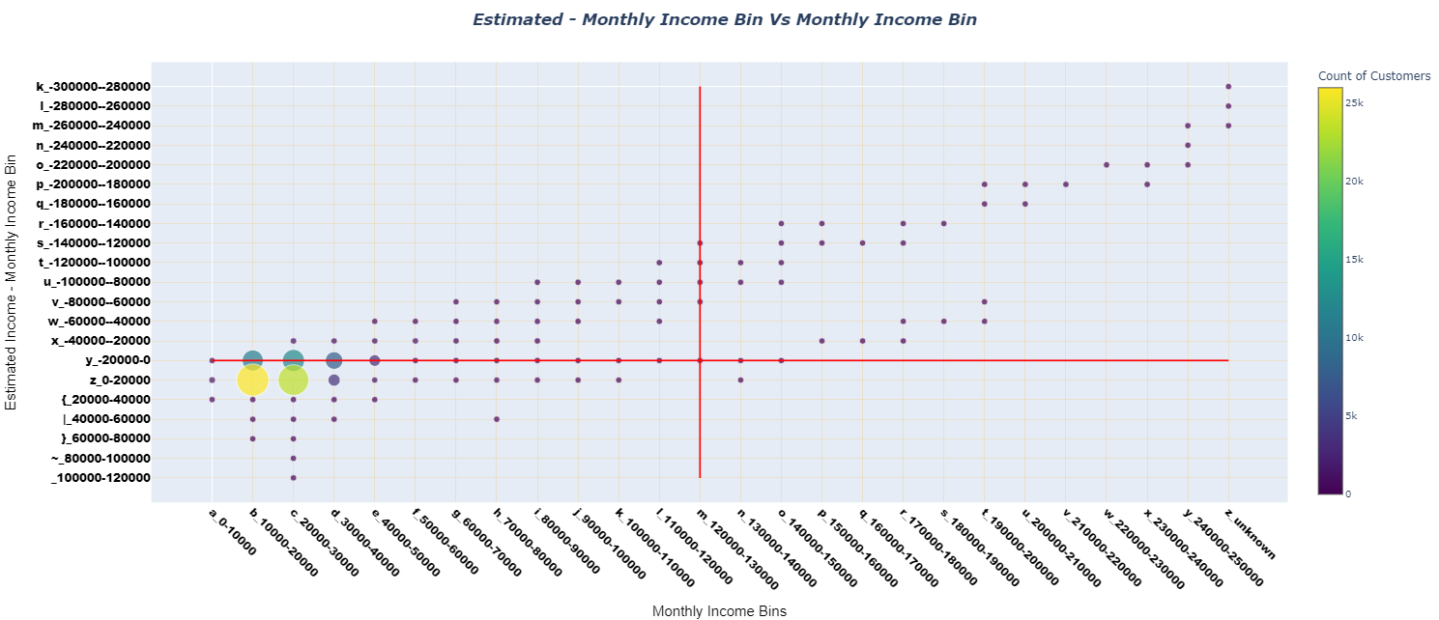
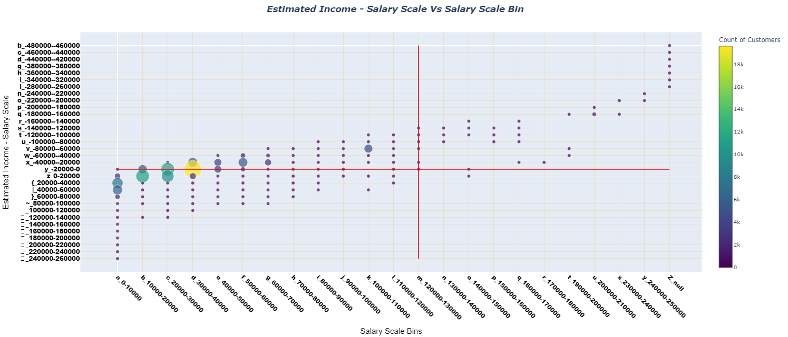
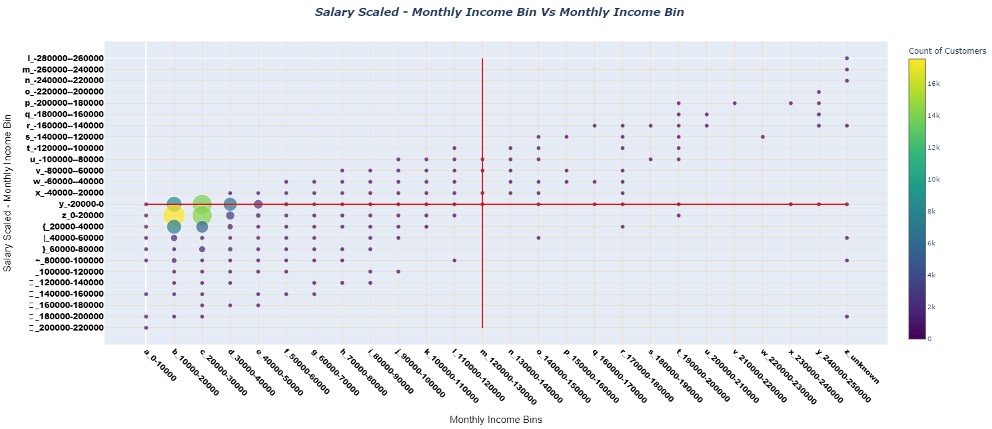
Prediction difference comparison of Estimated Income Model and Salary Scaled Model Vs Monthly Income
Both models capture the general trend of increasing income.
We can see a general upward trend, meaning that as actual income increases, the estimated income also increases. This suggests the model captures the overall income trend.
The "Salary Scaled Model" tends to overestimate income compared to the "Estimated Income Model."

Slide 10
Alpha Population Distribution Table
Sum of Number of Accounts | Column Labels
 | 1 | 2 | 3 | 4 | 5 | 6 | 7 | 8 | 9 | 10 | Grand Total
 | 32482.80625 | 30206.5 | 28710.1 | 26516 | 22923 | 18166.4 | 8888.28 | 8534.68 | 8251.89042 | 7084.207411
Row Labels | 145656.9984 | 32482.8 | 30206.5 | 28710.1 | 26516 | 22923 | 18166.4 | 8888.28 | 8534.68232 | 8251.890421
2023-06 - 2024-07 | 10.00% | 10.00% | 10.00% | 10.00% | 10.00% | 10.00% | 10.00% | 10.00% | 10.00% | 10.00% | 100.00%
2024-08 | 8.73% | 5.91% | 7.70% | 8.42% | 11.34% | 12.41% | 14.37% | 8.14% | 10.23% | 12.74% | 100.00%
2024-09 | 8.58% | 5.72% | 7.54% | 8.20% | 11.61% | 12.74% | 14.93% | 7.69% | 9.93% | 13.05% | 100.00%
2024-10 | 8.83% | 5.69% | 7.99% | 8.23% | 11.44% | 13.02% | 15.13% | 7.70% | 9.41% | 12.56% | 100.00%
2024-11 | 4.46% | 5.33% | 6.17% | 7.03% | 8.09% | 6.99% | 11.46% | 14.27% | 15.37% | 20.81% | 100.00%
2024-12 | 3.53% | 4.58% | 5.13% | 6.97% | 7.11% | 5.62% | 10.36% | 16.61% | 17.78% | 22.30% | 100.00%
2025-01 | 3.55% | 5.05% | 5.79% | 7.37% | 7.09% | 5.72% | 10.42% | 16.61% | 16.93% | 21.45% | 100.00%
2025-02 | 3.56% | 5.72% | 6.10% | 7.33% | 6.53% | 5.13% | 11.11% | 17.10% | 16.08% | 21.34% | 100.00%
Grand Total | 7.55% | 7.33% | 7.98% | 8.62% | 9.38% | 9.19% | 11.33% | 11.65% | 12.33% | 14.65% | 100.00%
Alpha PSI
Beta Income Bin | # Train (2024-06 - 2024-07) | # Test (2025-01 -2025-02) | #Train% | #Test% | A-B | Ln(A/B) | PSI
1 | 14203 | 1414 | 10.00% | 3.6% | 0.064447 | 1.034119 | 0.066646
2 | 14203 | 2118 | 10.00% | 5.3% | 0.046745 | 0.63007 | 0.029453
3 | 14203 | 2354 | 10.00% | 5.9% | 0.040811 | 0.524426 | 0.021402
4 | 14202 | 2926 | 10.00% | 7.4% | 0.026421 | 0.306835 | 0.008107
5 | 14203 | 2730 | 10.00% | 6.9% | 0.031357 | 0.37624 | 0.011798
6 | 14203 | 2178 | 10.00% | 5.5% | 0.045237 | 0.602135 | 0.027238
7 | 14202 | 4258 | 10.00% | 10.7% | -0.00707 | -0.06833 | 0.000483
8 | 14203 | 6685 | 10.00% | 16.8% | -0.06809 | -0.51932 | 0.035361
9 | 14203 | 6594 | 10.00% | 16.6% | -0.0658 | -0.50562 | 0.033271
10 | 14203 | 8513 | 10.00% | 21.4% | -0.11405 | -0.76105 | 0.086801
0 | 142028 | 39770 | 100.00% | 100.0% | 0.00% | 0 | 0.32056

