Slide 1

Beta 1 – Quick Demo and Stacking Model performance Document for Discussion January 2025

Slide 2
Best Beta 1 Demo Score with currently available data points at TSA onboarding
Top Features | Decremental Gini | Train Gini | Val Gini | July Gini | Aug Gini | Sep Gini
17 | cluster', 'nature_of_work_cat', 'gender', 'loan_monthly_income_WOE', 'source_funds', 'docType_cat', 'onb_time_of_day_cat', 'employment_type', 'brand', 'age_WOE', 'osversion_type_order', 'onb_week_of_month', 'email_secondary_domain', 'email_primary_domain', 'onb_province', 'onb_mon_of_year', 'diff_brth_city_n_onb_city_flg' | 0.4482 | 0.3437 | 0.3912 | 0.3984 | 0.3478
16 | diff_brth_city_n_onb_city_flg | 0.4675 | 0.3546 | 0.3924 | 0.3933 | 0.3598
15 | onb_mon_of_year | 0.4625 | 0.3556 | 0.3882 | 0.389 | 0.3513
14 | email_secondary_domain | 0.4763 | 0.3686 | 0.376 | 0.3995 | 0.3469
13 | email_primary_domain | 0.468 | 0.3571 | 0.3774 | 0.3912 | 0.3439
12 | onb_week_of_month | 0.4719 | 0.3618 | 0.3766 | 0.3959 | 0.3502
11 | onb_province | 0.4521 | 0.3516 | 0.3859 | 0.3767 | 0.3469
10 | source_funds | 0.4574 | 0.3614 | 0.3749 | 0.3713 | 0.3381
9 | osversion_type_order | 0.4529 | 0.3626 | 0.3781 | 0.3927 | 0.3445
8 | brand | 0.4088 | 0.348 | 0.3937 | 0.3901 | 0.3394
7 | age_WOE | 0.3969 | 0.3441 | 0.3622 | 0.3828 | 0.3329
6 | employment_type | 0.4017 | 0.3414 | 0.3863 | 0.4083 | 0.3334
Dataset​ | CatBoost​ Gini
Train (July 23 –June 24)​ | 0.4675
Test (Jul 24) | 0.3924
OOT 1 (Aug 24) | 0.3933
OOT 2 (Sep 24) | 0.3598

Slide 3
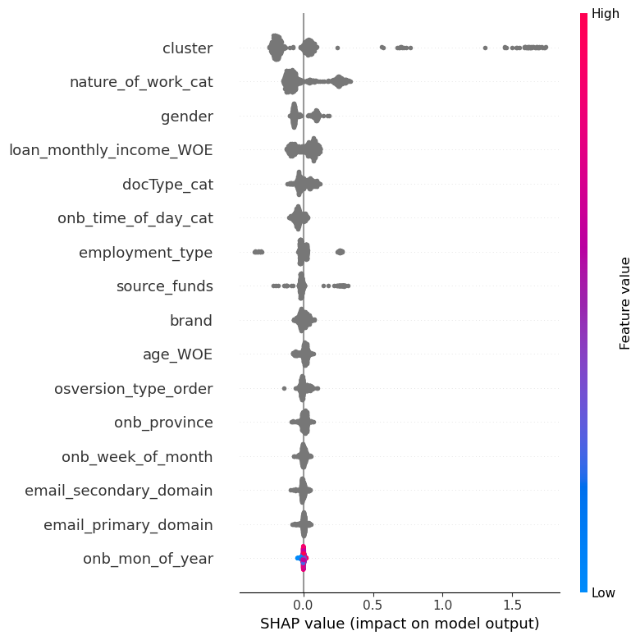
16 feats – SHAP chart
How to Read this SHAP chart?
Features are in decreasing order of importance
Left Blue, Right Red → +Ve Correlation
Left Red, Right Blue → -Ve Correlation
Grey color means missing value or categorical feat

Slide 4
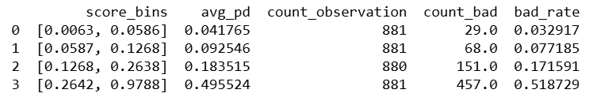
Beta 1 Stack Model = Apps Score + Beta 1 Demo Score with 16 features Model
Dataset | Apps Score for Android Quick Loan | Beta1 Demo Score | Beta 1 Stacking Model
Train (Jul 23 – Jun 24) | 0.53 | 0.4675 | 0.6754
Test (Jul 24) | 0.406 | 0.3924 | 0.5390
OOT 1 (Aug 24) | 0.372 | 0.3933 | 0.4730
OOT 2 (Sep 24) | 0.303 | 0.3598 | 0.5454
Cash Loans Approved b/w 1st May 2024 – 31st Oct 2024 for Android users (FPD30 rate)

Slide 5
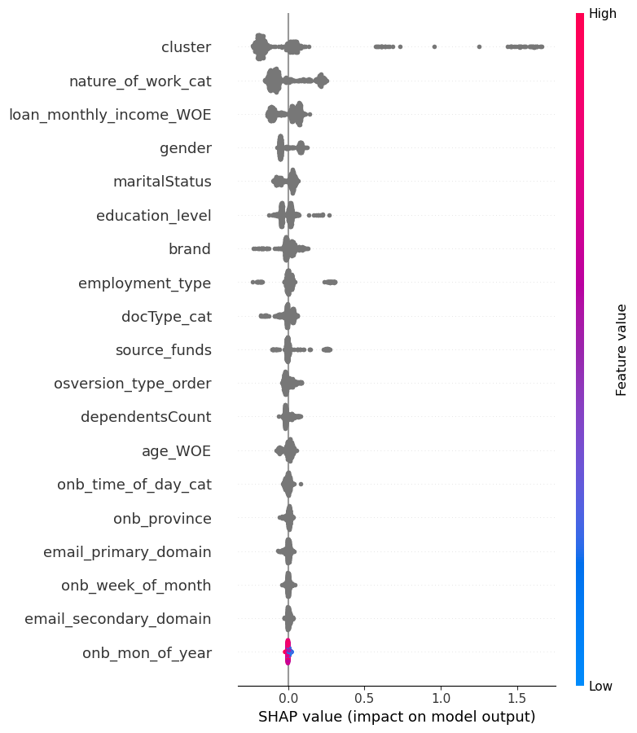
19 Feats -Model SHAP after adding Marital Status, No of Dependents, Education Level
How to Read this SHAP chart?
Features are in decreasing order of importance
Left Blue, Right Red → +Ve Correlation
Left Red, Right Blue → -Ve Correlation
Grey color means missing value or categorical feat

Slide 6
Final Model Selection using Decremental Gini Analysis
Top Features | Decremental Gini | Train Gini | Val Gini | July Gini | Aug Gini | Sep Gini
19 | 'cluster', 'nature_of_work_cat', 'loan_monthly_income_WOE', 'gender', 'maritalStatus', 'employment_type', 'education_level', 'brand', 'docType_cat', 'osversion_type_order', 'dependentsCount', 'source_funds', 'age_WOE', 'onb_time_of_day_cat', 'email_primary_domain', 'onb_province', 'onb_week_of_month', 'email_secondary_domain', 'onb_mon_of_year' | 0.4565 | 0.4305 | 0.3927 | 0.3744 | 0.3219
18 | onb_mon_of_year | 0.4555 | 0.4214 | 0.3915 | 0.3792 | 0.3249
17 | onb_week_of_month | 0.4596 | 0.4243 | 0.3856 | 0.391 | 0.3343
16 | email_secondary_domain | 0.4615 | 0.4327 | 0.4026 | 0.3843 | 0.3257
15 | onb_province | 0.4486 | 0.4219 | 0.3917 | 0.3763 | 0.329
14 | email_primary_domain | 0.4542 | 0.4251 | 0.3856 | 0.3521 | 0.3086
13 | source_funds | 0.4572 | 0.4136 | 0.3921 | 0.3553 | 0.3085
12 | onb_time_of_day_cat | 0.4523 | 0.4125 | 0.3848 | 0.3546 | 0.3039
11 | age_WOE | 0.4441 | 0.4137 | 0.3744 | 0.356 | 0.2893
10 | osversion_type_order | 0.4303 | 0.4017 | 0.3672 | 0.3455 | 0.2868
9 | dependentsCount | 0.4298 | 0.4008 | 0.3777 | 0.3693 | 0.3058
8 | docType_cat | 0.4273 | 0.3957 | 0.3466 | 0.3634 | 0.2859
7 | brand | 0.3828 | 0.4071 | 0.3495 | 0.348 | 0.2773
6 | education_level | 0.3774 | 0.3977 | 0.3381 | 0.3159 | 0.2715
Dataset | CatBoost
Train (July 23 –June 24) | 0.4615
Test (Jul 24) | 0.4026
OOT 1 (Aug 24) | 0.3843
OOT 2 (Sep 24) | 0.3257

Slide 7
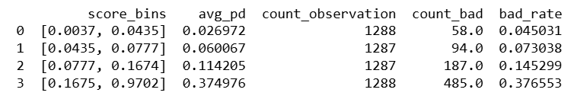
Beta 1 Stack Model = Apps Score + Beta 1 Demo Score with 16 features Model​
Dataset | Apps Score for Android Quick Loan | Beta1 Demo Score | Beta 1 Stacking Model
Train (Jul 23 – Jun 24) | 0.53 | 0.4615 | 0.6672
Test (Jul 24) | 0.406 | 0.4026 | 0.5080
OOT 1 (Aug 24) | 0.372 | 0.3843 | 0.5036
OOT 2 (Sep 24) | 0.303 | 0.3257 | 0.5358
Cash Loans Approved b/w 1st May 2024 – 31st Oct 2024 for Android users (FPD30 rate)

