Slide 1

CASH Alpha CIC Model
Presented by:
Data Science (Sowndarya, Bhuvanesh)
24th July 2025

Slide 2
Architecture Overview of TDB’s Risk Scorecards
For Cash Loan only
For both Cash and SIL
Limit Setting Model (Hosted in Digital Layer)
Credit Decisioning Model (Hosted in Taran)
Beta Stack
Alpha Stack
Trench 1: New Users - within 30 days from TSA Onboarding
Limit Setting Score = Gamma Stack
Beta Demo Score
Beta Demo Score
Gamma Demo Score
Apps Score
Apps Score
Selectively call Alpha
Apps Score
Credo Score
Users automatically move from Trench 1 to Trench 2 after 30 days if no disbursed loans
Credo Score
CIC Score
Gamma Income Model
Beta Income Model
Alpha Income Model
Users will stay in Trench 2 until 1st disbursed loan. His Gamma Stack will be re-calculated every 30-day anniversary from TSA onboarding date
Limit Setting Score = Gamma Stack
Beta Stack
Alpha Stack
Gamma Demo Score
Beta Demo Score
Beta Demo Score
Trench 2: Existing Users - After 30 days from TSA Onboarding AND Never Disbursed Loan
Apps Score
Apps Score
Selectively call Alpha
Apps Score
Transaction Score
Transaction Score
Transaction Score
CIC Score
Gamma Income Model
Beta Income Model
Alpha Income Model
Users will move to Trench 3 after 1st Disbursed Loan
Lowest Risk users from this B Score will be pre-approved for upsell and xsell. Medium Risk users from this B Score will have to go through Taran.
High Risk users from this B Score will not be given any offer.
B Score = Gamma Stack
Trench 3: Existing Users - After 30 days from 1st Disbursed Loan AND current DPD <= 10
Beta Stack
Alpha Stack
Gamma Demo Score
Apps Score
Beta Demo Score
Beta Demo Score
Apps Score
Apps Score
Enhanced Transaction Score
Selectively call Alpha
Enhanced Transaction Score
Once moved to Trench 3, user will forever remain in Trench 3. His Gamma Stack will be re-calculated every 30 days anniversary from 1st Loan Disbursement Date
Enhanced Transaction Score
CIC Score
Gamma Income Model
Beta Income Model
Alpha Income Model

Slide 3
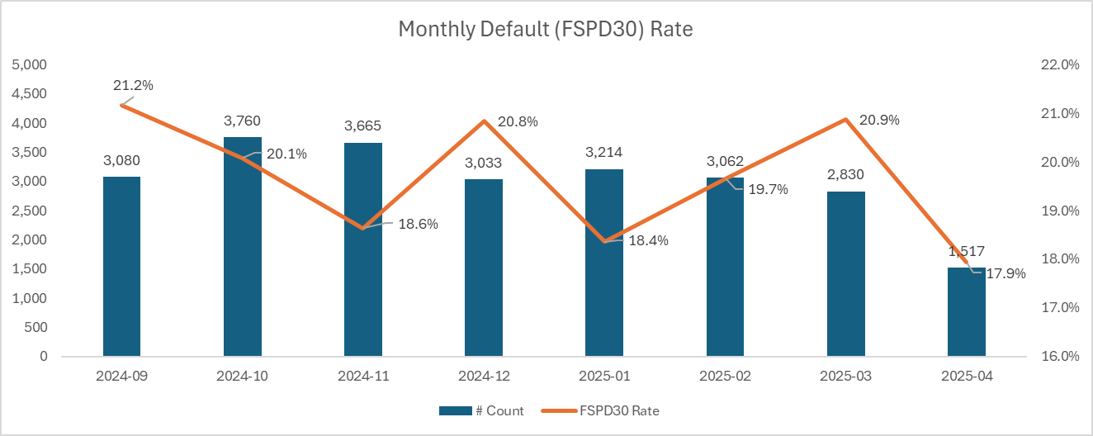
Cash Loan CIC Scorecard
 | Loan Disbursement Date | # Count | # Bad (FSPD30) Cash Loans | FSPD30 rate
Training (90%) | 01/09/2024 - 31/01/2025 | 15,076 | 2,991 | 19.8%
Validation (10%) | 01/09/2024 - 31/01/2025 | 1,676 | 321 | 19.2%
Feb (Test) | 01/02/2025 - 28/02/2025 | 3,062 | 602 | 19.7%
Mar (OOT) | 01/03/2025 - 31/03/2025 | 2,830 | 591 | 20.9%
*Apr (OOT) | 01/04/2025 – 21/04/2025 | 1,517 | 272 | 17.9%
3

Slide 4
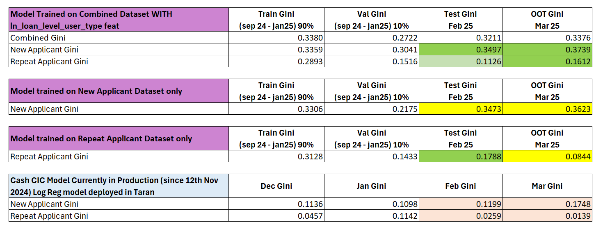
After lot of experimentations, the Model trained on combined dataset (new applicant + repeat applicant) along with the user_type feature showed the best performance and stability

Slide 5
Feature Selection Methodology Overview
Feature Selection Methodology Overview
166
Feats
112
Feats
103 Feats
60 Feats
12 Feats
Missing Rate < 95%
IV > 0.01
Inter-correlation < 75%
Individual Feature Evaluation
5

Slide 6
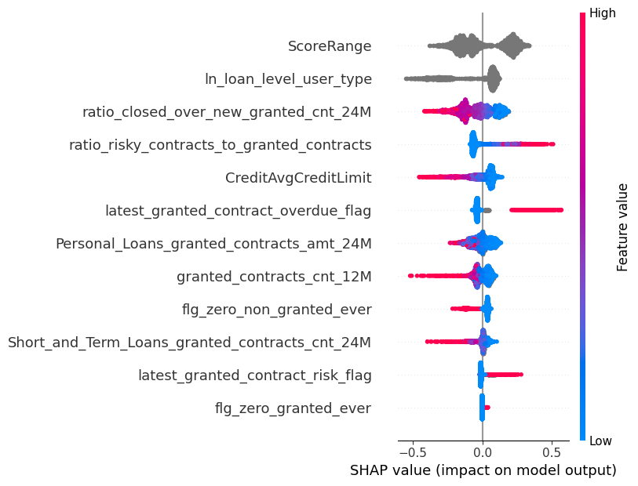
SHAP (12 feat)
The horizontal axis shows how much a feature affects the prediction. Points to the right mean the feature increases the prediction, and points to the left mean it decreases it.
The color of each dot shows the feature value: red means the value is high, and blue means the value is low. Grey means categorical feature.
If red dots are mostly on the right, it means high values of that feature increase Risk. If red dots are on the left, high values decrease Risk.
The features are listed on the vertical axis, from most important at the top to least important at the bottom.
6
Notes:
Descriptions need to be added

Slide 7
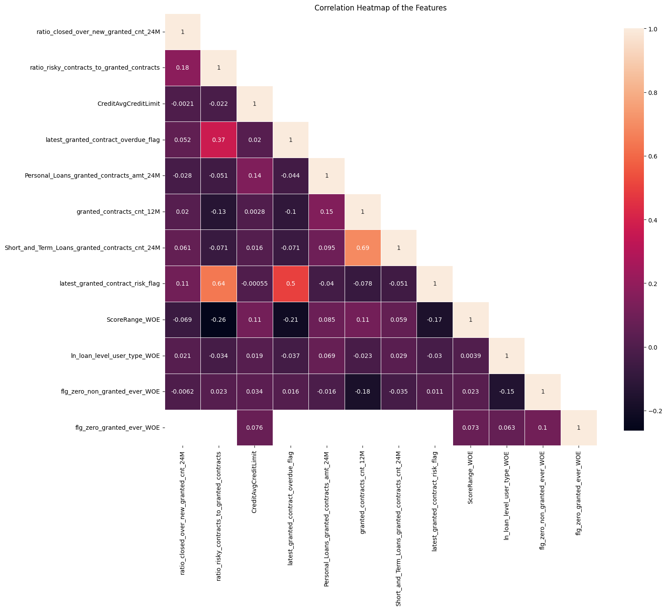
Inter-Correlation (12 feat)
The numbers show how strongly two features are related — values close to 1 mean a strong positive correlated (two features increase together), and values close to -1 mean a strong negative correlated (one feature increases while the other decreases).
Light-colored squares mean a stronger relationship, while dark ones mean weak or no relationship.
Most values here are small, so most features are not strongly related to each other — this is good for building models.
7
Notes:
Descriptions need to be added

Slide 8
Model Iteration | Features | Train (90%) Gini (Sep24 - Jan25) | Val (10%) Gini (Sep24 - Jan25) | Test Gini (Feb25) | OOT Gini (Mar25) | OOT Gini (*Apr25 - until 21st)
Model with top 5 feat | ScoreRange, ln_loan_level_user_type, ratio_closed_over_new_granted_cnt_24M, ratio_risky_contracts_to_granted_contracts, CreditAvgCreditLimit | 0.2770 | 0.2176 | 0.2493 | 0.2660 | 0.2822
Model with top 6 feat | latest_granted_contract_overdue_flag | 0.2850 | 0.2196 | 0.2595 | 0.2786 | 0.2844
Model with top 7 feat | Personal_Loans_granted_contracts_amt_24M | 0.2958 | 0.2129 | 0.2689 | 0.2895 | 0.2814
Model with top 8 feat | granted_contracts_cnt_12M | 0.3039 | 0.2247 | 0.2775 | 0.3001 | 0.2770
Model with top 9 feat | flg_zero_non_granted_ever | 0.3427 | 0.2360 | 0.2815 | 0.2942 | 0.2909
Model with top 10 feat | Short_and_Term_Loans_granted_contracts_cnt_24M | 0.3511 | 0.2446 | 0.2874 | 0.2966 | 0.3040
Model with top 11 feat | latest_granted_contract_risk_flag | 0.3250 | 0.2456 | 0.2841 | 0.2967 | 0.2936
Model with top 12 feat | flg_zero_granted_ever | 0.3251 | 0.2452 | 0.2860 | 0.2984 | 0.2977
12 feature model after Hyper Parameters Tuning | New + Repeat Applicant | 0.2999 | 0.2495 | 0.2843 | 0.2939 | 0.2992
 | New Applicant | 0.2883 | 0.2749 | 0.2972 | 0.2867 | 0.2555
 | Repeat Applicant | 0.2529 | 0.1553 | 0.1143 | 0.2120 | 0.1560
Hyperparameter | Value
learning_rate | 0.04871199769163818
depth | 4
l2_leaf_reg | 12.926755754057682
iterations | 2000
eval_metric | AUC
random_seed | 42
auto_class_weights | Balanced
early_stopping_rounds | 10
Hyperparameter values for the best model chosen after the HP Tuning using Optuna
8

Slide 9
SHAP Rank is overall Consistent Across Train, Test and OOT Datasets
Feature | Train_Rank | Feb_Rank | Mar_Rank | Apr_Rank
ScoreRange | 1 | 1 | 1 | 2
ln_loan_level_user_type | 2 | 2 | 2 | 1
ratio_closed_over_new_granted_cnt_24M | 3 | 3 | 3 | 3
ratio_risky_contracts_to_granted_contracts | 4 | 4 | 4 | 4
CreditAvgCreditLimit | 5 | 5 | 5 | 5
latest_granted_contract_overdue_flag | 6 | 6 | 6 | 6
flg_zero_non_granted_ever | 7 | 8 | 8 | 7
granted_contracts_cnt_12M | 8 | 7 | 7 | 8
Personal_Loans_granted_contracts_amt_24M | 9 | 9 | 9 | 9
Short_and_Term_Loans_granted_contracts_cnt_24M | 10 | 10 | 10 | 10
latest_granted_contract_risk_flag | 11 | 11 | 11 | 11
flg_zero_granted_ever | 12 | 12 | 12 | 12
9

Slide 10
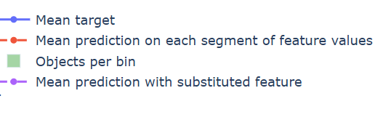
Feature Stability Plot Legend Table
 | Name | What It Shows | How to Interpret
Blue Line | Mean Target | The average true target value in each feature bin | If the line jumps around a lot, the target is unstable or noisy. If it moves smoothly, the target changes in a steady way.
Red Dashed Line | Mean Prediction | The model’s average prediction in each bin | Should generally follow the blue line. If it's a bit smoother, that means the model is generalizing well and avoiding overfitting.
Green Bars | Objects per Bin | The number of data points in each bin | Taller bars mean the signal is reliable. Very short bars mean there’s not much data, so predictions might be risky or unreliable.
Purple Dotted Line | Mean Prediction with Substituted Feature | What the model would predict if this feature was shuffled or replaced randomly | If it stays close to the red line, the model doesn’t rely much on this feature. If it's far from the red line, the model depends heavily on this feature.
10
Notes:
Descriptions need to be updated

Slide 11
Feature Evaluation Analysis (12 features)
11

Slide 12
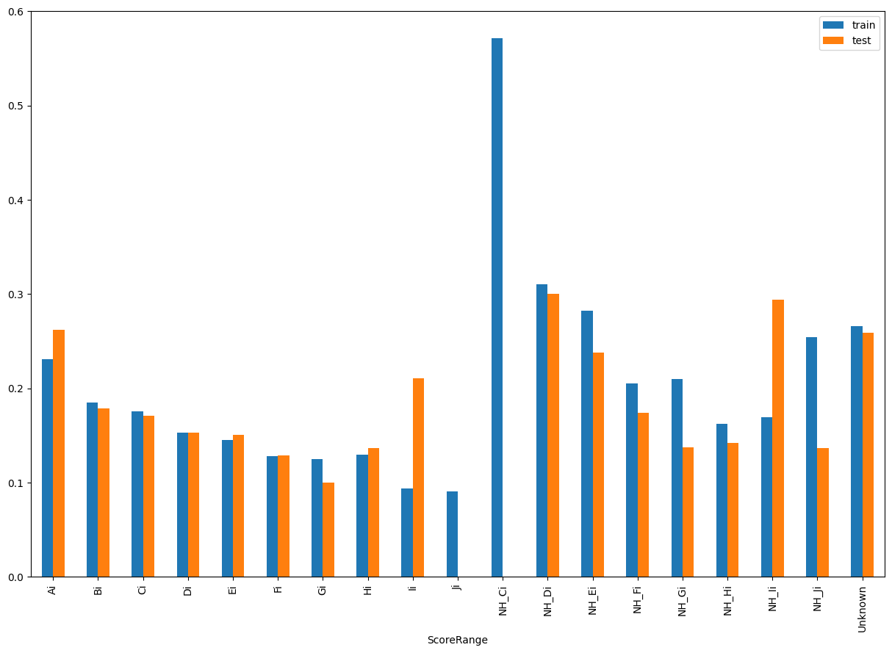
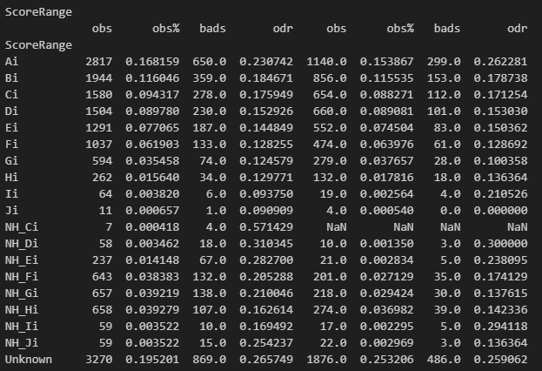
Rank# 1: ScoreRange (1 / 5) - Performance in Train vs Test <Disbursed>
This feature is indicative of the overall risk score segment of the user from CRIF.
12
Please note these are just WOE Bins, NOT the final Bins that Catboost chooses internally

Slide 13

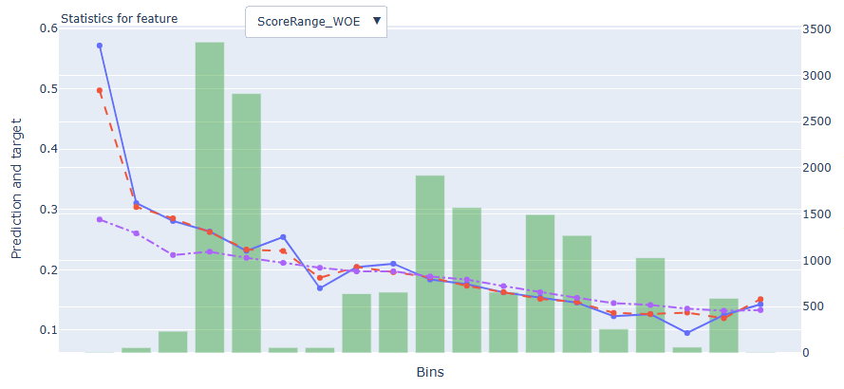
Rank# 1: ScoreRange (2 / 5) - Feature Statistics Analysis <Disbursed>​
The red line (model prediction) generally aligns with the blue line (actual outcome), suggesting the model understands this feature’s overall trend.
A small separation between the red and purple lines shows this feature contributes to refining predictions.
13

Slide 14
Rank# 1: ScoreRange (3 / 5) - MoM Feature Distribution <Applied>​
ScoreRange
month | Applied Count | Approval Rate (%) | Ai | Bi | NH_Fi | Ci | NH_Gi | NH_Hi | Di | Ei | Fi | NH_Ei | Gi | Hi | NH_Ji | NH_Ii | NH_Di | Ii | NH_Ci | Ji |  | Avg. CIC Score
2024-09 | 15,599 | 19.7% | 31.2% | 9.0% | 10.1% | 6.2% | 8.3% | 7.2% | 5.7% | 4.9% | 4.2% | 6.2% | 2.7% | 1.1% | 1.0% | 0.8% | 0.8% | 0.2% | 0.2% | 0.1% |  | 0.5524
2024-10 | 12,382 | 30.6% | 30.3% | 11.7% | 8.7% | 7.5% | 6.7% | 6.1% | 6.9% | 5.8% | 4.7% | 5.2% | 2.5% | 1.1% | 0.8% | 0.7% | 0.7% | 0.4% | 0.2% | 0.0% |  | 0.5394
2024-11 | 12,382 | 29.4% | 31.1% | 11.9% | 7.7% | 7.3% | 7.2% | 6.3% | 6.5% | 6.0% | 4.4% | 5.7% | 2.5% | 1.1% | 0.8% | 0.7% | 0.5% | 0.2% | 0.2% | 0.1% |  | 0.5411
2024-12 | 11,017 | 27.7% | 32.7% | 12.1% | 7.2% | 8.1% | 7.1% | 6.3% | 6.7% | 5.7% | 4.4% | 4.0% | 2.6% | 1.0% | 0.7% | 0.6% | 0.5% | 0.2% | 0.1% | 0.0% |  | 0.5302
2025-01 | 11,705 | 28.2% | 28.8% | 11.6% | 8.6% | 8.4% | 7.2% | 6.4% | 7.8% | 6.4% | 5.1% | 3.1% | 3.3% | 1.2% | 0.7% | 0.5% | 0.4% | 0.3% | 0.1% | 0.0% |  | 0.5231
2025-02 | 10,878 | 28.8% | 27.6% | 12.0% | 8.1% | 8.2% | 7.1% | 8.2% | 7.2% | 6.2% | 5.5% | 3.1% | 3.2% | 1.3% | 0.8% | 0.9% | 0.5% | 0.2% | 0.1% | 0.0% |  | 0.5278
2025-03 | 9,601 | 29.3% | 28.8% | 12.4% | 8.2% | 7.3% | 7.8% | 7.4% | 7.2% | 6.4% | 4.8% | 3.3% | 2.6% | 1.2% | 0.7% | 1.1% | 0.4% | 0.2% | 0.1% | 0.1% |  | 0.5249
2025-04 | 9,192 | 26.3% | 29.1% | 11.8% | 8.4% | 7.9% | 7.6% | 7.5% | 6.7% | 6.6% | 4.1% | 3.7% | 2.7% | 1.4% | 0.7% | 0.8% | 0.5% | 0.4% | 0.1% | 0.1% |  | 0.5267
2025-05 | 9,558 | 28.7% | 29.1% | 11.8% | 8.1% | 7.9% | 7.1% | 8.4% | 6.8% | 6.5% | 4.6% | 3.5% | 2.6% | 1.1% | 0.8% | 0.8% | 0.4% | 0.3% | 0.1% | 0.1% |  | 0.5188
2025-06 | 11,402 | 28.2% | 28.4% | 12.4% | 7.3% | 7.8% | 7.5% | 8.2% | 7.4% | 6.9% | 4.8% | 3.3% | 2.4% | 0.9% | 0.8% | 1.0% | 0.5% | 0.2% | 0.2% | 0.0% |  | 0.5225
High-score segment (Ai) shows a controlled and gradual decline, indicating stable behavior without abrupt shifts.
Mid-tier buckets (Bi, NH_Fi, Ci, NH_Gi, etc.) remain consistently distributed month-over-month, reflecting strong distributional stability.
Low-score categories stay minimal and stable throughout, reinforcing the overall feature reliability for modeling.
14

Slide 15
Rank# 1: ScoreRange (4 / 5) - MoM Feature Distribution <Applied> <User Type wise> ​
ScoreRange - New Applicant
month | Applied Count | Approval Rate (%) | Ai | Bi | NH_Fi | NH_Gi | NH_Hi | Ci | Di | Ei | NH_Ei | Fi | Gi | Hi | NH_Ji | NH_Ii | NH_Di | Ii | NH_Ci | Ji |  | Avg. CIC Score
2024-09 | 14,584 | 17.6% | 30.7% | 8.8% | 10.4% | 8.7% | 7.6% | 6.0% | 5.4% | 4.6% | 6.6% | 4.1% | 2.7% | 1.1% | 1.1% | 0.8% | 0.8% | 0.2% | 0.3% | 0.1% |  | 0.5621
2024-10 | 11,423 | 28.3% | 29.7% | 11.6% | 9.0% | 7.0% | 6.4% | 7.3% | 6.6% | 5.6% | 5.6% | 4.6% | 2.5% | 1.1% | 0.8% | 0.7% | 0.7% | 0.4% | 0.2% | 0.0% |  | 0.5505
2024-11 | 11,362 | 27.4% | 30.8% | 11.8% | 8.0% | 7.5% | 6.6% | 7.0% | 6.2% | 5.9% | 6.0% | 4.3% | 2.5% | 1.1% | 0.7% | 0.7% | 0.5% | 0.2% | 0.2% | 0.0% |  | 0.5526
2024-12 | 9,493 | 23.6% | 32.2% | 12.0% | 7.7% | 7.6% | 6.8% | 7.7% | 6.4% | 5.2% | 4.3% | 4.2% | 2.6% | 1.0% | 0.8% | 0.6% | 0.5% | 0.2% | 0.1% | 0.0% |  | 0.5501
2025-01 | 10,163 | 24.1% | 28.6% | 11.4% | 9.2% | 7.7% | 6.5% | 8.3% | 7.3% | 6.0% | 3.5% | 4.9% | 3.1% | 1.2% | 0.7% | 0.5% | 0.5% | 0.3% | 0.1% | 0.0% |  | 0.5424
2025-02 | 9,547 | 24.9% | 27.1% | 11.7% | 8.8% | 7.5% | 8.6% | 8.0% | 6.9% | 5.8% | 3.5% | 5.0% | 3.2% | 1.3% | 0.9% | 0.9% | 0.6% | 0.1% | 0.1% | 0.0% |  | 0.5462
2025-03 | 7,999 | 23.9% | 28.7% | 11.9% | 9.0% | 8.3% | 7.8% | 6.8% | 6.9% | 5.8% | 3.9% | 4.7% | 2.5% | 1.2% | 0.7% | 1.1% | 0.4% | 0.2% | 0.1% | 0.0% |  | 0.5499
2025-04 | 7,650 | 20.8% | 28.9% | 11.2% | 9.0% | 8.2% | 8.0% | 7.5% | 6.3% | 6.3% | 4.2% | 4.0% | 2.6% | 1.3% | 0.8% | 0.8% | 0.4% | 0.3% | 0.1% | 0.1% |  | 0.5510
2025-05 | 7,813 | 22.3% | 29.1% | 11.6% | 8.9% | 7.4% | 8.8% | 7.5% | 6.3% | 6.1% | 4.0% | 4.5% | 2.3% | 1.0% | 0.9% | 0.8% | 0.4% | 0.3% | 0.1% | 0.0% |  | 0.5454
2025-06 | 9,512 | 22.9% | 28.7% | 12.0% | 7.8% | 7.9% | 8.2% | 7.6% | 7.0% | 6.6% | 3.9% | 4.4% | 2.2% | 0.9% | 0.9% | 1.0% | 0.6% | 0.2% | 0.1% | 0.0% |  | 0.5473
ScoreRange - Repeat Applicant
month | Applied Count | Approval Rate (%) | Ai | Bi | Ci | Di | Ei | Fi | NH_Hi | NH_Fi | NH_Gi | Gi | Hi | NH_Ei | NH_Ii | NH_Ji | NH_Di | Ii | NH_Ci | Ji |  | Avg. CIC Score
2024-09 | 1,015 | 49.4% | 38.1% | 12.9% | 8.1% | 8.7% | 8.7% | 5.3% | 2.5% | 5.0% | 3.4% | 3.4% | 1.3% | 1.1% | 0.2% | 0.4% | 0.8% | 0.1% | 0.0% | 0.0% |  | 0.4140
2024-10 | 959 | 58.4% | 36.9% | 12.3% | 9.9% | 9.6% | 9.0% | 5.1% | 2.8% | 5.0% | 3.2% | 2.8% | 1.0% | 0.9% | 0.5% | 0.1% | 0.3% | 0.4% | 0.1% | 0.0% |  | 0.4066
2024-11 | 1,020 | 51.6% | 34.5% | 13.3% | 11.1% | 8.9% | 6.7% | 5.8% | 3.6% | 4.5% | 5.0% | 1.9% | 0.6% | 1.4% | 0.7% | 0.8% | 0.5% | 0.4% | 0.1% | 0.1% |  | 0.4133
2024-12 | 1,524 | 53.5% | 36.1% | 12.7% | 10.6% | 9.0% | 8.9% | 5.3% | 3.1% | 4.0% | 3.5% | 2.8% | 1.3% | 1.6% | 0.3% | 0.2% | 0.5% | 0.0% | 0.1% | 0.0% |  | 0.4066
2025-01 | 1,542 | 55.4% | 30.1% | 13.0% | 9.7% | 10.6% | 8.3% | 6.2% | 6.0% | 4.7% | 4.0% | 4.6% | 1.2% | 0.5% | 0.2% | 0.6% | 0.2% | 0.2% | 0.0% | 0.0% |  | 0.3959
2025-02 | 1,331 | 56.3% | 30.7% | 13.7% | 9.9% | 9.1% | 8.8% | 8.6% | 4.8% | 3.3% | 4.0% | 3.4% | 1.4% | 0.2% | 1.2% | 0.2% | 0.0% | 0.7% | 0.0% | 0.0% |  | 0.3952
2025-03 | 1,602 | 56.3% | 29.5% | 14.9% | 9.8% | 8.7% | 9.7% | 5.5% | 5.8% | 4.0% | 5.0% | 3.2% | 1.2% | 0.4% | 1.2% | 0.5% | 0.2% | 0.2% | 0.1% | 0.2% |  | 0.4002
2025-04 | 1,542 | 53.4% | 29.9% | 14.7% | 10.2% | 8.8% | 7.9% | 5.0% | 5.4% | 5.2% | 5.0% | 3.0% | 1.9% | 1.1% | 0.7% | 0.3% | 0.5% | 0.4% | 0.1% | 0.1% |  | 0.4061
2025-05 | 1,745 | 57.2% | 29.4% | 12.9% | 9.7% | 9.4% | 8.2% | 5.1% | 6.8% | 4.5% | 5.4% | 4.1% | 1.4% | 0.8% | 0.6% | 0.6% | 0.4% | 0.5% | 0.0% | 0.1% |  | 0.3999
2025-06 | 1,890 | 54.8% | 26.9% | 14.3% | 9.1% | 9.5% | 8.6% | 6.5% | 8.5% | 4.8% | 5.3% | 2.9% | 1.1% | 0.8% | 0.8% | 0.6% | 0.0% | 0.1% | 0.2% | 0.0% |  | 0.3977
15

Slide 16
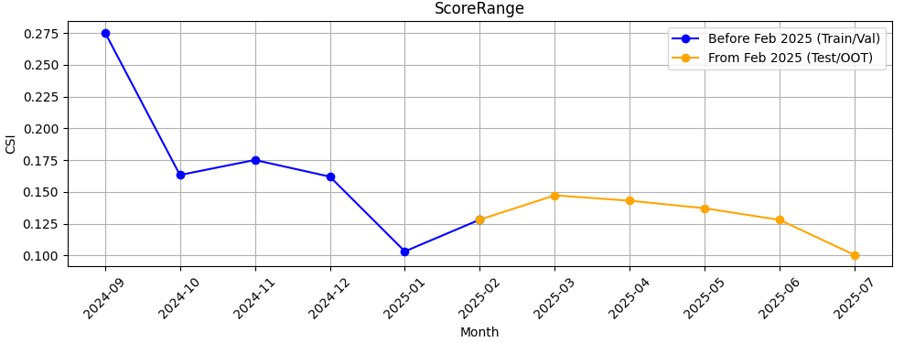
Rank# 1: ScoreRange (5 / 5) - Feature CSI Analysis <Applied>​
Baseline period: Sep’2024 to Jan’2025.
CSI for ScoreRange was moderately high during the baseline, peaking at ~0.28. In the Test/OOT period (Feb to Jul 2025), CSI values steadily declined and stayed close to the 0.1 threshold, indicating improved stability with no significant data drift observed.

Slide 17
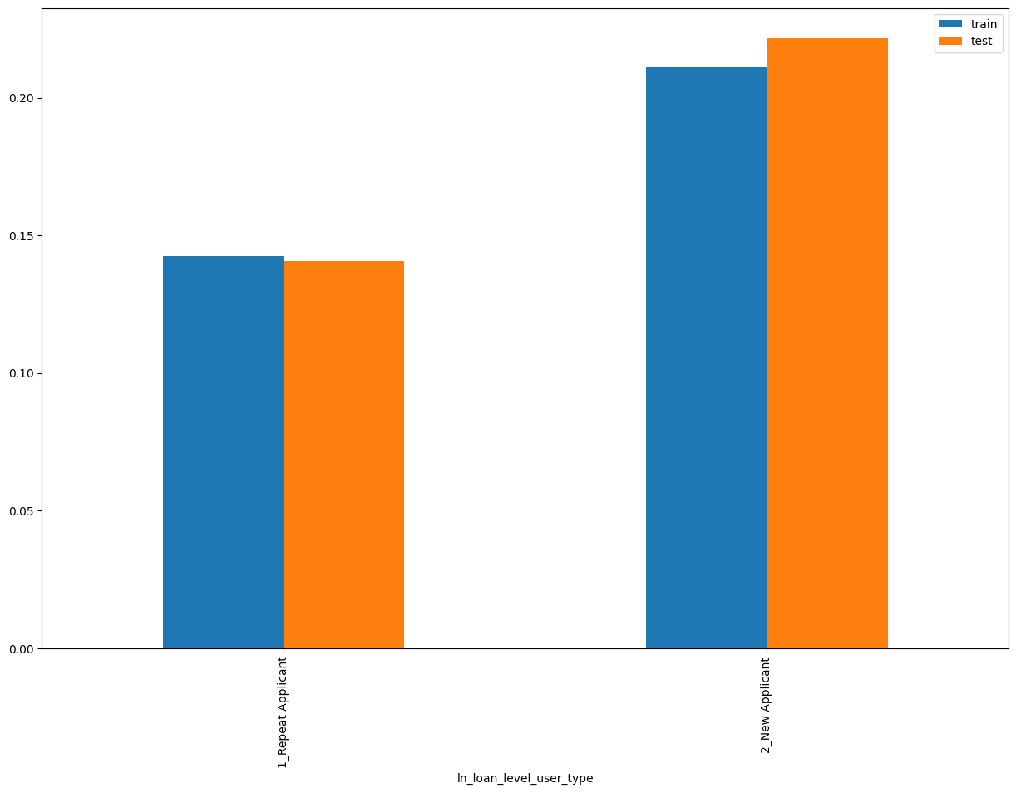
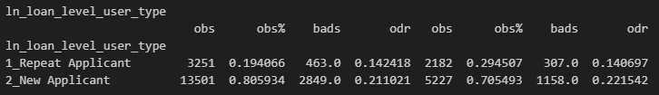
Rank# 2: ln_loan_level_user_type (1 / 4) - Performance in Train vs Test <Disbursed>
Loan level user type “New Applicant” or “Repeat Applicant”
17
Please note these are just WOE Bins, NOT the final Bins that Catboost chooses internally

Slide 18
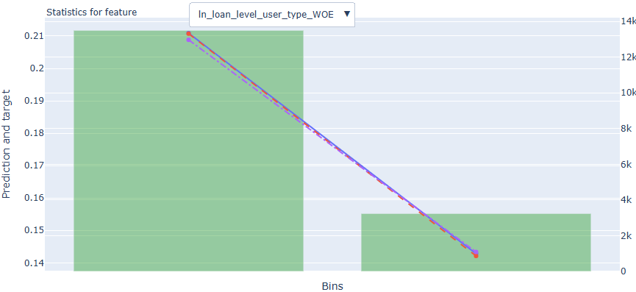
Rank# 2: ln_loan_level_user_type (2 / 4) - Feature Statistics Analysis <Disbursed>​
The red and blue lines overlap closely, indicating that the model is accurately capturing the relationship between this feature and default behavior.
The gap between the red and purple lines (small but visible) suggests that ln_loan_level_user_type adds predictive value — the model performs better with it included.
18

Slide 19
Rank# 2: ln_loan_level_user_type (3 / 4) - MoM Feature Distribution <Applied>​
ln_loan_level_user_type
month | Applied Count | Approval Rate (%) | 2_New Applicant | 1_Repeat Applicant |  | Avg. CIC Score
2024-09 | 15,599 | 19.7% | 93.5% | 6.5% |  | 0.5524
2024-10 | 12,382 | 30.6% | 92.2% | 7.8% |  | 0.5394
2024-11 | 12,382 | 29.4% | 91.8% | 8.2% |  | 0.5411
2024-12 | 11,017 | 27.7% | 86.2% | 13.8% |  | 0.5302
2025-01 | 11,705 | 28.2% | 86.8% | 13.2% |  | 0.5231
2025-02 | 10,878 | 28.8% | 87.8% | 12.2% |  | 0.5278
2025-03 | 9,601 | 29.3% | 83.3% | 16.7% |  | 0.5249
2025-04 | 9,192 | 26.3% | 83.2% | 16.8% |  | 0.5267
2025-05 | 9,558 | 28.7% | 81.7% | 18.3% |  | 0.5188
2025-06 | 11,402 | 28.2% | 83.4% | 16.6% |  | 0.5225
The New Applicant segment remains the majority group throughout, with a gradual and stable decline from ~93.5% to ~83.4%, indicating a controlled shift.
The Repeat Applicant share increases steadily but smoothly, from 6.5% to 18.3%, reflecting a consistent distribution shift without abrupt jumps.
Overall, the month-over-month changes are progressive and stable, making the feature reliable and suitable for modeling.

Slide 20
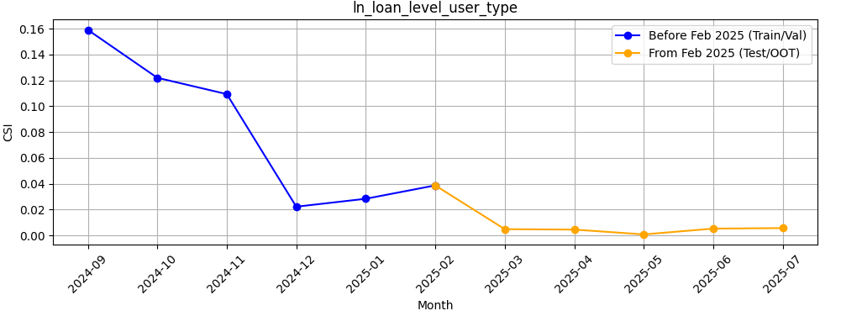
Rank# 2: ln_loan_level_user_type (4 / 4) - Feature CSI Analysis <Applied>​
Baseline period: Sep’2024 to Jan’2025.
CSI for ln_loan_level_user_type showed a downward trend during training and dropped sharply after Nov 2024. In the Test/OOT period (Feb to Jul 2025), CSI remained consistently below 0.01, confirming excellent feature stability and no data drift.

Slide 21
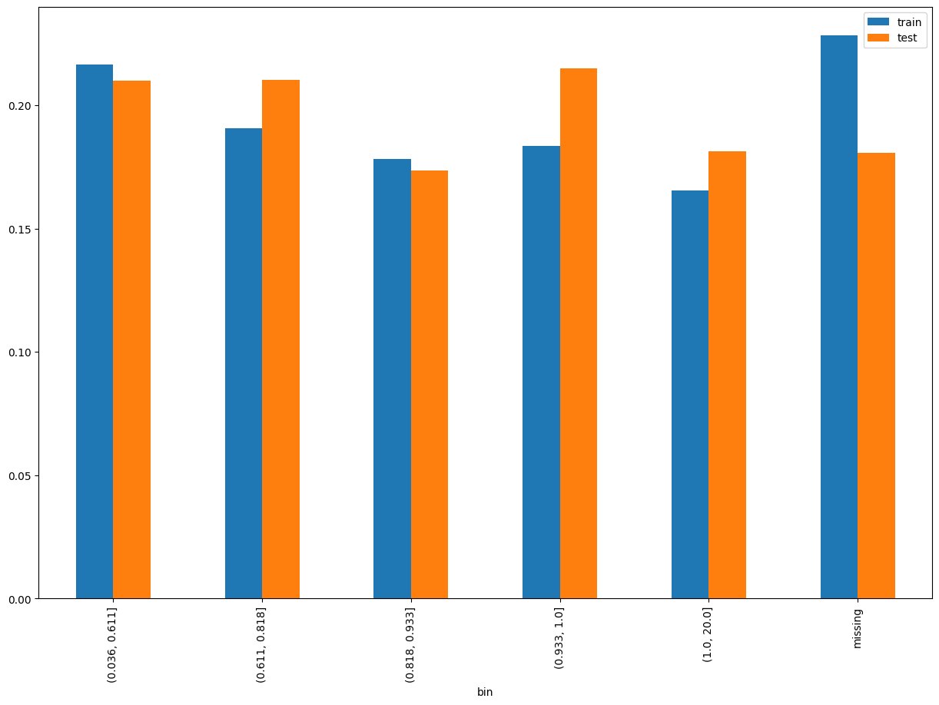
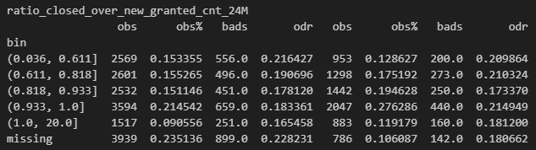
Rank# 3: ratio_closed_over_new_granted_cnt_24M (1 / 6) - Performance in Train vs Test <Disbursed>
Ratio of the number of contracts closed in the last 6 months to the number of new contracts granted in the last 24 months.
21
Please note these are just WOE Bins, NOT the final Bins that Catboost chooses internally

Slide 22
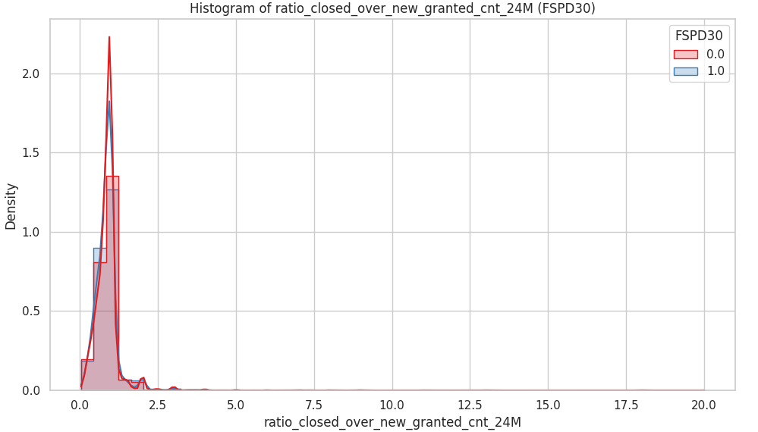
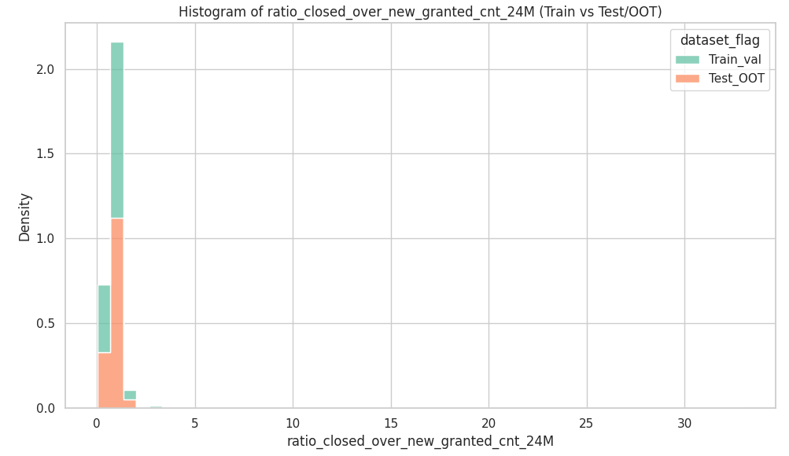
Rank# 3: ratio_closed_over_new_granted_cnt_24M (2 / 6) - Histogram <Disbursed>
The distributions for Train+Val (green) and Test+OOT (orange) are very closely aligned, with the majority of values concentrated between 0 and 2. There are some long-tail outliers (up to 30), but these are extremely rare. This suggests strong consistency between training and test datasets in terms of customer account behavior.
Both good (red) and bad (blue) customers are concentrated in the 0–2 range. However, good customers (red line) have a sharper peak around 1.0–1.5, suggesting they are more likely to have a higher proportion of closed accounts relative to new ones. In contrast, bad customers (blue line) tend to be more evenly spread within the low range.
22

Slide 23
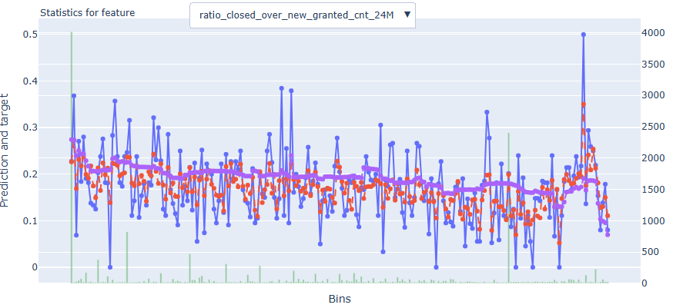
Rank# 3: ratio_closed_over_new_granted_cnt_24M (3 / 6) - Feature Statistics Analysis <Disbursed>​
The red line is smoother than the blue one, meaning the model has learned to generalize rather than overfit the noise in actual default rates
The gap between red and purple lines represents the contribution of this feature.
Since the red line often deviates from the purple one, this feature adds predictive value
23

Slide 24
Rank# 3: ratio_closed_over_new_granted_cnt_24M (4 / 6) - MoM Feature Distribution <Applied>​
ratio_closed_over_new_granted_cnt_24M
month | Applied Count | Approval Rate (%) | Mean |  | Avg. CIC Score
2024-09 | 15,599 | 19.7% | 0.89 |  | 0.5524
2024-10 | 12,382 | 30.6% | 0.88 |  | 0.5394
2024-11 | 12,382 | 29.4% | 0.92 |  | 0.5411
2024-12 | 11,017 | 27.7% | 0.93 |  | 0.5302
2025-01 | 11,705 | 28.2% | 0.96 |  | 0.5231
2025-02 | 10,878 | 28.8% | 0.95 |  | 0.5278
2025-03 | 9,601 | 29.3% | 0.92 |  | 0.5249
2025-04 | 9,192 | 26.3% | 0.92 |  | 0.5267
2025-05 | 9,558 | 28.7% | 0.92 |  | 0.5188
2025-06 | 11,402 | 28.2% | 0.92 |  | 0.5225
The mean ratio remains stable between 0.88 and 0.96, showing a controlled and consistent trend without sharp fluctuations.
After peaking in Jan–Feb 2025, the ratio stabilizes at 0.92 from Mar to Jun 2025, indicating convergence to a steady distribution.
The smooth progression and absence of volatility confirm the feature’s reliability and modeling stability over time.
24

Slide 25
Rank# 3: ratio_closed_over_new_granted_cnt_24M (5 / 6) - MoM Feature Distribution <Applied> <User Type wise>​
ratio_closed_over_new_granted_cnt_24M - New Applicant
month | Applied Count | Approval Rate (%) | Mean |  | Avg. CIC Score
2024-09 | 14,584 | 17.6% | 0.89 |  | 0.5621
2024-10 | 11,423 | 28.3% | 0.88 |  | 0.5505
2024-11 | 11,362 | 27.4% | 0.92 |  | 0.5526
2024-12 | 9,493 | 23.6% | 0.94 |  | 0.5501
2025-01 | 10,163 | 24.1% | 0.96 |  | 0.5424
2025-02 | 9,547 | 24.9% | 0.96 |  | 0.5462
2025-03 | 7,999 | 23.9% | 0.92 |  | 0.5499
2025-04 | 7,650 | 20.8% | 0.92 |  | 0.5510
2025-05 | 7,813 | 22.3% | 0.92 |  | 0.5454
2025-06 | 9,512 | 22.9% | 0.92 |  | 0.5473
ratio_closed_over_new_granted_cnt_24M - Repeat Applicant
month | Applied Count | Approval Rate (%) | Mean |  | Avg. CIC Score
2024-09 | 1,015 | 49.4% | 0.86 |  | 0.4140
2024-10 | 959 | 58.4% | 0.90 |  | 0.4066
2024-11 | 1,020 | 51.6% | 0.90 |  | 0.4133
2024-12 | 1,524 | 53.5% | 0.90 |  | 0.4066
2025-01 | 1,542 | 55.4% | 0.97 |  | 0.3959
2025-02 | 1,331 | 56.3% | 0.94 |  | 0.3952
2025-03 | 1,602 | 56.3% | 0.91 |  | 0.4002
2025-04 | 1,542 | 53.4% | 0.91 |  | 0.4061
2025-05 | 1,745 | 57.2% | 0.92 |  | 0.3999
2025-06 | 1,890 | 54.8% | 0.93 |  | 0.3977
The mean ratio increases gradually from 0.88–0.89 in late 2024 to 0.92–0.96 in early 2025, showing a controlled upward trend.
From Mar 2025 onward, values stabilize at 0.92, indicating strong consistency over recent months.
The distribution is smooth and predictable, reflecting high feature stability for the new applicant segment.
The mean steadily rises from 0.86 in Sep 2024 to 0.97 in Jan 2025, before settling into a narrow and stable range (0.91–0.93).
Despite a smaller sample size, the monthly trend is smooth without sharp volatility.
The consistent distribution highlights robust stability of this feature for repeat applicants over time.
25

Slide 26
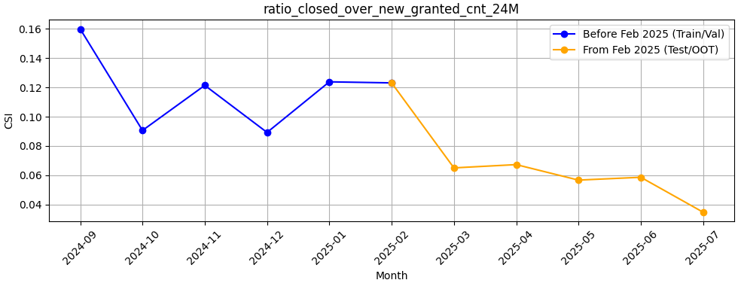
Rank# 3: ratio_closed_over_new_granted_cnt_24M (6 / 6) - Feature CSI Analysis <Applied>​
Baseline period: Sep’2024 to Jan’2025.
CSI for ratio_closed_over_new_granted_cnt_24M showed moderate variation during training, ranging from ~0.09 to ~0.16. From Feb to Jul 2025, CSI steadily declined and remained well below 0.1, indicating strong feature stability and no signs of data drift.
26

Slide 27
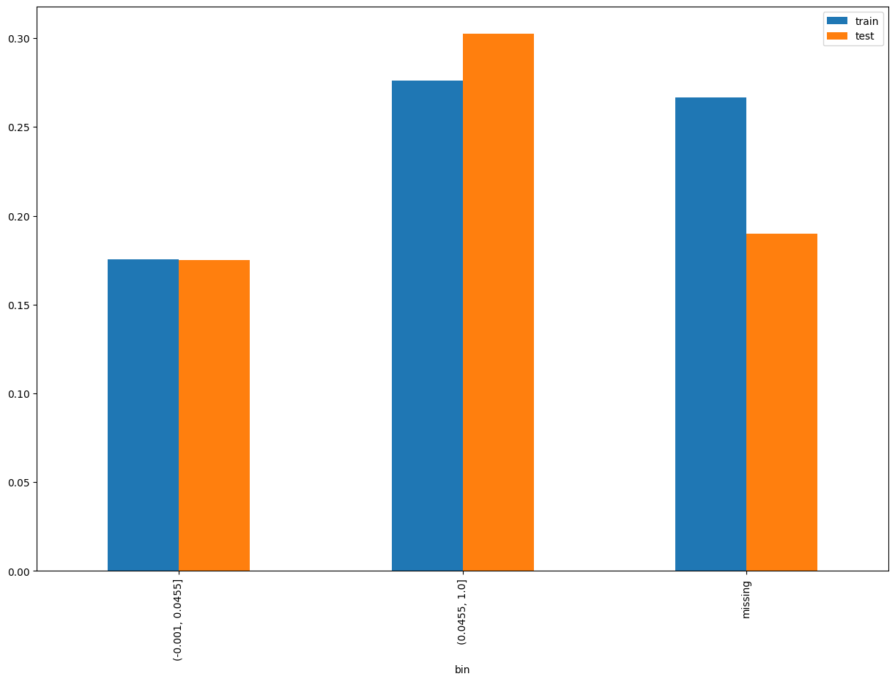
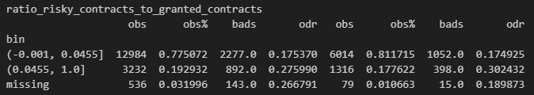
Rank# 4: ratio_risky_contracts_to_granted_contracts (1 / 6) - Performance in Train vs Test <Disbursed>
Ratio of the number of risky contracts to the number of contracts granted.
27
Please note these are just WOE Bins, NOT the final Bins that Catboost chooses internally

Slide 28
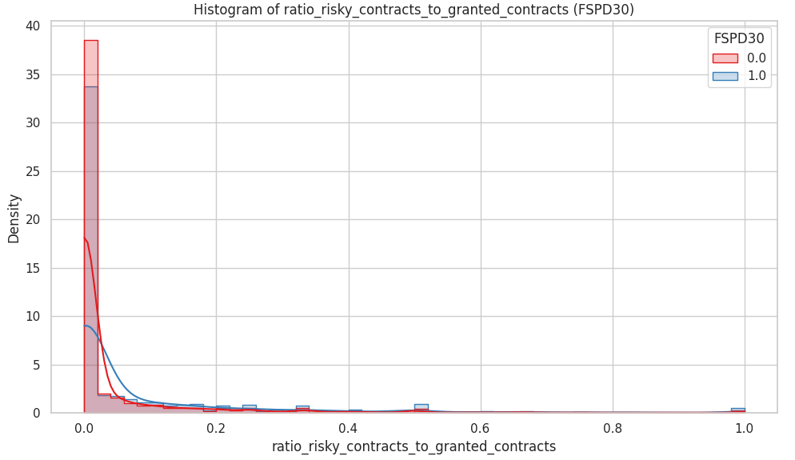
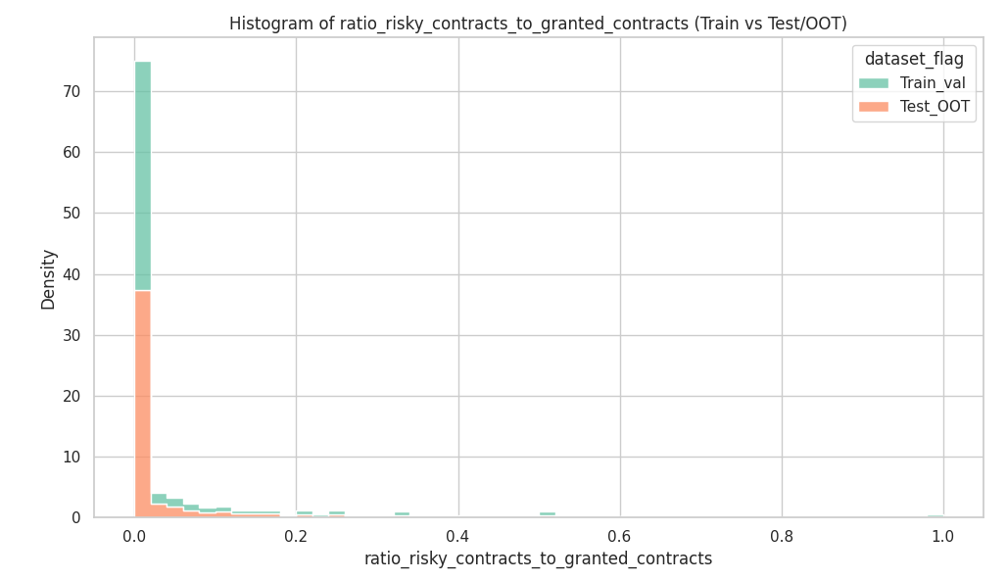
Rank# 4: ratio_risky_contracts_to_granted_contracts (2 / 6) - Histogram <Disbursed>
The vast majority of customers have a very low ratio (close to 0). The shape is heavily right-skewed, with only a few customers having a higher proportion of risky contracts. Test+OOT (orange) closely follows Train+Val (green), showing strong alignment and minimal distribution drift.
Both groups peak sharply near 0, but: Bad customers (blue) have slightly higher density at larger risky ratios (0.1–0.4). Good customers (red) are more concentrated in the lowest-risk zone. There is a clear and interpretable behavioral separation.
28

Slide 29
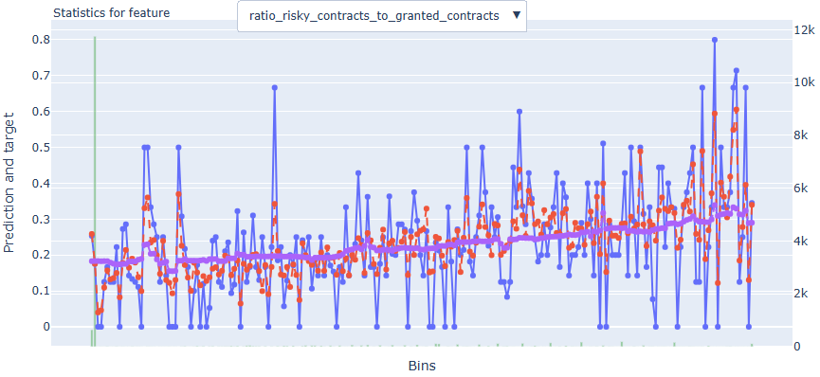
Rank# 4: ratio_risky_contracts_to_granted_contracts (3 / 6) - Feature Statistics Analysis <Disbursed>​
There is a clear upward trend: as the ratio of risky to granted contracts increases, so does the observed default rate.
Red line closely follows the shape of the blue line, capturing the overall increasing trend.
The gap between red and purple increases in higher bins, proving this feature has strong additive predictive power for identifying high-risk borrowers
29

Slide 30
Rank# 4: ratio_risky_contracts_to_granted_contracts (4 / 6) - MoM Feature Distribution <Applied>​
ratio_risky_contracts_to_granted_contracts
month | Applied Count | Approval Rate (%) | Mean |  | Avg. CIC Score
2024-09 | 15,599 | 19.7% | 0.08 |  | 0.5524
2024-10 | 12,382 | 30.6% | 0.07 |  | 0.5394
2024-11 | 12,382 | 29.4% | 0.08 |  | 0.5411
2024-12 | 11,017 | 27.7% | 0.08 |  | 0.5302
2025-01 | 11,705 | 28.2% | 0.07 |  | 0.5231
2025-02 | 10,878 | 28.8% | 0.08 |  | 0.5278
2025-03 | 9,601 | 29.3% | 0.07 |  | 0.5249
2025-04 | 9,192 | 26.3% | 0.07 |  | 0.5267
2025-05 | 9,558 | 28.7% | 0.07 |  | 0.5188
2025-06 | 11,402 | 28.2% | 0.07 |  | 0.5225
The mean ratio remains stable at 0.07–0.08 throughout, with only minor fluctuations across months.
There is no significant spike or drop, indicating consistent behavior in the proportion of risky contracts.
The feature shows strong month-over-month stability, suitable for use in modeling.
30

Slide 31
Rank# 4: ratio_risky_contracts_to_granted_contracts (5 / 6) - MoM Feature Distribution <Applied> <User Type wise>​
ratio_risky_contracts_to_granted_contracts - New Applicant
month | Applied Count | Approval Rate (%) | Mean |  | Avg. CIC Score
2024-09 | 14,584 | 17.6% | 0.08 |  | 0.5621
2024-10 | 11,423 | 28.3% | 0.07 |  | 0.5505
2024-11 | 11,362 | 27.4% | 0.08 |  | 0.5526
2024-12 | 9,493 | 23.6% | 0.08 |  | 0.5501
2025-01 | 10,163 | 24.1% | 0.08 |  | 0.5424
2025-02 | 9,547 | 24.9% | 0.09 |  | 0.5462
2025-03 | 7,999 | 23.9% | 0.08 |  | 0.5499
2025-04 | 7,650 | 20.8% | 0.08 |  | 0.5510
2025-05 | 7,813 | 22.3% | 0.07 |  | 0.5454
2025-06 | 9,512 | 22.9% | 0.08 |  | 0.5473
ratio_risky_contracts_to_granted_contracts - Repeat Applicant
month | Applied Count | Approval Rate (%) | Mean |  | Avg. CIC Score
2024-09 | 1,015 | 49.4% | 0.04 |  | 0.4140
2024-10 | 959 | 58.4% | 0.04 |  | 0.4066
2024-11 | 1,020 | 51.6% | 0.05 |  | 0.4133
2024-12 | 1,524 | 53.5% | 0.05 |  | 0.4066
2025-01 | 1,542 | 55.4% | 0.05 |  | 0.3959
2025-02 | 1,331 | 56.3% | 0.04 |  | 0.3952
2025-03 | 1,602 | 56.3% | 0.04 |  | 0.4002
2025-04 | 1,542 | 53.4% | 0.05 |  | 0.4061
2025-05 | 1,745 | 57.2% | 0.05 |  | 0.3999
2025-06 | 1,890 | 54.8% | 0.05 |  | 0.3977
The ratio stays mostly between 0.07 and 0.08, with a brief uptick to 0.09 in Feb 2025 that quickly normalizes.
Fluctuations are minimal and within a narrow band, supporting distributional consistency.
Overall, the feature remains stable and predictable for new applicants over time.
The mean oscillates gently between 0.04 and 0.05, reflecting a narrow and steady distribution.
No erratic behavior or volatility is observed month-to-month.
This indicates a highly stable trend within the repeat applicant segment, adding confidence in its modeling utility.
31

Slide 32
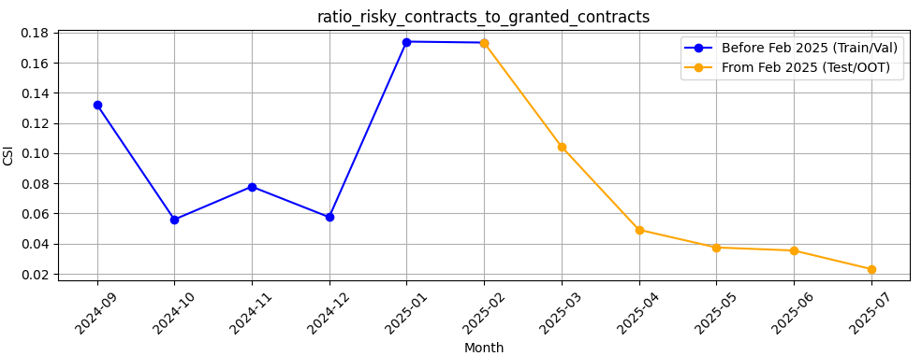
Rank# 4: ratio_risky_contracts_to_granted_contracts (6 / 6) - Feature CSI Analysis <Applied>​
Baseline period: Sep’2024 to Jan’2025.
CSI for ratio_risky_contracts_to_granted_contracts showed moderate fluctuations during training, with a spike in Jan 2025 (~0.17). Post Feb 2025, CSI values dropped sharply and consistently declined, staying well below 0.1 — indicating strong stability and no data drift in the Test/OOT period.
32

Slide 33
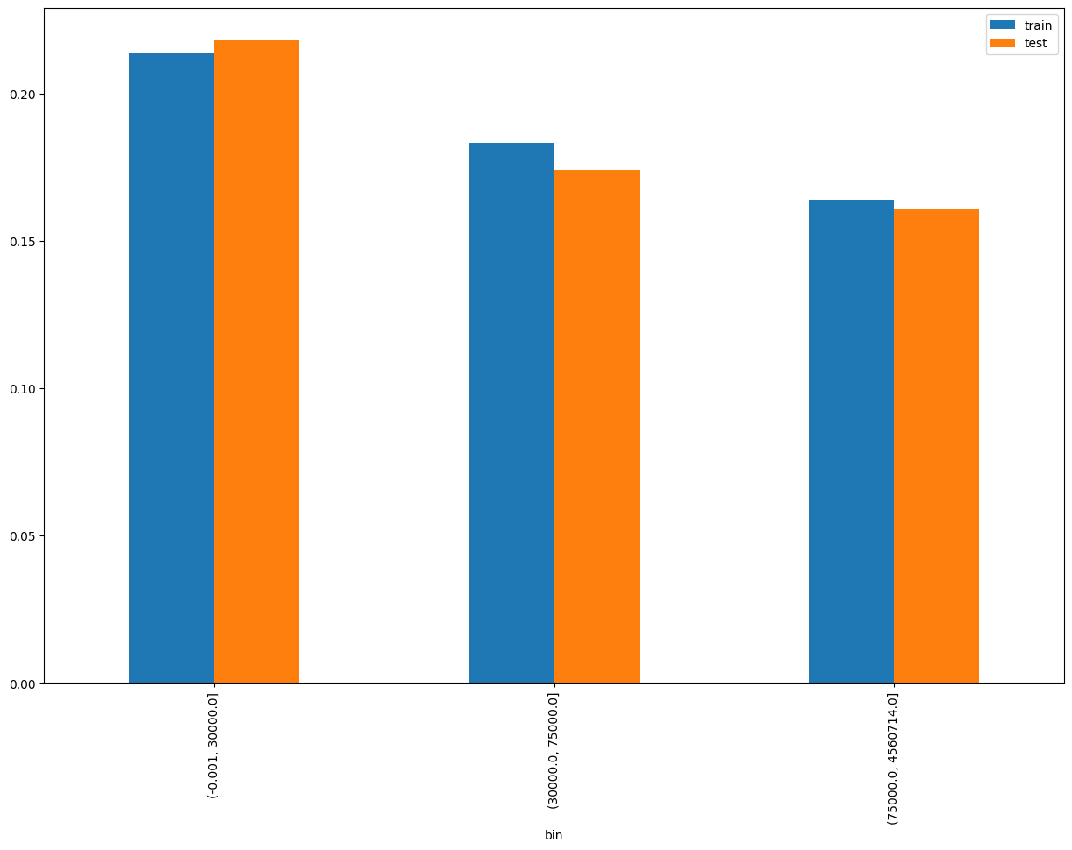
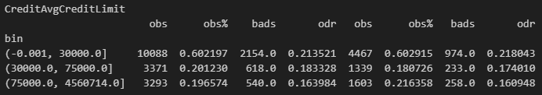
Rank# 5: CreditAvgCreditLimit (1 / 6) - Performance in Train vs Test <Disbursed>
Average credit limit across all credit card lines: Total Credit Limit / Total Number of Credit Card Lines.​
33
Please note these are just WOE Bins, NOT the final Bins that Catboost chooses internally

Slide 34
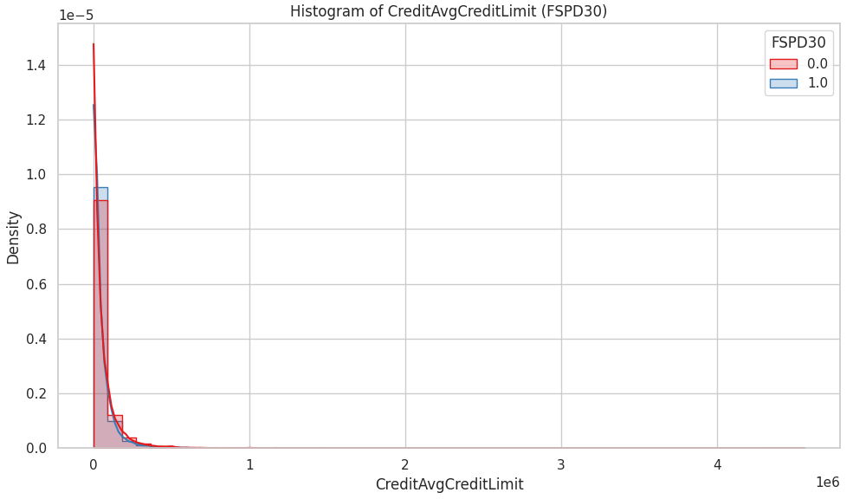
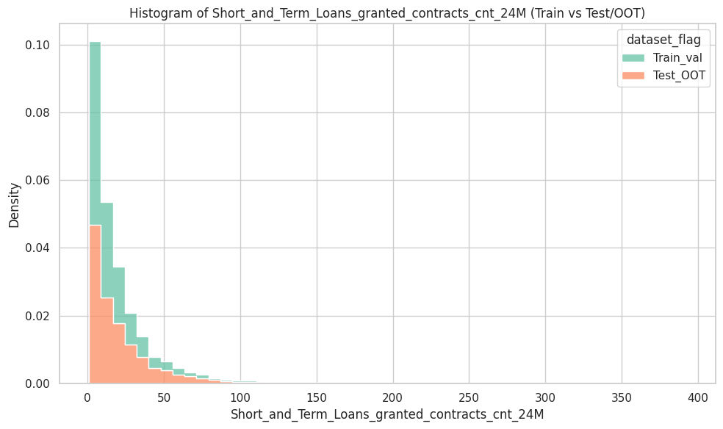
Rank# 5: CreditAvgCreditLimit (2 / 6) - Histogram <Disbursed>
Both datasets are right-skewed, with most values concentrated between 0 and 30 loans. The distribution is very consistent between Train+Val (green) and Test+OOT (orange), supporting model robustness.
Both good (red) and bad (blue) customers show extremely right-skewed distributions, concentrated heavily below 200,000 units, with long tails up to ~4 million. Good customers (red) show slightly higher densities in the mid-to-upper ranges. Bad customers are more concentrated near very low limits, potentially suggesting restricted credit access or limited history.
34

Slide 35
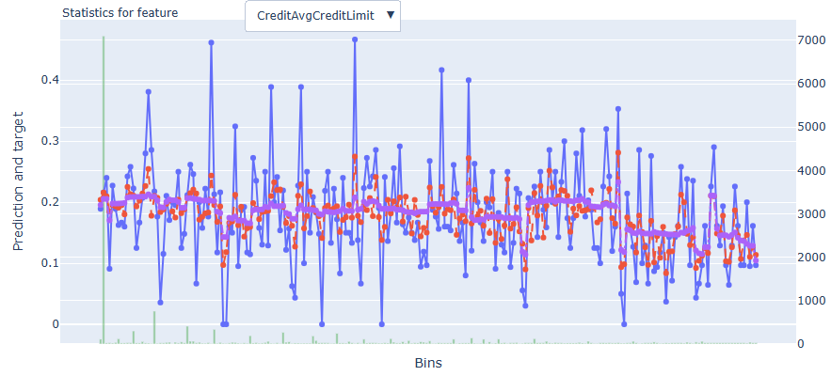
Rank# 5: CreditAvgCreditLimit (3 / 6) - Feature Statistics Analysis <Disbursed>​
Red line aligns reasonably well with the blue line, especially in the middle and higher bins.
The red–purple gap indicates this feature has moderate predictive value.
35

Slide 36
Rank# 5: CreditAvgCreditLimit (4 / 6) - MoM Feature Distribution <Applied>​
CreditAvg.CreditLimit
month | Applied Count | Approval Rate (%) | Mean |  | Avg. CIC Score
2024-09 | 15,599 | 19.7% | 16186.0 |  | 0.5524
2024-10 | 12,382 | 30.6% | 22603.2 |  | 0.5394
2024-11 | 12,382 | 29.4% | 23085.4 |  | 0.5411
2024-12 | 11,017 | 27.7% | 25330.8 |  | 0.5302
2025-01 | 11,705 | 28.2% | 23679.0 |  | 0.5231
2025-02 | 10,878 | 28.8% | 25271.7 |  | 0.5278
2025-03 | 9,601 | 29.3% | 25927.7 |  | 0.5249
2025-04 | 9,192 | 26.3% | 26122.8 |  | 0.5267
2025-05 | 9,558 | 28.7% | 27972.5 |  | 0.5188
2025-06 | 11,402 | 28.2% | 26199.8 |  | 0.5225
The average credit limit shows a steady upward trend from ~16K in Sep 2024 to ~26–28K by mid-2025.
The increase is gradual and progressive, without abrupt jumps or drops.
This smooth growth reflects a stable and reliable feature distribution over time.
36

Slide 37
Rank# 5: CreditAvgCreditLimit (5 / 6) - MoM Feature Distribution <Applied> <User Type wise>​
CreditAvg.CreditLimit - New Applicant
month | Applied Count | Approval Rate (%) | Mean |  | Avg. CIC Score
2024-09 | 14,584 | 17.6% | 15293.8 |  | 0.5621
2024-10 | 11,423 | 28.3% | 21582.9 |  | 0.5505
2024-11 | 11,362 | 27.4% | 21797.0 |  | 0.5526
2024-12 | 9,493 | 23.6% | 23369.4 |  | 0.5501
2025-01 | 10,163 | 24.1% | 21820.1 |  | 0.5424
2025-02 | 9,547 | 24.9% | 23503.0 |  | 0.5462
2025-03 | 7,999 | 23.9% | 23128.9 |  | 0.5499
2025-04 | 7,650 | 20.8% | 23445.1 |  | 0.5510
2025-05 | 7,813 | 22.3% | 24915.5 |  | 0.5454
2025-06 | 9,512 | 22.9% | 23826.7 |  | 0.5473
CreditAvg.CreditLimit - Repeat Applicant
month | Applied Count | Approval Rate (%) | Mean |  | Avg. CIC Score
2024-09 | 1,015 | 49.4% | 28848.4 |  | 0.4140
2024-10 | 959 | 58.4% | 34688.9 |  | 0.4066
2024-11 | 1,020 | 51.6% | 37353.1 |  | 0.4133
2024-12 | 1,524 | 53.5% | 37486.9 |  | 0.4066
2025-01 | 1,542 | 55.4% | 35416.1 |  | 0.3959
2025-02 | 1,331 | 56.3% | 37407.0 |  | 0.3952
2025-03 | 1,602 | 56.3% | 39540.4 |  | 0.4002
2025-04 | 1,542 | 53.4% | 39361.7 |  | 0.4061
2025-05 | 1,745 | 57.2% | 41612.2 |  | 0.3999
2025-06 | 1,890 | 54.8% | 38115.5 |  | 0.3977
The mean credit limit rises steadily from 15.3K to ~24.9K, with consistent growth month-over-month.
Minor fluctuations remain within a narrow range, ensuring predictable behavior.
The feature displays strong distributional stability, supporting modeling use for new applicants.
The mean increases from ~28.8K to over 41K, with a clear and smooth upward trend.
Month-to-month progression is stable, with no irregular shifts in values.
This consistent increase indicates high stability, making the feature dependable for modeling repeat applicants.
37

Slide 38
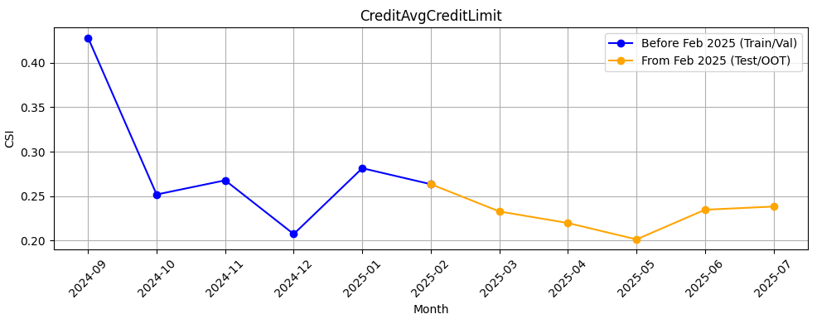
Rank# 5: CreditAvgCreditLimit (6 / 6) - Feature CSI Analysis <Applied>​
Baseline period: Sep’2024 to Jan’2025.
CSI for CreditAvgCreditLimit remained elevated during training, ranging from ~0.21 to ~0.43, indicating notable variability. In the Test/OOT period (Feb to Jul 2025), CSI steadily declined and stabilized around ~0.20–0.24, showing improved stability but still above the typical 0.1 threshold, suggesting mild drift persist.
38

Slide 39
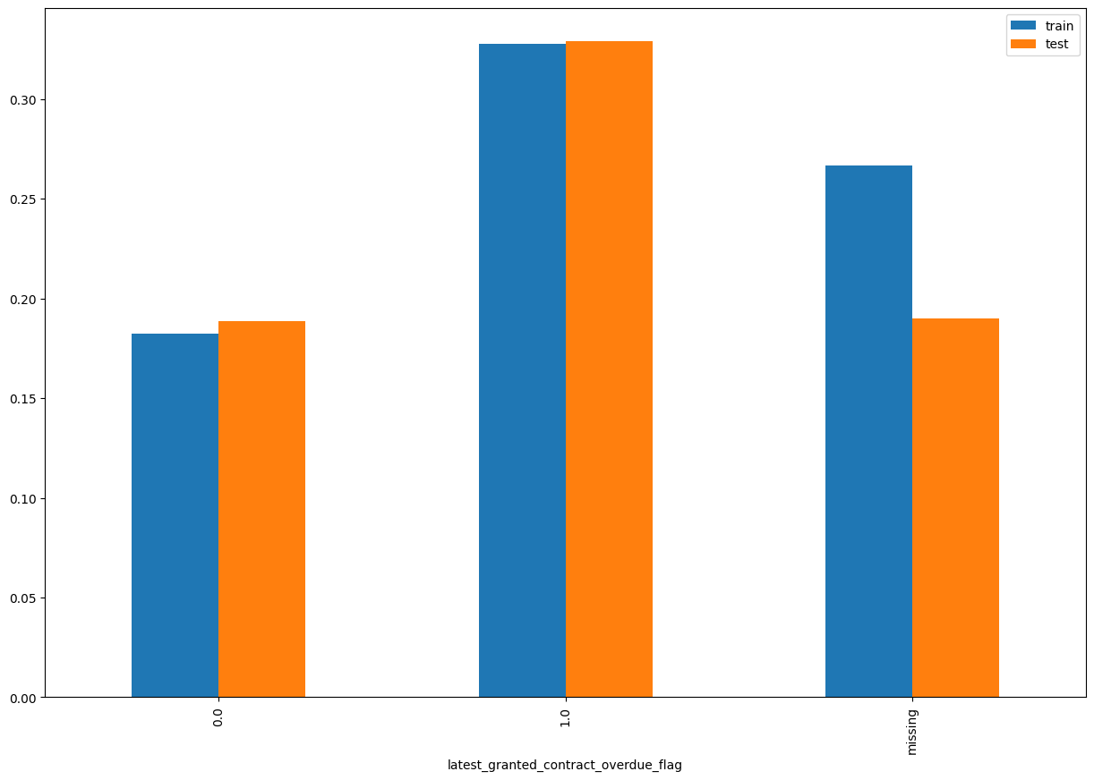
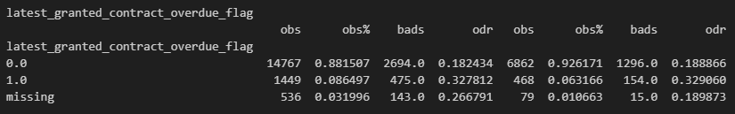
Rank# 6: latest_granted_contract_overdue_flag (1 / 4) - Performance in Train vs Test <Disbursed>
Indicates if the most recent granted contract was overdue (1 = Yes, 0 = No).
39
Please note these are just WOE Bins, NOT the final Bins that Catboost chooses internally

Slide 40
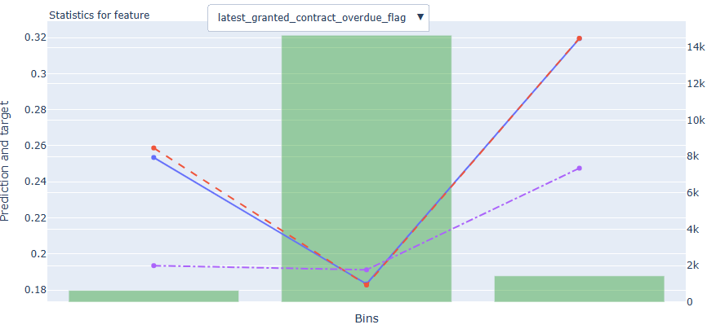
Rank# 6: latest_granted_contract_overdue_flag (2 /4) - Feature Statistics Analysis <Disbursed>​
The red line closely tracks the blue line across all bins, showing consistency in predicted probabilities.
There's a distinct gap between the red and purple lines, especially in the middle bins.
This indicates strong predictive power and good feature separation.
40

Slide 41
Rank# 6: latest_granted_contract_overdue_flag (3 / 4) - MoM Feature Distribution <Applied>​
latest_granted_contract_overdue_flag
month | Applied Count | Approval Rate (%) | Mean |  | Avg. CIC Score
2024-09 | 15,599 | 19.7% | 0.17 |  | 0.5524
2024-10 | 12,382 | 30.6% | 0.15 |  | 0.5394
2024-11 | 12,382 | 29.4% | 0.15 |  | 0.5411
2024-12 | 11,017 | 27.7% | 0.15 |  | 0.5302
2025-01 | 11,705 | 28.2% | 0.13 |  | 0.5231
2025-02 | 10,878 | 28.8% | 0.13 |  | 0.5278
2025-03 | 9,601 | 29.3% | 0.13 |  | 0.5249
2025-04 | 9,192 | 26.3% | 0.13 |  | 0.5267
2025-05 | 9,558 | 28.7% | 0.12 |  | 0.5188
2025-06 | 11,402 | 28.2% | 0.12 |  | 0.5225
The mean declines gradually from 0.17 to 0.12, showing a steady improvement in overdue behavior.
No erratic jumps are observed, and values stabilize at 0.12–0.13 from Jan 2025 onward.
The feature demonstrates strong distributional stability, ideal for modeling default risk.
41

Slide 42
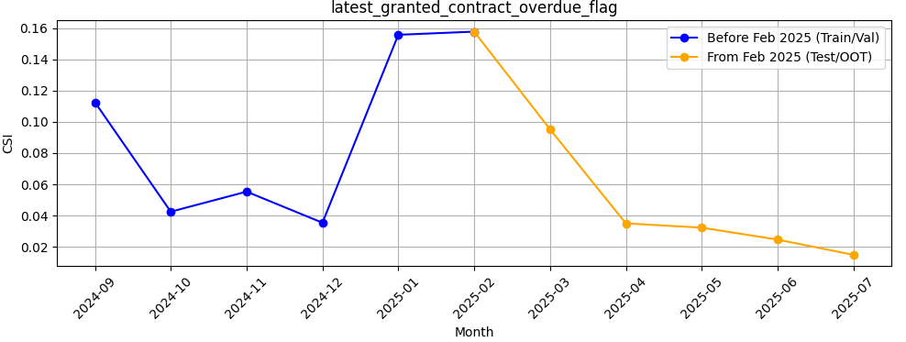
Rank# 6: latest_granted_contract_overdue_flag (4 / 4) - Feature CSI Analysis <Applied>​
Baseline period: Sep’2024 to Jan’2025.
CSI for latest_granted_contract_overdue_flag peaked in Jan–Feb 2025 (~0.16) but dropped quickly thereafter. From Mar to Jul 2025, CSI values fell well below 0.1 and stabilized, indicating no ongoing data drift and strong stability.
42

Slide 43
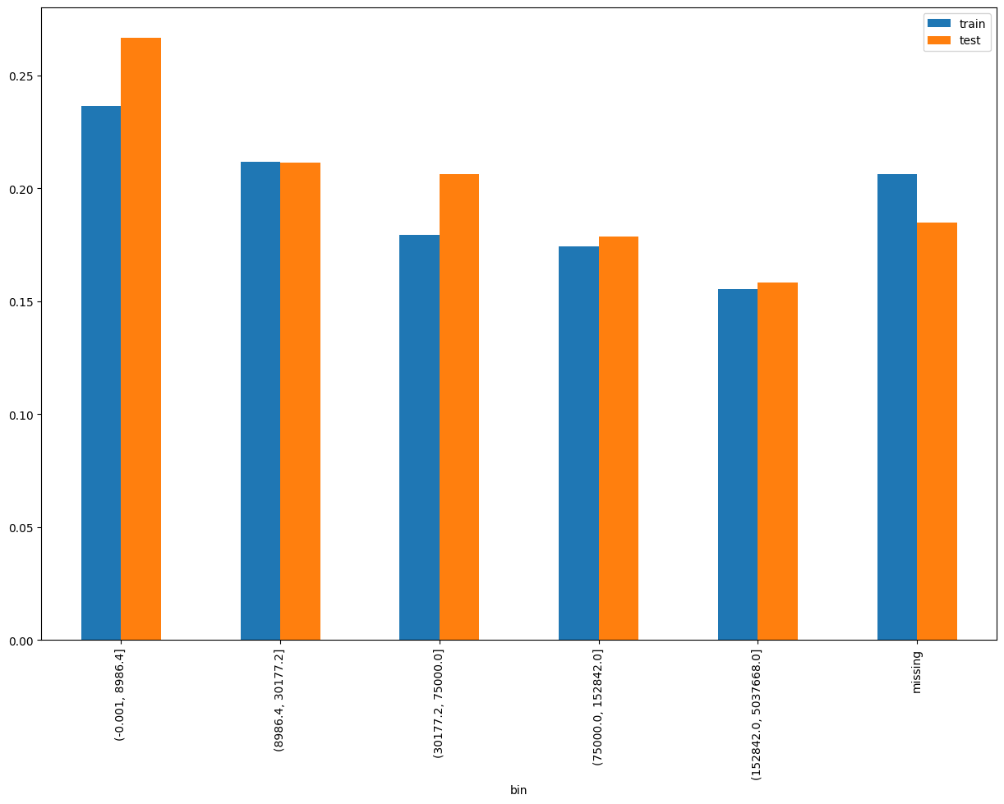
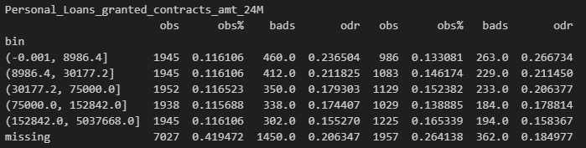
Rank# 7: Personal_Loans_granted_contracts_amt_24M (1 / 5) - Performance in Train vs Test <Disbursed>
Total amount of Personal Loans granted in the last 24 months.​
43
Please note these are just WOE Bins, NOT the final Bins that Catboost chooses internally

Slide 44
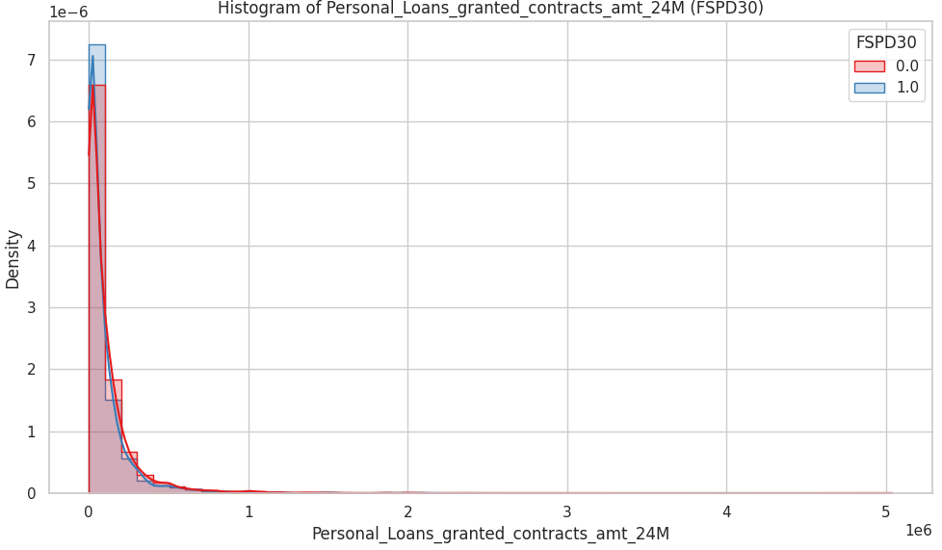
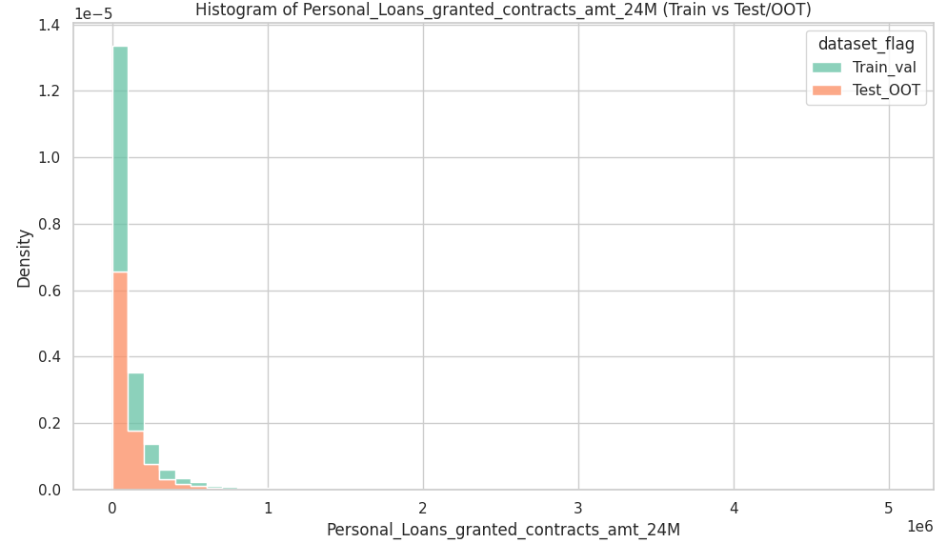
Rank# 7: Personal_Loans_granted_contracts_amt_24M (2 / 5) - Histogram <Disbursed>
Both Train+Val (green) and Test+OOT (orange) are heavily right-skewed, with the majority of loan amounts clustered near zero. There's good alignment between the datasets, with Test+OOT showing a slightly broader spread in the mid-range. Extreme outliers exist (up to ~5 million), but they are very rare and don't distort the general shape.
Both bad (blue) and good (red) customers are mostly concentrated at the lower end of the loan amount range. Bad customers show a slightly sharper peak at the lowest values, suggesting lower personal loan exposure. Good customers tend to have slightly more distributed exposure across a broader range.
44

Slide 45
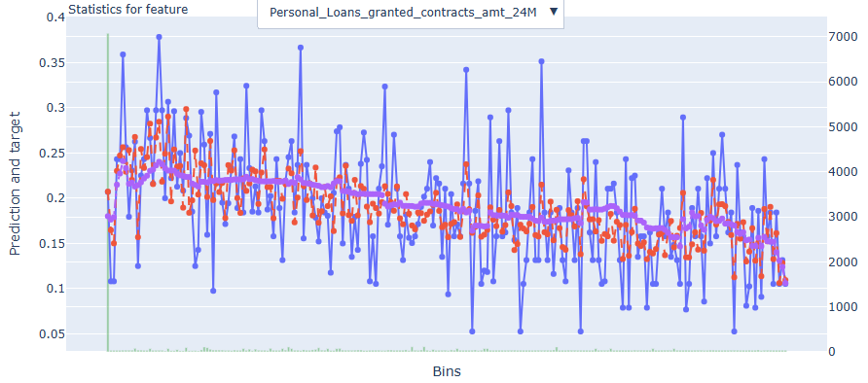
Rank# 7: Personal_Loans_granted_contracts_amt_24M (3 / 5) - Feature Statistics Analysis <Disbursed>​
The red line closely follows the blue line across most bins, showing prediction reliability.
There’s a noticeable downward trend indicating inverse correlation with risk.
The red–purple separation supports this feature’s moderate predictive power.
45

Slide 46
Rank# 7: Personal_Loans_granted_contracts_amt_24M (4 / 5) - MoM Feature Distribution <Applied>​
Personal_Loans_granted_contracts_amt_24M
month | Applied Count | Approval Rate (%) | Mean |  | Avg. CIC Score
2024-09 | 15,599 | 19.7% | 65282.0 |  | 0.5524
2024-10 | 12,382 | 30.6% | 73730.5 |  | 0.5394
2024-11 | 12,382 | 29.4% | 72660.9 |  | 0.5411
2024-12 | 11,017 | 27.7% | 86629.1 |  | 0.5302
2025-01 | 11,705 | 28.2% | 80002.7 |  | 0.5231
2025-02 | 10,878 | 28.8% | 84889.7 |  | 0.5278
2025-03 | 9,601 | 29.3% | 84755.8 |  | 0.5249
2025-04 | 9,192 | 26.3% | 73947.9 |  | 0.5267
2025-05 | 9,558 | 28.7% | 81209.1 |  | 0.5188
2025-06 | 11,402 | 28.2% | 77932.4 |  | 0.5225
The mean value shows an increasing trend from ~65K to ~87K before stabilizing near 77K–81K in mid-2025.
Though there are moderate fluctuations, the trend is smooth and interpretable.
The overall behavior reflects controlled variation, indicating reasonable stability.
46

Slide 47
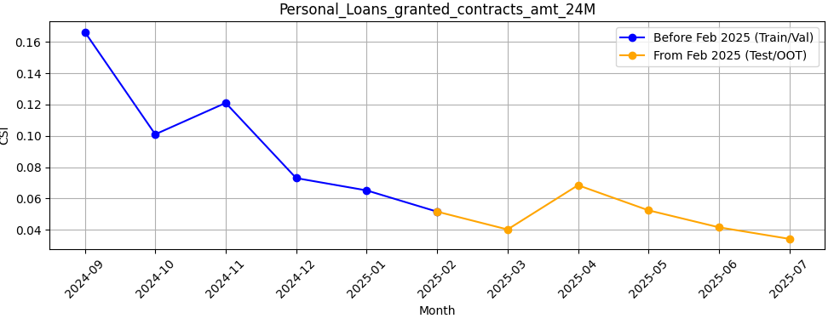
Rank# 7: Personal_Loans_granted_contracts_amt_24M (5 / 5) - Feature CSI Analysis <Applied>​
Baseline period: Sep’2024 to Jan’2025.
CSI for Personal_Loans_granted_contracts_amt_24M showed a downward trend during training, starting from ~0.16 and stabilizing below 0.07. From Feb to Jul 2025, CSI remained consistently low (≤ 0.07), indicating strong stability and no evidence of data drift.
47

Slide 48
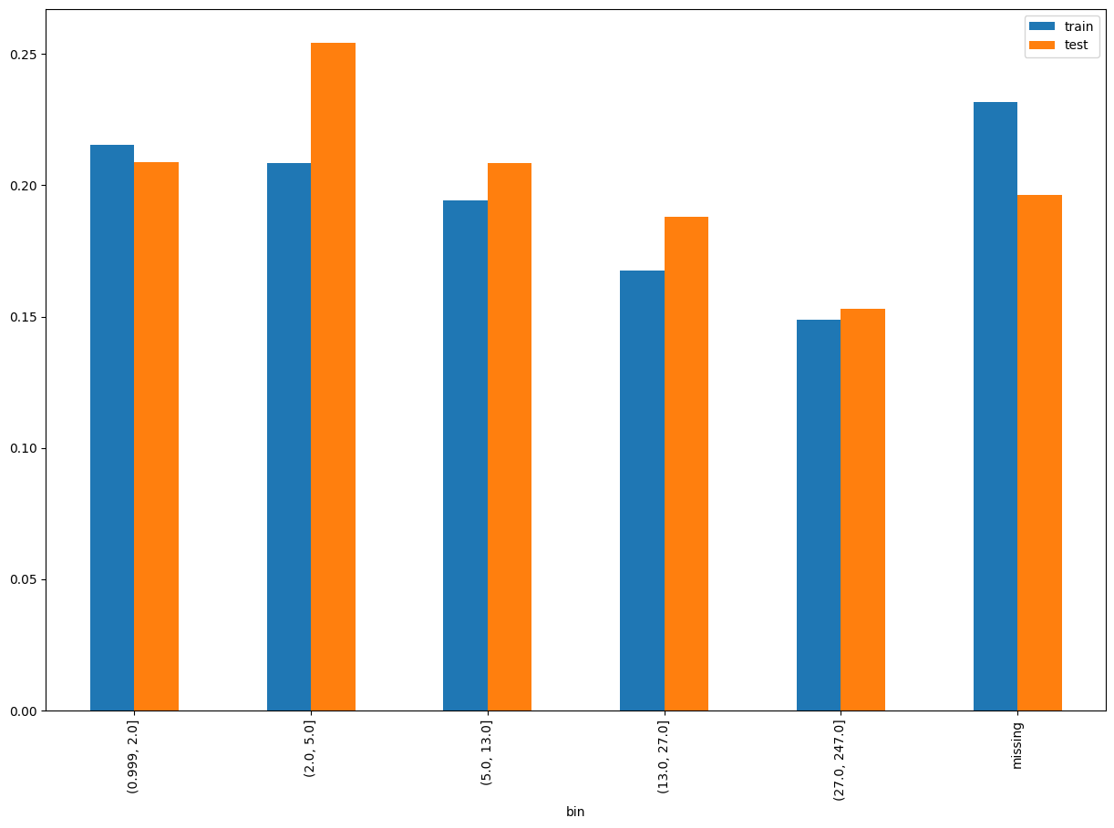
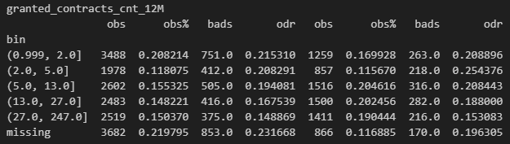
Rank# 8: granted_contracts_cnt_12M (1 / 5) - Performance in Train vs Test <Disbursed>
Total number of contracts granted in the last 12 months.​
48
Please note these are just WOE Bins, NOT the final Bins that Catboost chooses internally

Slide 49
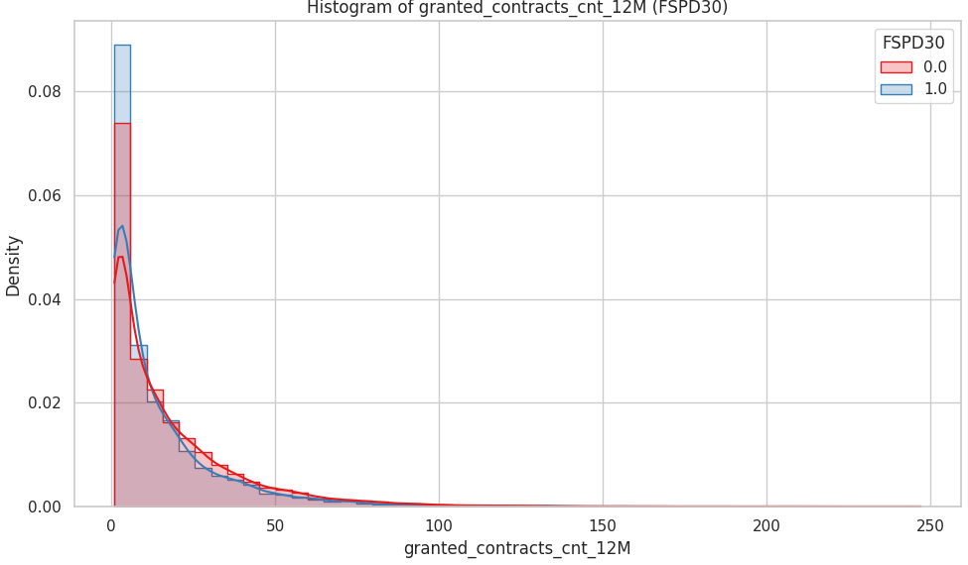
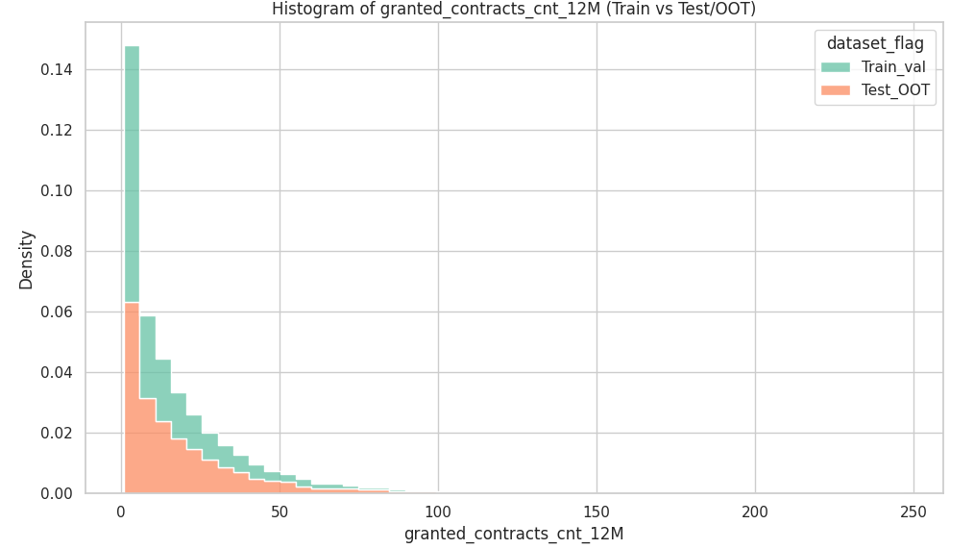
Rank# 8: granted_contracts_cnt_12M (2 / 5) - Histogram <Disbursed>
The distributions of Train+Val (green) and Test+OOT (orange) are very similar and right-skewed. Most customers have fewer than 30 contracts, with a sharp drop-off afterward. Test+OOT has a slightly flatter density, but both sets follow the same general trend, showing good consistency.
Bad customers (blue) show slightly higher density at very low contract counts (1–10). Good customers (red) have a more gradual decline, suggesting they tend to receive slightly more credit activity. The two curves begin to converge as the number of granted contracts increases beyond 30.
49

Slide 50
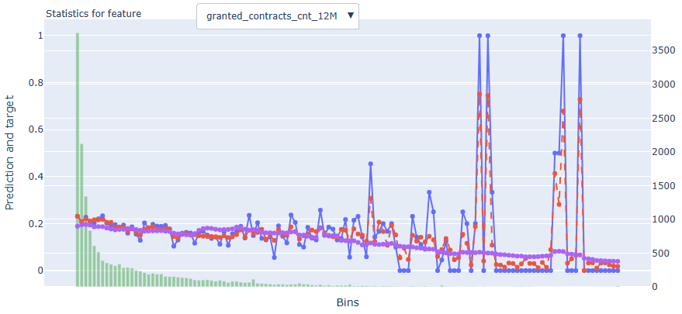
Rank# 8: granted_contracts_cnt_12M (3 / 5) - Feature Statistics Analysis <Disbursed>​
The red line closely follows the blue line, indicating good model calibration across bins.
The purple line is skewed towards lower bins, meaning most users have fewer granted contracts.
A clear red–blue gap in lower bins shows the model assigns higher risk to those segments, highlighting this feature’s predictive power.
50

Slide 51
Rank# 8: granted_contracts_cnt_12M (4 / 5) - MoM Feature Distribution <Applied>​
granted_contracts_cnt_12M
month | Applied Count | Approval Rate (%) | Mean |  | Avg. CIC Score
2024-09 | 15,599 | 19.7% | 9.87 |  | 0.5524
2024-10 | 12,382 | 30.6% | 11.31 |  | 0.5394
2024-11 | 12,382 | 29.4% | 11.01 |  | 0.5411
2024-12 | 11,017 | 27.7% | 11.28 |  | 0.5302
2025-01 | 11,705 | 28.2% | 12.11 |  | 0.5231
2025-02 | 10,878 | 28.8% | 12.25 |  | 0.5278
2025-03 | 9,601 | 29.3% | 12.01 |  | 0.5249
2025-04 | 9,192 | 26.3% | 10.47 |  | 0.5267
2025-05 | 9,558 | 28.7% | 11.89 |  | 0.5188
2025-06 | 11,402 | 28.2% | 12.73 |  | 0.5225
The mean count increases steadily from ~9.9 to 12.7, with a small dip in April 2025.
Monthly changes are gradual, showing no sudden spikes or noise.
The feature is consistently distributed and predictable, making it reliable for modeling usage intensity.
51

Slide 52
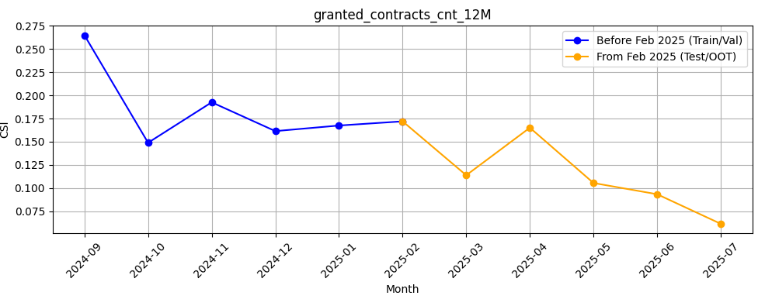
Rank# 8: granted_contracts_cnt_12M (5 / 5) - Feature CSI Analysis <Applied>​
Baseline period: Sep’2024 to Jan’2025.
CSI for granted_contracts_cnt_12M was relatively high during training (~0.15–0.27). In the Test/OOT period (Feb to Jul 2025), CSI showed a clear downward trend, dropping below 0.1 by May and reaching ~0.06 by July — indicating strong improvement in stability and no current data drift.
52

Slide 53
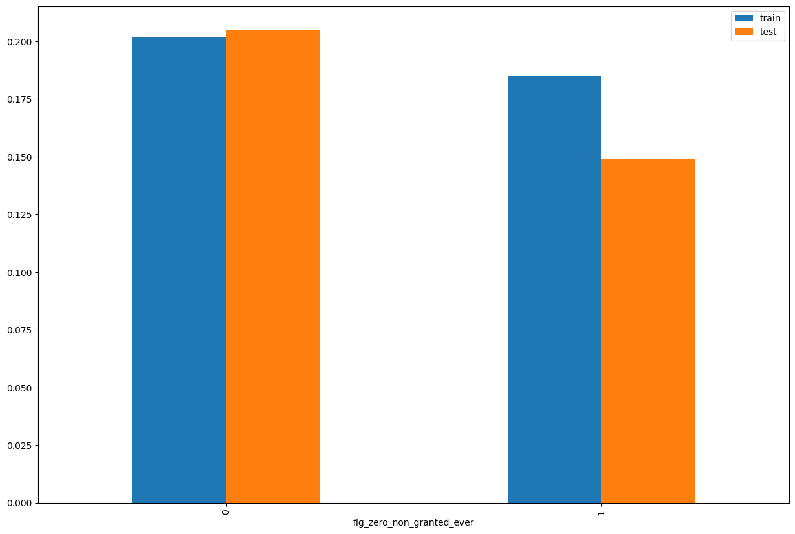
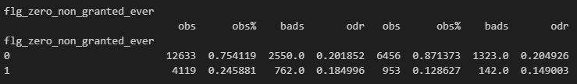
Rank# 9: flg_zero_non_granted_ever (1 / 4) - Performance in Train vs Test <Disbursed>
A flag (likely 1/0) that indicates whether the customer never had any loan applications rejected (i.e., non-granted contracts = 0).​
53
Please note these are just WOE Bins, NOT the final Bins that Catboost chooses internally

Slide 54
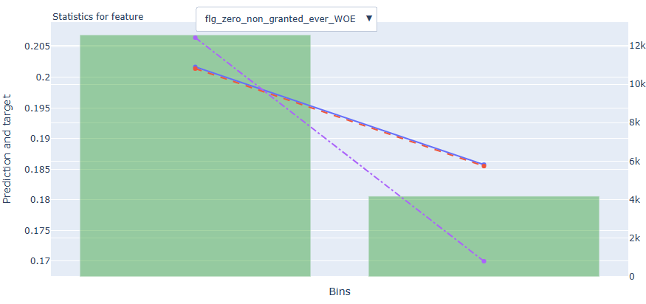
Rank# 9: flg_zero_non_granted_ever (2 / 4) - Feature Statistics Analysis <Disbursed>​
The red line follows the blue line reasonably well, showing the model captures the pattern in this feature.
There is a visible gap between the red and purple lines, which means the feature helps improve prediction accuracy.
The green bars show most of the data is concentrated in the first few bins, but there is still some spread across the range.
The target shows a slight downward trend as average credit limit increases, which supports this feature’s relevance in the model.
54

Slide 55
Rank# 9: flg_zero_non_granted_ever (3 / 4) - MoM Feature Distribution <Applied>​
flg_zero_non_granted_ever
month | Applied Count | Approval Rate (%) | 0 | 1 |  | Avg. CIC Score
2024-09 | 15,599 | 19.7% | 68.9% | 31.1% |  | 0.5524
2024-10 | 12,382 | 30.6% | 70.4% | 29.6% |  | 0.5394
2024-11 | 12,382 | 29.4% | 73.5% | 26.5% |  | 0.5411
2024-12 | 11,017 | 27.7% | 76.0% | 24.0% |  | 0.5302
2025-01 | 11,705 | 28.2% | 78.4% | 21.6% |  | 0.5231
2025-02 | 10,878 | 28.8% | 78.5% | 21.4% |  | 0.5278
2025-03 | 9,601 | 29.3% | 81.3% | 18.6% |  | 0.5249
2025-04 | 9,192 | 26.3% | 82.6% | 17.4% |  | 0.5267
2025-05 | 9,558 | 28.7% | 83.3% | 16.7% |  | 0.5188
2025-06 | 11,402 | 28.2% | 85.2% | 14.8% |  | 0.5225
The share of users with non-zero granted contracts (value = 0) steadily increases from 68.9% to 85.2%, reflecting improving engagement.
The shift is uniform and progressive, with a smooth decline in the 1 category.
The feature shows excellent stability with a clear trend, supporting its robustness for modeling.
55

Slide 56

Rank# 9: flg_zero_non_granted_ever (3 / 4) - Feature CSI Analysis <Applied>​
Baseline period: Sep’2024 to Jan’2025.
CSI for flg_zero_non_granted_ever was consistently low during the training phase, indicating a highly stable distribution. Although there is a gradual increase in CSI during the Test/OOT period (Feb to Jul 2025), values remain well below the 0.1 threshold throughout — peaking only around 0.073.
56

Slide 57


Rank# 10: Short_and_Term_Loans_granted_contracts_cnt_24M (1 / 5) - Performance in Train vs Test <Disbursed>
Count of Short and Term Loans granted in the last 12 months.​​
57
Please note these are just WOE Bins, NOT the final Bins that Catboost chooses internally

Slide 58


Rank# 10: Short_and_Term_Loans_granted_contracts_cnt_24M (2 / 5) – Histogram <Disbursed>
Both Train+Val (green) and Test+OOT (orange) show a highly right-skewed distribution, with most values concentrated at the lower end (0–30 loans). Although Test+OOT has slightly lower densities, especially at the peak, the overall shape and trend are consistent, confirming dataset alignment. A small number of extreme values (up to 400) are present but rare.
Bad customers (blue) have a slightly higher density at the very low end (0–5 loans). Good customers (red) show a broader distribution across slightly higher loan counts. The difference is subtle but suggests that very low short-term loan activity might correlate with higher risk, possibly indicating limited credit experience.
58

Slide 59

Rank# 10: Short_and_Term_Loans_granted_contracts_cnt_24M (3 / 5) - Feature Statistics Analysis <Disbursed>​
The red (prediction) and blue (actual target) lines show good alignment, indicating the model learns from this feature effectively.
The purple line shows a steep drop-off, meaning most users fall in lower bins (i.e., have fewer short-term loans).
Clear separation in higher bins suggests increased short-term loan activity is linked with higher default risk, making this feature predictive.
59

Slide 60
Rank# 10: Short_and_Term_Loans_granted_contracts_cnt_24M (4 / 5) - MoM Feature Distribution <Applied>​
Short_and_Term_Loans_granted_contracts_cnt_24M
month | Applied Count | Approval Rate (%) | Mean |  | Avg. CIC Score
2024-09 | 15,599 | 19.7% | 11.30 |  | 0.5524
2024-10 | 12,382 | 30.6% | 12.65 |  | 0.5394
2024-11 | 12,382 | 29.4% | 12.89 |  | 0.5411
2024-12 | 11,017 | 27.7% | 14.04 |  | 0.5302
2025-01 | 11,705 | 28.2% | 14.39 |  | 0.5231
2025-02 | 10,878 | 28.8% | 14.67 |  | 0.5278
2025-03 | 9,601 | 29.3% | 14.01 |  | 0.5249
2025-04 | 9,192 | 26.3% | 14.50 |  | 0.5267
2025-05 | 9,558 | 28.7% | 17.04 |  | 0.5188
2025-06 | 11,402 | 28.2% | 17.84 |  | 0.5225
The mean count shows a gradual increase from 11.3 to 17.8, with smooth progression over time.
The rise is consistent, with no sudden spikes or outliers.
This indicates strong trend-based stability, making the feature reliable for modeling loan behavior.
60

Slide 61

Rank# 10: Short_and_Term_Loans_granted_contracts_cnt_24M (5 / 5) - Feature CSI Analysis <Applied>​
Baseline period: Sep’2024 to Jan’2025.
CSI for Short_and_Term_Loans_granted_contracts_cnt_24M showed a declining trend during training. From Feb to Jul 2025, CSI remained consistently below 0.1, confirming good feature stability and no indication of drift.
61

Slide 62


Rank# 11: latest_granted_contract_risk_flag (1 / 4) - Performance in Train vs Test <Disbursed>
Indicates if the most recent contract had a risky status.
62
Please note these are just WOE Bins, NOT the final Bins that Catboost chooses internally

Slide 63

Rank# 11: latest_granted_contract_risk_flag (2 / 4) - Feature Statistics Analysis <Disbursed>​
The red line matches the blue line, showing the model understands this feature well.
There is a visible gap between the red and purple lines, meaning this feature contributes to better predictions.
63

Slide 64
Rank# 11: latest_granted_contract_risk_flag (3 / 4) - MoM Feature Distribution <Applied>​
latest_granted_contract_risk_flag
month | Applied Count | Approval Rate (%) | Mean |  | Avg. CIC Score
2024-09 | 15,599 | 19.7% | 0.07 |  | 0.5524
2024-10 | 12,382 | 30.6% | 0.07 |  | 0.5394
2024-11 | 12,382 | 29.4% | 0.08 |  | 0.5411
2024-12 | 11,017 | 27.7% | 0.08 |  | 0.5302
2025-01 | 11,705 | 28.2% | 0.08 |  | 0.5231
2025-02 | 10,878 | 28.8% | 0.08 |  | 0.5278
2025-03 | 9,601 | 29.3% | 0.07 |  | 0.5249
2025-04 | 9,192 | 26.3% | 0.07 |  | 0.5267
2025-05 | 9,558 | 28.7% | 0.07 |  | 0.5188
2025-06 | 11,402 | 28.2% | 0.07 |  | 0.5225
The mean value remains consistently between 0.07 and 0.08 throughout the entire period.
Minor fluctuations are observed briefly but are quickly corrected, reinforcing distributional consistency.
Overall, the feature is stable and predictable, showing no significant deviation month-to-month.
64

Slide 65

Rank# 11: latest_granted_contract_risk_flag (4 / 4) - Feature CSI Analysis <Applied>​
Baseline period: Sep’2024 to Jan’2025.
CSI for latest_granted_contract_risk_flag peaked briefly in Jan–Feb 2025 but dropped sharply after. From Mar to Jul 2025, CSI remained well below 0.1, confirming strong stability and no drift concerns.
65

Slide 66


Rank# 12: flg_zero_granted_ever (1 / 4) - Performance in Train vs Test <Disbursed>
A flag that indicates the user never had any granted loans (i.e., granted contracts = 0).​
66
Please note these are just WOE Bins, NOT the final Bins that Catboost chooses internally

Slide 67

Rank# 12: flg_zero_granted_ever (2 / 4) - Feature Statistics Analysis <Disbursed>​
The red line (model prediction) matches the blue line (actual outcome), showing the model understands this feature well.
There is a visible gap between the red and purple lines, meaning this feature contributes to better predictions.
The green bars show a higher number of records for value 1 compared to 0
The target rate is slightly lower for value 1, making this a useful binary flag for the model.
67

Slide 68
Rank# 12: flg_zero_granted_ever (3 / 4) - MoM Feature Distribution <Applied>​
flg_zero_granted_ever
month | Applied Count | Approval Rate (%) | 0 | 1 |  | Avg. CIC Score
2024-09 | 15,599 | 19.7% | 87.4% | 12.6% |  | 0.5524
2024-10 | 12,382 | 30.6% | 91.3% | 8.7% |  | 0.5394
2024-11 | 12,382 | 29.4% | 90.5% | 9.5% |  | 0.5411
2024-12 | 11,017 | 27.7% | 91.8% | 8.2% |  | 0.5302
2025-01 | 11,705 | 28.2% | 85.4% | 14.6% |  | 0.5231
2025-02 | 10,878 | 28.8% | 85.3% | 14.7% |  | 0.5278
2025-03 | 9,601 | 29.3% | 88.2% | 11.8% |  | 0.5249
2025-04 | 9,192 | 26.3% | 91.8% | 8.2% |  | 0.5267
2025-05 | 9,558 | 28.7% | 92.0% | 8.0% |  | 0.5188
2025-06 | 11,402 | 28.2% | 92.6% | 7.4% |  | 0.5225
The 0 category consistently dominates, fluctuating between 85% and 93%, with the 1 category decreasing steadily.
A brief spike in Jan–Feb 2025 (14–15%) is observed for value 1, but it quickly normalizes.
Despite minor fluctuations, the feature maintains a clear and stable distribution trend over time.
68

Slide 69

Rank# 12: flg_zero_granted_ever (4 / 4) - Feature CSI Analysis <Applied>​
Baseline period: Sep’2024 to Jan’2025.
CSI for flg_zero_granted_ever peaked briefly in Jan–Feb 2025 but dropped sharply afterward. From Mar to Jul 2025, CSI remained well below 0.1, indicating strong recovery in stability and no signs of drift.
69

Slide 70

THANK YOU!
​
Questions?
tonikbank.com

