Slide 1

Gamma Demo Scorecard for Cash Loan
Presented by:
Data Science
9th April 2025

Slide 2
Architecture Overview of TDB’s Risk Scorecards
For Cash Loan only
For both Cash and SIL
Limit Setting Model (Hosted in Digital Layer)
Credit Decisioning Model (Hosted in Taran)
Beta Stack
Alpha Stack
Trench 1: New Users - within 30 days from TSA Onboarding AND Never Disbursed Loan
Limit Setting Score = Gamma Stack
Beta Demo Score
Beta Demo Score
Gamma Demo Score
Apps Score
Apps Score
Selectively call Alpha
Apps Score
Credo Score
Users automatically move from Trench 1 to Trench 2 after 30 days if no disbursed loans
Credo Score
CIC Score
Gamma Income Model
Beta Income Model
Alpha Income Model
Users will stay in Trench 2 until 1st disbursed loan. His Gamma Stack will be re-calculated every 30-day anniversary from TSA onboarding date
Limit Setting Score = Gamma Stack
Beta Stack
Alpha Stack
Gamma Demo Score
Beta Demo Score
Beta Demo Score
Trench 2: Existing Users - After 30 days from TSA Onboarding AND Never Disbursed Loan
Apps Score
Apps Score
Selectively call Alpha
Apps Score
Transaction Score
Transaction Score
Transaction Score
CIC Score
Gamma Income Model
Beta Income Model
Alpha Income Model
Users will move to Trench 3 after 1st Disbursed Loan
Lowest Risk users from this B Score will be pre-approved for upsell and xsell. Medium Risk users from this B Score will have to go through Taran.
High Risk users from this B Score will not be given any offer.
B Score = Gamma Stack
Trench 3: Existing Users - After 30 days from 1st Disbursed Loan AND current DPD <= 10
Gamma Demo Score
Beta Stack
Alpha Stack
Apps Score
Beta Demo Score
Beta Demo Score
Apps Score
Apps Score
Enhanced Transaction Score
Selectively call Alpha
Enhanced Transaction Score
Once moved to Trench 3, user will forever remain in Trench 3. His Gamma Stack will be re-calculated every 30 days anniversary from 1st Loan Disbursement Date
Enhanced Transaction Score
CIC Score
Gamma Income Model
Beta Income Model
Alpha Income Model

Slide 3
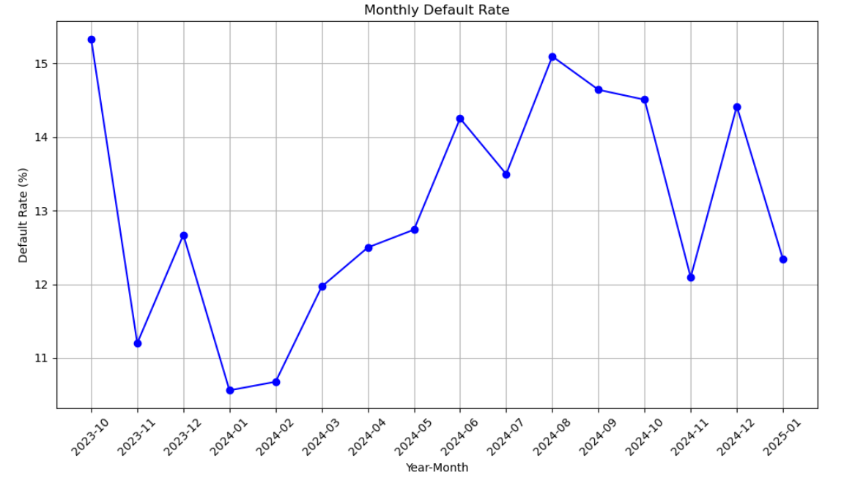
Cash Gamma Demo Score was developed on Trench 1 (DOB <= 30 and without any disbursed loan) and Trench 2 (DOB > 30 and without any disbursed loan)
 | Loan Disbursement Date | # CASH Loans |  |  | # Bad (FPD30) CASH Loans |  |  | FPD30 rate
 |  | Overall | Trench1 | Trench2 | Overall | Trench1 | Trench2 | Overall | Trench1 | Trench2
All Data Training – 90%,val – 10% | 06/10/2023 - 31/10/2024 | 15629 | 9887 | 5742 | 2199 | 1408 | 787 | 0.1404 | 0.1424 | 0.1369
Nov | 01/11/2024 - 30/11/2024 | 3241 | 1947 | 1294 | 221 | 221 | 171 | 0.121 | 0.1135 | 0.1321
Dec | 01/12/2024 - 31/12/2024 | 2282 | 1514 | 768 | 329 | 209 | 120 | 0.1442 | 0.138 | 0.1562
Jan | 01/01/2025 - 31/01/2025 | 1661 | 1596 | 889 | 205 | 198 | 116 | 0.1234 | 0.1240 | 0.1304

Slide 4
Model Iteration ​ | Top Features​ | Train Gini​ (2023-10-06- 2024-10-31)​ | Val Gini​ | Nov Gini​ | Dec Gini​ | Jan Gini​ (01-01-2025 - 31-01-2025)​
8 | ln_self_dec_income', 'ln_industry_new_cat_bin', 'ln_age', 'ln_education_level', 'ln_employment_type_new_cat', 'days_on_book', 'email_primary_domain', 'ln_marital_status', | 0.3041 | 0.3276 | 0.2204 | 0.1666 | 0.1428
9 | ln_doc_type_rolled | 0.3192 | 0.3356 | 0.2315 | 0.1744 | 0.163
10 | days_since_os_version_release | 0.3342 | 0.3344 | 0.2303 | 0.1775 | 0.1641
11 | ln_brand_cat | 0.3397 | 0.3391 | 0.2328 | 0.1733 | 0.1597
12 | 'ln_city_cat', | 0.3458 | 0.3417 | 0.2217 | 0.1718 | 0.158
13 | 'ln_osversion_type_order', | 0.3482 | 0.3406 | 0.2287 | 0.1748 | 0.1579
14 | 'ln_province_cat', | 0.3475 | 0.3393 | 0.2261 | 0.1731 | 0.1552
15 | 'name_email_match_score', | 0.3557 | 0.3421 | 0.231 | 0.1824 | 0.1574
16 | 'ln_cnt_dependents' | 0.3576 | 0.3452 | 0.2262 | 0.174 | 0.1527
10 feature model after Hyper Parameters Tuning​ | ​ | 0.2726 | 0.3214 | 0.2313 | 0.1605 | 0.1705

Slide 5
Cash Gamma Demo Model Performance
Gamma Demo Model Gini | 06/10/2023 - 31/10/2024​​ |  | 01/11/2024 - 30/11/2024​ | 01/12/2024 - 31/12/2024​​ | 01/01/2025 -31/01/2025​​
​ | Train Gini (90%)​​ | Val Gini (10%)​​ | Nov Gini​​ | Dec Gini​​ | Jan Gini
Overall Demo Model Gini | 0.2726 | 0.3214 | 0.2313 | 0.1605 | 0.1705
Demo Trench 1 Gini |  |  | 0.1839 | 0.1455 | 0.1784
Demo Tench 2 Gini |  |  | 0.2911 | 0.1864 | 0.1529

Slide 6
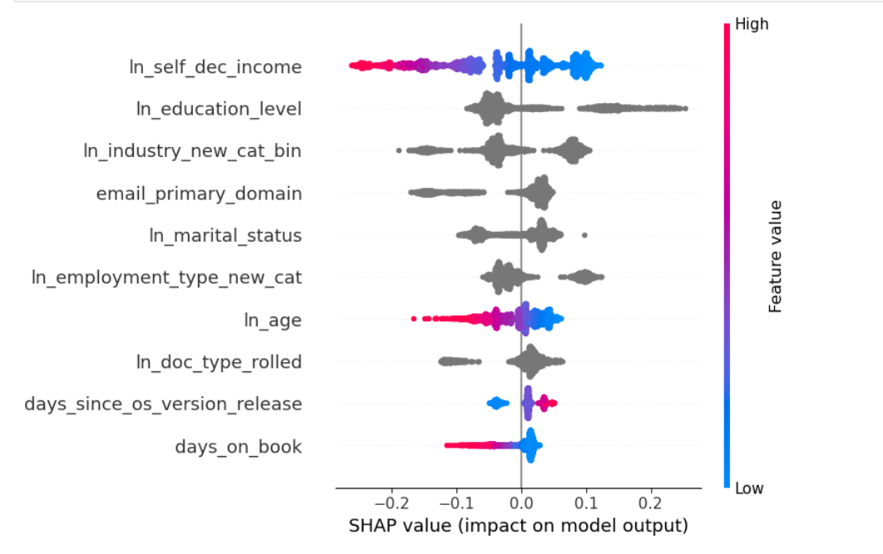
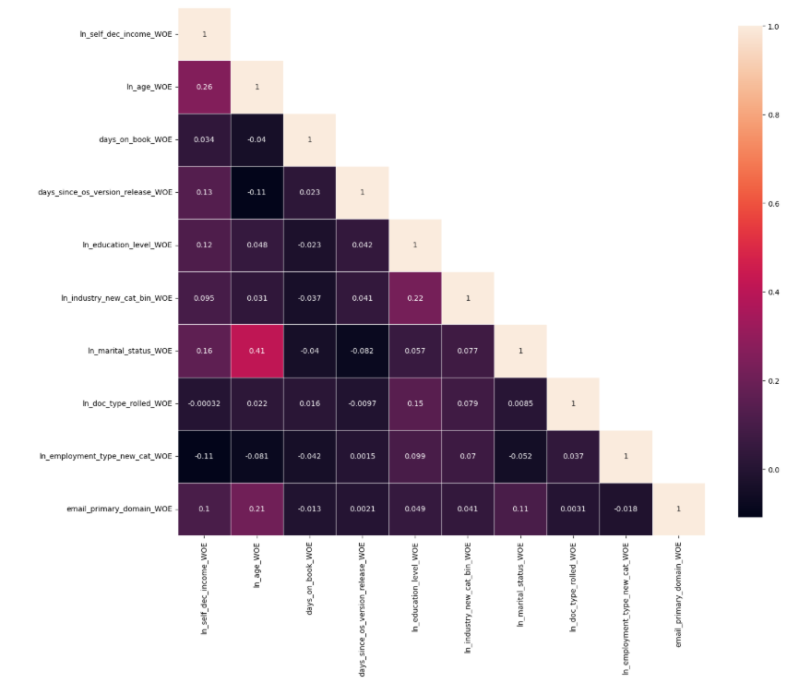
Gamma Quick Demo – Model Performance

Slide 7
Gamma Demo Quick

Slide 8
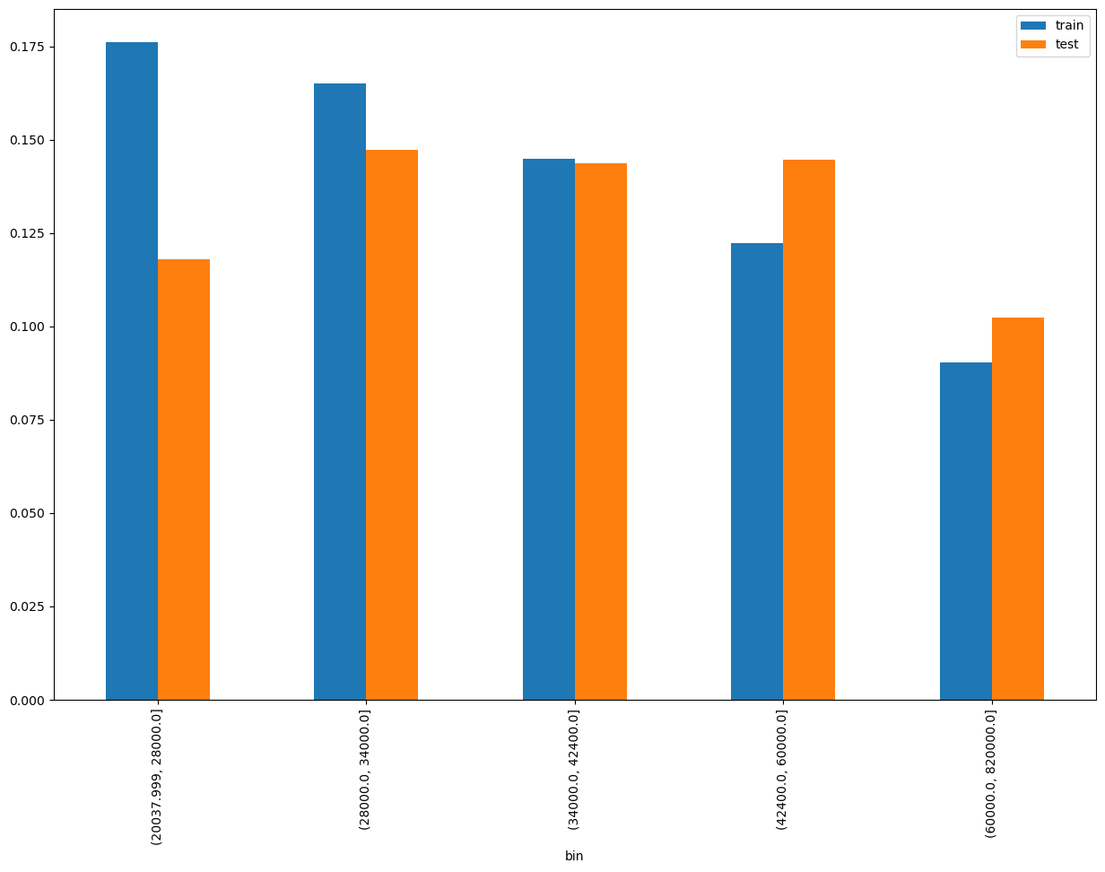
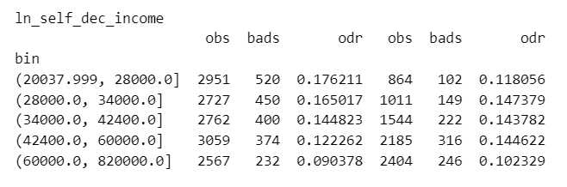
SHAP Rank: 1
ln_self_dec_income = Self declared Monthly income

Slide 9
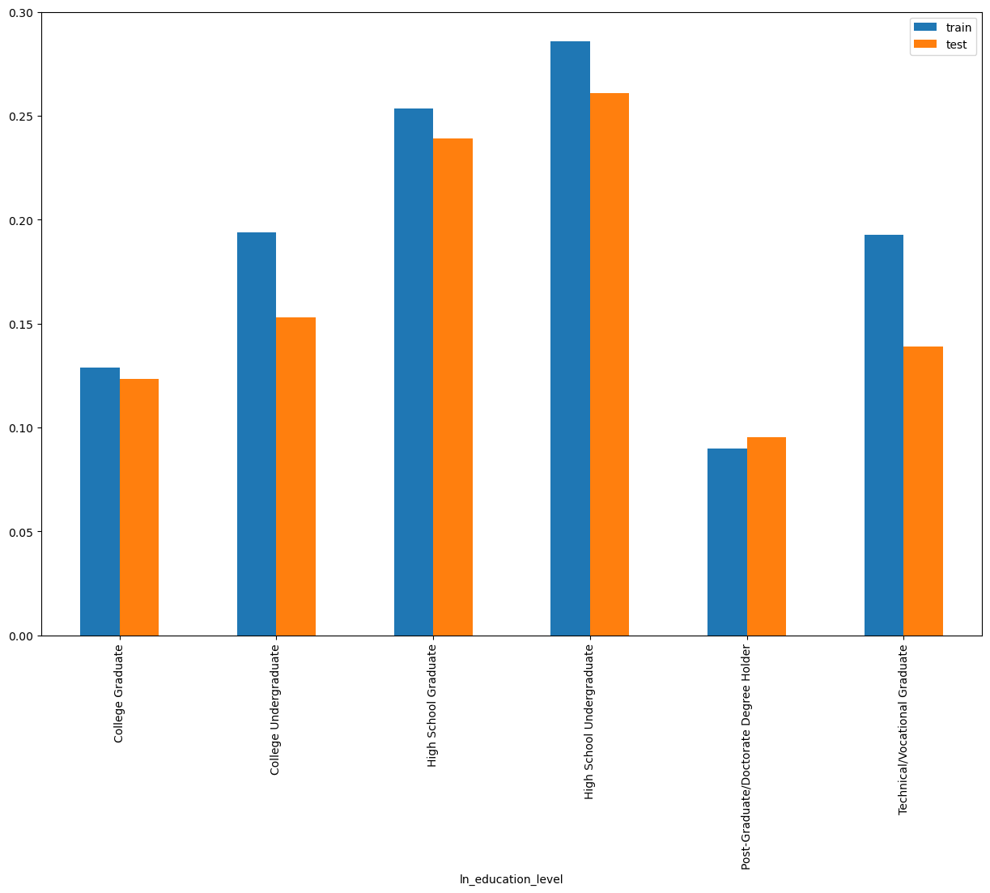
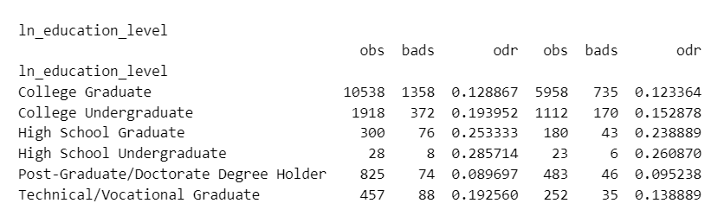
SHAP Rank: 2
ln_education_level = Education level of the customer

Slide 10
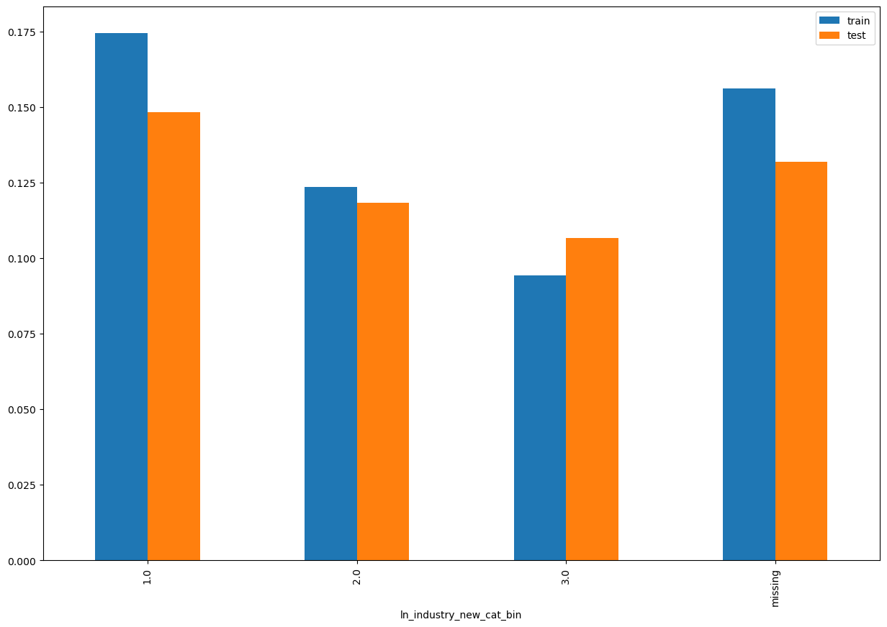
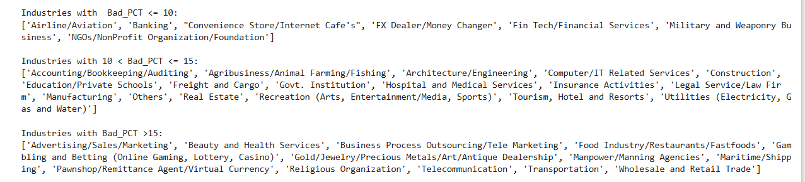
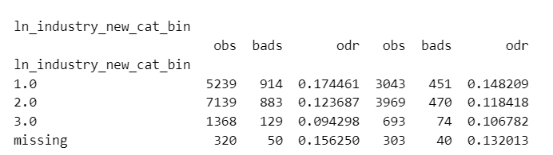
SHAP Rank: 3
ln_industry_new_cat_bin = Rolled up new Industry description

Slide 11
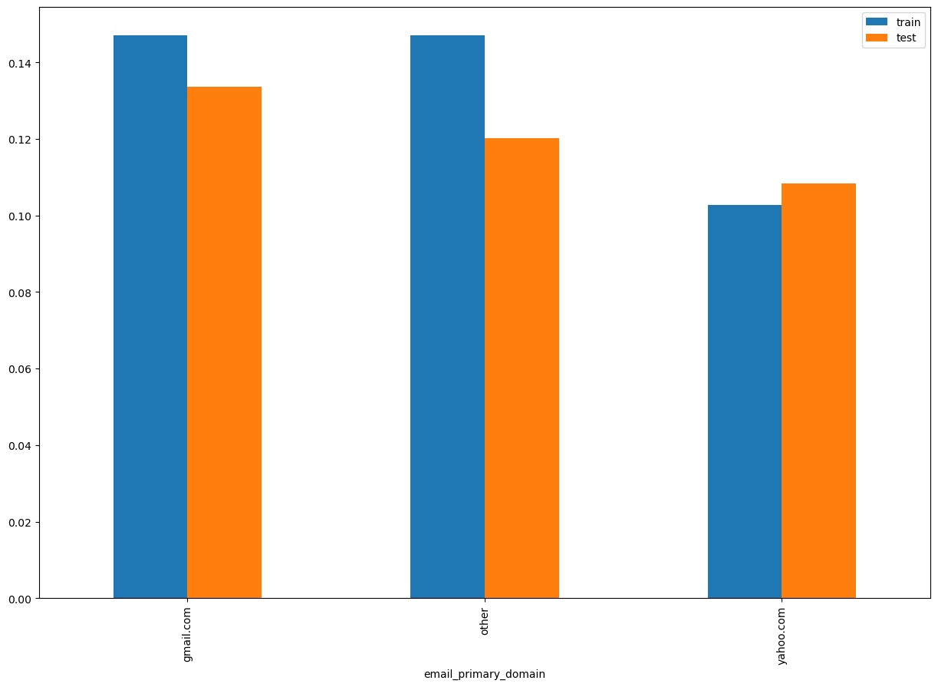
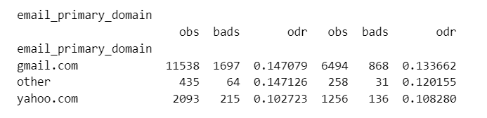
SHAP Rank: 4
email_primary_domain = primary domain of customer email

Slide 12
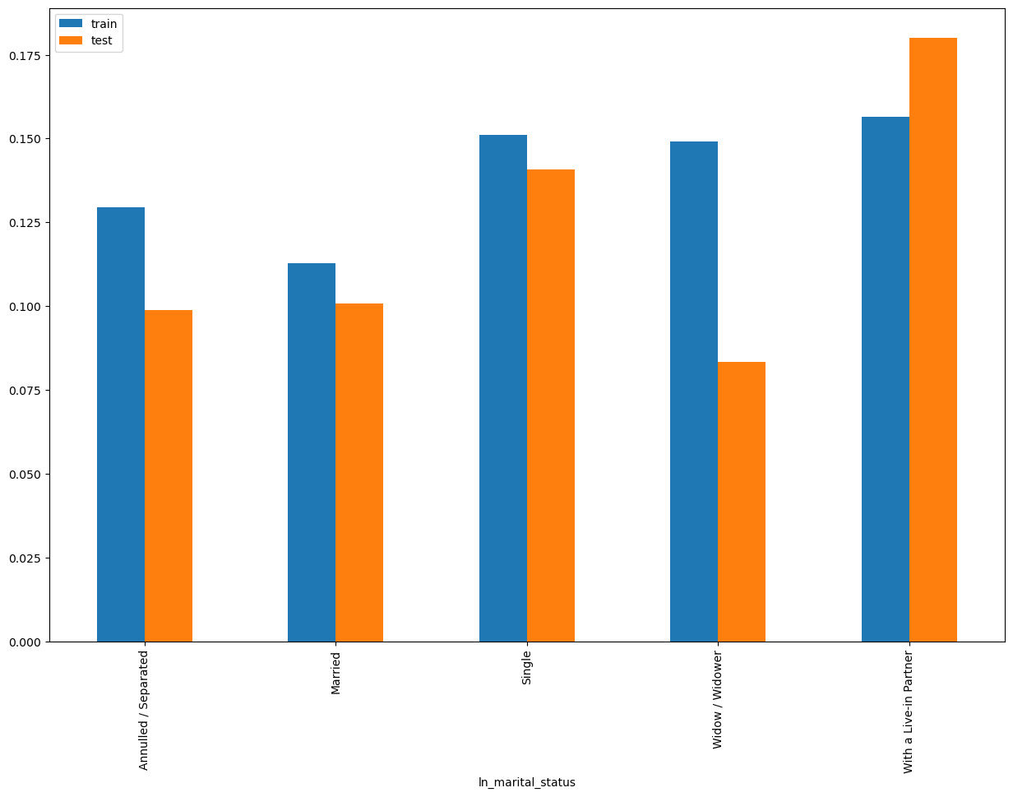
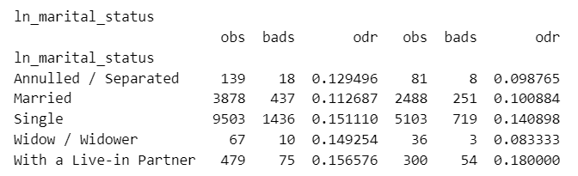
SHAP Rank: 5
ln_marital_status

Slide 13
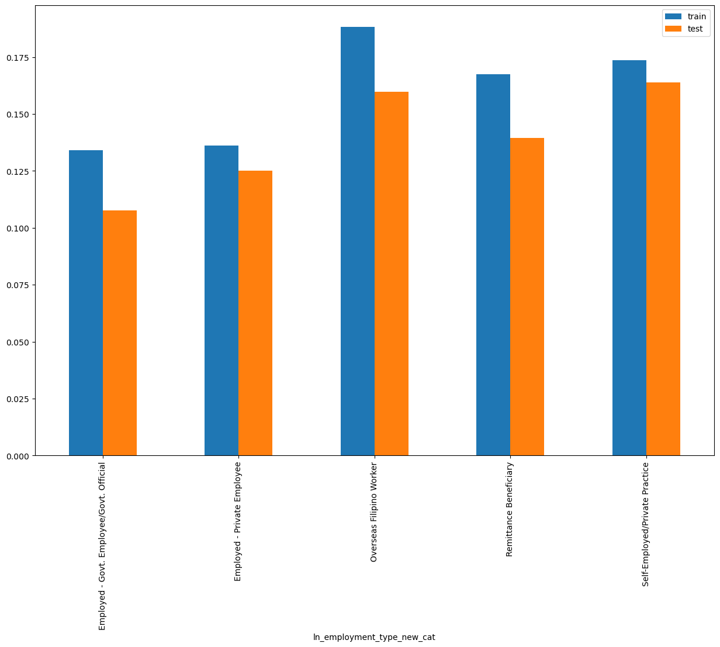
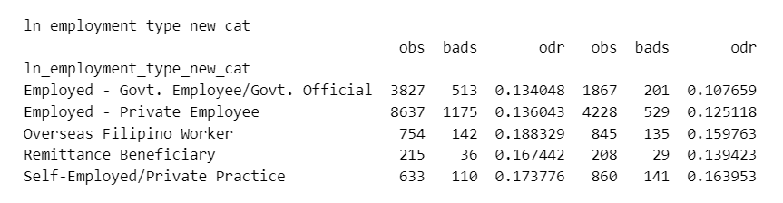
SHAP Rank: 6
ln_employment_type_new_cat = Rolled up new employment type

Slide 14
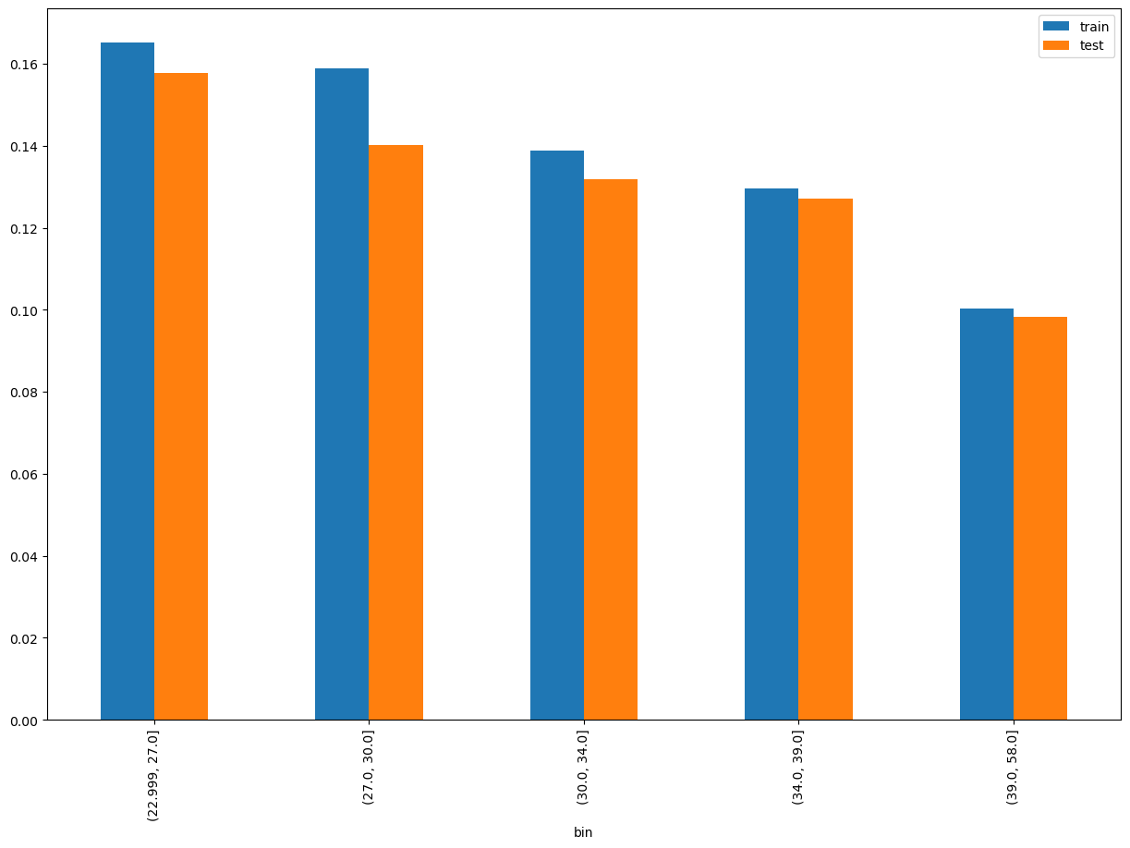
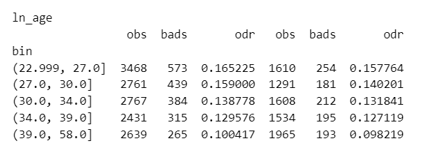
SHAP Rank: 7
ln_age = age of the customer

Slide 15
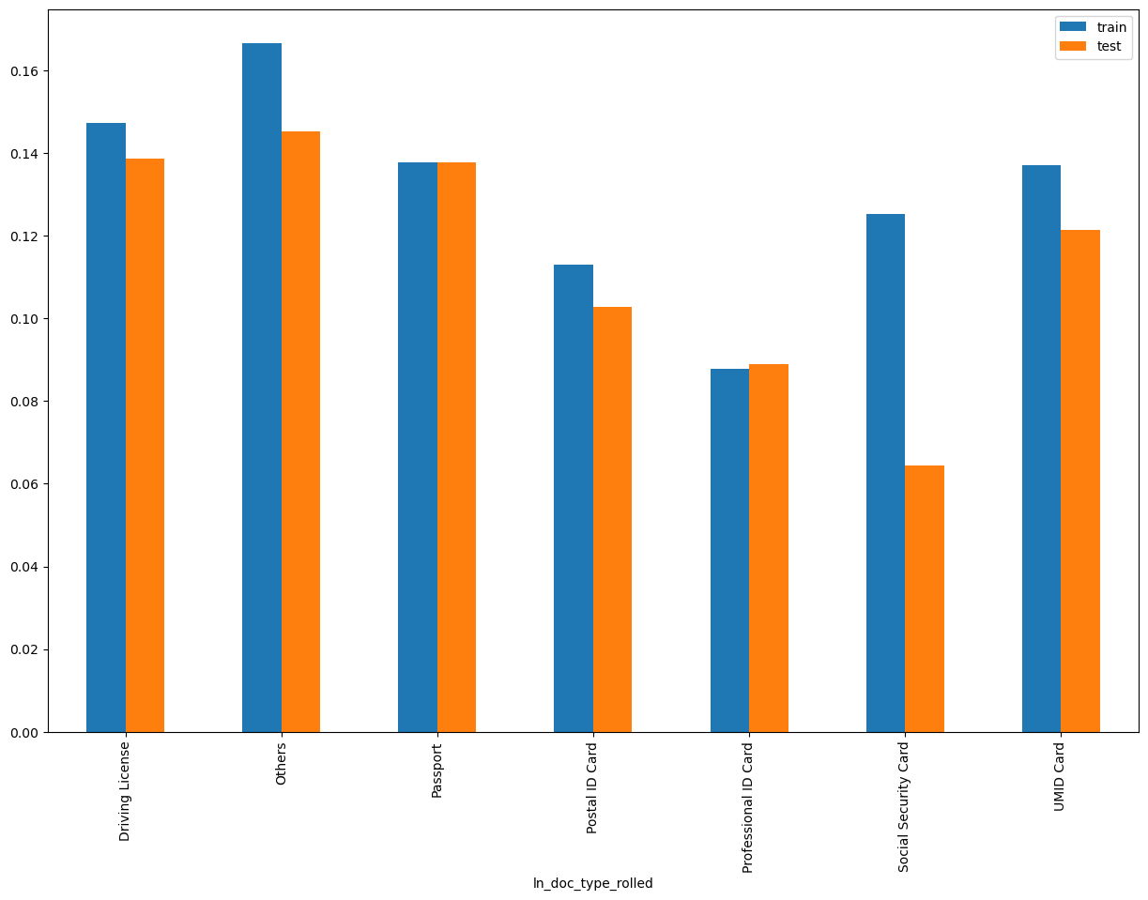
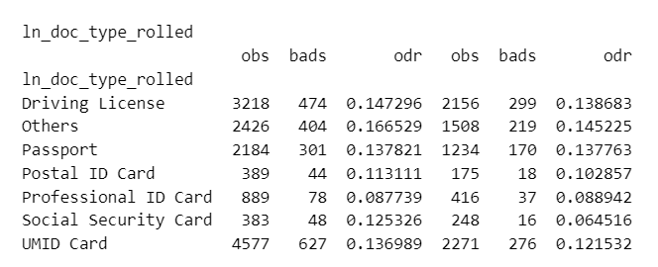
SHAP Rank: 8
ln_doc_type_rolled = Rolled up document type

Slide 16
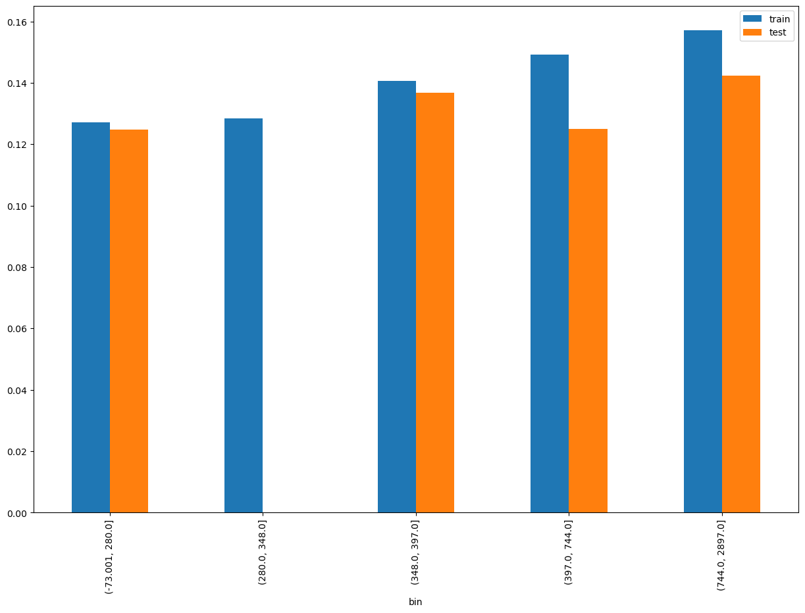
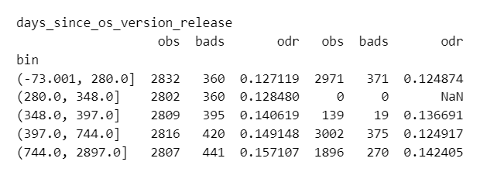
SHAP Rank: 9
days_since_os_version_release = (ln_appli_subt_time – osversion_release_date)

Slide 17
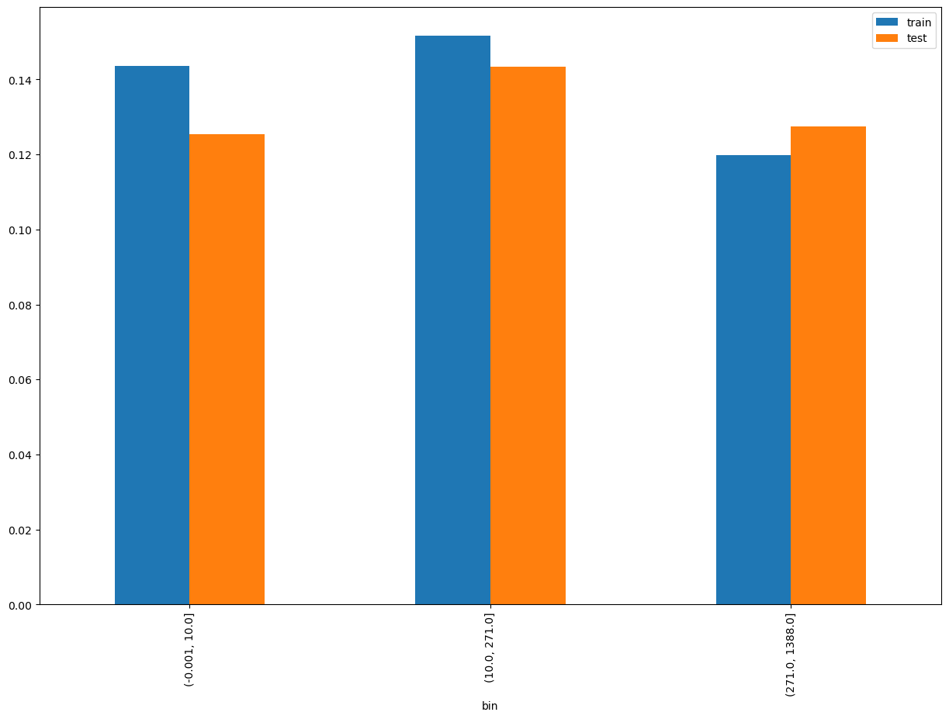
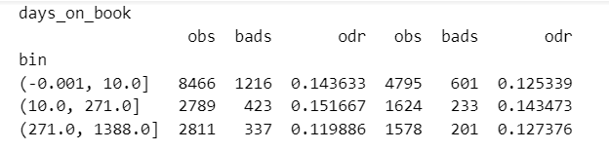
SHAP Rank: 10
days_on_book = (ln_application_submit_time - onboarding_date)

Slide 18

THANK YOU!
​
Questions?
tonikbank.com

