Slide 1

Gamma Demo Scorecard for Cash Loan
Presented by:
Data Science
30th June 2025

Slide 2
Architecture Overview of TDB’s Risk Scorecards
For Cash Loan only
For both Cash and SIL
Limit Setting Model (Hosted in Digital Layer)
Credit Decisioning Model (Hosted in Taran)
Beta Stack
Alpha Stack
Trench 1: New Users - within 30 days from TSA Onboarding AND Never Disbursed Loan
Limit Setting Score = Gamma Stack
Beta Demo Score
Beta Demo Score
Gamma Demo Score
Apps Score
Apps Score
Selectively call Alpha
Apps Score
Credo Score
Users automatically move from Trench 1 to Trench 2 after 30 days if no disbursed loans
Credo Score
CIC Score
Gamma Income Model
Beta Income Model
Alpha Income Model
Users will stay in Trench 2 until 1st disbursed loan. His Gamma Stack will be re-calculated every 30-day anniversary from TSA onboarding date
Limit Setting Score = Gamma Stack
Beta Stack
Alpha Stack
Gamma Demo Score
Beta Demo Score
Beta Demo Score
Trench 2: Existing Users - After 30 days from TSA Onboarding AND Never Disbursed Loan
Apps Score
Apps Score
Selectively call Alpha
Apps Score
Transaction Score
Transaction Score
Transaction Score
CIC Score
Gamma Income Model
Beta Income Model
Alpha Income Model
Users will move to Trench 3 after 1st Disbursed Loan
Lowest Risk users from this B Score will be pre-approved for upsell and xsell. Medium Risk users from this B Score will have to go through Taran.
High Risk users from this B Score will not be given any offer.
B Score = Gamma Stack
Trench 3: Existing Users - After 30 days from 1st Disbursed Loan AND current DPD <= 10
Gamma Demo Score
Beta Stack
Alpha Stack
Apps Score
Beta Demo Score
Beta Demo Score
Apps Score
Apps Score
Enhanced Transaction Score
Selectively call Alpha
Enhanced Transaction Score
Once moved to Trench 3, user will forever remain in Trench 3. His Gamma Stack will be re-calculated every 30 days anniversary from 1st Loan Disbursement Date
Enhanced Transaction Score
CIC Score
Gamma Income Model
Beta Income Model
Alpha Income Model

Slide 3
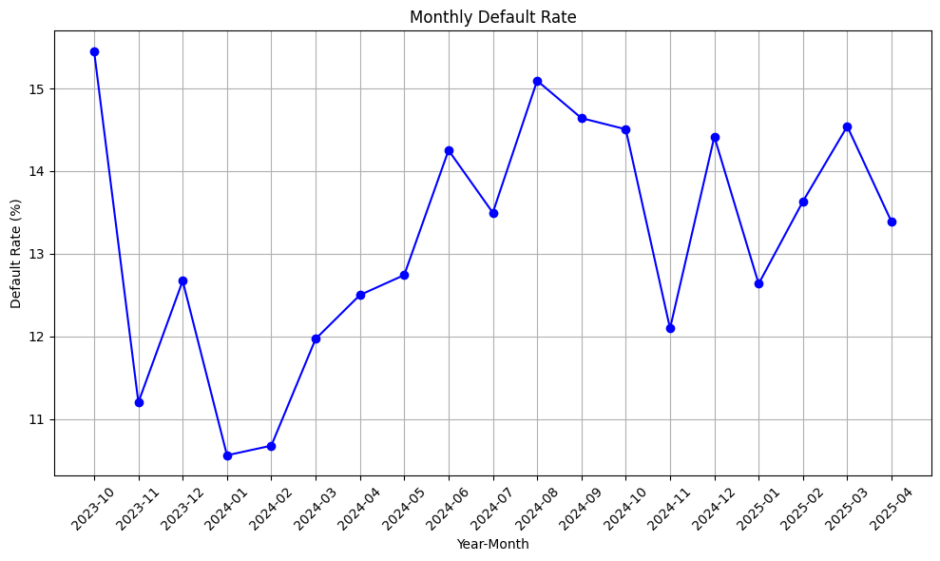
Cash Gamma Demo Score was developed on Trench 1 (DOB <= 30 and without any disbursed loan) and Trench 2 (DOB > 30 and without any disbursed loan)
 | Loan Disbursement Date | # CASH Loans |  |  | # Bad (FPD30) CASH Loans |  |  | FPD30 rate
 |  | Overall | Trench1 | Trench2 | Overall | Trench1 | Trench2 | Overall | Trench1 | Trench2
All Data Training – 90%,val – 10% | 06/10/2023 - 15/02/2025 | 24818 | 15677 | 9174 | 3367.0 | 2116.0 | 1255.0 | 0.1356 | 0.1349 | 0.1367
Test | 16/02/2025 - 15/03/2025 ​ | 2495 | 1262 | 1233 | 368.0 | 174.0 | 194.0 | 0.1474 | 0.1378 | 0.1573
OOT | 16/03/2025 - 15/04/2025 | 1581 | 816 | 765 | 228.0 | 103.0 | 125.0 | 0.1442 | 0.1262 | 0.1633

Slide 4
Model Iteration ​ | Top Features​ | Train Gini​ (06/10/2023 - 15/02/2025) | Val Gini​ | Test Gini (16/02/2025 - 15/03/2025) | OOT Gini (16/03/2025 - 15/04/2025)
5 | ln_industry_new_cat_bin ln_self_dec_income ln_age ln_education_level ln_marital_status | 0.2458 | 0.2253 | 0.2275 | 0.18
6 | ln_doc_type_rolled | 0.2632 | 0.2285 | 0.2393 | 0.1659
7 | email_primary_domain | 0.271 | 0.2275 | 0.2434 | 0.1531
8 | days_on_book | 0.2853 | 0.226 | 0.2434 | 0.1459
9 | Onboarding_time_of_day_cat | 0.2949 | 0.2262 | 0.2579 | 0.1497
10 | name_email_match_score | 0.2989 | 0.2319 | 0.2557 | 0.1417
11 | ln_city_cat | 0.2971 | 0.2331 | 0.2551 | 0.138
12 | ln_cnt_dependents | 0.2940 | 0.23 | 0.2516 | 0.1387
13 | ln_brand_cat | 0.3 | 0.2321 | 0.2557 | 0.1335
14 | ln_province_cat | 0.2992 | 0.2304 | 0.2583 | 0.147
14 feature model after Hyper Parameters Tuning​ | ​ | 0.3157 | 0.2287 | 0.2628 | 0.1623

Slide 5
Cash Gamma Demo Model Performance
Gamma Demo Model Gini | 06/10/2023 - 15/02/2025 |  | 16/02/2025 - 15/03/2025 ​ | 16/03/2025 - 15/04/2025 ​ ​​
​ | Train Gini (90%)​​ | Val Gini (10%)​​ | Test Gini​​ | OOT Gini​​
Overall Demo Model Gini | 0.3157 | 0.2287 | 0.2628 | 0.1623
Demo Trench 1 Gini |  |  | 0.2313 | 0.1207
Demo Tench 2 Gini |  |  | 0.2947 | 0.1207

Slide 6
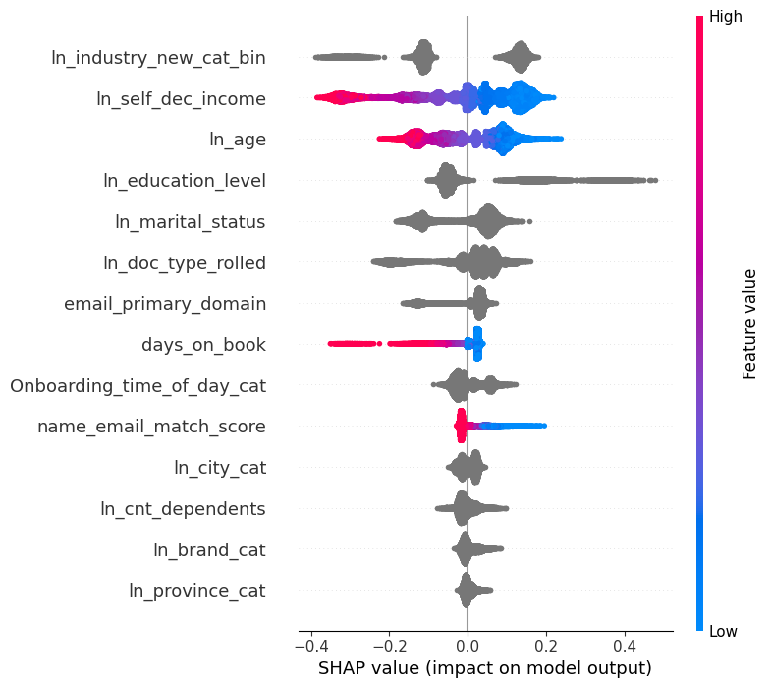
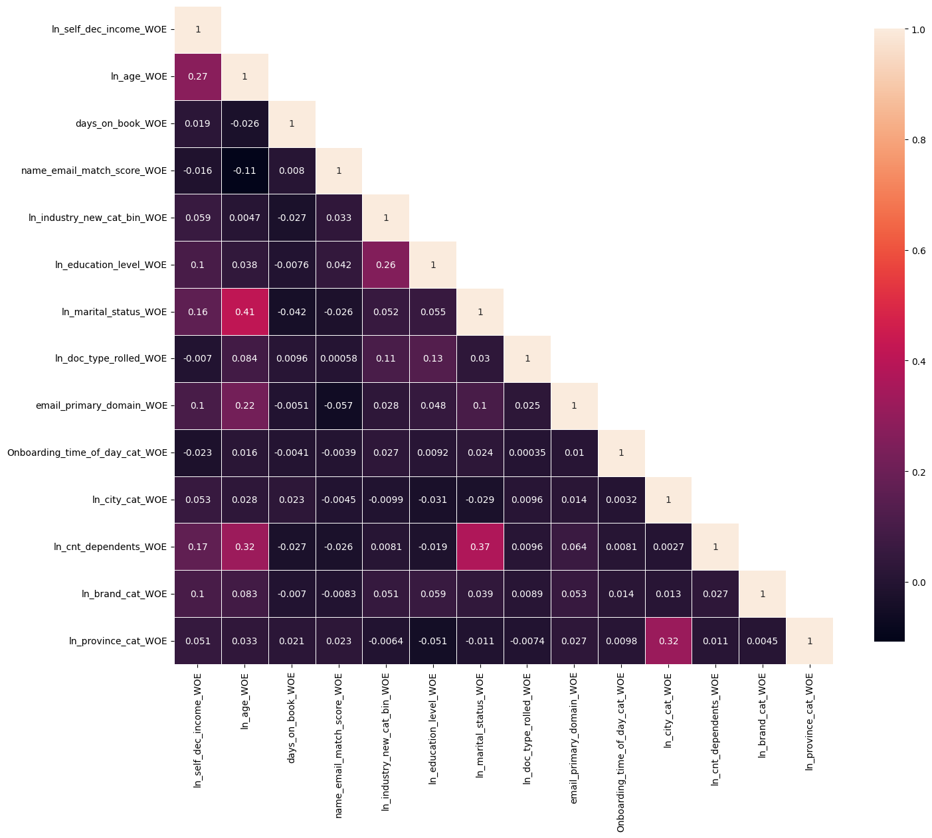
Gamma Quick Demo – Model Performance

Slide 7
Gamma Demo Quick

Slide 8
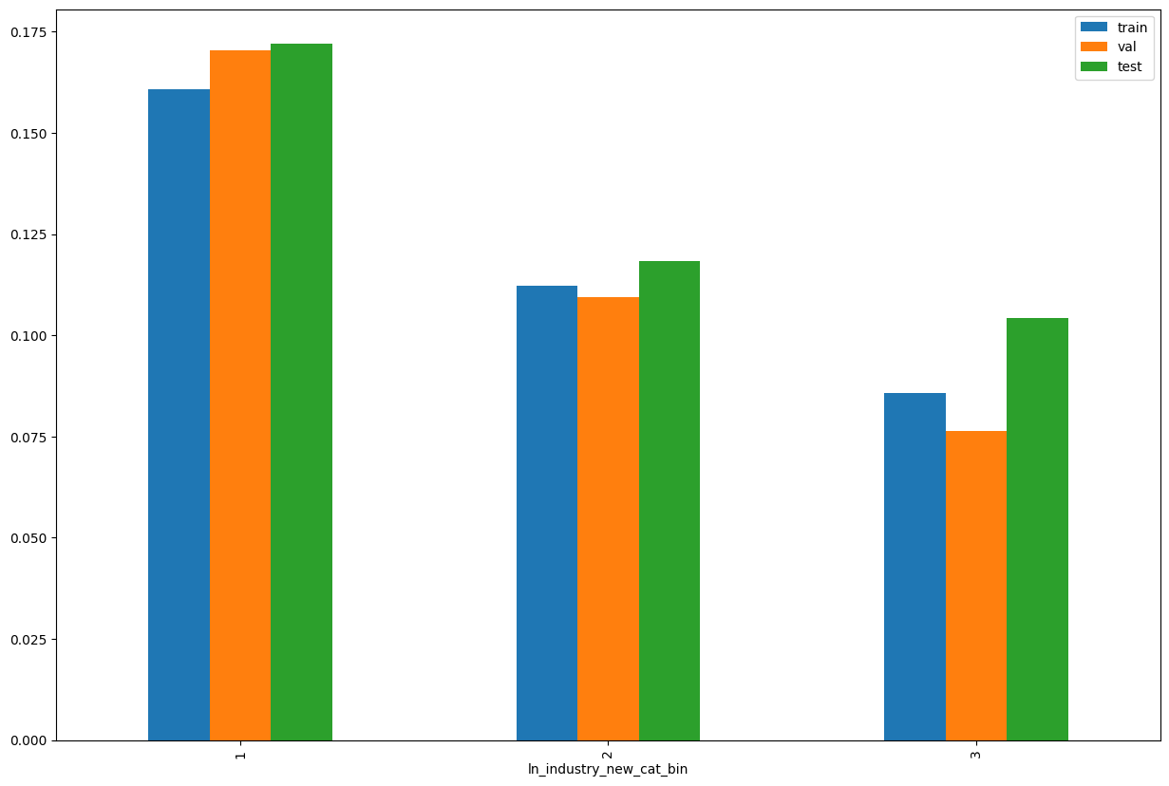
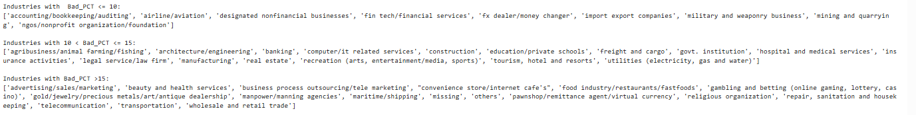

SHAP Rank: 1
ln_industry_new_cat_bin= Rolled up new Industry description
(Used Regex to identify the pattern)
Notes:
industry_desc_map = {
# r'(?i)^business\s*process\s*outsourcing(?:/tele\s*marketing)?$|^tele\s*marketing$': 'business process outsourcing/tele marketing',
r'(?i)(?:teleco|telco)': 'telecommunication',
r'(?i)^others$': 'others',
r'(?i)^(?:accounting|bookkeeping|auditing)(?:/bookkeeping)?(?:/auditing)?$': 'accounting/bookkeeping/auditing',
r'(?i)^computer(?:/it\s*related\s*services)?$|^it\s*related\s*services$': 'computer/it related services',
r'(?i)^(?:govt\.?|government\.?)\s*institution$': 'govt. institution',
r'(?i)^education(\s*/\s*private\s*schools|[\s]+private\s*schools)?$|^private\s*schools$': 'education/private schools',
r'(?i)^(?:wholesale\s+and\s+)?retail\s+trade$': 'wholesale and retail trade',
r'(?i)\b(beauty|health(?:\s+and\s+beauty)?(?:\s+services)?)\b': 'beauty and health services',
r'(?i)^freight(?:\s+and\s+cargo)?$|^cargo$': 'freight and cargo',
r'(?i)^transportation$': 'transportation',
r'(?i)bank': 'banking',
r'(?i)insurance': 'insurance activities',
r'(?i)\b(recreation|arts|entertainment|media|sports)\b': 'recreation (arts, entertainment/media, sports)',
r'(?i)\b(?:architecture\s*/\s*engineering|architecture|engineering)\b': 'architecture/engineering',
r'(?i)^(?=.*\b(advertising|sales|marketing)\b)(?!.*tele\s*marketing).*':
'advertising/sales/marketing',
r'(?i)^construction$': 'construction',
r'(?i)\b(?:food\s*industry\s*/\s*restaurants\s*/\s*fastfoods|food\s*industry|restaurants|fastfoods)\b':
'food industry/restaurants/fastfoods',
r'(?i)manufacturing': 'manufacturing',
r'(?i)\b(?:hospital\s+and\s+medical\s+services|hospital|medical\s+services)\b': 'hospital and medical services',
r'(?i)^real estate$': 'real estate',
r'(?i)\b(?:tourism,\s*hotel\s+and\s+resorts|tourism|hotel\s+and\s+resorts|hotel|resorts)\b':
'tourism, hotel and resorts',
r'(?i)\b(?:fin\s*tech\s*/\s*financial\s*services|fin\s*tech|financial\s*services)\b':
'fin tech/financial services',
r'(?i)\b(?:maritime\s*/\s*shipping|maritime|shipping)\b': 'maritime/shipping',
r'(?i)\b(?:manpower/manning\s*agencies|manpower|manning\s*agencies)\b': 'manpower/manning agencies',
r'(?i)\b(?:legal\s*service/law\s*firm|legal\s*service|law\s*firm)\b': 'legal service/law firm',
r'(?i)\b(?:pawnshop\s*/\s*remittance\s*agent\s*/\s*virtual\s*currency|pawnshop|remittance\s*agent|virtual\s*currency)\b':
'pawnshop/remittance agent/virtual currency',
r'(?i)\b(?:utilities\s*\(?(?:electricity|gas|water)[^\)]*\)?|utilities|electricity|gas|water)\b':
'utilities (electricity, gas and water)',
r'(?i)\b(?:ngos|non\s*profit\s*organization|foundation)\b': 'ngos/nonprofit organization/foundation',
r'(?i)\b(?:airline|aviation)\b': 'airline/aviation',
r'(?i)\b(?:agribusiness|animal\s*farming|fishing|agri)\b': 'agribusiness/animal farming/fishing',
r"(?i)(?:convenience\s*store|internet\s*cafe'?s?)": "convenience store/internet cafe's",
r'(?i)(?:gambling\s*and\s*betting|gambling|betting|online\s*gam|lottery|casino)':
'gambling and betting (online gaming, lottery, casino)',
r'(?i)\b(?:gold|jewelry|precious\s*metals|art|antique\s*dealership)\b':
'gold/jewelry/precious metals/art/antique dealership',
r'(?i)^religious organization$': 'religious organization',
r'(?i)\b(?:fx\s*dealer\s*/?\s*money\s*changer|fx\s*dealer|money\s*changer)\b': 'fx dealer/money changer',
r'(?i)\b(?:military and weaponry business|military|weaponry business)\b': 'military and weaponry business',
r'(?i)\b(business\s*process\s*outsourcing\s*/?\s*tele\s*marketing|business\s*process\s*outsourcing|tele\s*marketing|BPO)\b': 'business process outsourcing/tele marketing',
r'(?i)\b(housekeeping|sanitation|repair)\b' : 'repair, sanitation and housekeeping',
r'(?i)\b(import\s*export\s*companies|import\s*compan\w*|export\s*compan\w*)\b' : 'import export companies',
r'(?i)\b(mining\s+and\s+quarrying|mining|quarrying)\b' : 'mining and quarrying',
r'(?i)\b(designated\s+nonfinancial\s+businesses|nonfinancial\s+businesses)\b' : 'designated nonfinancial businesses',
# r'(?i)\b(housekeeping\s*/\s*sanitation\s*services|housekeeping|sanitation\s*services)\b' : 'housekeeping/sanitation services',
}
# Initialize a new column with default value
df['ln_industry_new_cat'] = 'new'
# Apply mapping using np.where
for pattern, label in industry_desc_map.items():
df['ln_industry_new_cat'] = np.where(df['ln_industry_new'].isna(), 'missing',
np.where( df['ln_industry_new'].str.strip().str.lower().str.contains(pattern, regex=True),
label, df['ln_industry_new_cat']
))

Slide 9
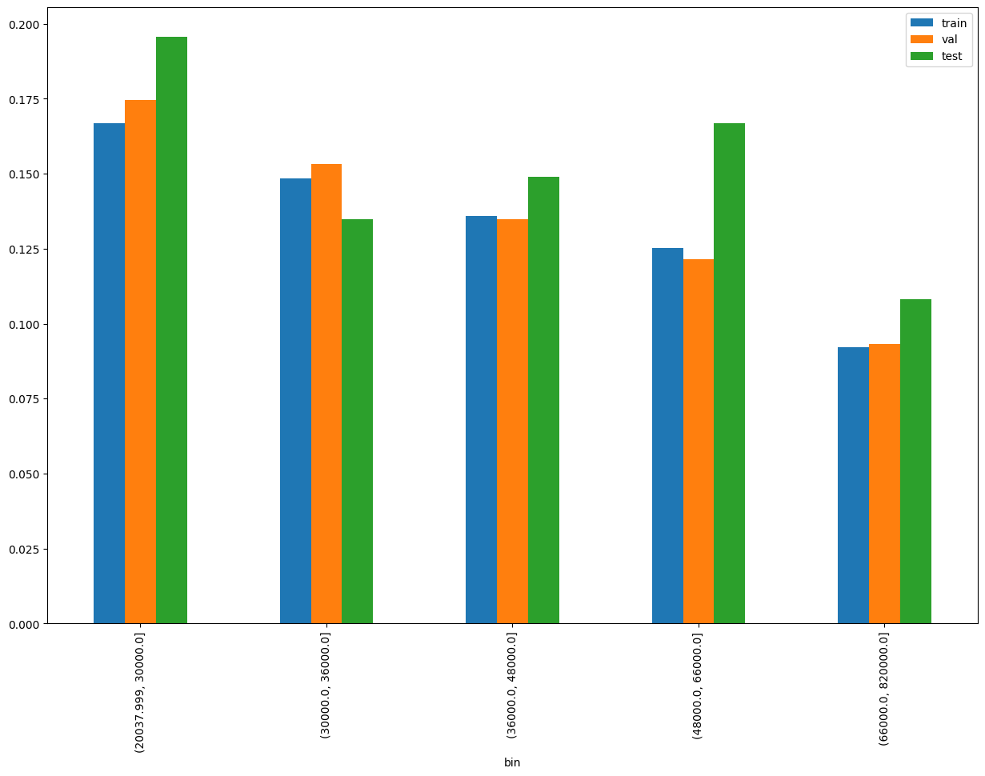
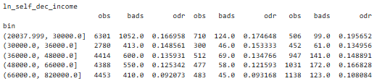
SHAP Rank: 2
ln_self_dec_income = Self declared Monthly income

Slide 10
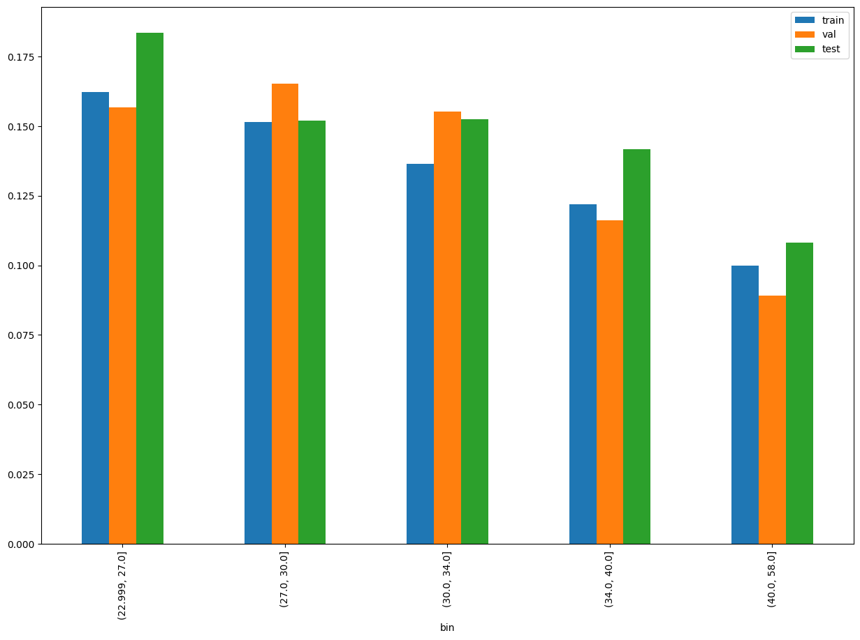
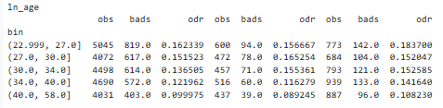
SHAP Rank: 3
ln_age= age of the customer

Slide 11
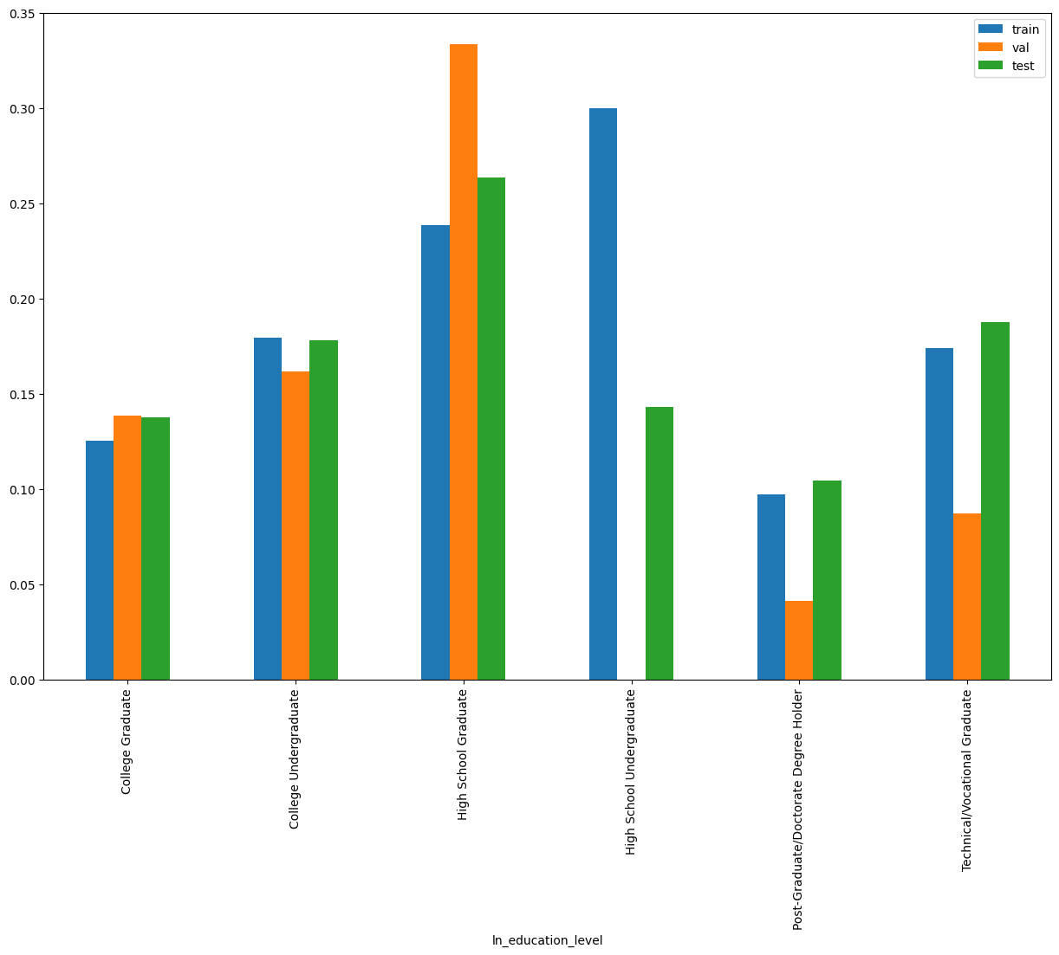
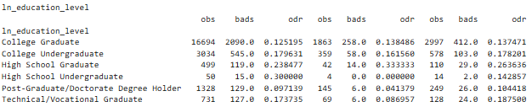
SHAP Rank: 4
ln_education_level

Slide 12
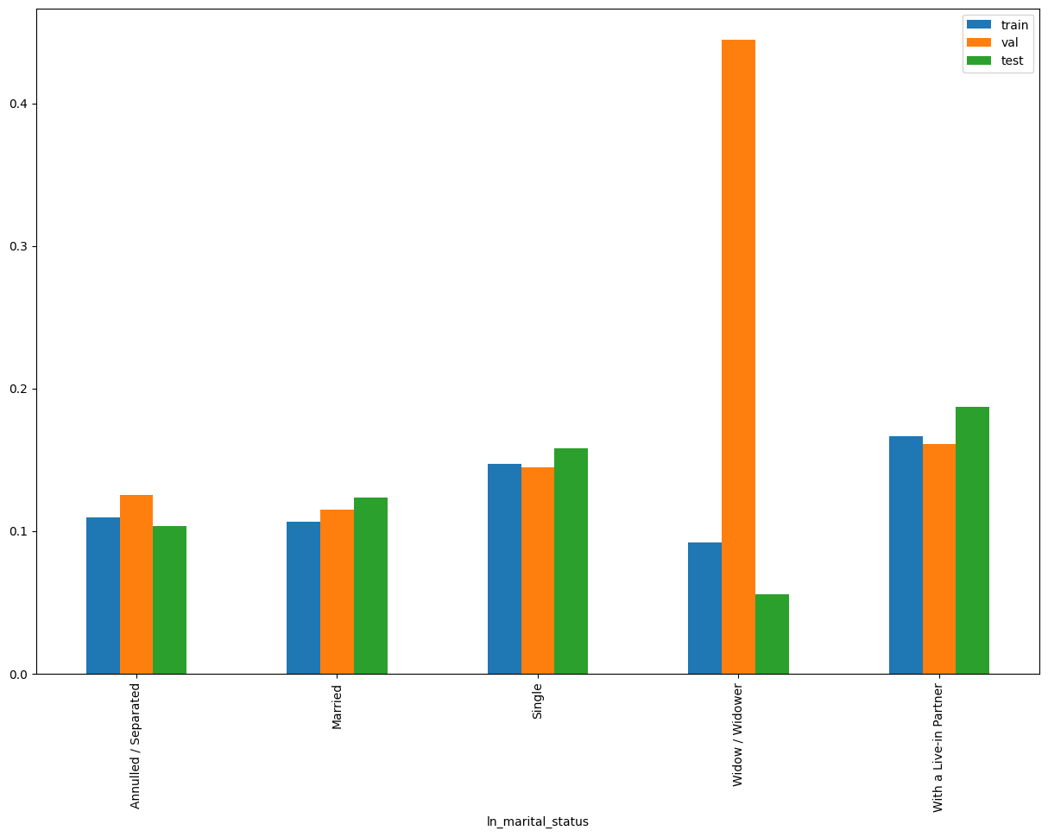
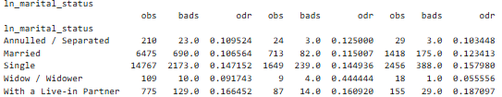
SHAP Rank: 5
ln_marital_status

Slide 13
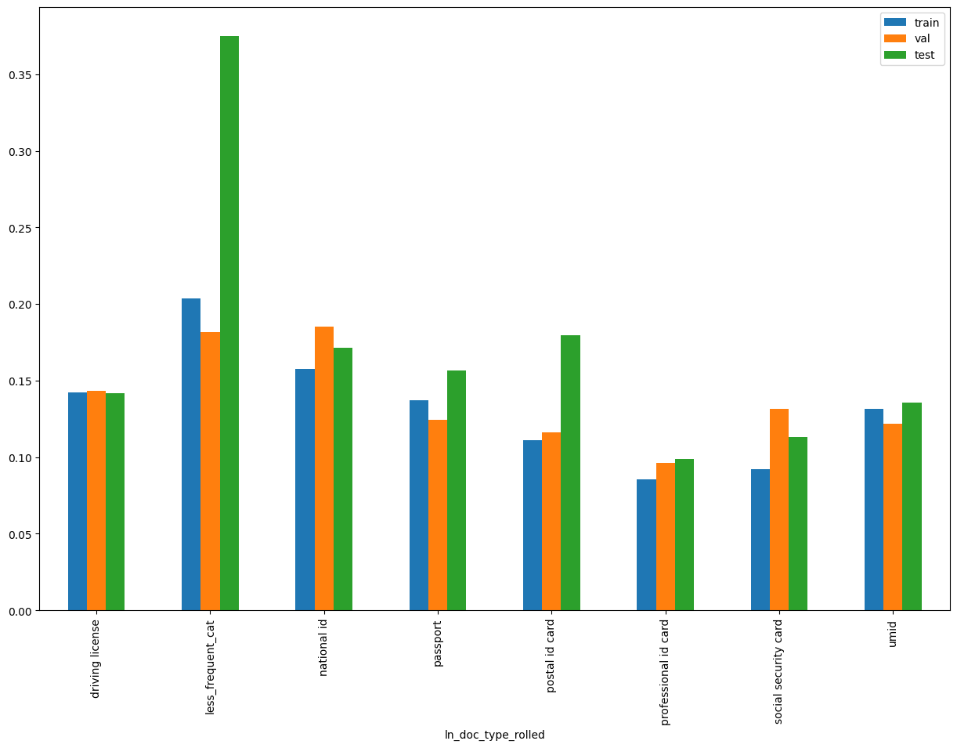

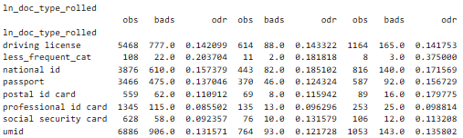
SHAP Rank: 6
ln_doc_type_rolled ( Used Regex to identify the pattern and rollup the feature)
distribution of less_frequent_cat
Notes:
doc_type_reference_map = {
r'(?i)(Driving|Drive|DL)': 'driving license',
r'(?i)(?:)(UMID)': 'umid',
r'(?i)(?:)(ePassport|Passport)': 'passport',
r'(?i)(?:)(Post)': 'postal id card',
r'(?i)(?:)(Social Sec|SSS|security)': 'social security card',
r'(?i)(professional(?:\s*-\s*|\s)id|prc)': 'professional id card',
r'(?i)^(?:philippines\s*[-]?\s*)?(digital(?:\s+or\s+ephilsys)?\s+id|ephilsys|philid|nation|ePhil|national\s+id|id)': 'national id'
}
# Initialize a new column with default value
df['ln_doc_type_rolled'] = 'less_frequent_cat'
# Apply mapping using np.where
for pattern, label in doc_type_reference_map.items():
df['ln_doc_type_rolled'] = np.where(df['ln_doc_type'].isna(), 'missing',
np.where(df['ln_doc_type'].str.strip().str.lower().str.contains(pattern, regex=True),
label,
df['ln_doc_type_rolled']
))

Slide 14
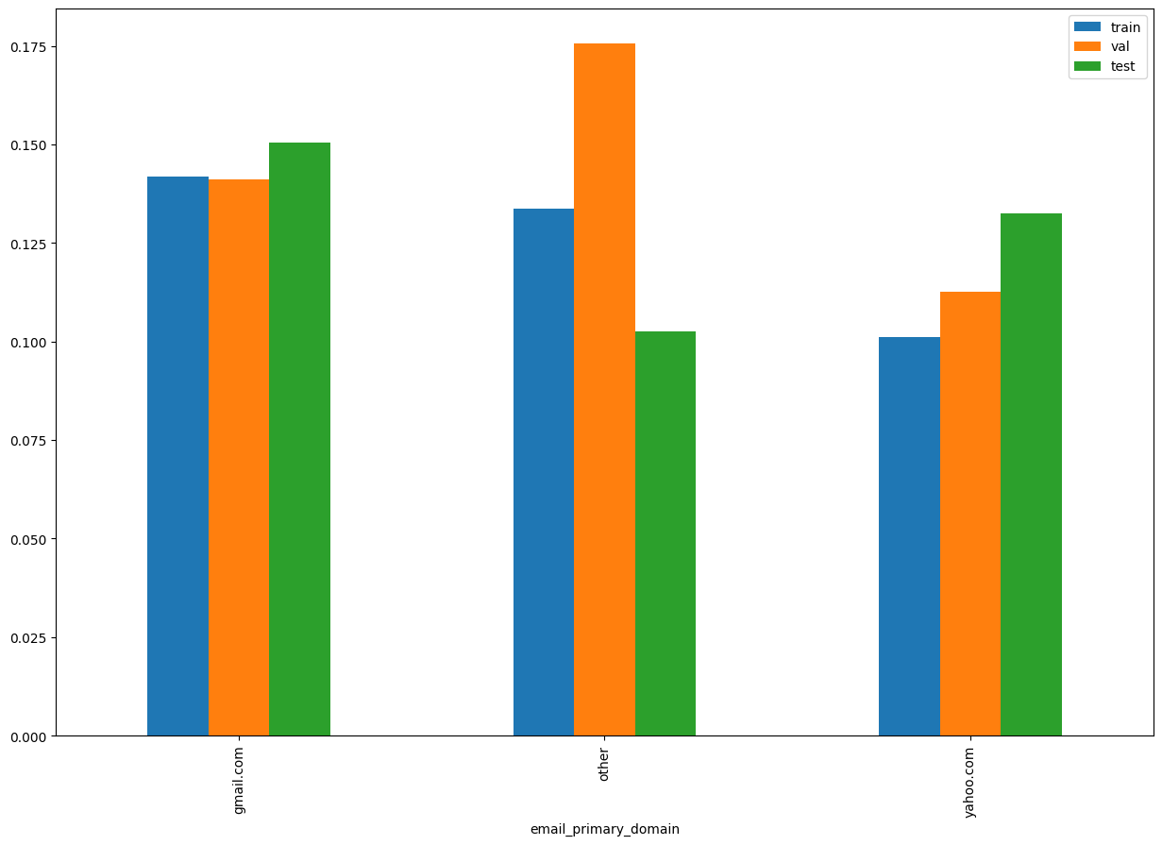

SHAP Rank: 7
email_primary_domain

Slide 15
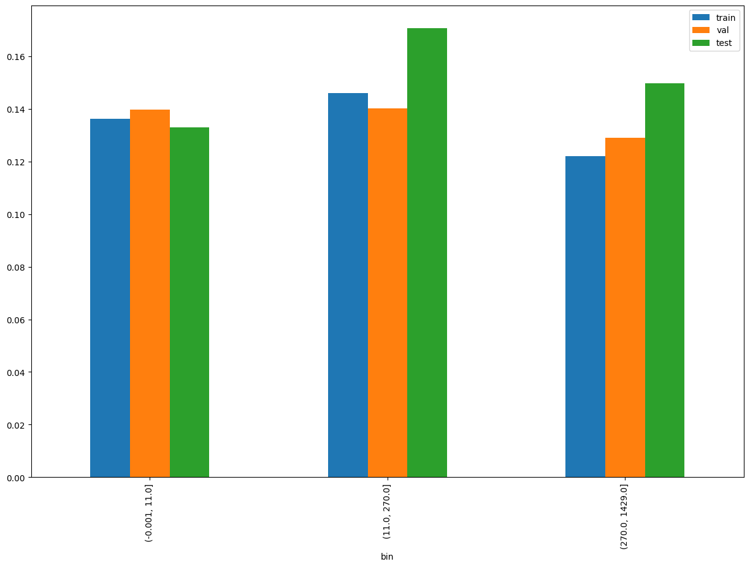

SHAP Rank: 8
days_on_book = (ln_application_submit_time - onboarding_date)

Slide 16
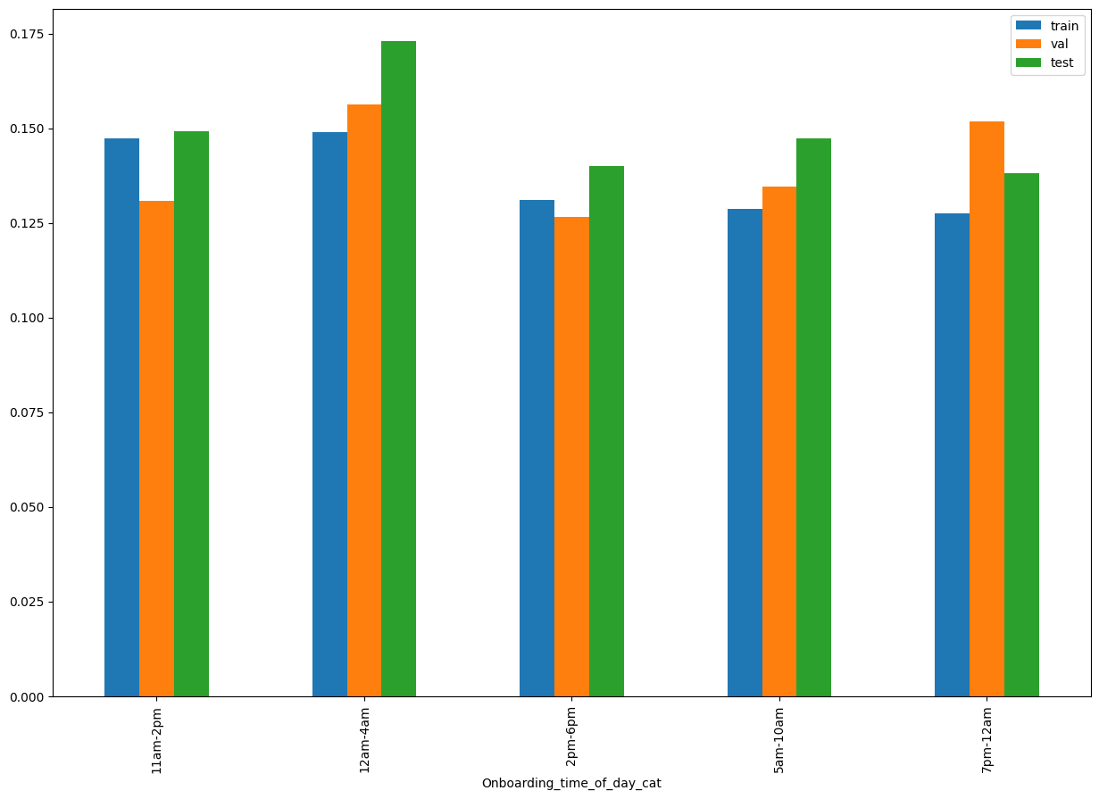
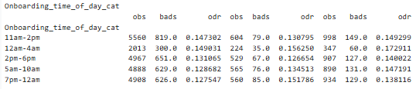
SHAP Rank: 9
Onboarding_time_of_day_cat

Slide 17
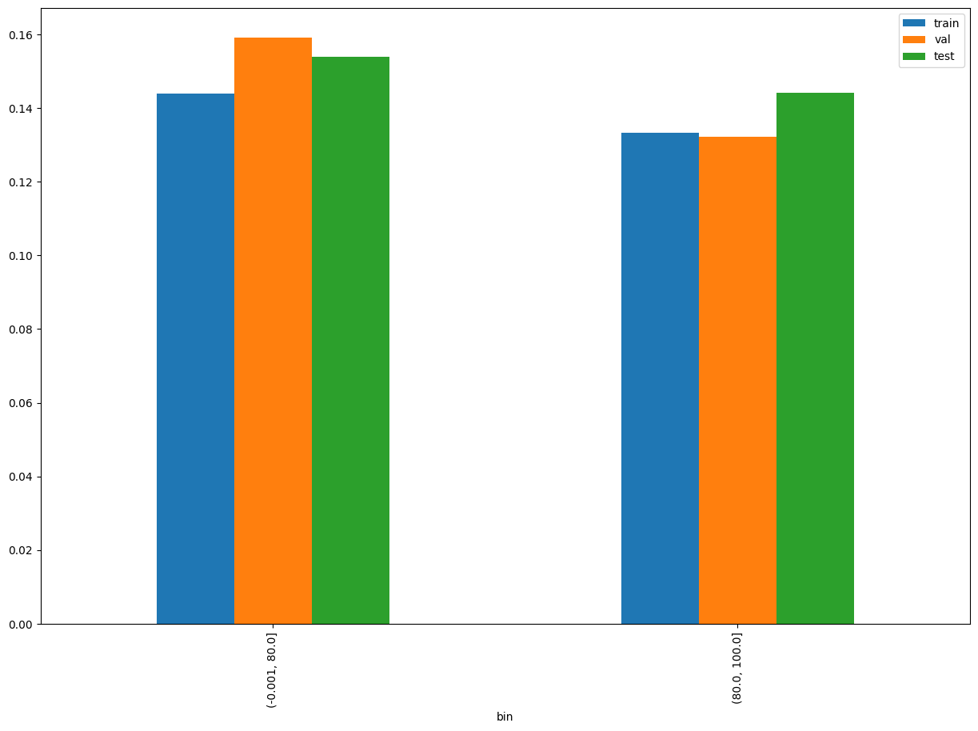

SHAP Rank: 10
name_email_match_score

Slide 18
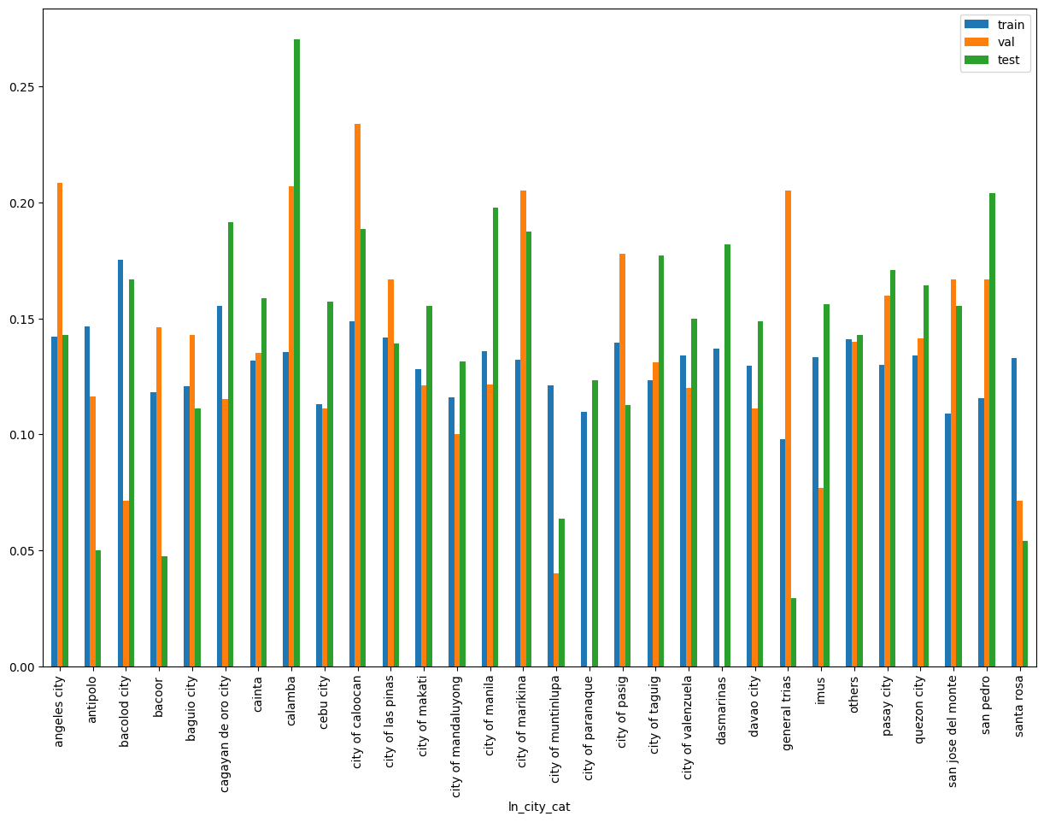
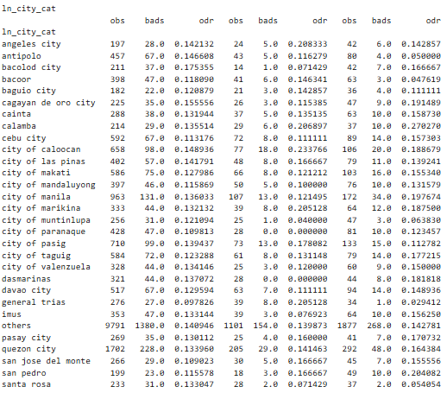
SHAP Rank: 11
ln_city_cat

Slide 19
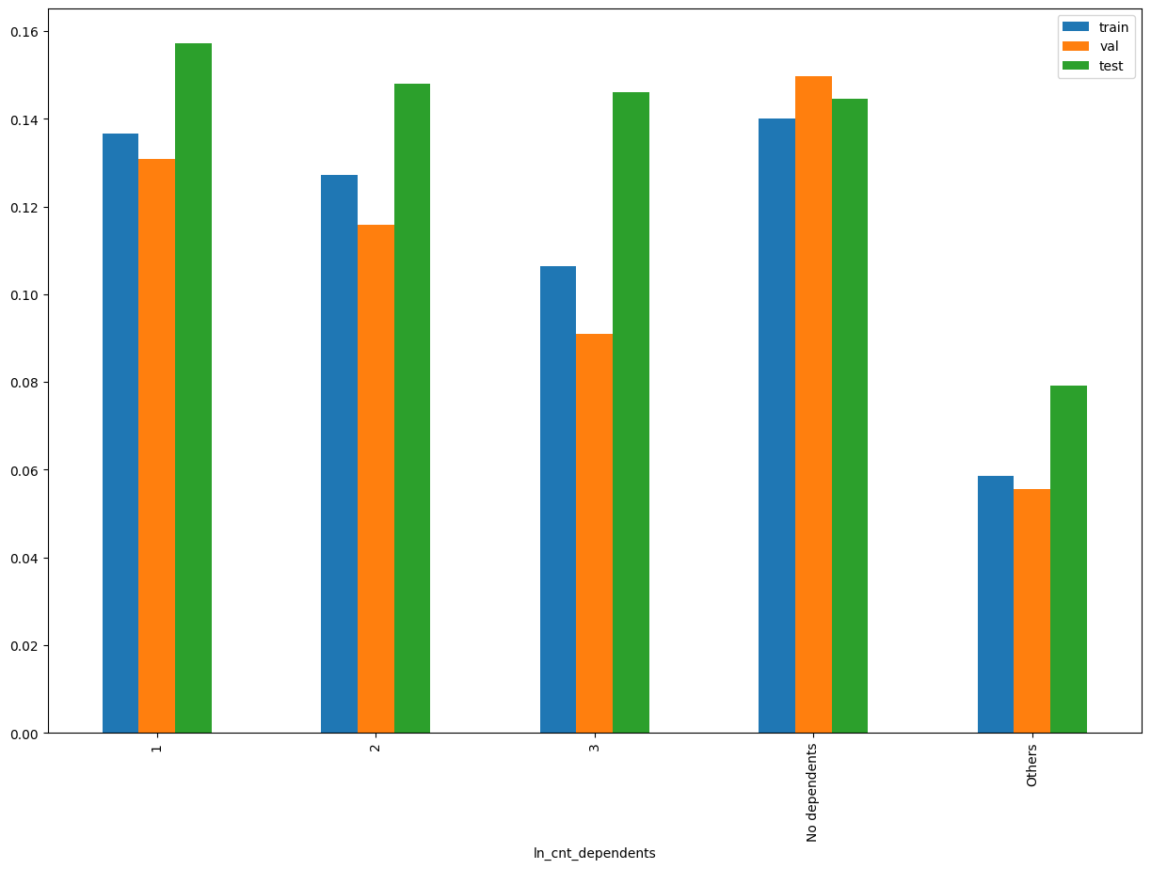
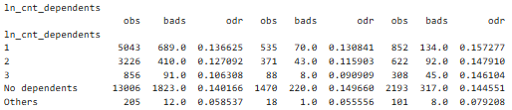
SHAP Rank: 12
ln_cnt_dependents

Slide 20
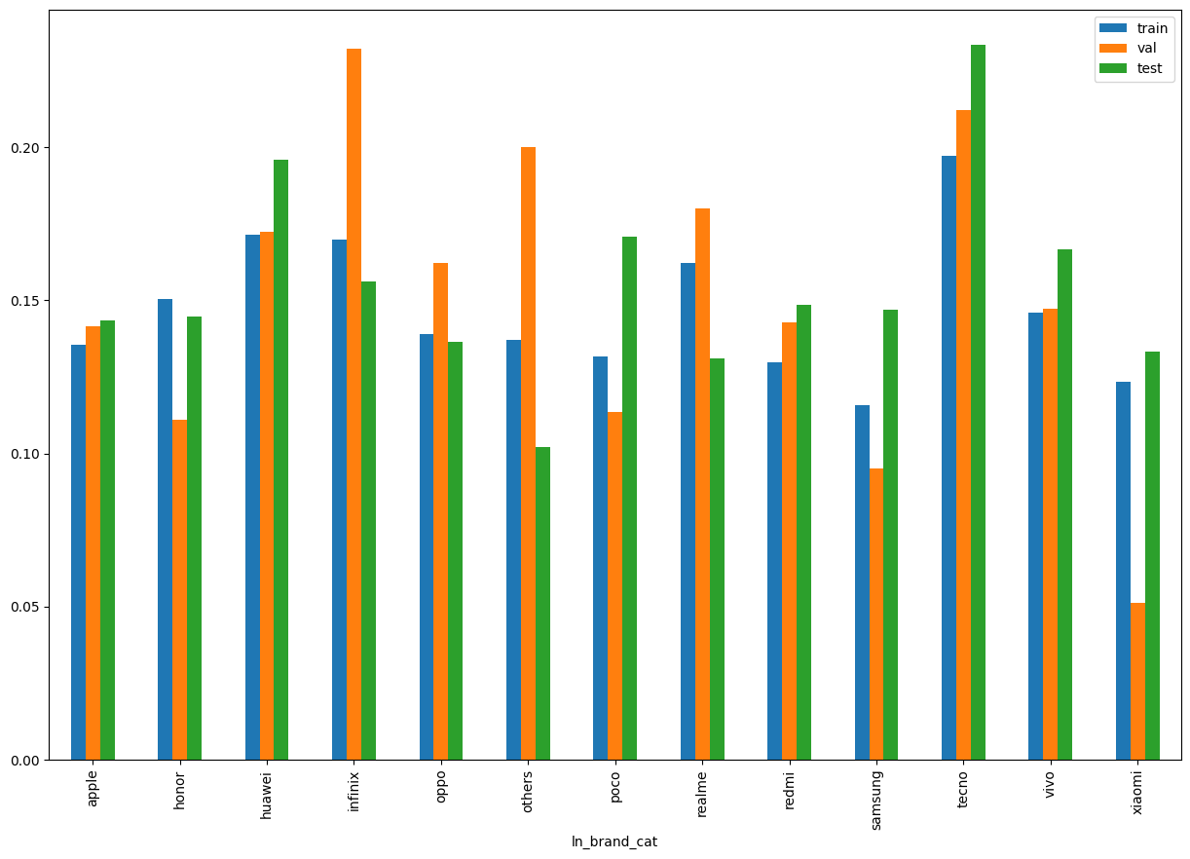
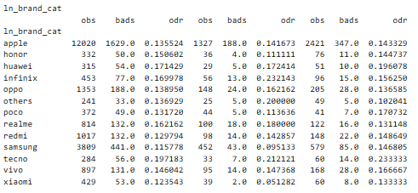
SHAP Rank: 13
ln_brand_cat

Slide 21
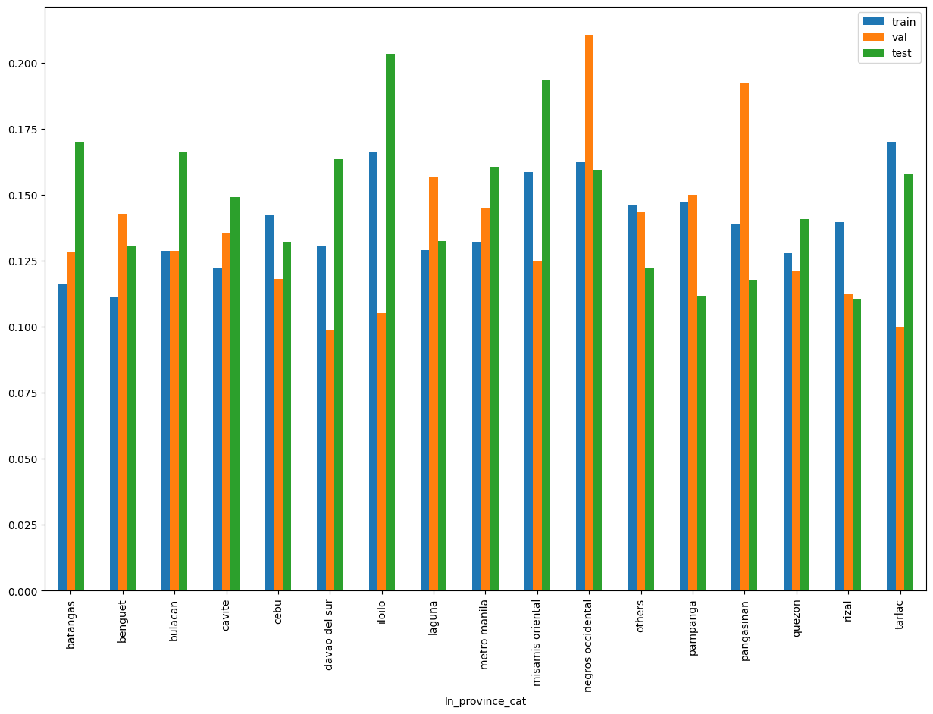
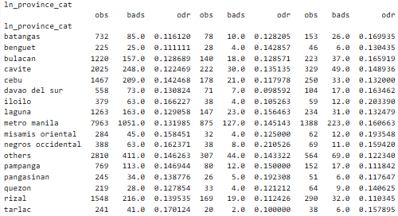
SHAP Rank: 14
ln_province_cat

Slide 22

THANK YOU!
​
Questions?
tonikbank.com

