Slide 1

Trench 2 Transaction Score
Presented by:
Data Science
March 2025

Slide 2
Architecture Overview of TDB’s Risk Scorecards
For Cash Loan only
For both Cash and SIL
Limit Setting Model (Hosted in Digital Layer)
Credit Decisioning Model (Hosted in Taran)
Beta Stack
Alpha Stack
Trench 1: New Users - within 30 days from TSA Onboarding
Limit Setting Score = Gamma Stack
Beta Demo Score
Beta Demo Score
Gamma Demo Score
Apps Score
Apps Score
Selectively call Alpha
Apps Score
Credo Score
Users automatically move from Trench 1 to Trench 2 after 30 days if no disbursed loans
Credo Score
CIC Score
Gamma Income Model
Beta Income Model
Alpha Income Model
Users will stay in Trench 2 until 1st disbursed loan. His Gamma Stack will be re-calculated every 30-day anniversary from TSA onboarding date
Limit Setting Score = Gamma Stack
Beta Stack
Alpha Stack
Gamma Demo Score
Beta Demo Score
Beta Demo Score
Trench 2: Existing Users - After 30 days from TSA Onboarding AND Never Disbursed Loan
Apps Score
Apps Score
Selectively call Alpha
Apps Score
Transaction Score
Transaction Score
Transaction Score
CIC Score
Gamma Income Model
Beta Income Model
Alpha Income Model
Users will move to Trench 3 after 1st Disbursed Loan
Lowest Risk users from this B Score will be pre-approved for upsell and xsell. Medium Risk users from this B Score will have to go through Taran.
High Risk users from this B Score will not be given any offer.
B Score = Gamma Stack
Trench 3: Existing Users - After 30 days from 1st Disbursed Loan AND current DPD <= 10
Beta Stack
Alpha Stack
Gamma Demo Score
Apps Score
Beta Demo Score
Beta Demo Score
Apps Score
Apps Score
Enhanced Transaction Score
Selectively call Alpha
Enhanced Transaction Score
Once moved to Trench 3, user will forever remain in Trench 3. His Gamma Stack will be re-calculated every 30 days anniversary from 1st Loan Disbursement Date
Enhanced Transaction Score
CIC Score
Gamma Income Model
Beta Income Model
Alpha Income Model

Slide 3
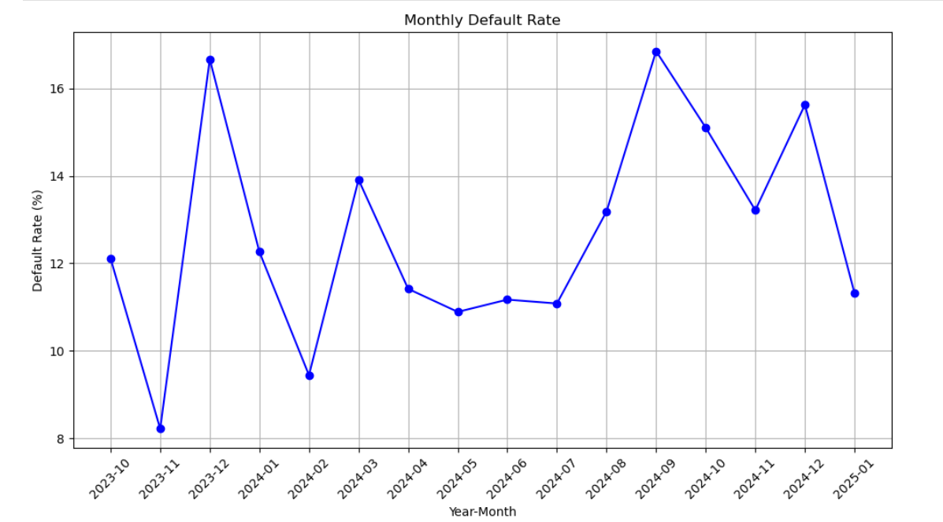
Cash Loan Gamma Transaction Scorecard was developed on Trench 2 users (30+ DOB users without any disbursed loan before)
 | Loan Disbursement Date | # count | # Bad (FPD30) Quick Loans | FPD30 rate
Training (90%) | 06/10/2023 - 31/10/2024 | 5173 | 706 | 0.1365
Validation (10%) | 06/10/2023 - 31/10/2024 | 575 | 81 | 0.1409
Nov(Test) | 01/11/2024 - 30/11/2024 | 1294 | 171 | 0.1321
Dec (OOT) | 01/12/2024 - 31/12/2024 | 768 | 120 | 0.1562
Jan (OOT) | 01/01/2025 - 11/01/2025 | 159 | 18 | 0.1132
FPD30 rate over the month

Slide 4
Feature Selection Methodology Overview
Feature Selection Methodology Overview
236
Feats
136
Feats
113 Feats
61 Feats
15 Feats
IV > 0.009
Missing Rate < 95%
Inter-correlation < 75%
Individual Feature Evaluation

Slide 5
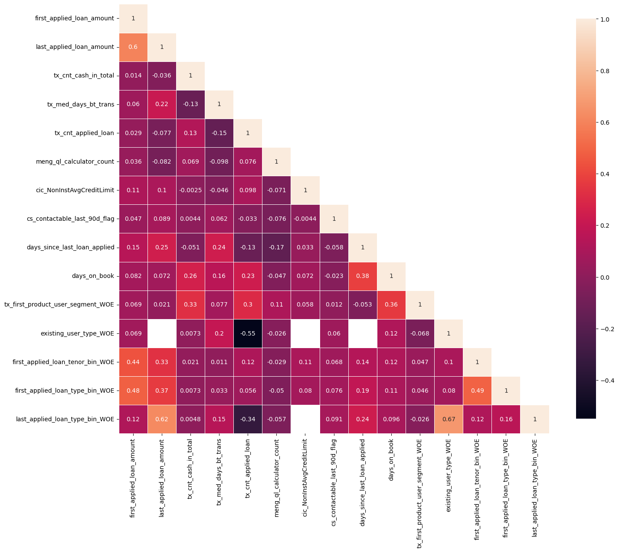
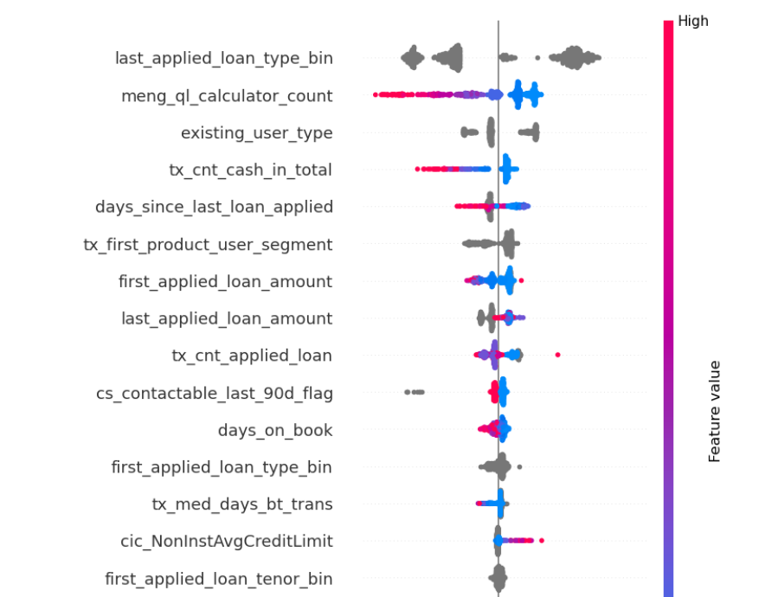
SHAP(15 feat)
Inter-Correlation (15 feat)

Slide 6
Model Iteration | Top Features | Train Gini (2023-10-06- 2024-10-31) | Val Gini | Nov Gini | Dec Gini | Jan Gini (01-01-2025 - 11-01-2025)
Model with top 8 feat | last_applied_loan_type_bin | 0.5504 | 0.515 | 0.3467 | 0.2707 | 0.4007
 | meng_ql_calculator_count
 | existing_user_type
 | tx_cnt_cash_in_total
 | days_since_last_loan_applied
 | tx_first_product_user_segment
 | first_applied_loan_amount
 | 'last_applied_loan_amount'
Model with top 9 feat | tx_cnt_applied_loan | 0.5651 | 0.4999 | 0.3463 | 0.2707 | 0.3857
Model with top 10 feat | cs_contactable_last_90d_flag | 0.5864 | 0.5136 | 0.355 | 0.2745 | 0.4121
Model with top 11 feat | days_on_book | 0.5923 | 0.51 | 0.3593 | 0.2785 | 0.4031
Model with top 12 feat | first_applied_loan_type_bin | 0.5843 | 0.5087 | 0.3634 | 0.2756 | 0.4015
Model with top 13 feat | tx_med_days_bt_trans | 0.6045 | 0.5158 | 0.3699 | 0.274 | 0.4031
Model with top 14 feat | cic_NonInstAvgCreditLimit | 0.6118 | 0.5241 | 0.3708 | 0.2777 | 0.3991
Model with top 15 feat | first_applied_loan_tenor_bin | 0.6236 | 0.5152 | 0.3767 | 0.2836 | 0.4236
Model with top 16 feat | tx_med_days_bw_new_dep_acct_open | 0.5937 | 0.5218 | 0.357 | 0.2681 | 0.3637
Model with top 17 feat | tx_cnt_incomplete_loan_apps | 0.5964 | 0.5122 | 0.3605 | 0.2628 | 0.3641
Model with top 18 feat | cic_granted_contracts_cnt_24M | 0.6088 | 0.5147 | 0.3676 | 0.2881 | 0.3834
Model with top 19 feat | cic_tot_active_contracts_os_amt | 0.5965 | 0.5166 | 0.3654 | 0.2761 | 0.3708
Model with top 20 feat | cic_CreditAvgCreditLimit | 0.5964 | 0.5119 | 0.3721 | 0.2744 | 0.3322
15 feature model after Hyper Parameters Tuning |  | 0.5635 | 0.5181 | 0.3686 | 0.2820 | 0.3834

Slide 7
Feature Evaluation Plots (15 features)

Slide 8
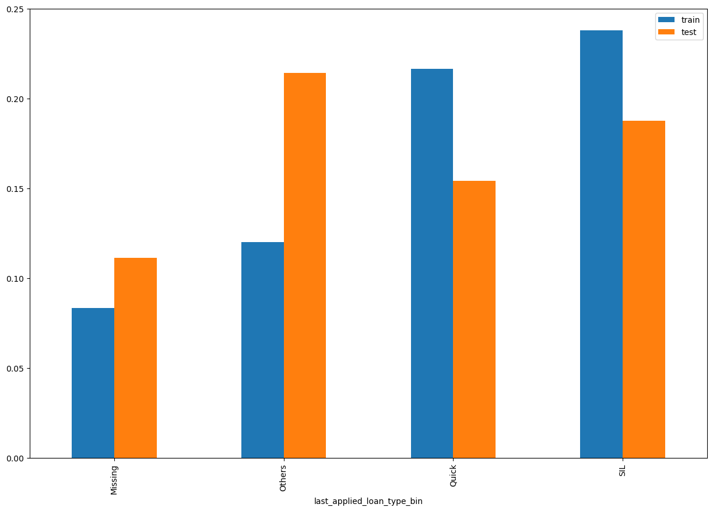
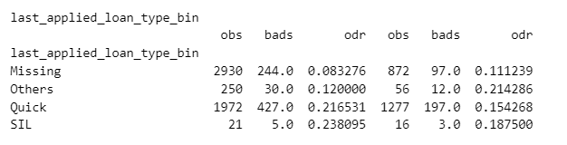
last_applied_loan_type_bin SHAP Rank: 1

Slide 9
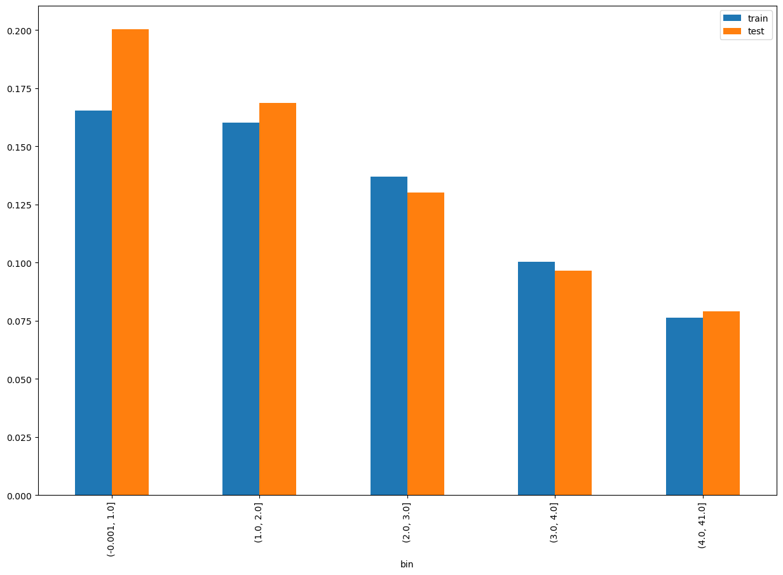
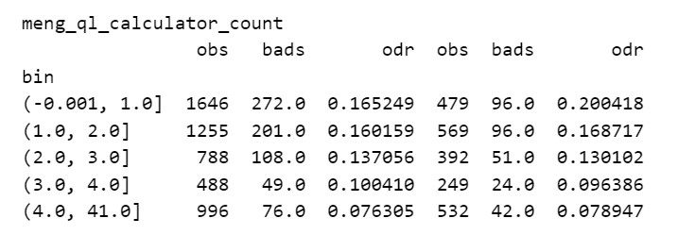
meng_ql_calculator_count SHAP Rank: 2

Slide 10
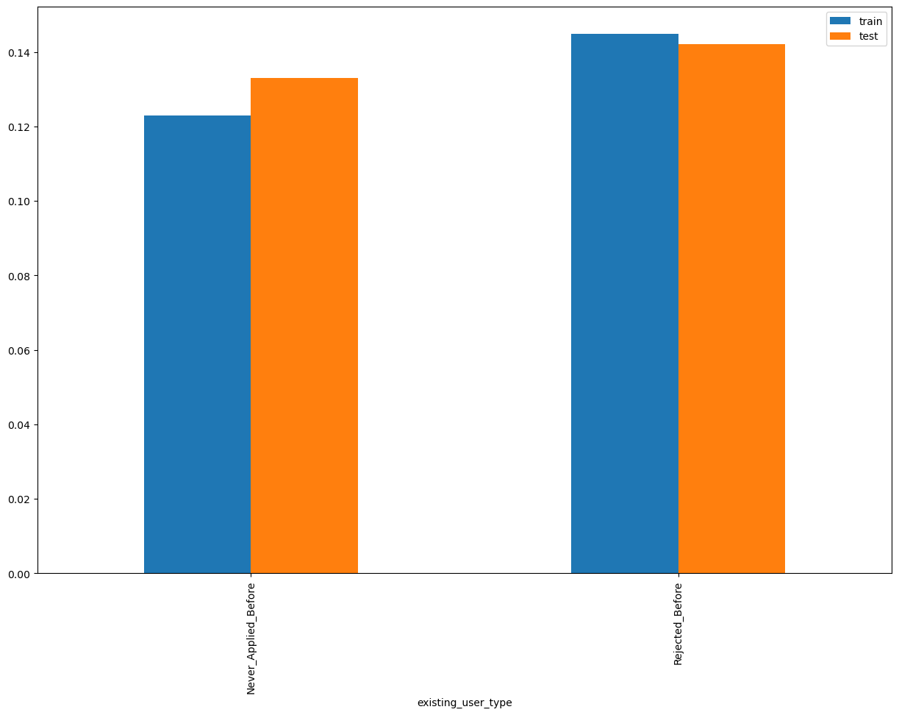
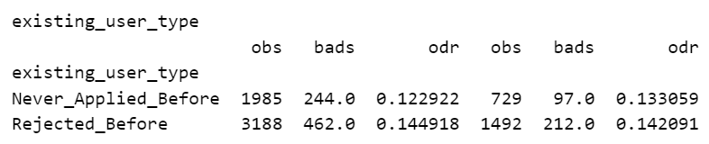
existing_user_type SHAP Rank: 3

Slide 11
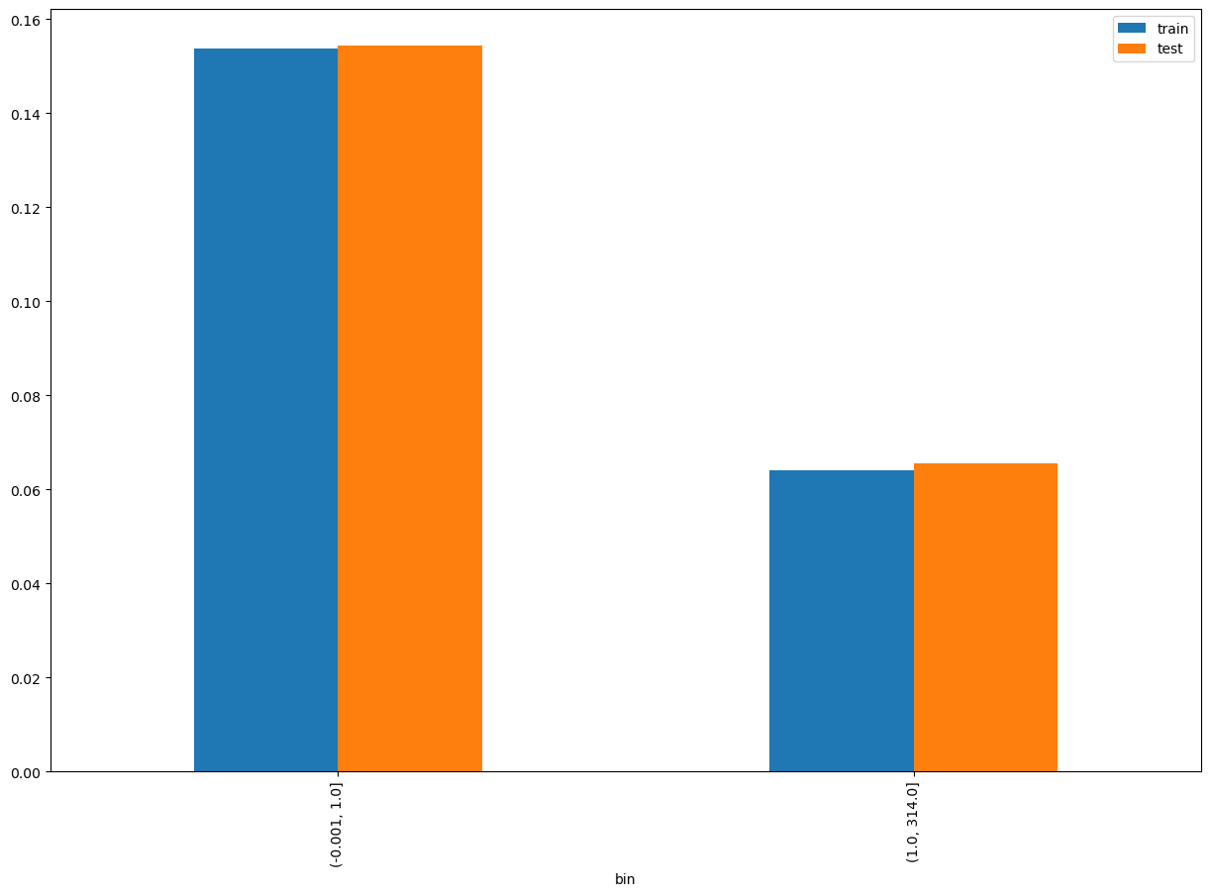
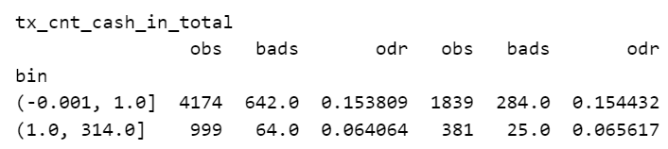
tx_cnt_cash_in_total SHAP Rank: 4

Slide 12
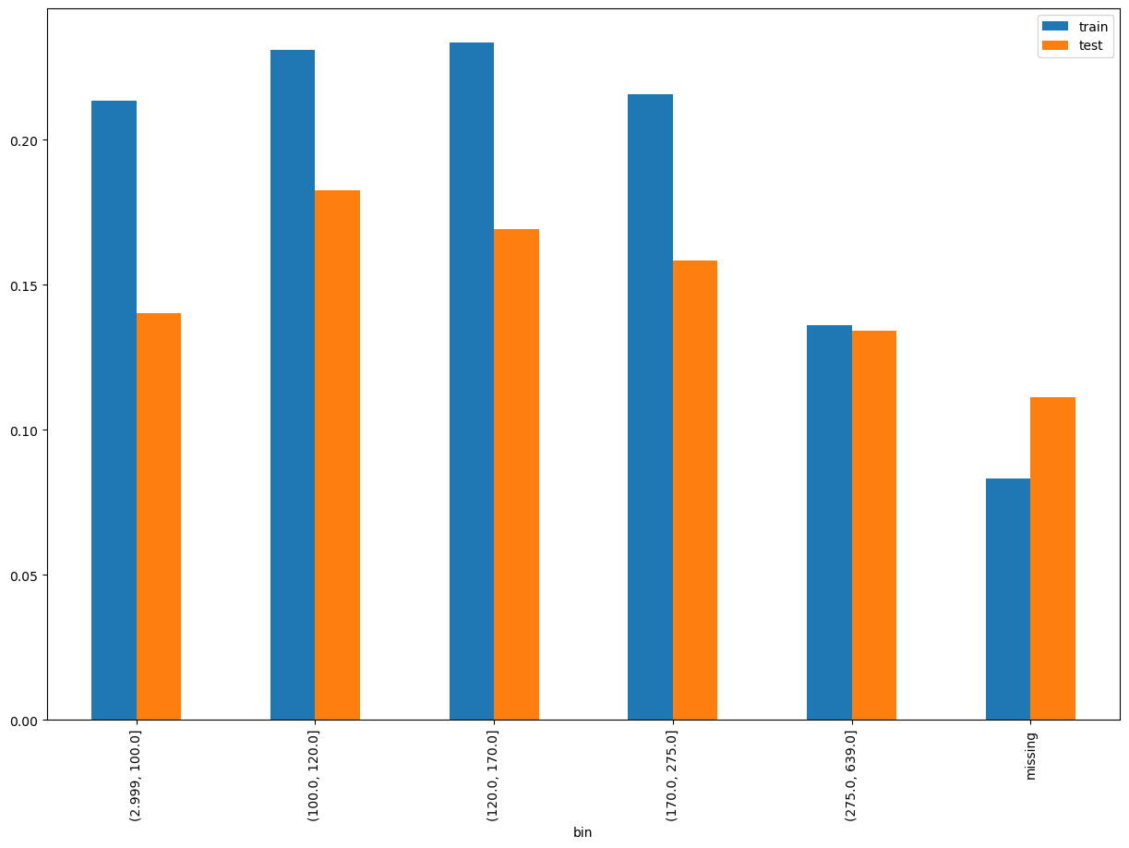
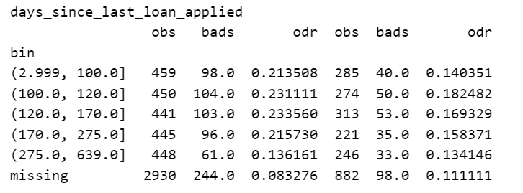
days_since_last_loan_applied (Forcefitted) SHAP Rank: 5

Slide 13
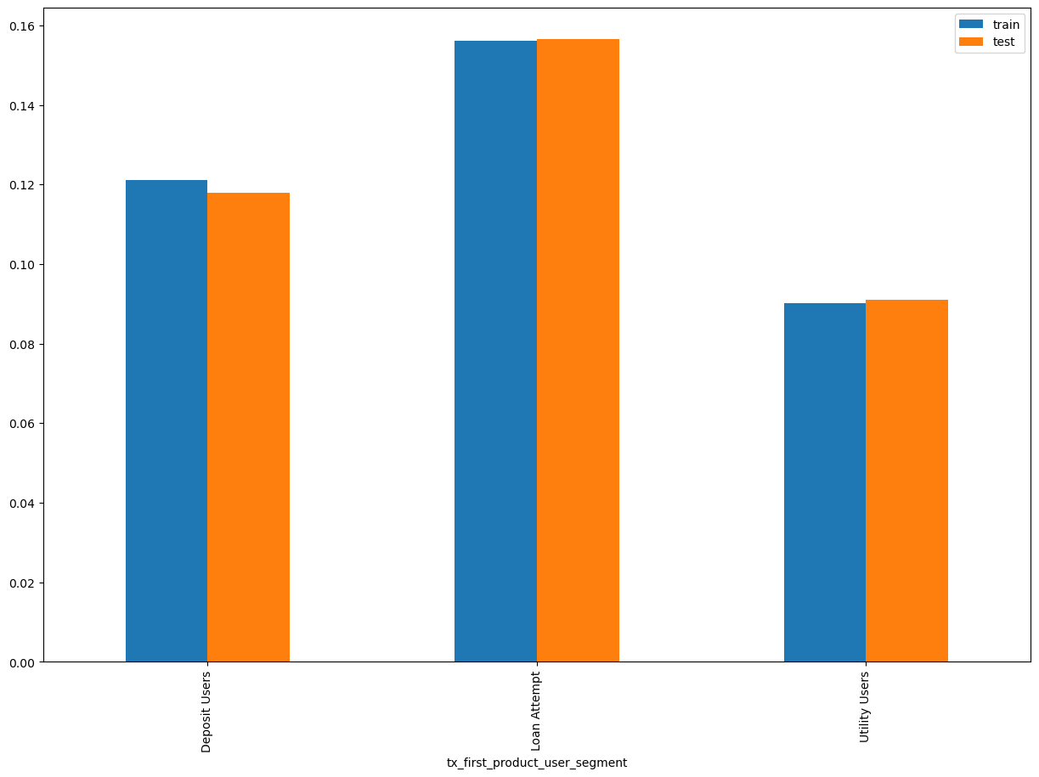
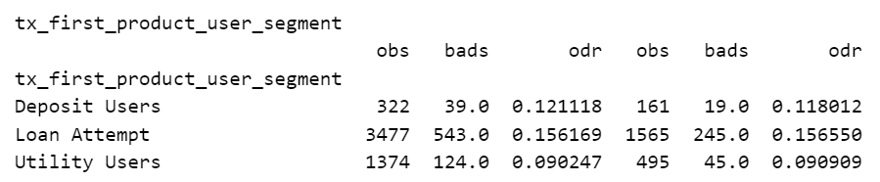
tx_first_product_user_segment SHAP Rank: 6

Slide 14
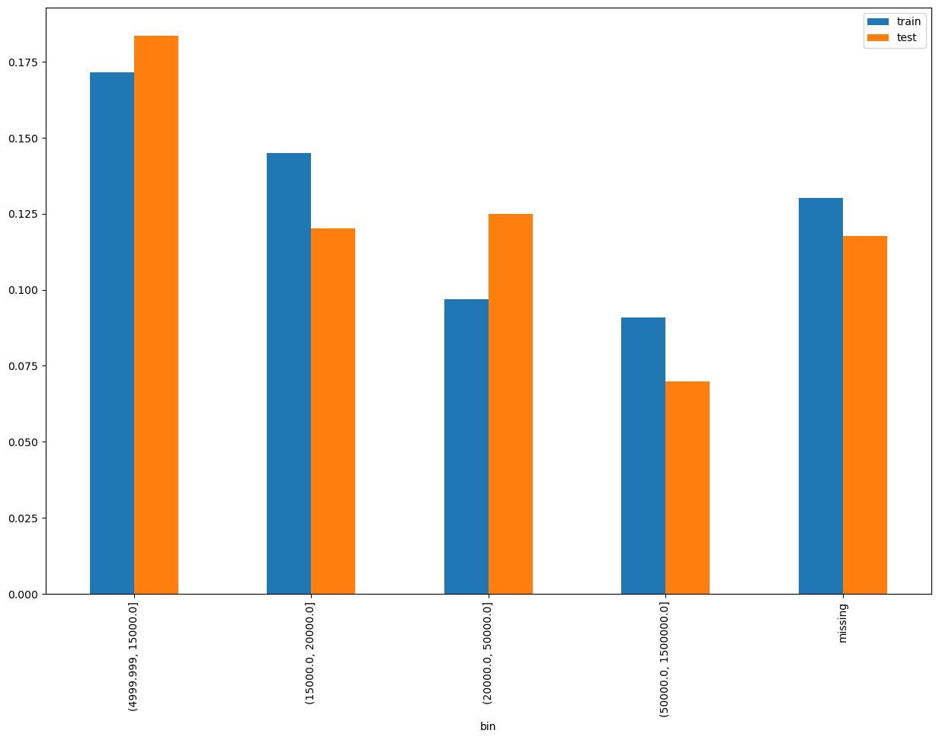
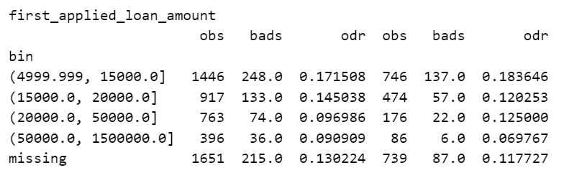
first_applied_loan_amount SHAP Rank: 7

Slide 15
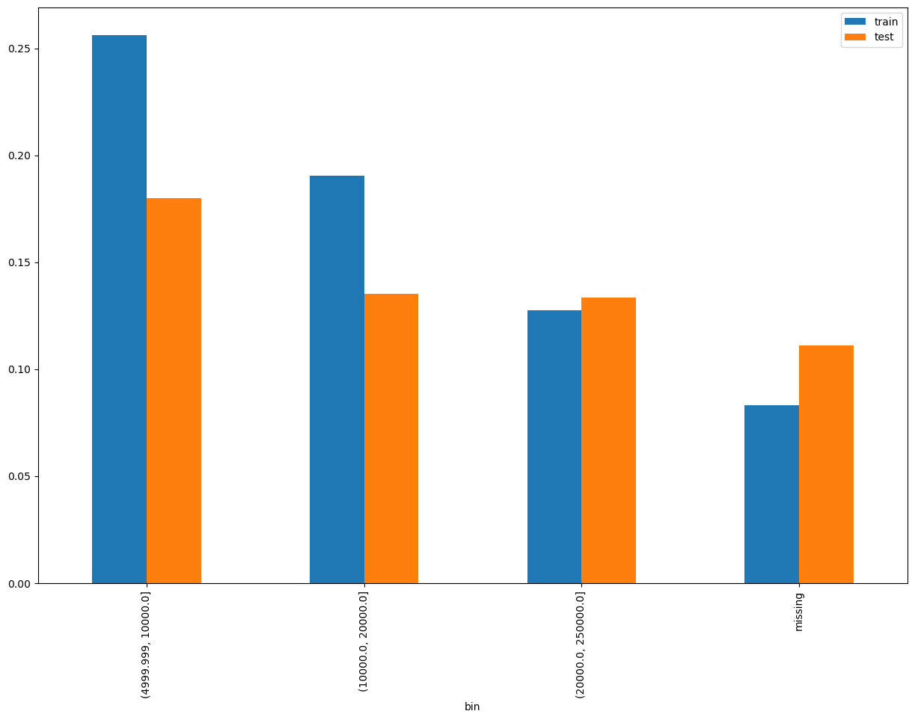
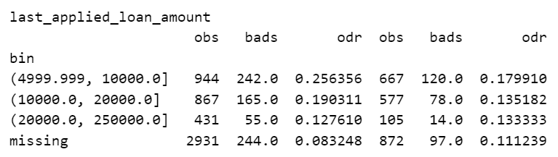
last_applied_loan_amount SHAP Rank: 8

Slide 16
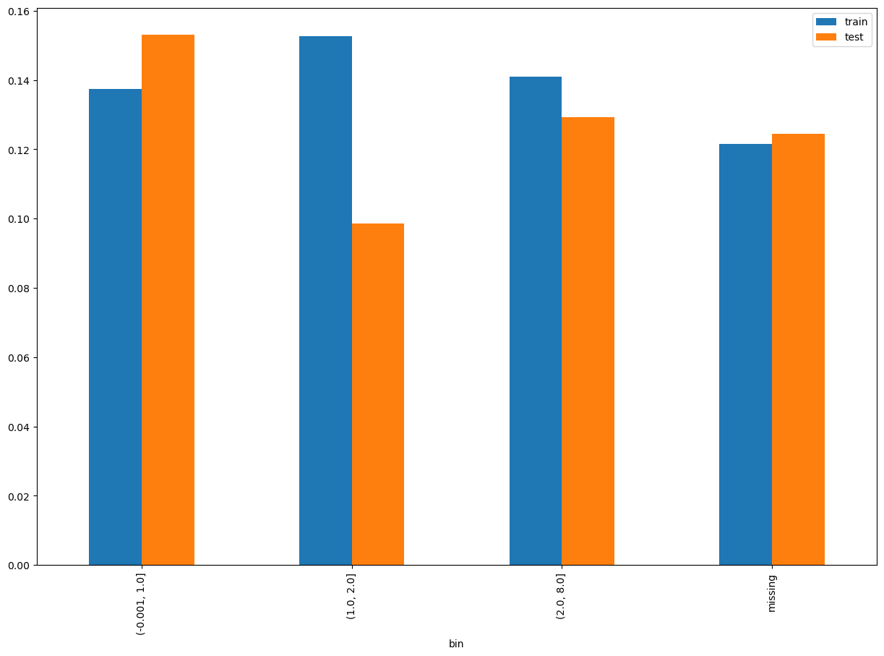
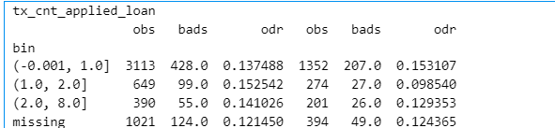
tx_cnt_applied_loan SHAP Rank: 9

Slide 17
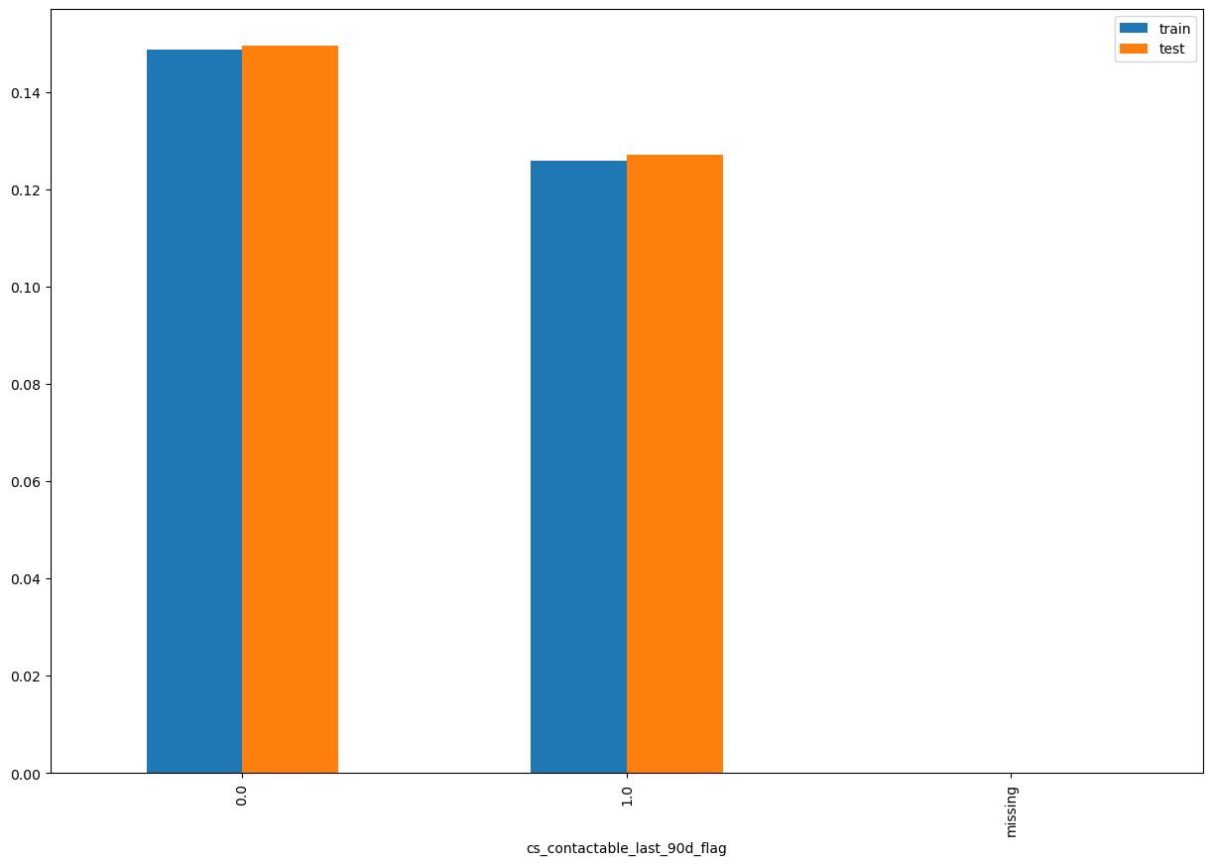
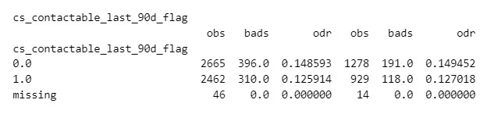
cs_contactable_last_90d_flag SHAP Rank: 10

Slide 18
Camp_group | flag_contactable_last90D | count_contactable_last90D | cnt_records
3.3 B3 | 1 | 1 | 1
5. Reference | 1 | 1 | 17
5. Reference | 1 | 2 | 1
other - NO CAMPAIGN NAME | 0 | 0 | 33669
other - BIG LOANS Campaign | 1 | 1 | 1
other - NO CAMPAIGN NAME | 1 | 9 | 25
other - NO CAMPAIGN NAME | 1 | 6 | 120
other - NO CAMPAIGN NAME | 1 | 12 | 7
other - NO CAMPAIGN NAME | 1 | 8 | 40
other - NO CAMPAIGN NAME | 1 | 14 | 5
other - NO CAMPAIGN NAME | 1 | 21 | 1
other - NO CAMPAIGN NAME | 1 | 5 | 204
other - NO CAMPAIGN NAME | 1 | 11 | 10
other - NO CAMPAIGN NAME | 1 | 7 | 58
other - NO CAMPAIGN NAME | 1 | 32 | 1
other - NO CAMPAIGN NAME | 1 | 10 | 19
other - NO CAMPAIGN NAME | 1 | 29 | 1
other - NO CAMPAIGN NAME | 1 | 15 | 7
other - NO CAMPAIGN NAME | 1 | 13 | 3
other - NO CAMPAIGN NAME | 1 | 24 | 1
other - NO CAMPAIGN NAME | 1 | 26 | 1
other - NO CAMPAIGN NAME | 1 | 19 | 2
other - NO CAMPAIGN NAME | 1 | 17 | 2
other - NO CAMPAIGN NAME | 1 | 28 | 2
other - NO CAMPAIGN NAME | 1 | 16 | 1
other - NO CAMPAIGN NAME | 1 | 1 | 10207
other - NO CAMPAIGN NAME | 1 | 2 | 2263
other - NO CAMPAIGN NAME | 1 | 3 | 819
other - NO CAMPAIGN NAME | 1 | 4 | 360
other - OB DST | 1 | 1 | 1
other - OB RTCC April 29 | 1 | 1 | 227
other - OB RTCC April 29 | 1 | 2 | 22
other - OB RTCC April 29 | 1 | 3 | 2
other - OB RTCC April 29 | 1 | 4 | 1
other - OB RTCC August 13 | 1 | 1 | 50
other - OB RTCC August 13 | 1 | 2 | 4
other - OB RTCC DECEMBER 15 | 1 | 1 | 19
other - OB RTCC NOVEMBER 26 | 1 | 1 | 11
other - OB RTCC NOVEMBER 26 | 1 | 2 | 1
other - OB RTCC OCTOBER 28 | 1 | 1 | 2
other - OB RTCC OCTOBER 30 B3 | 1 | 1 | 1
other - OB Zip Code BTS | 1 | 1 | 1
other - ONBOARDING DROP-OFFS | 1 | 1 | 1
other - RTCC APRIL 3 | 1 | 1 | 4
other - RTCC MAY 5 B1 | 1 | 1 | 1
other - RTCC MAY 6 B1 | 1 | 1 | 2
Outbound call types for this Contactability Feature

Slide 19
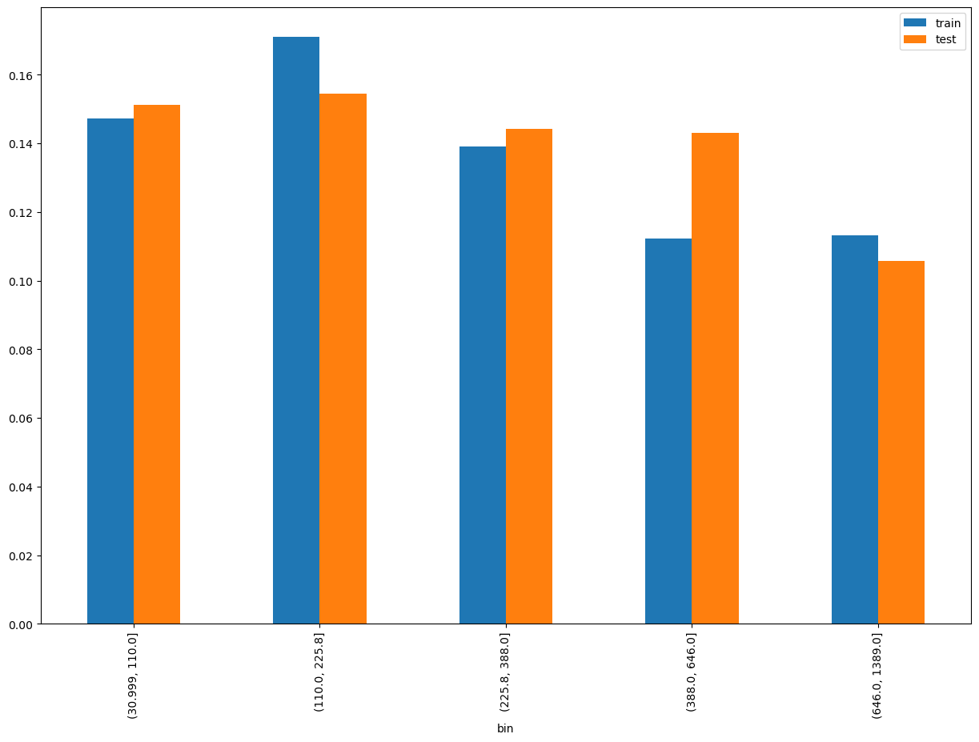
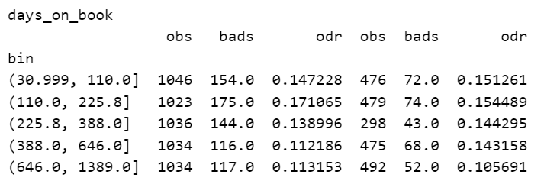
days_on_book SHAP Rank: 11

Slide 20
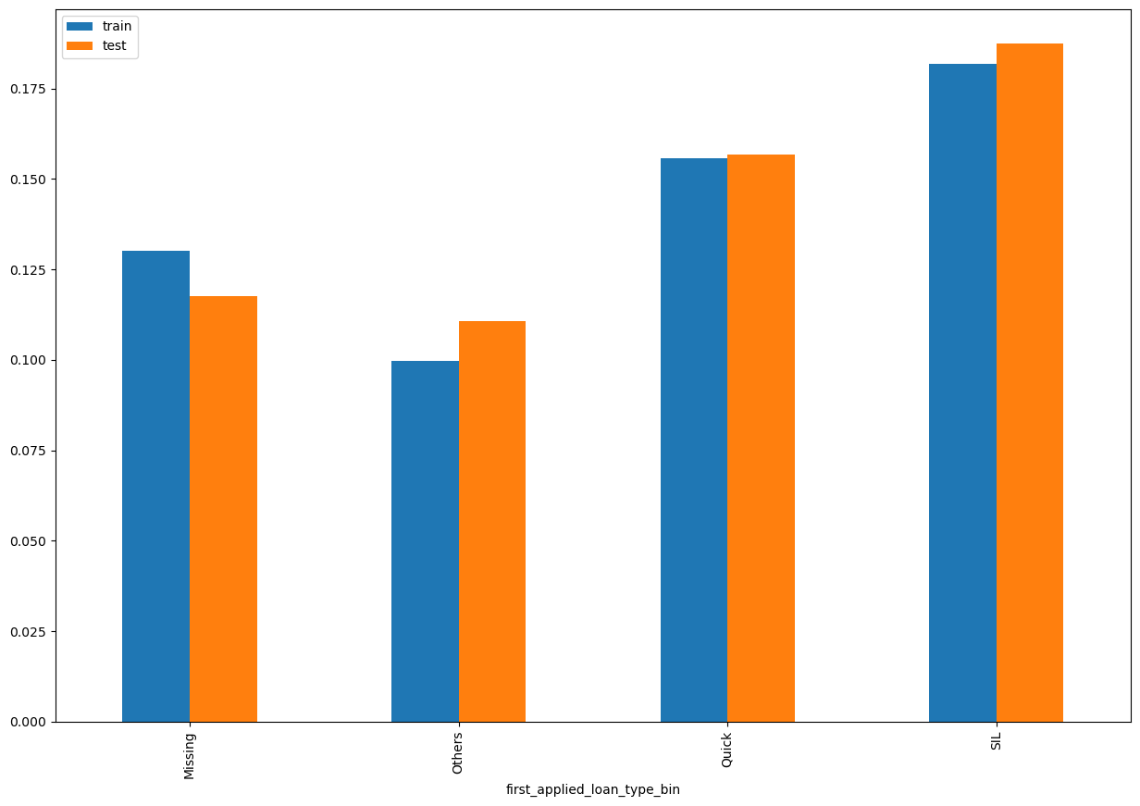
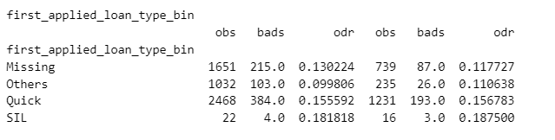
first_applied_loan_type_bin SHAP Rank: 12

Slide 21
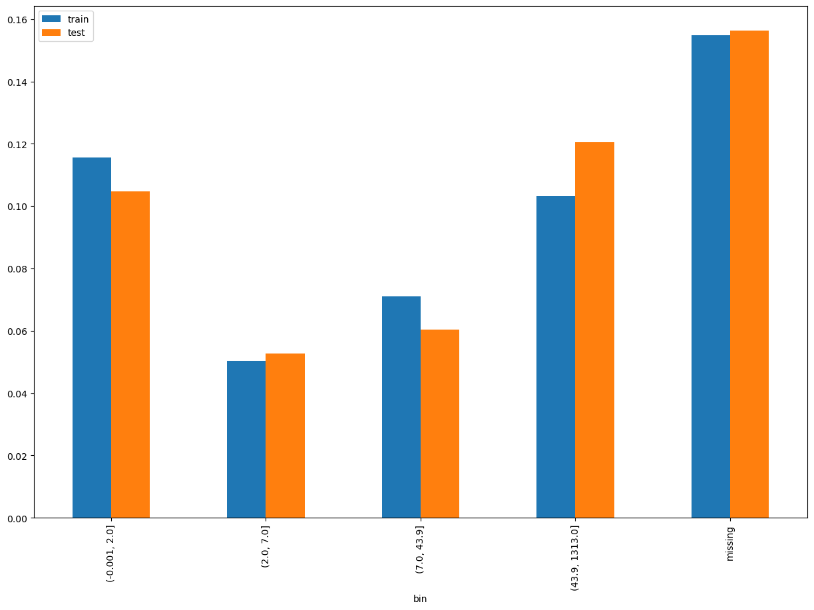
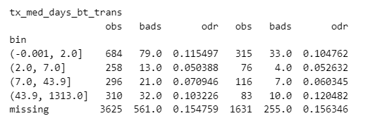
tx_med_days_bt_trans SHAP Rank: 13

Slide 22
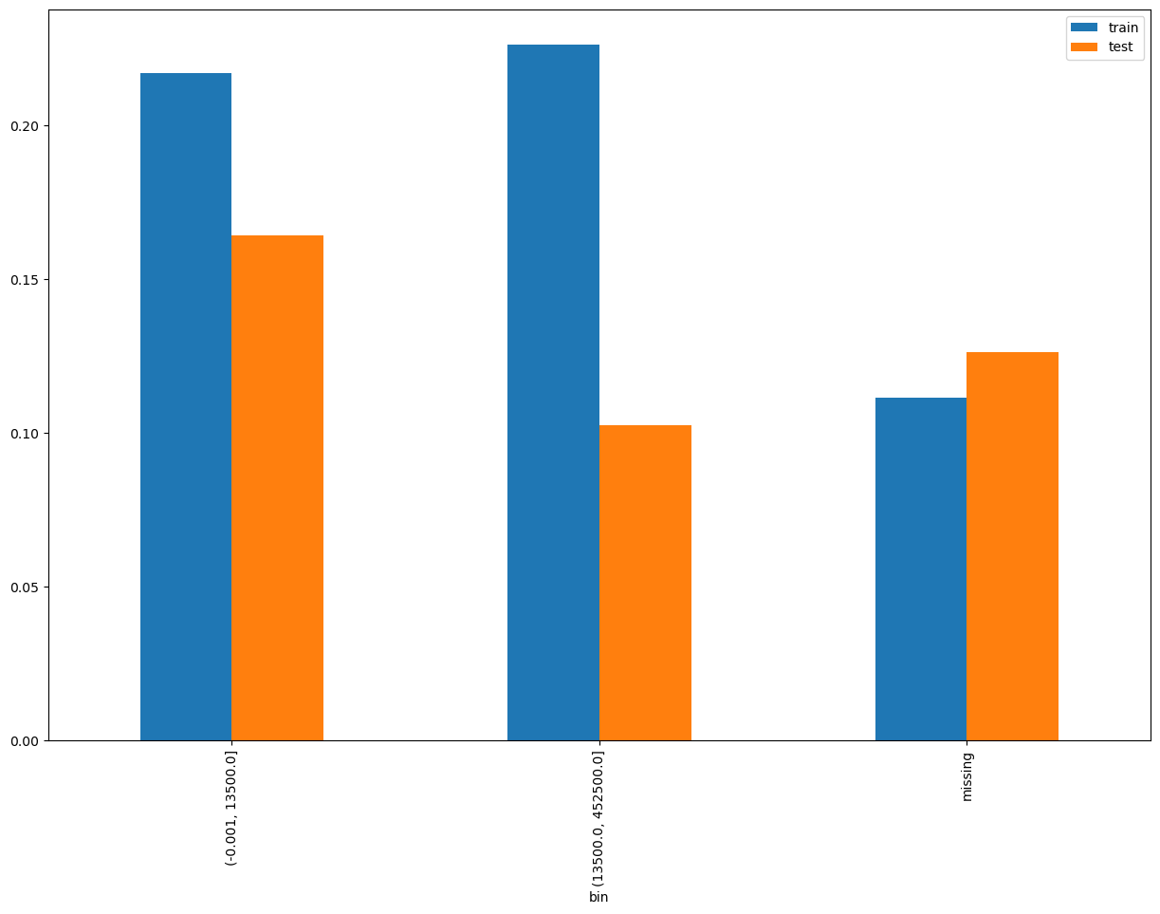
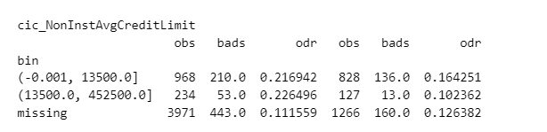
cic_NonInstAvgCreditLimit SHAP Rank: 14

Slide 23
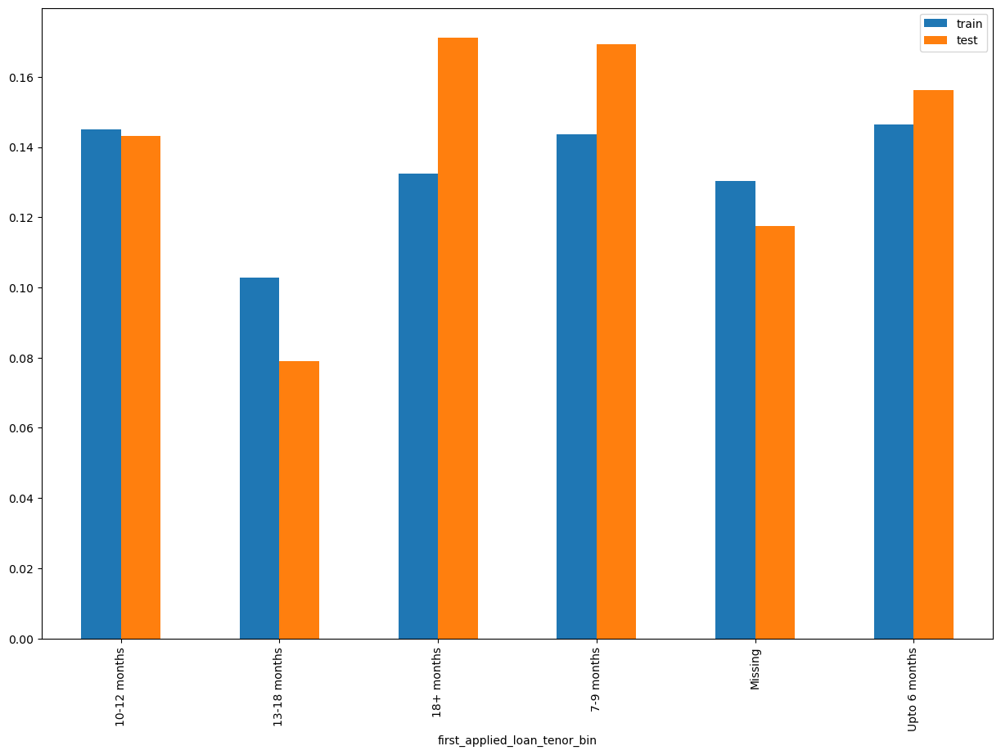
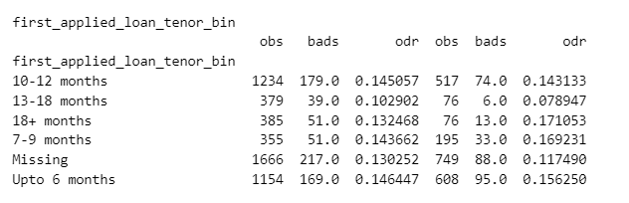
First_applied_loan_tenor_bin SHAP Rank: 15

Slide 24

THANK YOU!
​
Questions?
tonikbank.com

