Slide 1

Trench 2 Transaction Score
Presented by:
Data Science (Prakatheesh)
25th July 2025

Slide 2
Architecture Overview of TDB’s Risk Scorecards
For Cash Loan only
For both Cash and SIL
Limit Setting Model (Hosted in Digital Layer)
Credit Decisioning Model (Hosted in Taran)
Beta Stack
Alpha Stack
Trench 1: New Users - within 30 days from TSA Onboarding
Limit Setting Score = Gamma Stack
Beta Demo Score
Beta Demo Score
Gamma Demo Score
Apps Score
Apps Score
Selectively call Alpha
Apps Score
Credo Score
Users automatically move from Trench 1 to Trench 2 after 30 days if no disbursed loans
Credo Score
CIC Score
Gamma Income Model
Beta Income Model
Alpha Income Model
Users will stay in Trench 2 until 1st disbursed loan. His Gamma Stack will be re-calculated every 30-day anniversary from TSA onboarding date
Limit Setting Score = Gamma Stack
Beta Stack
Alpha Stack
Gamma Demo Score
Beta Demo Score
Beta Demo Score
Trench 2: Existing Users - After 30 days from TSA Onboarding AND Never Disbursed Loan
Apps Score
Apps Score
Selectively call Alpha
Apps Score
Transaction Score
Transaction Score
Transaction Score
CIC Score
Gamma Income Model
Beta Income Model
Alpha Income Model
Users will move to Trench 3 after 1st Disbursed Loan
Lowest Risk users from this B Score will be pre-approved for upsell and xsell. Medium Risk users from this B Score will have to go through Taran.
High Risk users from this B Score will not be given any offer.
B Score = Gamma Stack
Trench 3: Existing Users - After 30 days from 1st Disbursed Loan AND current DPD <= 10
Beta Stack
Alpha Stack
Gamma Demo Score
Apps Score
Beta Demo Score
Beta Demo Score
Apps Score
Apps Score
Enhanced Transaction Score
Selectively call Alpha
Enhanced Transaction Score
Once moved to Trench 3, user will forever remain in Trench 3. His Gamma Stack will be re-calculated every 30 days anniversary from 1st Loan Disbursement Date
Enhanced Transaction Score
CIC Score
Gamma Income Model
Beta Income Model
Alpha Income Model

Slide 3
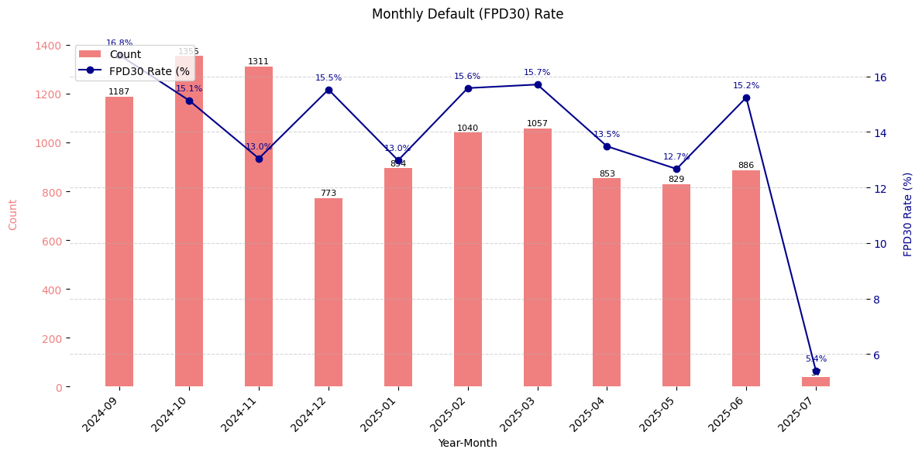
Transaction Score Card
 | Loan Disbursement Date | # Count | # Bad (FPD30) Cash Loans | FPD30 rate
Training (90%) | 01/09/2024 - 28/02/2025 | 6560 | 973 | 14.8%
Validation (10%) | 01/09/2024 - 28/02/2025 | 6560 | 973 | 14.8%
Mar (OOT) | 01/03/2025 - 31/03/2025 | 1057 | 161 | 15.7%
Apr (OOT) | 01/04/2025 - 30/04/2025 | 853 | 115 | 13.5%
May (OOT) | 01/05/2025 - 31/05/2025 | 829 | 105 | 12.7%
June (OOT) | 01/06/2025 - 30/06/2025 | 886 | 135 | 15.2%
July(OOT) | 01/07/2025 - 31/07/2025 | 37 | 2 | 5.41%

Slide 4
Feature Selection Methodology Overview
Feature Selection Methodology Overview
117
Feats
60
Feats
53 Feats
27 Feats
11 Feats
IV > 0.01
Missing Rate < 95%
Inter-correlation < 75%
Individual Feature Evaluation

Slide 5
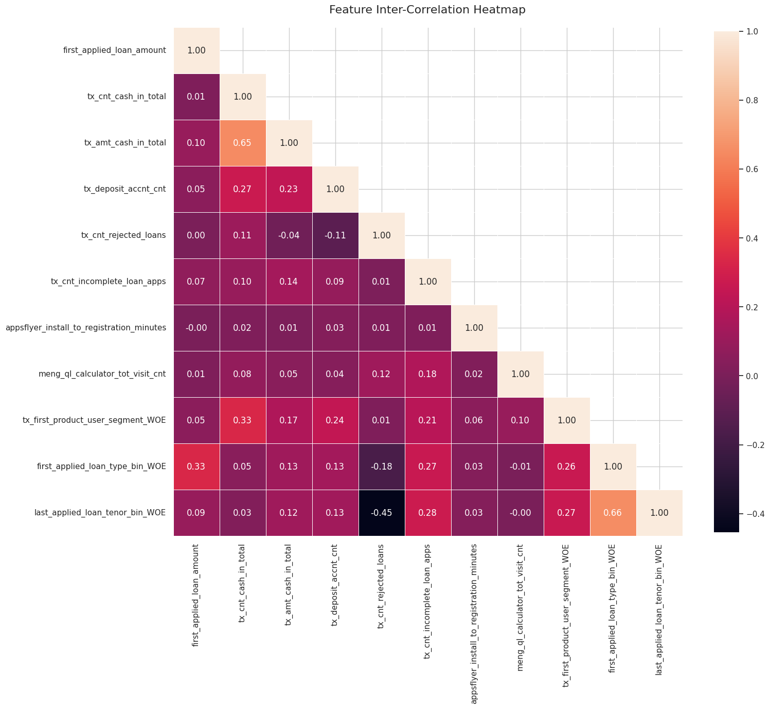
Inter-Correlation (11 feat)

Slide 6
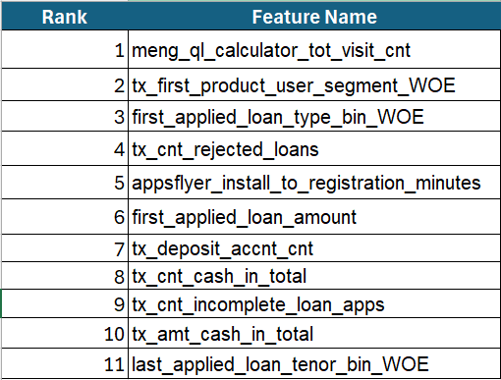
Log Reg Feature Importance Rank

Slide 7
Feature Description
Feature Name | Feature Description
meng_ql_calculator_tot_visit_cnt | Total number of Loan Calculator Visit till date. Data collected from MoEngage
tx_first_product_user_segment_woe | The feature tx_first_product_user_segment likely indicates the segment or category of the first product
first_applied_loan_type_bin | Users First applied loan type with bin segment
tx_cnt_rejected_loans | Number of loan rejected for the customer with the observation date
appsflyer_install_to_registration_minutes | captures the gap between installed time and onboarded (registration completion) time
first_applied_loan_amount | User's First Applied Loan amount
tx_deposit_accnt_cnt | tx_deposit_accnt_cnt likely represents the number of unique deposit accounts
tx_cnt_cash_in_total | Total count of cash in Transaction
tx_cnt_incomplete_loan_apps | tx_cnt_incomplete_loan_apps represents the count of loan applications a customer started but didn’t complete
tx_amt_cash_in_total | Total amount of cash in Transactions
last_applied_loan_tenor_bin | Last Applied loan tenor bin segment

Slide 8
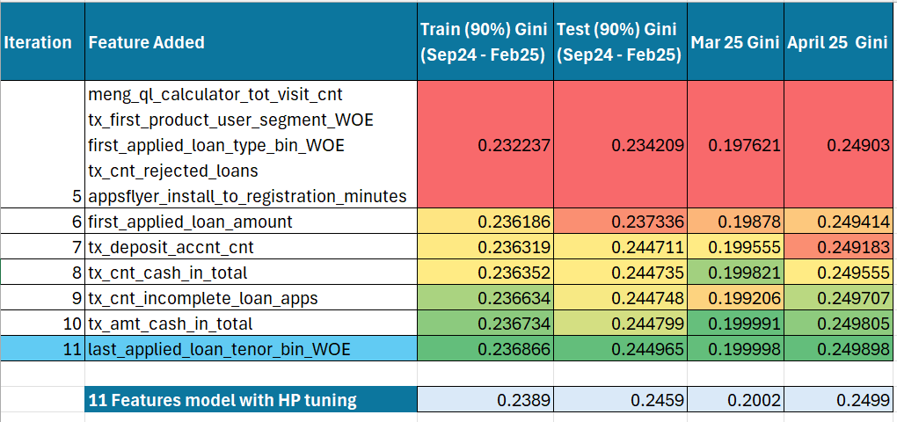

Slide 9
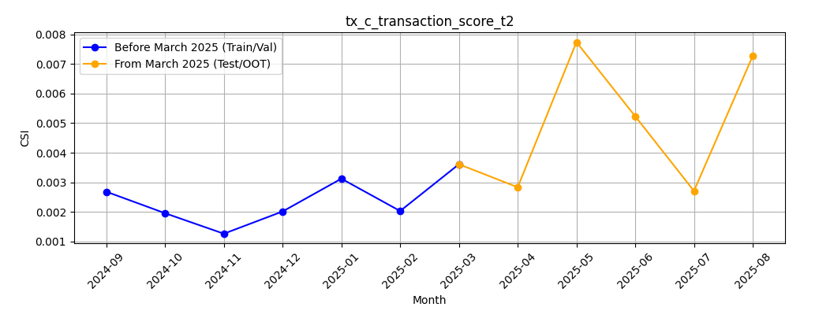
M-O-M Model PSI values (Baseline Training period) - overall Applied
9

Slide 10
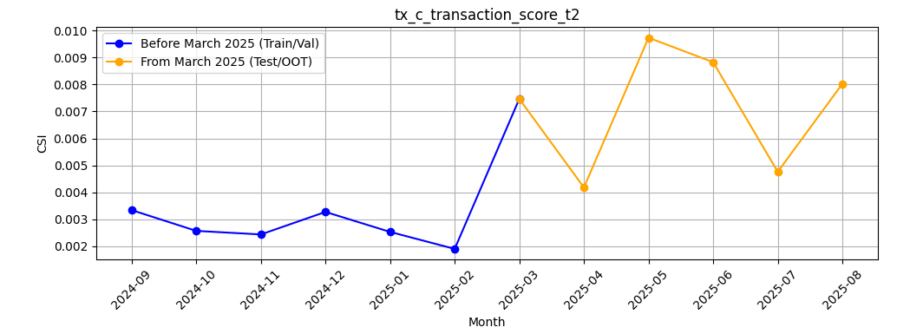
M-O-M Model PSI values (Baseline Training period) - Android Applied
10

Slide 11
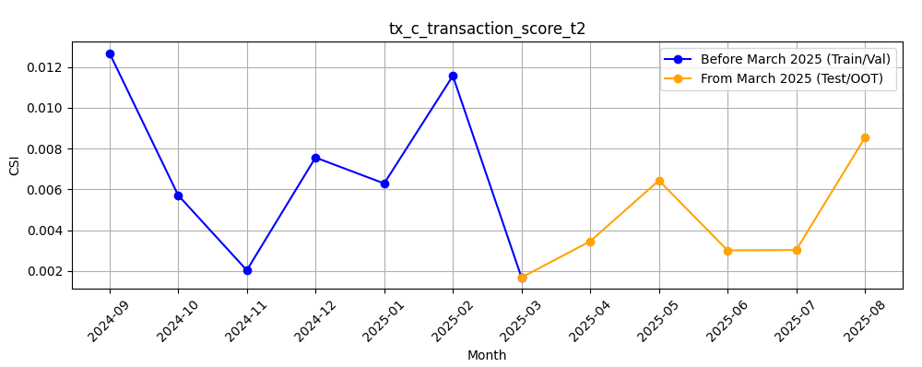
M-O-M Model PSI values (Baseline Training period) - iOS Applied
11

Slide 12
Feature Evaluation Plots (11 features)

Slide 13
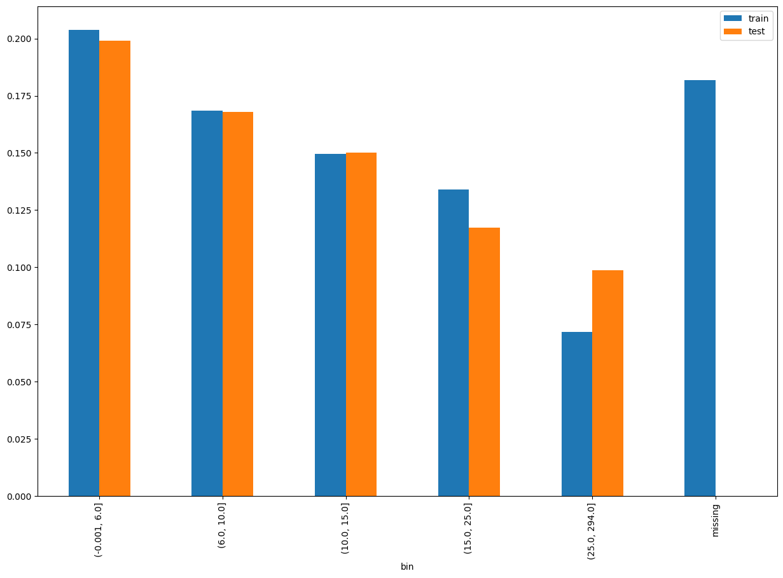
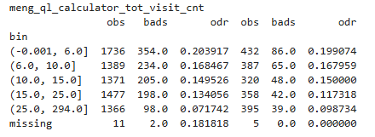
Rank# 1: meng_ql_calculator_tot_visit_cnt Performance in Train vs Test <Disbursed>
The feature meng_ql_calculator_tot_visit_cnt likely represents the total number of visits a user made to the Loan calculator

Slide 14
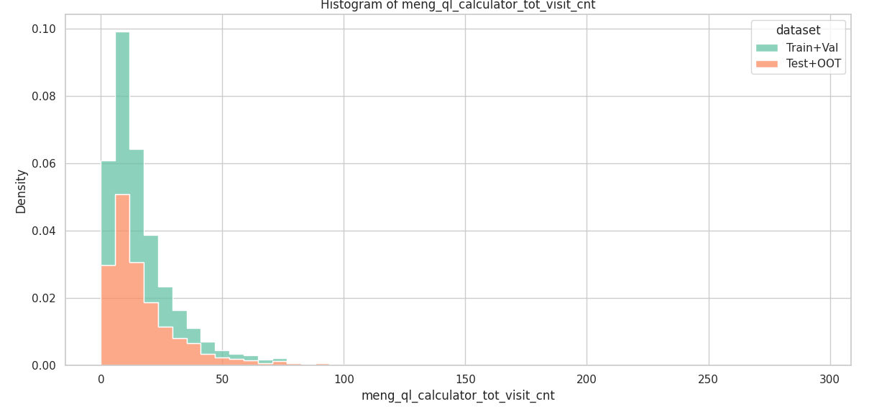
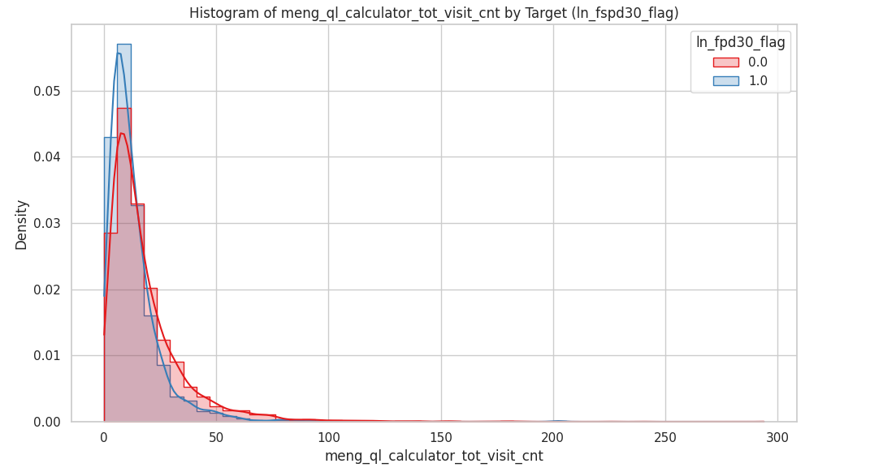
Rank# 1: meng_ql_calculator_tot_visit_cnt Histogram <Disbursed>
Both bad (blue) and good (red) customers are mostly concentrated at the lower end of the ql_calculater range. Bad customers show a slightly sharper peak at the lowest values. Good customers tend to have slightly more distributed exposure across a broader range.
Both Train+Val (green) and Test+OOT (orange) are heavily right-skewed, with the majority of ql calculator clustered near zero. There's good alignment between the datasets, with Test+OOT showing a slightly broader spread in the mid-range.

Slide 15
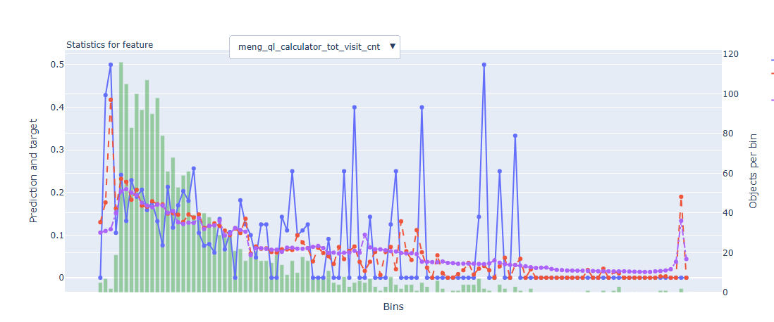
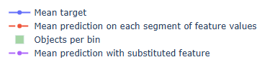
Rank# 1: meng_ql_calculator_tot_visit_cnt - Feature Statistics Analysis <Disbursed>​
​ ​
The red line closely tracks the blue line across all bins, showing consistency in predicted probabilities.
There's a distinct gap between the red and purple lines, especially in the middle bins.
This indicates strong predictive power and good feature separation.

Slide 16
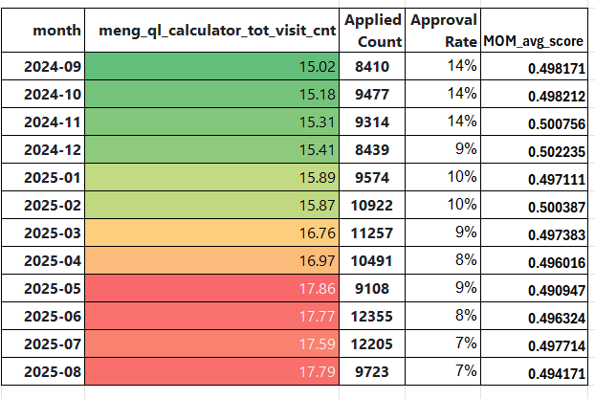
Rank# 1: meng_ql_calculator_tot_visit_cnt - MoM Feature Distribution <Applied>
The mean increases gradually from 14.27 to 16.42, showing a steady improvement in visit behavior.
No erratic jumps are observed in the Training and OOT
The feature demonstrates strong distributional stability, ideal for modeling default risk.

Slide 17
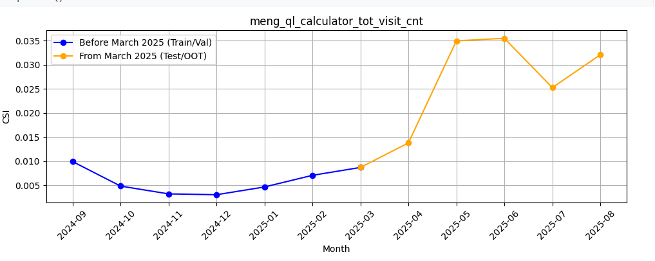
Rank# 1: meng_ql_calculator_tot_visit_cnt - Feature CSI Analysis <Applied> ​
Baseline period: Sep’2024 to Feb’2025.
CSI for meng_ql_calculator_tot_visit_cnt was moderately increasing until 2024-12 but decreasing until feb and again started increasing from march, possibly indicating very small shifting customer behavior. Despite the change, the feature maintains acceptable stability and continues to add predictive value

Slide 18
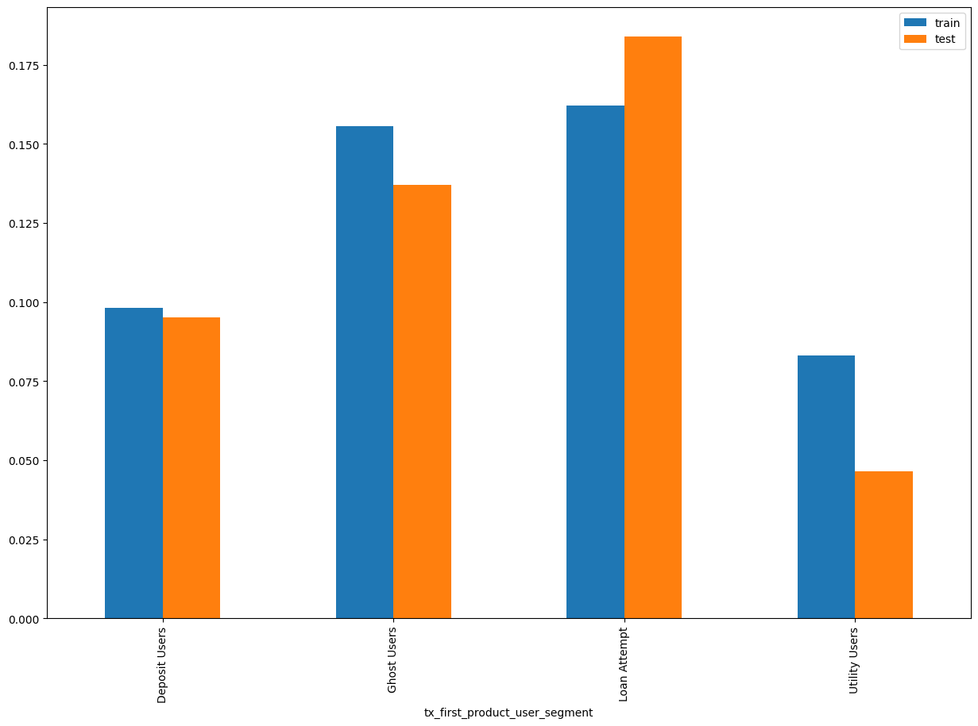
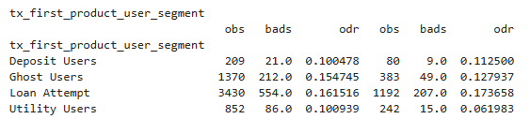
Rank# 2: tx_first_product_user_segment Performance in Train vs Test <Disbursed> The feature tx_first_product_user_segment likely indicates the segment or category of the first product

Slide 19
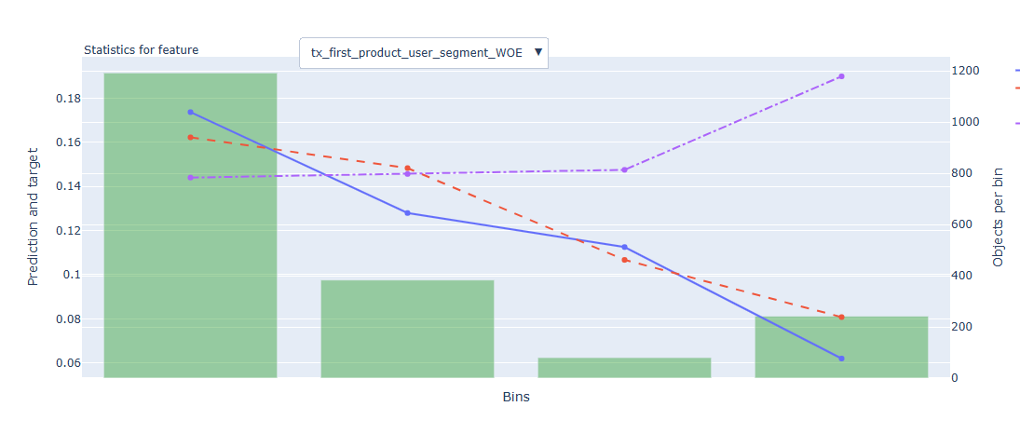
Rank# 2 : tx_first_product_user_segment Feature Statistics Analysis <Disbursed>
The red and blue lines overlap closely, indicating that the model is accurately capturing the relationship between this feature and default behavior.
The gap between the red and purple lines suggests that tx_first_product_user_segment adds predictive value — the model performs better with it included.

Slide 20
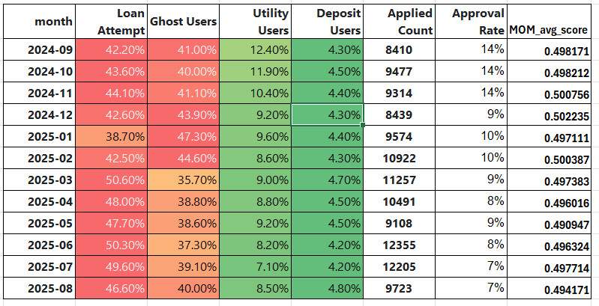
Rank# 2 :tx_first_product_user_segment MoM Feature Distribution <Applied>
Loan Attempt increases from jan and Ghost users decreases
Though there are moderate fluctuations, the trend is smooth and interpretable.
The overall behavior reflects controlled variation, indicating reasonable stability over scores

Slide 21
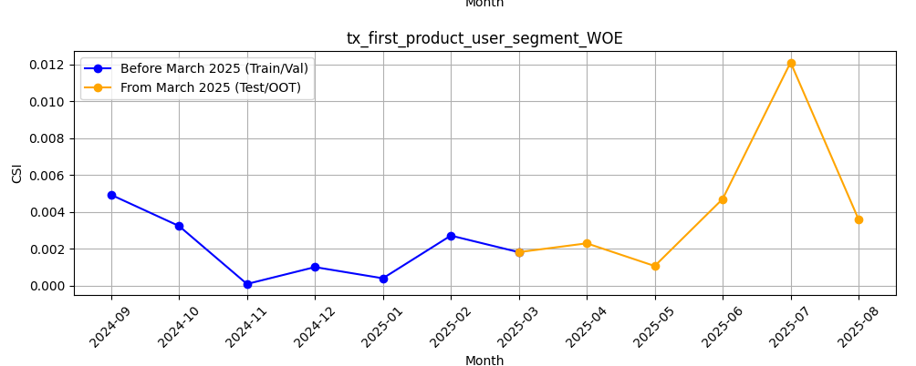
Rank# 2 :tx_first_product_user_segment Feature CSI Analysis <Applied>
Baseline period: Sep’2024 to Feb ’2025.
The CSI trend for tx_first_product_user_segment_WOE remains well below the 0.1 threshold across all months, indicating strong feature stability. Temporary dips and rebounds in April–June 2025 suggest minor fluctuations, but overall the feature is highly stable and reliable over time.

Slide 22
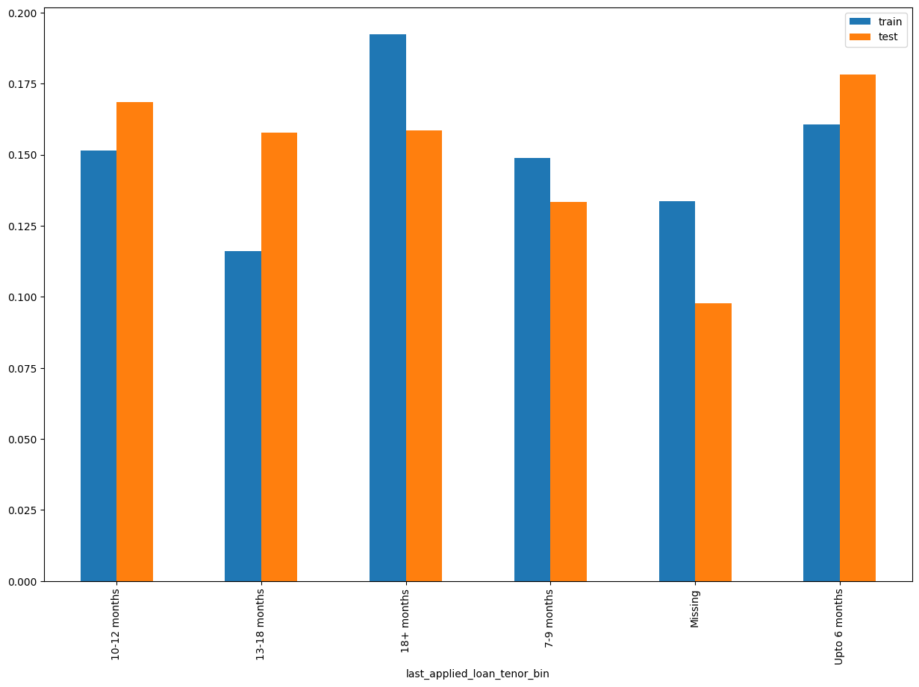
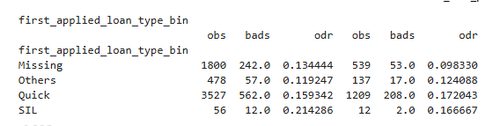
Rank# 3: first_applied_loan_type_bin Performance in Train vs Test <Disbursed> The feature first_applied_loan_type_bin likely represents a binned or grouped category of the first loan type the customer applied

Slide 23
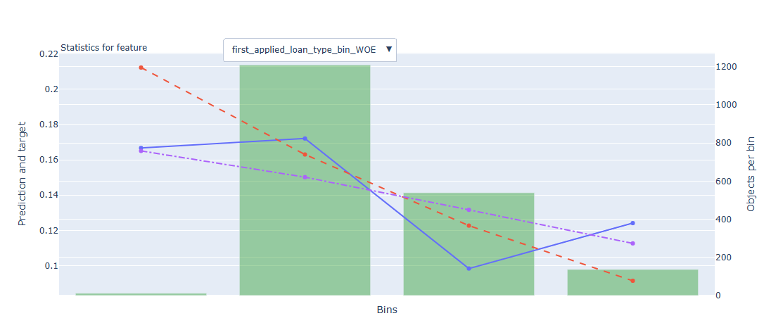
Rank# 3: first_applied_loan_type_bin - Feature Statistics Analysis <Disbursed>
The red line follows the blue line reasonably well, showing the model captures the pattern in this feature.
There is a visible gap between the red and purple lines, which means the feature helps improve prediction accuracy.
The green bars show most of the data is concentrated in the second bins, but there is still some spread across the range.

Slide 24
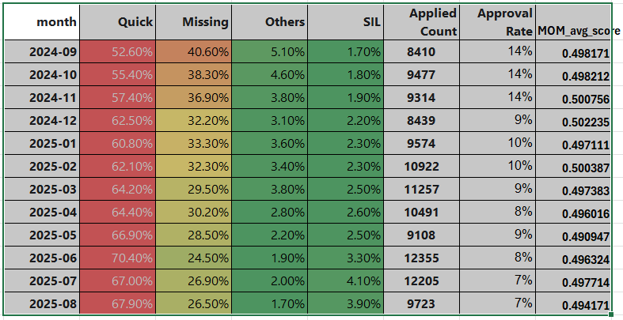
Rank# 3: first_applied_loan_type_bin - MOM Distibution <Applied>
Missing reduced over time which is expected
Over time Quick and sil is increasing which is good sign
The increase is gradual and progressive, without abrupt jumps or drops.
This smooth growth reflects a stable and reliable feature distribution over time.

Slide 25
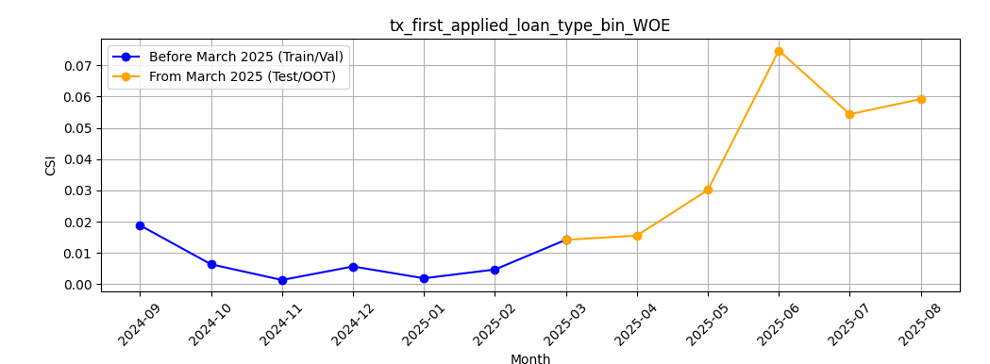
Rank# 3 first_applied_loan_type_bin Feature CSI Analysis <Applied>
Baseline period: Sep’2024 to Feb’2025.
This CSI stability graph for first_applied_loan_type_bin_WOE shows consistent stability (CSI < 0.1) across months, indicating no major population shift. While a slight increase in May–June 2025 is observed, the values remain within acceptable limits, reflecting stable model behavior

Slide 26
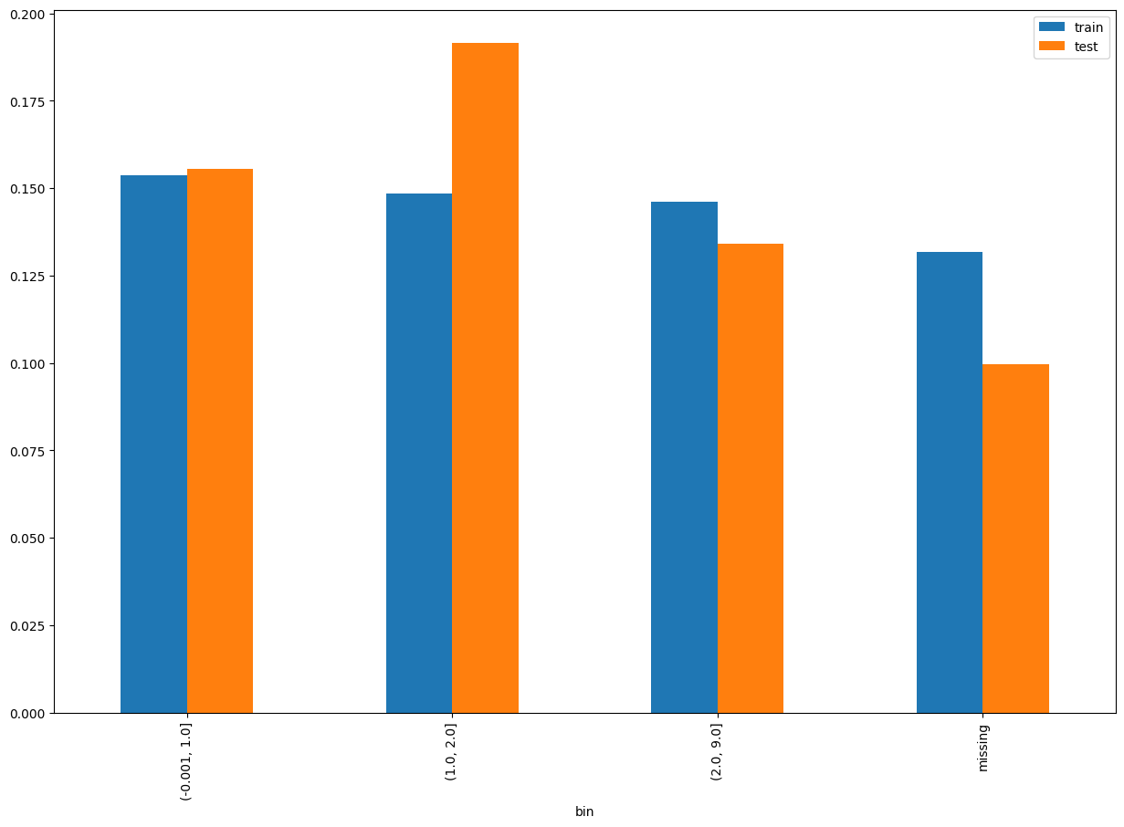
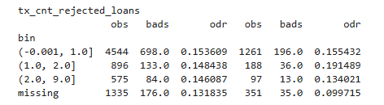
Rank# 4: tx_cnt_rejected_loans Performance in Train vs Test <Disbursed> The feature tx_cnt_rejected_loans represents the number of loan applications made by the customer that were rejected within a given observation window

Slide 27
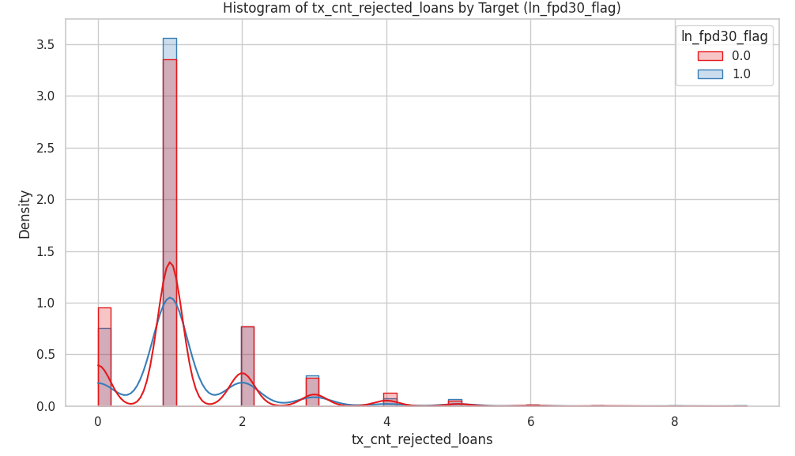
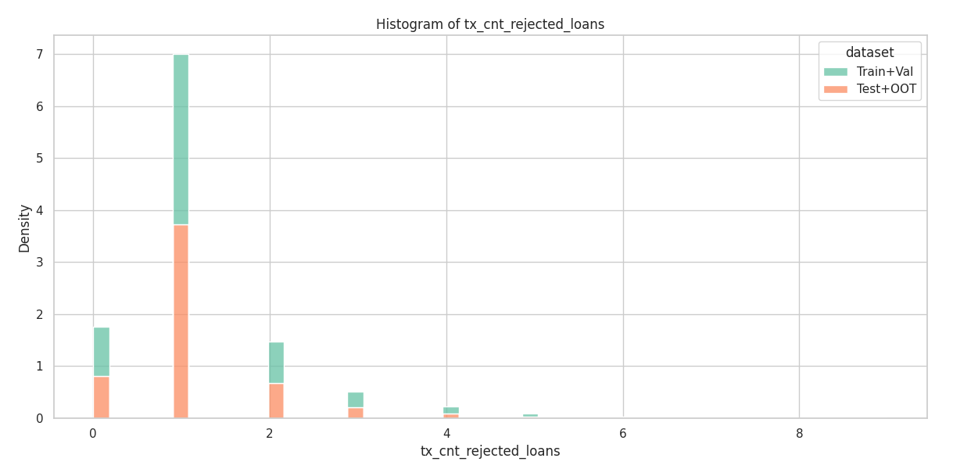
Rank# 4: tx_cnt_rejected_loans Histogram <Disbursed>
The distributions of Train+Val (green) and Test+OOT (orange) are very similar and right-skewed. Most customers have fewer than 2 counts, with a sharp drop-off afterward. Test+OOT has a slightly flatter density, but both sets follow the same general trend, showing good consistency.
Both blue and red lines form the same distibution and after 2 has very less in count but still the flag remains same

Slide 28
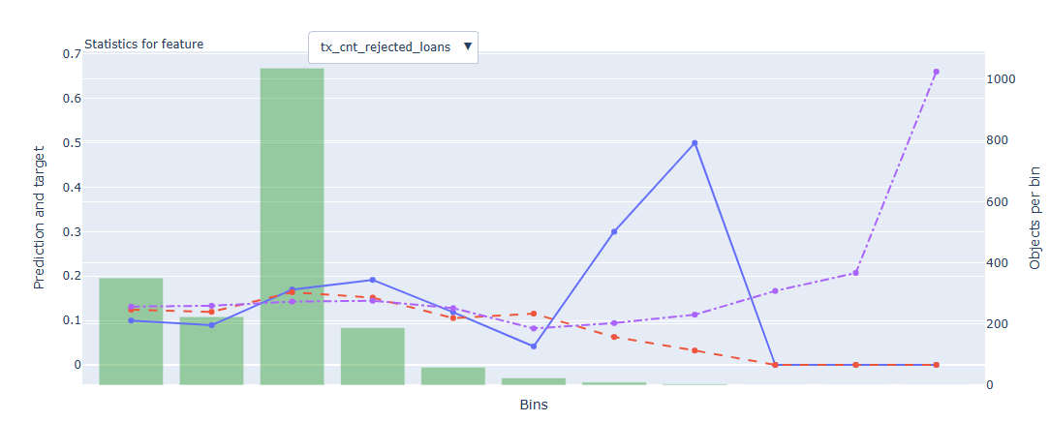
Rank# 4: tx_cnt_rejected_loans Feature Statistics Analysis <Disbursed>
The red line (model prediction) generally aligns with the blue line (actual outcome), suggesting the model understands this feature’s overall trend.
A small separation between the red and purple lines shows this feature contributes to refining predictions.

Slide 29
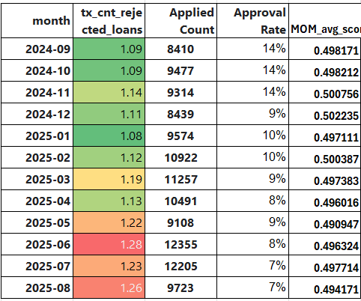
Rank# 4: tx_cnt_rejected_loans MOM Distibution <Applied>
The sift remains stable starting from this year jan to july
The shift is uniform and progressive, with a smooth decline in the 1 category.
The feature shows excellent stability with a clear trend, supporting its robustness for modeling.

Slide 30
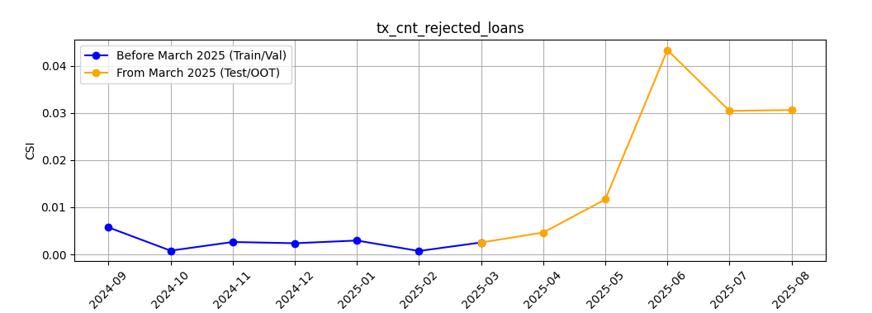
Rank# 4 tx_cnt_rejected_loans Feature CSI Analysis <Applied>
Baseline period: Sep’2024 to Feb ’2025.
The feature tx_cnt_rejected_loans shows stable CSI values below 0.1 throughout all months. A rise in CSI is observed from March 2025 onward, possibly indicating shifting customer behavior. Despite the change, the feature maintains acceptable stability and continues to add predictive value

Slide 31
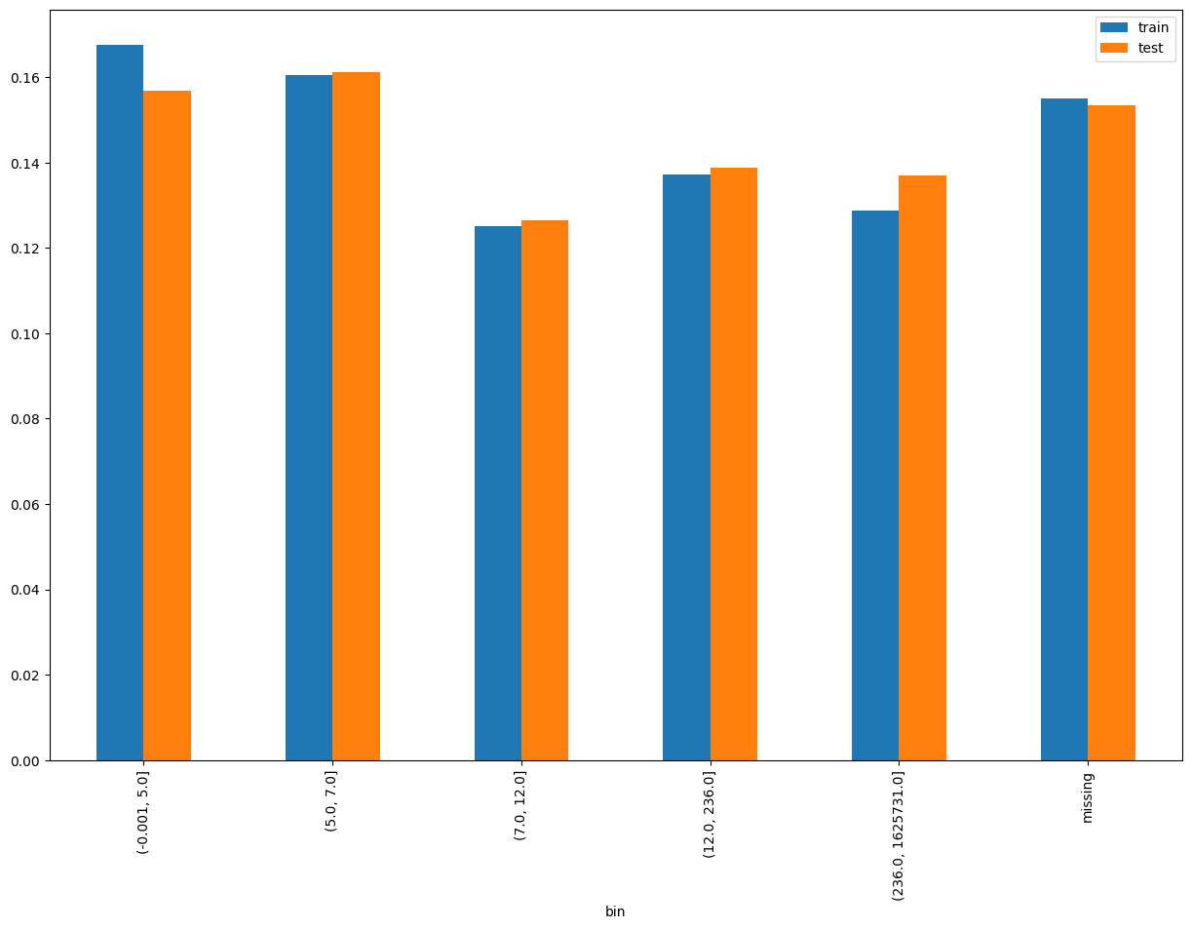
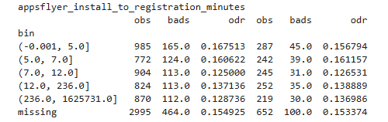
Rank# 5: appsflyer_install_to_registration_minutes Performance in Train vs Test <Disbursed>

Slide 32
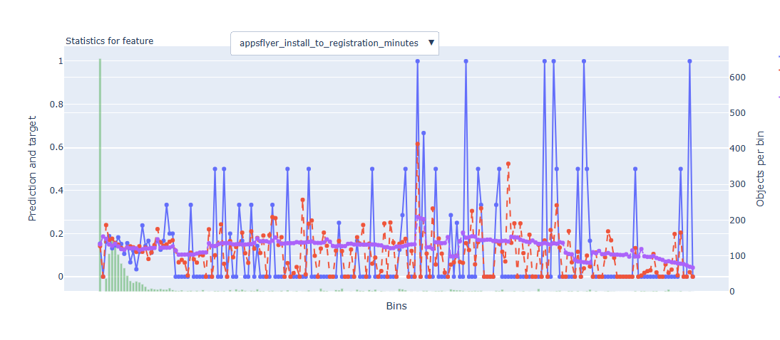
Rank# 5: appsflyer_install_to_registration_minutes Feature Statistics Analysis <Disbursed>
The red line (model prediction) generally aligns with the blue line (actual outcome), suggesting the model understands this feature’s overall trend.
A small separation between the red and purple lines shows this feature contributes to refining predictions.

Slide 33
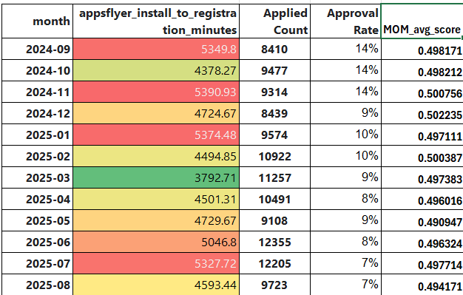
Rank# 5: appsflyer_install_to_registration_minutes MOM Distibution <Applied>
The average appflyer shows a steady upward trend from march to july
The increase is gradual and progressive, without abrupt jumps or drops.
This smooth growth reflects a stable and reliable feature distribution over time.

Slide 34
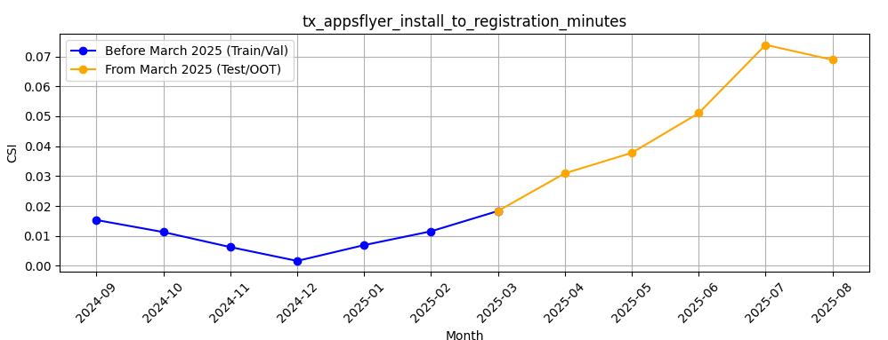
Rank# 5: appsflyer_install_to_registration_minutes Feature CSI Analysis <Applied>
Baseline period: Sep’2024 to Feb ’2025.
The feature appsflyer_install_to_registration_minutes shows strong month-on-month stability before March 2025 with low and consistent CSI values.From March onwards, CSI rises gradually but smoothly, indicating a steady shift rather than sudden volatility. Overall, the feature remains reliable with controlled changes, making it suitable for long-term model use

Slide 35
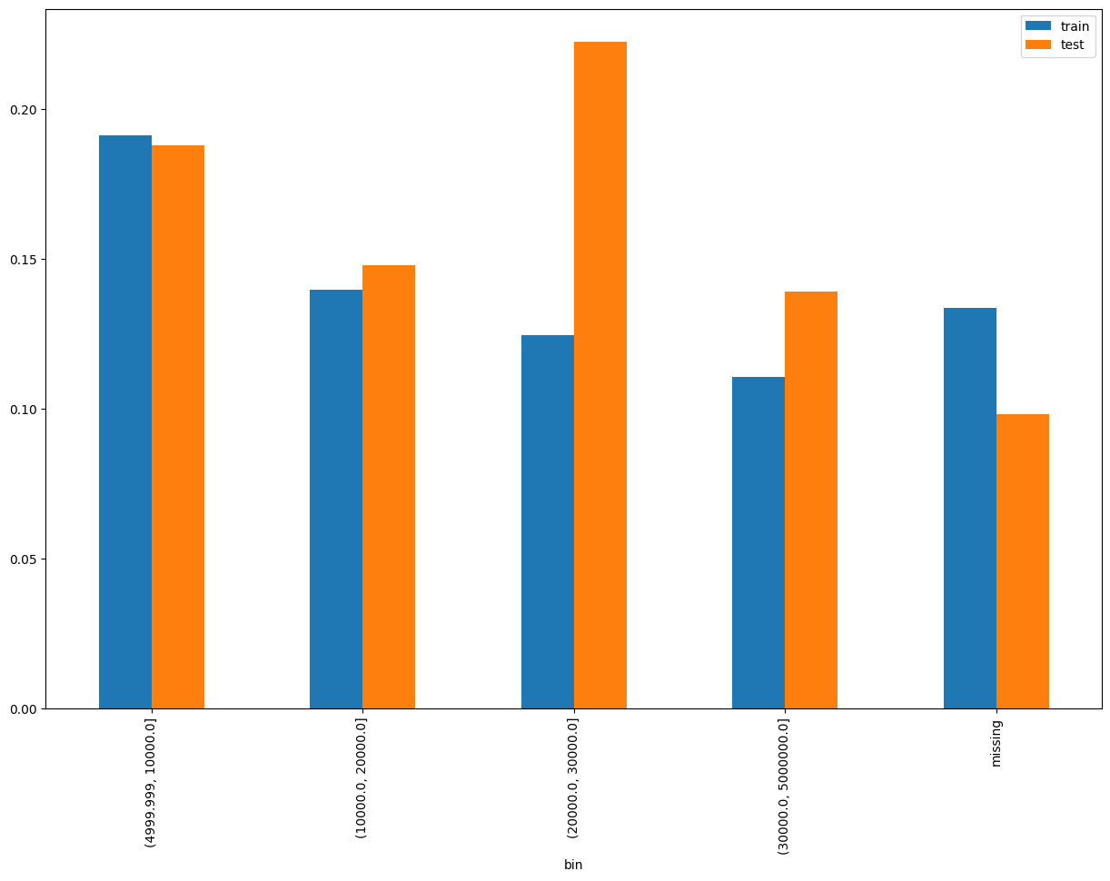
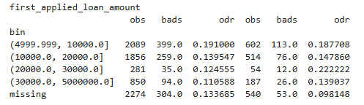
Rank# 6 : first_applied_loan_amount Performance in Train vs Test <Disbursed>

Slide 36
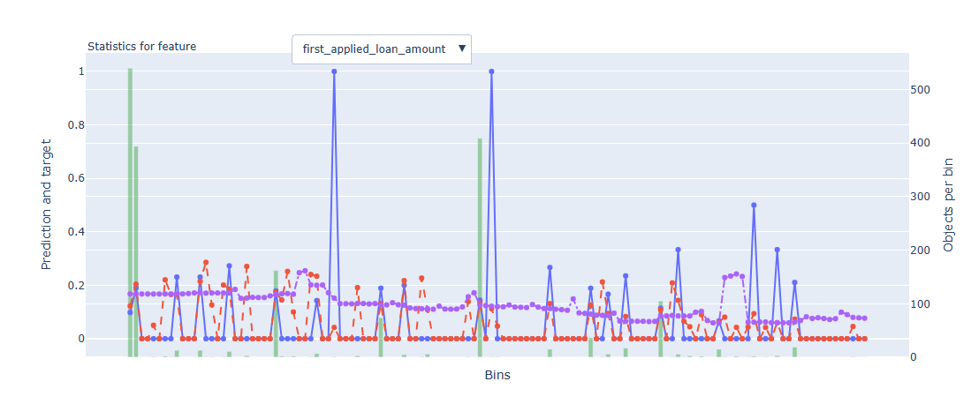
Rank# 6 : first_applied_loan_amount Feature Statistics Analysis <Disbursed>
The red line (model prediction) generally aligns with the blue line (actual outcome), suggesting the model understands this feature’s overall trend.
A small separation between the red and purple lines shows this feature contributes to refining predictions.

Slide 37
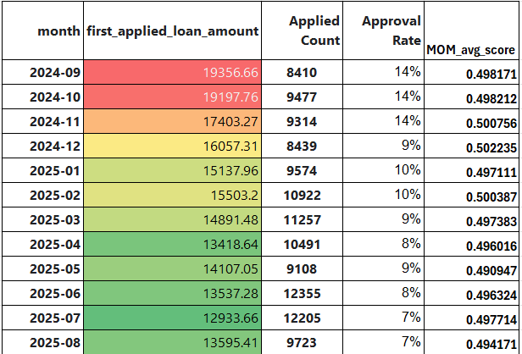
Rank# 6 : first_applied_loan_amount MOM Distibution <Applied>
The mean declines gradually from 187 to 127 showing a steady improvement in loan amount behavior.
No erratic jumps are observed
The feature demonstrates strong distributional stability, ideal for modeling default risk.

Slide 38
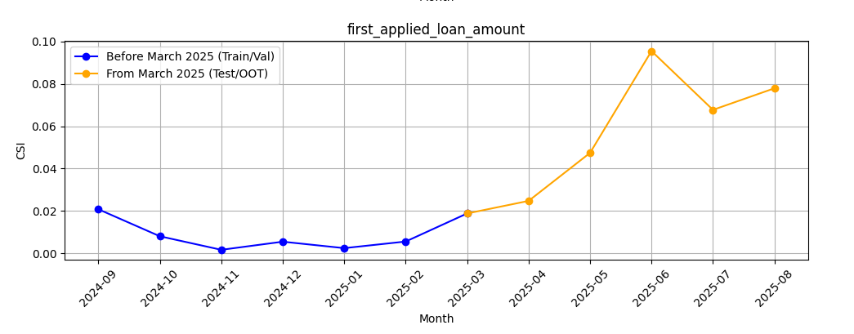
Rank# 6 : first_applied_loan_amount Feature CSI Analysis <Applied> ​
Baseline period: Sep’2024 to Feb ’2025.
The feature shows very stable CSI values with minimal fluctuation before March 2025, indicating strong month-on-month consistency. From March onwards, there's a gradual and then sharper increase in CSI, reflecting a rising contribution to model predictions Despite the uptick, the trend is systematic and controlled, suggesting the feature remains reliable and increasingly informative.

Slide 39
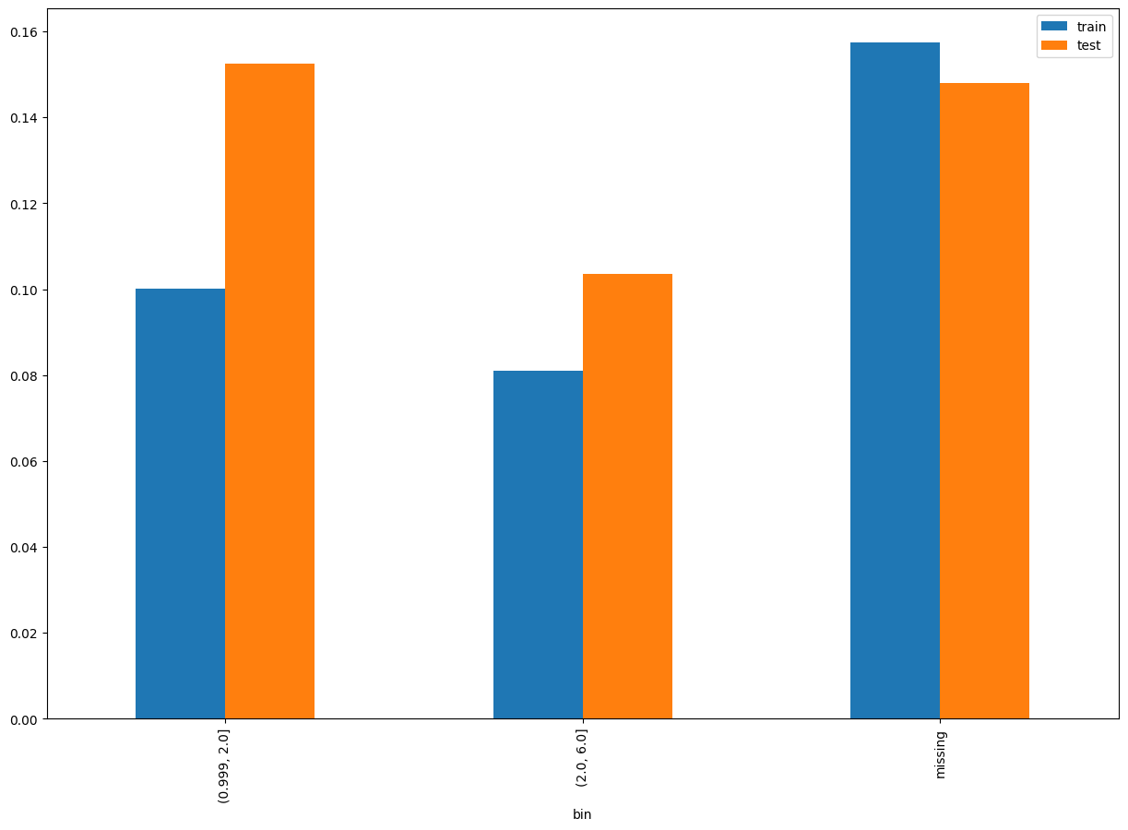
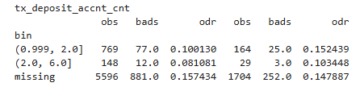
Rank# 7 : tx_deposit_accnt_cnt Performance in Train vs Test <Disbursed>

Slide 40
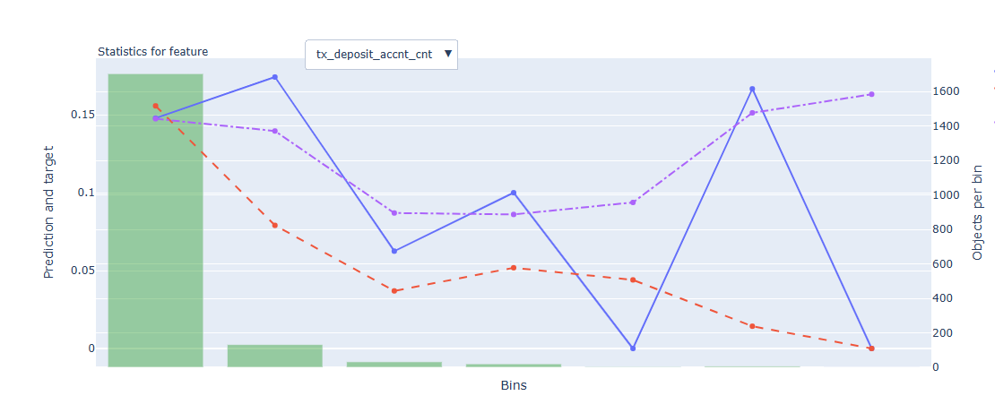
Rank# 7 : tx_deposit_accnt_cnt Feature Statistics Analysis <Disbursed>
The red line closely tracks the blue line across all bins, showing consistency in predicted probabilities.
There's a distinct gap between the red and purple lines, especially in the middle bins.
This indicates strong predictive power and good feature separation.

Slide 41
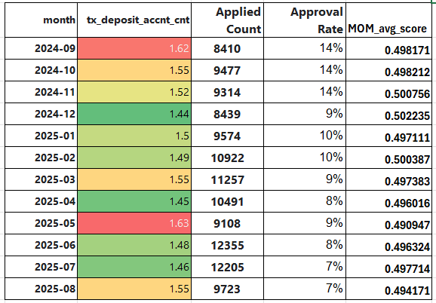
Rank# 7 : tx_deposit_accnt_cnt MOM Distibution <Applied>
No erratic jumps are observed,
The feature demonstrates strong distributional stability, ideal for modeling default risk.

Slide 42
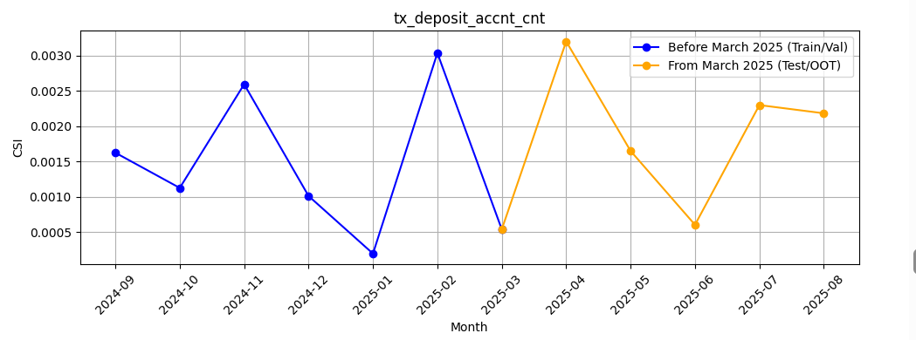
Rank# 7 : tx_deposit_accnt_cnt Feature CSI Analysis <Applied>
Baseline period: Sep’2024 to Feb ’2025.
The feature shows low and stable CSI values before March 2025, with a minor spike in February that quickly settles. Post-March, CSI remains well-controlled with slight month-on-month fluctuations, indicating resilience to recent data shifts. Overall, the feature maintains good stability and continues to contribute reliably to the model

Slide 43
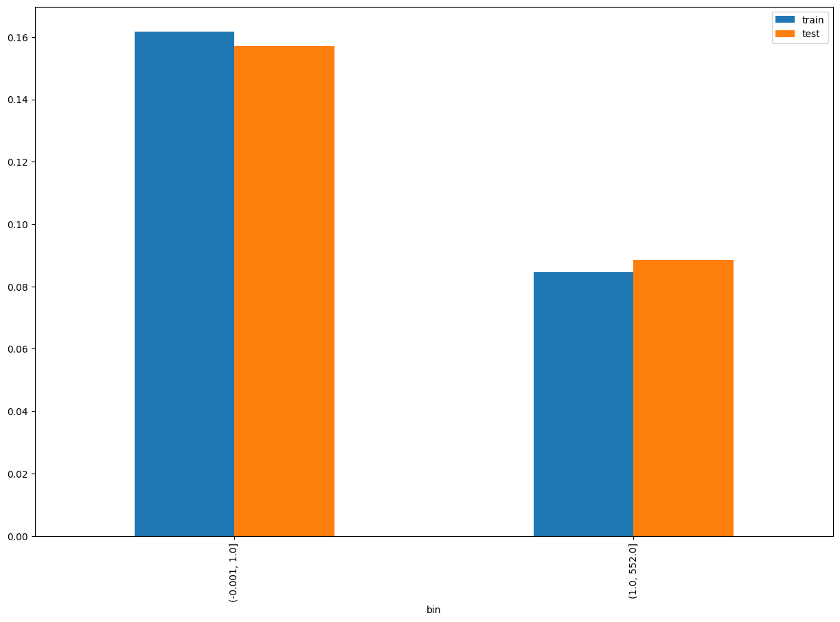

Rank# 8: tx_cnt_cash_in_total Performance in Train vs Test <Disbursed>

Slide 44
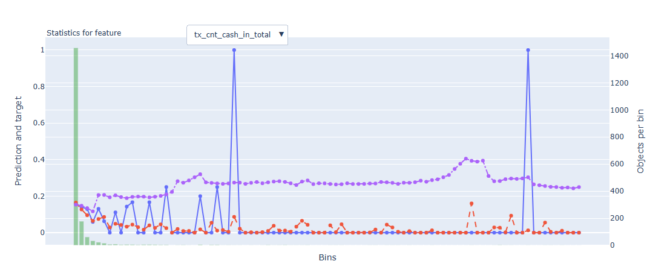
Rank# 8: tx_cnt_cash_in_total Feature Statistics Analysis <Disbursed>
The red line closely follows the blue line, indicating good model calibration across bins.
A clear red–blue gap in lower bins shows the model assigns higher risk to those segments, highligh

Slide 45
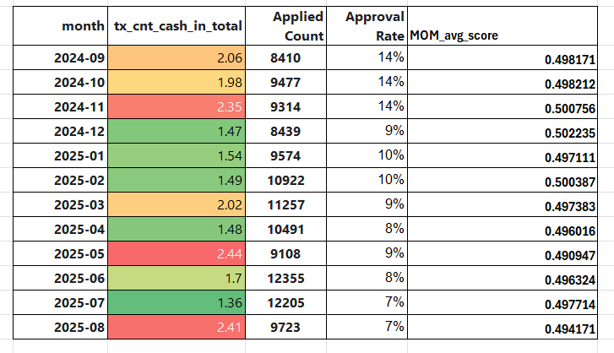
Rank# 8: tx_cnt_cash_in_total MOM Distibution <Applied>
They is very small deviation in mean but, at max it is reducing to 0.80
The feature shows excellent stability with a clear trend, supporting its robustness for modeling.
Overall, the month-over-month changes are progressive and stable, making the feature reliable and suitable for modeling.

Slide 46

Rank# 8 : tx_cnt_cash_in_total Feature CSI Analysis <Applied>
Baseline period: Sep’2024 to Jan’2025.
The feature shows consistent month-on-month CSI stability before March 2025, with a temporary peak in February that quickly normalizes. From March onwards, CSI values remain low and steady, reflecting a stable contribution during the Test/OOT period. Overall, the feature demonstrates strong temporal stability, making it dependable for model performance over time.

Slide 47


Rank# 9: tx_cnt_incomplete_loan_apps Performance in Train vs Test <Disbursed>

Slide 48

Rank# 9: tx_cnt_incomplete_loan_apps Feature Statistics Analysis <Disbursed>
The lower the bins mean target increases.
Red line closely follows the shape of the blue line, capturing the overall increasing trend.
The gap between red and purple increases in higher bins, proving this feature has strong additive predictive power for identifying high-risk borrowers

Slide 49

Rank# 9: tx_cnt_incomplete_loan_apps MOM Distibution <Applied>
Over the time the means decreases slightly but avg score remains as same over mom
The feature shows strong month-over-month stability, suitable for use in modeling.

Slide 50

Rank# 9 :tx_cnt_incomplete_loan_apps Feature CSI Analysis <Applied>
Baseline period: Sep’2024 to Jan’2025.
The feature remains highly stable before March 2025 with consistently low CSI values, showing excellent MoM consistency. After March, CSI fluctuates within an acceptable range, indicating some variation but no alarming instability. Overall, the feature continues to be reliable, with meaningful shifts that could reflect evolving user behavior patterns.

Slide 51


Rank# 10: tx_amt_cash_in_total Performance in Train vs Test <Disbursed>

Slide 52

Rank# 10: tx_amt_cash_in_total Feature Statistics Analysis <Disbursed>
The red line is smoother than the blue one, meaning the model has learned to generalize rather than overfit the noise in actual default rates
The gap between red and purple lines represents the contribution of this feature.
Since the red line often deviates from the purple one, this feature adds predictive value

Slide 53

Rank# 10: tx_amt_cash_in_total MOM Distibution <Applied>
Mom For march increased drastically but remains stables after March
Though there are moderate fluctuations, the trend is smooth and interpretable.
The overall behavior reflects controlled variation, indicating reasonable stability.

Slide 54

Rank# 10: tx_amt_cash_in_total Feature CSI Analysis <Applied>
Baseline period: Sep’2024 to Feb’2025.
The feature tx_amt_cash_in_total maintains stable CSI values before March 2025, showing reliable behavior during the training phase. Post-March, CSI remains within a controlled range with gentle shifts, indicating adaptability to recent data. This smooth month-on-month pattern highlights the feature’s robustness and consistent contribution to the model

Slide 55

Rank# 11: last_applied_loan_tenor_bin Performance in Train vs Test <Disbursed>

Slide 56

Rank# 11: last_applied_loan_tenor_bin Feature Statistics Analysis <Disbursed>
The red line (model prediction) matches the blue line (actual outcome), showing the model understands this feature well.
There is a visible gap between the red and purple lines, meaning this feature contributes to better predictions.
The mean target reduces over the decrease in bins

Slide 57

Rank# 11: last_applied_loan_tenor_bin MOM Distibution <Applied>
Missing reduced and 10 – 12 months increased a bit
But Avg transaction remains the stable across the mom
Despitevery minor fluctuations, the feature maintains a clear and stable distribution trend over time.

Slide 58

Rank# 11: last_applied_loan_tenor_bin Feature CSI Analysis <Applied>
Baseline period: Sep’2024 to Jan’2025.
The feature last_applied_loan_tenor_bin_WOE shows low and consistent CSI values before March 2025, indicating strong historical stability. In the OOT period (March to July 2025), CSI remains well below concern thresholds, with small and controlled fluctuations month-on-month. This consistent behavior across all months demonstrates that the feature is stable, reliable, and resilient to data shifts over time

Slide 59

THANK YOU!
​
Questions?
tonikbank.com

