Slide 1

Gamma Demo Refresh for Quick Loan
Presented by:
Data Science
February 2025

Slide 2
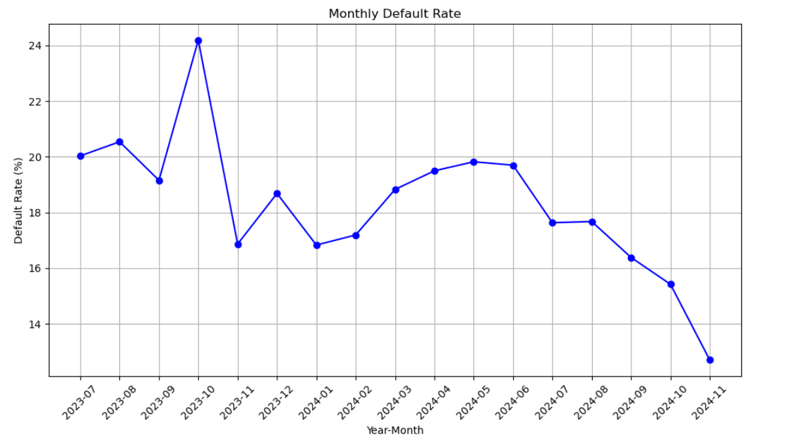
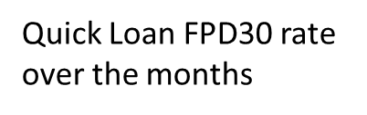
Gamma Quick Loans
 | Loan Disbursement Date | # All Quick Loans | # Bad (FPD30) Quick Loans | FPD30 rate
Training (90%) | 01/07/2023 - 30/06/2024 | 7144 | 1421 | 0.1989
Test (10%) | 01/07/2023 - 30/06/2024 | 794 | 166 | 0.2091
July | 01/07/2024 - 31/07/2024 | 998 | 176 | 0.1764
August | 01/08/2024 - 31/08/2024 | 2410 | 426 | 0.1768
September | 01/09/2024 - 30/09/2024 | 2435 | 399 | 0.1639
October | 01/10/2024 - 31/10/2024 | 3151 | 486 | 0.1542
November | 01/11/2024 - 30/11/2024 | 3086 | 392 | 0.127

Slide 3
Top 15 Feature Description (1 of 2)
Feature Name | Feature Description
ln_industry_new_cat_bin | We used the new Industry Descriptions for this provided by Dj and Mel. Basically, in our modeling dataset we replaced the old Industry Description name with the new Industry Description name. However, there are some completely new Industry Descriptions that DJ and Mel introduced which were never there before in our dataset. During inferencing those completely new ones will get mapped into a category called 'new'. After 4-5 months we will need to retrain this model to allocate them into proper industry description bins.
ln_self_dec_income | It represents the self-declared income of an individual, usually as part of a loan application process.
ln_osversion_type_order | The osversion feature for Android and iOS has been binned based on the bad rate, categorizing different OS versions according to their associated risk levels.
ln_doc_type_rolled | Type of KYC document uploaded by the customer. We aggregated similar categories into one, e.g. Driving License type 2018 and Driving License type 2022 would be combined into Driving License etc.
ln_marital_status | Marital status of the loan applicant: single/ married/ widow etc.
ln_age | Age of the loan applicant
ln_education_level | Education level given during loan application
name_email_match_score | This feature calculated the similarity matching score between users (firstname |middlename | lastname) and the first part of their email addresses and choose the max score. Usually risky users does not give their names in their emails and vice versa. So high match score means lower risk, and low match score means higher risk.
ln_cnt_dependents | Represents the number of dependents, with values ranging from 1 to 5 or more, indicating the family size or responsibility of the individual.

Slide 4
Top 15 Feature Description (2 of 2)
Feature Name | Feature Description
Onboarding_time_of_day_cat | It represents time_of_day represents the time of day when the onboarding process takes place, capturing variations in user behavior based on the time of interaction.
ln_source_funds_new_cat | We used the new Source funds for this provided by Dj and Mel. Basically, in our modeling dataset we replaced the old Source funds name with the new Source funds name. However, there are some completely new Source funds that DJ and Mel introduced which were never there before in our dataset. During inferencing those completely new ones will get mapped into a category called 'new'. After 4-5 months we will need to retrain this model to allocate them into proper Source funds bins.
email_primary_domain | This feature have the primary domain of user email id (E.g. gmail/yahoo/outlook etc)
ln_brand_cat | Means the device manufacturing brand of the loan applicant. E.g. Apple/ Samsung/ Oppo etc.
ln_telconame | Name of the Telco provider based on the Mobile number. Now in Loan application we do NOT ask the user to re-enter their Mobile number, but we ask them to enter one additional mobile number. This telconame is extracted from the primary mobile number given by the customer.
ln_employment_type_new_cat | We used the new Employment Type for this provided by Dj and Mel. Basically, in our modeling dataset we replaced the old Employment Type name with the new Employment Type name. However, there are some completely new Employment Types that DJ and Mel introduced which were never there before in our dataset. During inferencing those completely new ones will get mapped into a category called 'new'. After 4-5 months we will need to retrain this model to allocate them into proper Employment Type bins.

Slide 5
Feature Selection Methodology Overview
Feature Selection Methodology Overview
24 Feats
24
Feats
20
Feats
20
Feats
15
Feats
Missing Rate < 60%
IV > 0.002
IV > 0.002
Inter-correlation < 60%
Individual Feature Evaluation
(Marginal risk over WOE bins)
Individual Feature Evaluation
(Marginal risk over WOE bins)

Slide 6
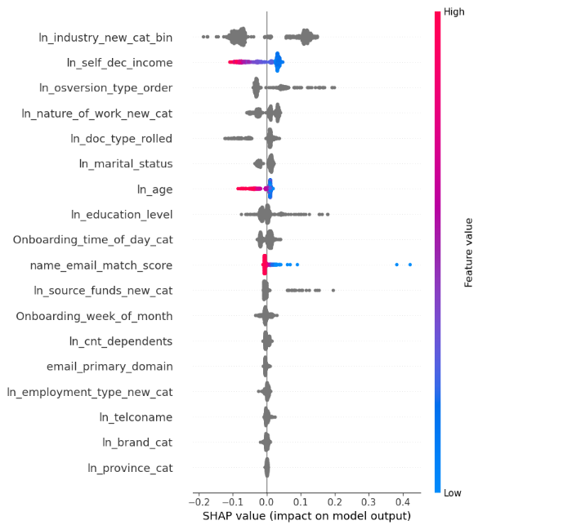
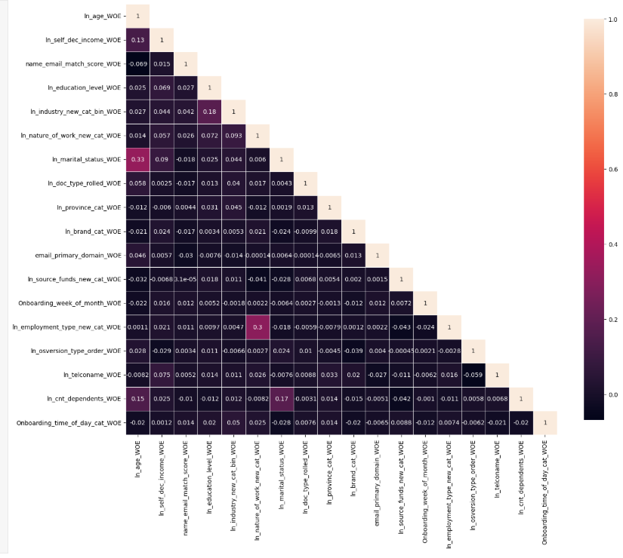
SHAP (all 18 Feats from initial shortlist)
InterCorrelation(all 18 Feats from initial shortlist)

Slide 7
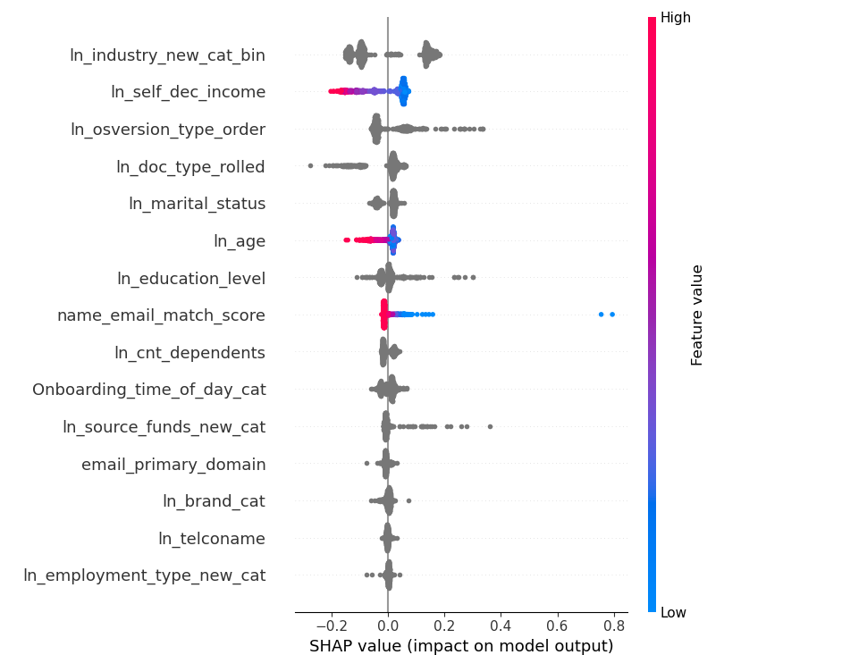
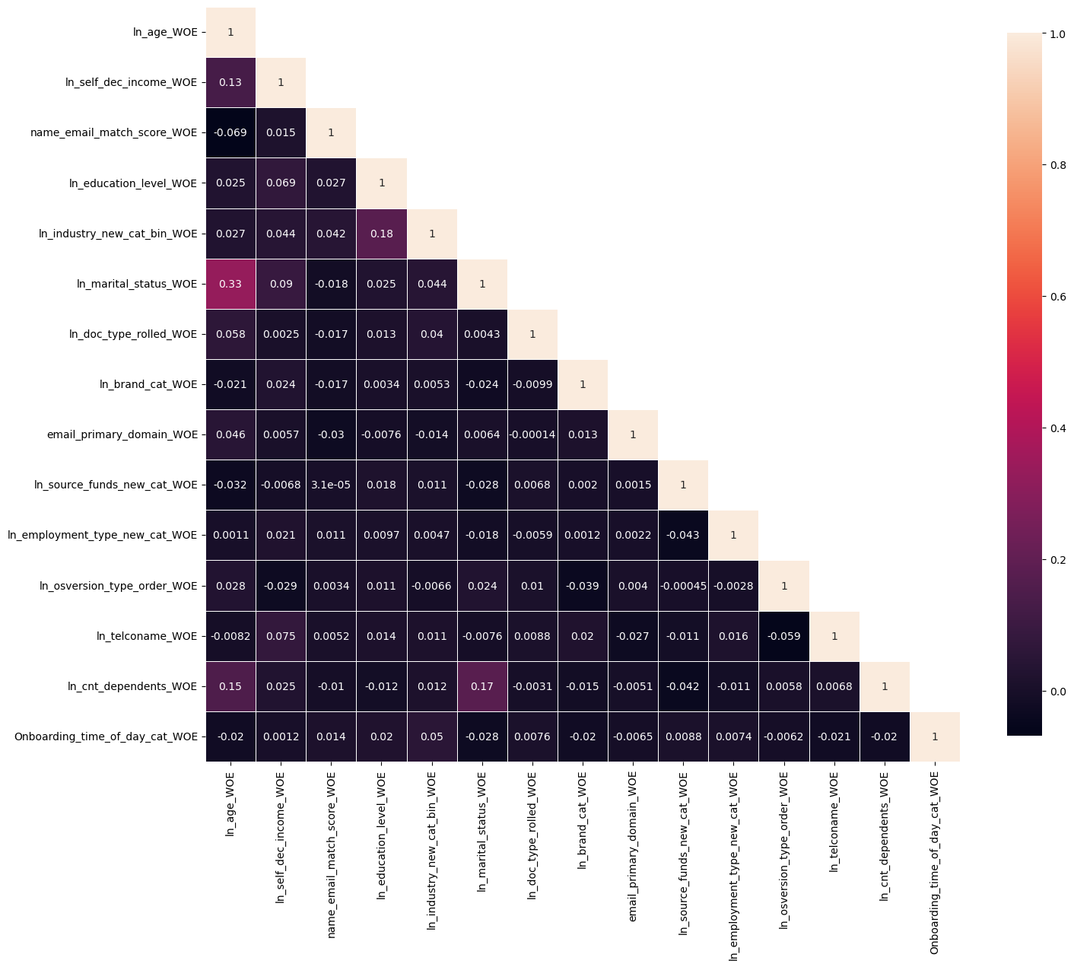
SHAP(15 Feats from final shortlist)
InterCorrelation(15 Feats from final shortlist)

Slide 8
Incremental Gini Table
Model Iteration | Top Features | Train Gini | Val Gini | July Gini | Aug Gini | Sep Gini | Oct Gini | Nov Gini
Model with top 11 feat | ln_industry_new_cat_bin', | 0.2487 | 0.103 | 0.1969 | 0.2237 | 0.1301 | 0.1946 | 0.1761
 | 'ln_self_dec_income',
 | 'ln_osversion_type_order',
Model with top 12 feat | email_primary_domain | 0.2385 | 0.0932 | 0.1848 | 0.2134 | 0.1196 | 0.1819 | 0.1682
Model with top 13 feat | ln_employment_type_new_cat | 0.2435 | 0.0994 | 0.1773 | 0.2179 | 0.1275 | 0.1764 | 0.1841
Model with top 14 feat | ln_telconame | 0.2353 | 0.0954 | 0.1851 | 0.2156 | 0.1548 | 0.196 | 0.1826
Model with top 15 feat | ln_brand_cat | 0.2667 | 0.1187 | 0.1976 | 0.2203 | 0.1434 | 0.203 | 0.1859
Model with top 16 feat | ln_province_cat | 0.2387 | 0.1092 | 0.181 | 0.2217 | 0.1435 | 0.1924 | 0.1821
'ln_doc_type_rolled',
'ln_marital_status',
'ln_age',
'ln_education_level',
name_email_match_score
ln_source_funds_new_cat
ln_cnt_dependents

Slide 9
Feature Evaluation Plots (15 features)

Slide 10
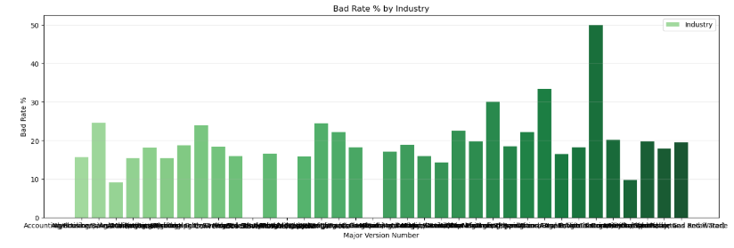
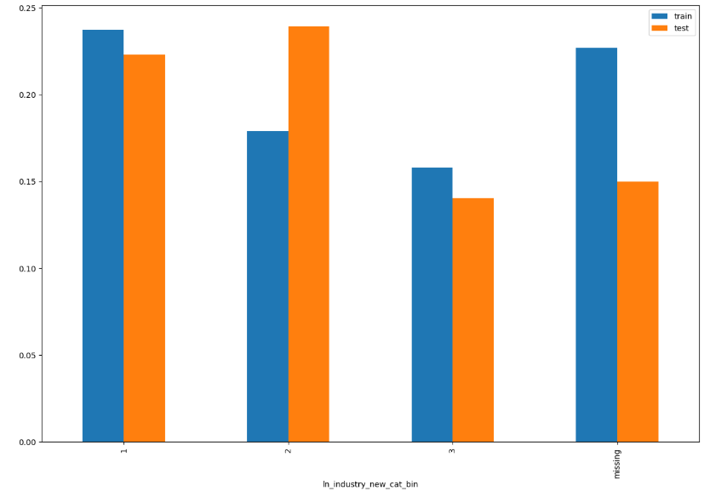
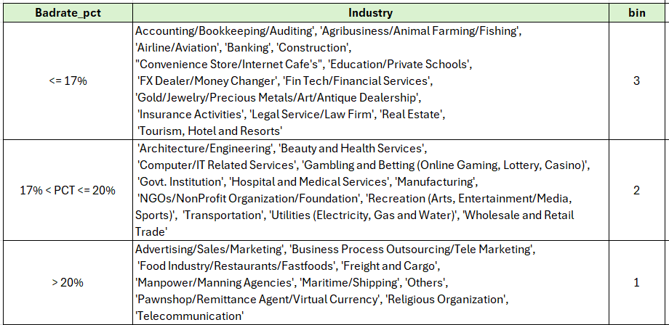
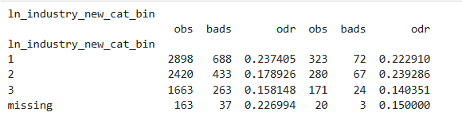
ln_industry_new_cat_bin

Slide 11
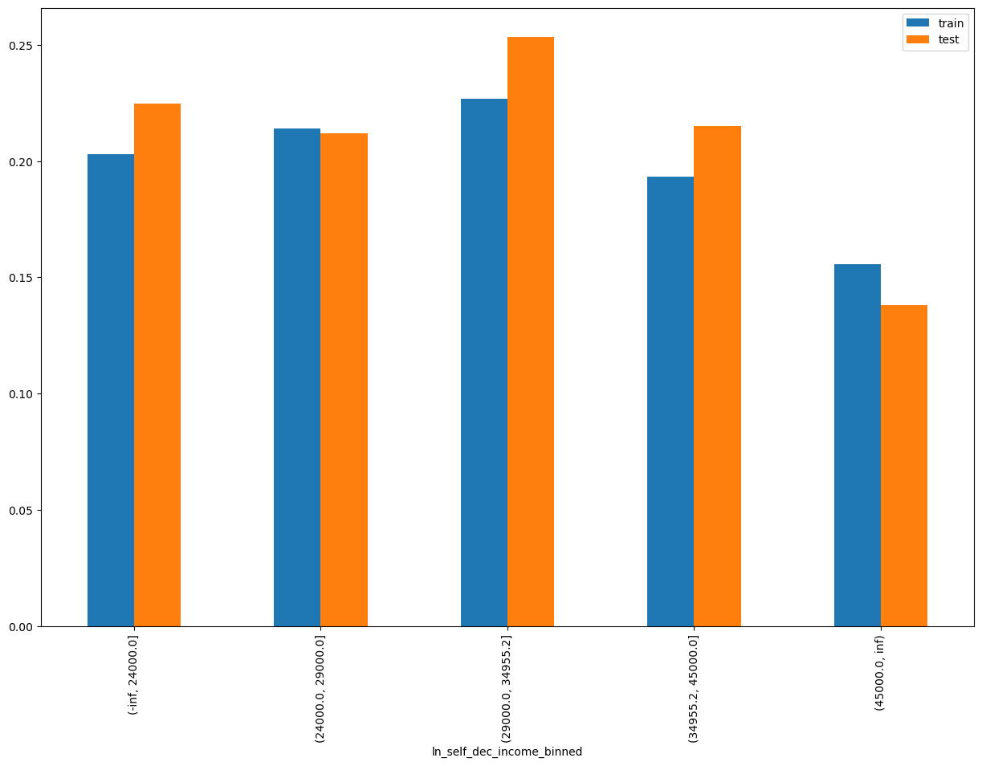
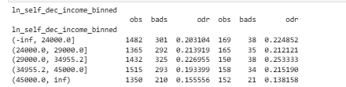
ln_self_dec_income

Slide 12
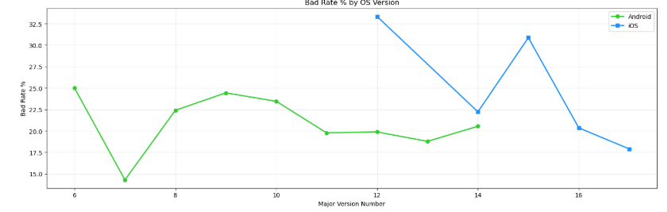
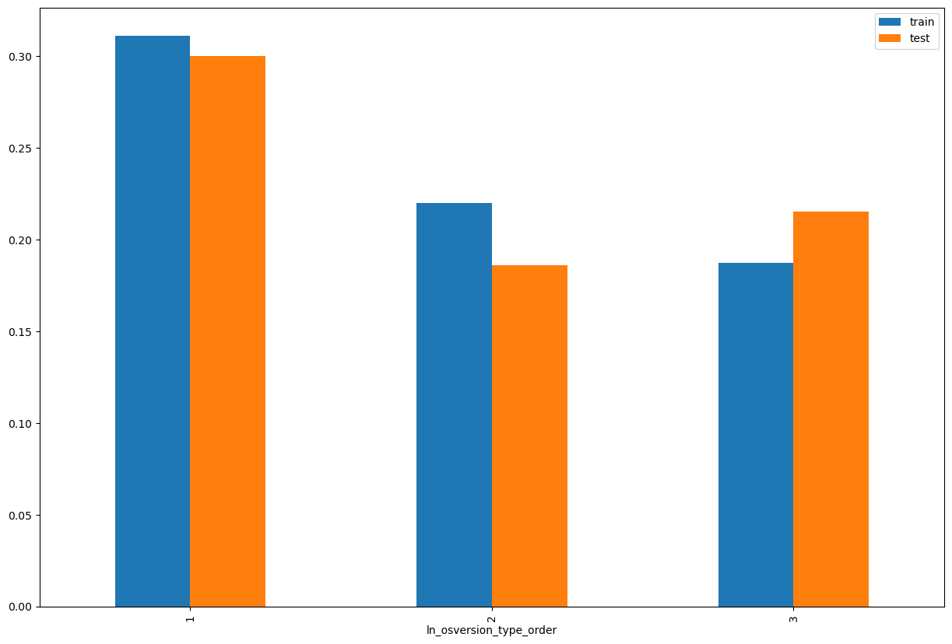
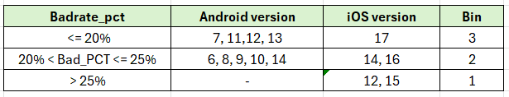
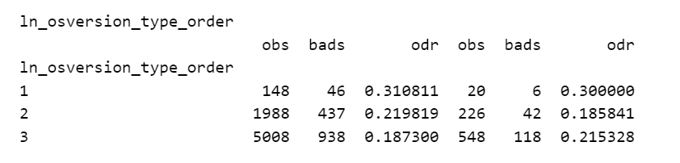
ln_osversion_type_order

Slide 13
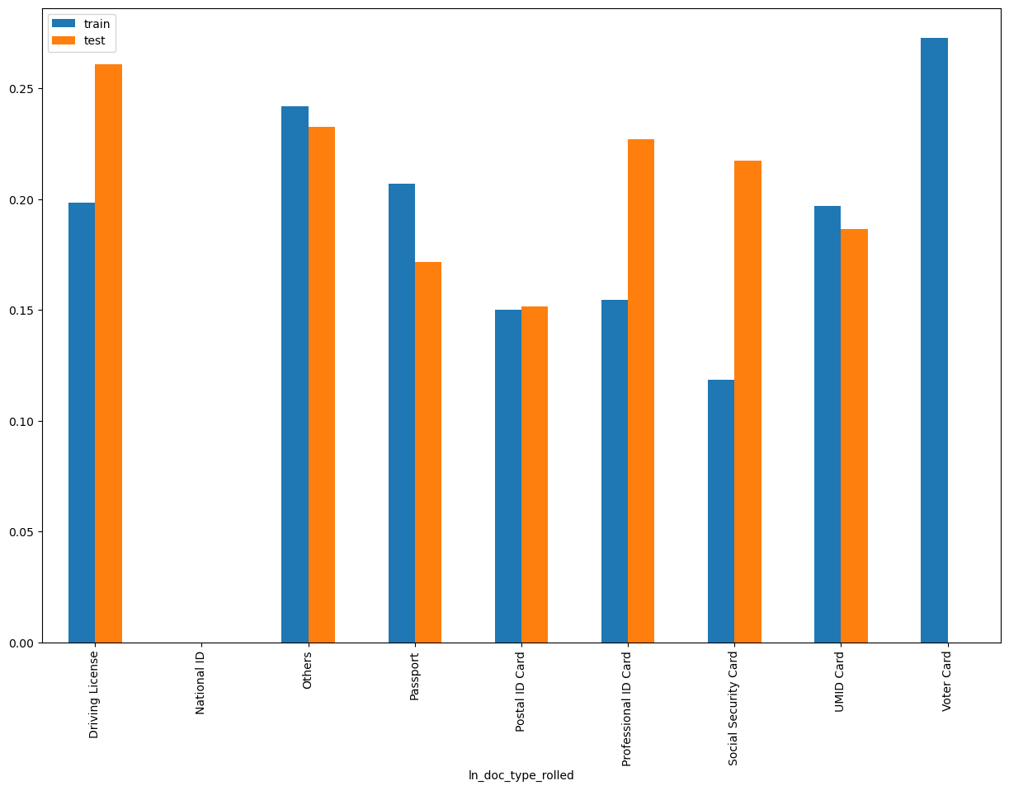
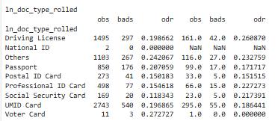
ln_doc_type_rolled

Slide 14
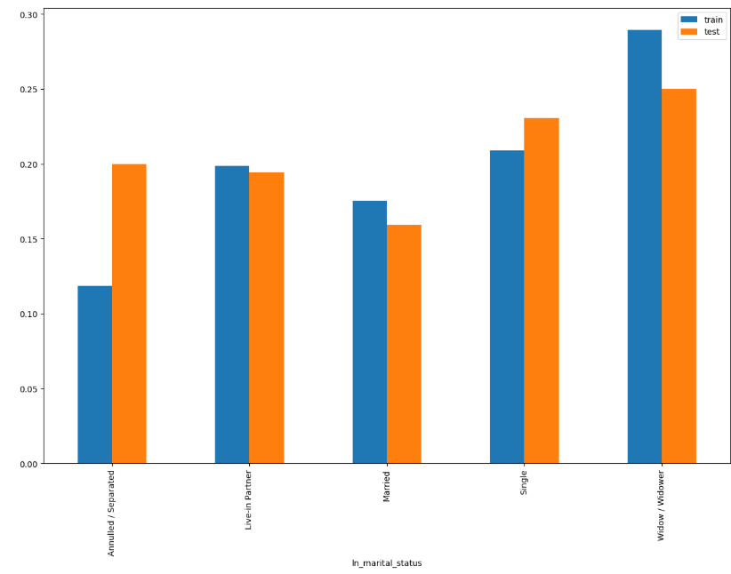
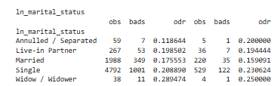
ln_marital_status

Slide 15
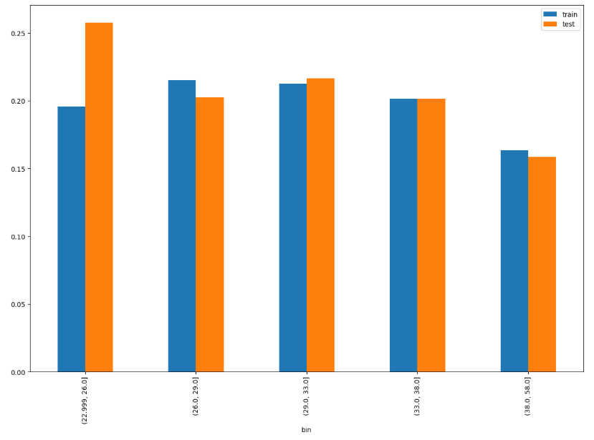
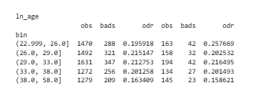
ln_age

Slide 16
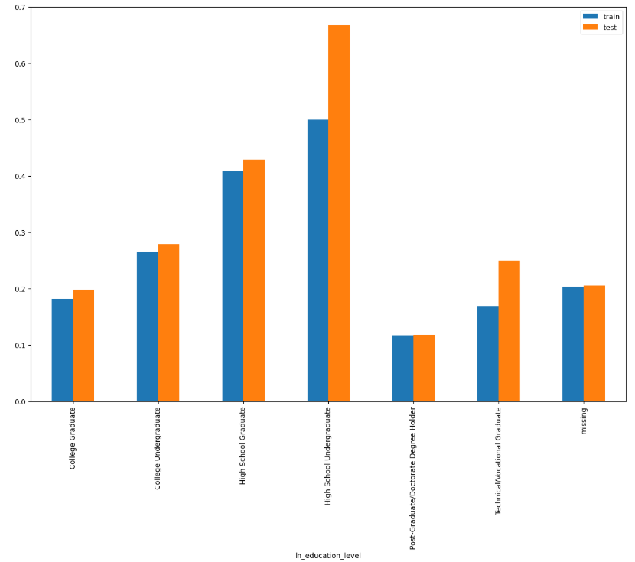
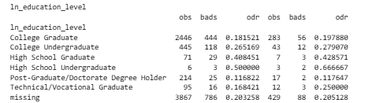
ln_education_level

Slide 17
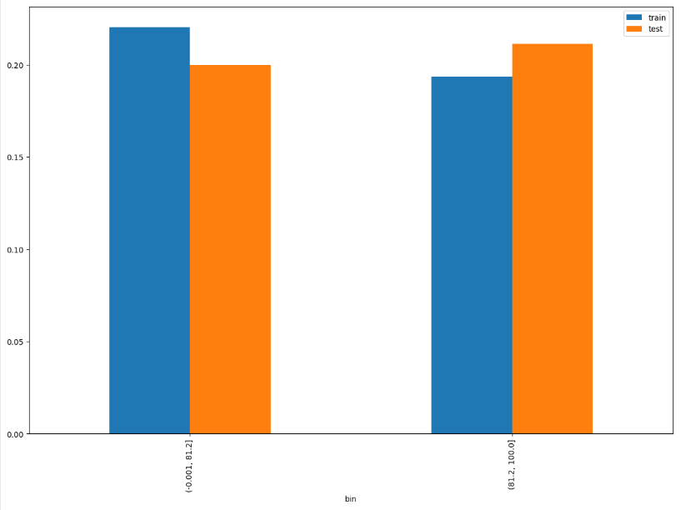

name_email_match_score

Slide 18
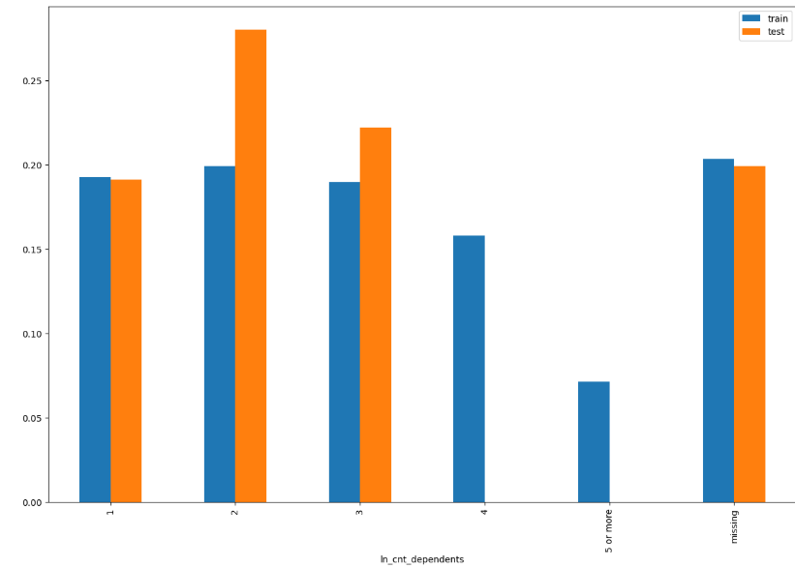
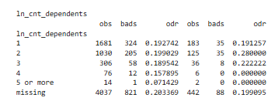
Ln_cnt_dependents

Slide 19
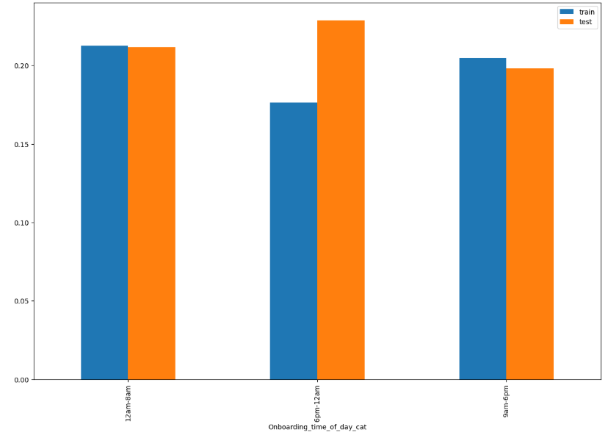

Onboarding_time_of_day_cat

Slide 20
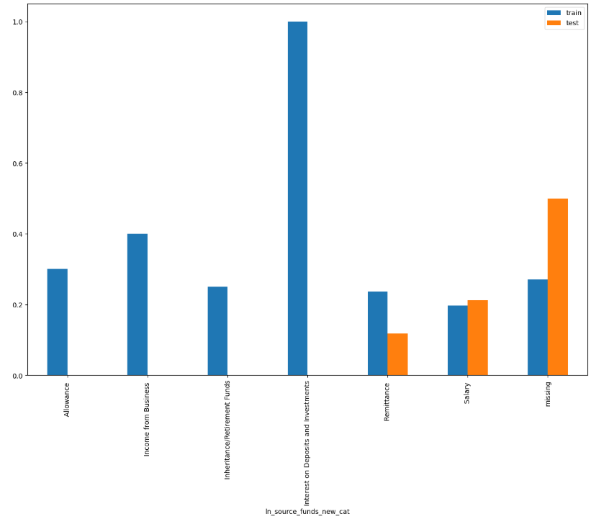
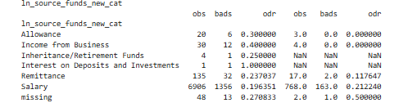
ln_source_funds_new_cat

Slide 21
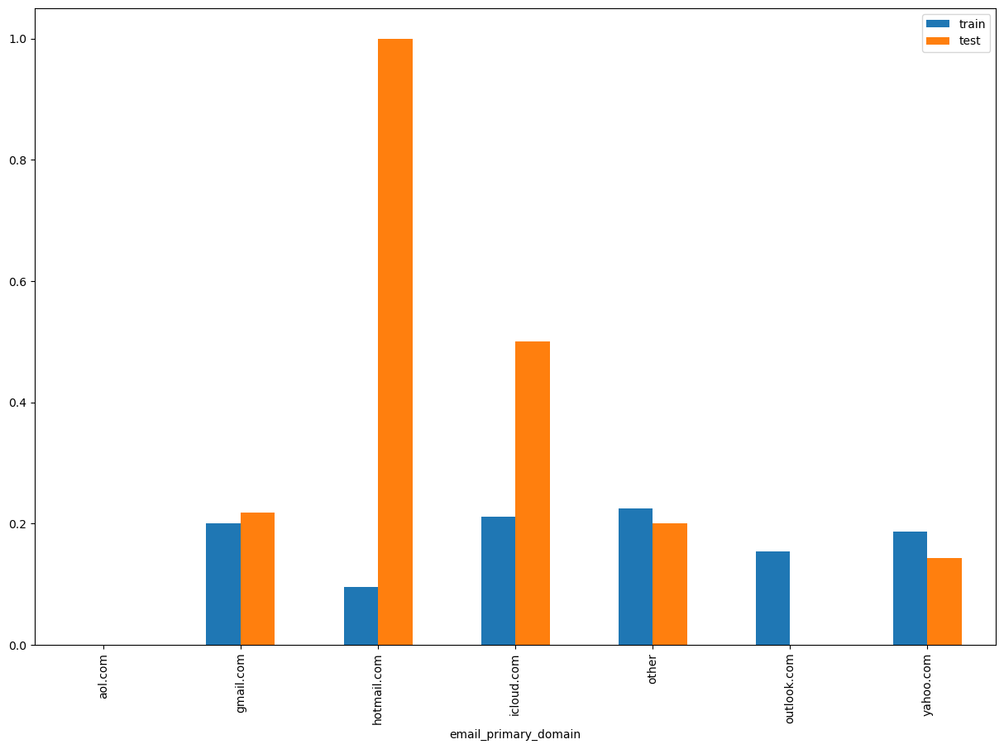
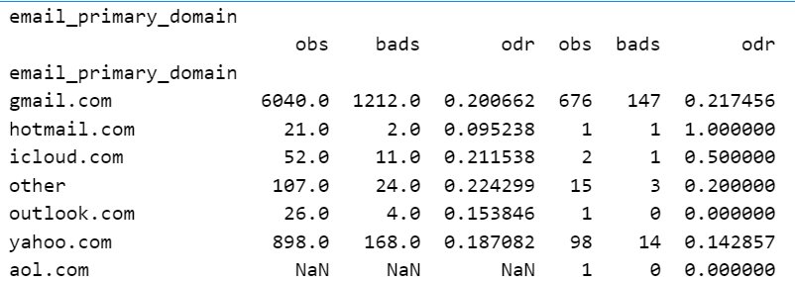
email_primary_domain

Slide 22
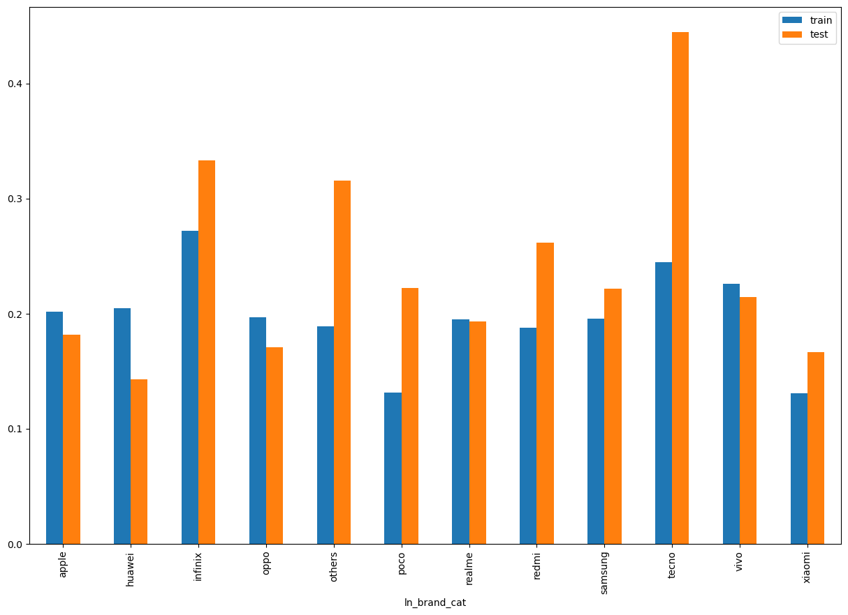
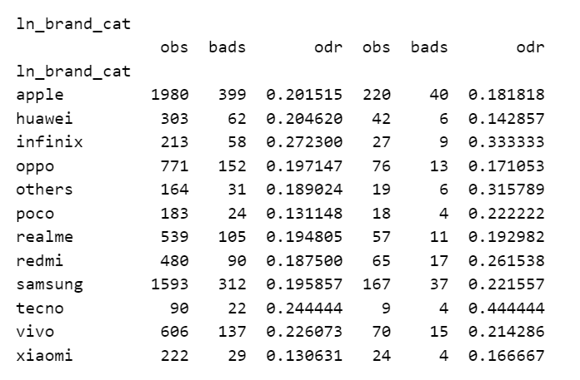
ln_brand_cat

Slide 23
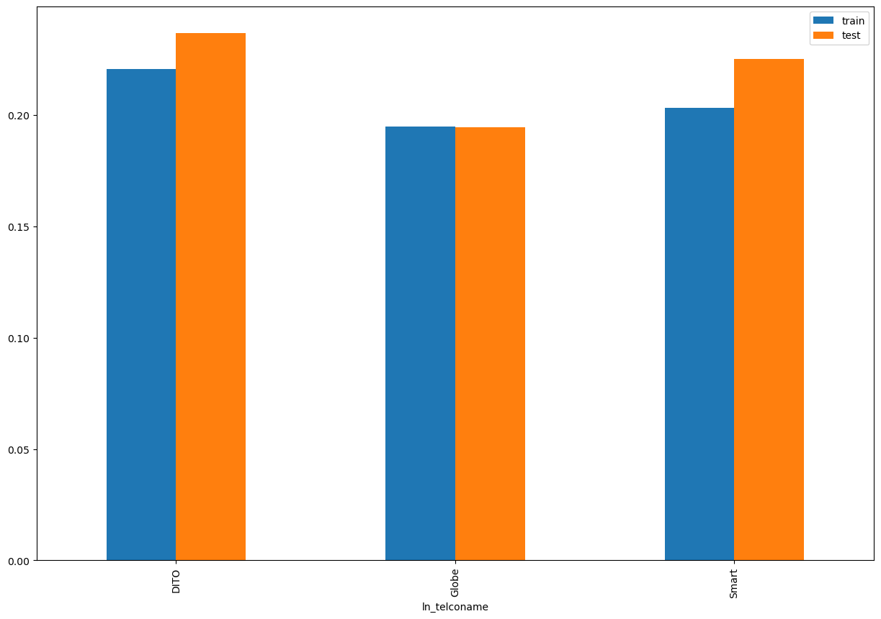
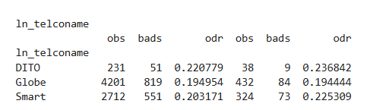
Ln_telconame

Slide 24
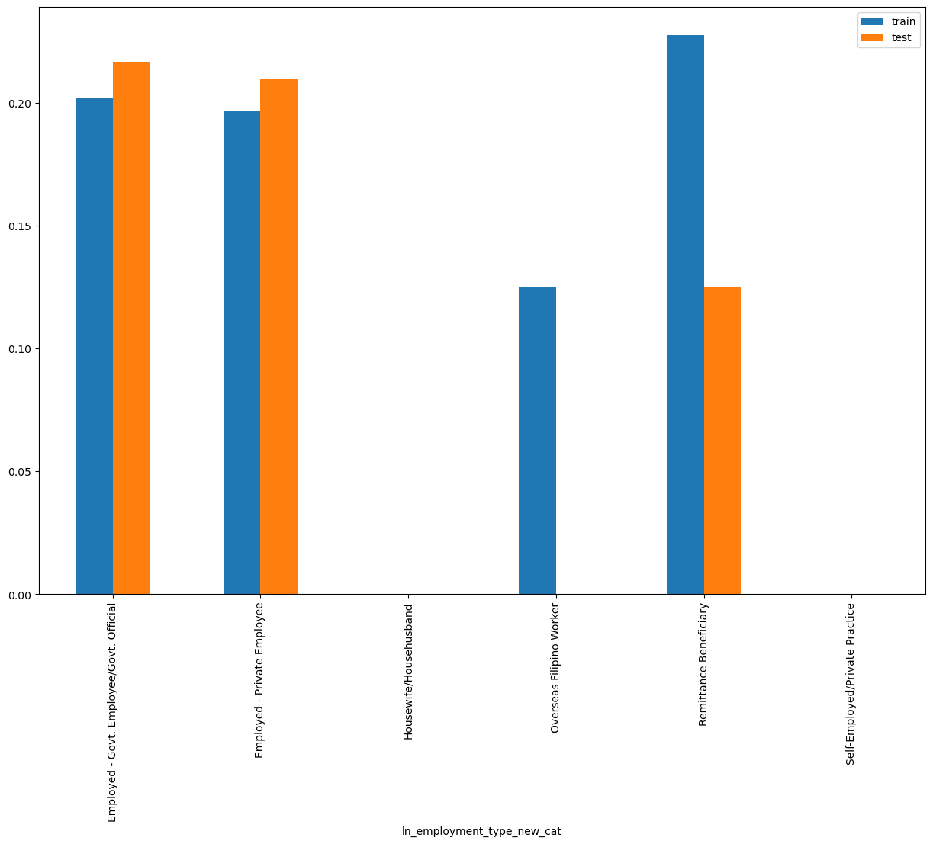
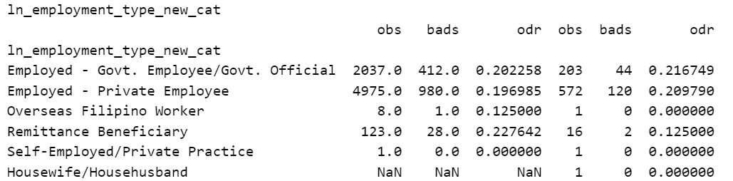
ln_employment_type_cat

Slide 25

THANK YOU!
​
Questions?
tonikbank.com

