Slide 1

Cash Loan Gamma Stacking Models Performance
Presented by:
Data Science
February 2025

Slide 2
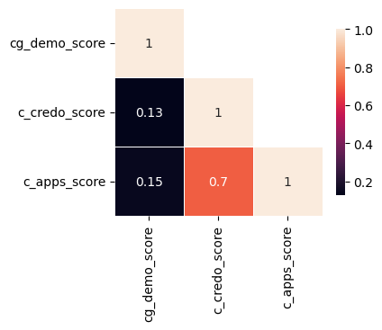
For Android Users: CatBoost Stacking (FPD30)
Gamma stacking – Android (Catboost) | 01/07/2023 - 30/06/2024 |  | 01/07/2024 - 31/07/2024 | 01/08/2024 - 31/07/2024 | 01/09/2024- 30/09/2024 | 01/10/2024- 31/10/2024 | 01/11/2024- 30/11/2024
 | Train Gini (90%) | Val Gini (10%) | July Gini | Aug Gini | Sep Gini | Oct Gini | Nov Gini
Demo - Current 15 feat Model (Catboost) | 0.2667 | 0.1187 | 0.1976 | 0.2203 | 0.1434 | 0.2030 | 0.1859
Demo + Apps | 0.5193 | 0.5036 | 0.4136 | 0.3814 | 0.3954 | 0.3447 | 0.3225
Demo + Credo | 0.4435 | 0.5506 | 0.4949 | 0.3194 | 0.3487 | 0.3236 | 0.2941
Demo + Apps +Credo | 0.5475 | 0.5639 | 0.4842 | 0.3960 | 0.4123 | 0.3671 | 0.3232
Gamma Stack
(Demo + Apps) outperforms clearly (Demo + Credo).
Adding Credo Score to (Demo + Apps) combination only improves the OOT Test Gini by 1-2 percentage points but makes the stack less stable.
Hence, this re-confirms our previous analysis that Demo + Apps score can provide good enough predictiveness for Risk Based ACL Segmentation and initial Limit Setting purpose

