Slide 1

Beta 2 Income Estimation Model For SIL & Cash Loans Data Science
January 2025

Slide 2
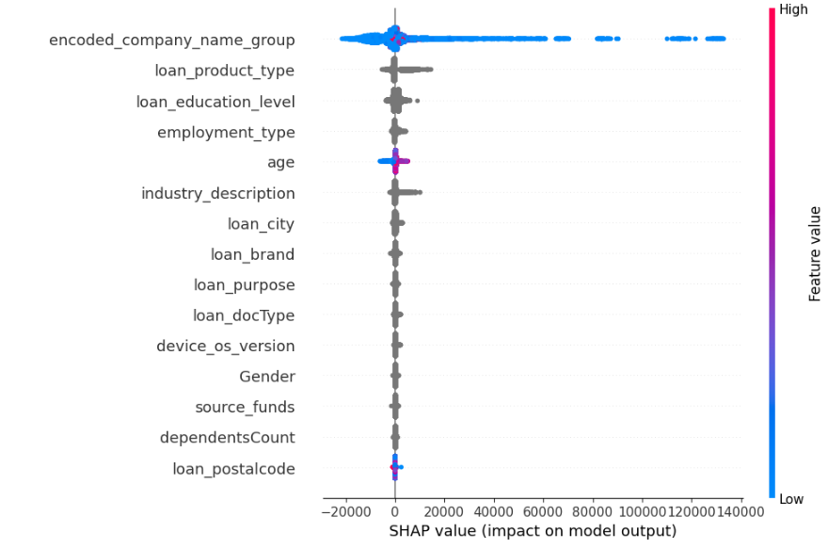
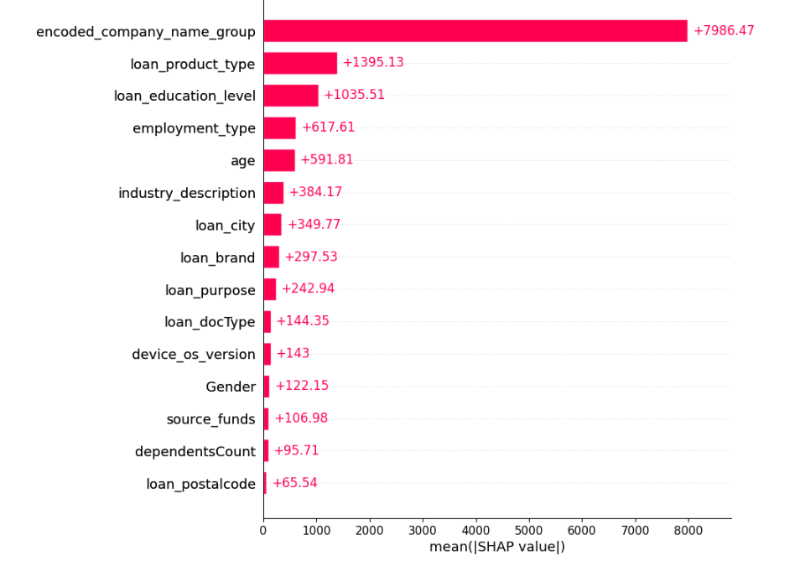
Machine Learning Model to estimate income by predicting how much income the customer would declare if s/he were a good customer
Model Name | Data Type | Mean Absolute Error (MAE) | Mean Squared Error (MSE) | Root Mean Squared Error (RMSE) | R-squared (R2) | Mean Absolute Percentage Error (MAPE)
Income Estimation Model Beta2 Step2 | Test (Aug 24) | 4195.85 | 155709526.9 | 12478.36 | 0.7134 | 0.1138
With TOP 15 Features | OOT Sep24 | 4077.51 | 139881752.3 | 11827.16 | 0.7015 | 0.128
 | OOT OCT24 | 4560.97 | 194865632.8 | 13959.43 | 0.6834 | 0.1326

Slide 3
Top 15 Feature Description (1 of 2)
Feature Name | Feature Description
encoded_company_name_group | This is combination of Frequency Encoding and Target Encoding of Companies calculated as df['encoded_company_name_group'] = freq_encoded * target_encoded What it does: Creates a combined score that considers both: How common a company is (frequency) What income level it's associated with (target encoding) Handles Rare Companies: Prevents weird results for companies with few customers Captures Patterns: Common companies influence the model more than rare ones Numerical Conversion: Turns company names into numbers computers can understand
loan_product_type | Quick/ SIL Instore/ SIL Zero/ SIL Competitor
loan_education_level | Education level given during loan application
employment_type | We used the new Employment Type for this provided by Dj and Mel. Basically, in our modeling dataset we replaced the old Employment Type name with the new Employment Type name. However, there are some completely new Employment Types that DJ and Mel introduced which were never there before in our dataset. During inferencing those completely new ones will get mapped into a category called 'new'. After 4-5 months we will need to retrain this model to allocate them into proper Employment Type bins.
age | Age of the applicant, used as-is without any transformation
industry_description | We used the new Industry Descriptions for this provided by Dj and Mel. Basically, in our modeling dataset we replaced the old Industry Description name with the new Industry Description name. However, there are some completely new Industry Descriptions that DJ and Mel introduced which were never there before in our dataset. During inferencing those completely new ones will get mapped into a category called 'new'. After 4-5 months we will need to retrain this model to allocate them into proper industry description bins.
loan_city | City from the Address given during loan application
loan_brand | Means the device manufacturing brand of the loan applicant. E.g. Apple/ Samsung/ Oppo etc.

Slide 4
Top 15 Feature Description (2 of 2)
Feature Name | Feature Description
loan_purpose | Purpose mentioned in the Loan application. For SIL this just means the SIL Product Type but for Cash Loans this means why the user needed the cash for (e.g. medical emergency etc.)
Loan_doc_type | Type of KYC document uploaded by the customer. We aggregated similar categories into one, e.g. Driving License type 2018 and Driving License type 2022 would be combined into Driving License etc.
device_os_version | Primary OS version of the Loan Applicant's mobile device. We created the binning in a way that any new primary OS version release will automatically get binned with the most recent OS version (and NOT with the Missing bin)
gender | Gender of the Loan applicant
source_of_funds | We used the new Source of Funds for this provided by Dj and Mel. Basically, in our modeling dataset we replaced the old Source of Funds name with the new Source of Funds name. However, there are some completely new Source of Funds that DJ and Mel introduced which were never there before in our dataset. During inferencing those completely new ones will get mapped into a category called 'new'. After 4-5 months we will need to retrain this model to allocate them into proper Source of Funds bins.
dependantsCount | Number of dependants of the loan applicant
Loan_postalcode | Postal Code from the Address given during loan application

Slide 5
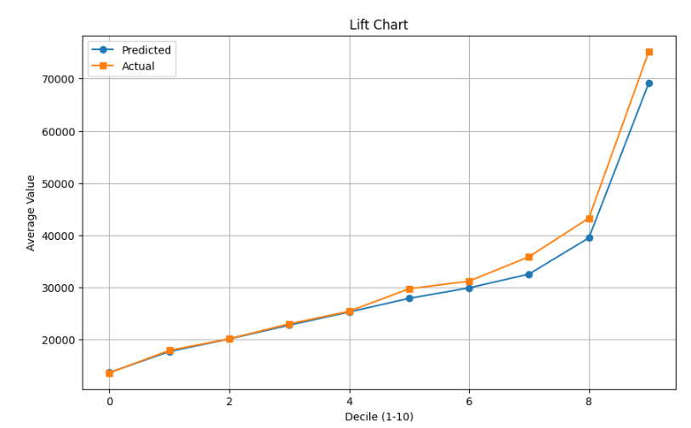
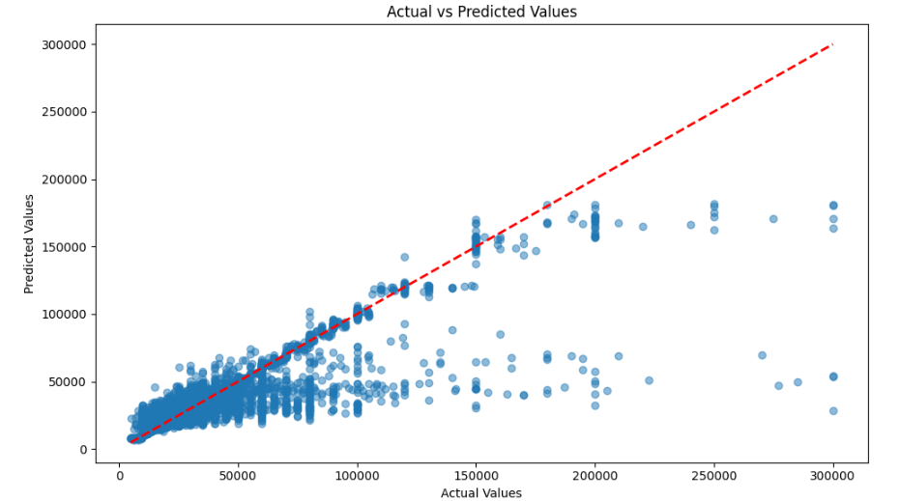
Actual Vs Predicted for the Good Users
For Good users Predicted should be close to Actuals, but for Bad users Predicted should be far from Actuals

Slide 6
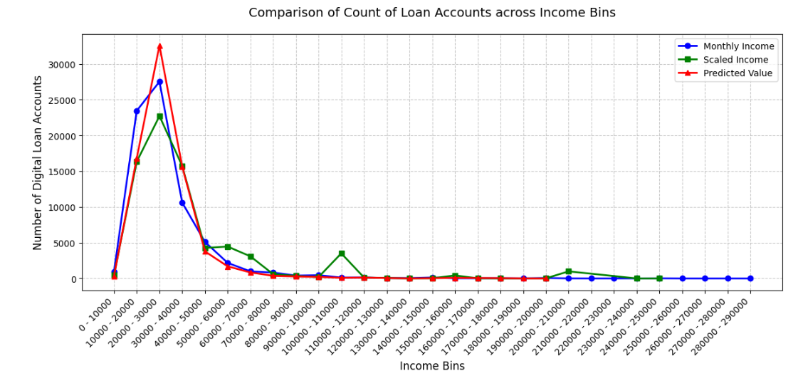
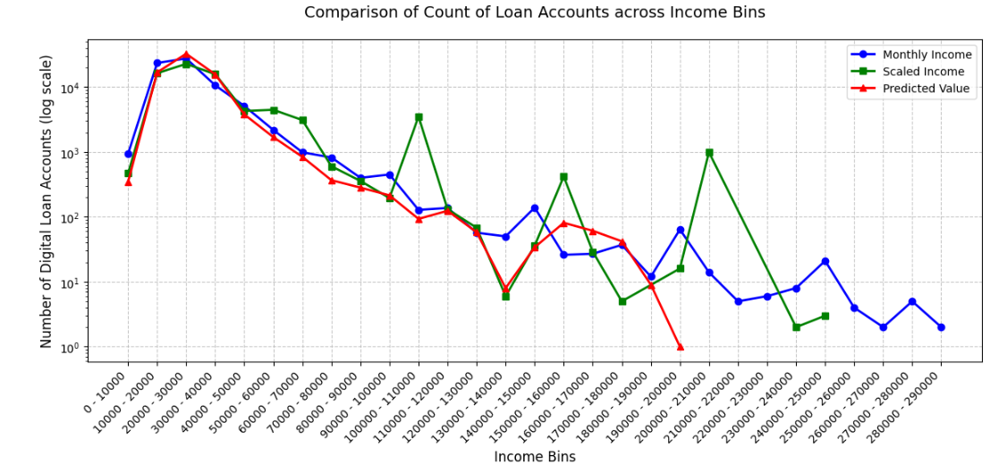
Count of users across various Income Bins
With Log Scale

Slide 7
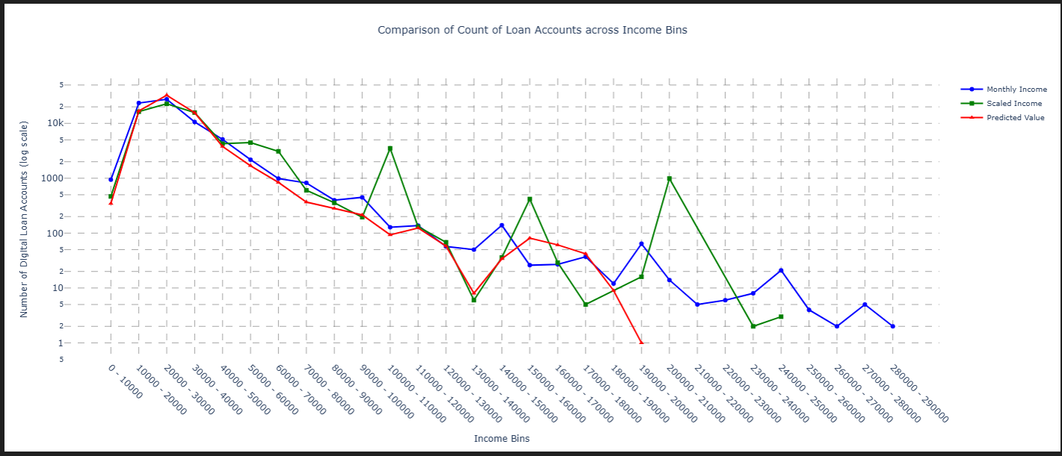
Similar to Previous Chart Created with Plotly for better visibility

Slide 8
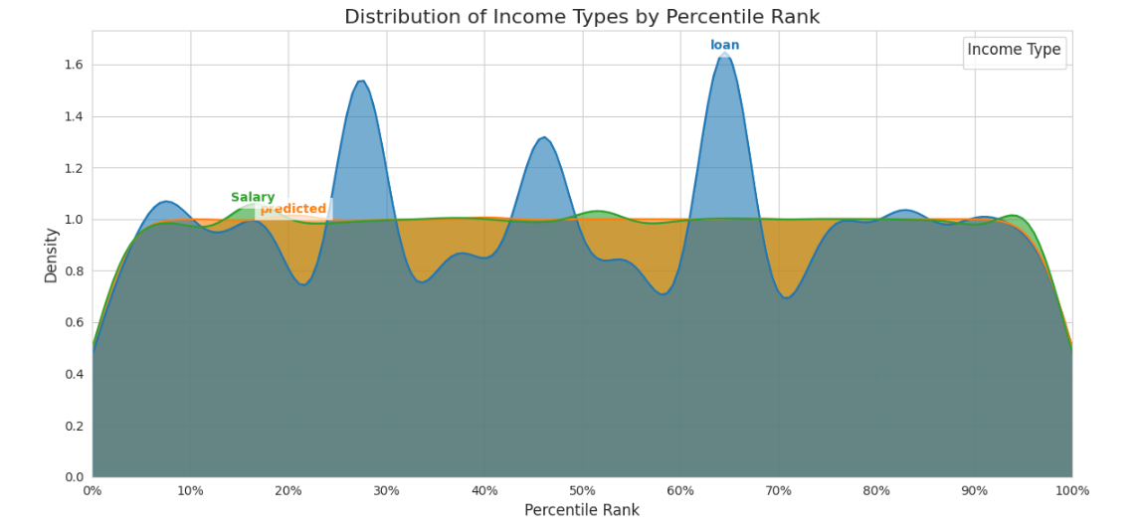
Our Model Estimated Income smoothens the Self-Declared Income better than Salary Scaled Income
Declared Monthly Income Distribution (Blue):
The Declared Monthly Income distribution shows two prominent peaks: one in the lower percentiles (around the 10th percentile) and another in the higher percentiles (around the 60th-70th percentile).
This suggests that individuals with both lower and higher loan monthly incomes exist in the data.
Model Predicted Monthly Income Distribution (Orange):
The Predicted Monthly income distribution is concentrated in the lower-to-middle percentile ranks, peaking around the 20th-30th percentile. This indicates that the prediction model used might be underestimating the income of individuals in the higher percentiles, or the predictions are more accurate/representative for individuals in the lower-to-middle income brackets.
Salary Scaled Income Estimation (Green):
The salary distribution is relatively uniform across most percentile ranks, with a slight increase in density towards the higher percentiles. This suggests that salaried individuals are present across all income levels, but there might be a slightly higher concentration of salaried individuals in the higher income brackets.

Slide 9
Proof that our Model Predicted Income is closest to Self-Declared Income if the user was a Good User
1. Smaller Interquartile Range (IQR):
The IQR for "Predicted To Monthly Income" is 576 (-286 to 290). This indicates that the middle 50% of the differences between declared and predicted incomes fall within a relatively narrow range.
In contrast, the IQR for "Salary Scale To Monthly Income" is likely much larger (though we don't have the exact values). This suggests greater variability in the scaled incomes themselves.
2. Median Closer to Zero:
The median for "Predicted To Monthly Income" is -1. This implies that for half of the individuals, the model's prediction is very close to their declared income.
While we don't have the median for "Salary Scale To Monthly Income," it's likely farther from zero given the larger IQR and the nature of scaling, which often shifts the distribution.

