Slide 1

SIL Gamma Trench2 Trx Model
Presented by:
Data Science (Sowndarya, Bhuvanesh)
8th August 2025

Slide 2
Architecture Overview of TDB’s Risk Scorecards
For Cash Loan only
For both Cash and SIL
Limit Setting Model (Hosted in Digital Layer)
Credit Decisioning Model (Hosted in Taran)
Beta Stack
Alpha Stack
Trench 1: New Users - within 30 days from TSA Onboarding
Limit Setting Score = Gamma Stack
Beta Demo Score
Beta Demo Score
Gamma Demo Score
Selectively call Alpha
Apps Score
Apps Score
Apps Score
Credo Score
Users automatically move from Trench 1 to Trench 2 after 30 days if no disbursed loans
Credo Score
CIC Score
Gamma Income Model
Beta Income Model
Alpha Income Model
Users will stay in Trench 2 until 1st disbursed loan. His Gamma Stack will be re-calculated every 30-day anniversary from TSA onboarding date
Limit Setting Score = Gamma Stack
Beta Stack
Alpha Stack
Gamma Demo Score
Beta Demo Score
Beta Demo Score
Trench 2: Existing Users - After 30 days from TSA Onboarding AND Never Disbursed Loan
Selectively call Alpha
Apps Score
Apps Score
Apps Score
Transaction Score
Transaction Score
Transaction Score
CIC Score
Gamma Income Model
Beta Income Model
Alpha Income Model
Users will move to Trench 3 after 1st Disbursed Loan
Lowest Risk users from this B Score will be pre-approved for upsell and xsell. Medium Risk users from this B Score will have to go through Taran.
High Risk users from this B Score will not be given any offer.
B Score = Gamma Stack
Trench 3: Existing Users - After 30 days from 1st Disbursed Loan AND current DPD <= 10
Beta Stack
Alpha Stack
Gamma Demo Score
Apps Score
Beta Demo Score
Beta Demo Score
Apps Score
Selectively call Alpha
Apps Score
Enhanced Transaction Score
Enhanced Transaction Score
Once moved to Trench 3, user will forever remain in Trench 3. His Gamma Stack will be re-calculated every 30 days anniversary from 1st Loan Disbursement Date
Enhanced Transaction Score
CIC Score
Gamma Income Model
Beta Income Model
Alpha Income Model

Slide 3
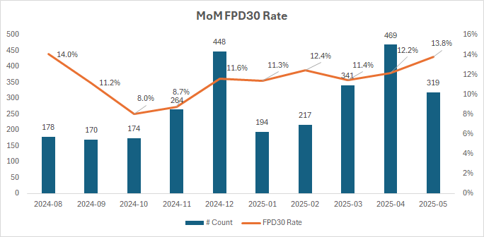
SIL Loan Gamma Trench2 Transaction Scorecard
 | Loan Disbursement Date | # Count | # Bad (FPD30) Cash Loans | FPD30 rate
Training (100%) | 01/09/2024 - 28/02/2025 | 1,645 | 182 | 11.1%
Validation | NA | NA | NA | NA
Mar (Test) | 01/03/2025 - 31/03/2025 | 341 | 39 | 11.4%
Apr (OOT) | 01/04/2025 - 30/04/2025 | 469 | 57 | 12.2%
May (OOT) | 01/05/2025 – 25/05/2025 | 319 | 44 | 13.8%
3

Slide 4
Feature Selection Methodology Overview
Feature Selection Methodology Overview
69
Feats
53
Feats
49 Feats
22 Feats
6 Feats
Missing Rate < 95%
IV > 0.01
Inter-correlation < 70%
Individual Feature Evaluation
4

Slide 5
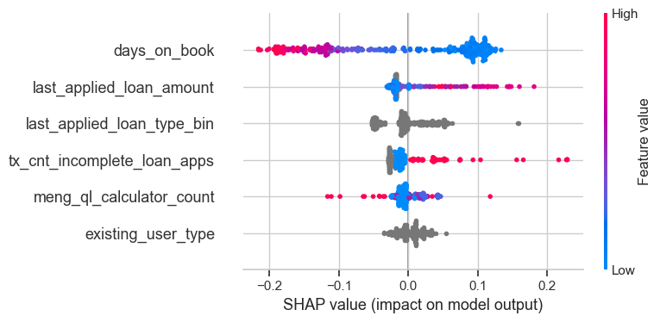
SHAP (6 feat)
The horizontal axis shows how much a feature affects the prediction. Points to the right mean the feature increases the prediction, and points to the left mean it decreases it.
The color of each dot shows the feature value: red means the value is high, and blue means the value is low. Grey means categorical feature.
If red dots are mostly on the right, it means high values of that feature increase Risk. If red dots are on the left, high values decrease Risk.
The features are listed on the vertical axis, from most important at the top to least important at the bottom.
5
Notes:
Descriptions need to be added

Slide 6
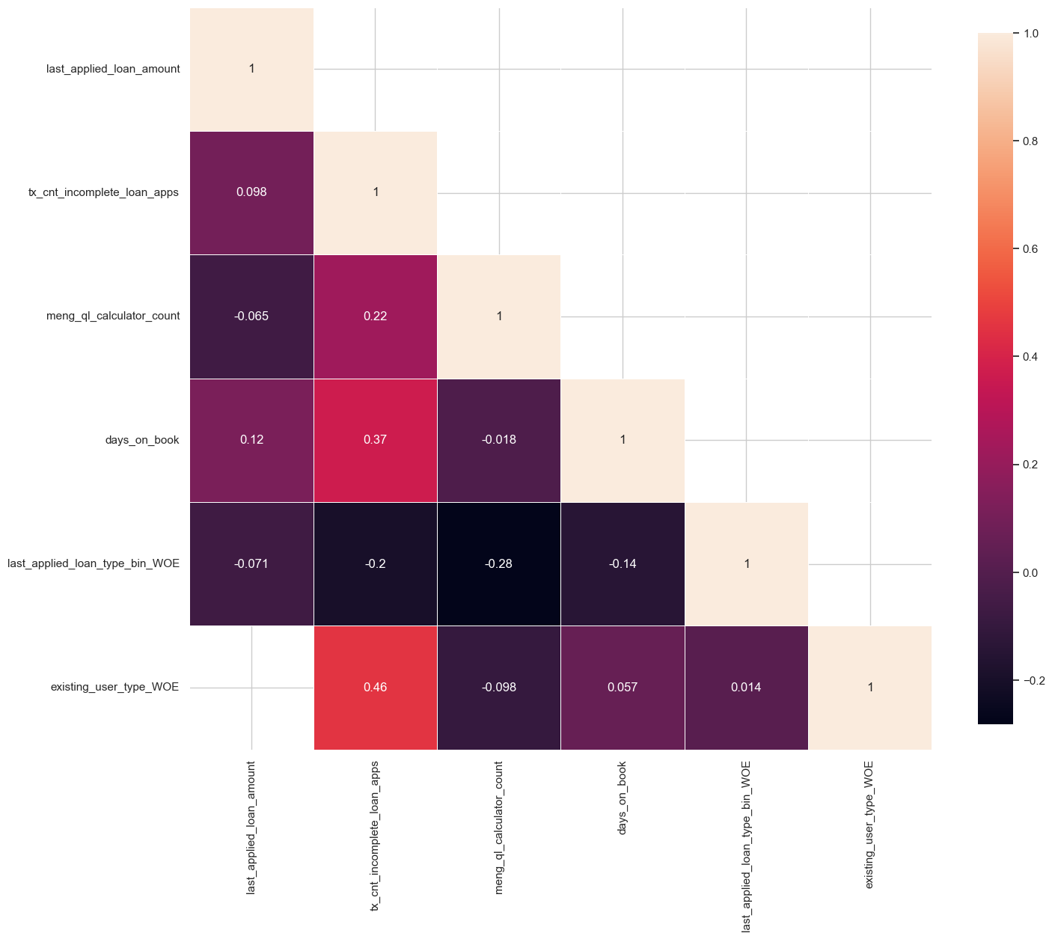
Inter-Correlation (6 feat)
The numbers show how strongly two features are related — values close to 1 mean a strong positive correlated (two features increase together), and values close to -1 mean a strong negative correlated (one feature increases while the other decreases).
Light-colored squares mean a stronger relationship, while dark ones mean weak or no relationship.
Most values here are small, so most features are not strongly related to each other — this is good for building models.
6
Notes:
Descriptions need to be added

Slide 7
Iteration | Feature Added | Train Gini (Aug24 - Feb25) | Mar Gini | Apr Gini | May Gini (until 25th)
1 | days_on_book_WOE | 0.144664 | -0.029886 | -0.149549 | 0.054628
2 | last_applied_loan_type_bin_WOE | 0.213572 | 0.005604 | 0.111225 | 0.060496
3 | tx_cnt_incomplete_loan_apps_WOE | 0.229049 | 0.053999 | 0.054207 | 0.071322
4 | meng_ql_calculator_count_WOE | 0.235776 | 0.049839 | 0.094873 | 0.081901
5 | existing_user_type_WOE | 0.246058 | 0.032348 | 0.118719 | 0.082810
6 | last_applied_loan_amount_WOE | 0.247264 | 0.044235 | 0.117995 | 0.098678
7 | tx_cnt_rejected_loans_WOE | 0.247891 | 0.043641 | 0.111906 | 0.093719
6 feature model after Hyper Parameters Tuning | 0.240384 | 0.061895 | 0.113993 | 0.117190
Gini with respect to FSPD30 (HP Tuned Model Built with FPD30) | 0.240384 | 0.061895 | 0.113993
Hyperparameter | Value
C | 0.01
l1_ratio | 0.1
max_iter | 400
penalty | elasticnet
solver | saga
Hyperparameter values for the best model chosen after the HP Tuning using GridSearchCV
7

Slide 8
SHAP Rank is overall Consistent Across Train, Test and OOT Datasets
feature | Train Rank | Mar Rank | Apr Rank | May Rank
days_on_book | 1 | 1 | 1 | 1
last_applied_loan_amount | 2 | 2 | 2 | 2
tx_cnt_incomplete_loan_apps | 3 | 4 | 4 | 4
last_applied_loan_type_bin | 4 | 3 | 3 | 3
meng_ql_calculator_count | 5 | 5 | 5 | 5
existing_user_type | 6 | 6 | 6 | 6
8

Slide 9
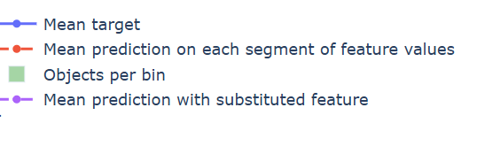
Feature Stability Plot Legend Table
 | Name | What It Shows | How to Interpret
Blue Line | Mean Target | The average true target value in each feature bin | If the line jumps around a lot, the target is unstable or noisy. If it moves smoothly, the target changes in a steady way.
Red Dashed Line | Mean Prediction | The model’s average prediction in each bin | Should generally follow the blue line. If it's a bit smoother, that means the model is generalizing well and avoiding overfitting.
Green Bars | Objects per Bin | The number of data points in each bin | Taller bars mean the signal is reliable. Very short bars mean there’s not much data, so predictions might be risky or unreliable.
Purple Dotted Line | Mean Prediction with Substituted Feature | What the model would predict if this feature was shuffled or replaced randomly | If it stays close to the red line, the model doesn’t rely much on this feature. If it's far from the red line, the model depends heavily on this feature.
9
Notes:
Descriptions need to be updated

Slide 10
Feature Evaluation Analysis (6 features)
10

Slide 11
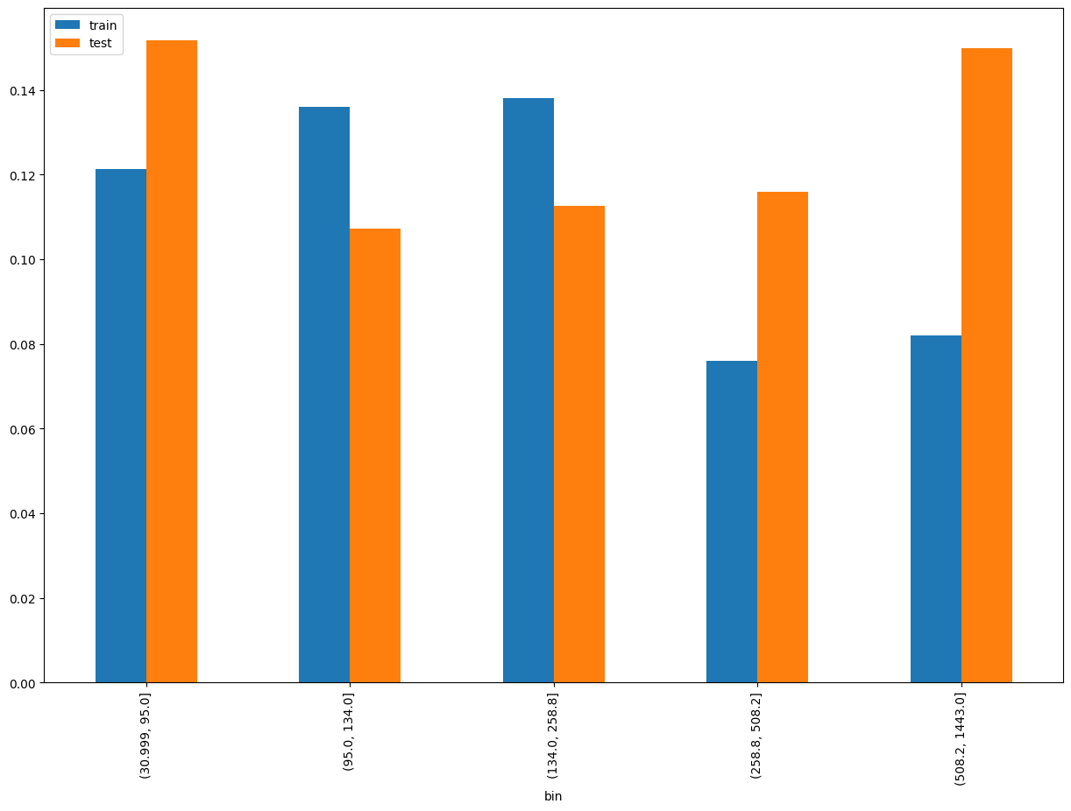
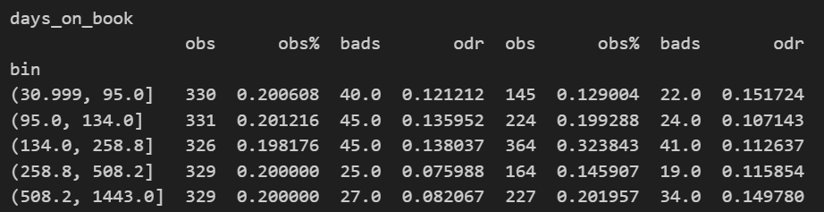
Rank# 1: days_on_book (1 / 5) - Performance in Train vs Test <Disbursed>
Days since loan applied from onboarding
11
Please note these are just WOE Bins, NOT the final Bins that Catboost chooses internally

Slide 12
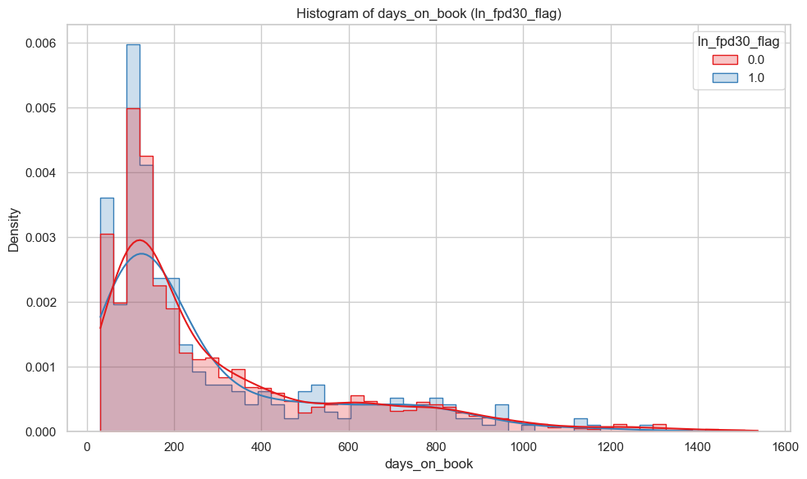
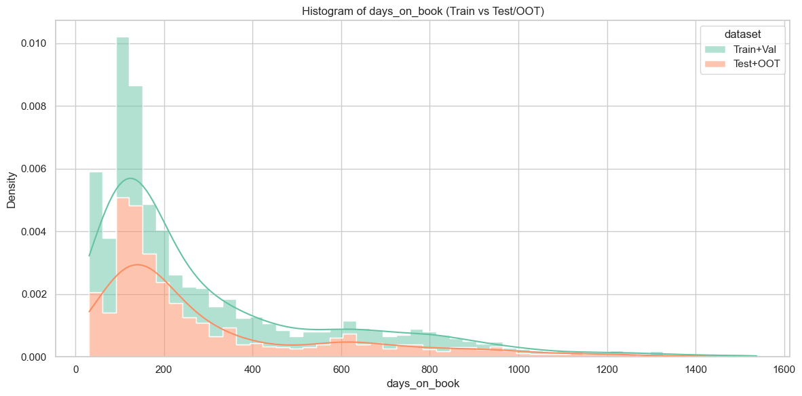
Rank# 1: days_on_book (2 / 5) - Histogram <Disbursed>
Distributions are well-aligned across datasets. Most values lie below1k with minimal density in the tail. No signs of drift, indicating feature stability.
Both good (red) and bad (blue) customers are heavily concentrated at less days_on_book from onboarding, with a steep right-skew. Bad customers show slightly higher density at very low values. Outliers above 1.4k days on book exist but are rare. Overall, distributions are very similar.
12

Slide 13

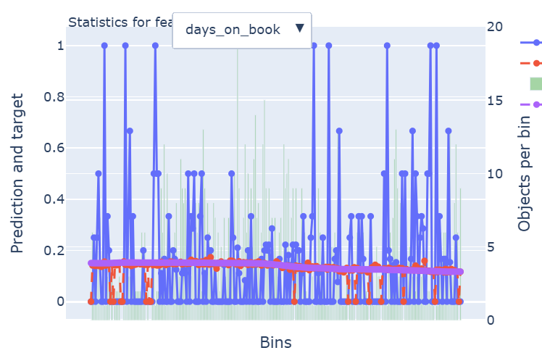
Rank# 1: days_on_book (3 / 5) - Feature Statistics Analysis <Disbursed>​
The red prediction line consistently tracks the actual target (blue), demonstrating strong alignment and model reliability.
The smooth trend with minimal fluctuations indicates a low-noise, high-signal contribution from the days_on_book feature.
A stable object distribution across bins (purple) further confirms the feature’s robustness and suitability for predictive modeling.
13

Slide 14
Rank# 1: days_on_book (4 / 5) - MoM Feature Distribution <Applied>​
days_on_book | Applied Count | Approval Rate | Mean |  | Avg. Trx Score
2024-08 | 586 | 30.4% | 299.3 |  | 0.108189
2024-09 | 613 | 28.1% | 282.2 |  | 0.108201
2024-10 | 613 | 28.2% | 308.5 |  | 0.107331
2024-11 | 770 | 34.2% | 282.8 |  | 0.110015
2024-12 | 1,481 | 30.5% | 276.1 |  | 0.111033
2025-01 | 674 | 28.3% | 295.2 |  | 0.109256
2025-02 | 721 | 30.2% | 310.9 |  | 0.109477
2025-03 | 896 | 37.8% | 313.3 |  | 0.108629
2025-04 | 1,080 | 43.5% | 298.7 |  | 0.109448
2025-05 | 1,029 | 40.0% | 306.3 |  | 0.107512
2025-06 | 993 | 35.9% | 323.7 |  | 0.108095
2025-07 | 1,070 | 34.9% | 315.9 |  | 0.106806
The mean days on book increases gradually from 299.3 to 315.9, reflecting a steady rise in user retention over time.
The consistent growth with no major fluctuations makes this feature highly useful for modeling.
14

Slide 15
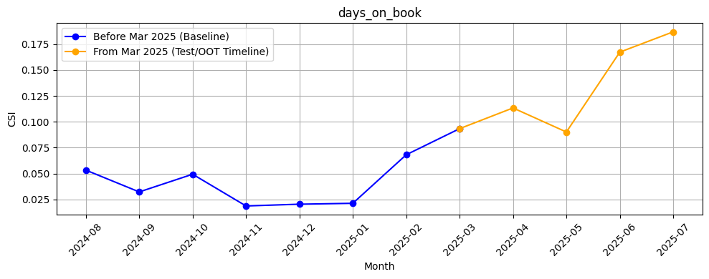
Rank# 1: days_on_book (5 / 5) - Feature CSI Analysis <Applied>​
Baseline period: Aug’2024 to Feb’2025.
CSI values for days_on_book remained relatively stable and low during the baseline period (Aug’2024 to Feb’2025), ranging from ~0.03 to ~0.09. In the Test/OOT period (Mar to Jul 2025), CSI values show a steady increase, reaching ~0.18 in July. This consistent upward trend is expected as days_on_book, increases over time. The pattern reflects the feature stable and suitable for modeling.
15

Slide 16
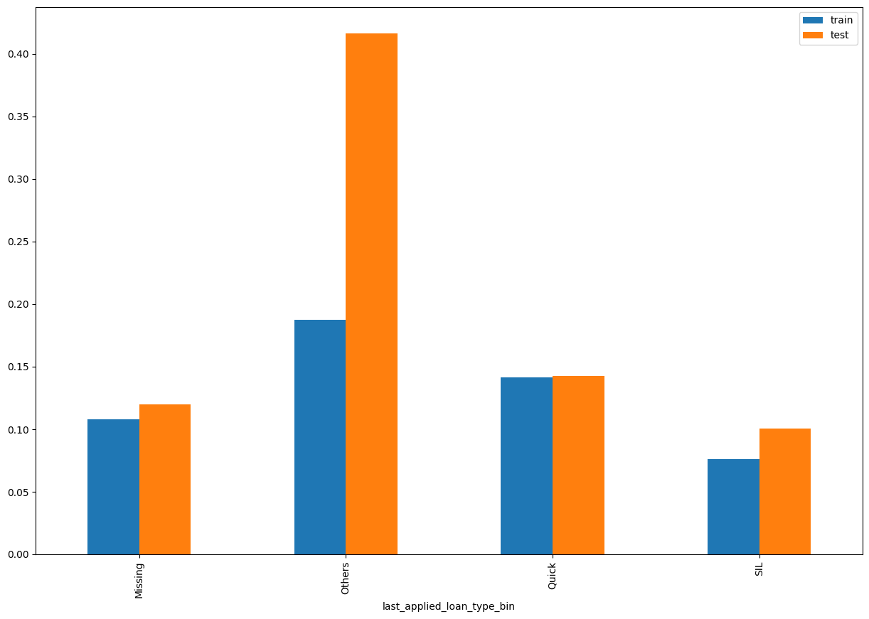
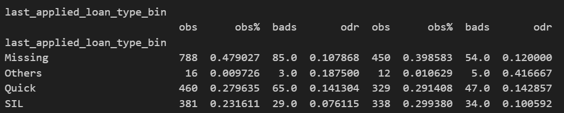
Rank# 2: last_applied_loan_type_bin (1 / 4) - Performance in Train vs Test <Disbursed>
Last applied loan type of customer
16

Slide 17
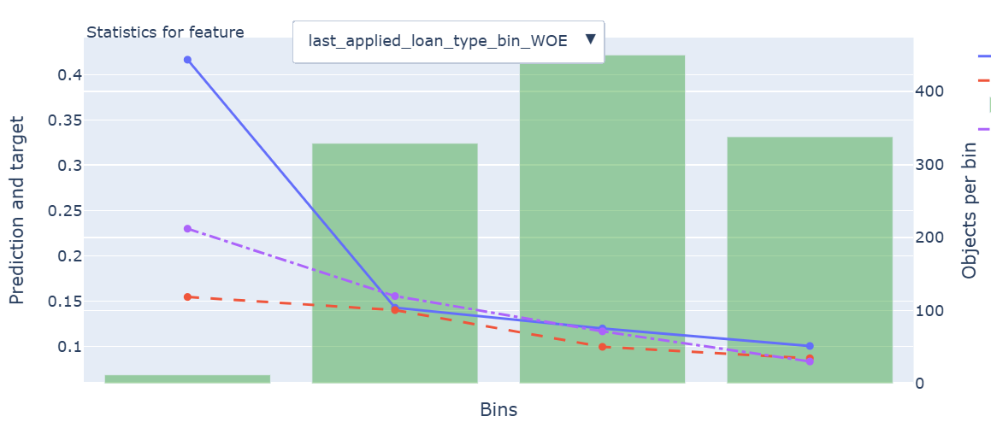
Rank# 2: last_applied_loan_type_bin (2 / 4) - Feature Statistics Analysis <Disbursed>​
The red line (model prediction) generally aligns with the blue line (actual outcome), suggesting the model understands this feature’s overall trend.
A small separation between the red and purple lines shows this feature contributes to refining predictions.
17

Slide 18
Rank# 2: last_applied_loan_type_bin (3 / 4) - MoM Feature Distribution <Applied>​
last_applied_loan_type_bin | Applied Count | Approval Rate | Missing | SIL | Quick | Others |  | Avg. Trx Score
2024-08 | 586 | 30.4% | 44.54% | 29.52% | 24.74% | 1.19% |  | 0.108189
2024-09 | 613 | 28.1% | 42.58% | 32.46% | 23.98% | 0.98% |  | 0.108201
2024-10 | 613 | 28.2% | 45.35% | 30.51% | 23.33% | 0.82% |  | 0.107331
2024-11 | 770 | 34.2% | 41.95% | 30.52% | 27.40% | 0.13% |  | 0.110015
2024-12 | 1,481 | 30.5% | 40.92% | 28.83% | 29.78% | 0.47% |  | 0.111033
2025-01 | 674 | 28.3% | 41.39% | 30.71% | 27.30% | 0.59% |  | 0.109256
2025-02 | 721 | 30.2% | 37.17% | 33.29% | 29.40% | 0.14% |  | 0.109477
2025-03 | 896 | 37.8% | 35.71% | 35.49% | 27.90% | 0.89% |  | 0.108629
2025-04 | 1,080 | 43.5% | 34.07% | 35.83% | 29.26% | 0.83% |  | 0.109448
2025-05 | 1,029 | 40.0% | 34.99% | 36.54% | 27.89% | 0.58% |  | 0.107512
2025-06 | 993 | 35.9% | 31.62% | 35.85% | 32.02% | 0.50% |  | 0.108095
2025-07 | 1,070 | 34.9% | 30.65% | 41.03% | 27.94% | 0.37% |  | 0.106806
The “Missing” category shows a steady decline from 44.54% to 30.65%, while categories like SIL and Quick maintain stable proportions with minimal fluctuations.
The feature remains stable, with no drastic shifts, making it useful for modeling user preferences regarding loan types over time.
18

Slide 19
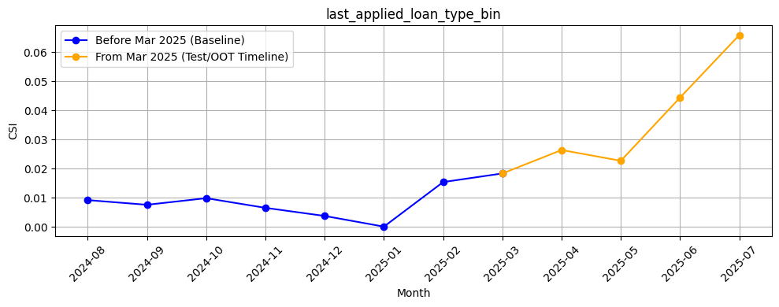
Rank# 2: last_applied_loan_type_bin (4 / 4) - Feature CSI Analysis <Applied>​
Baseline period: Aug’2024 to Feb’2025.
CSI values for last_applied_loan_type_bin were consistently low during the baseline period (Aug’2024–Feb’2025), ranging from ~0.00 to ~0.015. Although there's a gradual increase in the Test/OOT period, peaking at ~0.065 in July 2025, values remain comfortably below the 0.1 threshold. The upward trend may reflect shifting user preferences, making it a potentially valuable predictor while still maintaining distributional stability.

Slide 20
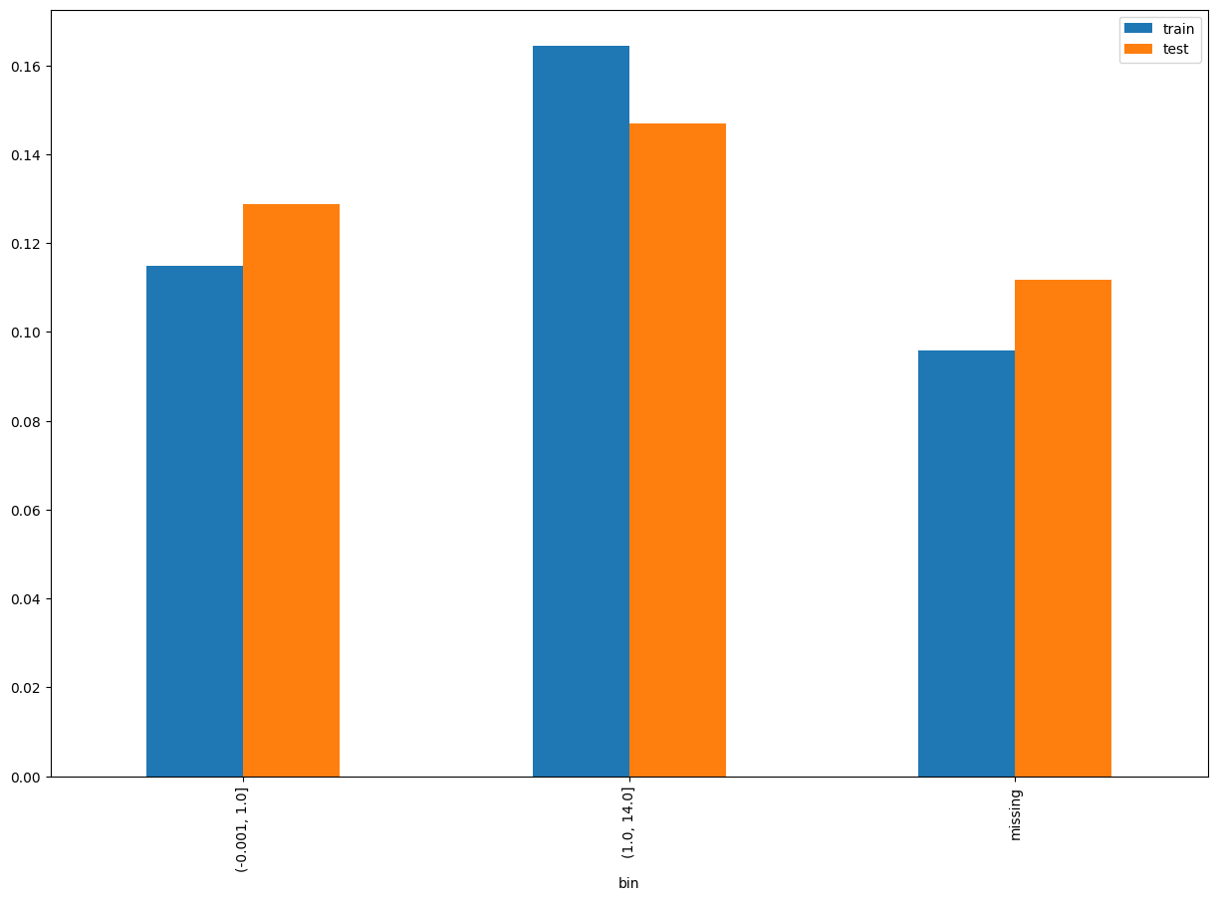
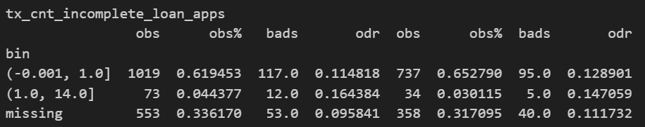
Rank# 3: tx_cnt_incomplete_loan_apps (1 / 5) - Performance in Train vs Test <Disbursed>
Total count of incomplete loan application
20
Please note these are just WOE Bins, NOT the final Bins that Catboost chooses internally

Slide 21
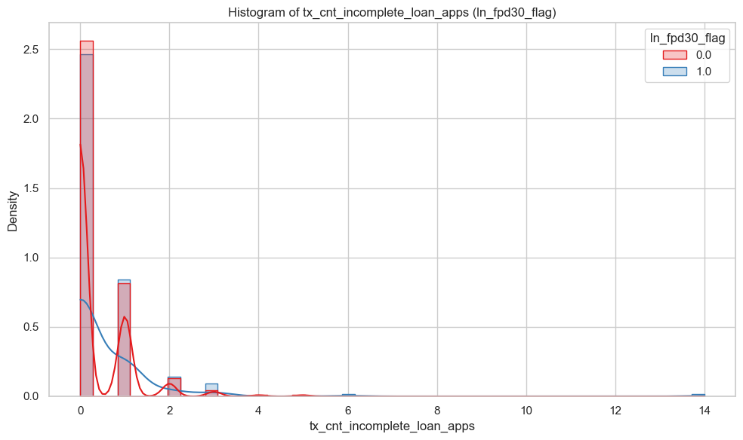
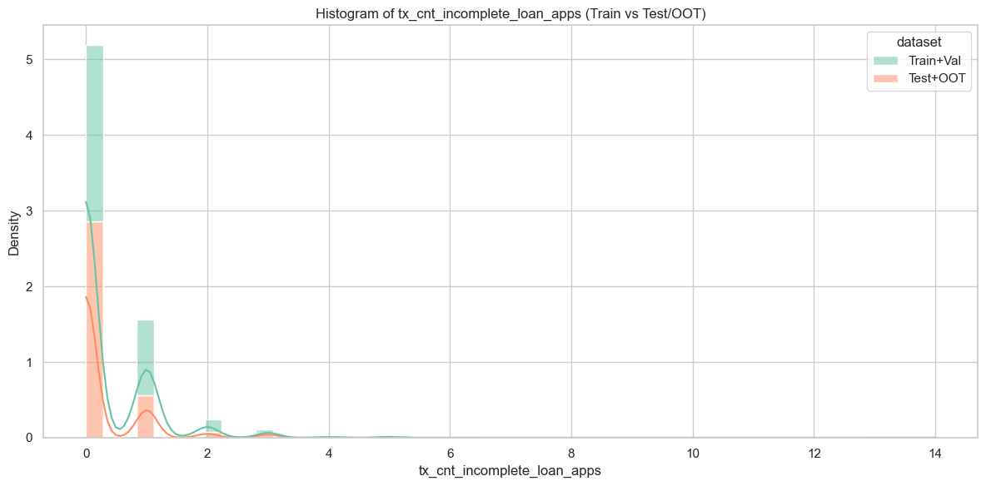
Rank# 3: tx_cnt_incomplete_loan_apps (2 / 5) - Histogram <Disbursed>
Distributions are well-aligned across datasets. Most values lie below 0-1 with minimal density in the tail. No signs of drift, indicating feature stability.
Both good (red) and bad (blue) customers are heavily concentrated between 0-1 incomplete loans, with a steep right-skew. Both customers show slightly higher density at very low values. Outliers are above 3 incomplete transaction loan application. Overall, distributions are very similar.
21

Slide 22
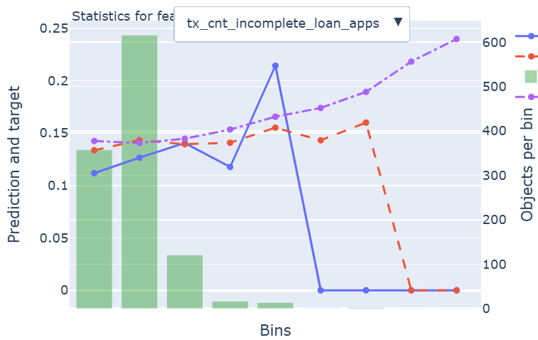
Rank# 3: tx_cnt_incomplete_loan_apps (3 / 5) - Feature Statistics Analysis <Disbursed>​
The red prediction line shows strong alignment with the target (blue) in most bins, indicating effective model learning from this feature.
Prediction stability is highest in bins with substantial data, showcasing its reliability where it matters most.
The rising object count trend (purple line) confirms this feature’s growing importance and consistent contribution to the model.
22

Slide 23
Rank# 3: tx_cnt_incomplete_loan_apps (4 / 5) - MoM Feature Distribution <Applied>​
tx_cnt_incomplete_loan_apps | Applied Count | Approval Rate | Mean |  | Avg. Trx Score
2024-08 | 586 | 30.4% | 0.45 |  | 0.108189
2024-09 | 613 | 28.1% | 0.35 |  | 0.108201
2024-10 | 613 | 28.2% | 0.39 |  | 0.107331
2024-11 | 770 | 34.2% | 0.41 |  | 0.110015
2024-12 | 1,481 | 30.5% | 0.3 |  | 0.111033
2025-01 | 674 | 28.3% | 0.31 |  | 0.109256
2025-02 | 721 | 30.2% | 0.3 |  | 0.109477
2025-03 | 896 | 37.8% | 0.25 |  | 0.108629
2025-04 | 1,080 | 43.5% | 0.26 |  | 0.109448
2025-05 | 1,029 | 40.0% | 0.17 |  | 0.107512
2025-06 | 993 | 35.9% | 0.17 |  | 0.108095
2025-07 | 1,070 | 34.9% | 0.17 |  | 0.106806
The mean value for incomplete loan applications decreases steadily from 0.45 to 0.17.
It shows excellent stability with no sudden changes, making it useful for modeling trends related to incomplete loan applications.
23

Slide 24
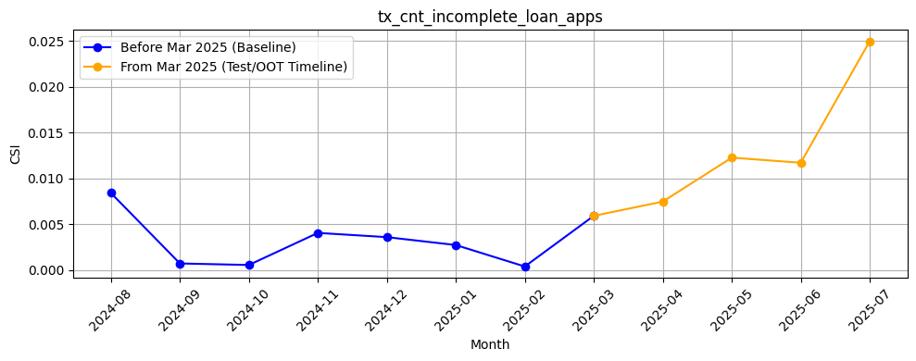
Rank# 3: tx_cnt_incomplete_loan_apps (5 / 5) - Feature CSI Analysis <Applied>​
Baseline period: Aug’2024 to Feb’2025.
CSI values for tx_cnt_incomplete_loan_apps remain extremely low throughout the baseline period and stay well below the 0.1 threshold during the Test/OOT period, peaking only at ~0.025 in July 2025. Despite a slight upward trend, the overall values indicate strong feature stability. This controlled variation may reflect evolving but valuable customer behavior, making the feature both stable and informative for modeling.
24

Slide 25
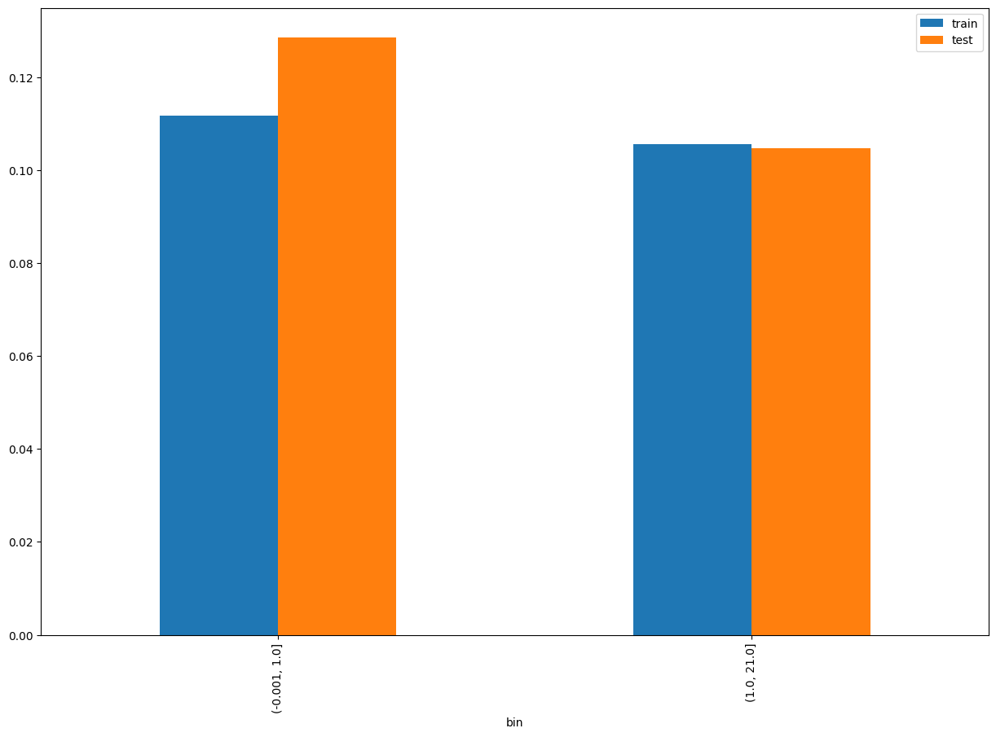
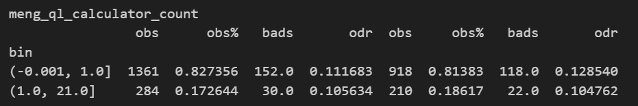
Rank# 4: meng_ql_calculator_count (1 / 5) - Performance in Train vs Test <Disbursed>
Total visit count of moengage calculator
25
Please note these are just WOE Bins, NOT the final Bins that Catboost chooses internally

Slide 26
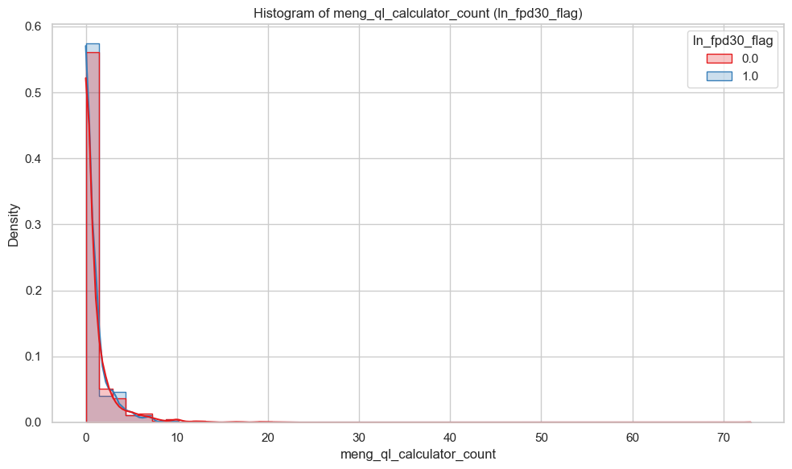
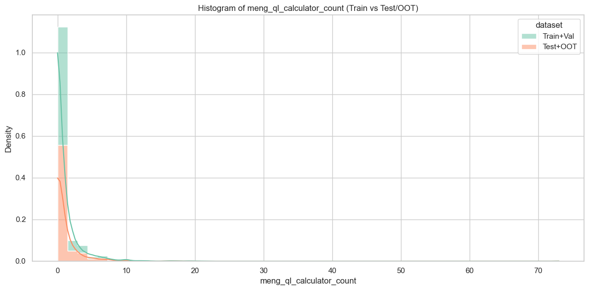
Rank# 4: meng_ql_calculator_count (2 / 5) - Histogram <Disbursed>
The distributions of meng_ql_calculator_count are highly consistent across Train+Val (green) and Test+OOT (orange) datasetsA few long-tail values (extending beyond 20) exist but have negligible density, indicating no evidence of data drift and confirming feature stability over time.
Both good (red) and bad (blue) customers are predominantly clustered between 0–5 meng_ql_calculator_count, showing a strong right-skewed distribution. While the two groups follow nearly identical patterns, bad customers (blue) appear slightly more concentrated at very low calculator counts. A few extreme outliers (above 20) are present but extremely rare. Overall, the distribution overlap is high, suggesting this feature may have limited discriminatory power between good and bad customers.
26

Slide 27
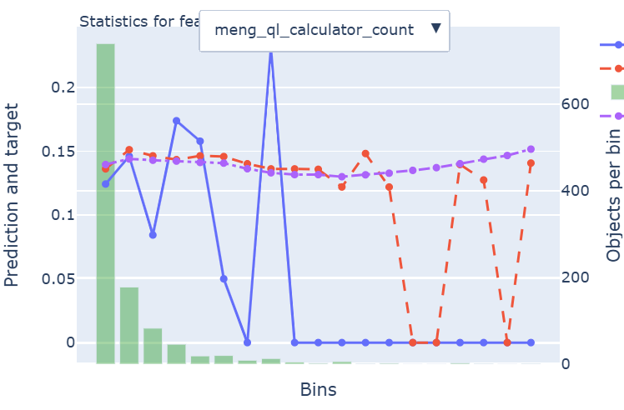
Rank# 4: meng_ql_calculator_count (3 / 5) - Feature Statistics Analysis <Disbursed>​
The red prediction line remains well-aligned with the actual target (blue) across early and mid bins, showing reliable predictive behavior.
The trend indicates meaningful signal especially in bins with higher object density, suggesting strong learning from this feature.
The steady object distribution (purple line) across bins supports its robustness and continued contribution to model performance.
27

Slide 28
Rank# 4: meng_ql_calculator_count (4 / 5) - MoM Feature Distribution <Applied>​
meng_ql_calculator_count | Applied Count | Approval Rate | Mean |  | Avg. Trx Score
2024-08 | 586 | 30.4% | 0.73 |  | 0.108189
2024-09 | 613 | 28.1% | 0.74 |  | 0.108201
2024-10 | 613 | 28.2% | 0.81 |  | 0.107331
2024-11 | 770 | 34.2% | 0.92 |  | 0.110015
2024-12 | 1,481 | 30.5% | 1.03 |  | 0.111033
2025-01 | 674 | 28.3% | 0.89 |  | 0.109256
2025-02 | 721 | 30.2% | 0.96 |  | 0.109477
2025-03 | 896 | 37.8% | 1.01 |  | 0.108629
2025-04 | 1,080 | 43.5% | 1.02 |  | 0.109448
2025-05 | 1,029 | 40.0% | 0.95 |  | 0.107512
2025-06 | 993 | 35.9% | 1.14 |  | 0.108095
2025-07 | 1,070 | 34.9% | 1.11 |  | 0.106806
The mean value increases from 0.73 to 1.11, indicating a steady rise in loan calculator usage over time.
The feature remains stable, with no significant disruptions, making it useful for modeling.
28

Slide 29
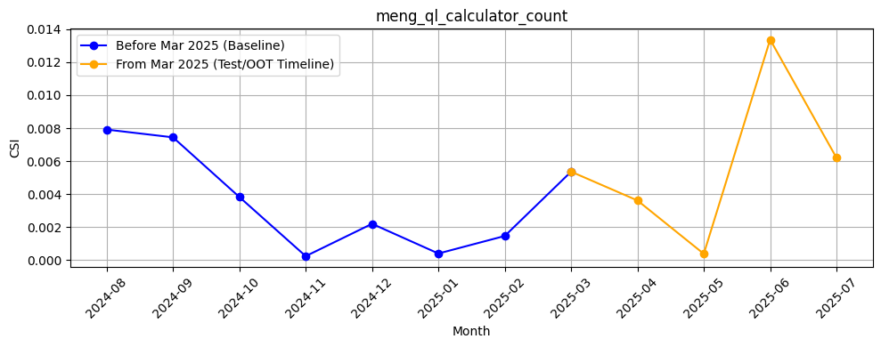
Rank# 4: meng_ql_calculator_count (5 / 5) - Feature CSI Analysis <Applied>​
Baseline period: Aug’2024 to Feb’2025.
CSI remained low and stable during training, ranging from ~0.001 to ~0.008, indicating minimal distribution shift. In the Test/OOT period (Mar to Jul 2025), CSI peaked at ~0.014 in Jun but remained well below the 0.2 threshold overall. This pattern reflects good stability with no major drift concerns making suitable for model.
29

Slide 30
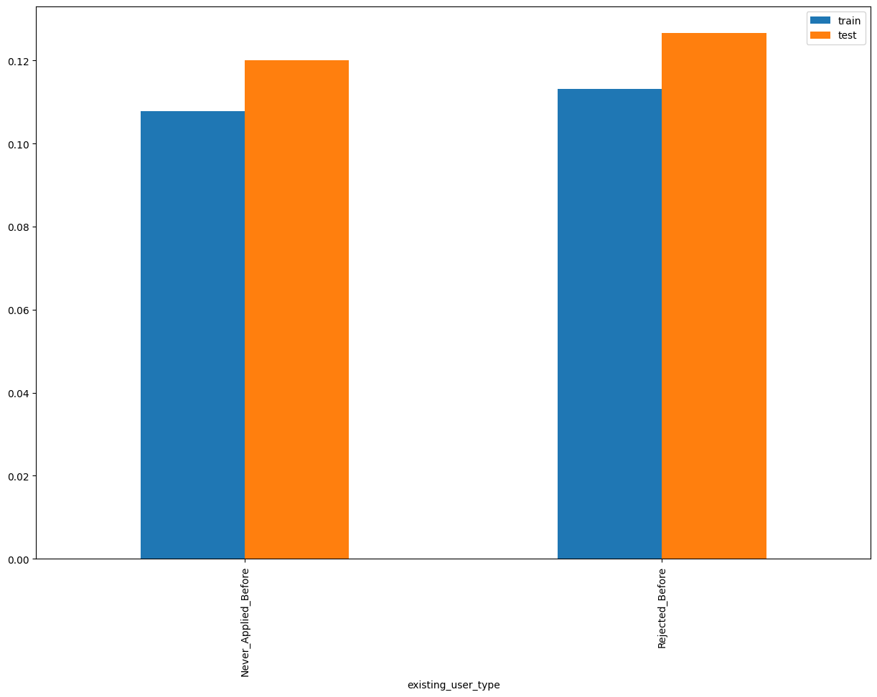
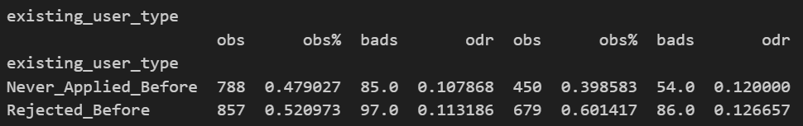
Rank# 5: existing_user_type (1 / 4) - Performance in Train vs Test <Disbursed>
Existing user type – (Never applied or Rejected before)
30

Slide 31
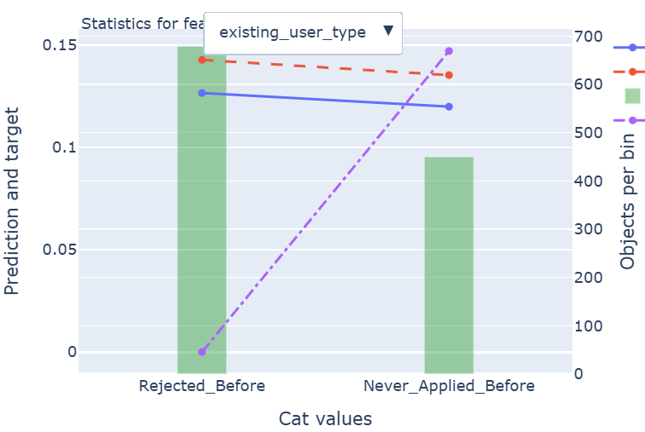
Rank# 5: existing_user_type (2 / 4) - Feature Statistics Analysis <Disbursed>​
The prediction line (red) closely follows the actual target (blue) across both categories, showing consistent model behavior. Clear separation between categories reflects the feature’s ability to distinguish user types effectively.
Balanced object distribution (green bars) across classes ensures the model learns from sufficient data in both segments.
31

Slide 32
Rank# 5: existing_user_type (3 / 4) - MoM Feature Distribution <Applied>​
existing_user_type | Applied Count | Approval Rate | Rejected_Before | Never_Applied_Before |  | Avg. Trx Score
2024-08 | 586 | 30.4% | 55.46% | 44.54% |  | 0.108189
2024-09 | 613 | 28.1% | 57.42% | 42.58% |  | 0.108201
2024-10 | 613 | 28.2% | 54.65% | 45.35% |  | 0.107331
2024-11 | 770 | 34.2% | 58.05% | 41.95% |  | 0.110015
2024-12 | 1,481 | 30.5% | 59.08% | 40.92% |  | 0.111033
2025-01 | 674 | 28.3% | 58.61% | 41.39% |  | 0.109256
2025-02 | 721 | 30.2% | 62.83% | 37.17% |  | 0.109477
2025-03 | 896 | 37.8% | 64.29% | 35.71% |  | 0.108629
2025-04 | 1,080 | 43.5% | 65.93% | 34.07% |  | 0.109448
2025-05 | 1,029 | 40.0% | 65.01% | 34.99% |  | 0.107512
2025-06 | 993 | 35.9% | 68.38% | 31.62% |  | 0.108095
2025-07 | 1,070 | 34.9% | 69.35% | 30.65% |  | 0.106806
“Rejected_Before” gradually increases, while “Never_Applied_Before” decreases inversely, with smooth transitions across the months.
The stable inverse relationship between the categories ensures this feature is reliable for modeling the distinction between repeat and first-time applicants.
32

Slide 33
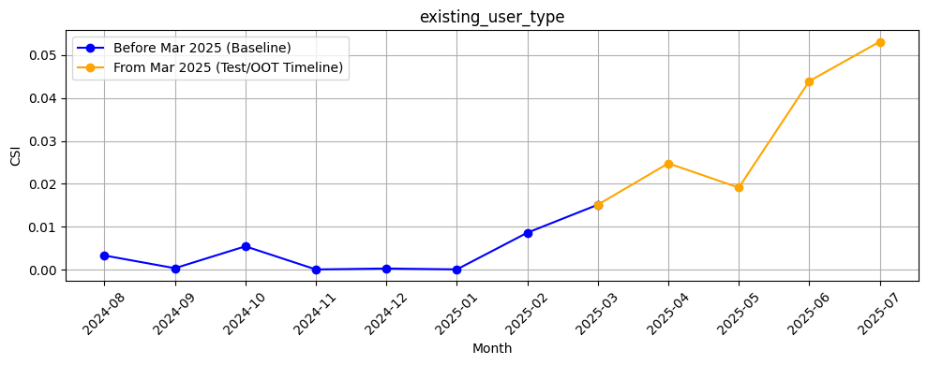
Rank# 5: existing_user_type (4 / 4) - Feature CSI Analysis <Applied>​
Baseline period: Aug’2024 to Feb’2025.
CSI values for existing_user_type remained relatively low and stable during the baseline, ranging from ~0.001 to ~0.01. In the Test/OOT period (Mar to Jul 2025), CSI values stay around ~0.03 and peaking at ~0.05 in July. While still under the 0.2 threshold, making the feature stable and suitable for model.

Slide 34
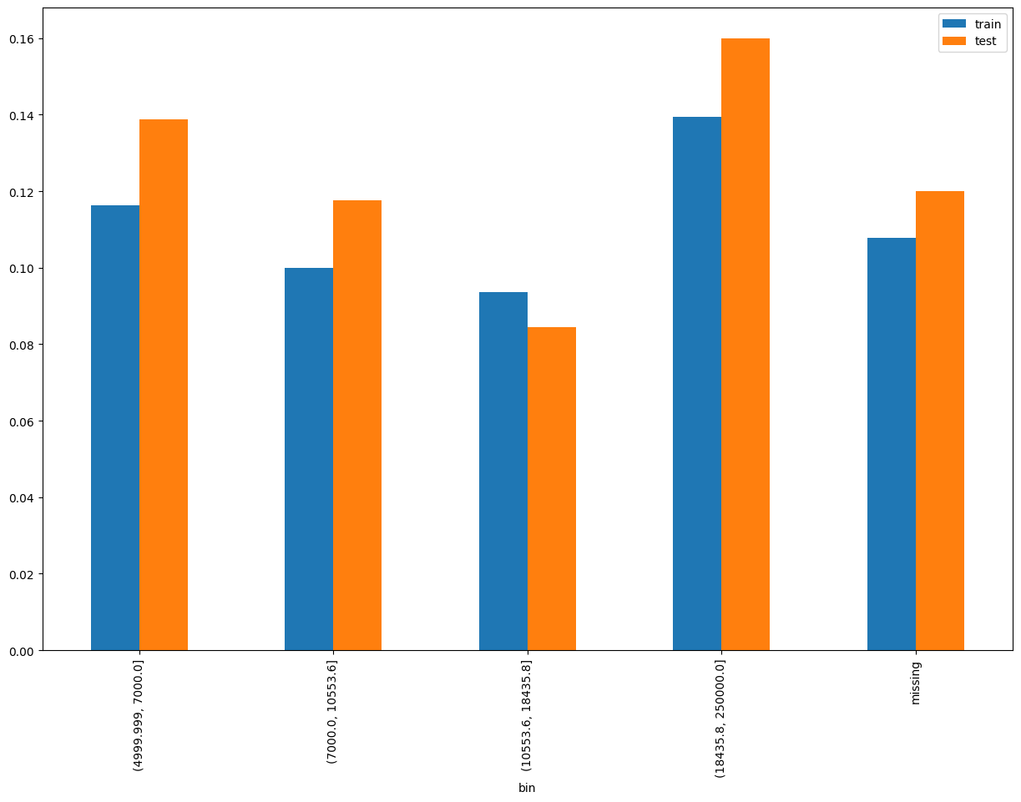
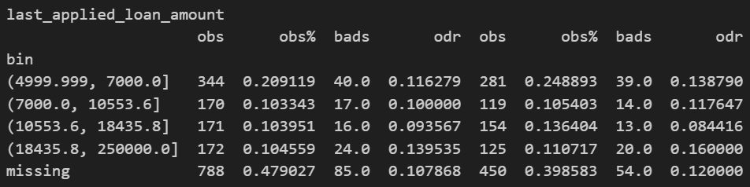
Rank# 6: last_applied_loan_amount (1 / 5) - Performance in Train vs Test <Disbursed>
Last applied loan amount
34
Please note these are just WOE Bins, NOT the final Bins that Catboost chooses internally

Slide 35
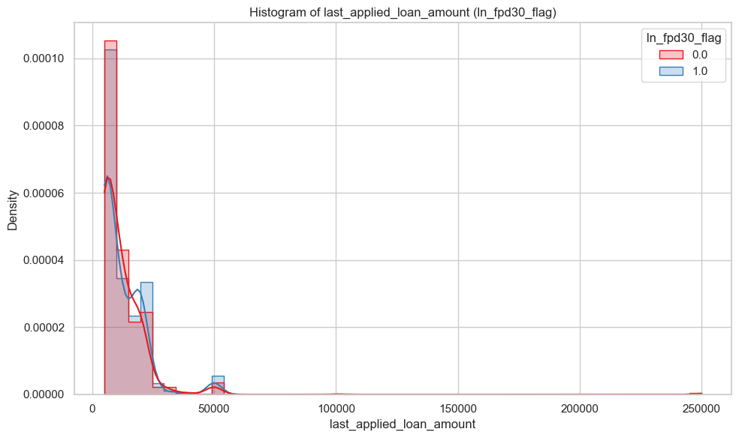
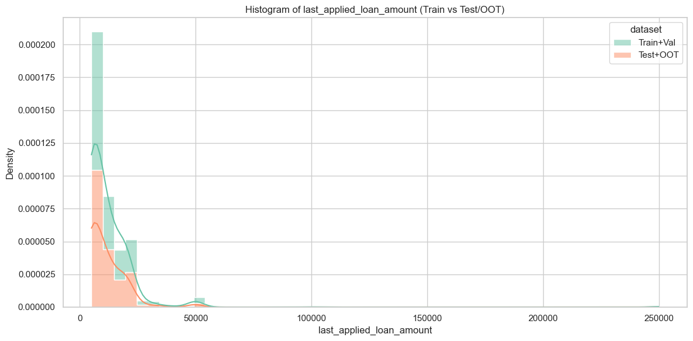
Rank# 6: last_applied_loan_amount (2 / 5) - Histogram <Disbursed>
Distributions between Train+Val (green) and Test+OOT (orange) are well-aligned and overlap closely. No significant distributional drift is observed, suggesting stable feature behavior across time.
Both good (red) and bad (blue) customers have loan amounts mostly concentrated between 5,000 to 30,000, showing a steep right-skew. Good customers show slightly higher density around 10,000 to 20,000. Values above 100,000 are rare, with both groups tapering off similarly in the long tail.
35

Slide 36
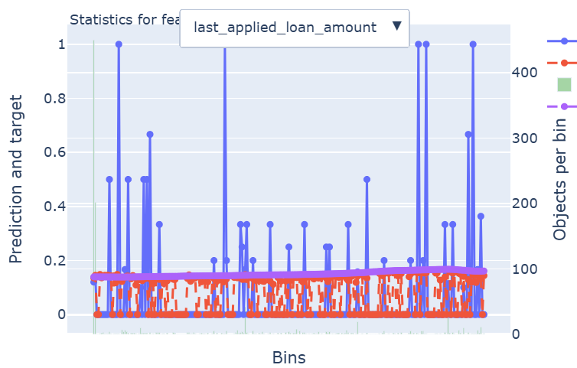
Rank# 6: last_applied_loan_amount (3 / 5) - Feature Statistics Analysis <Disbursed>​
The red prediction line consistently tracks the actual target (blue) across bins, showing strong alignment and model stability.
The trend is smooth with minimal volatility, indicating low noise and reliable signal from this feature.
Consistent object distribution in higher bins (purple line) supports the feature’s robustness and suitability for modeling.
36

Slide 37
Rank# 6: last_applied_loan_amount (4 / 5) - MoM Feature Distribution <Applied>​
last_applied_loan_amount | Applied Count | Approval Rate | Mean |  | Avg. Trx Score
2024-08 | 586 | 30.4% | 12,171 |  | 0.108189
2024-09 | 613 | 28.1% | 12,707 |  | 0.108201
2024-10 | 613 | 28.2% | 11,581 |  | 0.107331
2024-11 | 770 | 34.2% | 10,810 |  | 0.110015
2024-12 | 1,481 | 30.5% | 10,888 |  | 0.111033
2025-01 | 674 | 28.3% | 11,038 |  | 0.109256
2025-02 | 721 | 30.2% | 10,467 |  | 0.109477
2025-03 | 896 | 37.8% | 12,025 |  | 0.108629
2025-04 | 1,080 | 43.5% | 11,316 |  | 0.109448
2025-05 | 1,029 | 40.0% | 11,220 |  | 0.107512
2025-06 | 993 | 35.9% | 11,347 |  | 0.108095
2025-07 | 1,070 | 34.9% | 11,138 |  | 0.106806
Loan amounts fluctuate slightly between 12,171 and 11,138, with minimal variance.
The feature maintains stability with consistent loan amounts, making it valuable for modeling trends in loan application amounts over time.
37

Slide 38
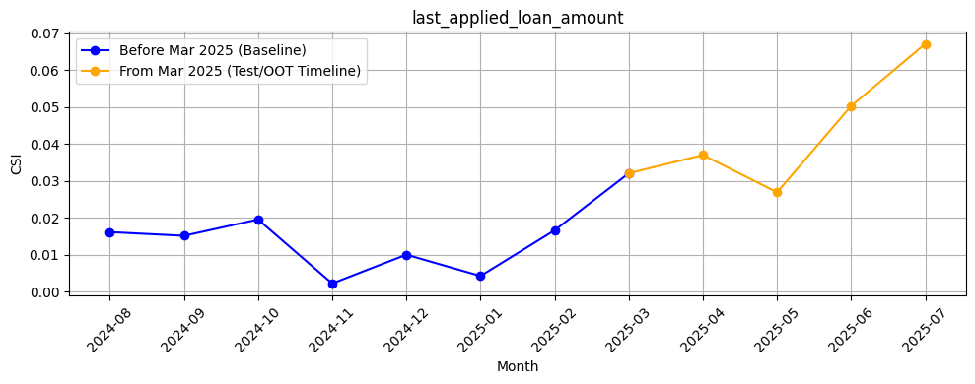
Rank# 6: last_applied_loan_amount (5 / 5) - Feature CSI Analysis <Applied>​
Baseline period: Aug’2024 to Feb’2025.
CSI values for last_applied_loan_amount remained relatively low and stable during the baseline, ranging from ~0.01 to ~0.03. In the Test/OOT period (Mar to Jul 2025), CSI values stay around the 0.03 , peaking at ~0.07 in July and remaining elevated through Jul. While still under the 0.2 threshold, this have feature stability and suitable for model
38

Slide 39

THANK YOU!
​
Questions?
tonikbank.com

