Slide 1

SIL Stacking Models Performance
Presented by:
Data Science
January 2025

Slide 2
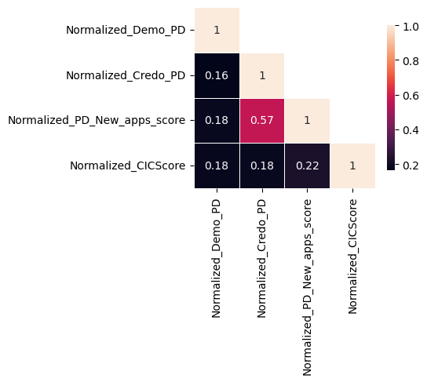
For Android Users
Beta 2 stacking - Android | 01/07/2023 - 30/06/2024 |  | 01/07/2024 - 31/07/2024 | 01/08/2024 - 31/07/2024 | 01/09/2024- 30/09/2024 | 01/10/2024- 25/10/2024
 | Train Gini (90%) | Val Gini (10%) | July Gini | Aug Gini | Sep Gini | Oct Gini
Demo -Current 16 feat Model (Catboost) – v2 | 0.4409 | 0.3812 | 0.3790 | 0.3642 | 0.3476 | 0.3070
Demo + Credo | 0.5206 | 0.5146 | 0.4395 | 0.4320 | 0.4172 | 0.3798
Demo + Apps | 0.5698 | 0.5586 | 0.4480 | 0.4286 | 0.4205 | 0.3748
Demo + Apps + Credo | 0.5789 | 0.5635 | 0.4551 | 0.4408 | 0.4317 | 0.3916
Demo + Credo + CIC | 0.5557 | 0.5226 | 0.4702 | 0.4601 | 0.4581 | 0.4158
Demo + Apps + CIC | 0.5974 | 0.5553 | 0.4719 | 0.4589 | 0.4549 | 0.4126
Demo + Apps + Credo + CIC | 0.6019 | 0.5577 | 0.4802 | 0.4667 | 0.4637 | 0.4271
Beta 2 Stack
Alpha Stack
In Beta 2 Stack, Credo is adding 1-2 ppt Gini
In Alpha Stack, Credo is adding 1 ppt Gini
Credo Score and Apps Score is moderately correlated (correlation coefficient = 0.57)

Slide 3
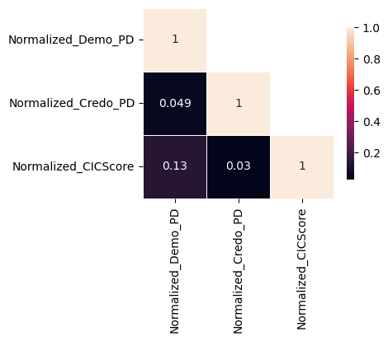
For iOS Users
Beta 2 stacking - ios | 01/07/2023 - 30/06/2024 |  | 01/07/2024 - 31/07/2024 | 01/08/2024 - 31/07/2024 | 01/09/2024- 30/09/2024 | 01/10/2024- 25/10/2024
 | Train Gini (90%) | Val Gini (10%) | July Gini | Aug Gini | Sep Gini | Oct Gini
Demo -Current 16 feat Model (Catboost) – v2 | 0.4409 | 0.3812 | 0.3790 | 0.3642 | 0.3476 | 0.3070
Demo + Credo | 0.4883 | 0.4278 | 0.3927 | 0.3373 | 0.4045 | 0.2936
Demo + CIC | 0.5061 | 0.5273 | 0.4831 | 0.3673 | 0.4373 | 0.3829
Demo + Credo + CIC | 0.5597 | 0.5104 | 0.4839 | 0.3676 | 0.4419 | 0.3938
Beta 2 Stack
Alpha Stack
In Beta 2 Stack, Credo is adding 2-6 ppt Gini
In Alpha Stack, Credo is adding 1 ppt Gini

