Slide 1

Trench 3 Demo Model for Cash
Presented by:
Data Science
09th June 2025

Slide 2
Architecture Overview of TDB’s Risk Scorecards
For Cash Loan only
For both Cash and SIL
Limit Setting Model (Hosted in Digital Layer)
Credit Decisioning Model (Hosted in Taran)
Beta Stack
Alpha Stack
Trench 1: New Users - within 30 days from TSA Onboarding
Limit Setting Score = Gamma Stack
Beta Demo Score
Beta Demo Score
Gamma Demo Score
Apps Score
Apps Score
Selectively call Alpha
Apps Score
Credo Score
Users automatically move from Trench 1 to Trench 2 after 30 days if no disbursed loans
Credo Score
CIC Score
Gamma Income Model
Beta Income Model
Alpha Income Model
Users will stay in Trench 2 until 1st disbursed loan. His Gamma Stack will be re-calculated every 30-day anniversary from TSA onboarding date
Limit Setting Score = Gamma Stack
Beta Stack
Alpha Stack
Gamma Demo Score
Beta Demo Score
Beta Demo Score
Trench 2: Existing Users - After 30 days from TSA Onboarding AND Never Disbursed Loan
Apps Score
Apps Score
Selectively call Alpha
Apps Score
Transaction Score
Transaction Score
Transaction Score
CIC Score
Gamma Income Model
Beta Income Model
Alpha Income Model
Users will move to Trench 3 after 1st Disbursed Loan
Lowest Risk users from this B Score will be pre-approved for upsell and xsell. Medium Risk users from this B Score will have to go through Taran.
High Risk users from this B Score will not be given any offer.
B Score = Gamma Stack
Trench 3: Existing Users - After 30 days from 1st Disbursed Loan AND current DPD <= 10
Beta Stack
Alpha Stack
Gamma Demo Score
Apps Score
Beta Demo Score
Beta Demo Score
Apps Score
Apps Score
Enhanced Transaction Score
Selectively call Alpha
Enhanced Transaction Score
Once moved to Trench 3, user will forever remain in Trench 3. His Gamma Stack will be re-calculated every 30 days anniversary from 1st Loan Disbursement Date
Enhanced Transaction Score
CIC Score
Gamma Income Model
Beta Income Model
Alpha Income Model

Slide 3
Cash Loan B Score Demo Scorecard was developed on Trench 3 users
 | Loan Disbursement Date | # Count | # Bad (FSPD30) Cash Loans | FSPD30 rate
Training | 01/01/2024 - 31/10/2024 | 11,653 | 1,116 | 9.6%
Nov (Validation) | 01/11/2024 - 30/11/2024 | 1,638 | 137 | 8.4%
Dec (Test) | 01/12/2024 - 31/12/2024 | 2,314 | 258 | 11.1%
Jan (OOT) | 01/01/2025 - 31/01/2025 | 2,591 | 270 | 10.4%
Feb (OOT) | 01/02/2025 - 29/02/2025 | 2,735 | 332 | 12.1%
Type of 2nd Onwards Disbursed Loans Used for Modeling – Cash Offer
Loan Type Used in Modeling | Type of Previous Disbursed Loan
Flex-up, Reloan, Quick (Organic Cash Repeat), Flex | Can be anything
Note: Only 2nd onwards disbursed loans are considered for training and testing the model. The previous loan type can be of any category.

Slide 4
Feature Selection Methodology Overview
Feature Selection Methodology Overview
34
Feats
33
Feats
30 Feats
30 Feats
11 Feats
IV > 0.01
Missing Rate < 95%
Inter-correlation < 75%
Individual Feature Evaluation

Slide 5
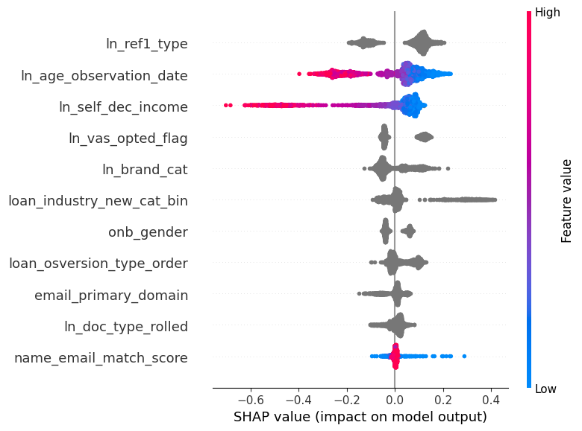
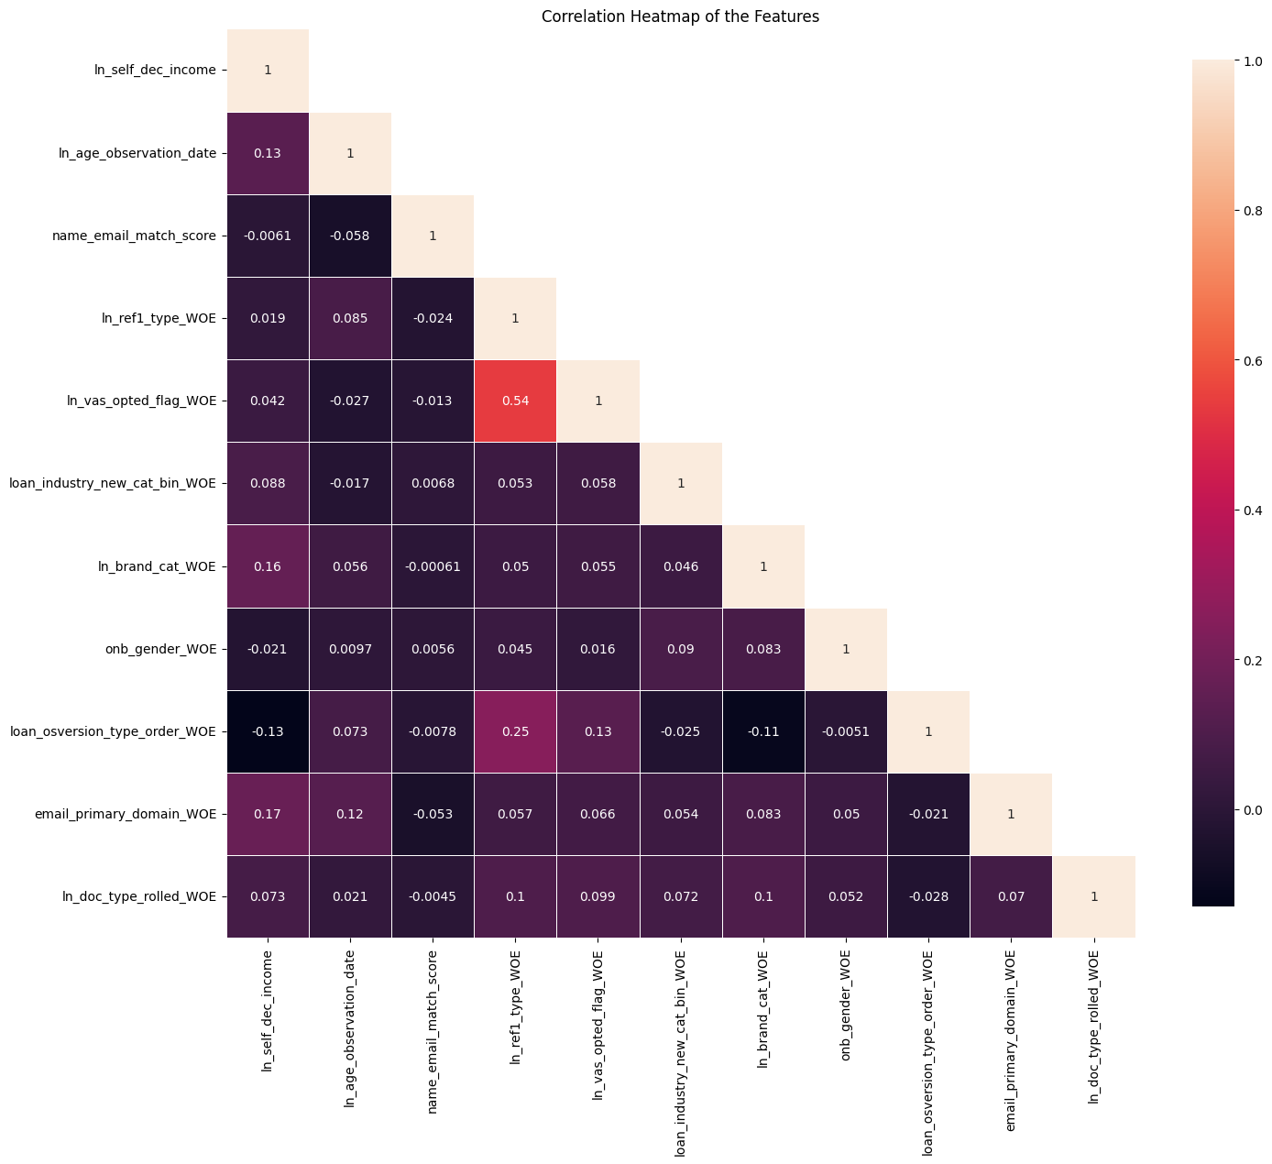
SHAP(11 feat)
Inter-Correlation (11 feat)

Slide 6
Model Iteration | Features | Train Gini (Jan'24 - Oct'24) | Val Gini (Nov'24) | Test Gini (Dec'24) | OOT Gini (Jan'25) | OOT Gini (Feb'25)
Model with top 3 feat | ln_ref1_type, ln_self_dec_income, ln_age_observation_date | 0.2539 | 0.2317 | 0.1720 | 0.1490 | 0.1846
Model with top 4 feat | ln_vas_opted_flag | 0.2688 | 0.2628 | 0.1853 | 0.1691 | 0.1576
Model with top 5 feat | loan_industry_new_cat_bin | 0.2566 | 0.2654 | 0.1804 | 0.1948 | 0.1641
Model with top 6 feat | ln_brand_cat | 0.2829 | 0.2566 | 0.1716 | 0.1839 | 0.1676
Model with top 7 feat | onb_gender | 0.2944 | 0.2512 | 0.1911 | 0.1885 | 0.1682
Model with top 8 feat | loan_osversion_type_order | 0.2825 | 0.2458 | 0.1902 | 0.1940 | 0.1704
Model with top 9 feat | email_primary_domain | 0.2844 | 0.2481 | 0.1885 | 0.1892 | 0.1619
Model with top 10 feat | ln_doc_type_rolled | 0.2965 | 0.2528 | 0.1932 | 0.1955 | 0.1680
Model with top 11 feat | name_email_match_score | 0.3065 | 0.2574 | 0.1836 | 0.1893 | 0.1642
11 feature model after Hyper Parameters Tuning |  | 0.2881 | 0.2730 | 0.1743 | 0.1906 | 0.1602

Slide 7
Feature Evaluation Plots (11 features)

Slide 8
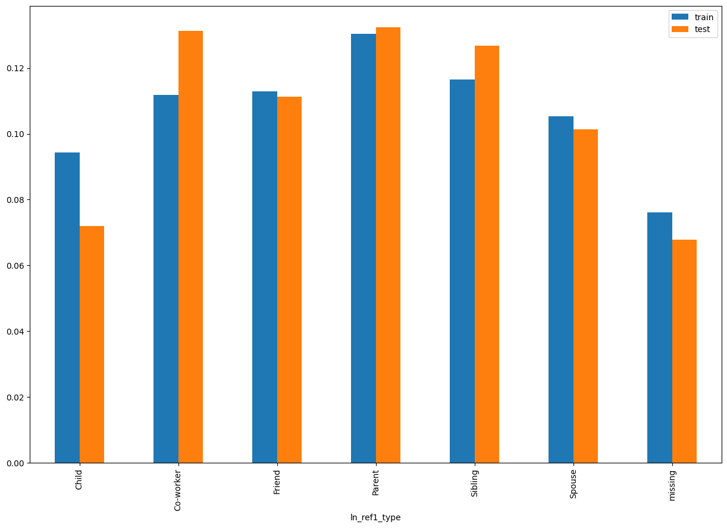
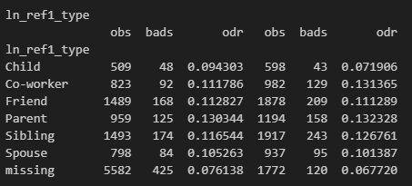
ln_ref1_type SHAP Rank: 1 Relationship of the first reference person to the individual (e.g., sibling, friend, spouse).

Slide 9
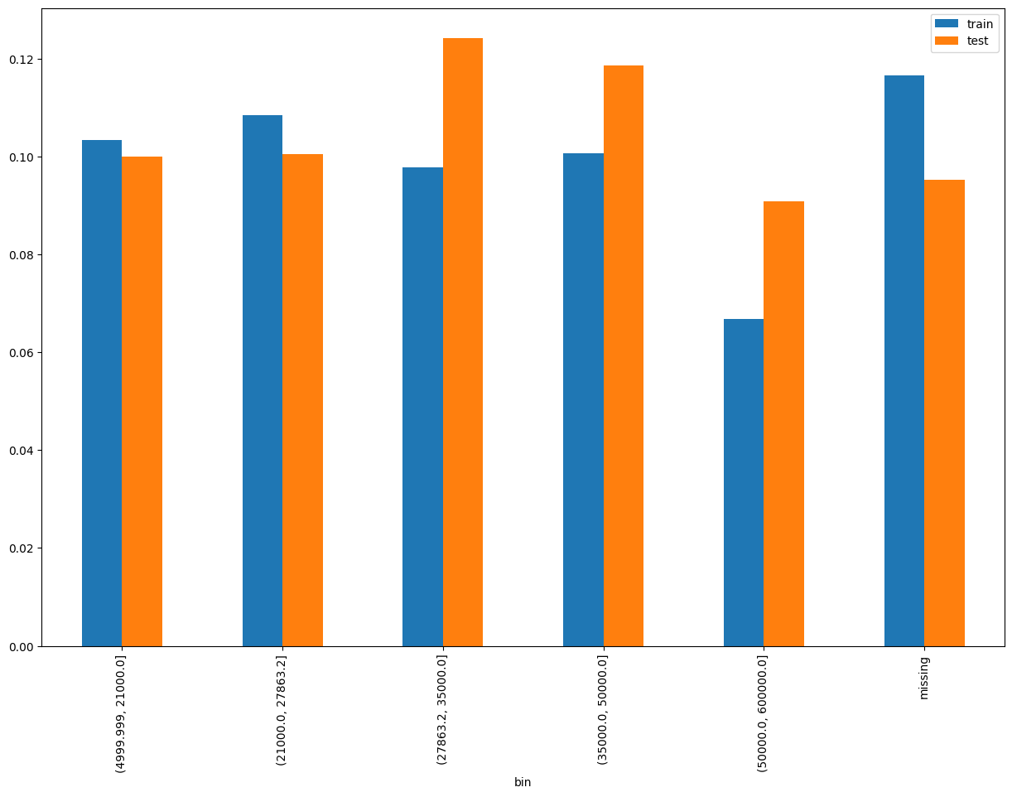
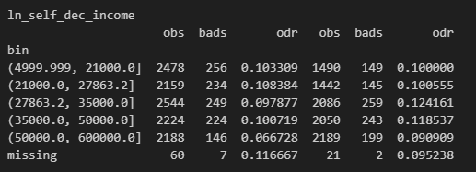
ln_self_dec_income SHAP Rank: 2 Self declared income of customer

Slide 10
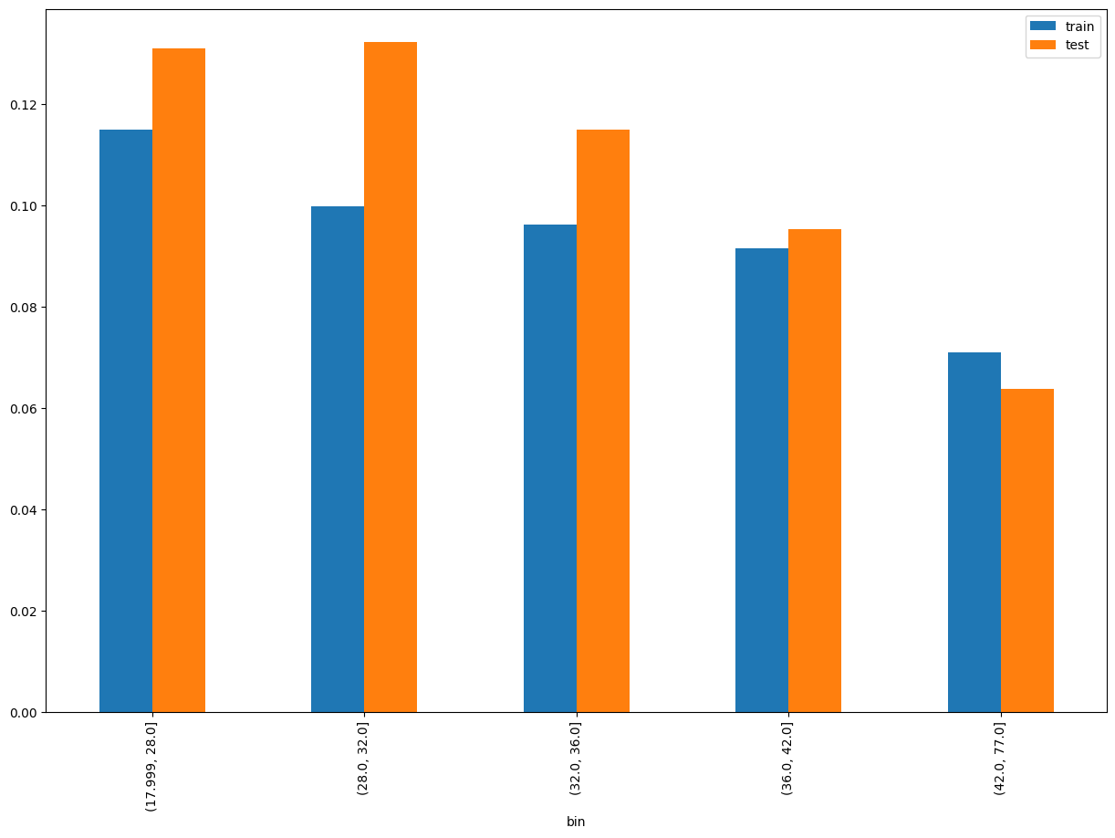
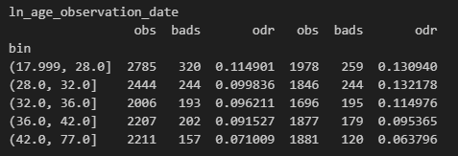
ln_age_observation_date SHAP Rank: 3 Calculates the person's age in years based on their birth date and loan application date.

Slide 11
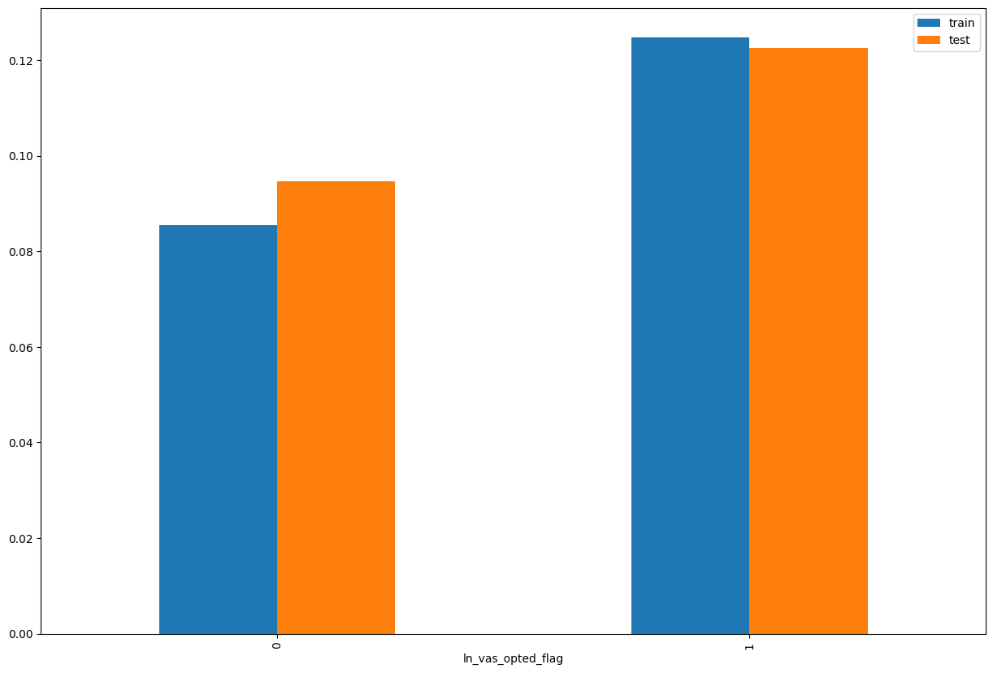
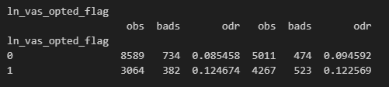
ln_vas_opted_flag SHAP Rank: 4 Indicates whether the user has opted for any value-added services, such as PayHinga (payment holiday feature).

Slide 12
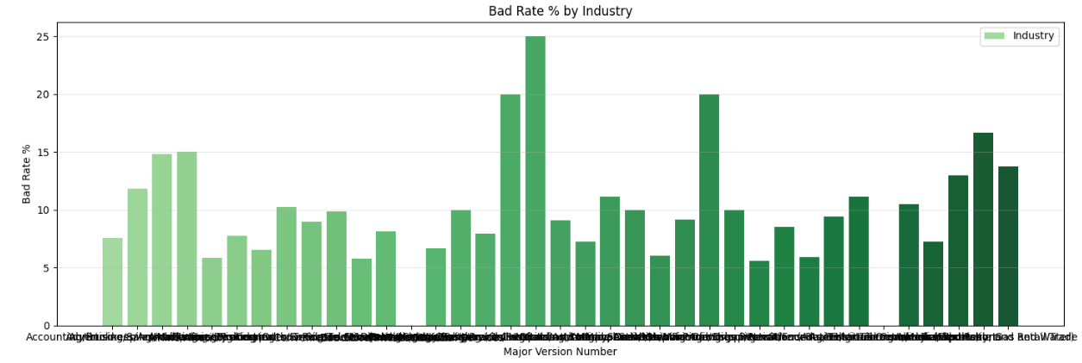
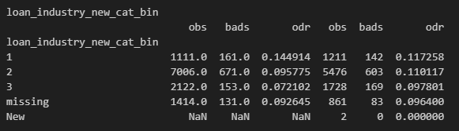
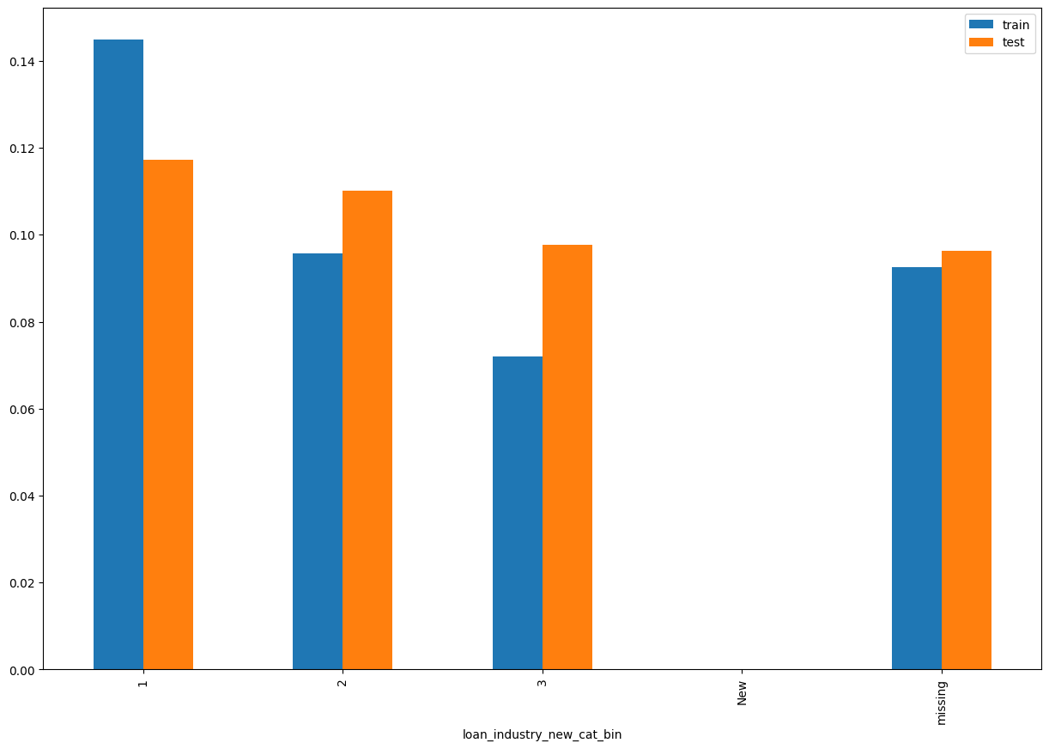
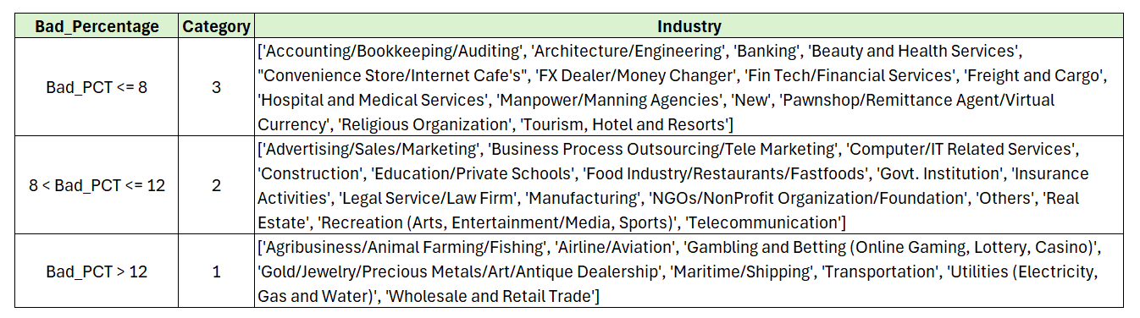
loan_industry_new_cat_bin SHAP Rank: 5 Industry category associated with the customer.

Slide 13
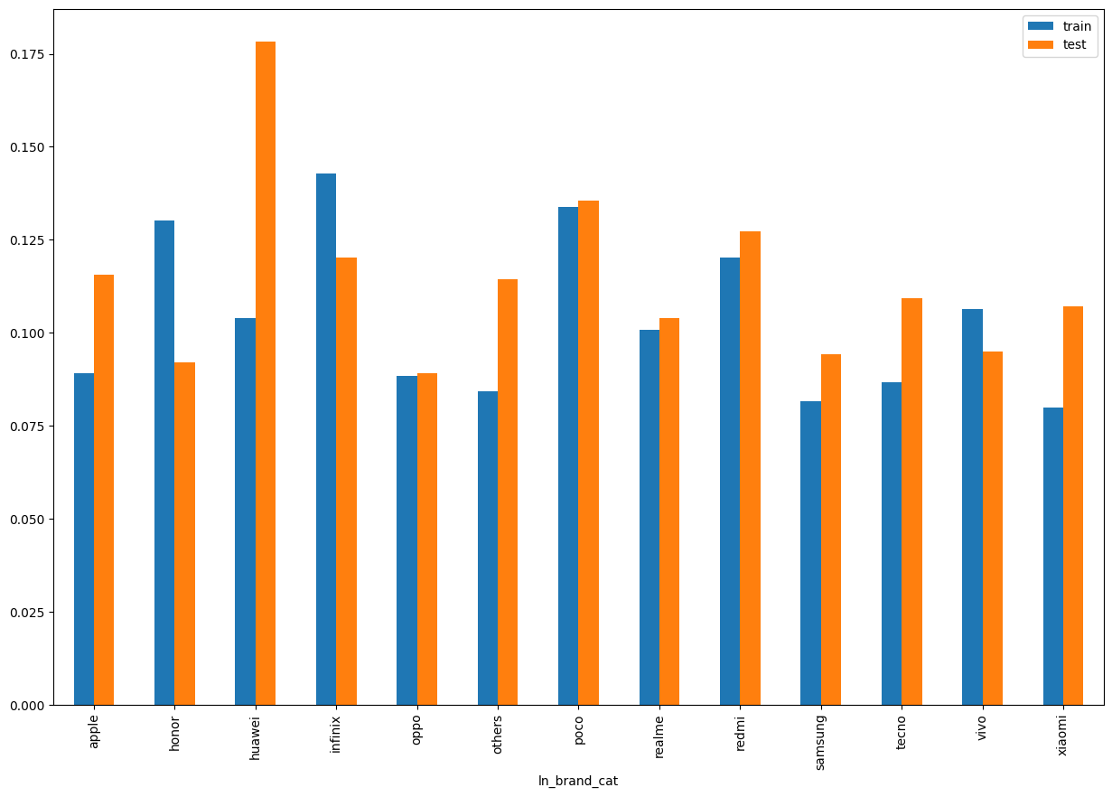
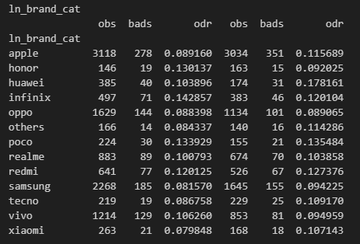
ln_brand _cat SHAP Rank: 6 Categorized mobile phone brand based on frequency, with brands having fewer than 100 records grouped as 'others'

Slide 14
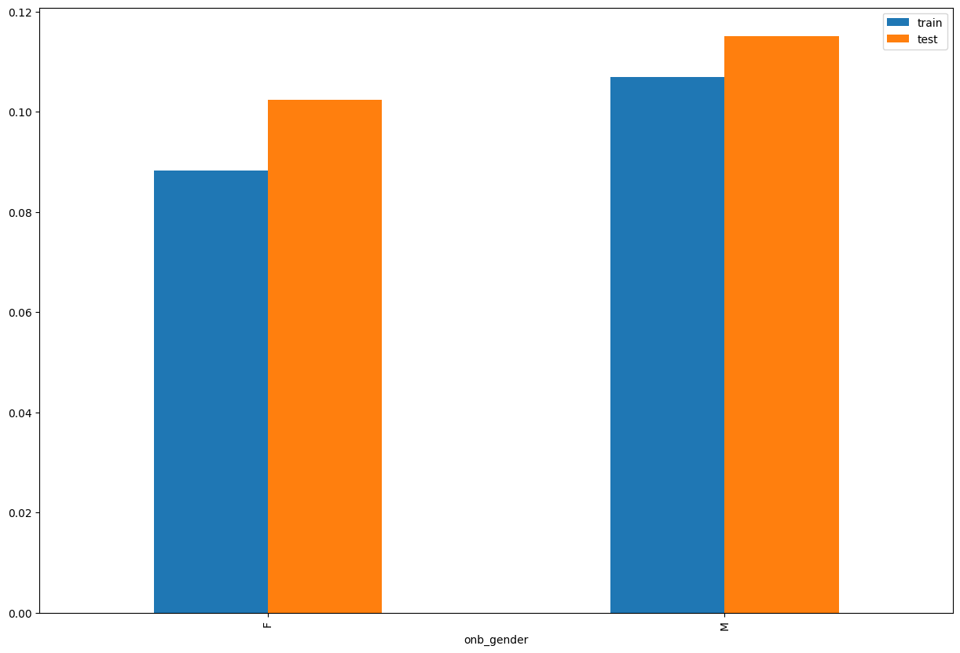
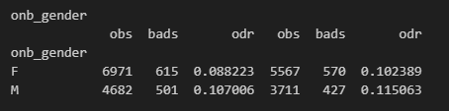
onb_gender SHAP Rank: 7 Gender of the individual, categorized as male or female.

Slide 15
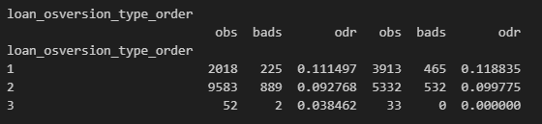
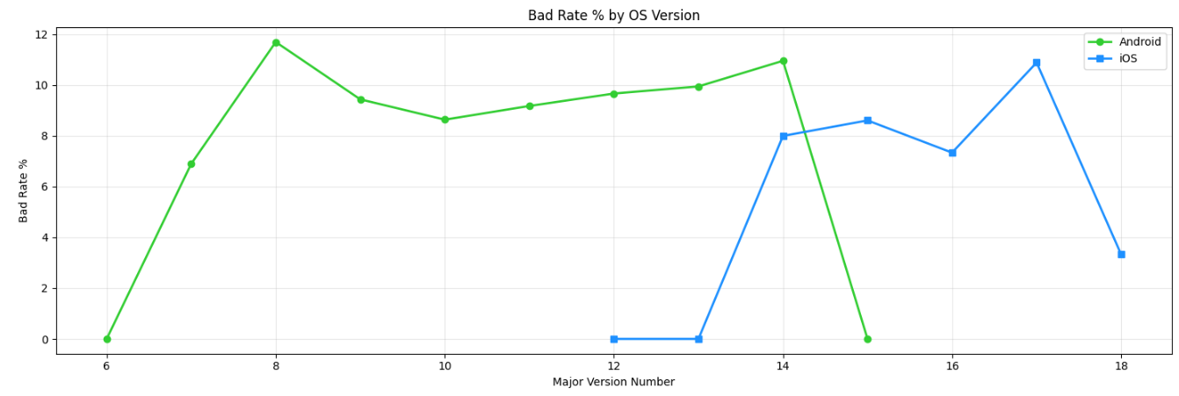
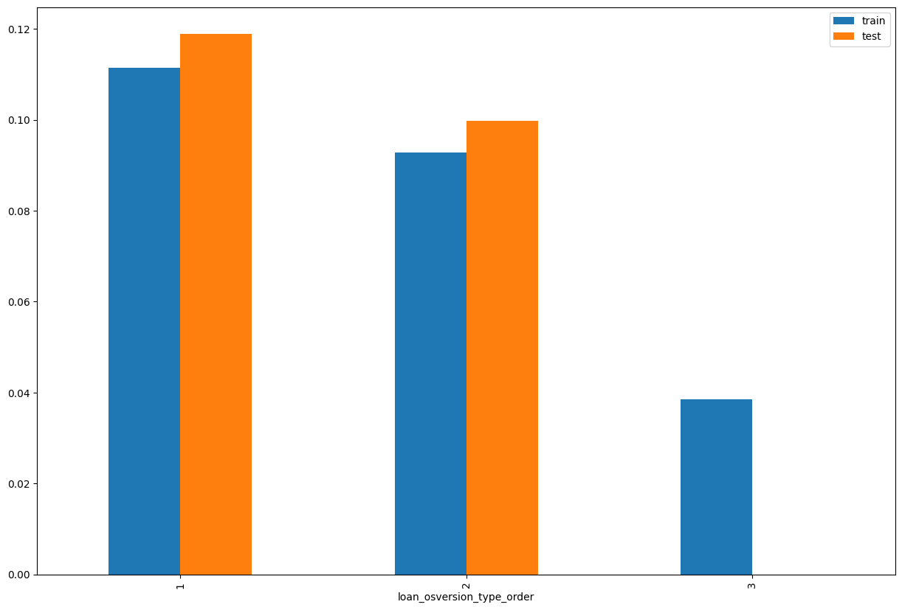
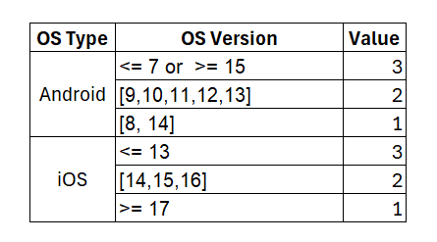
loan_osversion_type_order SHAP Rank: 8 A categorical feature that classifies the OS version of a user's device into an ordered group based on the OS type (Android or iOS) and version number.

Slide 16
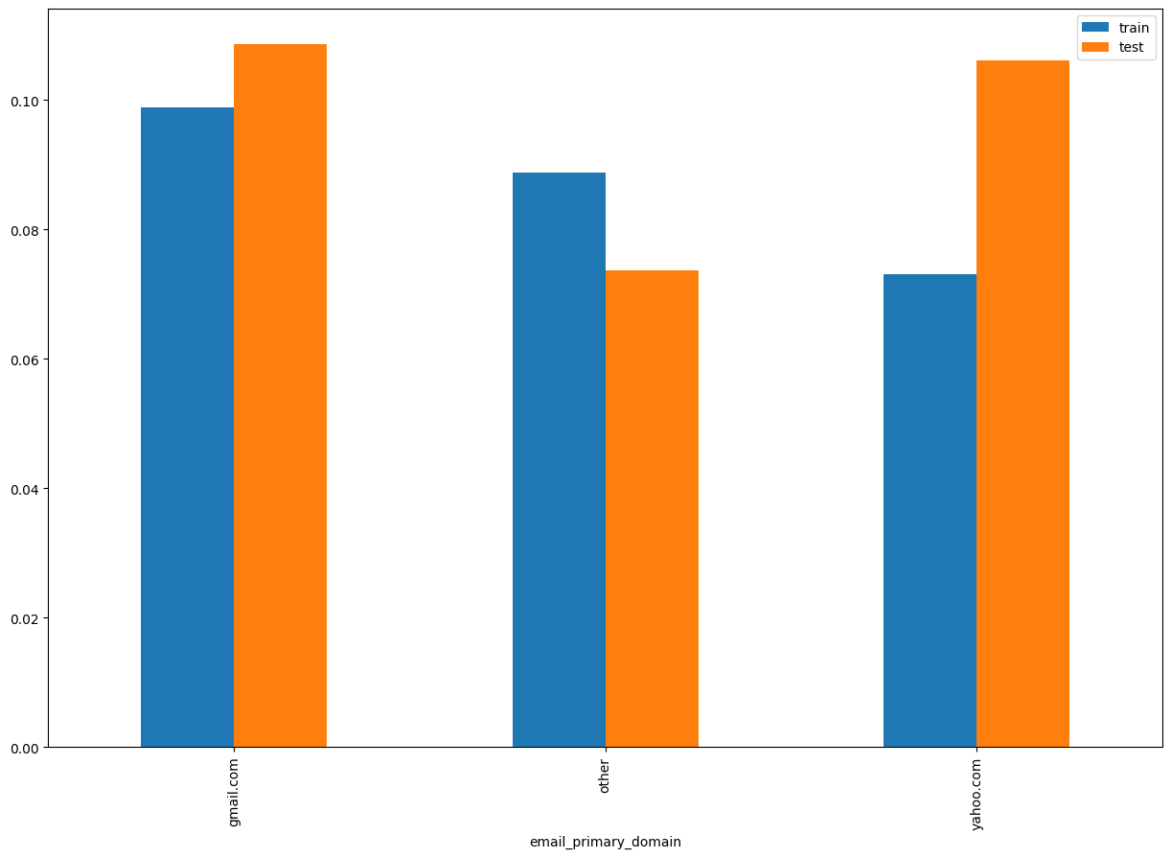
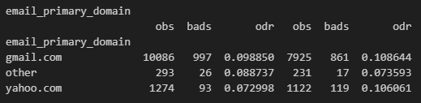
email_primary_domain SHAP Rank: 9 Extracted domain from the primary email address of the user.

Slide 17
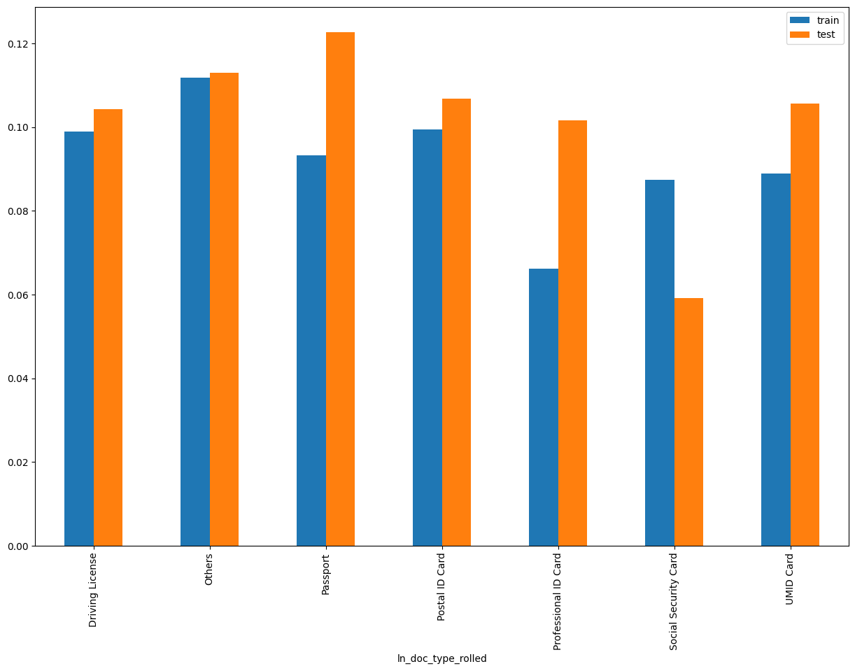
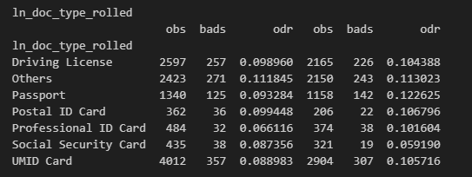
ln_doc_type_rolled SHAP Rank: 10 Document type used for identification.

Slide 18
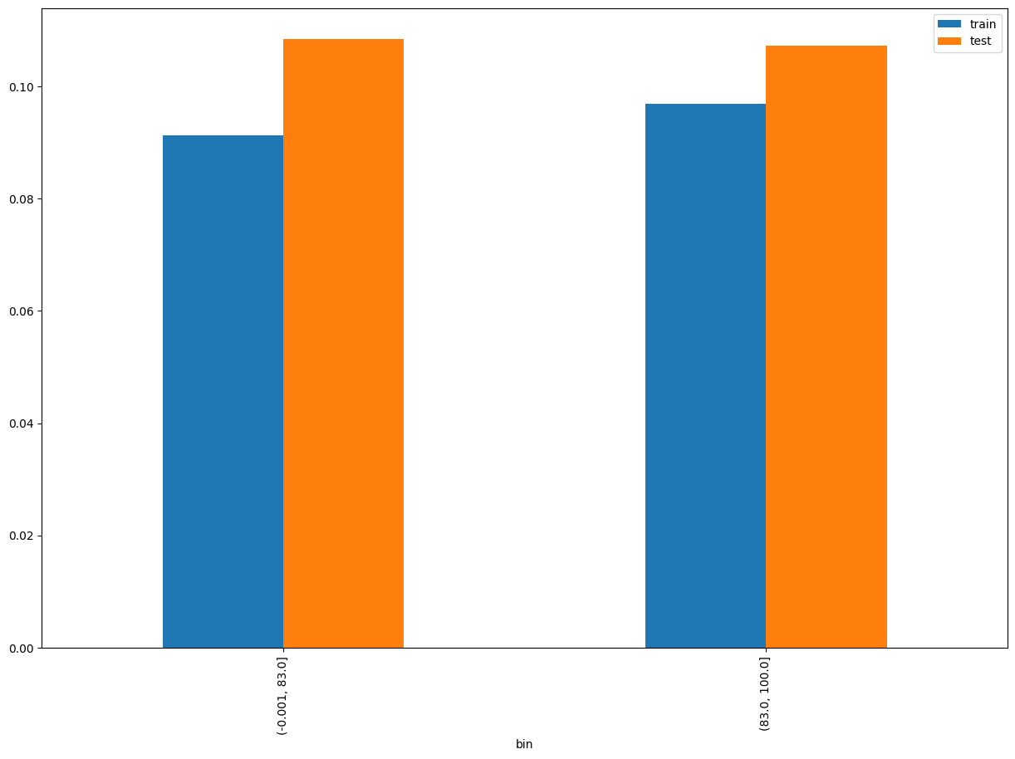
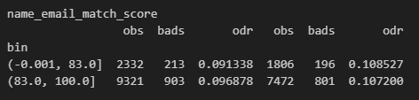
name_email_match_score SHAP Rank: 11 A numerical score (0–100) representing the highest fuzzy string similarity between a user's first name, middle name, or last name and the local part of their email address (i.e., the portion before the @ symbol).

Slide 19

THANK YOU!
​
Questions?
tonikbank.com

