Slide 1

Trench 3 Transaction Score for B Score Model for Cash
Presented by:
Data Science
12th June 2025

Slide 2
Architecture Overview of TDB’s Risk Scorecards
For Cash Loan only
For both Cash and SIL
Limit Setting Model (Hosted in Digital Layer)
Credit Decisioning Model (Hosted in Taran)
Beta Stack
Alpha Stack
Trench 1: New Users - within 30 days from TSA Onboarding
Limit Setting Score = Gamma Stack
Beta Demo Score
Beta Demo Score
Gamma Demo Score
Apps Score
Apps Score
Selectively call Alpha
Apps Score
Credo Score
Users automatically move from Trench 1 to Trench 2 after 30 days if no disbursed loans
Credo Score
CIC Score
Gamma Income Model
Beta Income Model
Alpha Income Model
Users will stay in Trench 2 until 1st disbursed loan. His Gamma Stack will be re-calculated every 30-day anniversary from TSA onboarding date
Limit Setting Score = Gamma Stack
Beta Stack
Alpha Stack
Gamma Demo Score
Beta Demo Score
Beta Demo Score
Trench 2: Existing Users - After 30 days from TSA Onboarding AND Never Disbursed Loan
Apps Score
Apps Score
Selectively call Alpha
Apps Score
Transaction Score
Transaction Score
Transaction Score
CIC Score
Gamma Income Model
Beta Income Model
Alpha Income Model
Users will move to Trench 3 after 1st Disbursed Loan
Lowest Risk users from this B Score will be pre-approved for upsell and xsell. Medium Risk users from this B Score will have to go through Taran.
High Risk users from this B Score will not be given any offer.
B Score = Gamma Stack
Trench 3: Existing Users - After 30 days from 1st Disbursed Loan AND current DPD <= 10
Beta Stack
Alpha Stack
Gamma Demo Score
Apps Score
Beta Demo Score
Beta Demo Score
Apps Score
Apps Score
Enhanced Transaction Score
Selectively call Alpha
Enhanced Transaction Score
Once moved to Trench 3, user will forever remain in Trench 3. His Gamma Stack will be re-calculated every 30 days anniversary from 1st Loan Disbursement Date
Enhanced Transaction Score
CIC Score
Gamma Income Model
Beta Income Model
Alpha Income Model

Slide 3
Cash Loan B Score Transaction Scorecard was developed on Trench 3 users
 | Loan Disbursement Date | # Count | # Bad (FSPD30) Cash Loans | FSPD30 rate
Training | 01/01/2024 - 31/10/2024 | 11,653 | 1,116 | 9.6%
Nov (Validation) | 01/11/2024 - 30/11/2024 | 1,638 | 137 | 8.4%
Dec (Test) | 01/12/2024 - 31/12/2024 | 2,314 | 258 | 11.1%
Jan (OOT) | 01/01/2025 - 31/01/2025 | 2,591 | 270 | 10.4%
Feb (OOT) | 01/02/2025 - 29/02/2025 | 3,115 | 361 | 11.6%
Type of 2nd Onwards Disbursed Loans Used for Modeling – Cash Offer
Loan Type Used in Modeling | Type of Previous Disbursed Loan
Flex-up, Reloan, Quick (Organic Cash Repeat), Flex | Can be anything
Note: Only 2nd onwards disbursed loans are considered for training and testing the model. The previous loan type can be of any category.

Slide 4
FSPD30 rate month-on-month (Cash)
 | Overall |  |  | Quick |  |  | Reloan |  |  | Flex-up
Vintage | # Count | # Bad (FSPD30) | FSPD30 rate | # Count | # Bad (FSPD30) | FSPD30 rate | # Count | # Bad (FSPD30) | FSPD30 rate | # Count | # Bad (FSPD30) | FSPD30 rate
2024-01 | 788 | 58 | 7.36% | 54 | 6 | 11.11% | 440 | 33 | 7.50% | 284 | 18 | 6.34%
2024-02 | 876 | 77 | 8.79% | 106 | 11 | 10.38% | 413 | 34 | 8.23% | 355 | 32 | 9.01%
2024-03 | 999 | 109 | 10.91% | 140 | 26 | 18.57% | 447 | 37 | 8.28% | 412 | 46 | 11.17%
2024-04 | 1,022 | 100 | 9.78% | 155 | 15 | 9.68% | 420 | 26 | 6.19% | 447 | 59 | 13.20%
2024-05 | 1,028 | 95 | 9.24% | 203 | 20 | 9.85% | 310 | 19 | 6.13% | 515 | 56 | 10.87%
2024-06 | 793 | 65 | 8.20% | 208 | 24 | 11.54% | 226 | 15 | 6.64% | 359 | 26 | 7.24%
2024-07 | 1,181 | 109 | 9.23% | 248 | 29 | 11.69% | 441 | 27 | 6.12% | 492 | 53 | 10.77%
2024-08 | 1,573 | 196 | 12.46% | 413 | 56 | 13.56% | 427 | 36 | 8.43% | 733 | 104 | 14.19%
2024-09 | 1,714 | 167 | 9.74% | 531 | 67 | 12.62% | 533 | 47 | 8.82% | 650 | 53 | 8.15%
2024-10 | 1,679 | 140 | 8.34% | 589 | 73 | 12.39% | 523 | 28 | 5.35% | 567 | 39 | 6.88%
2024-11 | 1,638 | 137 | 8.36% | 559 | 65 | 11.63% | 644 | 45 | 6.99% | 435 | 27 | 6.21%
2024-12 | 2,314 | 258 | 11.15% | 860 | 156 | 18.14% | 584 | 36 | 6.16% | 870 | 66 | 7.59%
2025-01 | 2,591 | 270 | 10.42% | 914 | 130 | 14.22% | 1,072 | 92 | 8.58% | 605 | 48 | 7.93%
2025-02 | 3,115 | 361 | 11.59% | 791 | 112 | 14.16% | 1,429 | 175 | 12.25% | 895 | 74 | 8.27%
Overall | 21,311 | 2,142 | 10.05% | 5,771 | 790 | 13.69% | 7,909 | 650 | 8.22% | 7,619 | 701 | 9.20%
Notes:
Yet to update

Slide 5
Feature Selection Methodology Overview
303
Feats
204
Feats
120 Feats
71 Feats
14 Feats
Missing Rate <= 90%
IV > 0.008
Inter-correlation < 70%
Individual Feature Evaluation

Slide 6
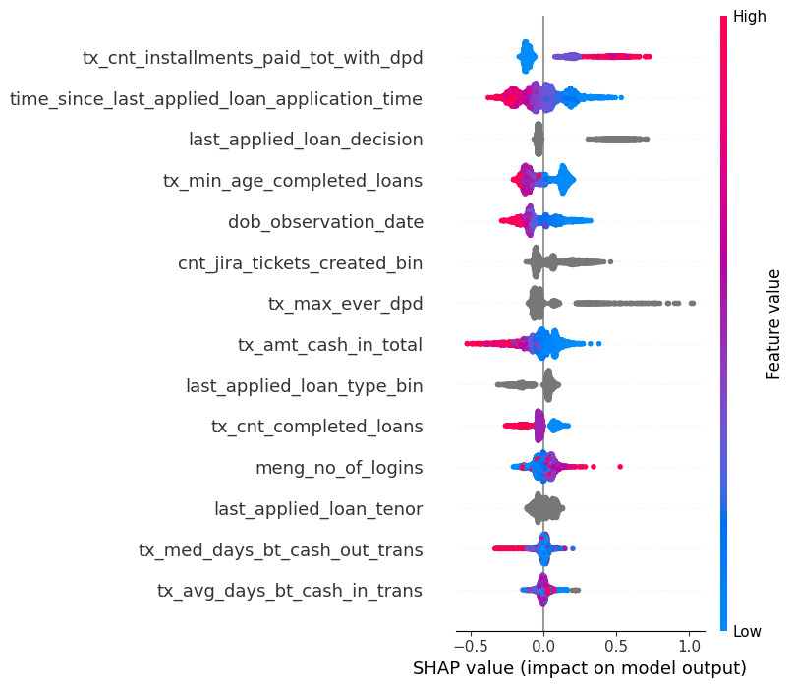
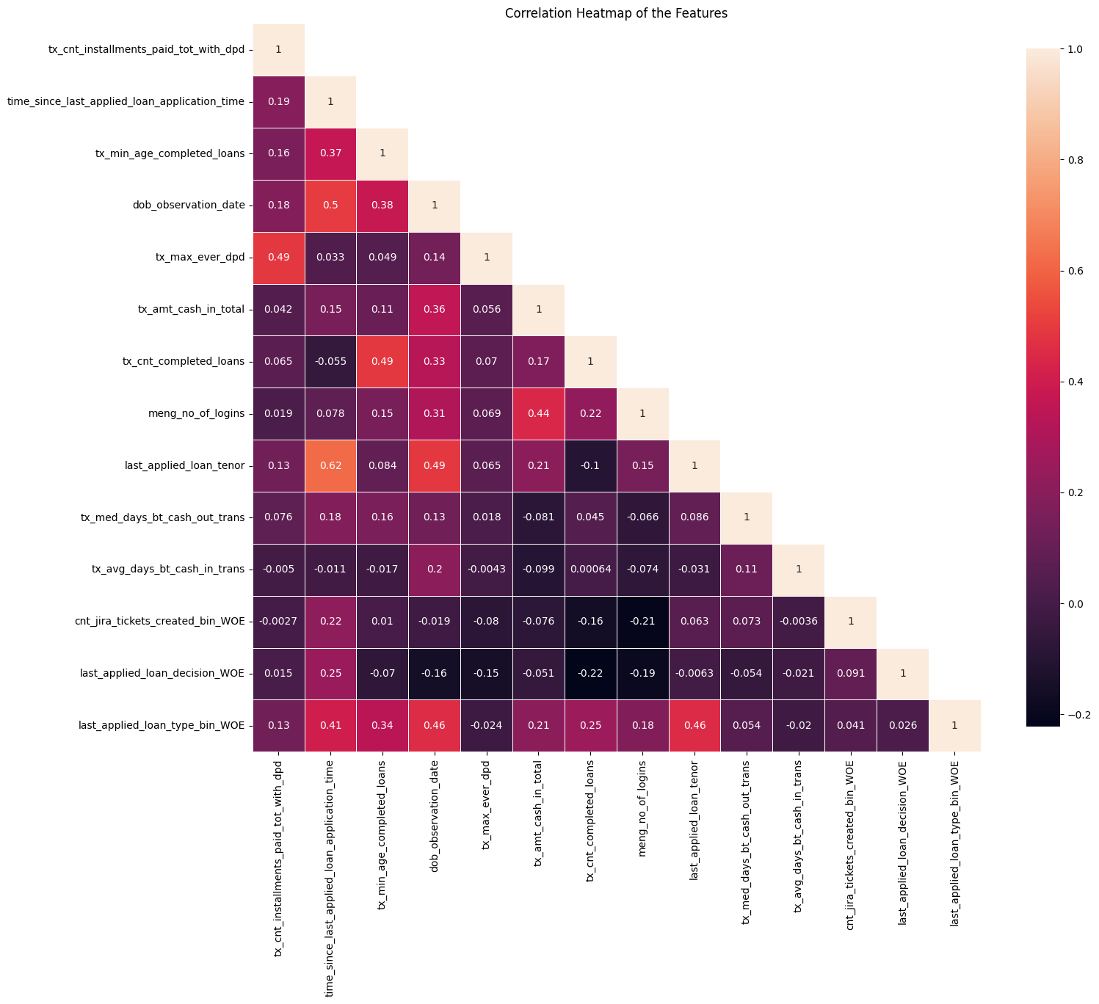
SHAP (14 feat)
Inter-Correlation (14 feat)

Slide 7
Model Iteration | Features | Train Gini (Jan'24 - Oct'24) | Val Gini (Nov'24) | Test Gini (Dec'24) | OOT Gini (Jan'25) | OOT Gini (Feb'25)
Model with top 5 feat | tx_cnt_installments_paid_tot_with_dpd, time_since_last_applied_loan_application_time, last_applied_loan_decision, tx_min_age_completed_loans, dob_observation_date | 0.3906 | 0.3435 | 0.2487 | 0.2439 | 0.2127
Model with top 6 feat | cnt_jira_tickets_created_bin | 0.3659 | 0.3367 | 0.2693 | 0.2370 | 0.2358
Model with top 7 feat | tx_max_ever_dpd | 0.3875 | 0.3375 | 0.2832 | 0.2312 | 0.2383
Model with top 8 feat | tx_amt_cash_in_total | 0.4139 | 0.3870 | 0.2948 | 0.2497 | 0.2490
Model with top 9 feat | last_applied_loan_type_bin | 0.4096 | 0.3909 | 0.2929 | 0.2481 | 0.2539
Model with top 10 feat | tx_cnt_completed_loans | 0.4109 | 0.3940 | 0.2993 | 0.2455 | 0.2636
Model with top 11 feat | meng_no_of_logins | 0.4104 | 0.3941 | 0.3041 | 0.2481 | 0.2528
Model with top 12 feat | last_applied_loan_tenor | 0.4287 | 0.3895 | 0.3118 | 0.2494 | 0.2533
Model with top 13 feat | tx_med_days_bt_cash_out_trans | 0.4616 | 0.3967 | 0.3178 | 0.2389 | 0.2472
Model with top 14 feat | tx_avg_days_bt_cash_in_trans | 0.4337 | 0.3956 | 0.3118 | 0.2493 | 0.2549
Model with top 15 feat | cs_contactable_last_90d_cnt | 0.4755 | 0.3945 | 0.3154 | 0.2358 | 0.2522
14 feature model after Hyper Parameters Tuning |  | 0.4086 | 0.3963 | 0.3025 | 0.2625 | 0.2651

Slide 8
Feature Evaluation Plots (14 features)

Slide 9
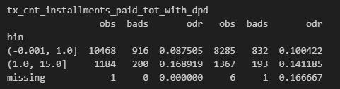
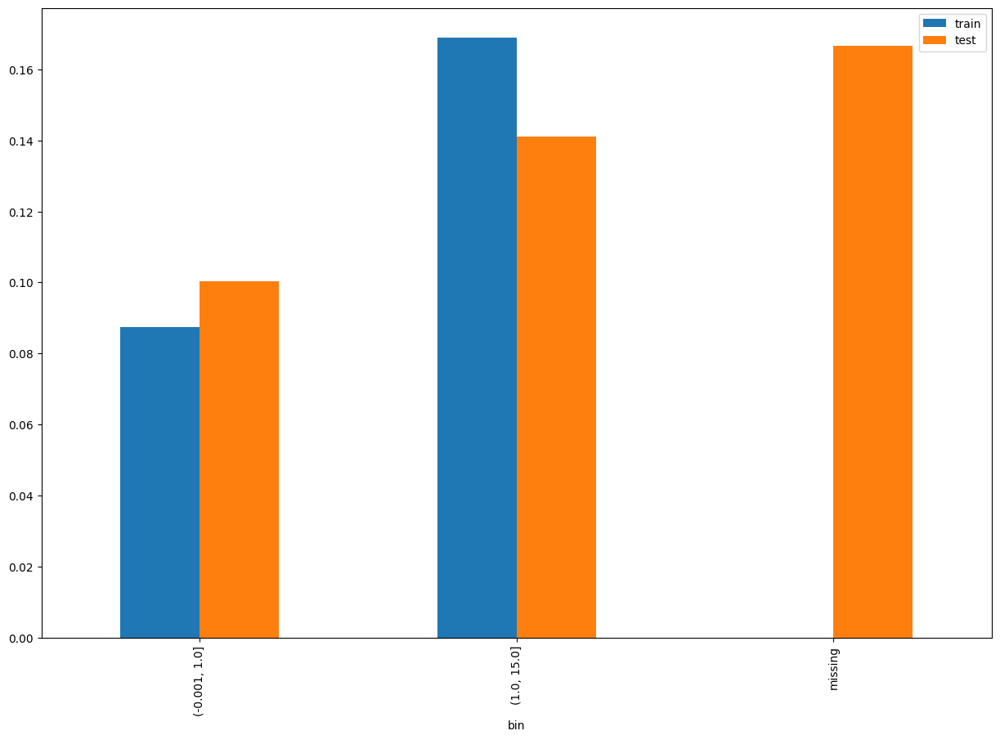
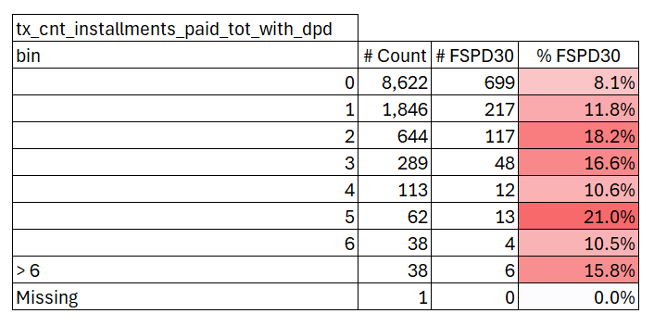
tx_cnt_installments_paid_tot_with_dpd
SHAP Rank: 1
Total number of installments paid with DPD>0 by the customer from all earlier loans anytime before the observation date.
Train (01/01/2024 - 31/10/2024)

Slide 10
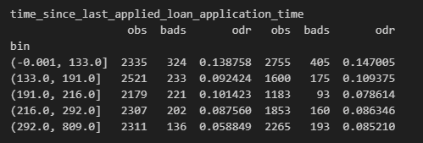
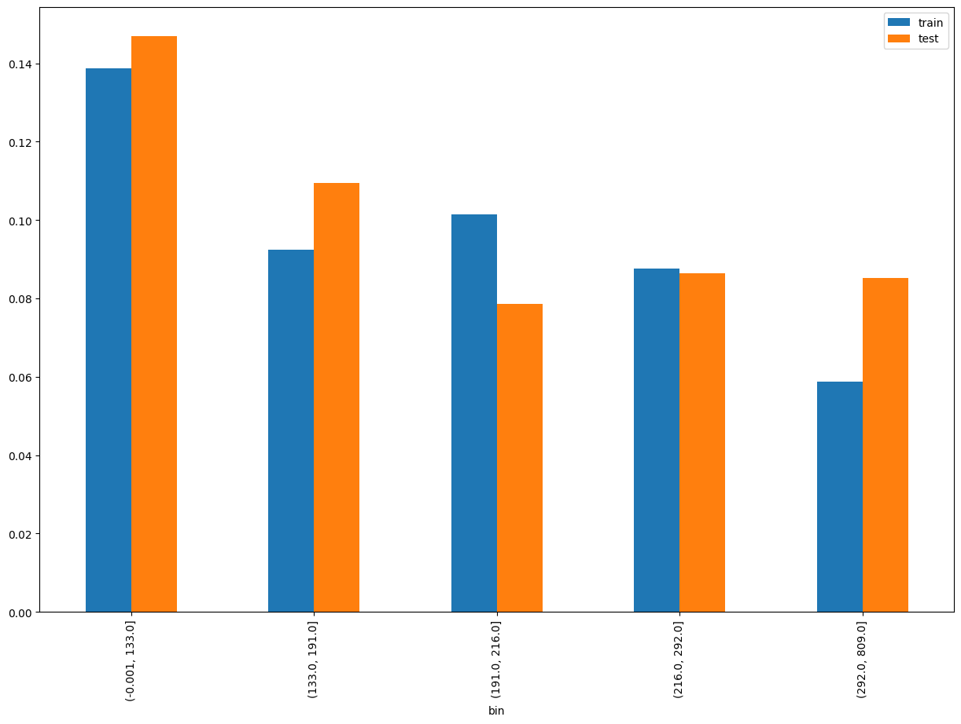
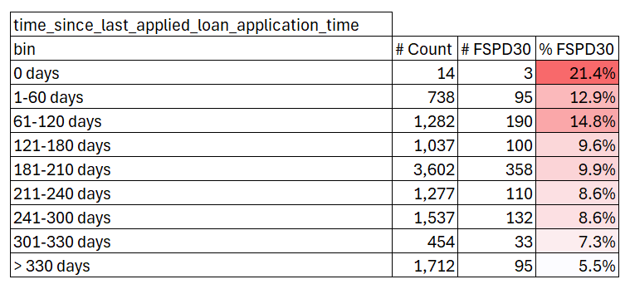
time_since_last_applied_loan_application_time
SHAP Rank: 2
This feature captures the duration in days that has passed since the customer last applied for a loan until the observation date.
Train (01/01/2024 - 31/10/2024)

Slide 11
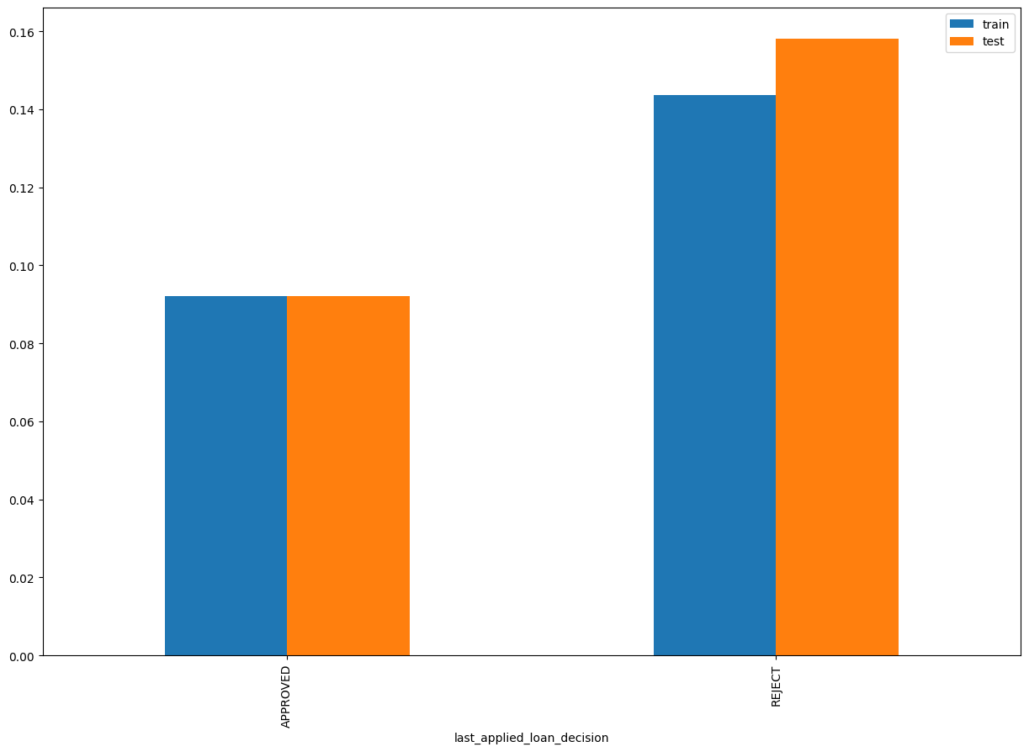
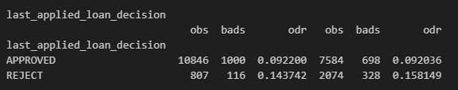
last_applied_loan_decision
SHAP Rank: 3
The decision outcome of the most recent loan application.

Slide 12
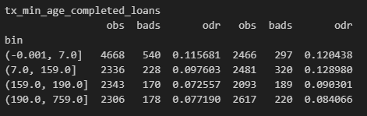
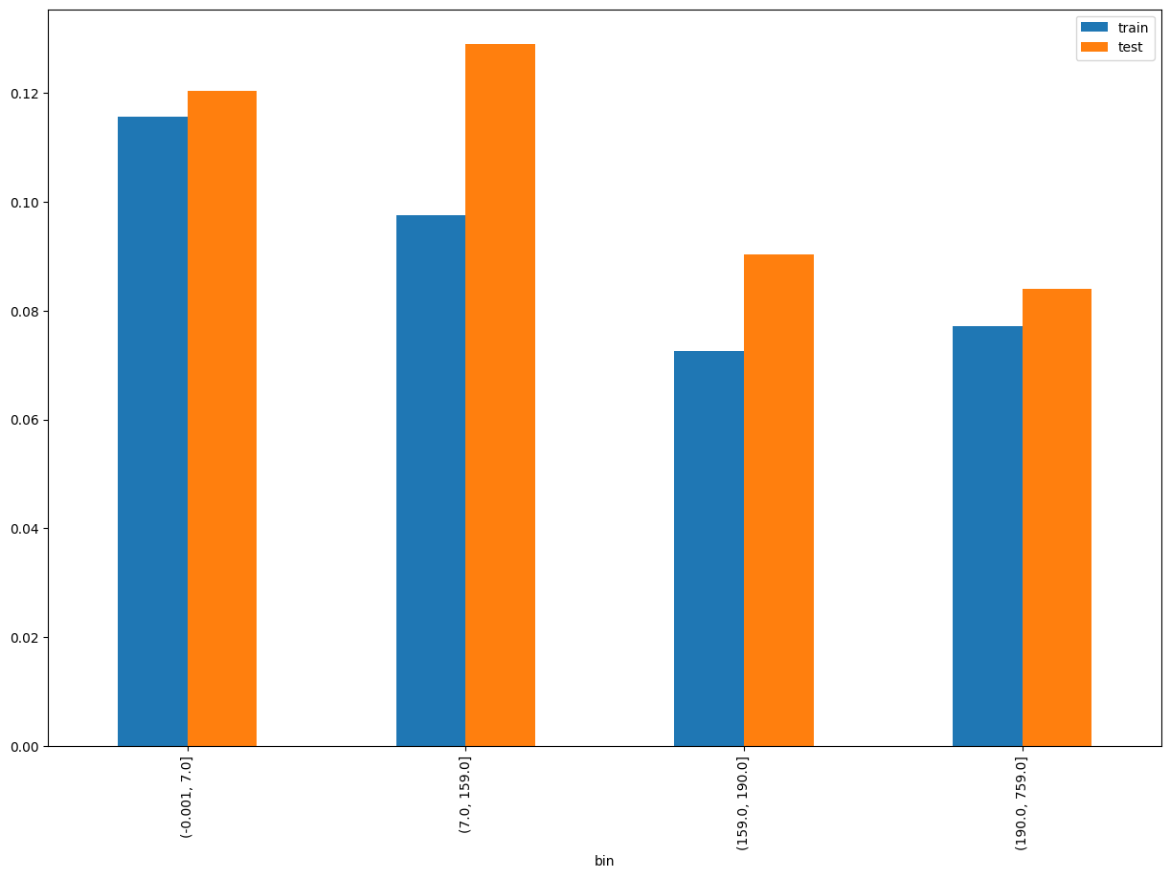
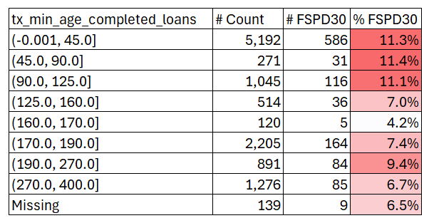
tx_min_age_completed_loans
SHAP Rank: 4
Minimum Age of Completed Loans: This feature captures the shortest duration from the start to the completion of loans in the customer's history.
Train (01/01/2024 - 31/10/2024)

Slide 13
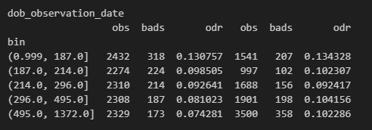
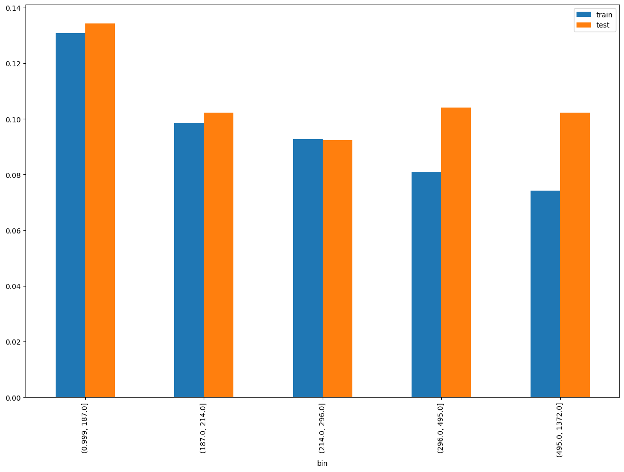
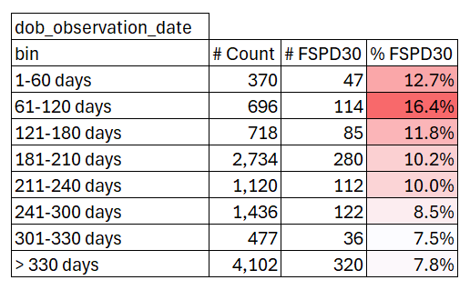
dob_observation_date
SHAP Rank: 5
This feature captures the total number of days the customer has been with us, starting from the date they opened their Tonik Savings Account (ln_application_submit_time - onboarding_date). Please note that the Observation Date = Application Submit Datetime of the current loan under consideration.
Train (01/01/2024 - 31/10/2024)

Slide 14
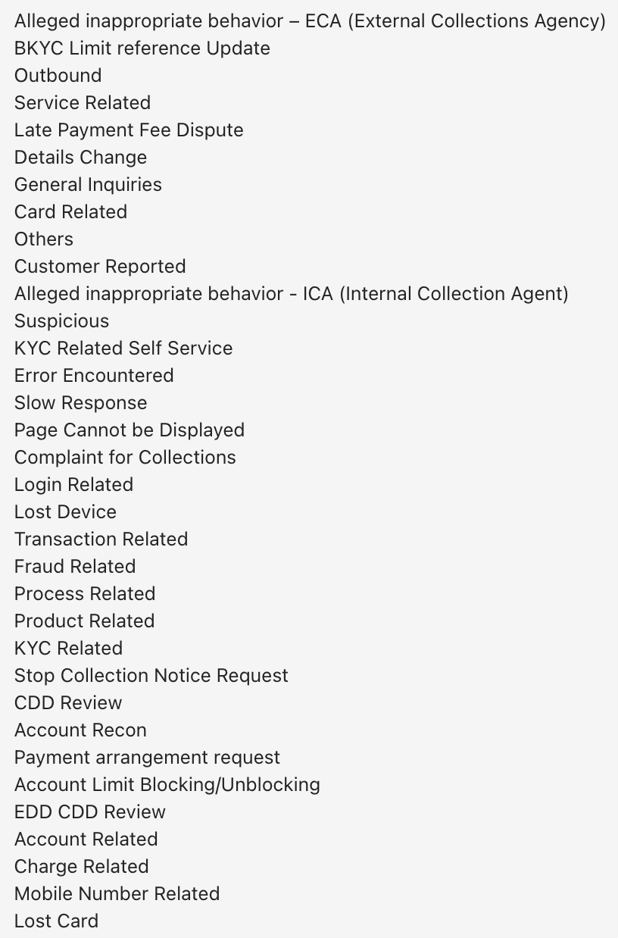
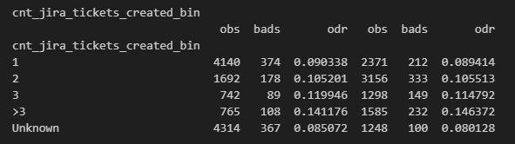
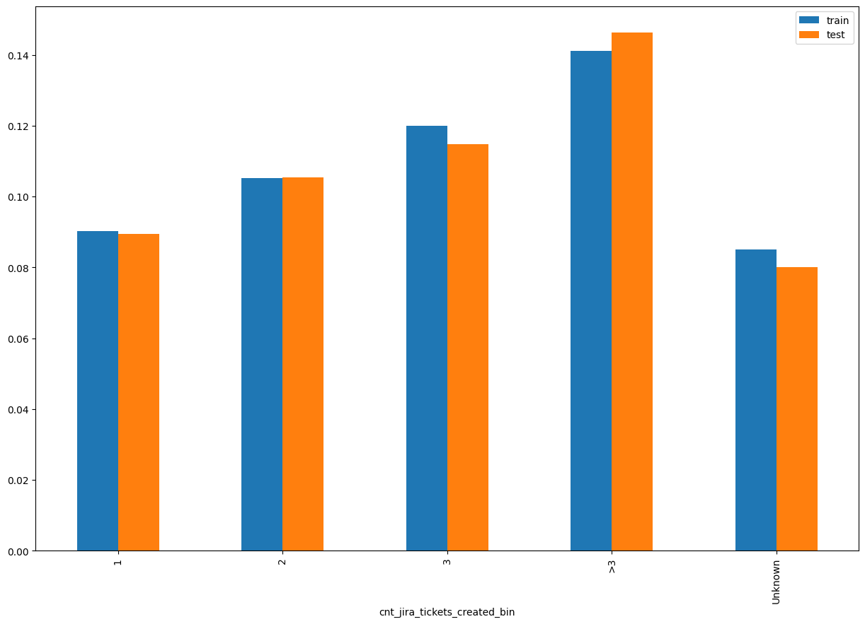
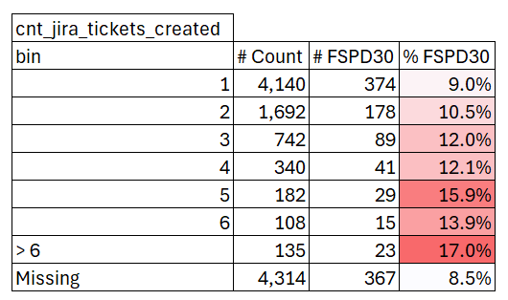
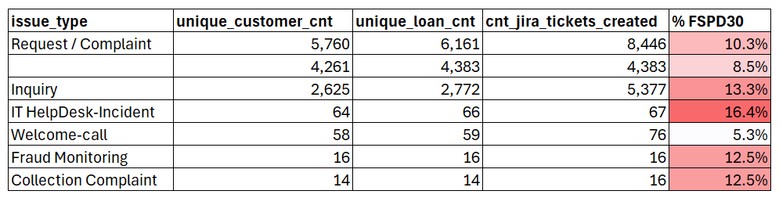
cnt_jira_tickets_created_bin
SHAP Rank: 6
JIRA Ticket Reasons
Jira Tickets Raised by or for Customers: This feature captures any type of Jira ticket raised either by the customer or on behalf of the customer. Tickets can be initiated during the application or onboarding process due to discrepancies in the data provided by the customer, or they can be raised by the customer to address any issues they are facing.
Train (01/01/2024 - 31/10/2024)
For Description of Jira ticket type click here

Slide 15
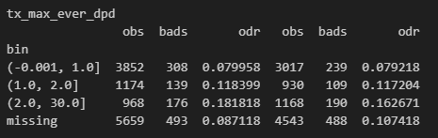
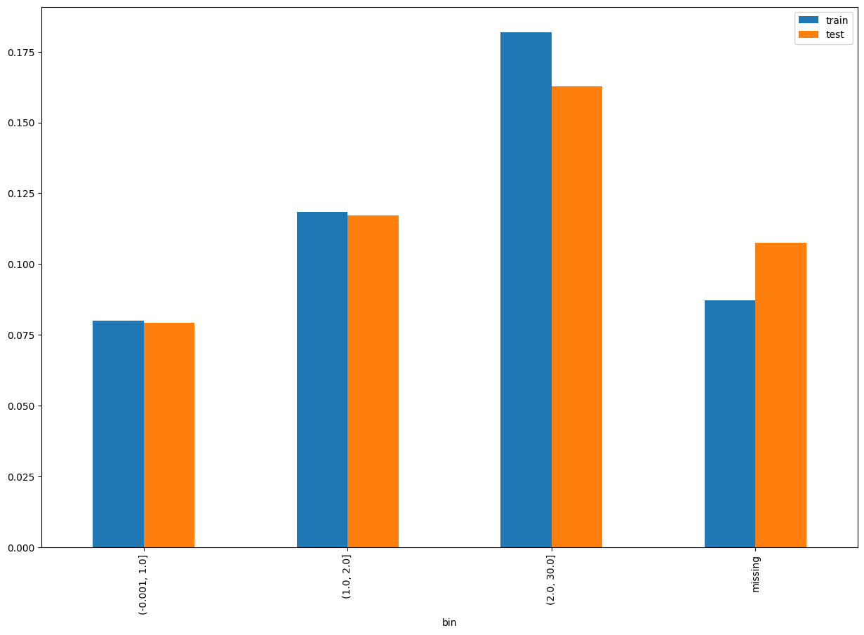
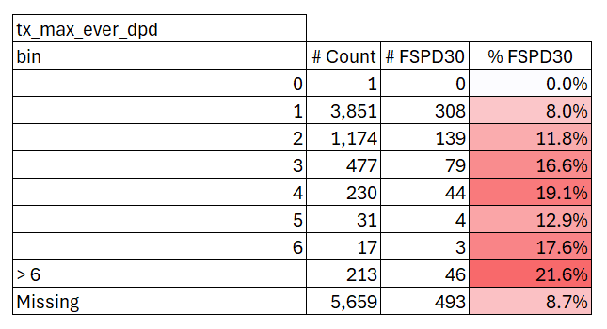
tx_max_ever_dpd
SHAP Rank: 7
This feature captures the highest number of days a customer has been past due in their repayment history. The missing indicates that in previous loans the customer has settled without even reaching the first due date.
Train (01/01/2024 - 31/10/2024)

Slide 16
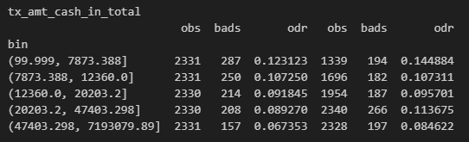
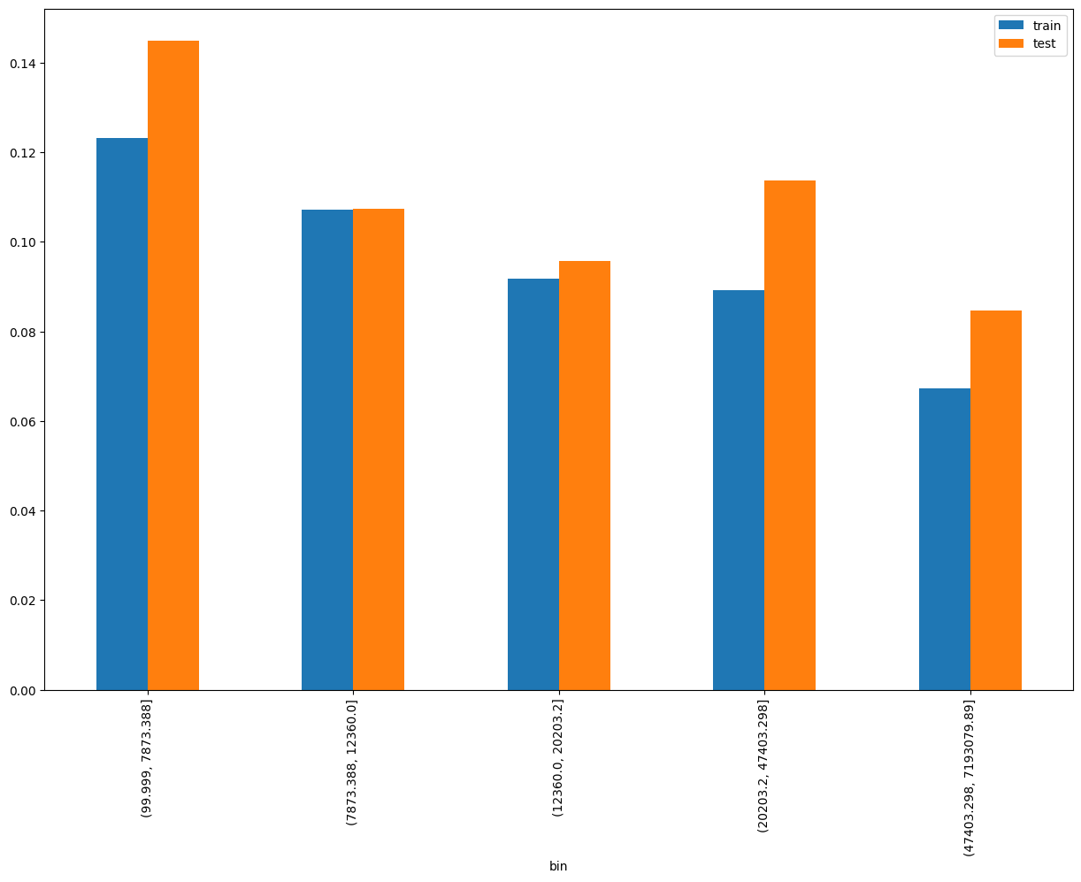
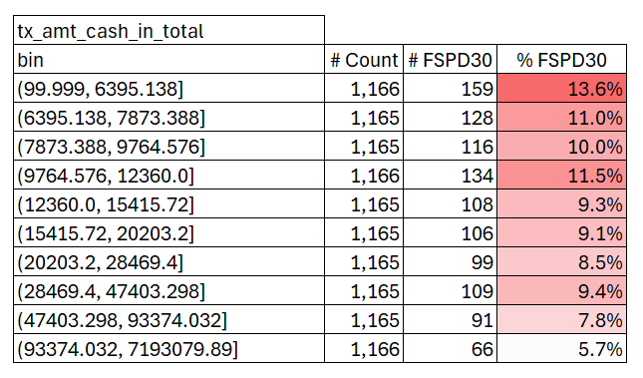
tx_amt_cash_in_total
SHAP Rank: 8
This metric represents the cumulative amount of cash transactions credited to customer accounts up to the observation date. It specifically excludes any loan amounts received by the customer. The transactions considered include transfers from Other Tonik to Tonik accounts as well as transfers from other banks to Tonik accounts.
Train (01/01/2024 - 31/10/2024)

Slide 17
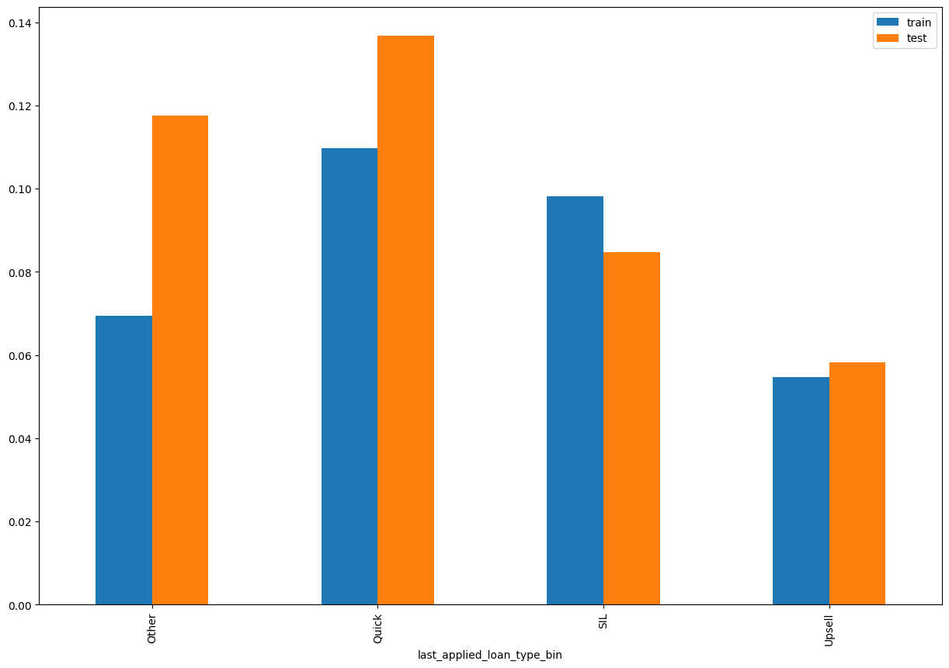
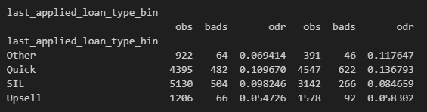
last_applied_loan_type_bin
SHAP Rank: 9
This feature is a simplified version of the last applied loan type, representing the type of loan the customer applied for in their most recent application. This Last Applied loan could have been approved or denied.
Flex: Refers to flex loans.
Other: Includes various loan types such as Flex-up, Reloan, Big-loan, TSA-ACL, etc.
Quick: Refers to cash loans.
SIL: Represents shop installment loans.

Slide 18
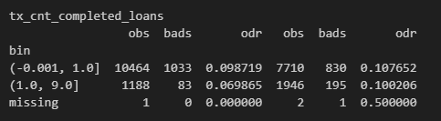
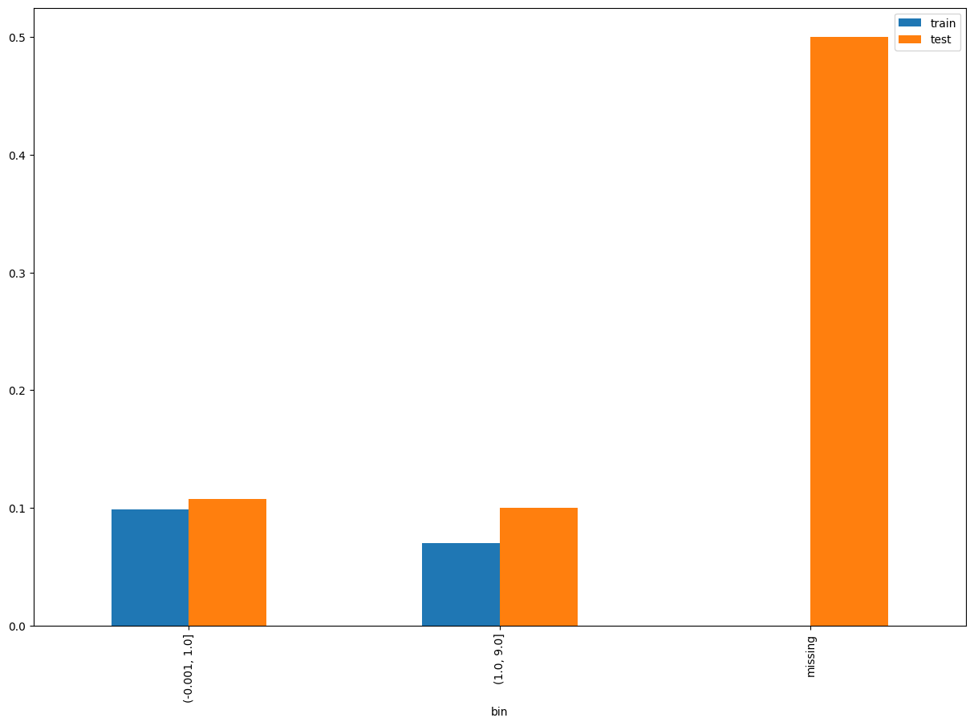
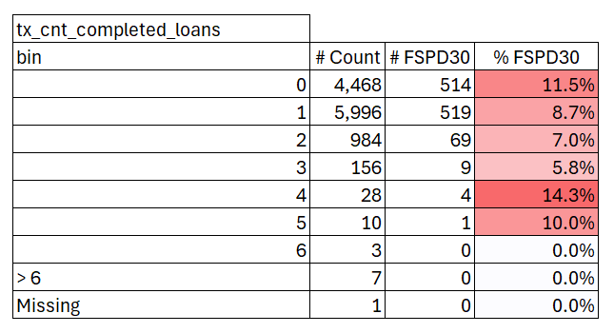
tx_cnt_completed_loans
SHAP Rank: 10
Total number of loans that have been successfully completed anytime before the observation date.
Train (01/01/2024 - 31/10/2024)

Slide 19
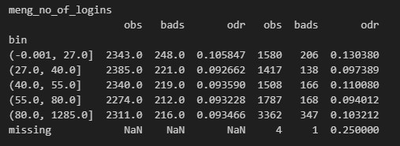
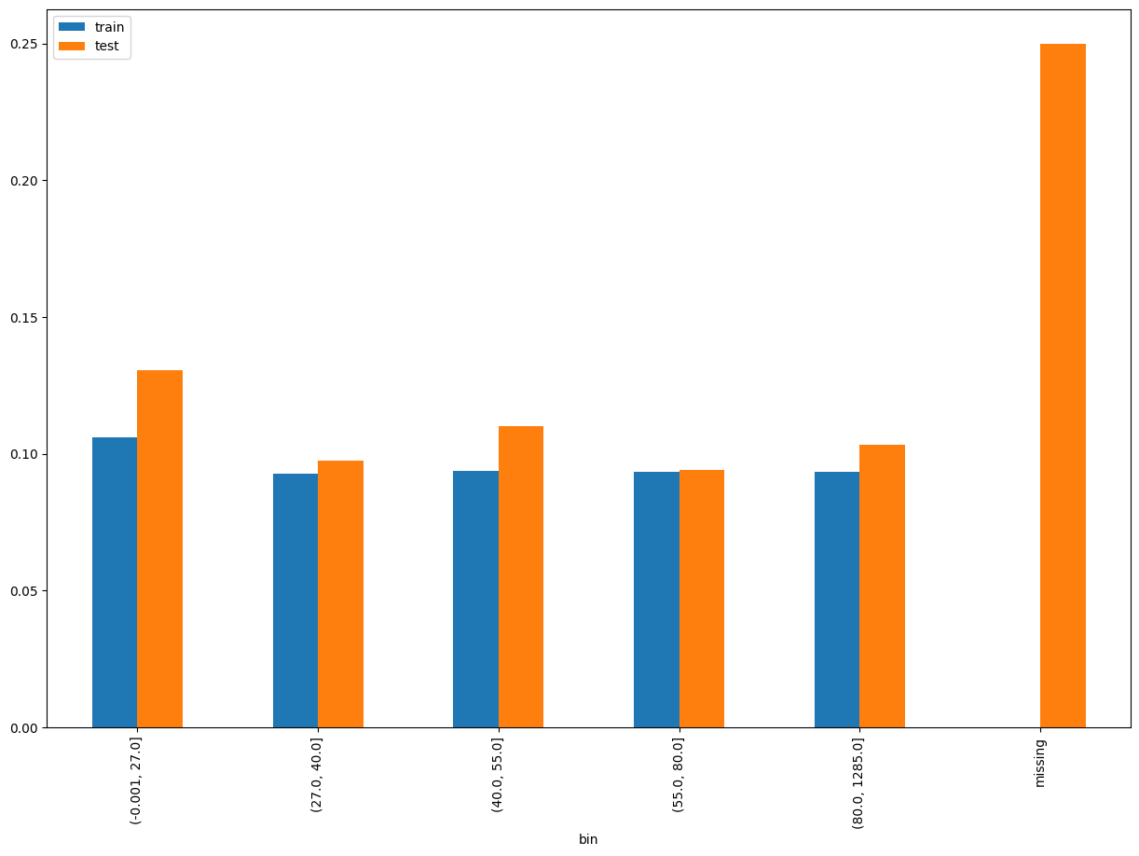
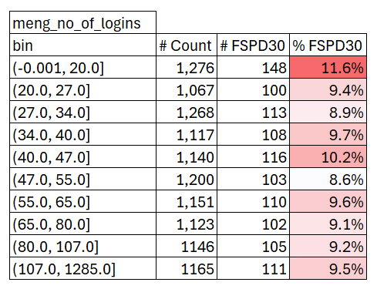
meng_no_of_logins
SHAP Rank: 11
Number of times the customer have logged in to the Tonik app anytime before the observation date, with data sourced from Mo-engage.
Train (01/01/2024 - 31/10/2024)

Slide 20
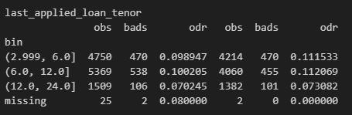
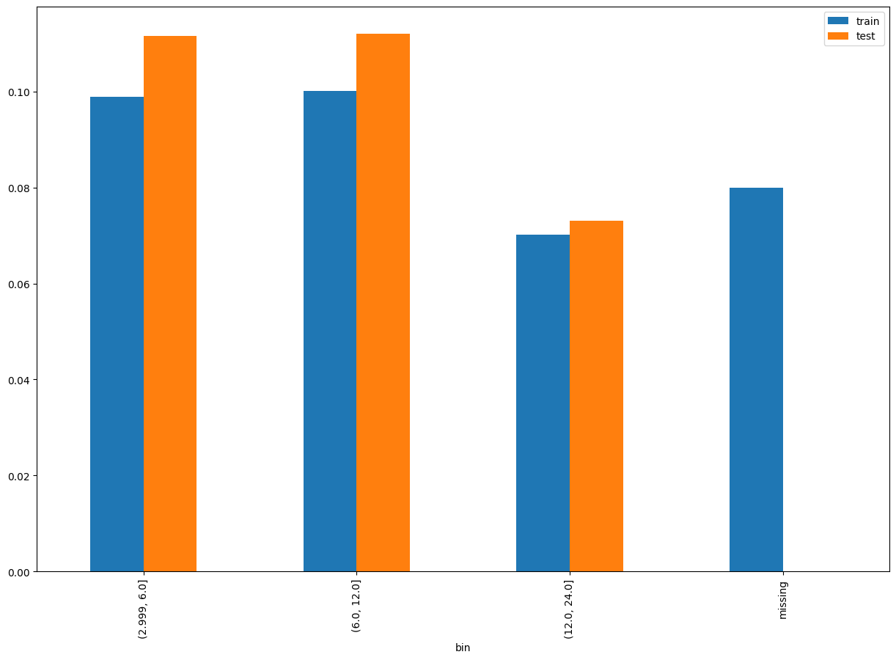
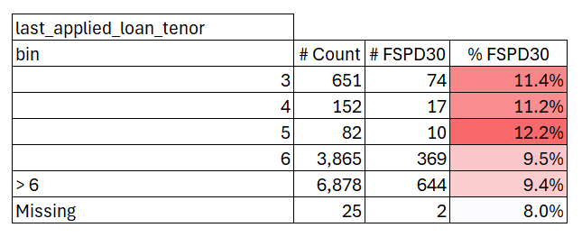
last_applied_loan_tenor
SHAP Rank: 12
The tenor of the previously applied loan.
Train (01/01/2024 - 31/10/2024)

Slide 21
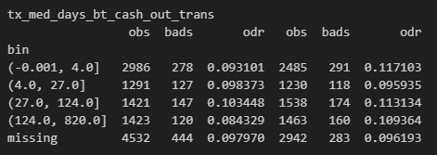
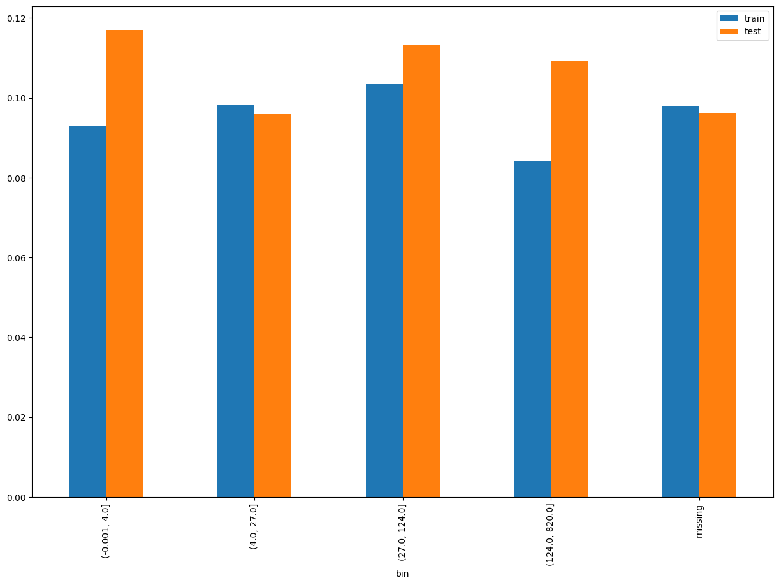
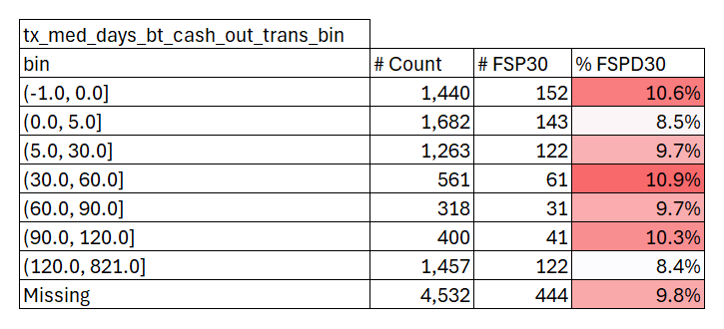
tx_med_days_bt_cash_out_trans
SHAP Rank: 13
The median number of days between cash-out transactions.
Train (01/01/2024 - 31/10/2024)

Slide 22
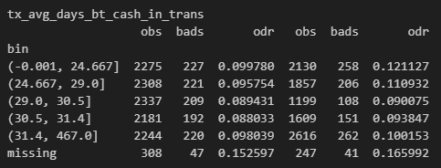
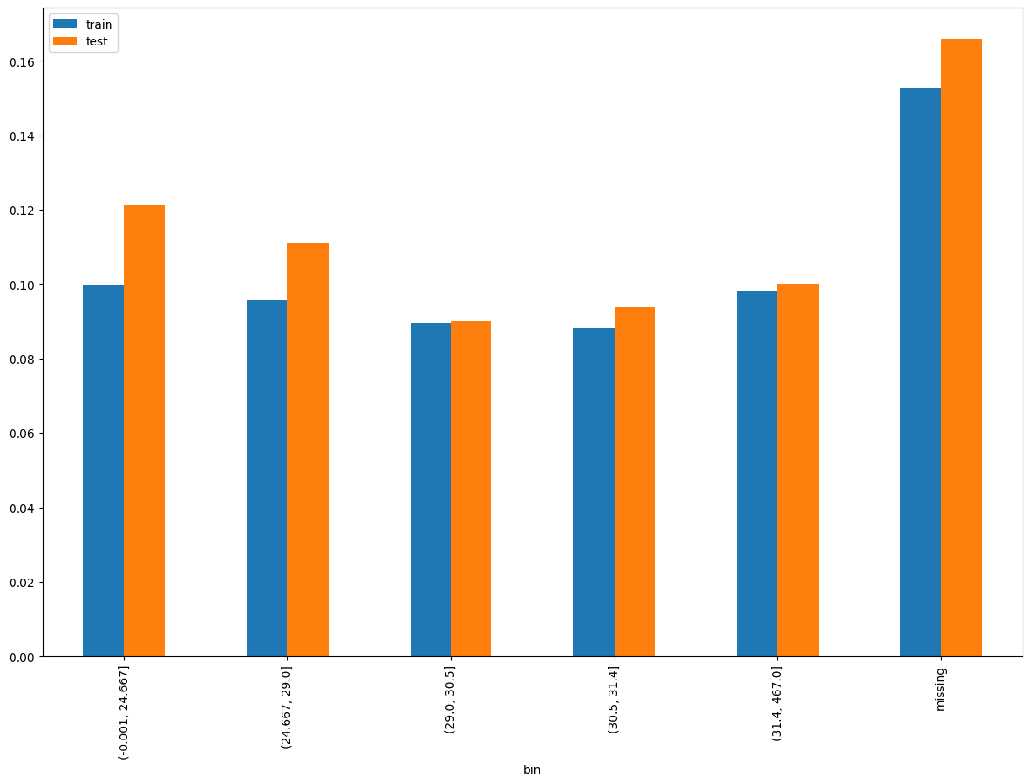
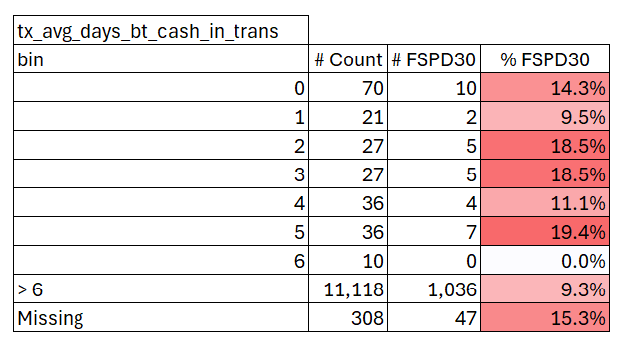
tx_avg_days_bt_cash_in_trans
SHAP Rank: 14
The average number of days between cash-in transactions.
Train (01/01/2024 - 31/10/2024)

Slide 23

THANK YOU!
​
Questions?
tonikbank.com

Slide 24
Types of Jira Tickets
Alleged Inappropriate Behavior – ECA: Reports of inappropriate behavior by External Collections Agency.
BKYC Limit Reference Update: Requests to update the BKYC limit reference.
Outbound: Issues related to outbound communications.
Service Related: General service-related inquiries or complaints.
Late Payment Fee Dispute: Disputes regarding late payment fees.
Details Change: Requests to change personal or account details.
General Inquiries: Miscellaneous questions or information requests.
Card Related: Issues or inquiries related to credit or debit cards.
Others: Any other types of tickets not categorized elsewhere.
Customer Reported: Issues reported directly by the customer. Alleged
Inappropriate Behavior – ICA: Reports of inappropriate behavior by Internal Collection Agent.
Suspicious: Reports of suspicious activities or transactions.
KYC Related Self Service: Issues related to self-service KYC processes.
Error Encountered: Reports of errors encountered during usage. Slow Response: Complaints about slow response times.
Page Cannot be Displayed: Issues where a webpage cannot be displayed.
Complaint for Collections: Complaints related to collection processes.
Login Related: Issues related to logging into accounts.
Lost Device: Reports of lost devices.
Transaction Related: Issues or inquiries related to transactions.
Fraud Related: Reports of fraudulent activities.
Process Related: Issues related to specific processes.
Product Related: Inquiries or complaints about products.
KYC Related: Issues related to KYC processes.
Stop Collection Notice Request: Requests to stop collection notices.
CDD Review: Requests for Customer Due Diligence reviews.
Account Recon: Requests for account reconciliation.
Payment Arrangement Request: Requests to arrange payment schedules.
Account Limit Blocking/Unblocking: Requests to block or unblock account limits.
EDD CDD Review: Enhanced Due Diligence and Customer Due Diligence reviews.
Account Related: General account-related issues.
Charge Related: Inquiries or disputes related to charges.
Mobile Number Related: Issues related to mobile numbers.
Lost Card: Reports of lost cards.
Back

