Slide 1

Trench 3 Demo Model for SIL
Presented by:
Data Science
12th June 2025

Slide 2
Architecture Overview of TDB’s Risk Scorecards
For Cash Loan only
For both Cash and SIL
Limit Setting Model (Hosted in Digital Layer)
Credit Decisioning Model (Hosted in Taran)
Beta Stack
Alpha Stack
Trench 1: New Users - within 30 days from TSA Onboarding
Limit Setting Score = Gamma Stack
Beta Demo Score
Beta Demo Score
Gamma Demo Score
Apps Score
Apps Score
Selectively call Alpha
Apps Score
Credo Score
Users automatically move from Trench 1 to Trench 2 after 30 days if no disbursed loans
Credo Score
CIC Score
Gamma Income Model
Beta Income Model
Alpha Income Model
Users will stay in Trench 2 until 1st disbursed loan. His Gamma Stack will be re-calculated every 30-day anniversary from TSA onboarding date
Limit Setting Score = Gamma Stack
Beta Stack
Alpha Stack
Gamma Demo Score
Beta Demo Score
Beta Demo Score
Trench 2: Existing Users - After 30 days from TSA Onboarding AND Never Disbursed Loan
Apps Score
Apps Score
Selectively call Alpha
Apps Score
Transaction Score
Transaction Score
Transaction Score
CIC Score
Gamma Income Model
Beta Income Model
Alpha Income Model
Users will move to Trench 3 after 1st Disbursed Loan
Lowest Risk users from this B Score will be pre-approved for upsell and xsell. Medium Risk users from this B Score will have to go through Taran.
High Risk users from this B Score will not be given any offer.
B Score = Gamma Stack
Trench 3: Existing Users - After 30 days from 1st Disbursed Loan AND current DPD <= 10
Beta Stack
Alpha Stack
Gamma Demo Score
Apps Score
Beta Demo Score
Beta Demo Score
Apps Score
Apps Score
Enhanced Transaction Score
Selectively call Alpha
Enhanced Transaction Score
Once moved to Trench 3, user will forever remain in Trench 3. His Gamma Stack will be re-calculated every 30 days anniversary from 1st Loan Disbursement Date
Enhanced Transaction Score
CIC Score
Gamma Income Model
Beta Income Model
Alpha Income Model

Slide 3
Sil Loan B Score Demo Scorecard was developed on Trench 3 users
 | Loan Disbursement Date | # Count | # Bad (FSPD30) Cash Loans | FSPD30 rate
Training | 01/01/2024 - 31/10/2024 | 2,809 | 135 | 4.8%
Nov (Validation) | 01/11/2024 - 30/11/2024 | 807 | 36 | 4.5%
Dec (Test) | 01/12/2024 - 31/12/2024 | 1,953 | 145 | 7.4%
Jan (OOT) | 01/01/2025 - 31/01/2025 | 828 | 42 | 5.1%
Feb (OOT) | 01/02/2025 - 29/02/2025 | 497 | 10 | 5.2%
Type of 2nd Onwards Disbursed Loans Used for Modelling – SIL offers
Type of 2nd Onwards Disbursed Loans Used for Modeling – Sil Offer​ ​
Loan Type Used in Modeling​ | Type of Previous Disbursed Loan​
Sil-Instore, Sil ​Competitor, Sil Repeat, Sil ZERO | Can be anything​
​ | ​
Note: Only 2nd onwards disbursed loans are considered for training and testing the model. The previous loan type can be of any category.​

Slide 4
Feature Selection Methodology Overview
Feature Selection Methodology Overview
34
Feats
33
Feats
31 Feats
31 Feats
13 Feats
IV > 0.01
Missing Rate < 95%
Inter-correlation < 75%
Individual Feature Evaluation

Slide 5
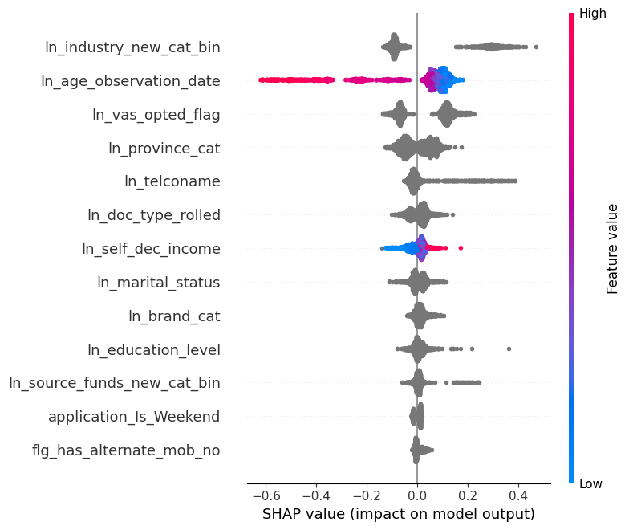
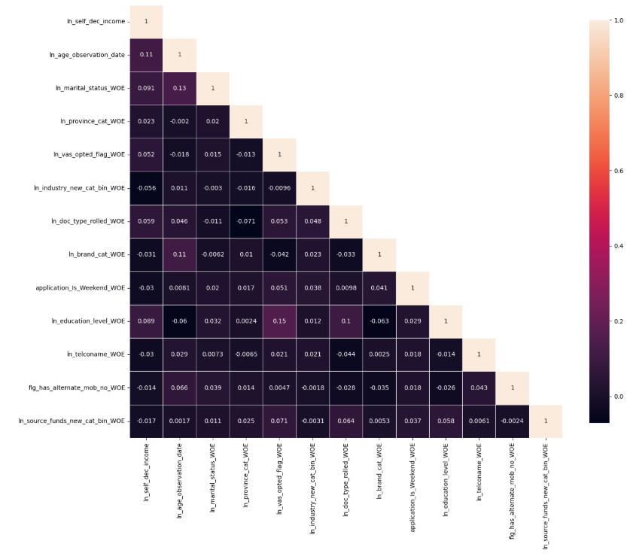
SHAP(13 feat)
Inter-Correlation (13 feat)

Slide 6
Model Iteration | Features | Train Gini (Jan'24 - Oct'24) | Val Gini (Nov'24) | Test Gini (Dec'24) | OOT Gini (Jan'25 + Feb'25)
Model with top 5 feat | ln_age_observation_date_WOE, ln_industry_new_cat_bin_WOE, ln_vas_opted_flag_WOE, ln_province_cat_WOE, ln_marital_status_WOE | 0.3436 | 0.2616 | 0.1228 | 0.2115
Model with top 6 feat | ln_self_dec_income_WOE | 0.3447 | 0.2577 | 0.1357 | 0.2410
Model with top 7 feat | ln_telconame_WOE | 0.3605 | 0.2659 | 0.1362 | 0.2509
Model with top 8 feat | ln_doc_type_rolled_WOE | 0.3703 | 0.3115 | 0.1399 | 0.2420
Model with top 9 feat | ln_brand_cat_WOE | 0.3723 | 0.3331 | 0.1486 | 0.2403
Model with top 10 feat | ln_source_funds_new_cat_bin_WOE | 0.3715 | 0.3395 | 0.1530 | 0.2396
Model with top 11 feat | ln_education_level_WOE | 0.3802 | 0.3480 | 0.1516 | 0.2444
Model with top 12 feat | flg_has_alternate_mob_no_WOE | 0.3801 | 0.3459 | 0.1525 | 0.2466
Model with top 13 feat | application_Is_Weekend_WOE | 0.3806 | 0.3467 | 0.1534 | 0.2471
Model with top 14 feat | ln_ref1_type_WOE | 0.3900 | 0.2632 | 0.1612 | 0.1712
13 feature model after Hyper Parameters Tuning |  | 0.3771 | 0.3152 | 0.1433 | 0.2387

Slide 7
Feature Evaluation Plots (13 features)

Slide 8
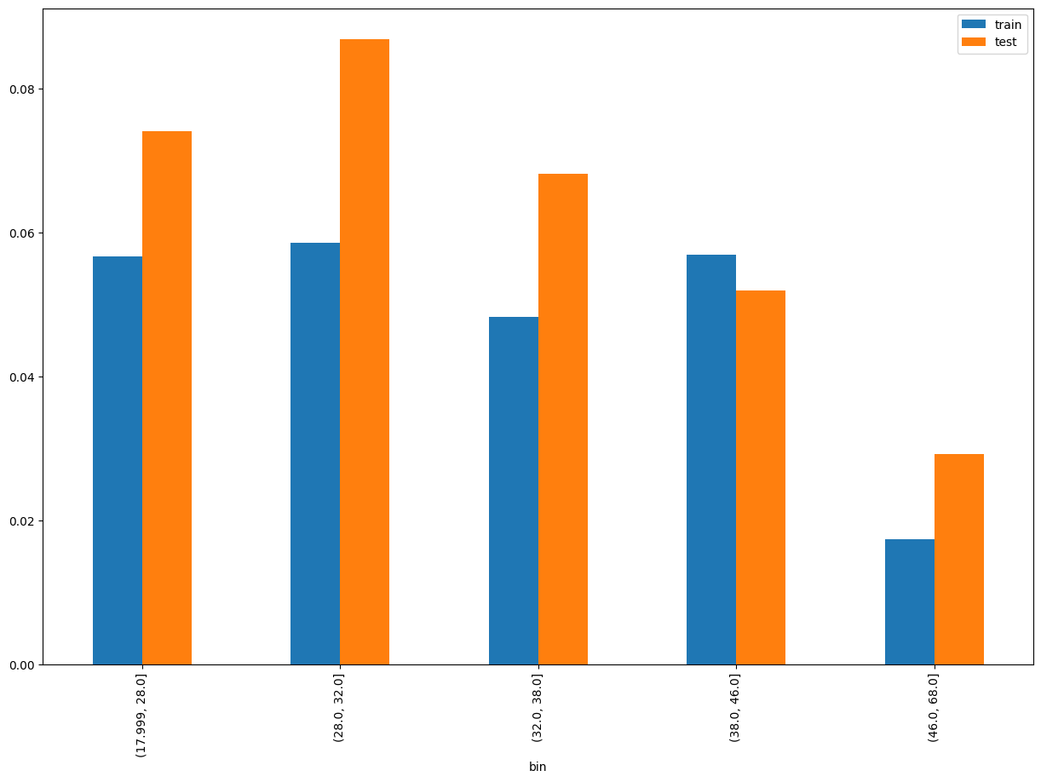
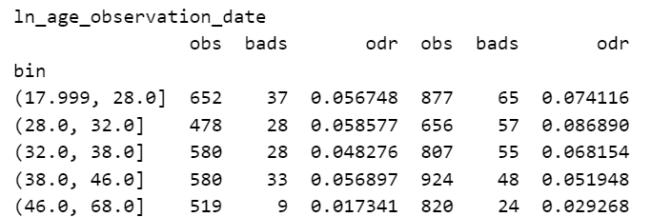
ln_age_observation_date SHAP Rank: 1 Calculates the person's age in years based on their birth date and loan application date.

Slide 9
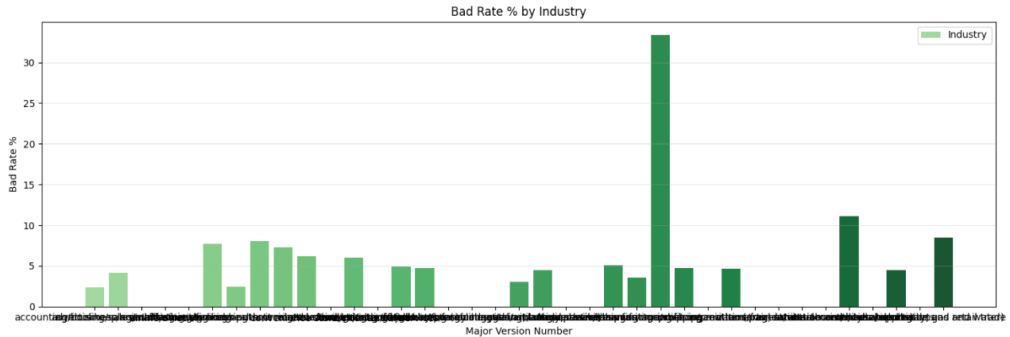
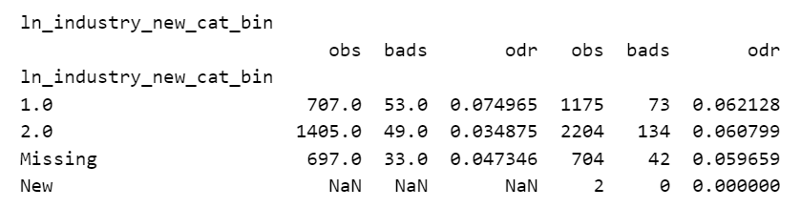
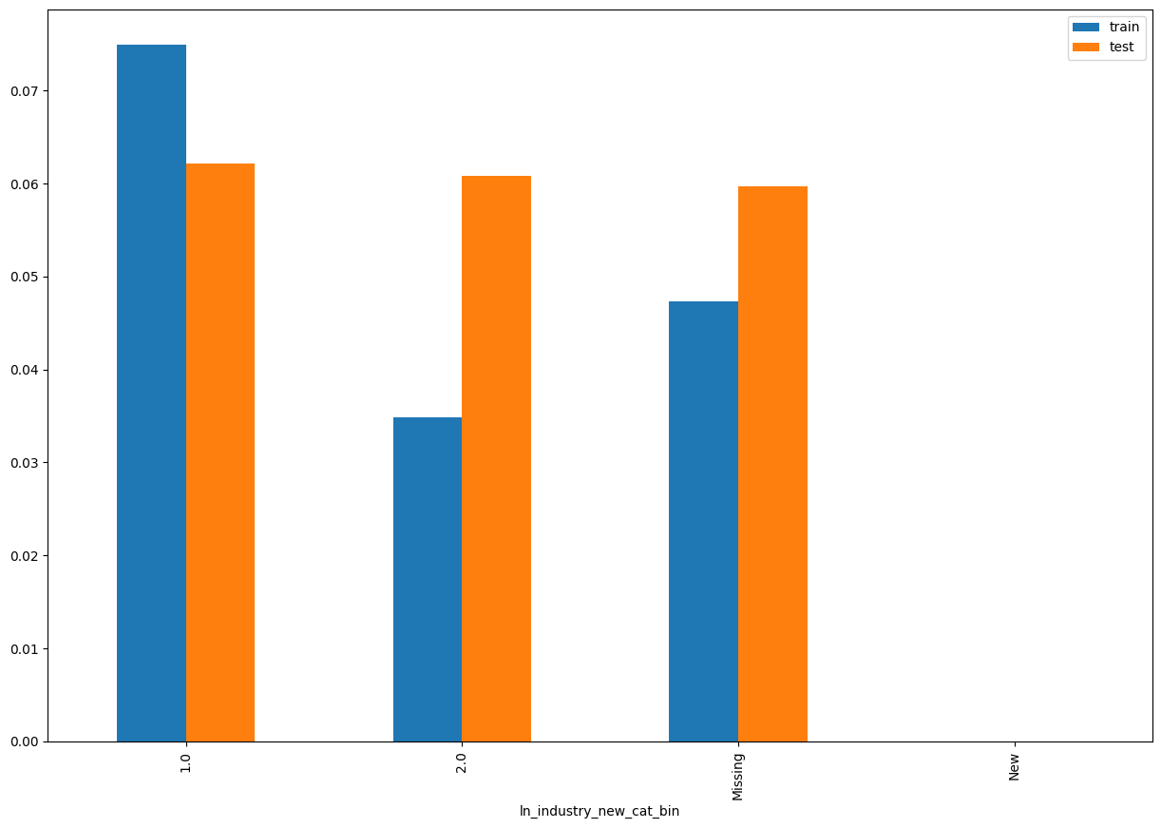
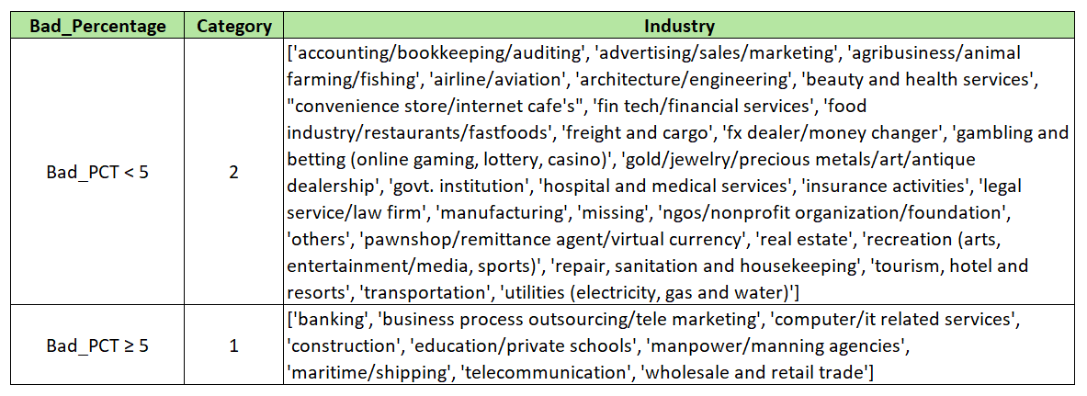
ln_industry_new_cat_bin SHAP Rank: 2 Industry category of the customer, with known categories labeled as 1, or 2, and any unseen categories during training treated as 'New'

Slide 10
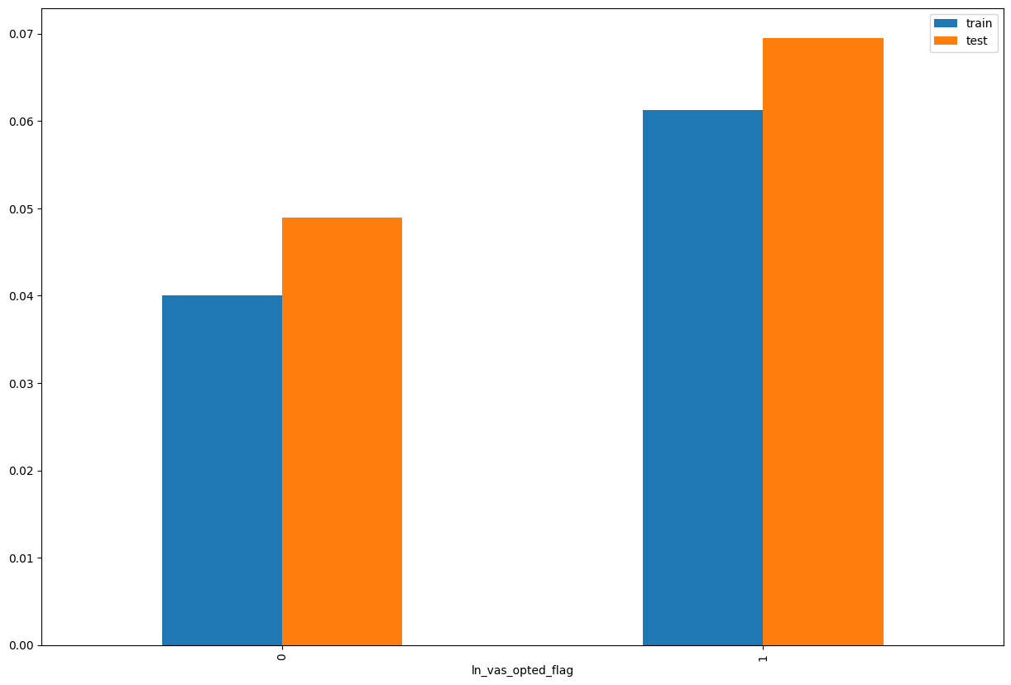
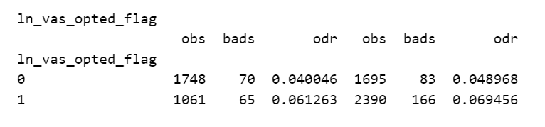
ln_vas_opted_flag SHAP Rank: 3 Indicates whether the user has opted for any value-added services, such as PayHinga (payment holiday feature).

Slide 11
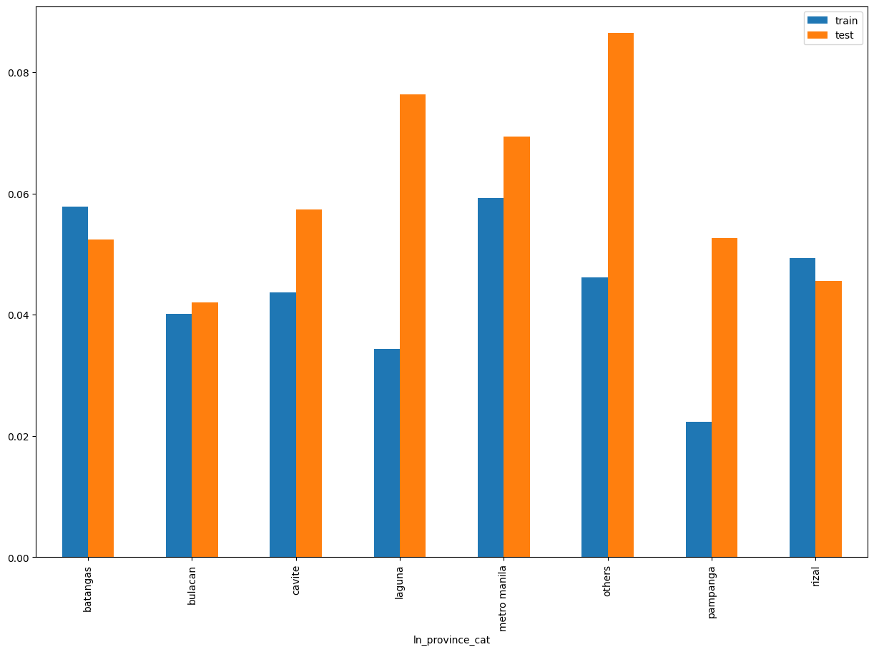
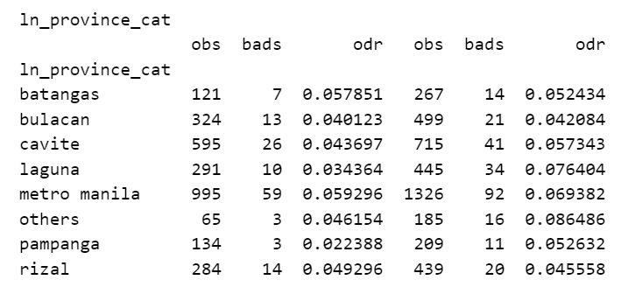
ln_province_cat SHAP Rank: 4 Categorized province of loan disbursement based on frequency, with provinces having fewer than 100 records grouped as Others.

Slide 12
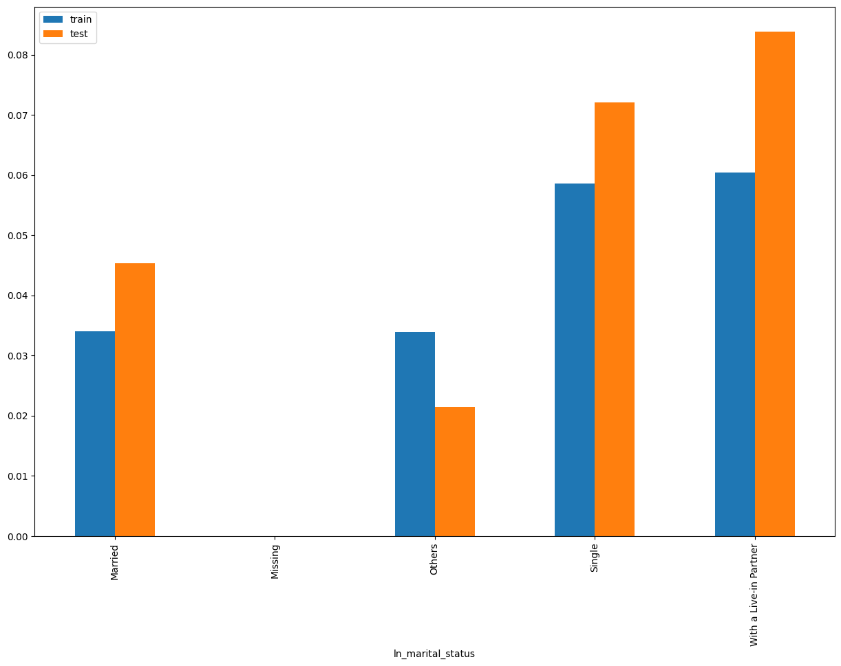
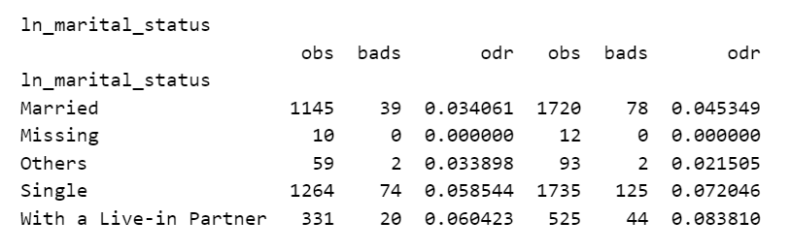
ln_marital_status SHAP Rank: 5 Marital status of the individual, with categories having fewer than 500 records grouped as 'Others' and missing values labeled as 'Missing'.

Slide 13
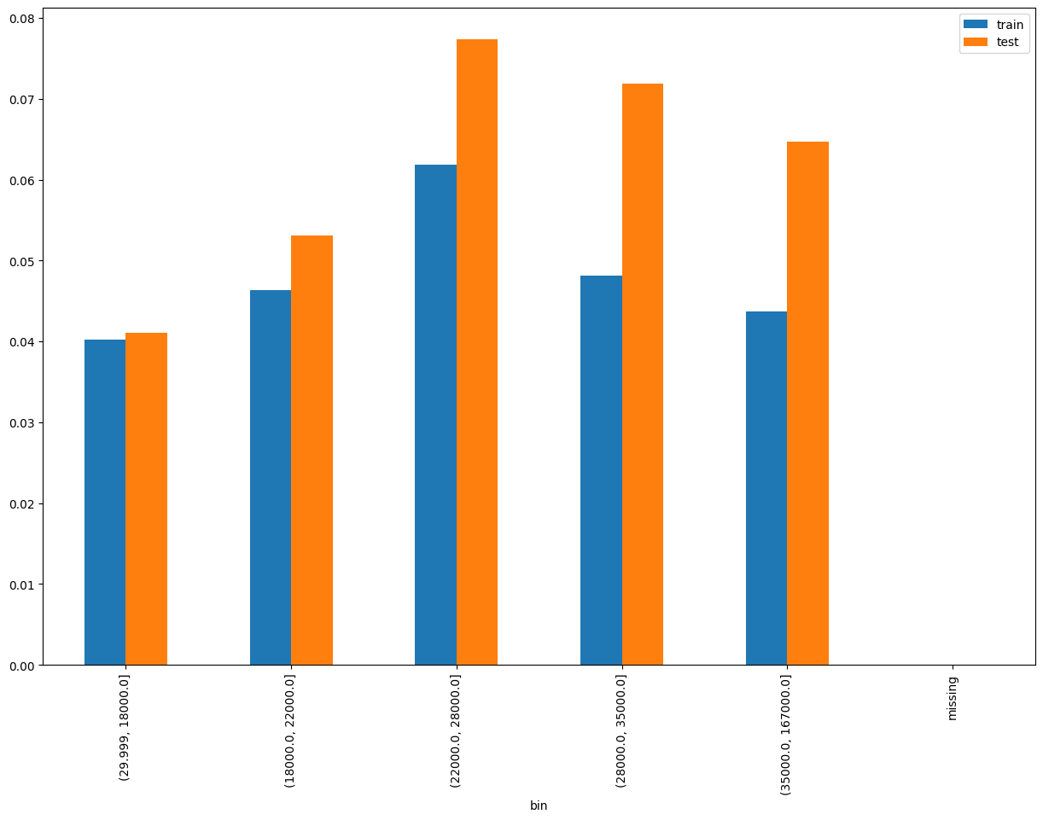
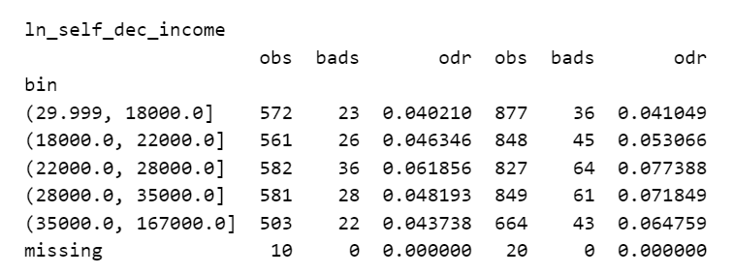
ln_self_dec_income SHAP Rank: 6 Self declared income of customer

Slide 14
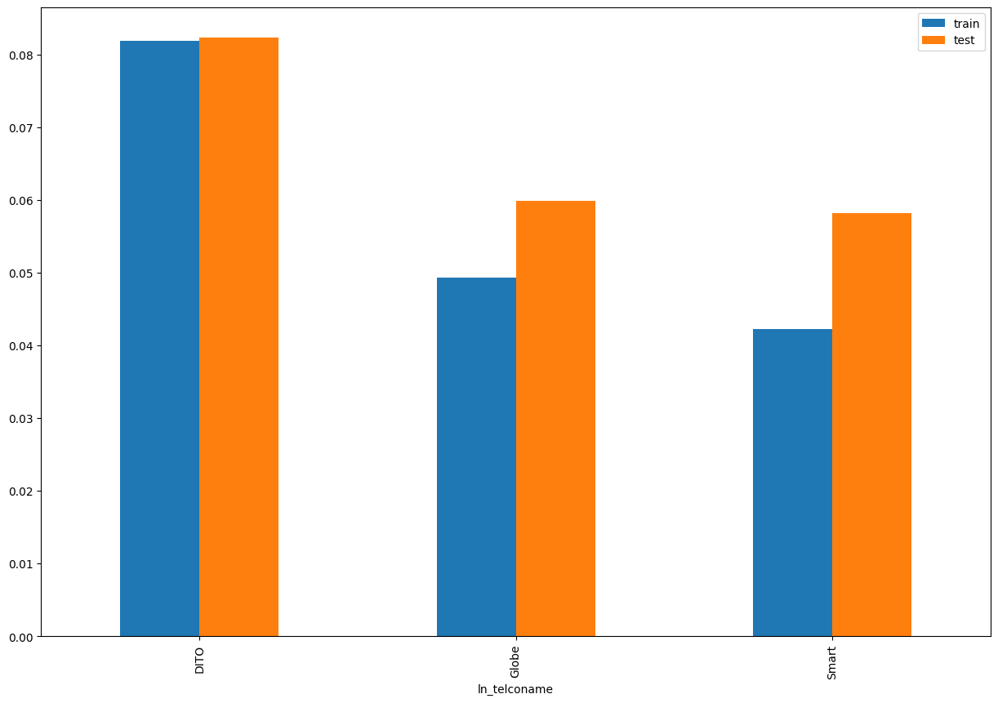
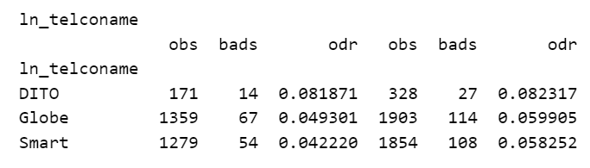
ln_teleconame SHAP Rank: 7 Telecom provider categorized as Globe, Smart, or DITO based on the prefix of the individual's mobile number.

Slide 15
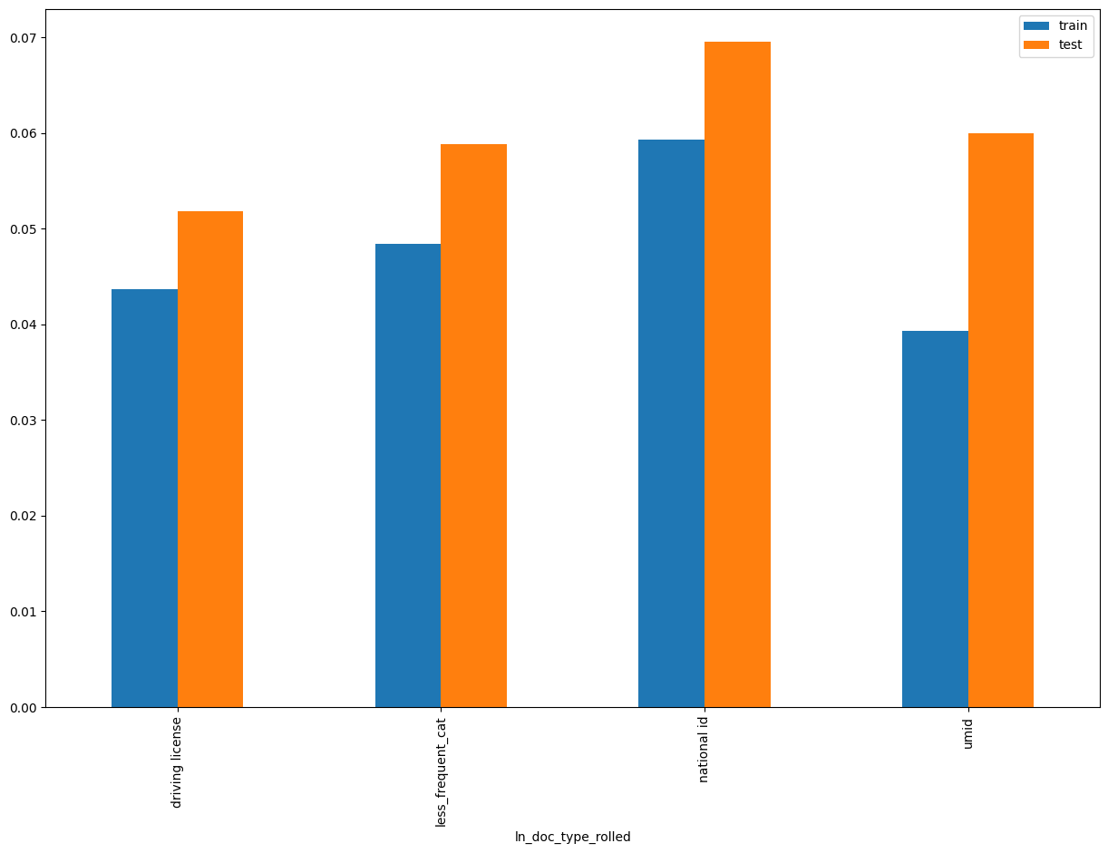
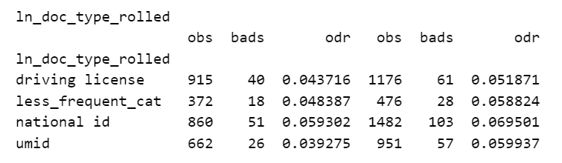
ln_doc_type_rolled SHAP Rank: 8 Document type used for identification, with types having fewer than 500 records grouped as 'Other Doc Types'

Slide 16
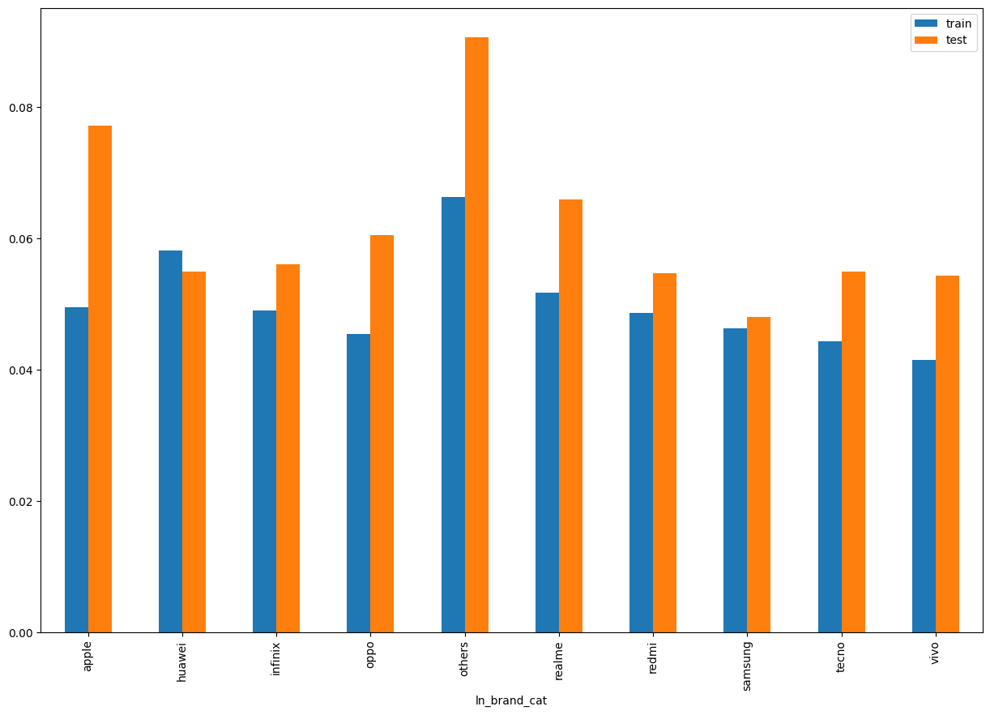
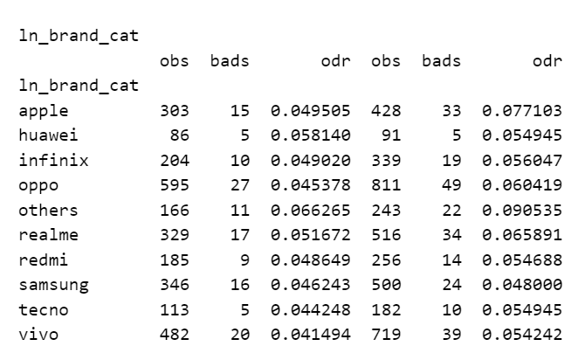
ln_brand _cat SHAP Rank: 9 Categorized mobile phone brand based on frequency, with brands having fewer than 100 records grouped as 'others'.

Slide 17
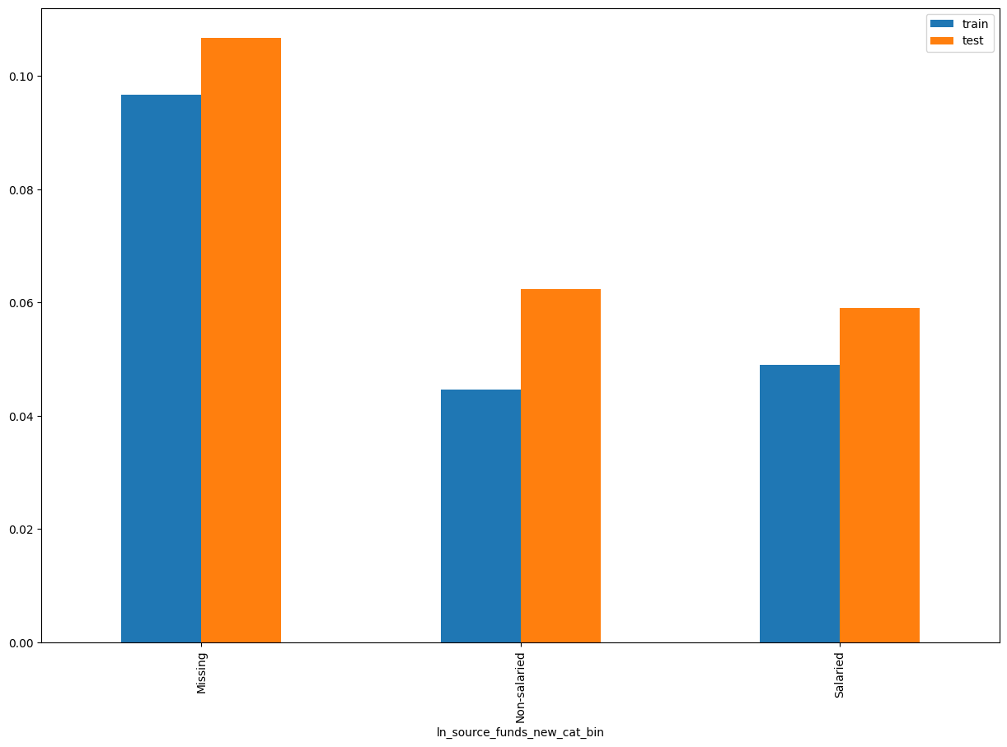
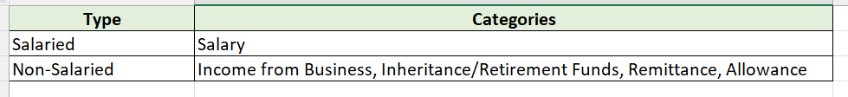
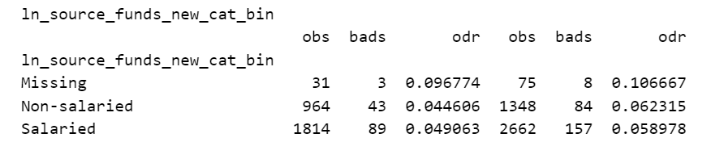
ln_source_of_funds_new_cat_bin SHAP Rank: 10 Feature categorizes the origin of an individual's funds

Slide 18
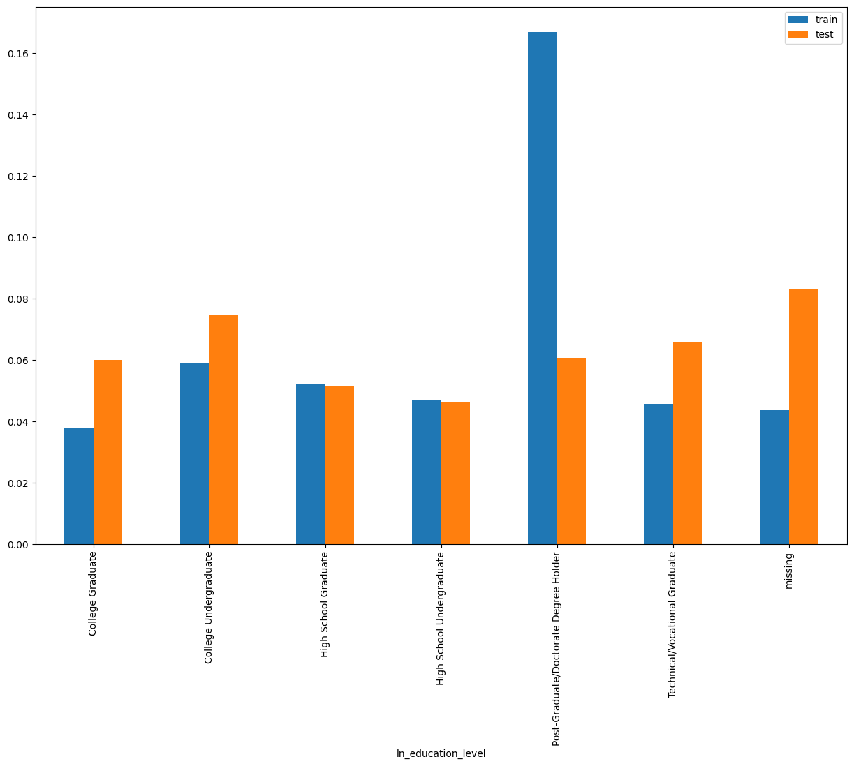
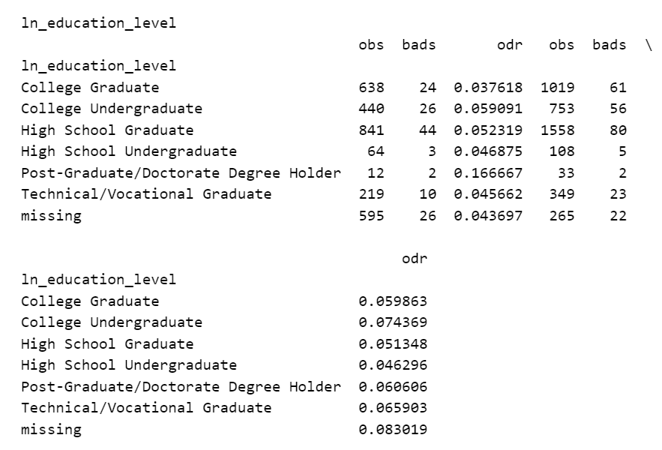
ln_education_level SHAP Rank: 11 Highest educational attainment level of the customer.

Slide 19
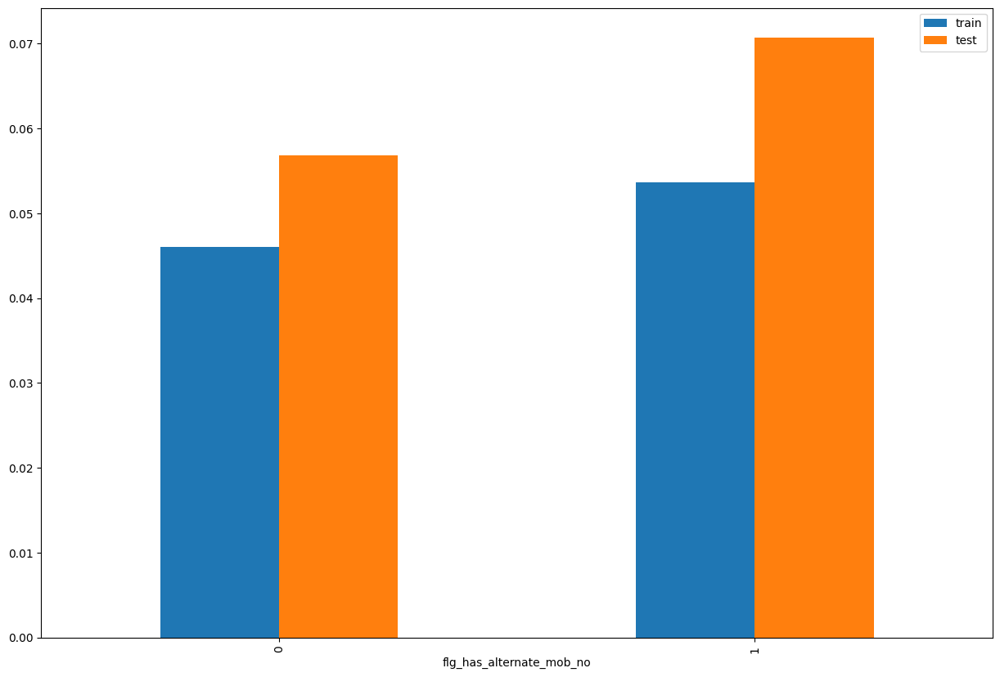
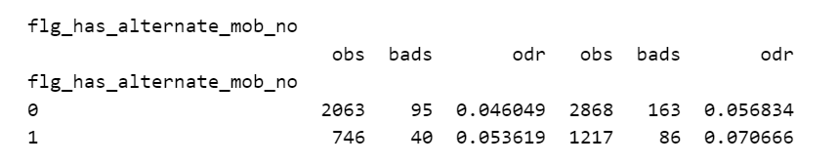
flg_has_alternate_mob_no SHAP Rank: 12 Flag indicating whether an alternate mobile number is provided (1) or not (0).

Slide 20
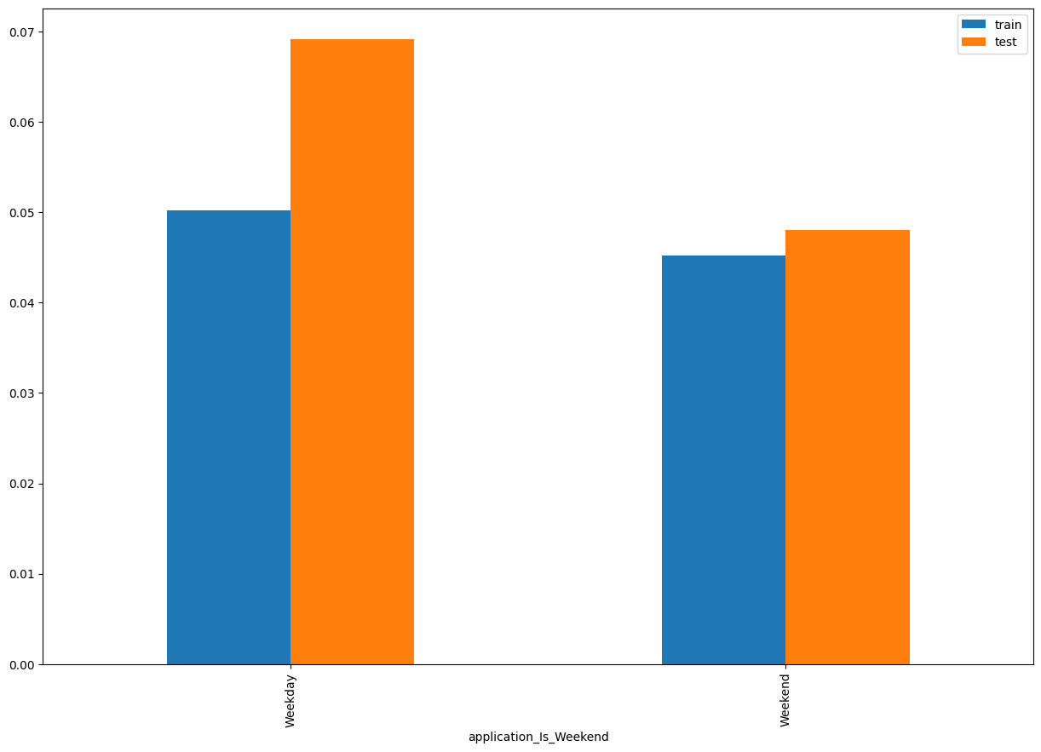
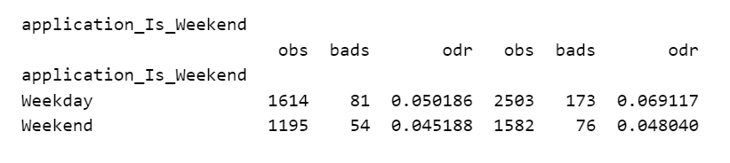
Application_Is_Weekend SHAP Rank: 13 Indicates whether the loan application was submitted on a weekend or a weekday.

Slide 21

THANK YOU!
​
Questions?
tonikbank.com

