Slide 1

Trench 3 Transaction Score for B Score Model for SIL
Presented by:
Data Science
08th May 2025

Slide 2
Architecture Overview of TDB’s Risk Scorecards
For Cash Loan only
For both Cash and SIL
Limit Setting Model (Hosted in Digital Layer)
Credit Decisioning Model (Hosted in Taran)
Beta Stack
Alpha Stack
Trench 1: New Users - within 30 days from TSA Onboarding
Limit Setting Score = Gamma Stack
Beta Demo Score
Beta Demo Score
Gamma Demo Score
Apps Score
Apps Score
Selectively call Alpha
Apps Score
Credo Score
Users automatically move from Trench 1 to Trench 2 after 30 days if no disbursed loans
Credo Score
CIC Score
Gamma Income Model
Beta Income Model
Alpha Income Model
Users will stay in Trench 2 until 1st disbursed loan. His Gamma Stack will be re-calculated every 30-day anniversary from TSA onboarding date
Limit Setting Score = Gamma Stack
Beta Stack
Alpha Stack
Gamma Demo Score
Beta Demo Score
Beta Demo Score
Trench 2: Existing Users - After 30 days from TSA Onboarding AND Never Disbursed Loan
Apps Score
Apps Score
Selectively call Alpha
Apps Score
Transaction Score
Transaction Score
Transaction Score
CIC Score
Gamma Income Model
Beta Income Model
Alpha Income Model
Users will move to Trench 3 after 1st Disbursed Loan
Lowest Risk users from this B Score will be pre-approved for upsell and xsell. Medium Risk users from this B Score will have to go through Taran.
High Risk users from this B Score will not be given any offer.
B Score = Gamma Stack
Trench 3: Existing Users - After 30 days from 1st Disbursed Loan AND current DPD <= 10
Beta Stack
Alpha Stack
Gamma Demo Score
Apps Score
Beta Demo Score
Beta Demo Score
Apps Score
Apps Score
Enhanced Transaction Score
Selectively call Alpha
Enhanced Transaction Score
Once moved to Trench 3, user will forever remain in Trench 3. His Gamma Stack will be re-calculated every 30 days anniversary from 1st Loan Disbursement Date
Enhanced Transaction Score
CIC Score
Gamma Income Model
Beta Income Model
Alpha Income Model

Slide 3
Sil Loan B-score Scorecard was developed on Trench 3 users
 | Loan Disbursement Date | # Count | # Bad (FSPD30) Cash Loans | FSPD30 rate
Training (90%) | 01/01/2024 - 30/11/2024 | 3,258 | 154 | 4.72%
Validation (10%) | 01/01/2024 - 30/11/2024 | 346 | 17 | 4.68%
Dec (Test) | 01/12/2024 - 31/12/2024 | 1,757 | 144 | 7.57%
Jan (OOT) | 01/01/2025 - 17/01/2025 | 441 | 26 | 5.56%
Type of 2nd Onwards Disbursed Loans Used for Modelling – SIL offers
Type of 2nd Onwards Disbursed Loans Used for Modeling – Sil Offer​ ​
Loan Type Used in Modeling​ | Type of Previous Disbursed Loan​
Sil-Instore, Sil ​Competitor, Sil Repeat, Sil ZERO | Can be anything​
​ | ​
Note: Only 2nd onwards disbursed loans are considered for training and testing the model. The previous loan type can be of any category.​

Slide 4
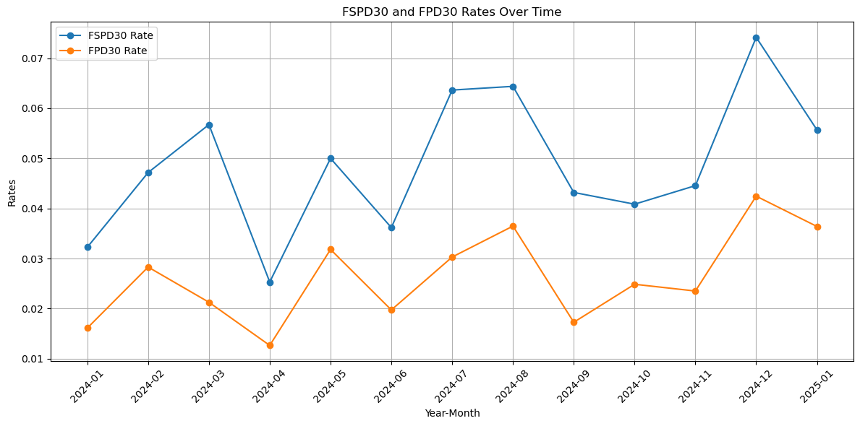
FSPD30 rate month-on-month (SIL)

Slide 5
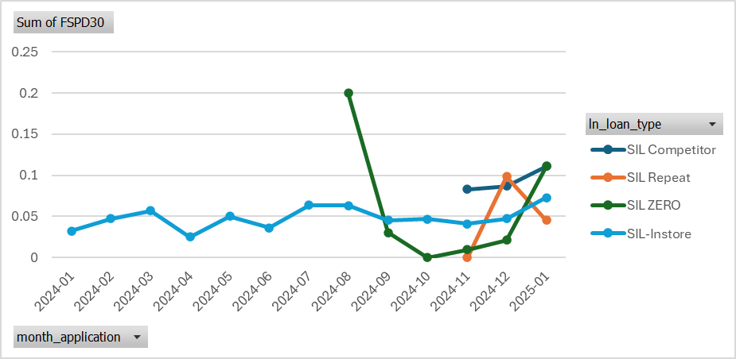
FSPD30 rate month-on-month (SIL)

Slide 6
Feature Selection Methodology Overview
323
Feats
175
Feats
148 Feats
84 Feats
15 Feats
Missing Rate <= 90%
IV > 0.008
Inter-correlation < 70%
Individual Feature Evaluation

Slide 7
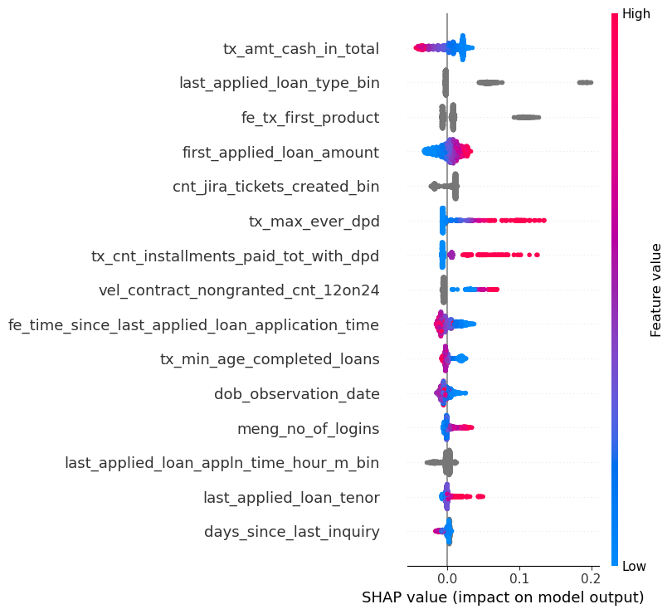
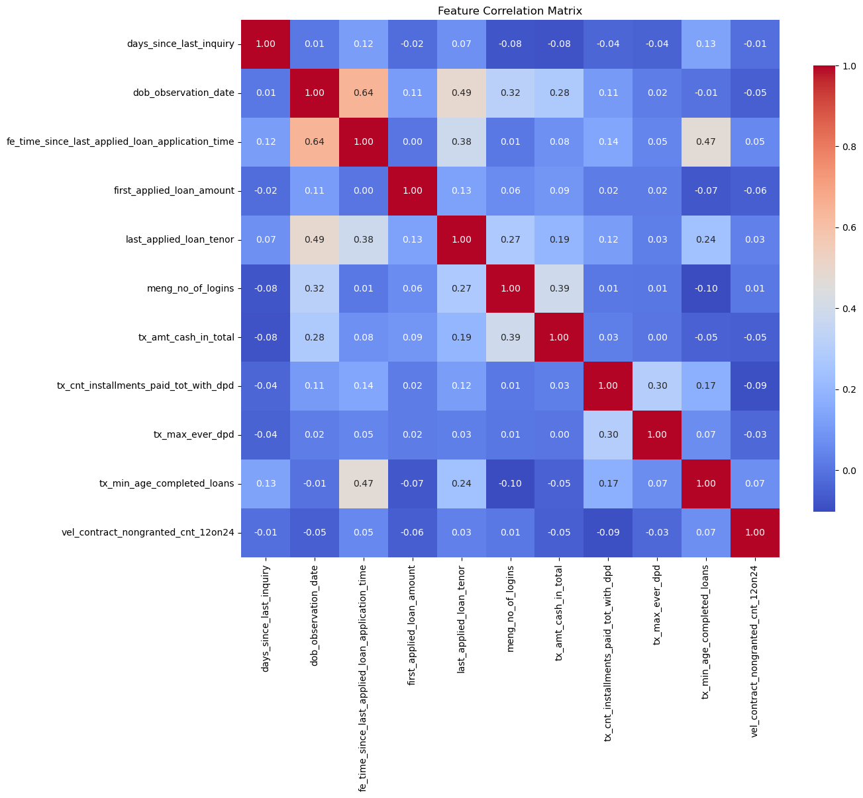
SHAP(15 feat)
Inter-Correlation (15 feat)

Slide 9
Feature Evaluation Plots (15 features)

Slide 10
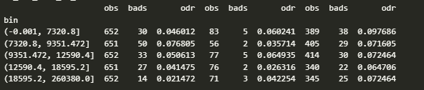
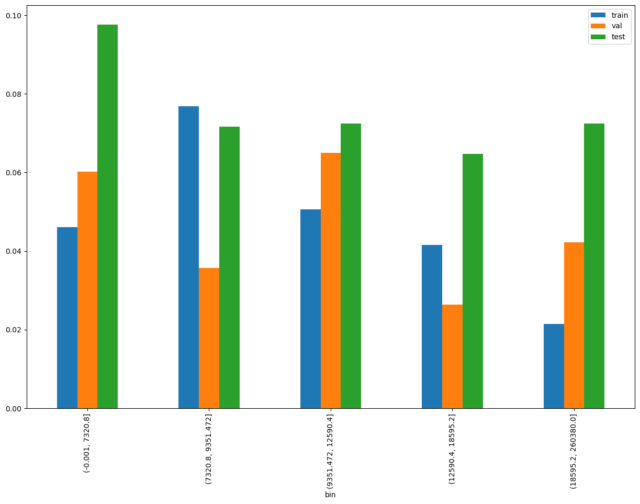
tx_amt_cash_in_total
SHAP Rank: 1
Total Cash Transactions: This metric represents the cumulative amount of cash transactions credited to customer accounts up to the observation date. It specifically excludes any loan amounts received by the customer. The transactions considered include transfers from Tonik to Tonik accounts as well as transfers from other banks to Tonik accounts.

Slide 11
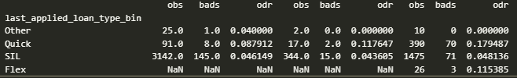
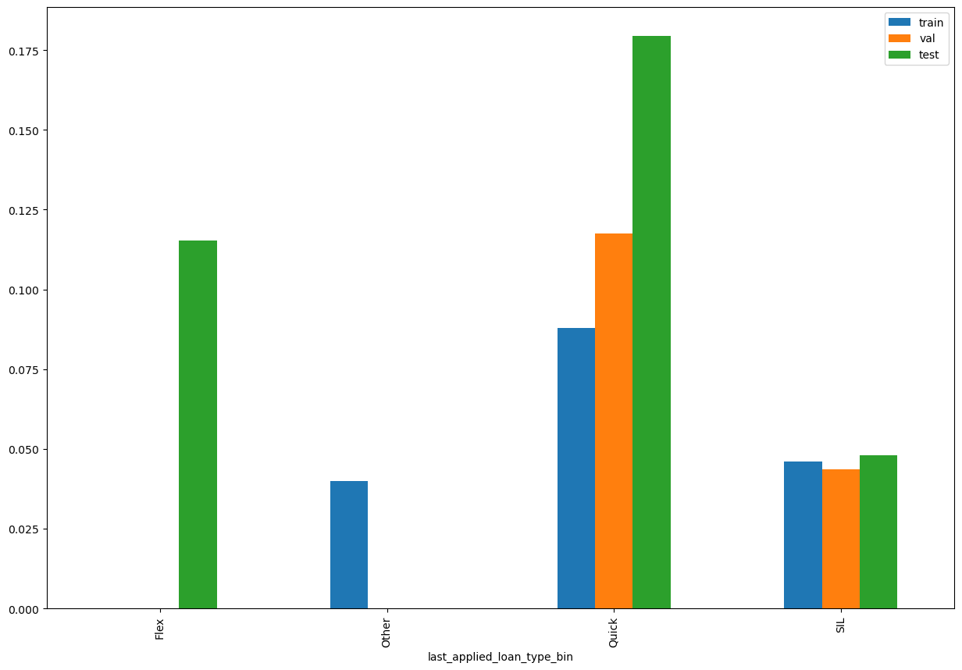
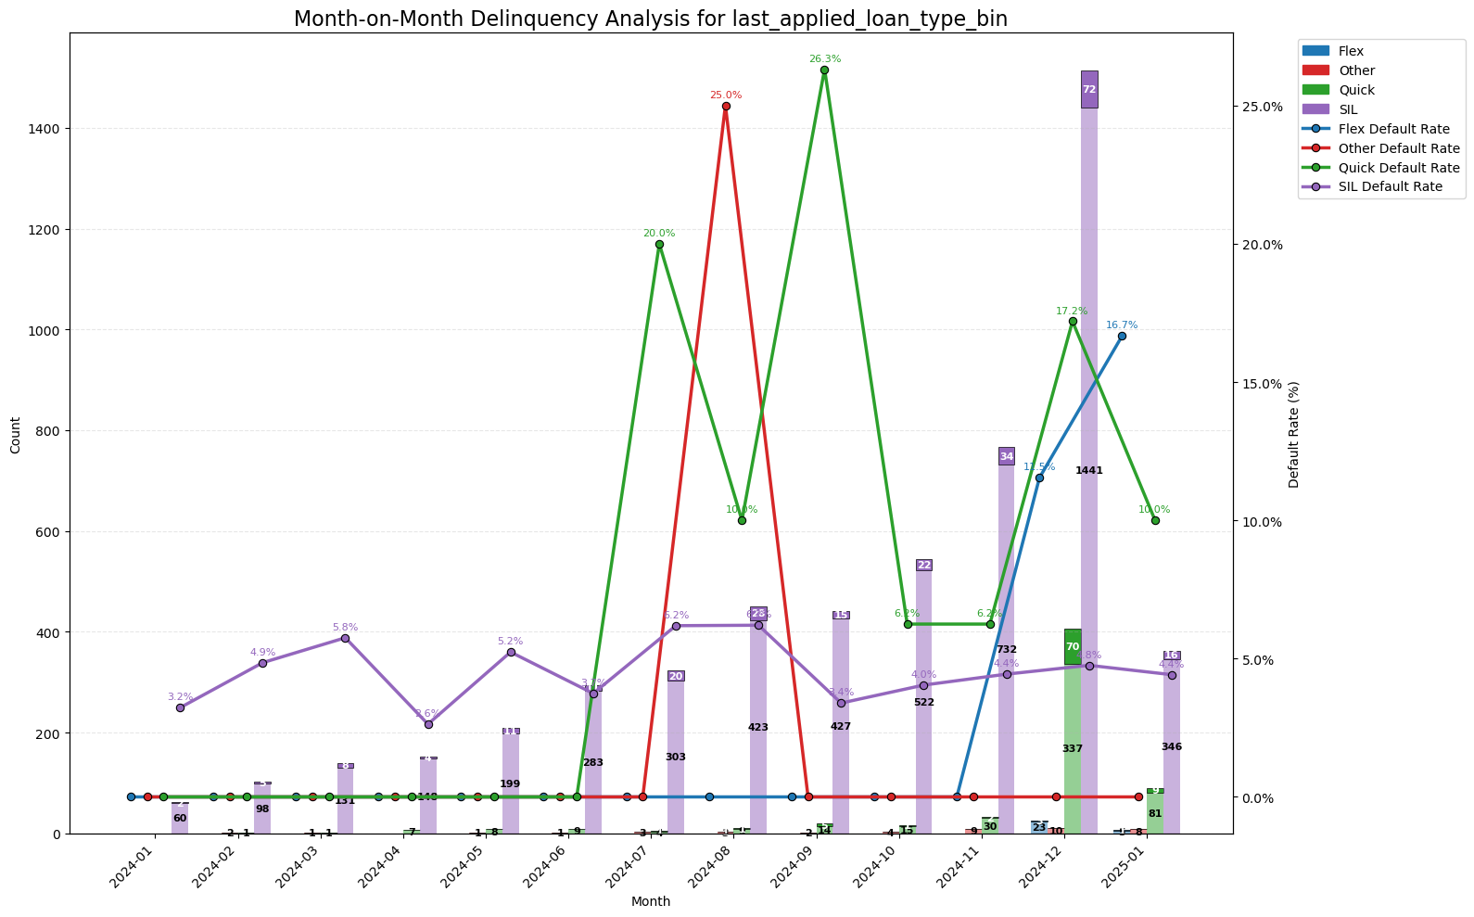
last_applied_loan_type_bin
SHAP Rank: 2
Last Applied Loan Type Bin: This feature is a simplified version of the last applied loan type, representing the type of loan the customer applied for in their most recent application.
Other: Includes various loan types such as Flex-up, Reloan, Big-loan, TSA-ACL, etc.
Quick: Refers to cash loans.
SIL: Represents shop installment loans.

Slide 12
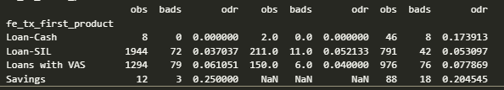
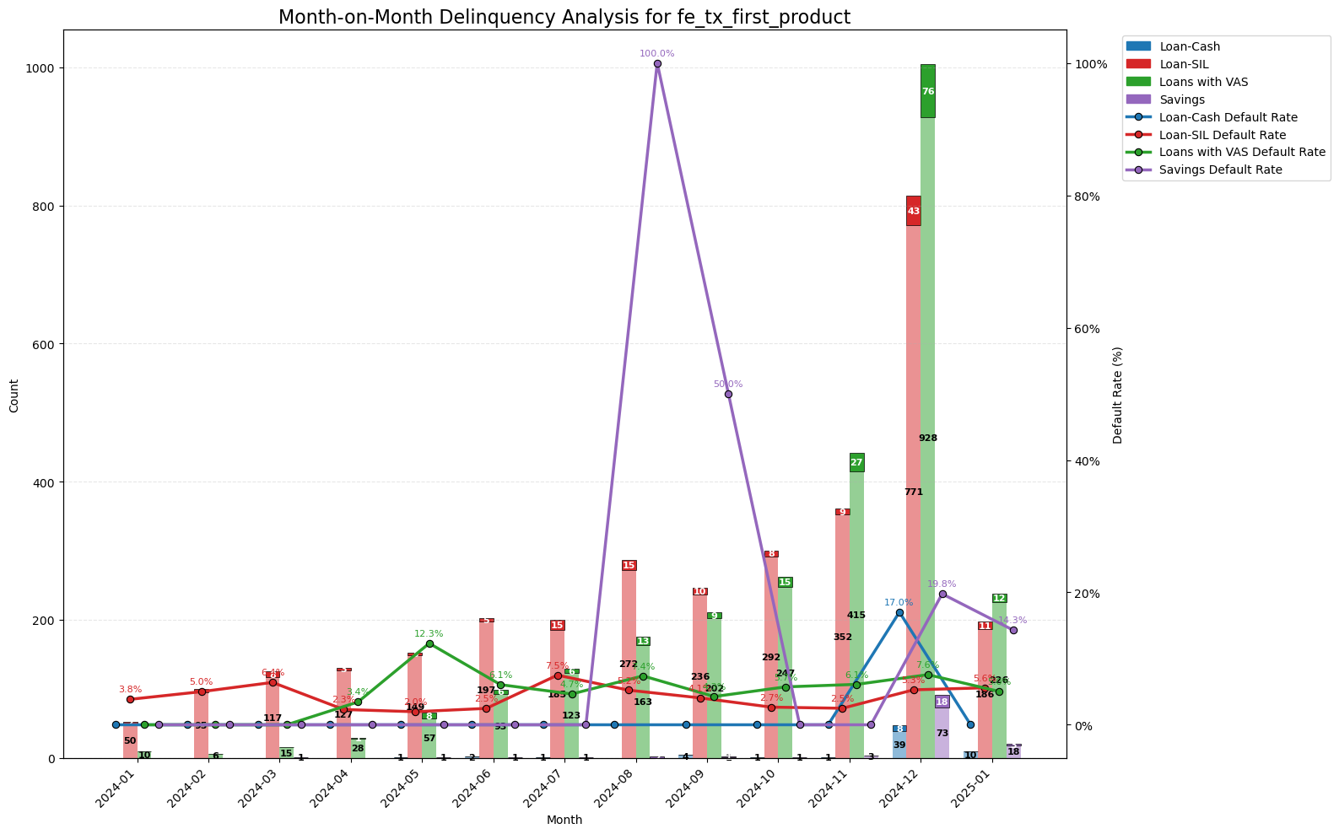
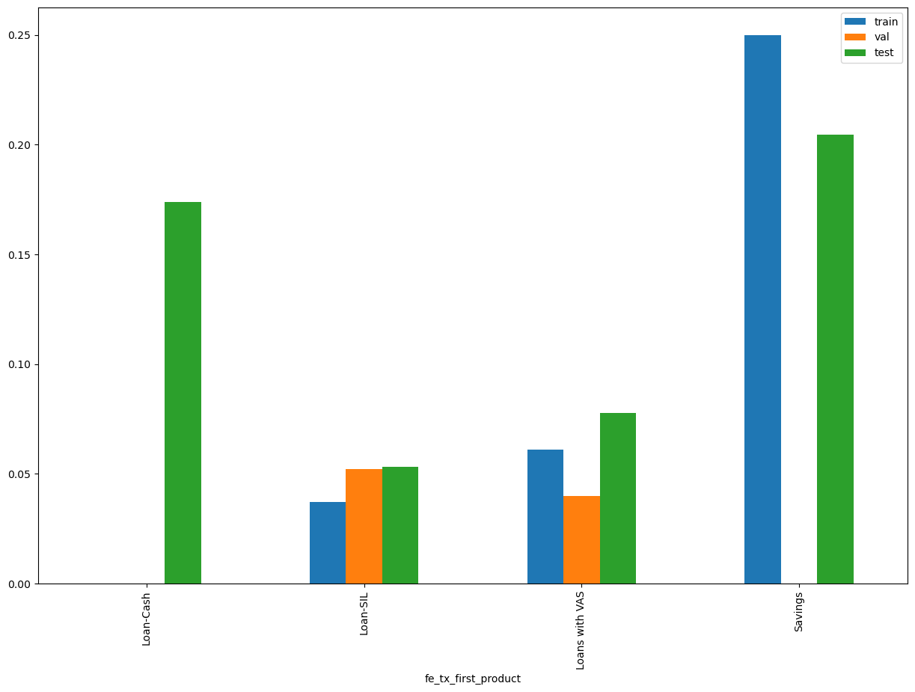
fe_tx_first_product
SHAP Rank: 3
First Product Selected by Customer: This feature represents the initial product chosen by the customer and is a simplified version of the original feature.
Loan-Cash: Quick loans without Value-Added Services (VAS).
Loan-SIL: Shop installment loans without VAS.
Loan-VAS: Any type of loan that includes VAS.
Savings: Indicates that the first product selected was a savings product.

Slide 13

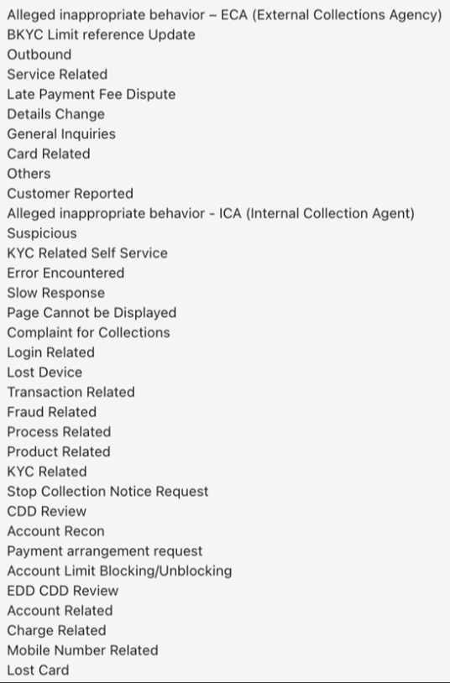
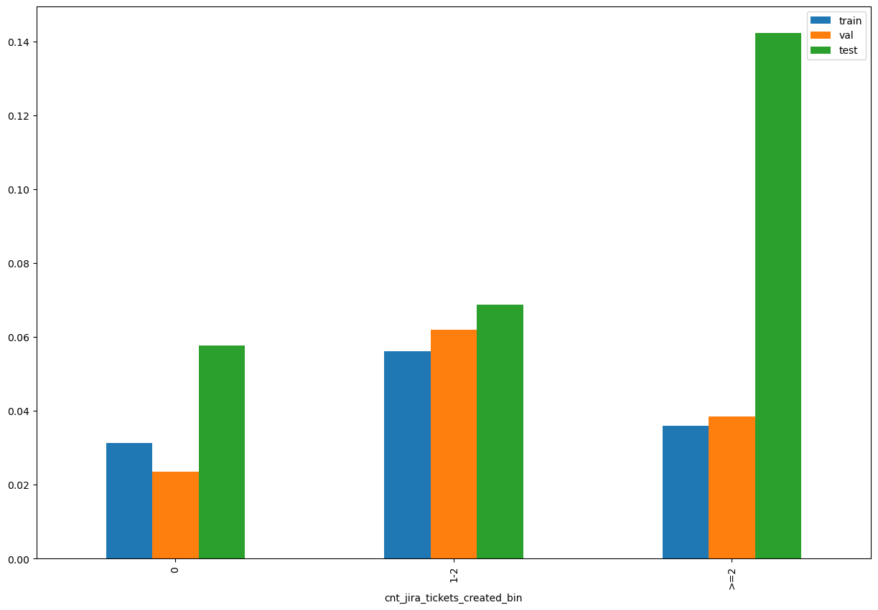
cnt_jira_tickets_created_bin
SHAP Rank: 4
Jira Tickets Raised by or for Customers: This feature captures any type of Jira ticket raised either by the customer or on behalf of the customer. Tickets can be initiated during the application or onboarding process due to discrepancies in the data provided by the customer, or they can be raised by the customer to address any issues they are facing.
For Description of Jira ticket type click here

Slide 14
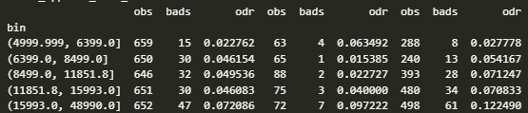
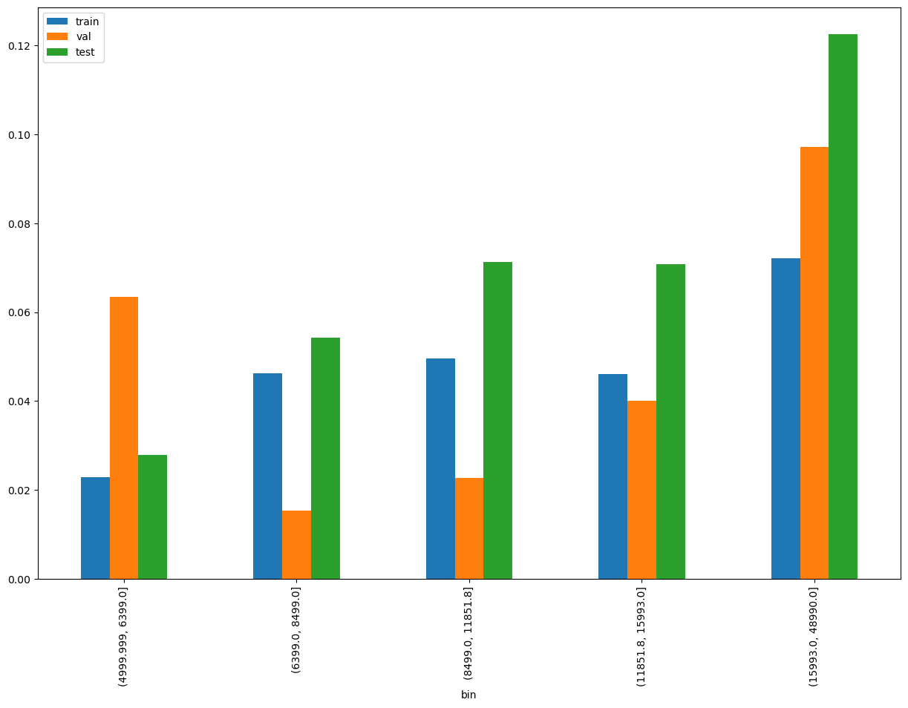
first_applied_loan_amount
SHAP Rank: 5
Loan Applied Amount in Customer’s First Ever Application: This feature captures the total amount of the loan that the customer applied for in their very first application. This is related to customer applying for loan in Tonik.

Slide 15

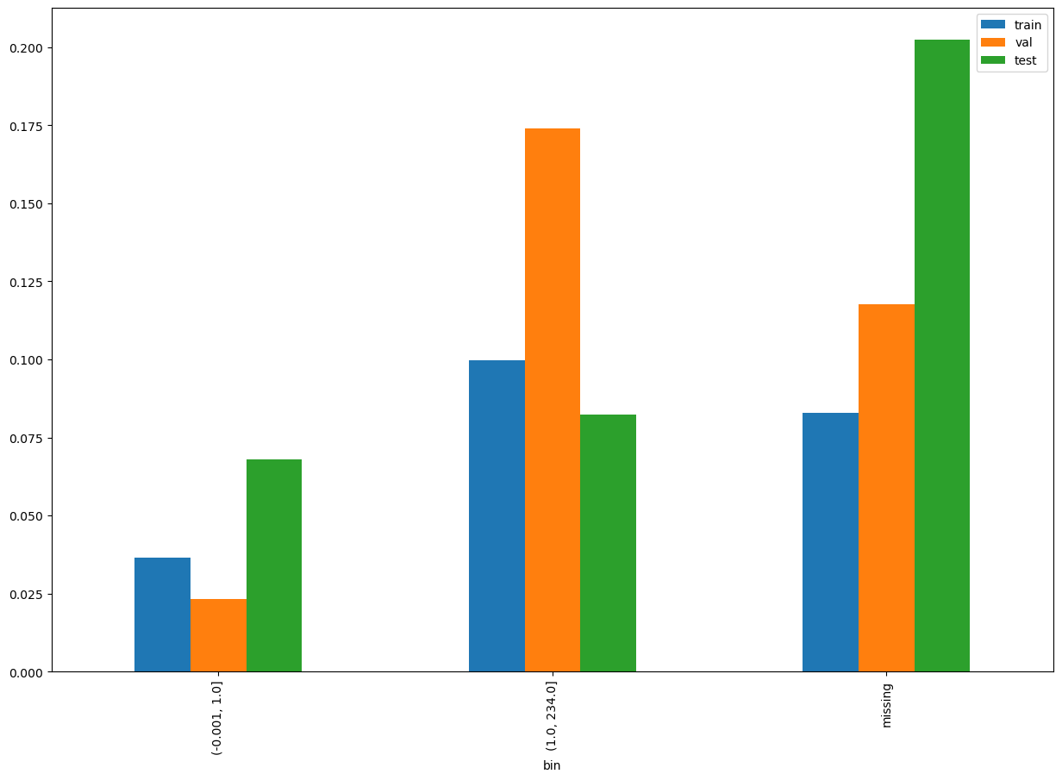
tx_max_ever_dpd
SHAP Rank: 6
Maximum Ever Days Past Due in Customer’s Repayment History: This feature captures the highest number of days a customer has been past due in their repayment history. The missing indicates that in previous loans the customer has settled without even reaching the first due date.

Slide 16

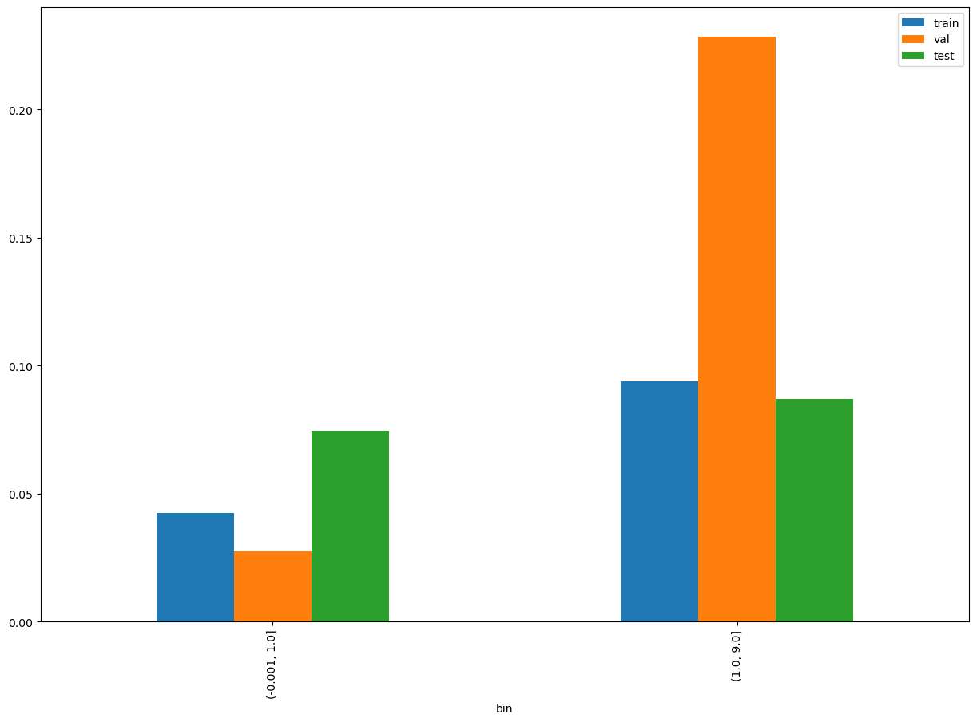
tx_cnt_installments_paid_tot_with_dpd
SHAP Rank: 7
Total Installments Paid by Customer with Some Days Past Due: This feature captures the total number of installments paid by the customer that were past due by a few days.

Slide 17

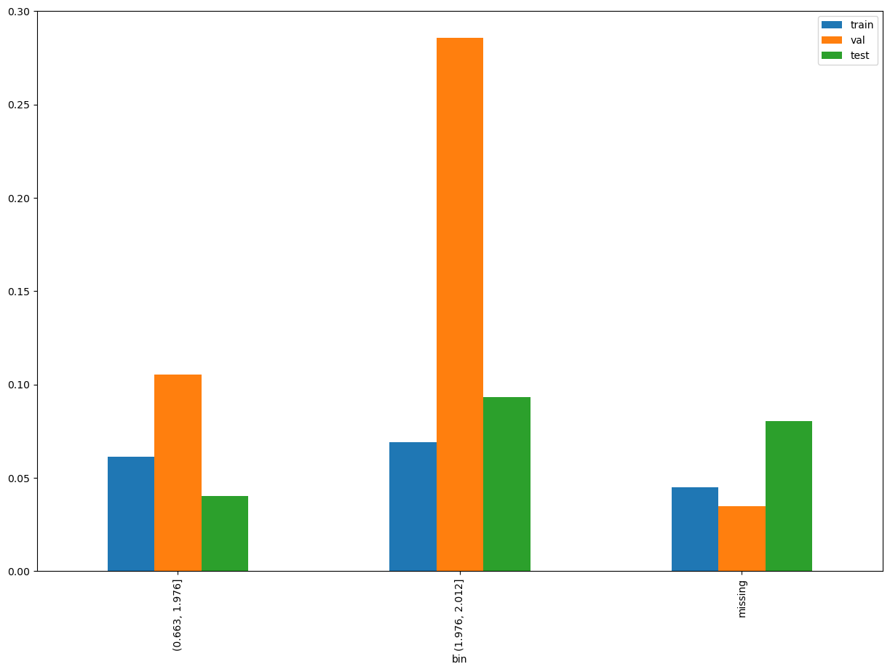
vel_contract_nongranted_cnt_12on24
SHAP Rank: 8
Velocity of Non-Granted Contracts in Last 12 to 24 Months: This feature captures the increase in the number of non-granted contracts observed in the credit bureau data over the past 12 to 24 months.

Slide 18
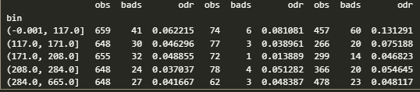
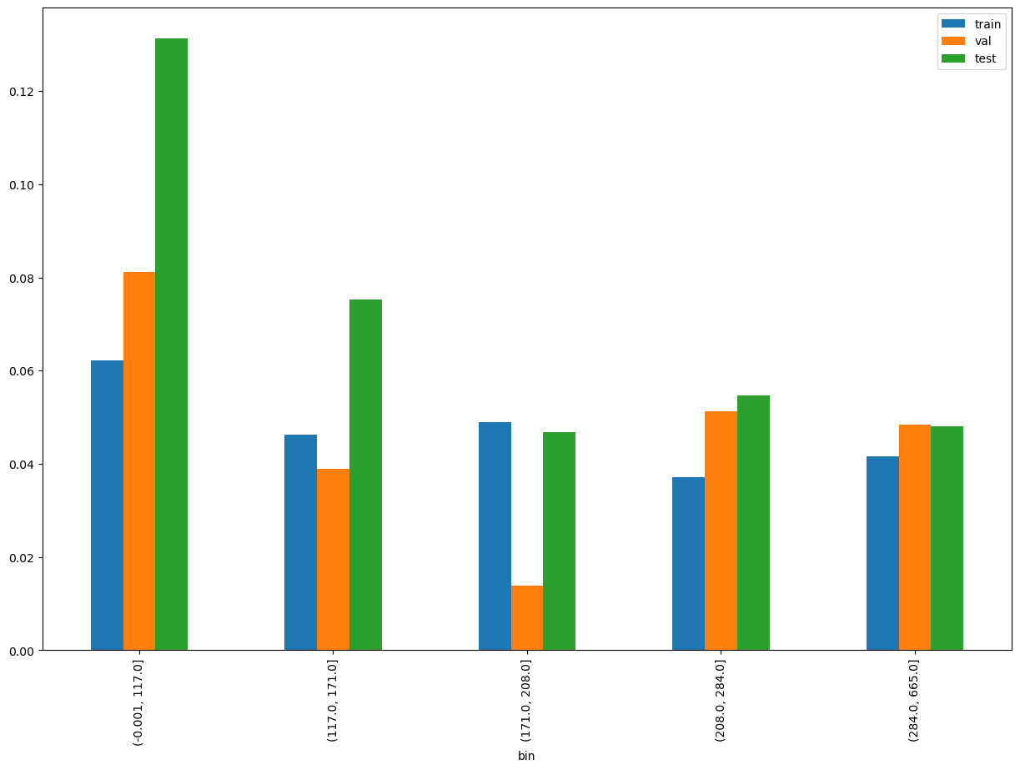
fe_time_since_last_applied_loan_application_time
SHAP Rank: 9
Time Since Last Applied Loan Application: This feature captures the duration that has passed since the customer last applied for a loan.

Slide 19
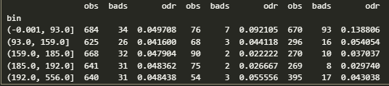
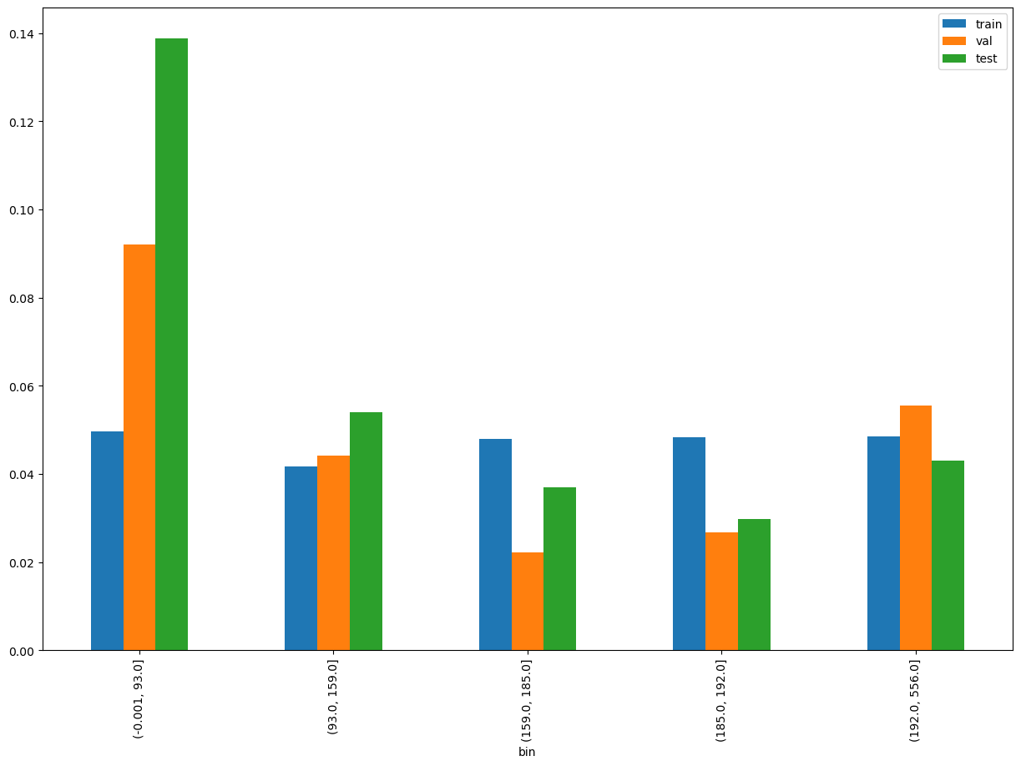
tx_min_age_completed_loans
SHAP Rank: 10
Minimum Age of Completed Loans: This feature captures the shortest duration from the start to the completion of loans in the customer's history.

Slide 20
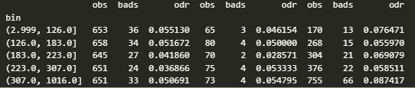
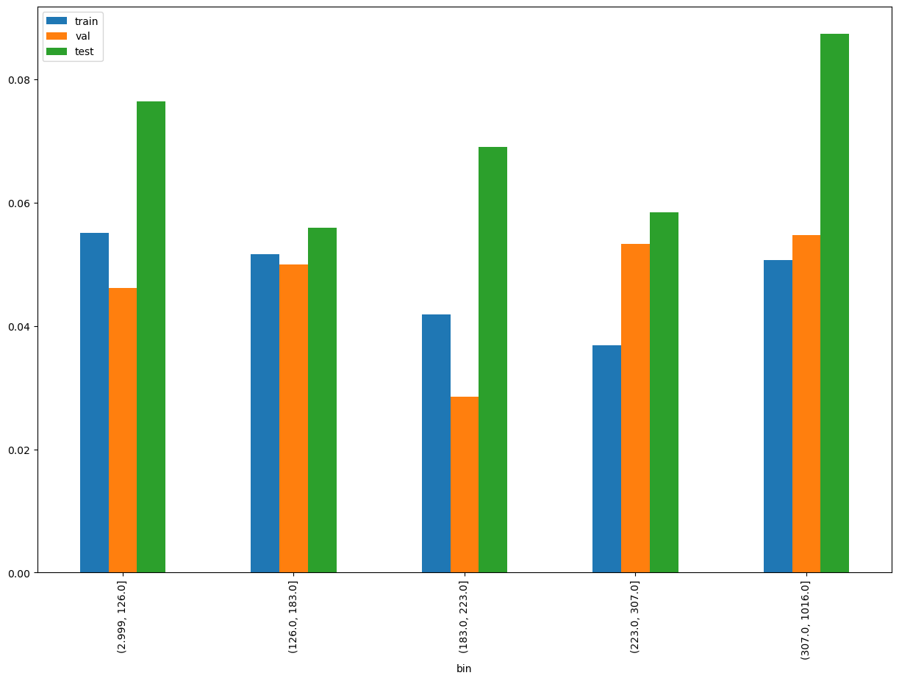
dob_observation_date
SHAP Rank: 11
Days on Book Since Onboarding: This feature captures the total number of days the customer has been with us, starting from the date they opened their Tonik Savings Account.

Slide 21
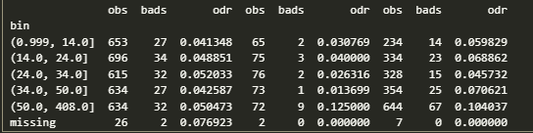
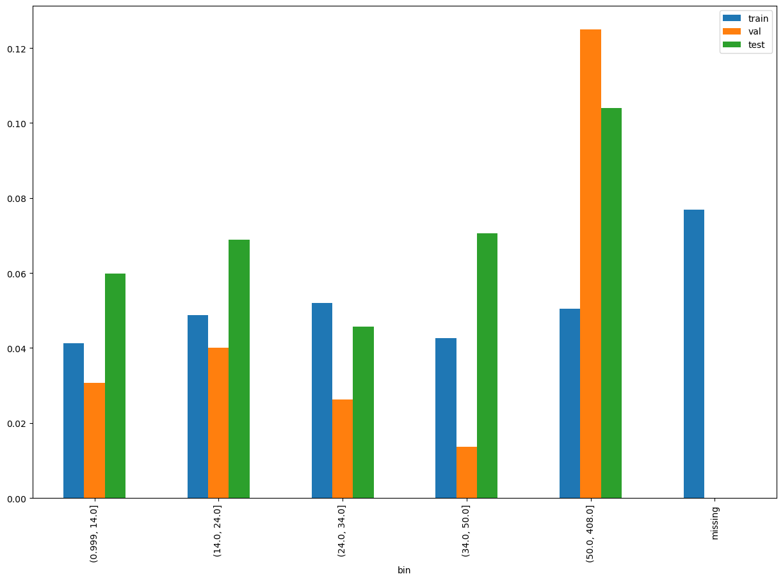
meng_no_of_logins
SHAP Rank: 12
Number of Logins in Our App: This feature captures the total number of times the customer has logged into our app, with data sourced from Mo-engage.

Slide 22
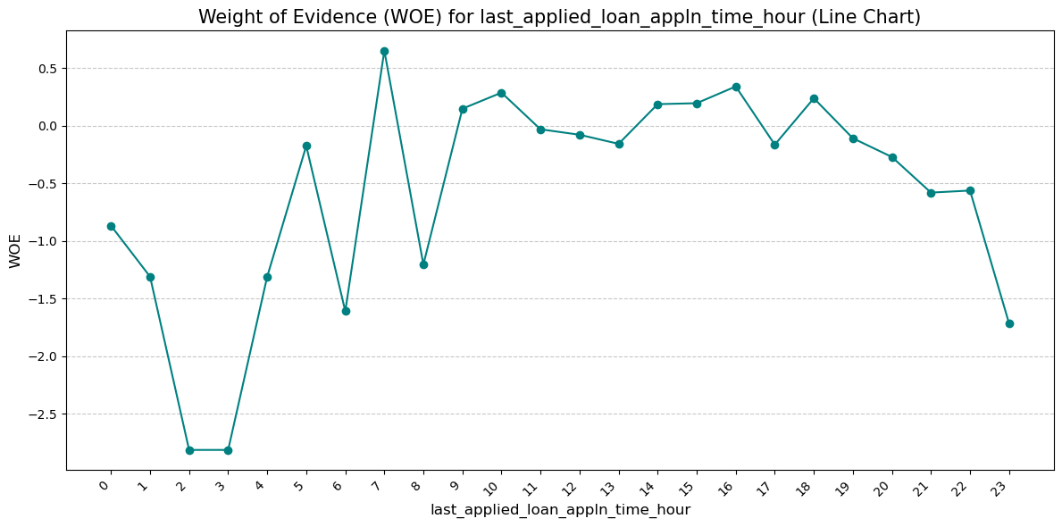

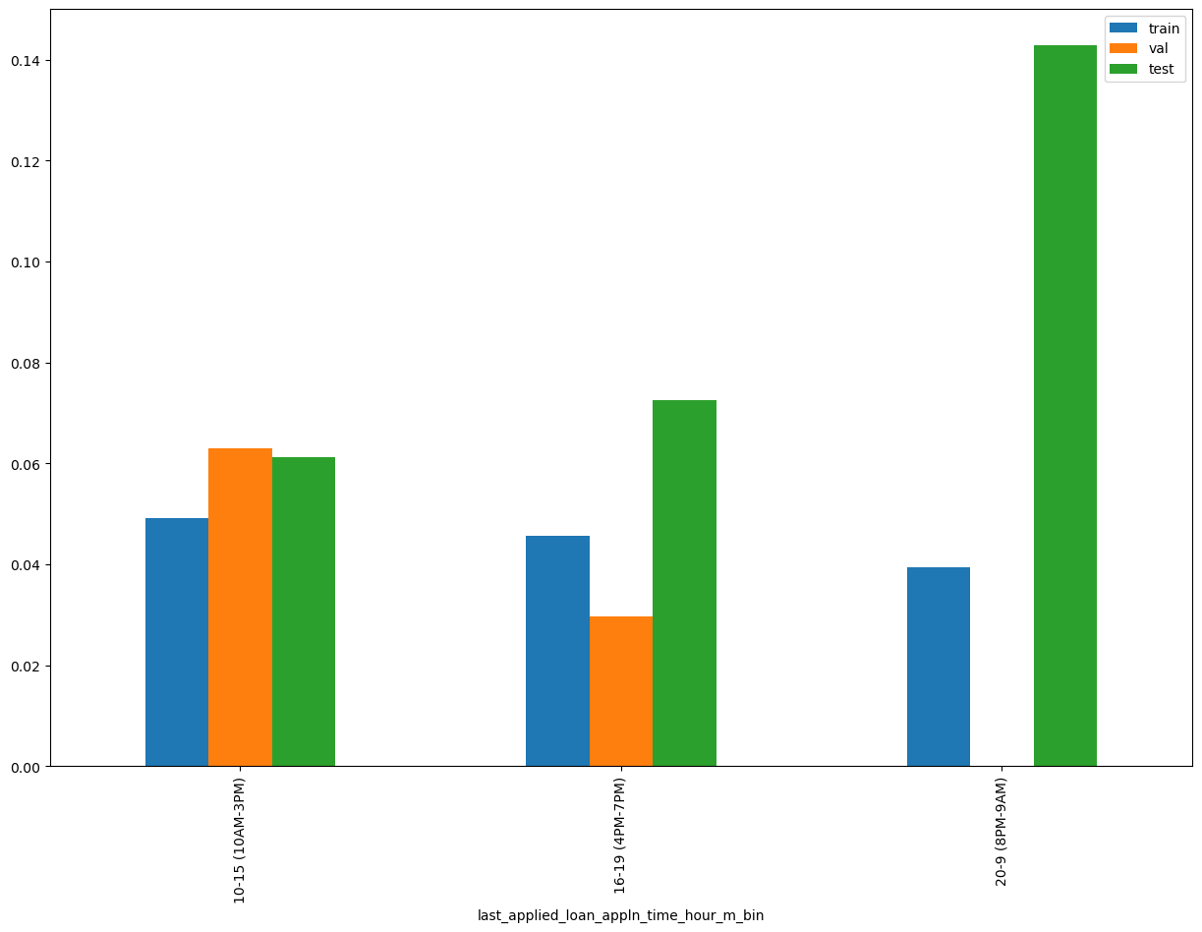
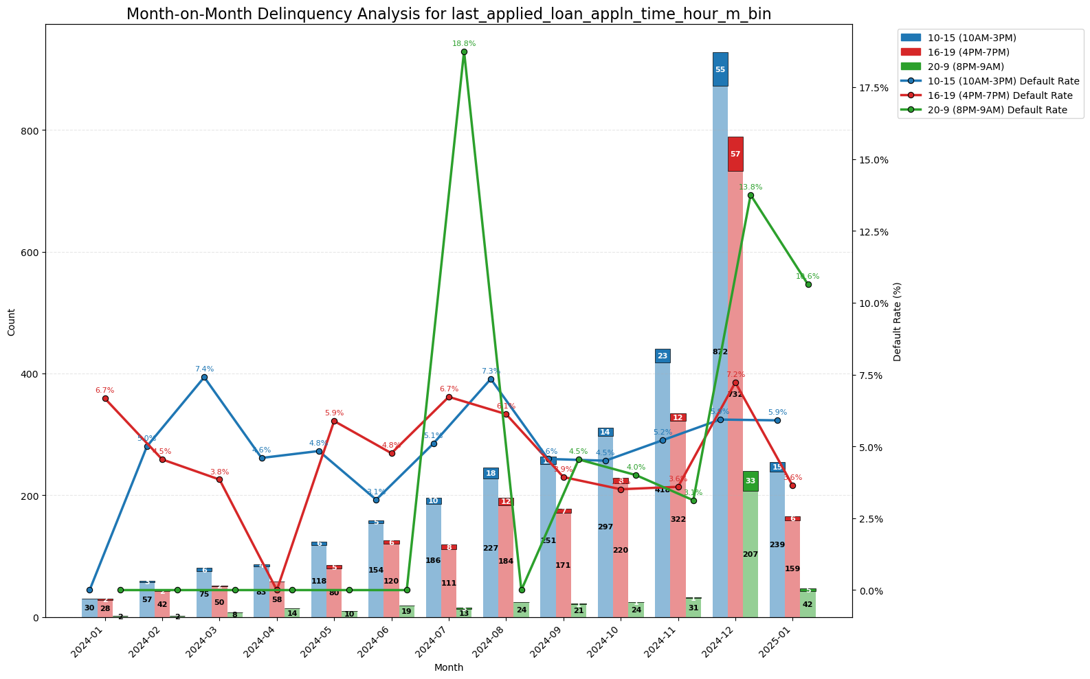
last_applied_loan_appln_time_hour_m_bin
SHAP Rank: 13
Bin of Hour of Application for Last Applied Loan: This feature captures the hour of the day when the customer last applied for a loan. The hour is extracted from the application time and then categorized into bins based on Weight of Evidence (WOE).

Slide 23

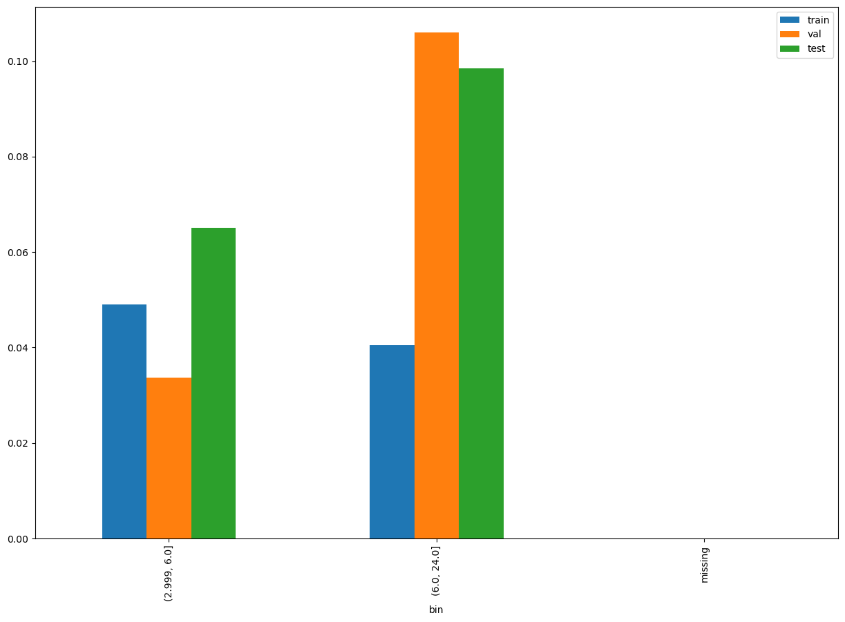
last_applied_loan_tenor
SHAP Rank: 14
Tenor of Last Applied Loan: This feature captures the duration or term of the loan that the customer applied for in their most recent application.

Slide 24
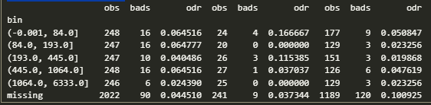
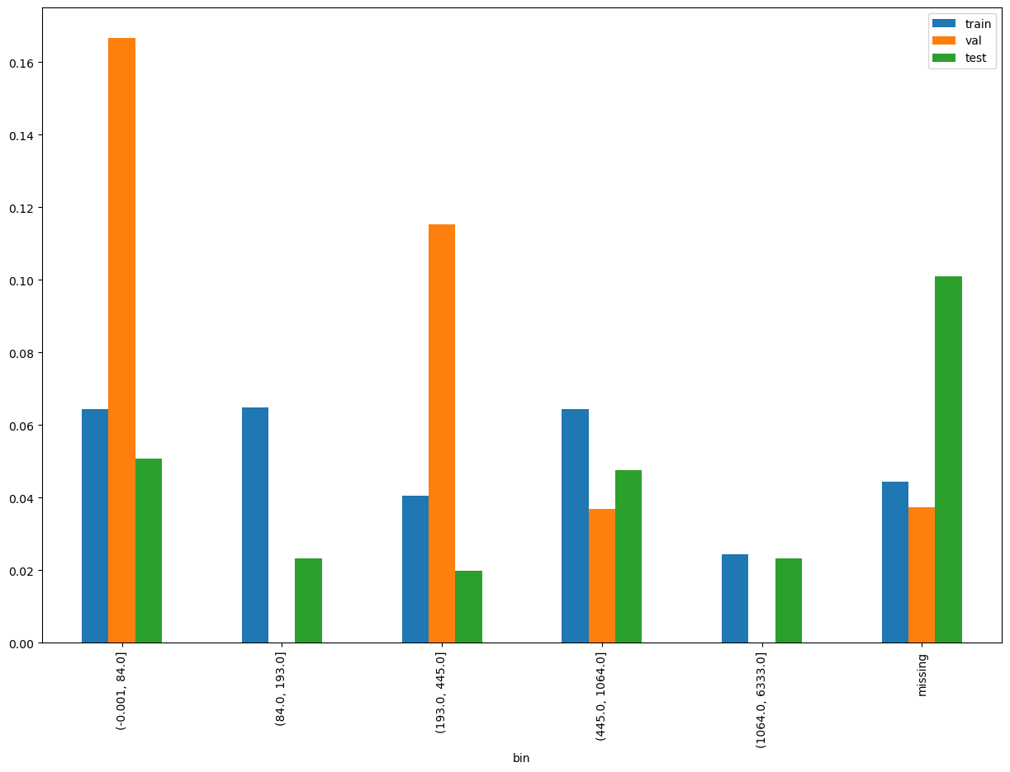
days_since_last_inquiry
SHAP Rank: 15
Number of Days Since Last Inquiry: This bureau feature captures the total number of days that have passed since the customer last made an inquiry.

Slide 25

THANK YOU!
​
Questions?
tonikbank.com

Slide 26
Types of Jira Tickets
Alleged Inappropriate Behavior – ECA: Reports of inappropriate behavior by External Collections Agency.
BKYC Limit Reference Update: Requests to update the BKYC limit reference.
Outbound: Issues related to outbound communications.
Service Related: General service-related inquiries or complaints.
Late Payment Fee Dispute: Disputes regarding late payment fees.
Details Change: Requests to change personal or account details.
General Inquiries: Miscellaneous questions or information requests.
Card Related: Issues or inquiries related to credit or debit cards.
Others: Any other types of tickets not categorized elsewhere.
Customer Reported: Issues reported directly by the customer. Alleged
Inappropriate Behavior – ICA: Reports of inappropriate behavior by Internal Collection Agent.
Suspicious: Reports of suspicious activities or transactions.
KYC Related Self Service: Issues related to self-service KYC processes.
Error Encountered: Reports of errors encountered during usage. Slow Response: Complaints about slow response times.
Page Cannot be Displayed: Issues where a webpage cannot be displayed.
Complaint for Collections: Complaints related to collection processes.
Login Related: Issues related to logging into accounts.
Lost Device: Reports of lost devices.
Transaction Related: Issues or inquiries related to transactions.
Fraud Related: Reports of fraudulent activities.
Process Related: Issues related to specific processes.
Product Related: Inquiries or complaints about products.
KYC Related: Issues related to KYC processes.
Stop Collection Notice Request: Requests to stop collection notices.
CDD Review: Requests for Customer Due Diligence reviews.
Account Recon: Requests for account reconciliation.
Payment Arrangement Request: Requests to arrange payment schedules.
Account Limit Blocking/Unblocking: Requests to block or unblock account limits.
EDD CDD Review: Enhanced Due Diligence and Customer Due Diligence reviews.
Account Related: General account-related issues.
Charge Related: Inquiries or disputes related to charges.
Mobile Number Related: Issues related to mobile numbers.
Lost Card: Reports of lost cards.
Back

