Slide 1
EDA (web interactive vs html/pdf report)
Feature engineering
Model dev
Performance/Reporting
Feature statistics (global/target based)
Feature selection
Key metrics performance
Time-based statistics
Feature generation
Final features statistic
Pairwise correlation
Model training
Decile tables
Interaction plots
Model tuning
Stability

Slide 2
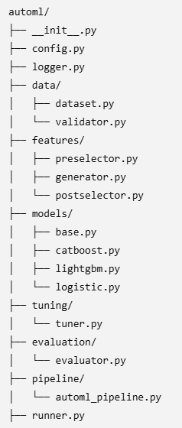
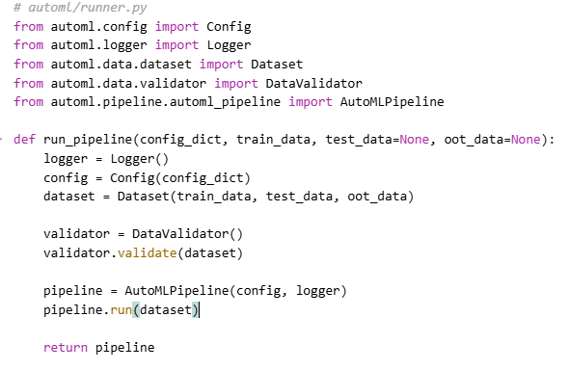
Model dev
Feature selection
Feature generation
Model training
Model tuning

