Slide 1

Beta 1 Income Estimation Model
on Cash Loan January 2025

Slide 2
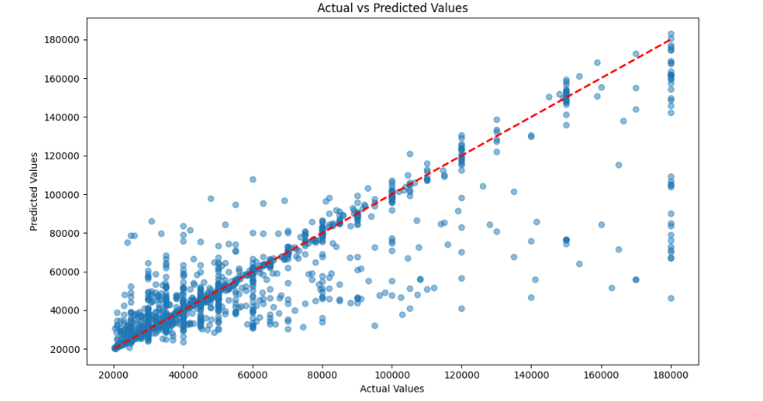
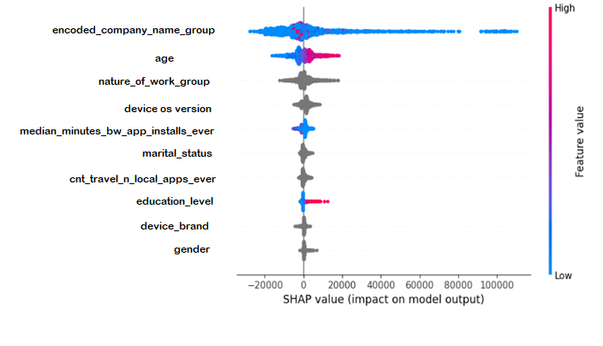
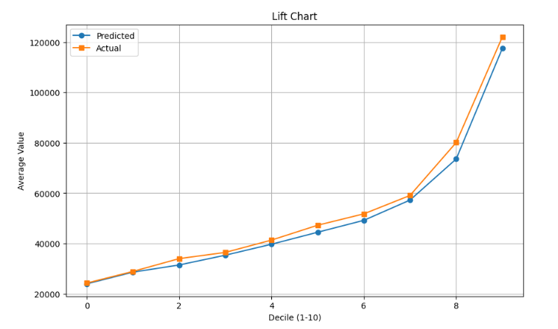
Beta 1 Model – Income Estimation (Regression)
Beta1 Step2 Top Ten Feature

