Slide 1

Scorecard documentation – Demo CASH November 2024

Slide 2
Scorecard Development – Content
Intro
Motivation
Development sample
Model
Final model description
Development parameters – features, target
Method used
Model features
Model performance
Implementation notes (optionally)

Slide 3
INTRO

Slide 4
Motivation
The New Demographic Models for Quick and SIL are deployed in April 2024.
We aim to improve the model quality as we have 12 months of data, and we seek for better model performance. We also see the existing model to be not performing as well as in its initial deployment.
In this iteration, due to time constraints we only retrained the Quick Demo model with the newer training data.

Slide 5
Development Sample
The development sample has the following characteristics:
Start date: July 2023
End date: June 2024
Portfolio used: Quick loans only
Overall number of total records used: 13710
Target variable
Target variable: FSPD30
Target hits: 2718
Target frequency: 19.82% (= 2718/13710)
Development details:
Training sample: 90%
Testing sample: 10%
Data sample for score development – pls refer to specific table, or append the script in TXT/SQL for data gathering and feature selection

Slide 6
MODEL

Slide 7
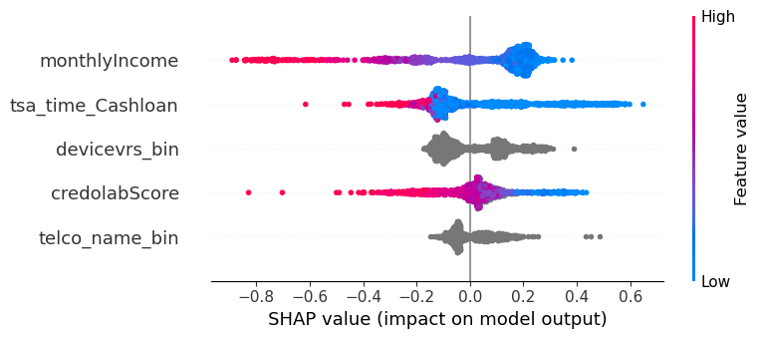
Final Model
Feature | Coefficient
Intecept term | -1.388964
credolabScore (WOE Transformed) | -0.722441
tsa_time_Cashloan (WOE Transformed) | -0.893719
monthlyIncome (WOE Transformed) | -0.808371
telco_name_bin(WOE Transformed) | -0.512429
devicevrs_bin (WOE Transformed) | -0.482859
How to Read this SHAP chart?
Features are in decreasing order of importance
Left Blue, Right Red → +Ve Correlation
Left Red, Right Blue → -Ve Correlation
Grey color means missing value or categorical feat

Slide 8
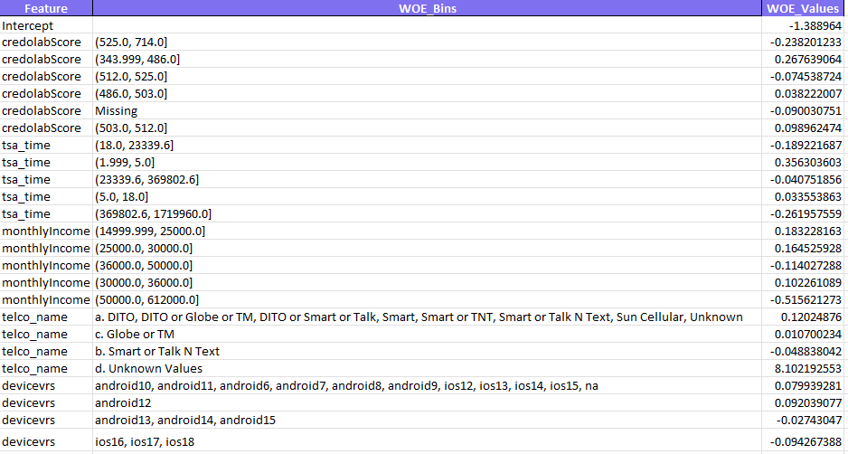
Final Model Scaled

Slide 9
Development Parameters
Development
Method used: Binning and WOE logistic regression to retrain on the same features.
Logistic regression parameters:
Approach 1 - WOE logistic regression on same binning and same WOE binning
Approach 2- binning and WOE logistic regression to retrain on the same features.
Compared and finalized the approach which have better Gini.
Overall number of total records used:
Train: 12,339
Test: 1371

Slide 10
Development Algorithm
Description
Logistic regression is a statistical method used for binary classification, which means it predicts one of two possible outcomes based on one or more predictor variables.
In banking, it is commonly used to assess the likelihood of events such as loan defaults, credit risk, or customer churn.
How It Works:
Logistic regression models the relationship between independent variables (such as income, credit score, loan amount, etc.) and a binary dependent variable (e.g., default vs. non-default).
Instead of predicting a value directly, it estimates the probability that a given instance falls into one of the two categories using a logistic function, which produces outputs between 0 and 1.

Slide 11

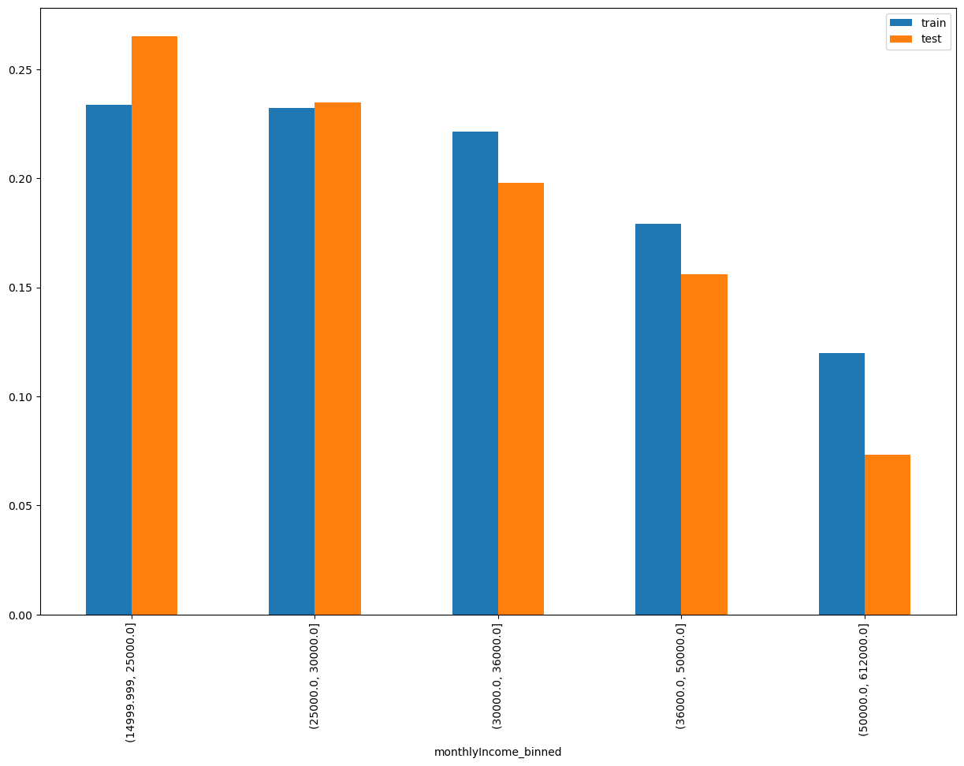
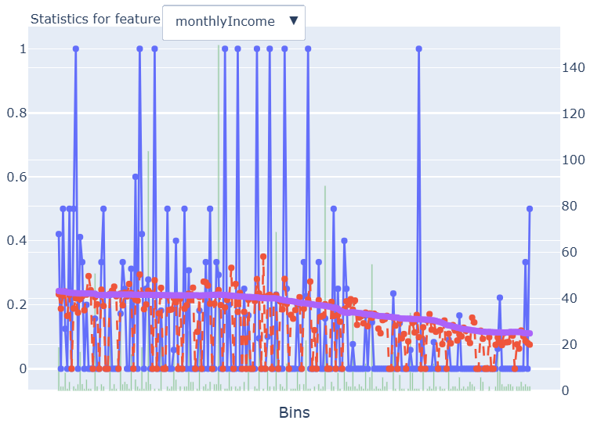
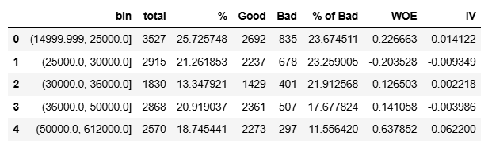
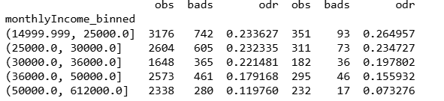
monthlyIncome = Monthly income of user This feature broadly indicates if lesser monthly income, higher the risk.

Slide 12
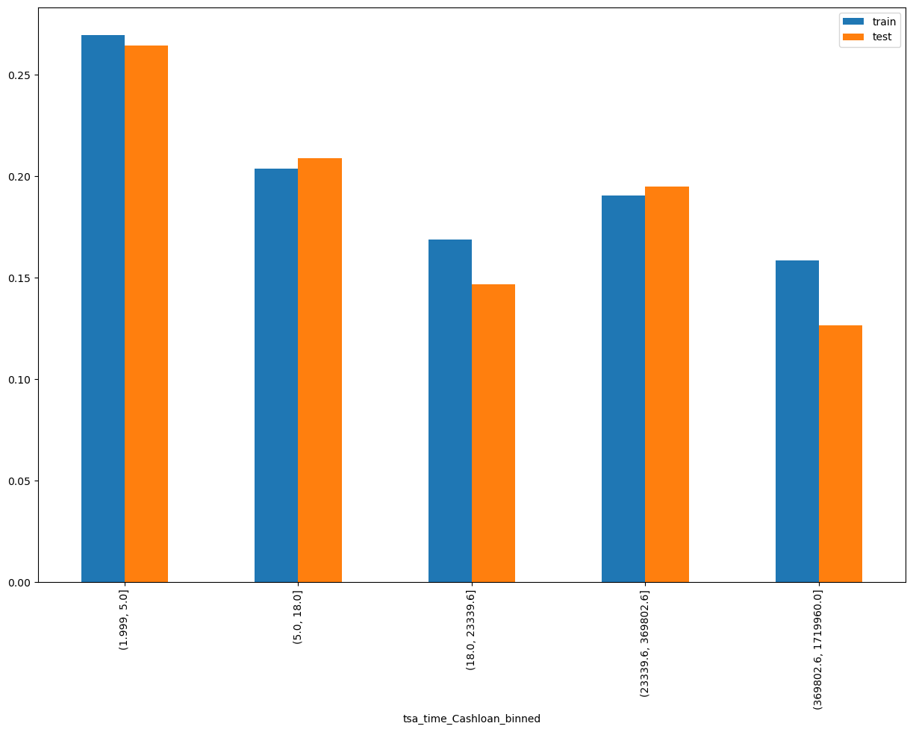
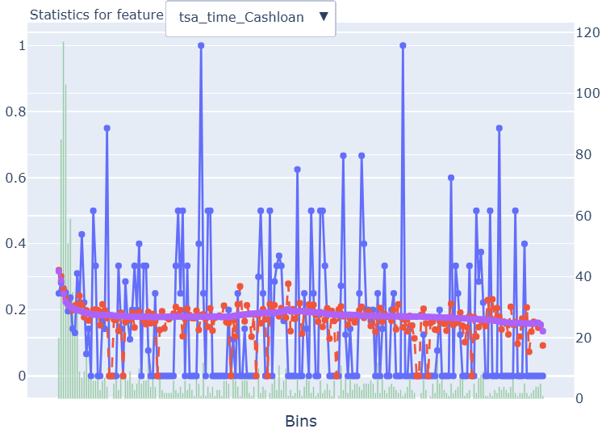
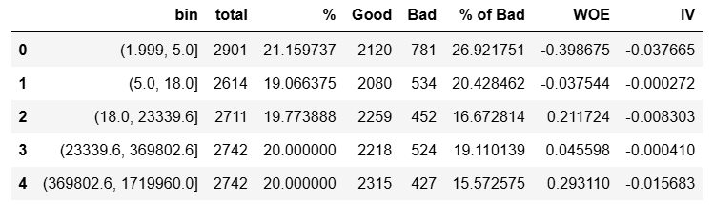
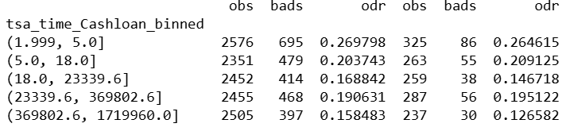
tsa_time_Cashloan= Difference between startApplyDateTime and tsa onboarding time. If time increase ,it indicates lower the risk
Notes:
CASE
WHEN ContractTypeDesc = 'Time Loan' THEN 'Time Loans’
WHEN ContractTypeDesc IN ('Short Term Loan', 'Term Loan') THEN 'Short and Term Loans'
WHEN ContractTypeDesc = 'Home equity loan' THEN 'Home Equity Loans'
WHEN ContractTypeDesc IN ('Credit Card', 'Credit Card - MultiCurrency', 'Credit Card - Shared Limit') THEN 'Credit Cards'
WHEN ContractTypeDesc IN ('Loan Line', 'Credit Line') THEN 'Credit Lines'
WHEN ContractTypeDesc IN ('Mortgage/Real Estate', 'Real estate leasing') THEN 'Real Estate Loans'
WHEN ContractTypeDesc = 'Trust Loan' THEN 'Trust Loans'
WHEN ContractTypeDesc = 'Personal Loan' THEN 'Personal Loans' ELSE 'Other Loans’
END AS loan_segment

Slide 13
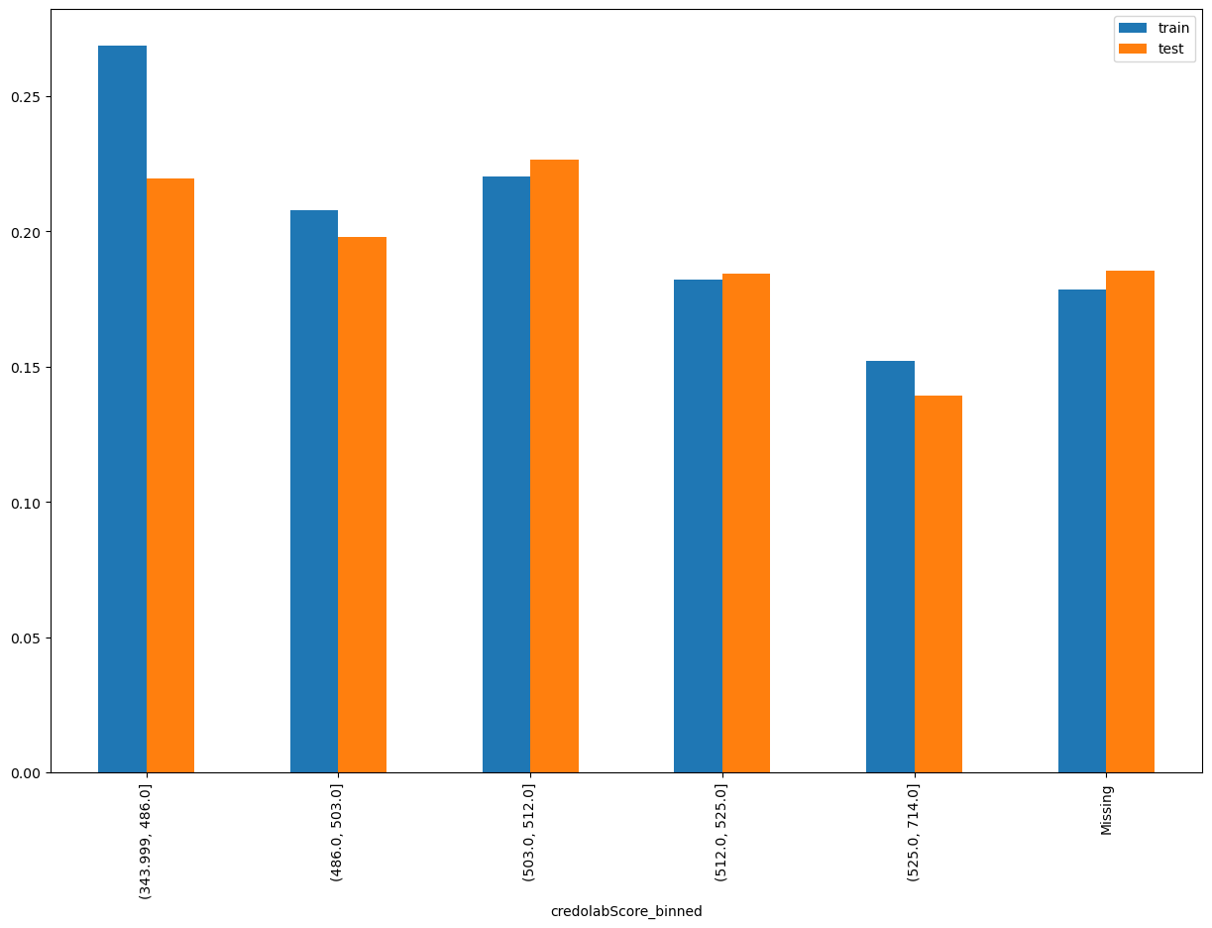
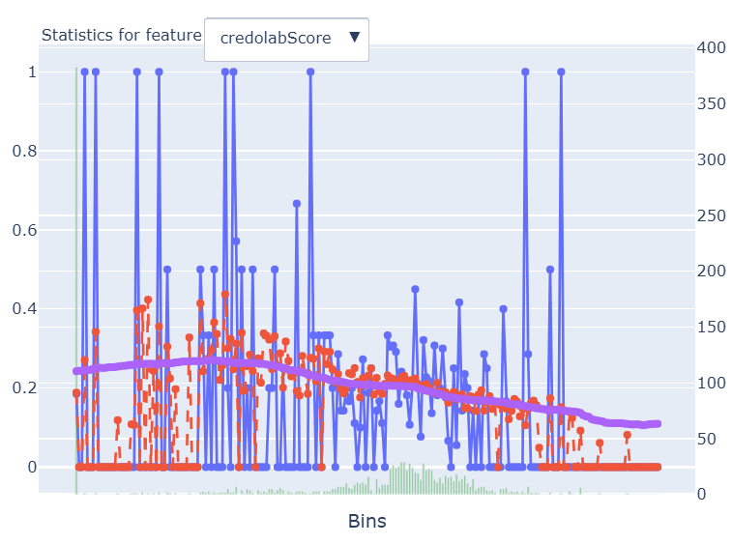
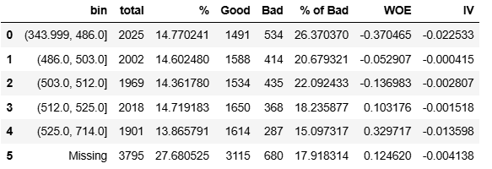
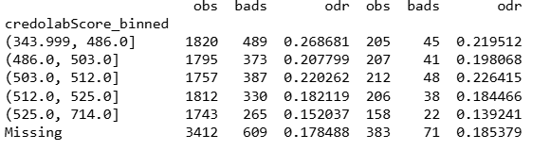
credolabScore= Score generated by credolab for user This feature indicates if credolabscore increase lesser the risk

Slide 14
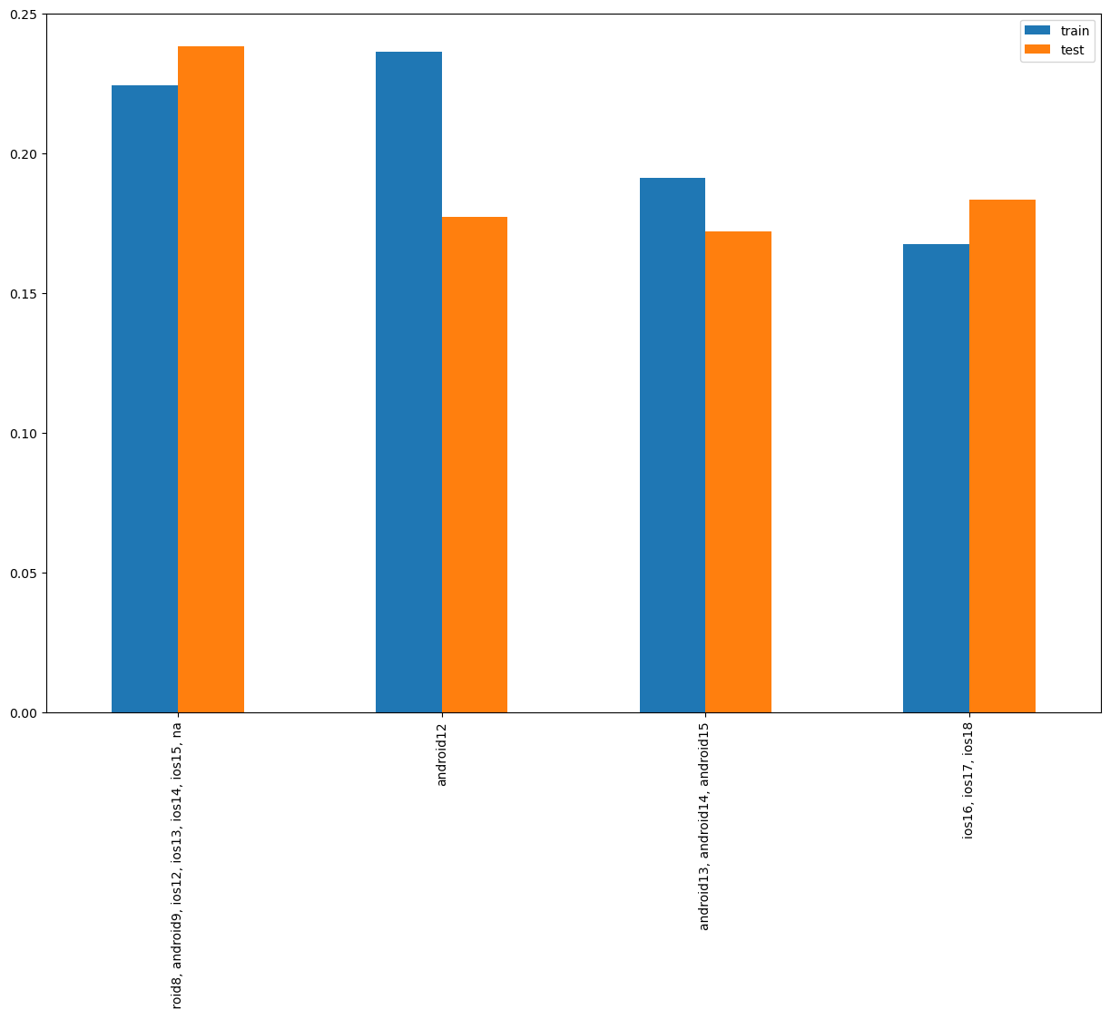
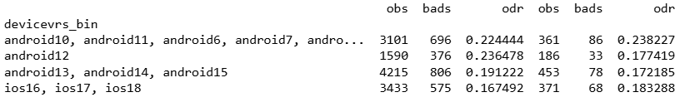
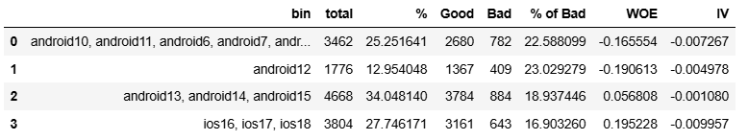
devicevrs_bin= these are the device versions of users

Slide 15
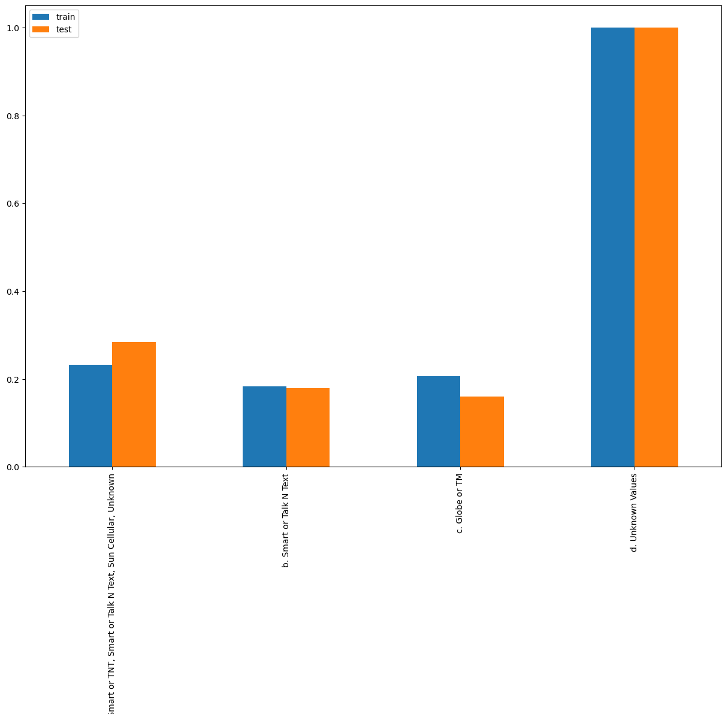
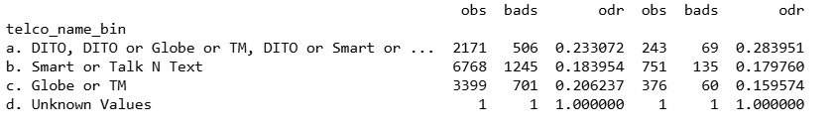
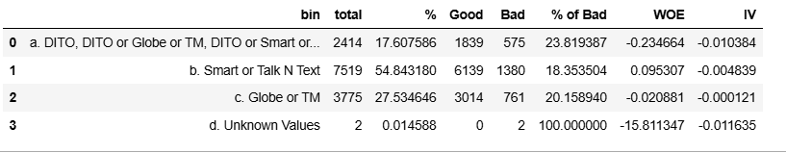
telco_name_bin= Name of telecommunication provider of user

Slide 16
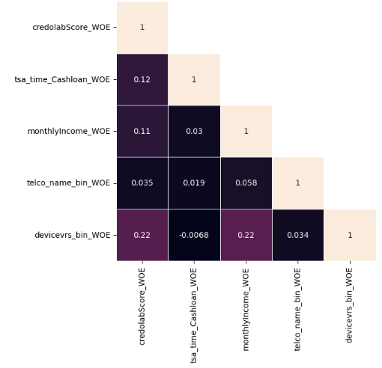

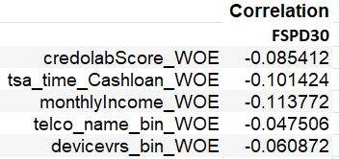
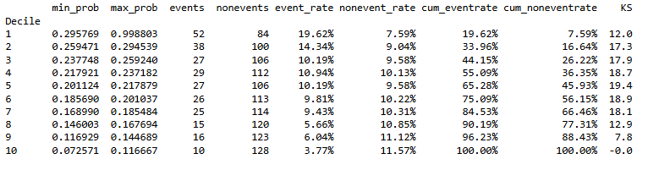
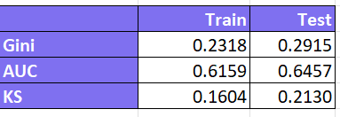
Model Performance

Slide 17
END

