Slide 1
CS387 Project:
Restaurant Management System
Parth Laturia - 180050071
Anish Deshpande - 180100013
Rajat Jain - 180100091
Devansh Chandak - 180110027

Slide 2
Key Requirements
A login screen to then proceed to the respective pages for the owner, the employees and the user. Each has a logout option too.
Customer
View profile, their individual order history, and the recommended (top) dishes for them.
View and select dishes and quantities either from the menu or the suggested dishes, and place an order.
Owner
View, update, delete and add inventory. View, update, add or delete employee information.
Allot orders to chefs for preparation and to waiters for delivery. View qty ordered for each dish per day.
View analytics, statistical reports of top orders, loyal customers, top chefs, profits, expenditure, wastage.
Employee
View their profile and the orders allocated to them to cook or serve, and mark the tasks as done after.
Backend Updates
Inventory quantity updated automatically when an order is placed.
Update/delete/creation of employees/inventory directly updated to database.
Allotment and completion of orders done automatically so that visible after login of that employee.
Additional Features
Time Series Analytics: Owner can view profit, wastage and expenditure based on start and end date.
Atomicity: Ensure that add/update/delete operations do not violate atomicity constraints.
Statistical reports: Graphs, statistical measures and a ‘Save as PDF’ option.
Automation: Recommend Dishes to Users, alert owner if ingredients quantity less than a threshold.

Slide 3
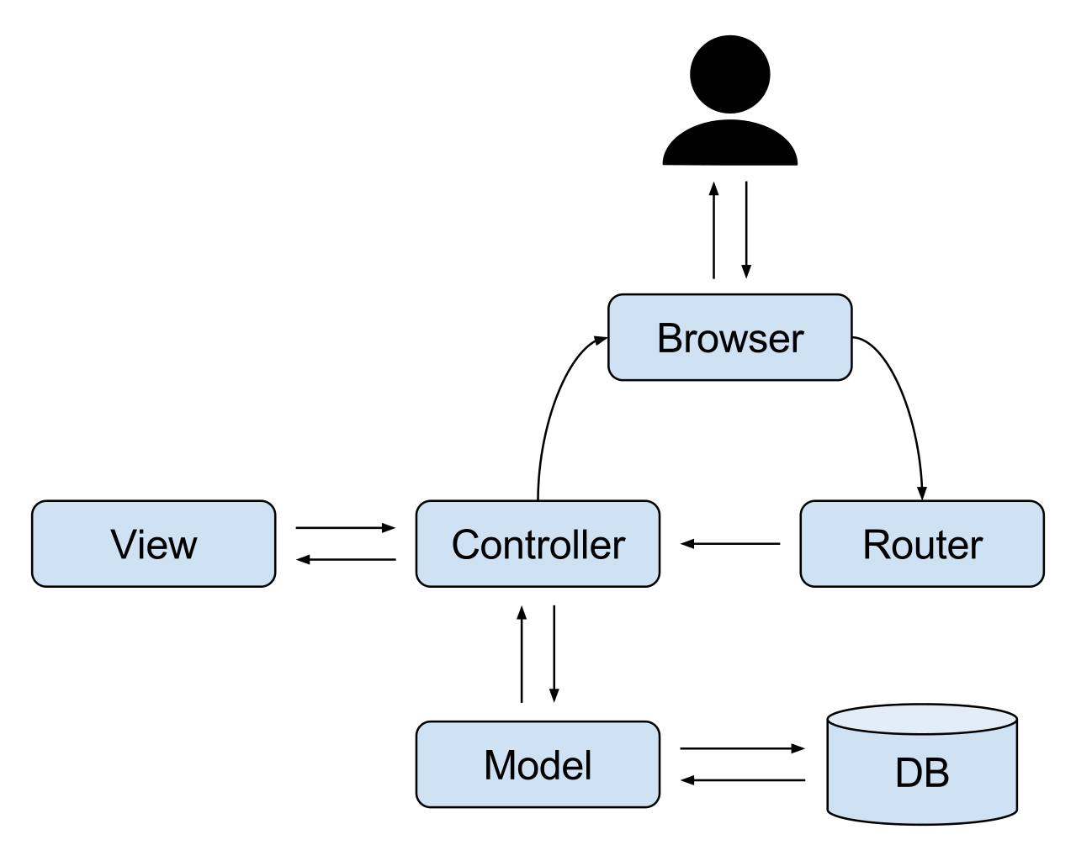
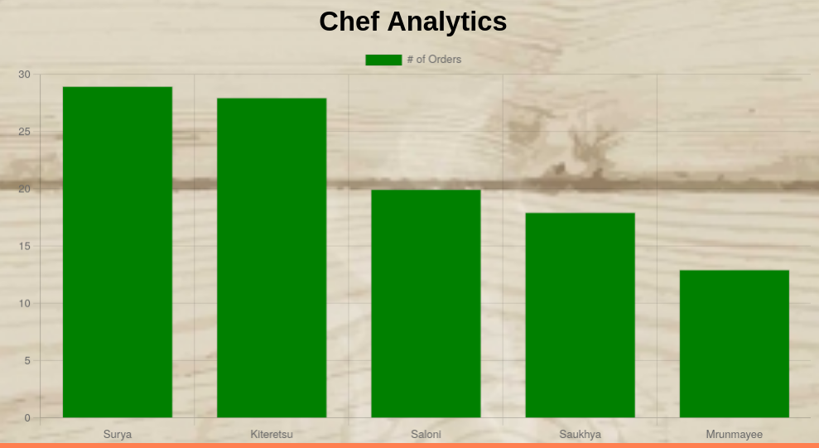
Implementation￼ Notes
Type of System: Local Server, GUI website application.
Framework/Packages Used:
Node.Js (Express), MVC Architecture
Bootstrap
Chart.JS, html2pdf.js
Data storage:
SQL Database: PostgreSQL, terminal/ pgAdmin4 interface.
Security: Cookie based authentication, login checks at each function. Ensure logout is successful and not circumvented by cache. Prevent SQL injections.

Slide 4
TEST RESULTS
Test for Search Engine
Filter Button (Indian/Chinese, Starter/.., Cost)
Test to Place an Order
Order Button
Test to Manage Employee Information
Display Employee Information
Add New Employee Button
Update Button
Delete Button
Test for Analytics
User Analytics
Chef Analytics
Waiter Analytics
Order Analytics
Restaurant Analytics (With Time Series)
Test to Allot Order to Chef
Allot Order Button
Add Button
Cook/Serve Button
Automation
Recommended Dishes List
Test for Order History
For Owner (With Time Series)
For User
Test to Update Inventory
Display Inventory
Add New Inventory Button
Increment Button
Delete Button
Test for Serving Food
Allot Serve Order Button
Add Button
Cook/Serve Button
Statistical Report of Restaurant’s Expenditure, Profit and Wastage with Pdf
Atomicity Assurance
Security
Error Handling
Through Console.logs
Website does NOT crash
For some buttons, if they are pressed > 1 redundantly, no change (Eg: Cook/Serve Button)

