Slide 1

WIPRO NGA Program – LSP Batch
Capstone Project Presentation – 22 July 2024
Presented by -
Aravinthan M
J. Chandra kiran
Chetan Raj Patel
D.Chandu Charan
A.Hareesh
B.Yedukondalu
A.Sai Sree ramulu
A.Saipraveen kumar
Project Title Here – Device Configuration MicroService
www.rpsconsulting.in

Slide 2

Objectives :
Set Up the Development Environment
Review NETCONF and RESTCONF Protocols
Implement Basic NETCONF Operations
Implement Basic RESTCONF Operations
Knowing about Microservices
Develop Support for Configuration Changes and Fetches
System Integration and Documentation
2024 - RPS Consulting all rights reserved

Slide 3
Set Up the Development Environment :
Installed Necessary Tools:
Java Development Kit (JDK)
Maven for project dependency management
IDE (e.g., IntelliJ IDEA, Eclipse)
Git for version control
2024 - RPS Consulting all rights reserved

Slide 4
Create Project Structure:
We had Initialized a new Maven project.
And Set up a Git repository and push the initial project structure as group git repository.
Install Libraries:
Added dependencies for Netconf4J and Apache HTTP Client in the pom.xml (for Maven)
Netconf4J: It is a Java library that provides tools and functionalities to interact with network devices using the NETCONF protocol.
Apache HTTP Client: It is a robust and versatile library developed by the Apache Software Foundation for making HTTP requests in Java. It simplifies the process of sending HTTP requests and handling HTTP responses in a variety of ways.
2024 - RPS Consulting all rights reserved

Slide 5
Install the libraries for Netconf4J and Apache HttpCilent
Netconf4J dependency :
<dependencies>
<dependency>
<groupId>org.opendaylight.netconf</groupId> <artifactId>netconf4j</artifactId>
<version>1.0.0</version>
</dependency>
Apache HttpClient dependency :
<dependency>
<groupId>org.apache.httpcomponents</groupId> <artifactId>httpclient</artifactId>
<version>4.5.13</version>
</dependency>
</dependencies>
2024 - RPS Consulting all rights reserved

Slide 6
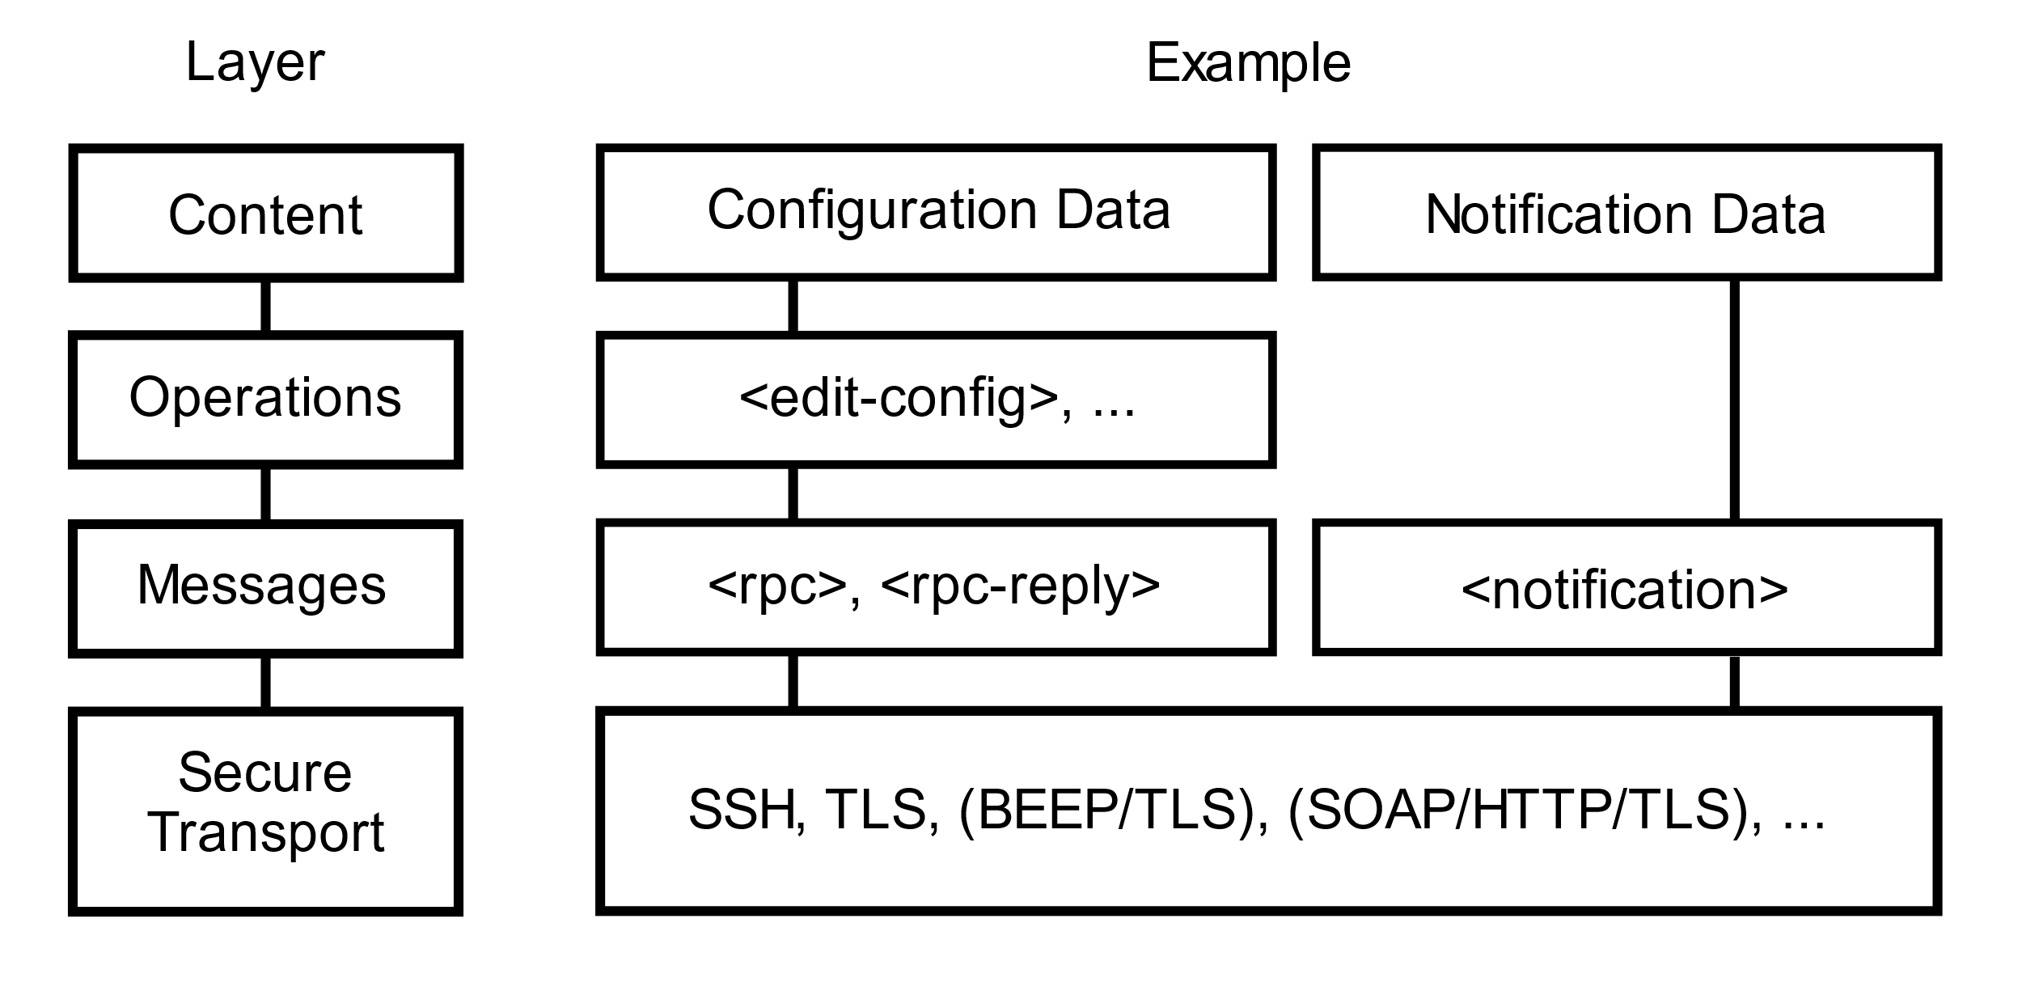
INTRODUCTION TO NETCONF
Network Configuration Protocol (NETCONF) is a session-based network management protocol, NETCONF allows retrieving state or configuration data and manipulating configuration data on network device.
NETCONF provides a clear separation of the Configuration and state data.
NETCONF uses XML-encoded Remote Procedure Calls (RPCs) for farming request and response message.
2024 - RPS Consulting all rights reserved

Slide 7
NETCONF Architecture
Components
Client: Issues configuration commands
Server: Applies the configurations to network devices
Operations
Get
Get-config,
Edit-config,
Copy-config,
Delete-config,
Lock,
Unlock
2024 - RPS Consulting all rights reserved

Slide 8
NETCONF Operations
Get:
Retrieve running configuration data.
Edit-config:
Change configuration data.
Copy-config:
Copy configuration data between data stores.
Delete-config:
Remove configuration data from a target datastore.
2024 - RPS Consulting all rights reserved

Slide 9
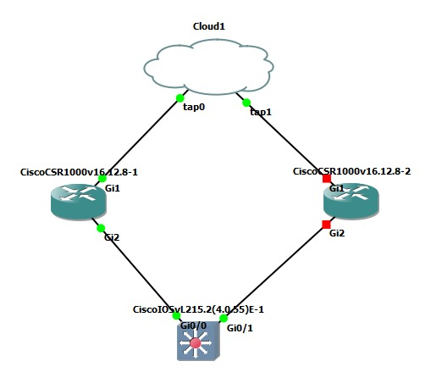
Creating a Topology and Configuring the Router NetConf
Go to Config Mode:
Conf t
User admin privilege 15 secret cisco123
aaa new-model
aaa authentication login default local
aaa authorization exec default local
Netconf-yang
Show platform software yang-management process
2024 - RPS Consulting all rights reserved

Slide 10
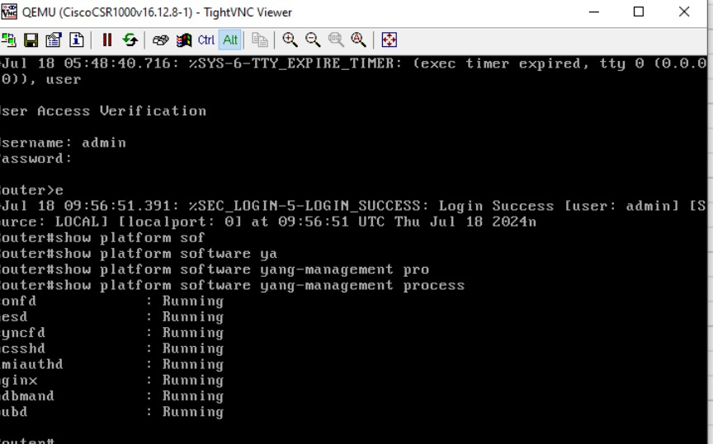
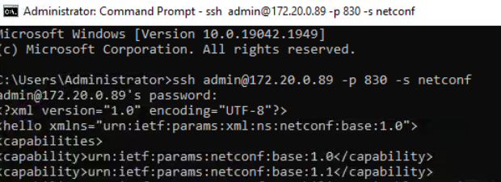
Show platform software yang-management process
Establishing Connection Via SSH Client to remote devices
ssh admin@ 172.20.0.89 -p 830 –s netconf
2024 - RPS Consulting all rights reserved

Slide 11
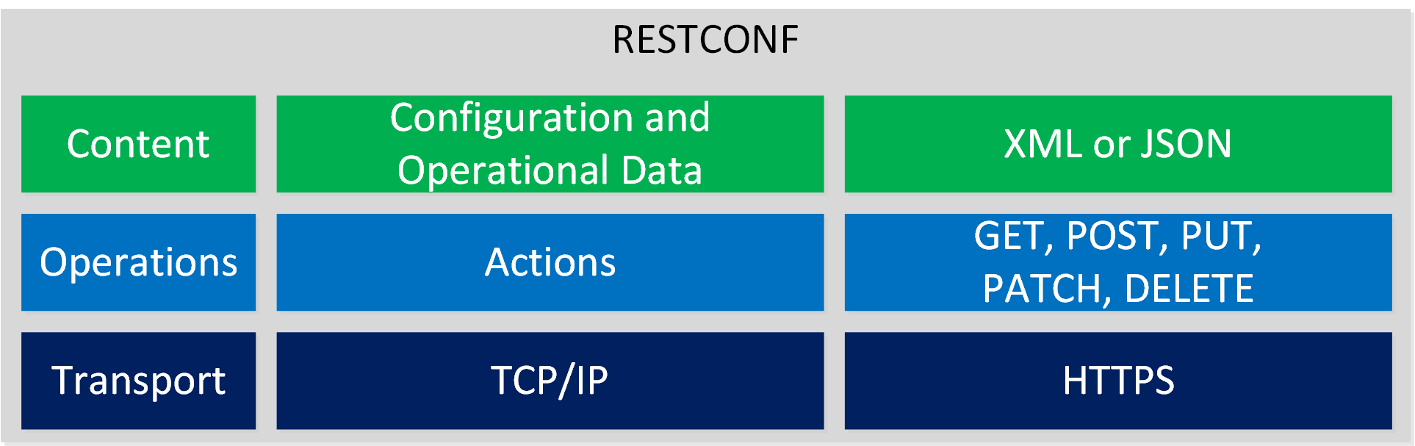
INTRODUCTION TO RESTCONF
RESTCONF is an HTTP-based protocol that provides a programmatic interface for accessing data defined in YANG (Yet Another Next Generation), using the datastore concepts defined in the Network Configuration Protocol (NETCONF).
Designed to complement NETCONF.
Uses HTTP for communication.
Data encoded in XML or JSON.
2024 - RPS Consulting all rights reserved

Slide 12
RESTCONF Architecture
Components
Client: Makes HTTP requests
Server : Manages network configurations
Operations
GET,
POST,
PUT,
DELETE,
PATCH
2024 - RPS Consulting all rights reserved

Slide 13
RESTCONF Operations
Detailed Operations
GET: Retrieve data
POST: Create new data
PUT: Replace existing data
DELETE: Remove data
PATCH: Modify existing data
2024 - RPS Consulting all rights reserved

Slide 14
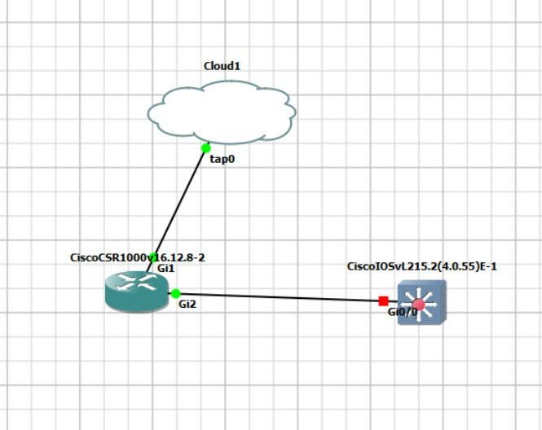
Creating a Topology and Configuring the Router RESTCONF
Go to Config Mode:
Conf t
User admin privilege 15 secret cisco123
aaa new-model
aaa authentication login default local
aaa authorization exec default local
Netconf-yang
Show platform software yang-management process
Go to Config Mode Set RestConf
Conf t
Restconf
Ip http secure server
2024 - RPS Consulting all rights reserved

Slide 15
Show platform software yang-management process(All process running)
Establishing Connection Via SSH Client to remote devices
ssh admin@ 172.20.0.89 -p 830 –s Netconf
Go to postman check Restconf interface
(https://172.20.0.89/restconf/data/ietf-interfaces:interfaces)
2024 - RPS Consulting all rights reserved

Slide 16
Microservices
Microservices is an architectural style that structures an application as a collection of small, autonomous services modeled around a business domain. Each service is self-contained, and it can be developed, deployed, and scaled independently.
Architecture Layers of Microservices
Controller Layer
Role: Handles incoming HTTP requests, maps them to the appropriate service methods, and returns responses.
Advantage: Acts as an interface between the client and the service layer, facilitating request handling and response formulation.
2024 - RPS Consulting all rights reserved

Slide 17
Microservices
Service Layer
Role: Contains the business logic of the application, processes data received from the controller, and makes calls to the repository layer.
Advantage: Centralizes business logic, making it easier to manage and ensuring a clear separation of concerns between the controller and data access.
Repository Layer
Role: Manages data persistence, interacts with the database or other data storage mechanisms to perform CRUD (Create, Read, Update, Delete) operations.
Advantage: Isolates data access logic, enabling easy updates to the data storage mechanisms without affecting business logic or controllers.
2024 - RPS Consulting all rights reserved

Slide 18
NETCONF VS RESTCONF
Similarities
Both are network configuration protocols
Both use YANG for data modeling
Differences
Transport Protocol: NETCONF uses SSH, RESTCONF uses HTTP
Data Encoding: NETCONF uses XML, RESTCONF uses XML or JSON
Ease of Use: RESTCONF is considered more user-friendly due to its RESTful nature
2024 - RPS Consulting all rights reserved

Slide 19
Use Cases for NETCONF
Large-scale network configurations
Automated network management
Complex configuration tasks requiring transactions
2024 - RPS Consulting all rights reserved

Slide 20
Use Cases for NETCONF
Web-based network management interfaces
Lightweight configuration tasks
Integration with modern web services and APIs
2024 - RPS Consulting all rights reserved

Slide 21
Future of Network Configuration
Trends:
Increased adoption of SDN (Software-Defined Networking)
Enhanced automation and AI-driven network management
Continued evolution of protocols to meet emerging needs
2024 - RPS Consulting all rights reserved

Slide 22
CONCLUSION
By following this detailed project plan, we can successfully develop the Device Configuration Microservice, ensuring it interfaces effectively with network devices using NETCONF and RESTCONF protocols. The integration with the Configuration Database Microservice and the comprehensive testing will guarantee a robust and reliable solution for network configuration management
2024 - RPS Consulting all rights reserved

