Slide 1

Lost Memories Game Pitch
By Dexavier Chang and Rasheed Ackbar

Slide 2
Game Progression
You start out at a resolution and try to find out how you got there.
Each level is a different significant event in desecending order.
Each time you pass a checkpoint in a level the game becomes black and white simulating the past.
You are in the past for a fixed amount of time.
Once the past is over the game reverts back to the present in color.

Slide 3
Core Mechanics and Systems
Rolling and Jumping
Melee Attacks
The Stick of Truth

Slide 4
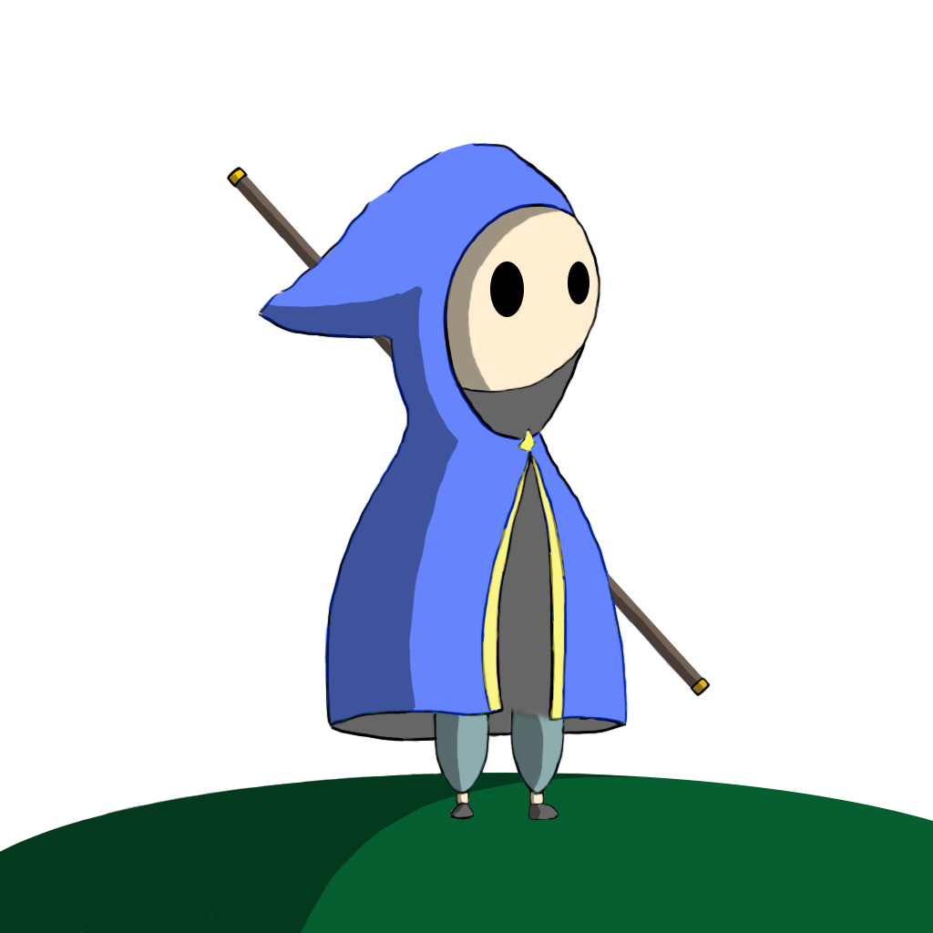

Concept Art

Slide 5

Concept Art Continued

