Slide 1

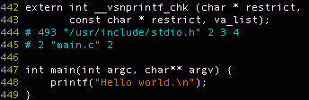
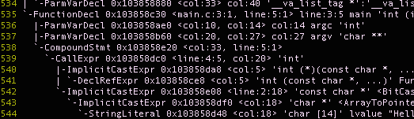
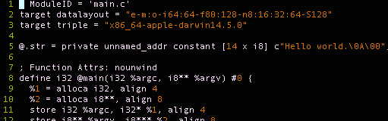
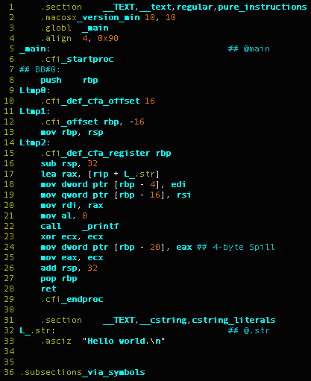
Compilation of C
Abdulrahman Alshammari, Dylan Chapp, Jaewoong Yoo
CISC 471/672 Compiler Construction, Fall 2016
Language Overview
Key Language Features
C is an imperative, statically, weakly, typed language with manual memory management
Software commonly implemented in C:
Operating systems
High performance scientific applications
Embedded systems
Type System:
Static: Type-safety properties of C programs can be determined at compile-time.
Weak: User can bypass the type-system e.g., pointer arithmetic or implicit type conversions
Manual memory management:
Allows programmer good control over mapping of data structures to memory for performance-critical code
Compilation Stages with Example Outputs
Macros
Allows programmer to include needed library headers, define platform-specific constants, etc.
Not part of C grammar, hence preprocess before lex/parse
Scoping Rules
Macros
Allows programmer to include needed library headers, define platform-specific constants, etc
Not part of C grammar, hence preprocess before lex/parse
C Source with Macros
Global vs. Block Scopes
Location
in Memory
Global variable with static scope Accessible only from this file
Global Scope Accessible from
any file
Preprocessor:
Converts C source code containing macros—e.g., #define—into pure C source code
Runtime Stack:
Contains data whose lifetime is determined by the scope(s) it belongs to
Pure C Source Code
#include<stdlib.h>
#include<foo.h>
// A global variable
char a[6] = “global”;
// A static global variable
static int count = 0;
int main(int argc, char** argv)
{
// A local variable
int local = 1;
// Dynamically allocated // object
Foo f = new Foo();
}
… Space for stack and
heap to grow into …
Lexer:
Scan for valid C
Scan for blocks of inline assembly
Clang AST
Runtime Heap:
Contains data whose lifetime is managed by the programmer
User-defined types
Requires inter- mingling lexing and parsing
If a definition of a new type is parsed, update lexer stage to accommodate
Static Section:
Contains data that will persist throughout execution
Block Scope
LLVM IR
Parser:
Hand-tuned recursive descent parser
Constructs abstract syntax tree (AST) which can then be traversed to do various forms of semantic analysis
Challenges
• Managing accessibility of non-static global
variables
• Implementing pointers, pointer casts, pointer arithmetic
Code Generation:
Generate assembly code from IR and from any blocks of inline assembly
Rely on C Runtime Library to reduce code size
x86 Assembly
C Runtime Library
Compiler and target architecture specific
Contains low-level routines used by the compiler to create an executable that can interact with the OS through syscalls
C Runtime Library
Compiler and target architecture specific
Contains low-level routines used by the compiler to create an executable that can interact with the OS through system calls
References
C11 Standard, ISO/IEC 9899:2011
XXX
XXXX
XXXX

