Slide 1

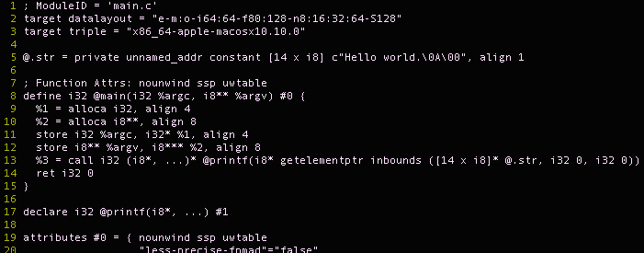
Compiling C / Placeholder Title
Abdulrahman Alshammari, Dylan Chapp, Jaewoong Yoo
CISC 471/672 Compiler Construction, Fall 2016
Language Overview
Key Language Features
Runtime Stack
C is an imperative, statically, weakly, typed language with manual memory management
Software commonly implemented in C:
Operating systems
High performance scientific applications
Embedded systems
Dynamic memory allocation
All function parameters passed by value
Type System:
Static: Type-safety properties of C programs can be determined at compile-time.
Weak: User can bypass the type-system e.g., pointer arithmetic or implicit type conversions
… Space for stack and
heap to grow into …
Runtime Heap
Static
#define DBG
#define y 1
…
int res = f(x,y,dbg);
#ifdef DBG
printf(dbg);
#endif
…
C Source Code with Macros
Language Implementation Process
Executable
Token Requests
User-defined types
If a definition of a new type is parsed, update lexer stage
E
E
+
E
+
Typedef lexeme
id
id
id
id
Code Generation:
Generate from IR and from any blocks of inline assembly
Rely on C Runtime Library to reduce code size
Until 2006, GCC used parser generated by Bison
Now GCC uses a hand-written recursive-descent parser
Better performance and better error messages than ones we’d get from an automatically generated parser
Macro Preprocessor:
Converts C source code containing macros—e.g., #define—into pure C source code
Often used for toggling platform- specific features for portability
Lexer:
Scan for valid C
Scan for blocks of inline assembly
Parser:
Hand-tuned recursive descent parser
Does some semantic analysis during AST construction
C Runtime Library
Compiler and target architecture specific
Contains low-level routines used by the compiler to create an executable that can interact with the OS through syscalls
Intermediate Representations
…
int res = f(x,1,dbg);
printf(dbg);
…
Update Lexer
T_{i}
Token Stream
Pure C Source Code
Intermediate Representation Example
Challenges
Intermediate representations (IR) depends on compiler (e.g., gcc vs. clang)
We show an example of the IR that clang generates for a hello world program
Unlike gcc, which uses different IRs for each of its passes, clang uses only the LLVM IR for all passes
System calls:
C’s ability to interface with the OS depends on wrappers around actual OS system calls implemented in the C Runtime Library
Dealing with undefined behavior
Detect it at compile time when possible?
Or leave it up to the programmer?
Function pointers
Global vars over multiple files
Lots of system calls (they’re not technically C, they’re part of the C runtime that we call Unix)
Static vars
Call by value param passing
Storage allocation diagram (satck, static, heap)
C Source Code
Source code:
#include<stdlib.h> int main(...) {
…
}
LLVM IR:
LLVM IR:
LLVM IR

