Slide 1
Dependency Analysis for OpenMP Tasking

Slide 2
What is Task Parallelism?
A programming model that provides a task abstraction and some mechanism for task scheduling
Notes:
A programming model for (typically) shared-memory systems (e.g., individual compute nodes of HPC systems).
Can be extended to distributed-memory systems; usually by coupling the tasking runtime to a global address space (GAS) runtime
Tasking can (and is) implemented at various levels of the system stack. There are language level implementations (C++11 comes to mind), language extensions (OpenMP), libraries (Intel TBB), and runtime systems for enhancing the performance of the above (Argobots)

Slide 3
What is Task Parallelism?
A programming model that provides a task abstraction and some mechanism for task scheduling
Task == Some code and some data
Task Scheduling == deciding how threads will work on tasks (often at runtime, often non-deterministically)
Notes:
Definitions are informal here, but if we really need the precise definitions in the scope of this work we refer to the following:
For “task”:
OpenMP 4.5 specification - “A specific instance of executable code and its data environment, generated when a thread encounters a task, taskloop, parallel, target, or teams construct (or any combined construct that specifies any of these constructs).” (1.2.5 Tasking Terminology, pg. 9)
OpenMP 5.0 draft specification - “A specific instance of executable code and its data environment that the OpenMP implementation can schedule for execution by threads.” (Sec. 1.2.5 Tasking Terminology, pg. 11)
For “task scheduling”:
See OpenMP 4.5 specification and OpenMP 5.0 draft for scheduling constraints
See implementations otherwise

Slide 4
Why Task Parallelism?
Current
Planned Upgrades
Exascale Goals
K. Raffenetti, “Interconnects”, ATPESC Workshop 2018 http://press3.mcs.anl.gov/atpesc/files/2018/08/ATPESC_2018_Track-1_7_7-30_2pm_Raffenetti-Interconnects.pdf

Slide 5
Debugging Challenges
Tasks form a complex directed acyclic graph (DAG) of dependencies
The DAG may be generated dynamically at runtime and may vary from run to run
If an application hangs, it is hard to tell which task(s) are to blame
Haugen B, Richmond S, Kurzak J, Steed CA, Dongarra J. Visualizing execution traces with task dependencies. InProceedings of the 2nd Workshop on Visual Performance Analysis 2015 Nov 15 (p. 2). ACM.

Slide 6
Problem Statement (Informal)
Suppose one task gets stuck (e.g., deadlock).
The application will eventually hang.
How does the user find the bug?
Equivalently, how does the user know which task got stuck?

Slide 7
Problem Statement (Formal)
Suppose User starts the application at time T_{start} where:
D is the DAG of task dependences of the application
For all t_{src} and t_{dst} in D, t_{src} -> t_{dst} means that task t_{dst} depends on task t_{src}
All tasks have a current state (e.g., executing, complete, suspended)
Adversary picks arbitrary t_{err} in D and replaces its normal execution with an infinite loop
User stops the execution at some time T_{hang} and is allowed to look at the D and the state of any t in D.
Can the User identify t_{err}?

Slide 8
Our Approach - An OMPT Tool
Use the OpenMP Tool Interface (OMPT) to monitor creation and management of tasks
Build the task dependency DAG in response to OMPT events
Upon termination of the application, label tasks (i.e., vertices in the DAG) as suspicious or non-suspicious and output a visualization of the labeled DAG

Slide 9
Minimal Example
Generating Code
Resulting Dependency DAG

Slide 10
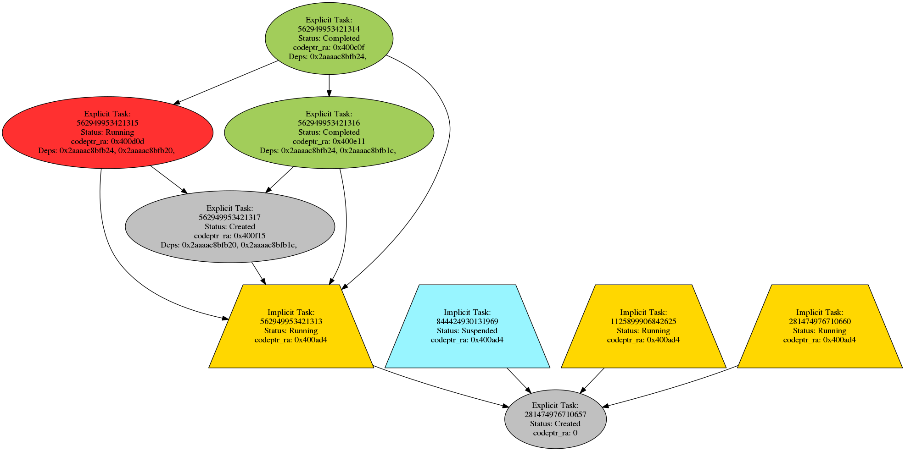
Tool Output
Stuck task flagged as suspicious
Currently based on simple heuristics (e.g., the task is the only un-completed dependency of scheduled task)
Notes:
SLIDE NUMBERS
Add a legend for colors
Task IDs are so large they are illegible
Translate the addresses to something more meaningful
Need a much more simplified version of the DAG output - connect to

Slide 11
Tool Output
Stuck task flagged as suspicious
Currently based on simple heuristics (e.g., the task is the only un-completed dependency of scheduled task)
These addresses let us relate tasks back to source code

Slide 12
Preliminary Results
Target Applications: Barcelona OpenMP Task Suite (BOTS)
Methodology:
No Tool: run time of application without any OMPT tool Baseline-Tool: run time of application with a skeleton tool
Full-Tool: run time of application with our OMPT tool linked
A. Duran et al. Barcelona OpenMP tasks suite: A set of benchmarks targeting the exploitation of task parallelism in OpenMP. In Proceedings of the International Conference on Parallel Processing (ICPP), pp. 124-131, 2009

Slide 13
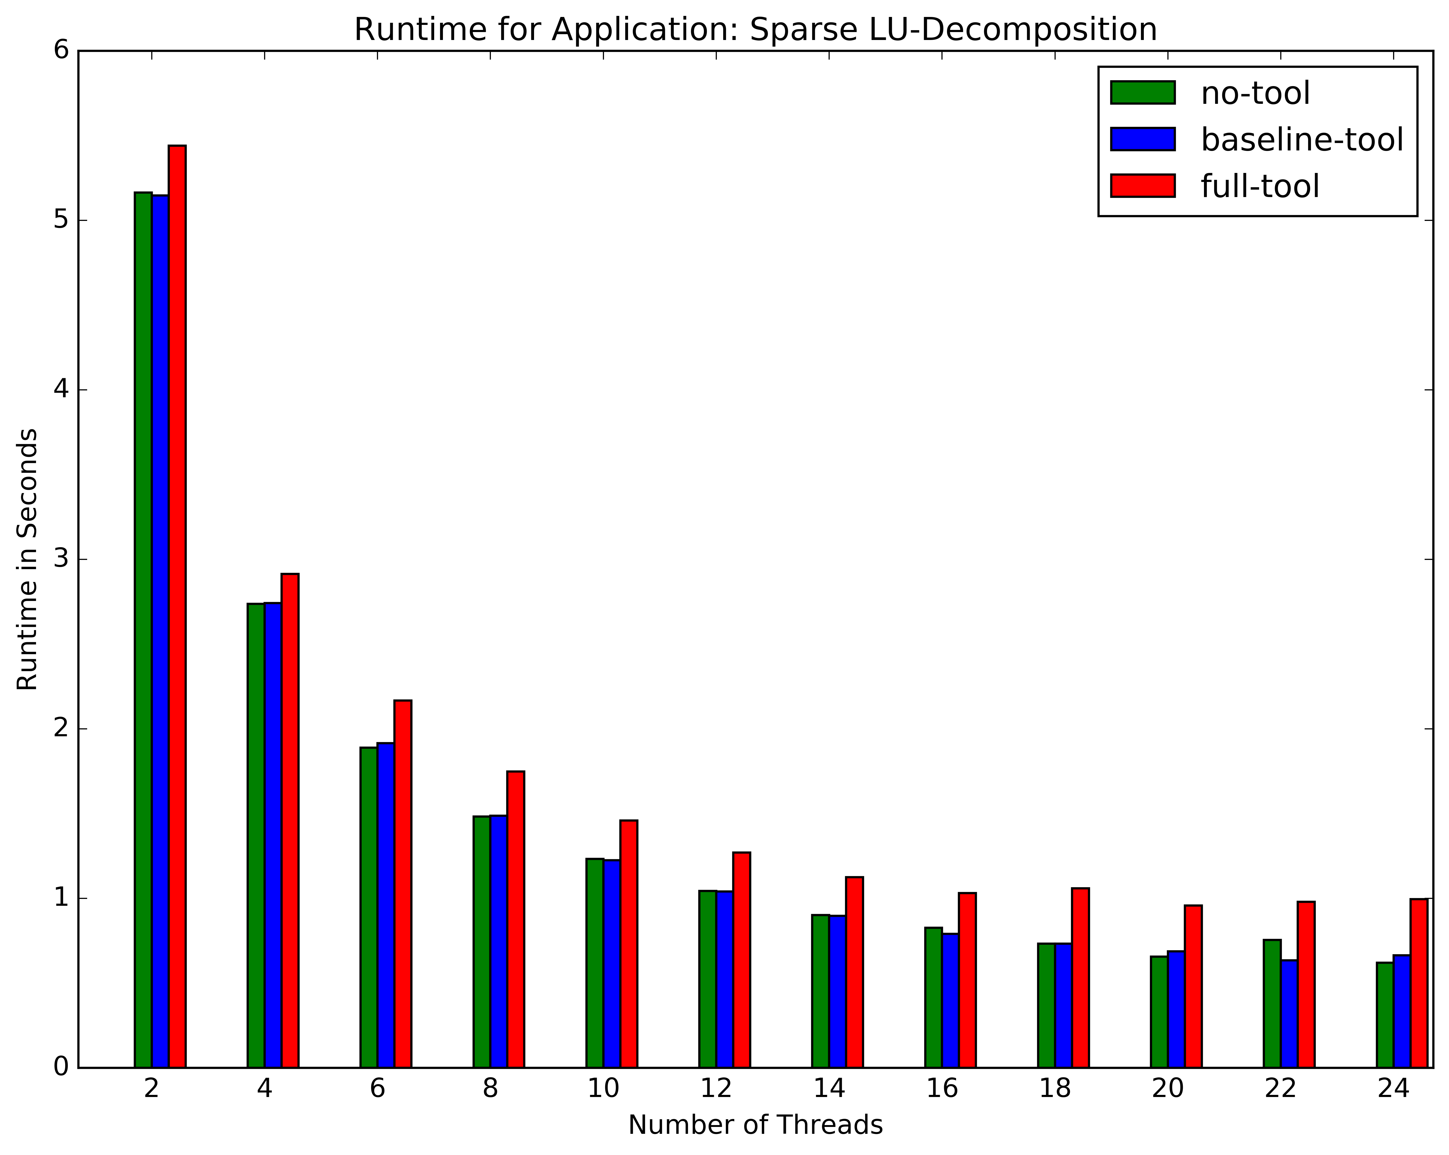
Tool Performance - SparseLU

Slide 14
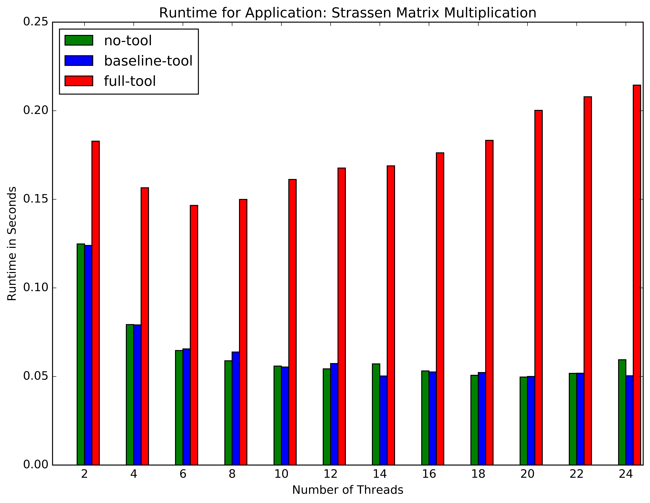
Tool Performance - Strassen
Notes:
Absolute and relative values for overhead

Slide 15
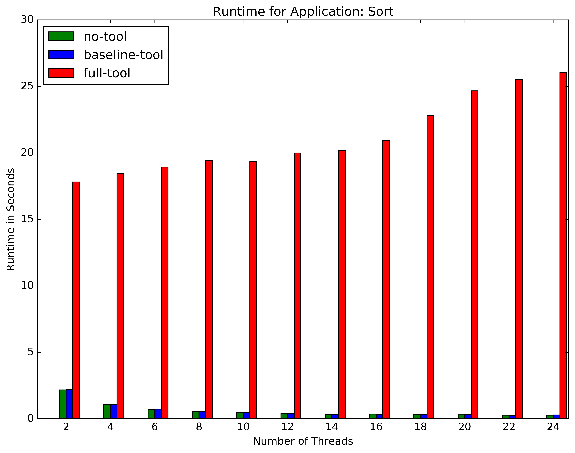
Tool Performance - Quicksort

Slide 16
Lessons Learned
We need better methods for flagging tasks
We need to understand the source of tool overhead and control it better
We need a compelling evaluation, both in terms of correctness and performance

Slide 17
Task Flagging Based on Task Scheduling Points
OpenMP tasks contain a series of task scheduling points (TSPs)
The series of TSPs define a finer-grained notion of task status than we currently use
Hypothesis: Stuck tasks will have anomalous series of TSPs

Slide 18
Anatomy of a Task
At scheduling point: Executing thread can suspend this task region and switch to another task region
Task Chunk 0
Task
t
task scheduling point 0
Task Chunk 1
task scheduling point 1
…
task scheduling point k-2
Task Chunk
k-1
task scheduling point k-1

Slide 19
Anatomy of a Task
At scheduling point: Executing thread can suspend this task region and switch to another task region
Between scheduling points:
Executing thread must continue working on task chunk
Task Chunk 0
Task
t
task scheduling point 0
Task Chunk 1
task scheduling point 1
…
task scheduling point k-2
Task Chunk
k-1
task scheduling point k-1

Slide 20
Anatomy of a Task
Task Chunk 0
Task
t
task scheduling point 0
Task Chunk 1
Series of task scheduling points ==
“Task fingerprint”
task scheduling point 1
…
task scheduling point k-2
Task Chunk
k-1
task scheduling point k-1

Slide 21
Anatomy of a Task
Task Chunk 0
Task
t
task scheduling point 0
Task Chunk 1
Series of task scheduling points ==
“Task fingerprint”
Useful for flagging suspicious tasks?
task scheduling point 1
…
task scheduling point k-2
Task Chunk
k-1
task scheduling point k-1

Slide 22
Proposed Evaluation
Inject artificial hangs into the BOTS application source code in random locations
Run the modified BOTS applications with our OMPT tool linked
Compare the source code locations reported by the tool (i.e., those corresponding to suspicious tasks) with the known locations
Metrics for success:
Accuracy (Locations of injected hangs)
Performance (comparable with other debugging tools for shared memory applications)

