Slide 1
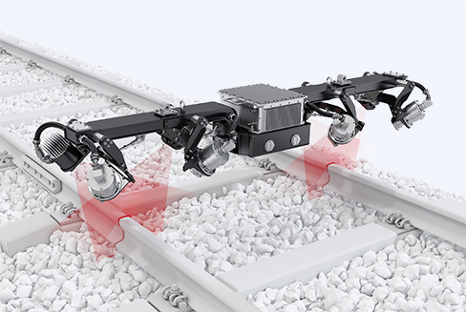
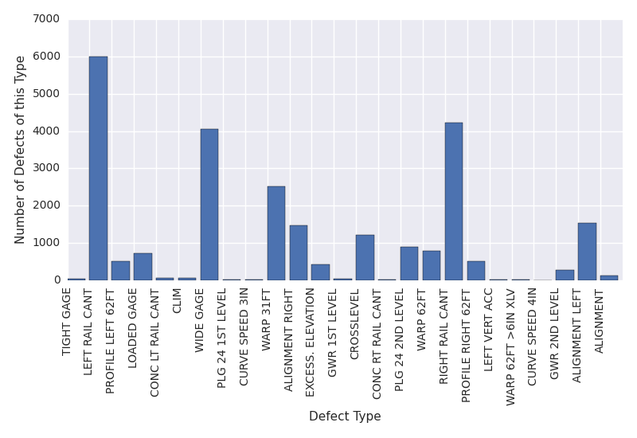
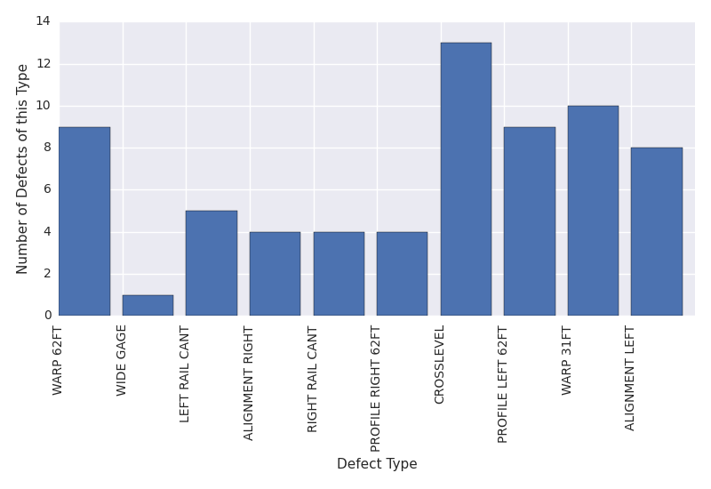
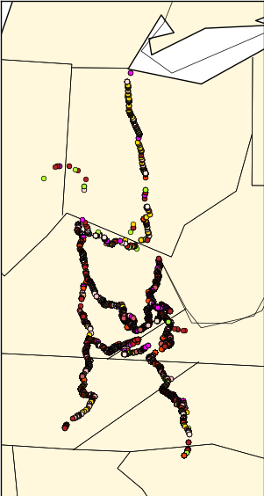
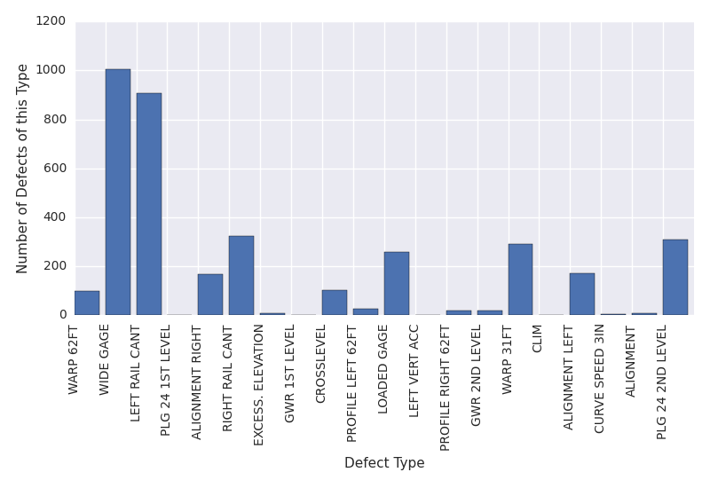
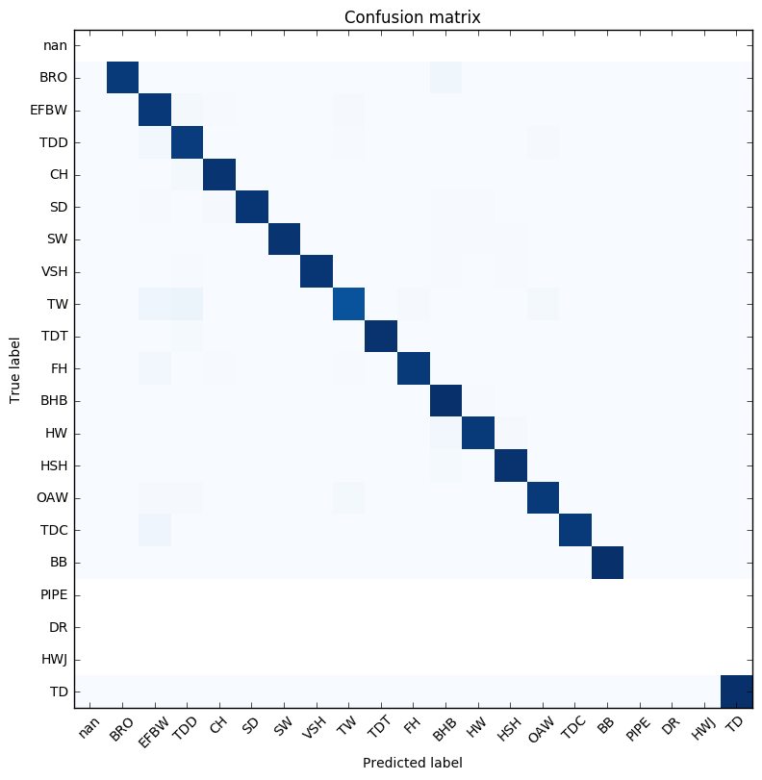
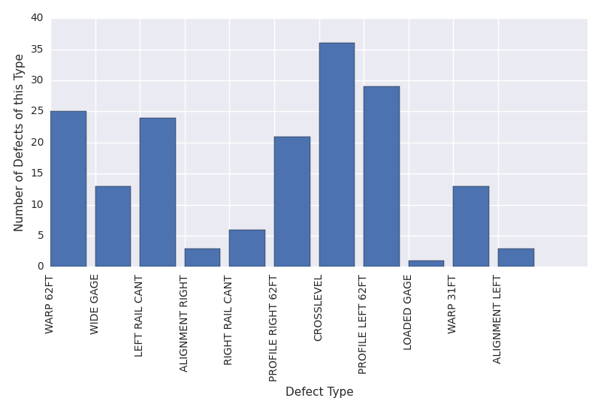
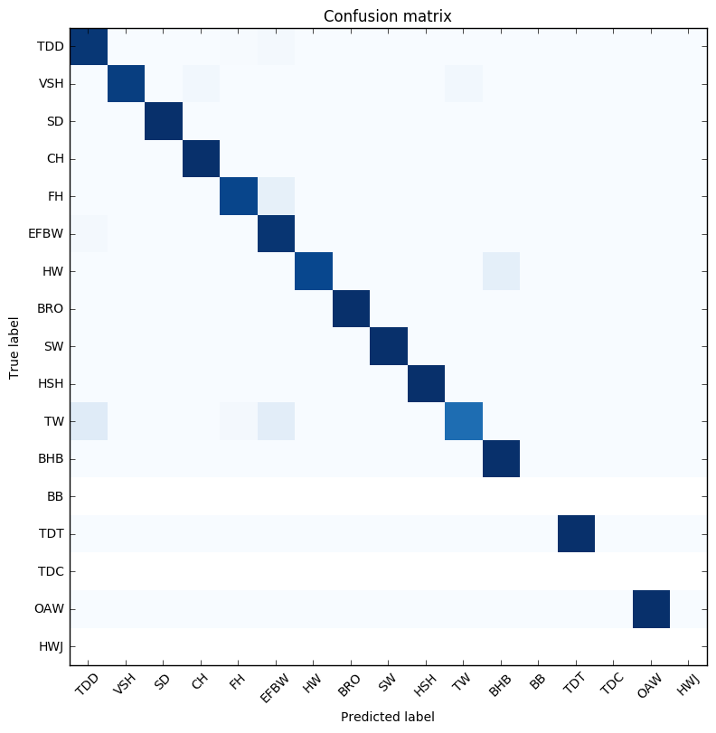

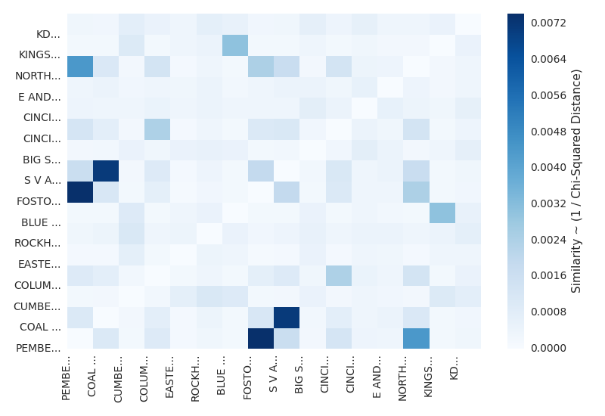
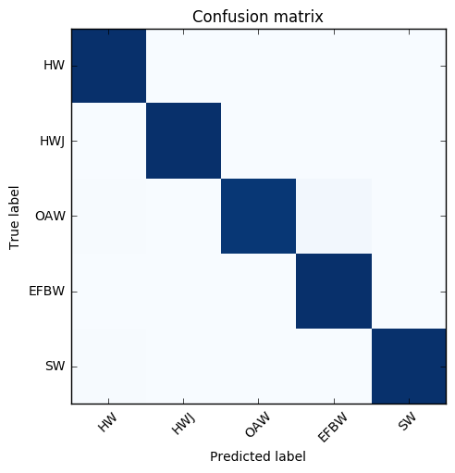
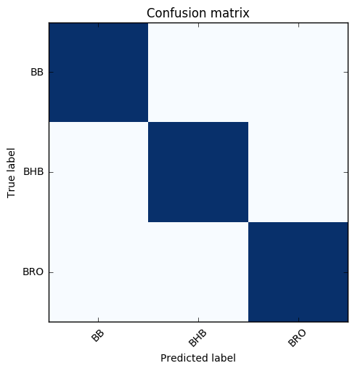
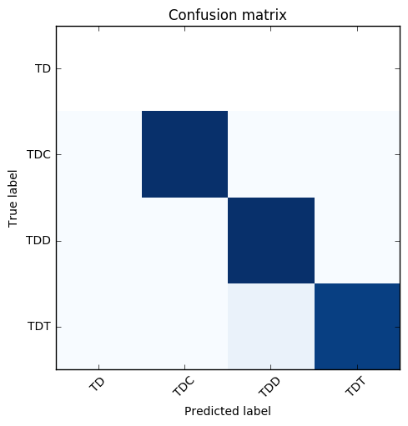
Leveraging Spark and Docker for Scalable, Reproducible Analysis of Railroad Defects
Dylan Chapp and Surya Kasturi Advisors: Michela Taufer and Nii Attoh-Okine
Motivation
Rail and Track Defects Data Sets
Railroad network resiliency depends identification of defects
Sensor-equipped monitoring cars collect rail and track-geometry data
Can we use the data to predict defect occurrences in rail subdivisions?
Rail defects data: physical degradation
26,432 20-dimensional data points
Track geometry data: misalignment
25,421 41-dimensional data points
Mixed numerical and categorical data
Sensor-equipped Monitoring Car with its sensors
Scalable Reproducible Data Analysis Workflow
Track Defect Data
Analysis Platform: PySpark + MLLib
Docker Container
Preprocessing
Parallelized with Spark, scales to larger datasets
Extracts logically related subsets of data
Filters out records with missing data
Filters out irrelevant feature columns
Targeted Subset of Data
MLLib Analysis Tools
Descriptive Statistics
Classification
Clustering
Input Data
Analysis Code
Rail Defect Data
Package data, scripts, configs as a Docker container
Collaborators can easily reproduce our analysis
Hosted on DockerHub: https://hub.docker.com/r/dchapp/rail
Data is now ready to be ingested by an analysis tool, or directly visualized
Visualization
Generate plots specific to analysis technique
Raw data provided by collaborators
Global Defect Distribution
Predicting Defect Types
Track Region Similarity Analysis
Can we predict defects in railroad tracks?
Railroad defects are classified using Decision Tree
Defect size, accumulated tonnage, rail weight, rail section age are used as features
Can track regions be grouped so that defect-type classifiers trained on region-specific data achieve better accuracy?
1: Extract each pair of regions’ defect distributions
Fostoria
Fostoria Defect Distribution
Eastern Kentucky Defect Distribution
Confusion Matrix
All defects
Classifier trained on the entire dataset resulted in confidence level of 42.8%
This could be because all defects are not a function of same features
Classifier trained on the entire dataset under AP division. This resulted in 49.8% confidence level.
Defects are grouped based on their properties. When the classifier is modeled on all transverse defects data resulted in 93.8% confidence level.
Pemberville
Pemberville Defect Distribution
2: Compute the Chi-Squared Similarity of each pair of defect distributions
We measure subdivision similarity by chi-square distance between defect distributions
Geographically close subdivisions have similar defect distributions
Confusion Matrix
Defects in
AP Divison
Map of all track geometry defects Colored by defect class
3: Group regions together whose defect distributions are sufficiently similar
In progress:
Training classifiers on subsets of defect data from statistically similar regions
Now we treat Fostoria and Pemberville as 1 region
References
Confusion Matrix
Subset o
A. Zarembski, “Some Examples of Big Data in Railroad Engineering”, IEEE International Conference on Big Data, 2014
Track Inspector Rail Defect Reference Manual, Federal Railroad Administration, Rev. 2, 2015
Heatmap of regions’ defect similarities
Acknowledgements / funding

