Slide 1
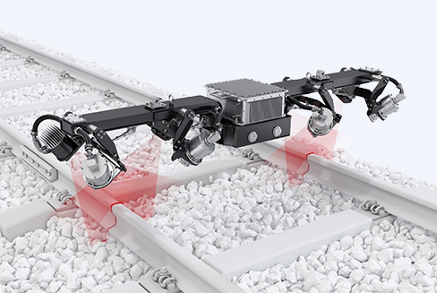
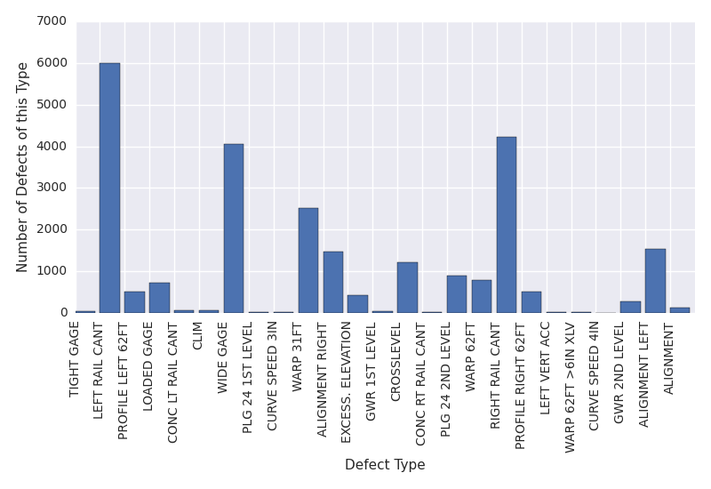
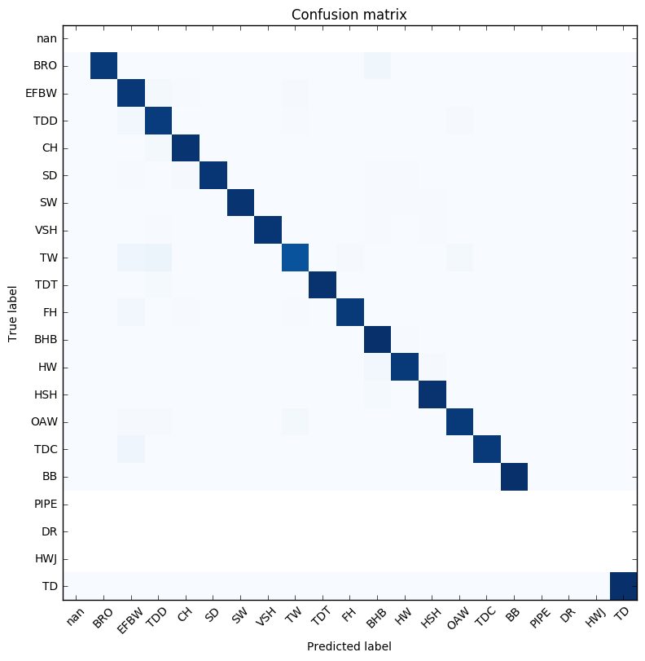
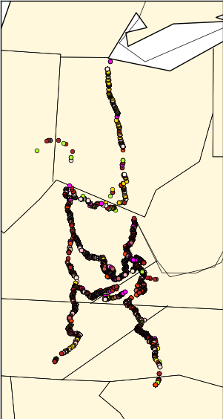
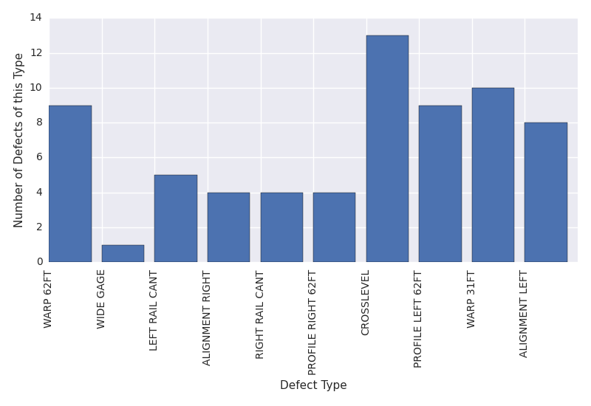
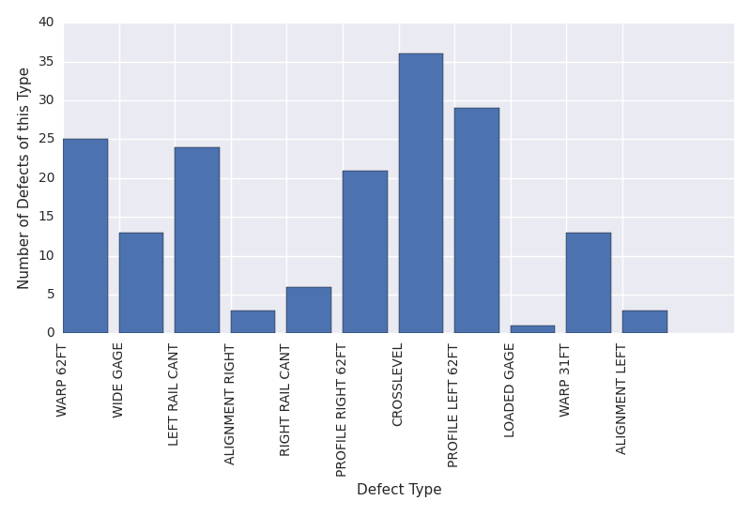
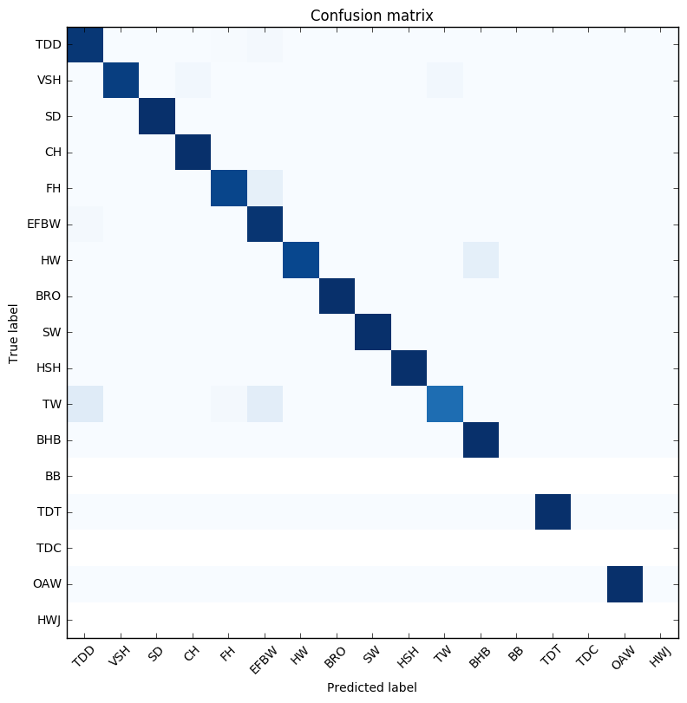
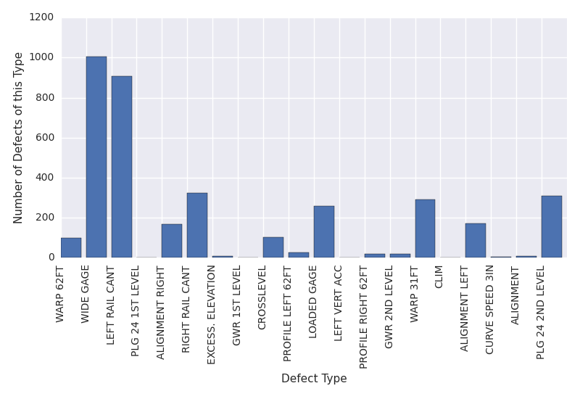
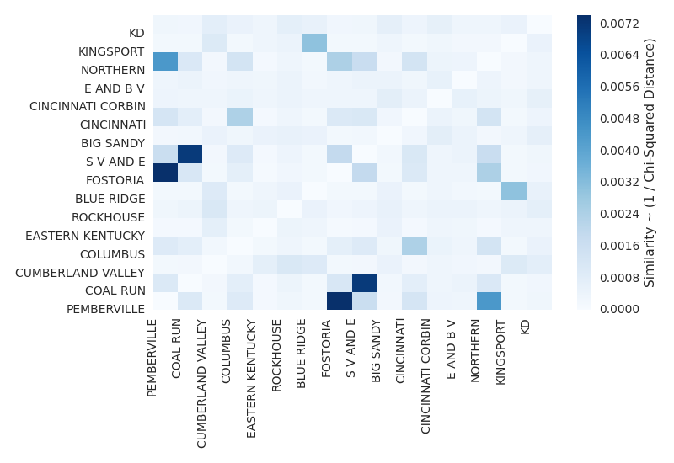
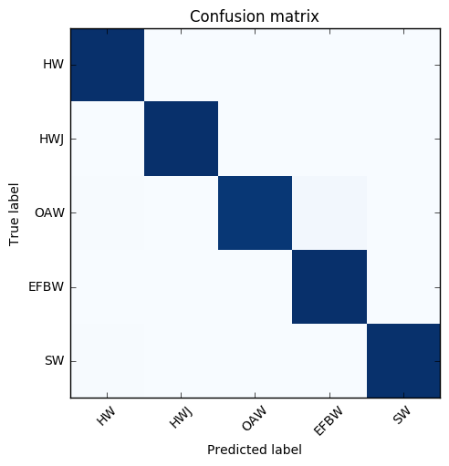
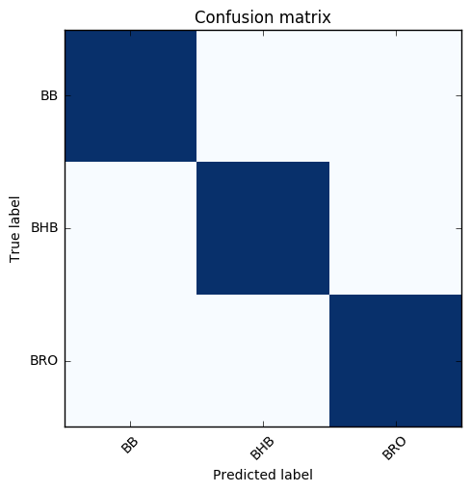
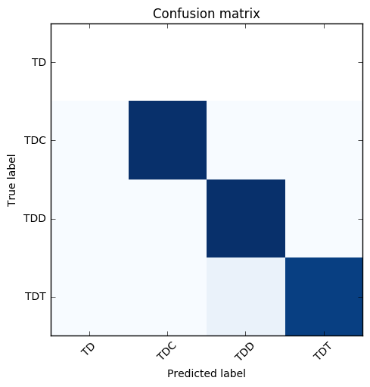
Leveraging Spark and Docker for Scalable, Reproducible Analysis of Railroad Defects
Dylan Chapp and Surya Kasturi Advisors: Michela Taufer and Nii Attoh-Okine
Motivation
Rail and Track Defects Data Sets
Railroad network resiliency depends identification of defects
Sensor-equipped monitoring cars collect rail and track-geometry data
Can we use the data to predict defect occurrences in rail subdivisions?
Rail defects data: physical degradation
26,432 20-dimensional data points
Track geometry data: misalignment
25,421 41-dimensional data points
Mixed numerical and categorical data
We use Docker for:
Reproducible workflow
Distribution to collaborators
Sensor-equipped Monitoring Car with its sensors
Image Sources: FRA Inspection Manual A. Zarembski, “Some Examples of Big Data in Railroad Engineering”, IEEE Conference on Big Data 2014
Scalable Reproducible Data Analysis Workflow
Analysis Platform: PySpark + MLLib
Docker Container
Track Geometry Defects:
Track Defect Data
Preprocessing
Parallelized with Spark, scales to larger datasets
Filters records with missing data
MLLib Analysis Tools
Descriptive Statistics
Classification
Clustering
Input Data
Analysis Code
Describes misalignment of track components
25,421 41-dimensional data points
Mixed categorical / numerical
We use Apache Spark for:
Scalability and resilience
Availability of machine learning libraries
Targeted Subset of Data
Rail Defect Data
Package data, scripts, configs as a Docker container
Collaborators can easily reproduce our analysis
Hosted on DockerHub: https://hub.docker.com/r/dchapp/rail
Data is now ready to be ingested by an analysis tool, or directly visualized
Visualization
Generate plots specific to analysis technique
Raw data provided by collaborators
Predicting Defect Types
Subdivision Similarity Analysis
Railroad Defect Data
Can we predict defects in railroad tracks?
Railroad defects are classified using Decision Tree
Defect size, accumulated tonnage, rail weight, rail section age are used as features
How do subdivisions’ defect distributions compare:
To each other?
To the global distribution?
Global Defect Distribution
Defects in railroad infrastructure impact safety
Railroad engineering community is interested in prediction of defects
Rail Defect Data:
26432 20-dimensional data points
Track Geometry Defect Data:
25421 41-dimensional data points
Confusion Matrix
All defects
Classifier trained on the entire dataset resulted in confidence level of 42.8%
This could be because all defects are not a function of same features
Classifier trained on the entire dataset under AP division. This resulted in 49.8% confidence level.
Defects are grouped based on their properties. When the classifier is modeled on all transverse defects data resulted in 93.8% confidence level.
Fostoria
Fostoria Defect Distribution
Pemberville
Pemberville Defect Distribution
Confusion Matrix
Defects in
AP Divison
Eastern Kentucky
Eastern Kentucky Defect Distribution
Confusion Matrix
Subset o
We measure subdivision similarity by chi-square distance between defect distributions
Geographically close subdivisions have similar defect distributions
Acknowledgements / funding

