Slide 1
StarLord
Gráficas computaciónales
Luis Eduardo Barajas Pérez A01370934
Daniel Charua A01017419

Slide 2
About the game
The game is very similar to StarFox game. This is a very popular first shooter 90's game. Our project will have also this functionality, gamebility, and graphics.
The player will control the arrowing spaceship piloted by captain star fox as he navigates through space avoiding enemies and objects in the journey ,

Slide 3
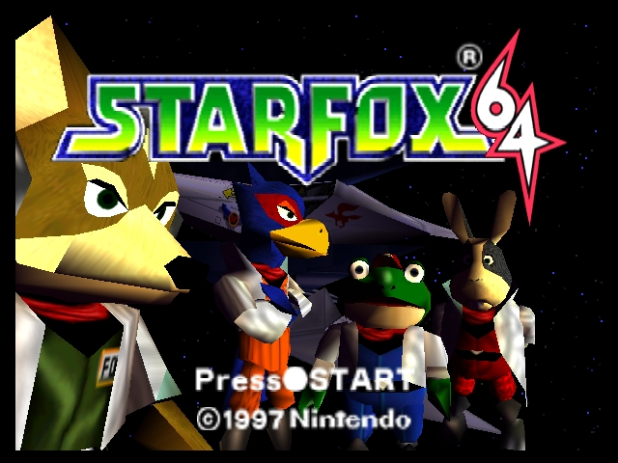

Slide 4
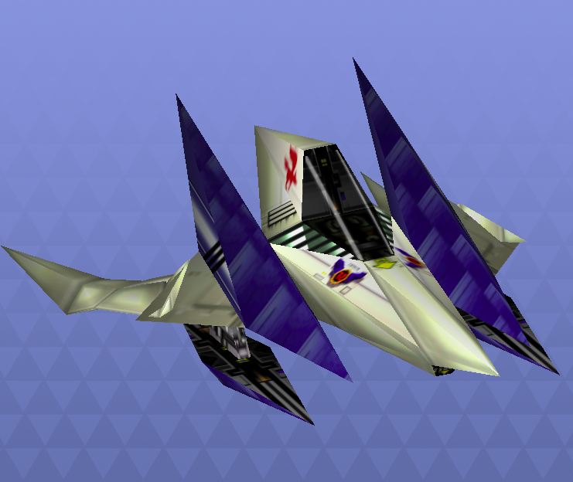
Arrowing spaceship

Slide 5
Enemies
Andross's is the main army of the planet Venom, which operates under Andross. Although most of the army is decimated by the Star Fox team and the Corneria Army, a small group of them are present for the Aparoid invasion.
The Anglar Emperor is the leader of the Anglar race, and the primary antagonist of Star Fox Command. Originating on Venom, he appears as a final boss for several missions. He pilots a large serpent-like creature known as the Arrowhead. In some of the final missions, he becomes a very large angler fish, capable of taking the player's ship into his mouth, which is reminiscent of an attack used by Andross in other games.

Slide 6
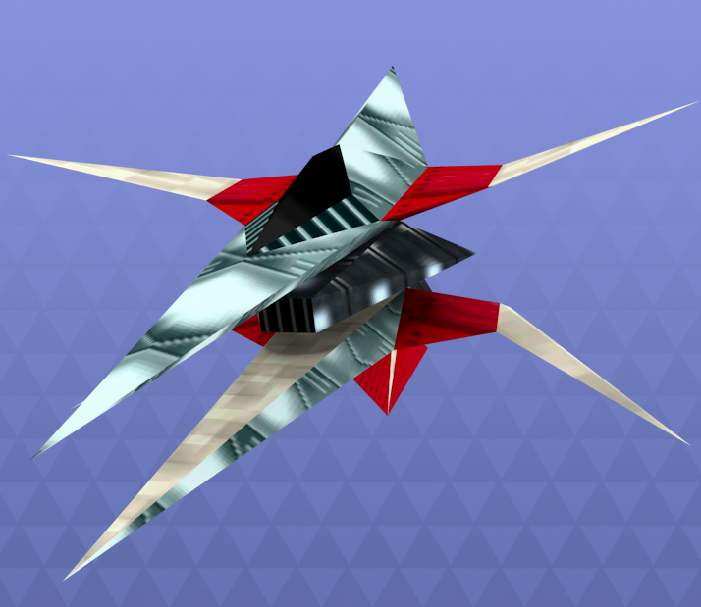
Wolf II

Slide 7
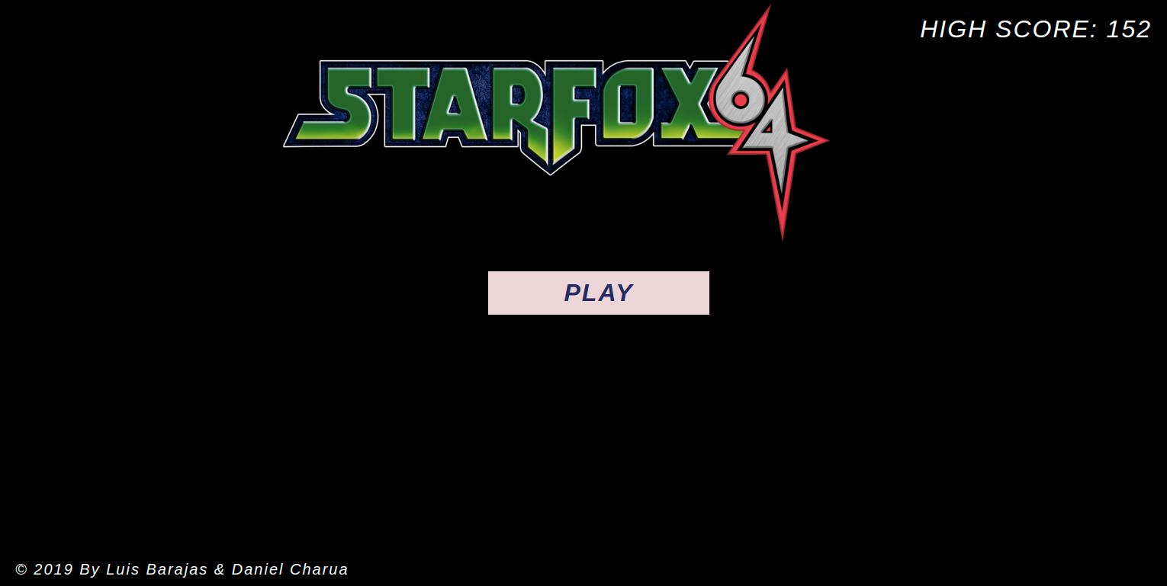
Menu

Slide 8
Game Play
Horizontal Movement: The player will be able to move in the horizontal axis the spaceship with the arrow keys
Shoot: The player will be able to shoot pressing the click button in the mouse
Rotation Movement: The spaceship will rotate always following the mouse movement from the player
HUD: The game will always display to the player the hud (heads-up display) having the current score of the game, the live that it has remaining and a hint to the user to press R if it wants to restart the game
R to restart game: The player will be able to press R whenever it wants to restart the current game.
Enemy death: The enemy will die if anything of the following happens:
A bullet shot by player hits it
It goes beyond the field of view for the camera
It collides with the player
Score will increment: The score will increment if a bullet that the player shot collides an enemy or the spaceship of the player collides with the Score Powerup.
Player’s health will decrease: The health of the player will decrease if anything of the following happens:
A bullet shot by enemy hits it
It collides with enemy or asteroid
Player’s health will increase: The health of the player will increase if it collides with the Med Kit Powerup.

Slide 9
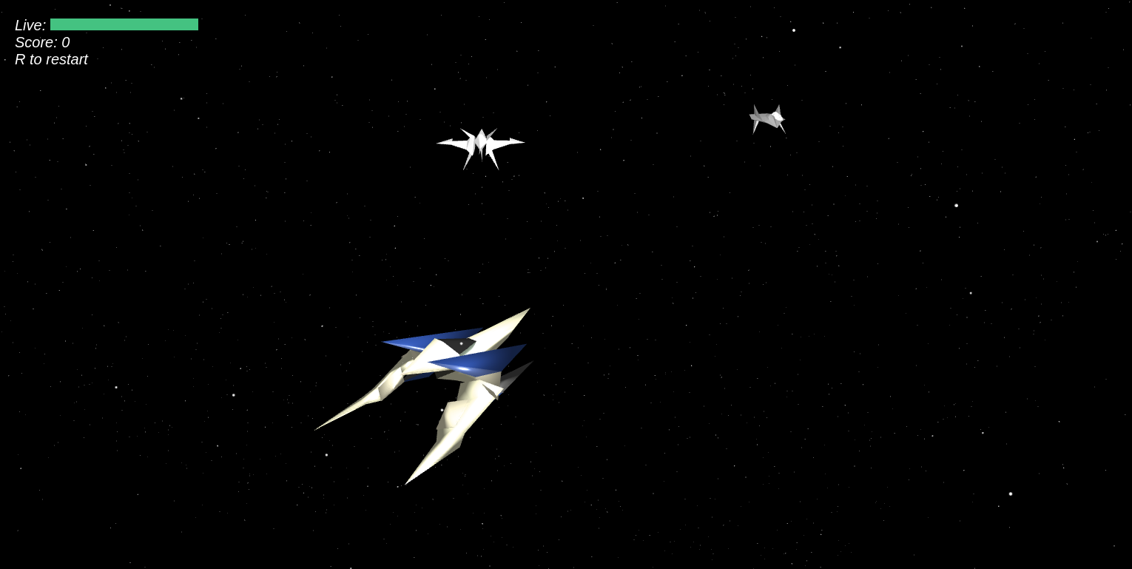
Playing

Slide 10
Thanks!

