Slide 1
Predicting Hits in Baseball
Daniel Cho

Slide 2
Column | Description
Season | Season year
Name | Name of player
AB | At-bats
H | Hits
AVG | Batting average
BABIP | Batting average of balls in play
LD% | Percentage of hits that are line drives
wOBA | Weighted on-base percentage
Contact% | Percentage of swings that make contact with the ball
Swing% | Percentage of swings
Soft% | Percentage of soft contact
Med% | Percentage of medium contact
Hard% | Percentage of hard contact

Slide 3
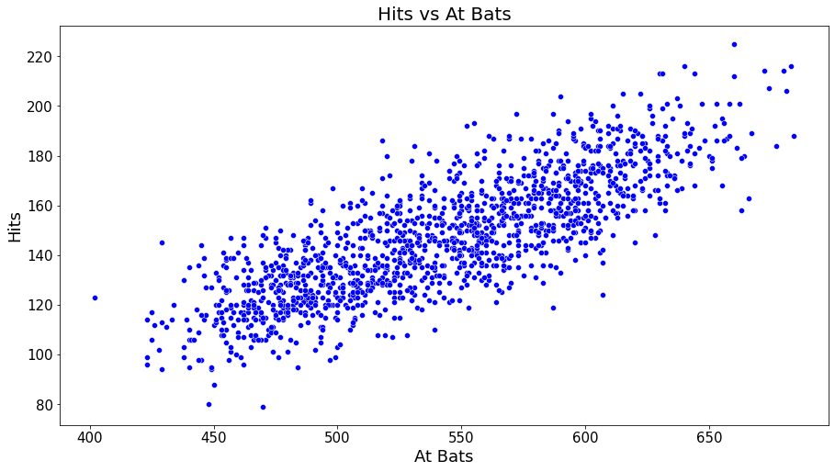

Slide 4
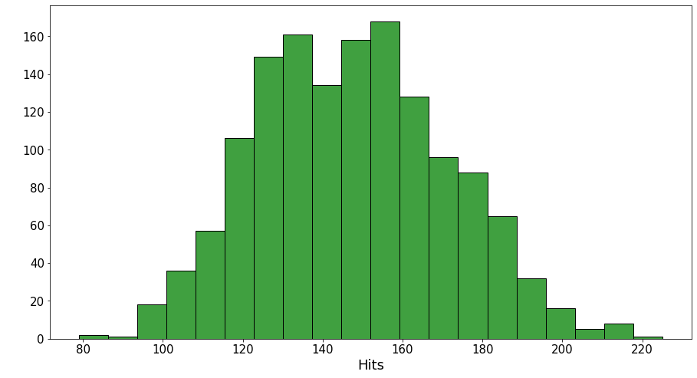

Slide 5
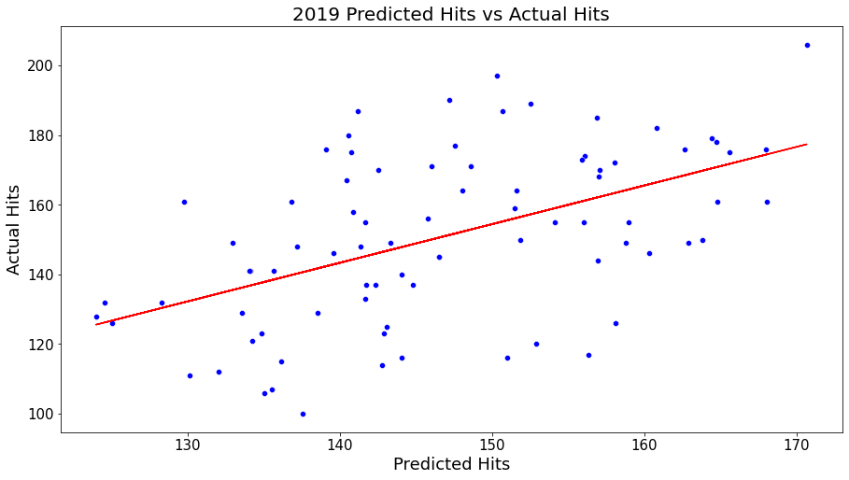
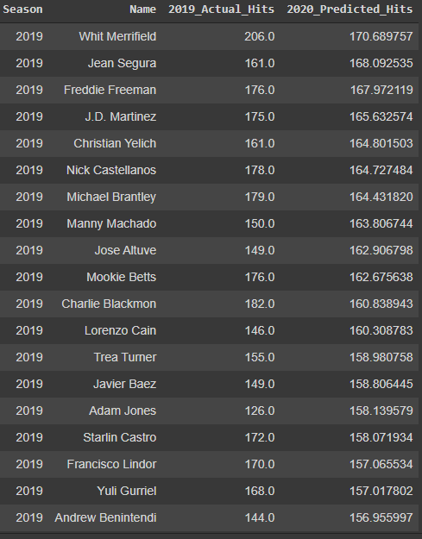

Slide 6
Linear Regression
Training data
Mean absolute error: 16.929
Score: 0.255
Testing data
Mean absolute error: 17.116
Score: 0.251

