Slide 1
Sales Prediction
Daniel Cho

Slide 2
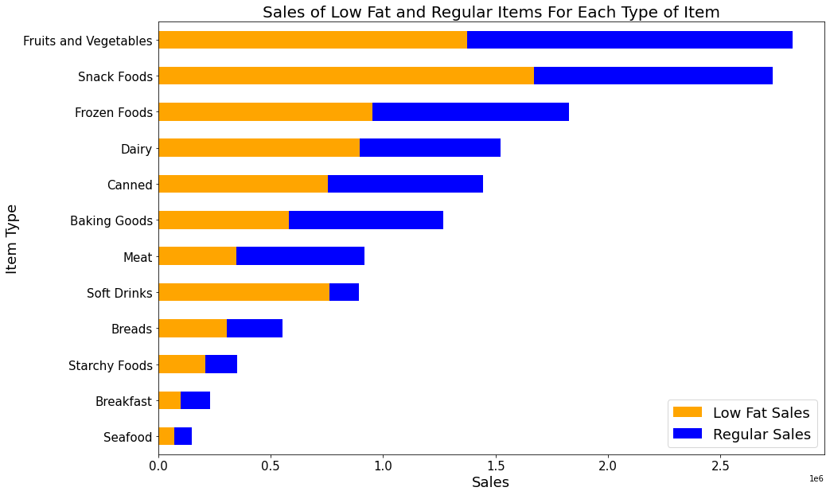

Slide 3
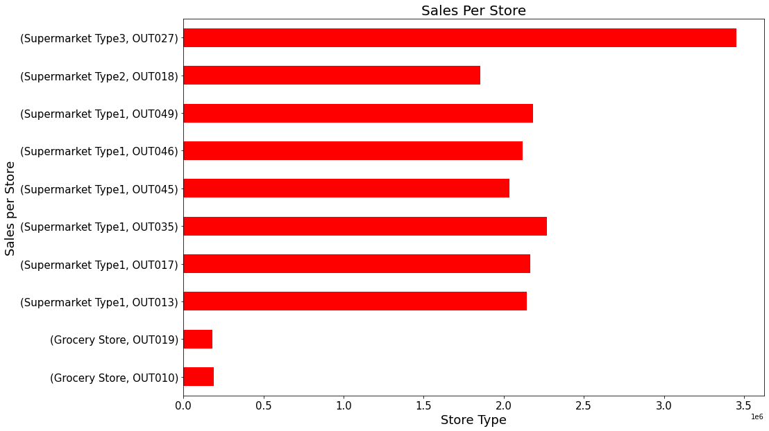

Slide 4
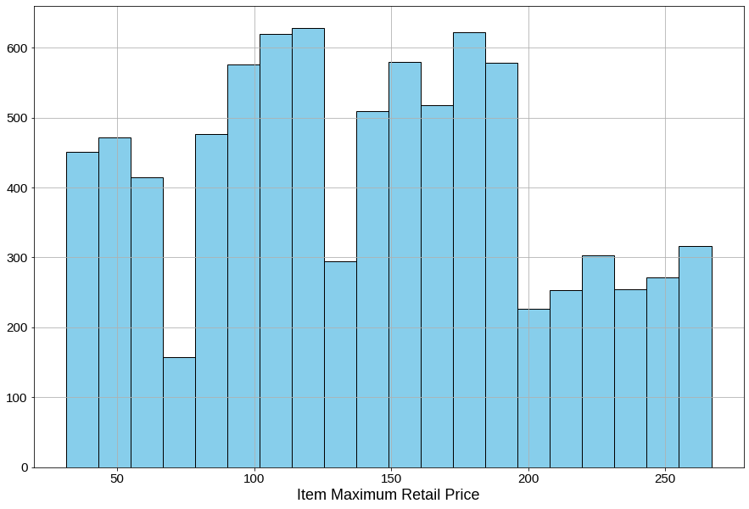

Slide 5
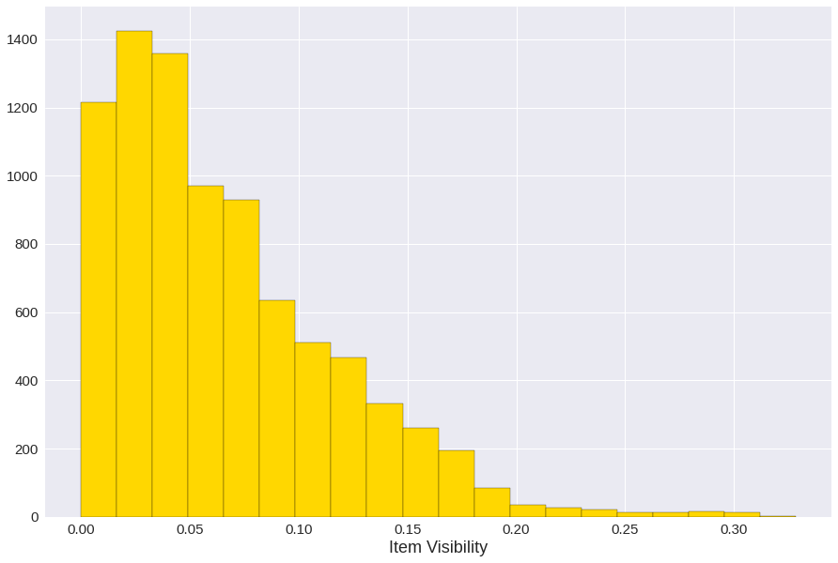

Slide 6
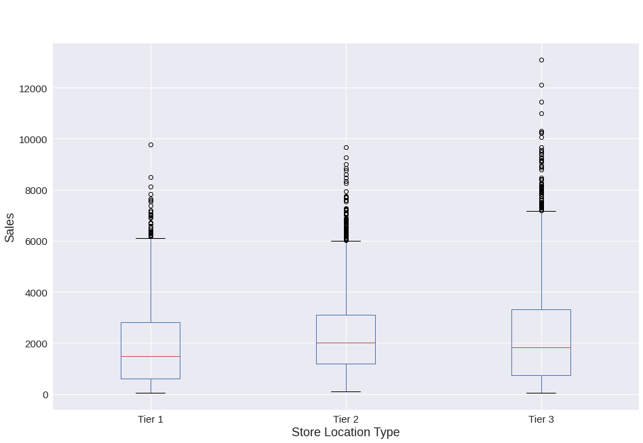

Slide 7
Sales Predictions
Linear regression model
Test r² score: 0.54972
Bagged trees model
Test r² score: 0.53538
Random forest model
Test r² score: 0.53448

