Slide 1
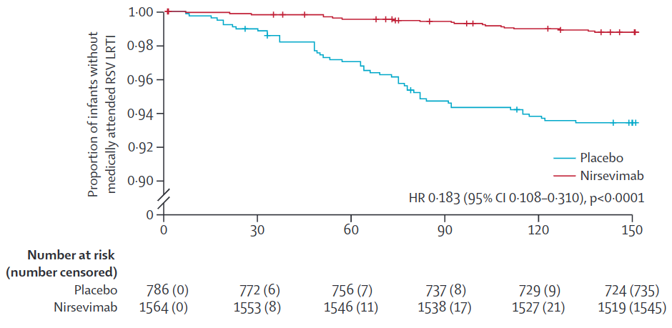
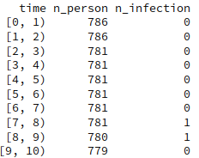
Data
Kaplan-Meier data (Simoes et al., 2023)
Daily data

Slide 2
Models
Placebo: n_infection ~ Poiss(n_person * attack_rate)
Nirsevimab: n_infection ~ Poiss[n_person * attack_rate * (1 - waning)]
Attack rate in placebo group:
Constant: A
“Normal”: A + B exp[-C² (t – D)² / 2]
Waning:
Constant: A
Linear: 1 – (A + B t)
Exponential: - A exp(B t)

Slide 3
Priors
Attack rate in placebo group:
Constant: A
A ~ U(0, 1)
“Normal”: A + B exp[-C² (t – D)² / 2]
A ~ U(0, 1)
B ~ U(0, 1)
C ~ U(0, 0.1)
D ~ U(0, 150)

Slide 4
Priors
Waning:
Constant: A
A ~ U(0, 1)
Linear: 1 – (A + B t)
A ~ U(0, 1)
B ~ U(0, 1/150)
Exponential: - A exp(B t)
A ~ U(-1, 0)
B ~ U(-1, 0)

Slide 5
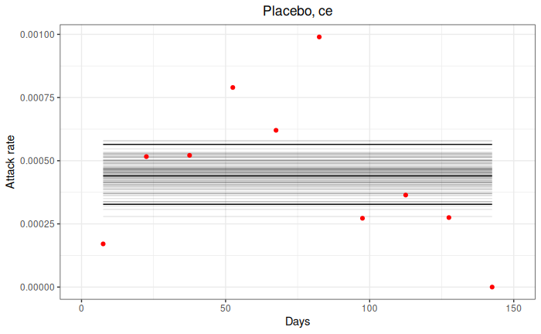
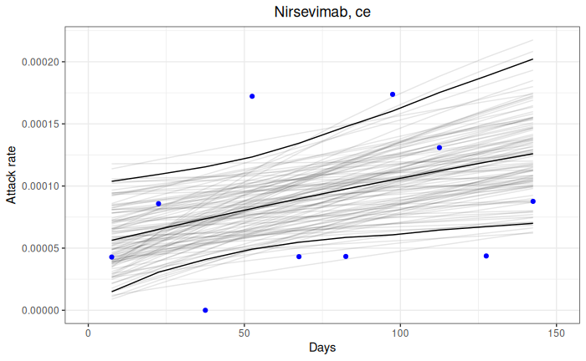
Fits
Constant attack rate, exponential waning

Slide 6
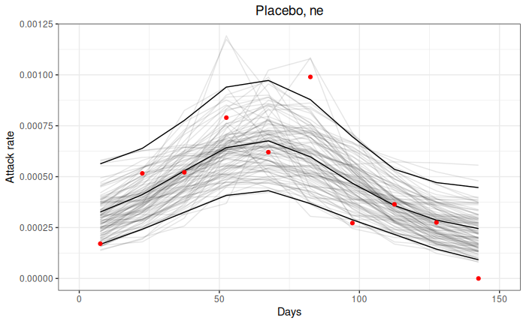
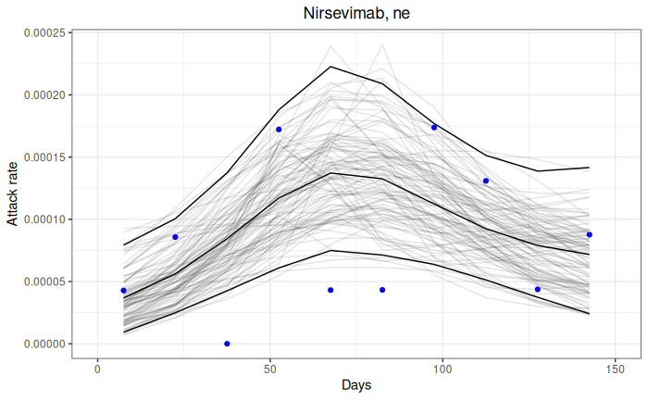
Fits
“Normal” attack rate, exponential waning

Slide 7
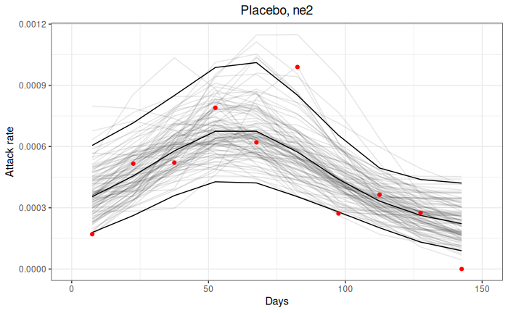
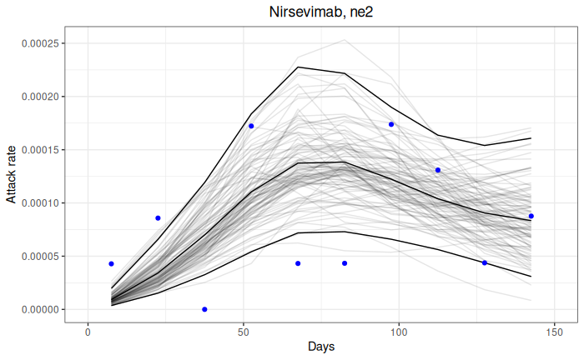
Fits
“Normal” attack rate, exponential waning with fixed efficacy = 1 at t = 0

Slide 8
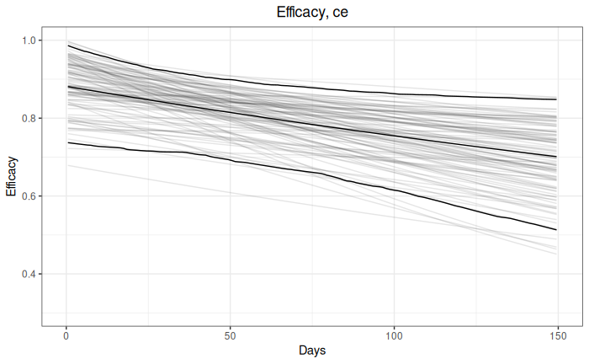
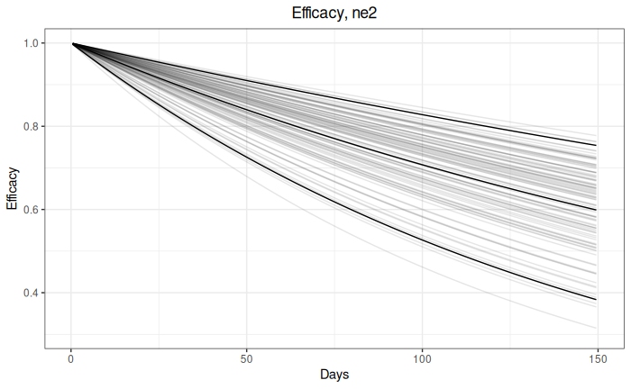
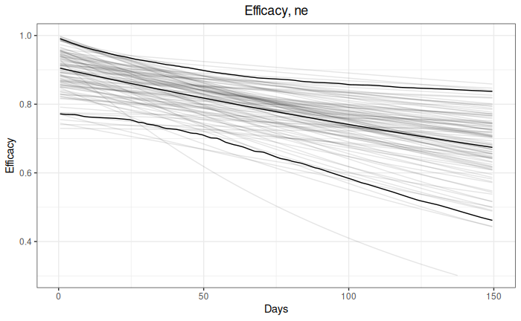
Waning

Slide 9
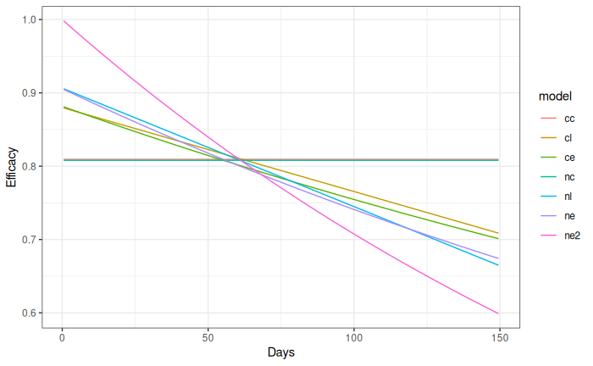
Waning

