Slide 1
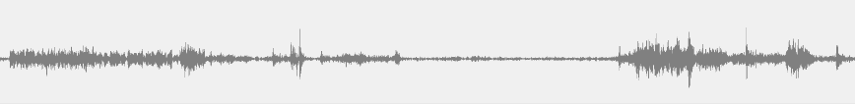
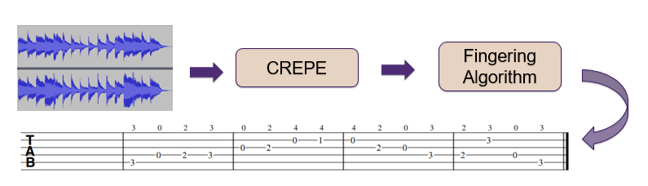
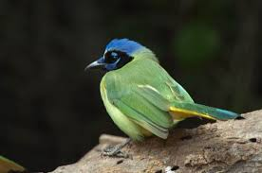
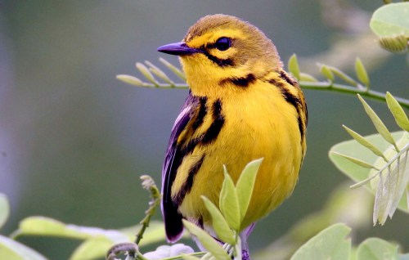
2019 EECS 352 Final Presentations
See more at
guitabwebsite.github.io
GuiTabs: an automatic guitar
transcription generator
David Hofferber, Joseph Eligon, Joshua Fields
Machine Perception of Audio and Music. Northwestern University, USA
1. Why do we label audio?
4. Approach: a Human-in-the-loop system
To quantify sound events to understand the context
To build a database for audio search engines
To collect training data for machine learning tasks in audio
The success of interactive searching system depends on how to incorporate human knowledge into the retrieval task
Speech recording
5. I-SED: Interactive Sound Event Detector [Kim ,2017]
USER
Bob
Sue
1. The user defines the target
sound by selecting the region
4. User feedback: adjusting
region boundaries and labeling
Nature recording
2. How do we label audio?
Manual way
Expensive and time-consuming
Expert labeling typically takes 3 minutes for each 1 minute of audio
Automatic way
Uses machine learning model.
Requires enough training data of pre-defined classes (thousands of labeled examples) and fine-tuning for specific applications.
Unreliable for mission critical tasks.
Collecting additional negative regions
6. User input / feedback -1: Relevance feedback, user segmentation
7. User input / feedback -2: Vocal imitation
Why vocal imitation?
A simple and easy way to describe a sound event.
Provides the system with more information about the target sound quickly
Search methods using vocal imitations
3. Problems
We have a long audio track to be labeled (days or weeks of audio).
We do not have enough pre-labeled examples of the sounds of interest to train an accurate machine labeler.
We do not have any prior knowledge about the audio track to be labeled until actually listening to it. (e.g. what sound events and how many each of them is recorded in the track)
Some applications require ground truth-level accuracy. (e.g. medical data)
Using either fully manual or fully automatic labeling is not feasible
An example of difficult queries
cough+laugh
Issues
How to measure the similarity between a real sound event and its vocal imitation
How to control the quality of vocal imitations from different users.
It is hard for a machine to know which sound is the target sound in the query.
A user might be able to specify the target sound by imitating it!
Acknowledgements: This work was supported by NSF Grant 1617497

