Slide 1
M1 J7 junction and A405

Slide 2
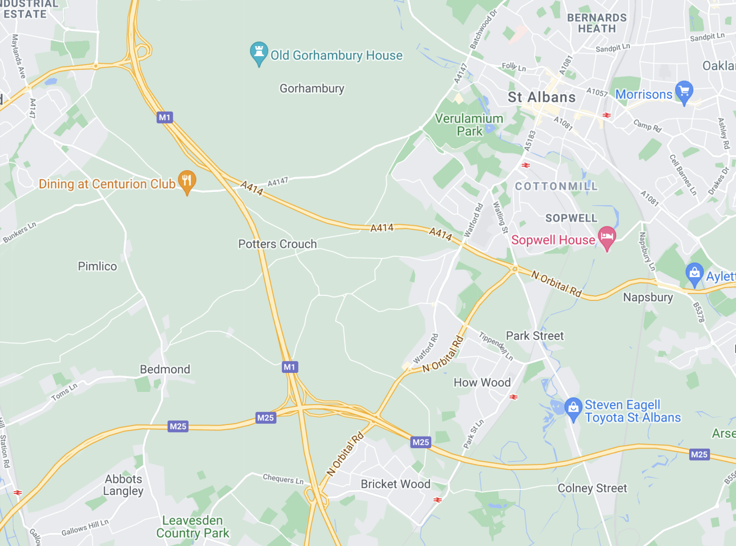
A414 portion
Starts at southbound traffic junction 7 and ends at Park Street Roundabout.

