Slide 1
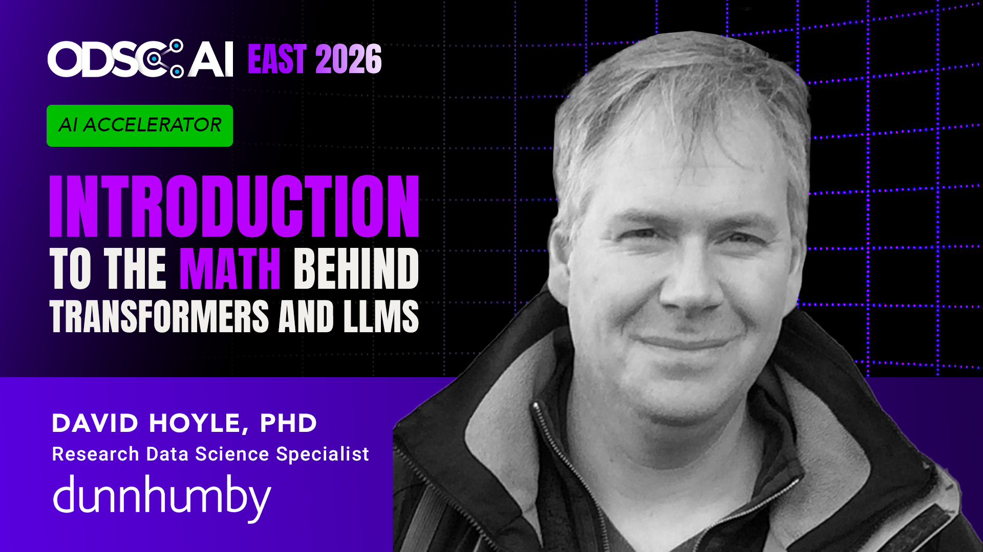

Slide 2

Outline
github.com/dchoyle/ODSCEast2026_TransformerBootcamp
01 | What we will learn
02 | Predicting the next word
03 | Simple approaches
04 | Word embeddings
05 | Transformers
06 | Back to predicting the next word
07 | Different types of transformers
08 | Wrap-up

Slide 3
Outline
github.com/dchoyle/ODSCEast2026_TransformerBootcamp
01 | What we will learn
02 | Predicting the next word
03 | Simple approaches
04 | Word embeddings
05 | Transformers
06 | Back to predicting the next word
07 | Different types of transformers
08 | Wrap-up
Break

Slide 4
Outline
github.com/dchoyle/ODSCEast2026_TransformerBootcamp
01 | What we will learn
02 | Predicting the next word
03 | Simple approaches
04 | Word embeddings
05 | Transformers
06 | Back to predicting the next word
07 | Different types of transformers
08 | Wrap-up
Code example
Code example

Slide 5

What we will learn
The mathematical challenges of next word prediction
The basic mathematical ideas behind Transformers
How Transformers predict words and sentences
To get comfortable at a high-level with how LLMs work at a mathematical level
To lose your fear of the science of LLMs

Slide 6
What we will not learn
How to train foundational models
How to build transformer-based chatbots
How to prompt
Agentic AI
How to make $$$Millions from AI

Slide 7

What I assume you know
Basic probability, e.g. conditional probability
Basic linear algebra, e.g. matrix multiplication as a transformation
Basic machine learning, e.g. training a model by minimizing a loss function

Slide 8
Predicting the next word
What this enables, tokens and sequences

Slide 9
Predicting the next word
What are we trying to achieve?
The cat sat on the ….

Slide 10
Predicting the next word
What are we trying to achieve?
The cat sat on the mat

Slide 11
Predicting the next word
What are we trying to achieve?
The quick brown fox jumped over the …….

Slide 12
Predicting the next word
What are we trying to achieve?
The quick brown fox jumped over the lazy
The quick brown fox jumped over the lazy …..

Slide 13
Predicting the next word
What are we trying to achieve?
The quick brown fox jumped over the lazy
The quick brown fox jumped over the lazy dog

Slide 14

Predicting the next word
What are we trying to achieve?
$$w_{1},w_{2},…,w_{K} → w_{1},w_{2},…,w_{K},w_{K+1} → w_{1},w_{2},…,w_{K},w_{K+1},w_{K+2}$$
$${→w}_{1},w_{2},…,w_{K},w_{K+1},…,w_{2K}$$

Slide 15
Predicting the next word
What are we trying to achieve?
“I wandered lonely as a cloud that floats on high o'er vales and hills,
when all at once …….”
→ “I wandered lonely as a cloud that floats on high o'er vales and hills, when all at once I saw a crowd, a host of golden daffodils”
William Wordsworth, 1807

Slide 16
Words as tokens
Words are the sentence natural units of a sentence.
We breaks down a sentence into these units:
the cat sat on the mat → [the, cat, sat, on, the mat]
We call these units “tokens”
Tokens don’t have to be complete words:
quick brown fox jumped over → [quick, brown, fox, jump, ed, over]

Slide 17
Sequences
A natural language sentence is just a sequence of tokens
Our modelling challenge is “predict the next token in given the preceding sequence of tokens”
We find sequences of tokens everywhere, not just in language
I will almost always be referring to words in a sentence

Slide 18
Simple approaches
Naïve models that are wrong and what we can learn from that

Slide 19

Simple approaches: Markov models
Example: “The more you know, the more you realize you don't know” Aristotle
$$P_{ij}= \text{Prob}\left(\text{Word} i \text{in} \text{vocabulary}\text{ | }\text{preceding} \text{word} \text{is} \text{word} j \text{in} \text{vocabulary} \right)$$
To
 | the | more | you | know | realize | don’t
the | 0.00 | 0.96 | 0.01 | 0.01 | 0.01 | 0.01
more | 0.02 | 0.00 | 0.9 | 0.01 | 0.03 | 0.04
you | 0.05 | 0.05 | 0.00 | 0.3 | 0.3 | 0.3
know | 0.9 | 0.02 | 0.03 | 0.00 | 0.03 | 0.02
realize | 0.05 | 0.1 | 0.7 | 0.1 | 0.00 | 0.05
don’t | 0.01 | 0.01 | 0.14 | 0.5 | 0.34 | 0.00
$$P_{ij}=$$
From

Slide 20



Simple approaches: Markov models
Example: “The more you know, the more you realize you don't know” Aristotle
 | the | more | you | know | realize | don’t
the | 0.00 | 0.96 | 0.01 | 0.01 | 0.01 | 0.01
more | 0.02 | 0.00 | 0.9 | 0.01 | 0.03 | 0.04
you | 0.05 | 0.05 | 0.00 | 0.3 | 0.3 | 0.3
know | 0.9 | 0.02 | 0.03 | 0.00 | 0.03 | 0.02
realize | 0.05 | 0.1 | 0.7 | 0.1 | 0.00 | 0.05
don’t | 0.01 | 0.01 | 0.14 | 0.5 | 0.34 | 0.00
$$P_{ij}=$$
The more
$$i$$
$$j$$

Slide 21


Simple approaches: Markov models
Example: “The more you know, the more you realize you don't know” Aristotle
 | the | more | you | know | realize | don’t
the | 0.00 | 0.96 | 0.01 | 0.01 | 0.01 | 0.01
more | 0.02 | 0.00 | 0.9 | 0.01 | 0.03 | 0.04
you | 0.05 | 0.05 | 0.00 | 0.3 | 0.3 | 0.3
know | 0.9 | 0.02 | 0.03 | 0.00 | 0.03 | 0.02
realize | 0.05 | 0.1 | 0.7 | 0.1 | 0.00 | 0.05
don’t | 0.01 | 0.01 | 0.14 | 0.5 | 0.34 | 0.00
$$P_{ij}=$$
The more you
$$i$$
$$j$$

Slide 22


Simple approaches: Markov models
Example: “The more you know, the more you realize you don't know” Aristotle
 | the | more | you | know | realize | don’t
the | 0.00 | 0.96 | 0.01 | 0.01 | 0.01 | 0.01
more | 0.02 | 0.00 | 0.9 | 0.01 | 0.03 | 0.04
you | 0.05 | 0.05 | 0.00 | 0.3 | 0.3 | 0.3
know | 0.9 | 0.02 | 0.03 | 0.00 | 0.03 | 0.02
realize | 0.05 | 0.1 | 0.7 | 0.1 | 0.00 | 0.05
don’t | 0.01 | 0.01 | 0.14 | 0.5 | 0.34 | 0.00
$$P_{ij}=$$
The more you know
$$i$$
$$j$$

Slide 23


Simple approaches: Markov models
Example: “The more you know, the more you realize you don't know” Aristotle
 | the | more | you | know | realize | don’t
the | 0.00 | 0.96 | 0.01 | 0.01 | 0.01 | 0.01
more | 0.02 | 0.00 | 0.9 | 0.01 | 0.03 | 0.04
you | 0.05 | 0.05 | 0.00 | 0.3 | 0.3 | 0.3
know | 0.9 | 0.02 | 0.03 | 0.00 | 0.03 | 0.02
realize | 0.05 | 0.1 | 0.7 | 0.1 | 0.00 | 0.05
don’t | 0.01 | 0.01 | 0.14 | 0.5 | 0.34 | 0.00
$$P_{ij}=$$
The more you know the
$$i$$
$$j$$

Slide 24


Simple approaches: Markov models
Example: “The more you know, the more you realize you don't know” Aristotle
 | the | more | you | know | realize | don’t
the | 0.00 | 0.96 | 0.01 | 0.01 | 0.01 | 0.01
more | 0.02 | 0.00 | 0.9 | 0.01 | 0.03 | 0.04
you | 0.05 | 0.05 | 0.00 | 0.3 | 0.3 | 0.3
know | 0.9 | 0.02 | 0.03 | 0.00 | 0.03 | 0.02
realize | 0.05 | 0.1 | 0.7 | 0.1 | 0.00 | 0.05
don’t | 0.01 | 0.01 | 0.14 | 0.5 | 0.34 | 0.00
$$P_{ij}=$$
The more you know the more
$$i$$
$$j$$

Slide 25


Simple approaches: Markov models
Example: “The more you know, the more you realize you don't know” Aristotle
 | the | more | you | know | realize | don’t
the | 0.00 | 0.96 | 0.01 | 0.01 | 0.01 | 0.01
more | 0.02 | 0.00 | 0.9 | 0.01 | 0.03 | 0.04
you | 0.05 | 0.05 | 0.00 | 0.3 | 0.3 | 0.3
know | 0.9 | 0.02 | 0.03 | 0.00 | 0.03 | 0.02
realize | 0.05 | 0.1 | 0.7 | 0.1 | 0.00 | 0.05
don’t | 0.01 | 0.01 | 0.14 | 0.5 | 0.34 | 0.00
$$P_{ij}=$$
The more you know the more you
$$i$$
$$j$$

Slide 26


Simple approaches: Markov models
Example: “The more you know, the more you realize you don't know” Aristotle
 | the | more | you | know | realize | don’t
the | 0.00 | 0.96 | 0.01 | 0.01 | 0.01 | 0.01
more | 0.02 | 0.00 | 0.9 | 0.01 | 0.03 | 0.04
you | 0.05 | 0.05 | 0.00 | 0.3 | 0.3 | 0.3
know | 0.9 | 0.02 | 0.03 | 0.00 | 0.03 | 0.02
realize | 0.05 | 0.1 | 0.7 | 0.1 | 0.00 | 0.05
don’t | 0.01 | 0.01 | 0.14 | 0.5 | 0.34 | 0.00
$$P_{ij}=$$
The more you know the more you realize
$$i$$
$$j$$

Slide 27


Simple approaches: Markov models
Example: “The more you know, the more you realize you don't know” Aristotle
 | the | more | you | know | realize | don’t
the | 0.00 | 0.96 | 0.01 | 0.01 | 0.01 | 0.01
more | 0.02 | 0.00 | 0.9 | 0.01 | 0.03 | 0.04
you | 0.05 | 0.05 | 0.00 | 0.3 | 0.3 | 0.3
know | 0.9 | 0.02 | 0.03 | 0.00 | 0.03 | 0.02
realize | 0.05 | 0.1 | 0.7 | 0.1 | 0.00 | 0.05
don’t | 0.01 | 0.01 | 0.14 | 0.5 | 0.34 | 0.00
$$P_{ij}=$$
The more you know the more you realize you
$$i$$
$$j$$

Slide 28
Simple approaches: Markov models
Example: “The more you know, the more you realize you don't know” Aristotle
 | the | more | you | know | realize | don’t
the | 0.00 | 0.96 | 0.01 | 0.01 | 0.01 | 0.01
more | 0.02 | 0.00 | 0.9 | 0.01 | 0.03 | 0.04
you | 0.05 | 0.05 | 0.00 | 0.3 | 0.3 | 0.3
know | 0.9 | 0.02 | 0.03 | 0.00 | 0.03 | 0.02
realize | 0.05 | 0.1 | 0.7 | 0.1 | 0.00 | 0.05
don’t | 0.01 | 0.01 | 0.14 | 0.5 | 0.34 | 0.00
$$P_{ij}=$$
The more you know the more you realize you don’t
$$i$$
$$j$$

Slide 29


Simple approaches: Markov models
Example: “The more you know, the more you realize you don't know” Aristotle
 | the | more | you | know | realize | don’t
the | 0.00 | 0.96 | 0.01 | 0.01 | 0.01 | 0.01
more | 0.02 | 0.00 | 0.9 | 0.01 | 0.03 | 0.04
you | 0.05 | 0.05 | 0.00 | 0.3 | 0.3 | 0.3
know | 0.9 | 0.02 | 0.03 | 0.00 | 0.03 | 0.02
realize | 0.05 | 0.1 | 0.7 | 0.1 | 0.00 | 0.05
don’t | 0.01 | 0.01 | 0.14 | 0.5 | 0.34 | 0.00
$$P_{ij}=$$
The more you know the more you realize you don’t know
$$i$$
$$j$$

Slide 30
Simple approaches: Markov models
Each separate word corresponds to a column in the transition matrix:
“know” = ( 0,0,0,1,0,0)
Small fixed vocabulary ⇒ Moving six-dimensional discrete state-space
Model is probabilistic:
P(“know” | “you”) = 0.3 , P(“realize” | “you”) = 0.3 , P(“don’t” | “you”) = 0.3
Could easily have generated,
‘The more you don’t the more you realize you don’t realize’

Slide 31
Simple approaches: Markov models
Problems:
1. Our vocabulary is large, e.g. 170000 – 700000 words
Large transition matrix
2a. We only take into account the preceding word
→ “Many adults drink beer” , “Many newborn babies drink beer”
“beer” has the same probability of occurring after the word “drink” in this model
2b. Expanding to transitions between pairs of words increases state space
e.g. (many, adults) → (adults, drink) → (drink, beer)

Slide 32
Word embeddings
Correcting our mistakes

Slide 33
Word embeddings
Reduce to a fixed lower dimensionality
3-dimensional
6-dimensional
realize
“the” = (1,0,0,0,0,0)
“more” = (0,1,0,0,0,0)
“you” = (0,0,1,0,0,0)
“know” = (0,0,0,1,0,0)
“realize” = (0,0,0,0,1,0)
“don’t” = (0,0,0,0,0,1)
the
Map
more
you
know
don’t

Slide 34
Word embeddings
Reduce to a fixed lower dimensionality
Word2Vec: 300-dimensional
GPT-3 (Davinci): 12288-dimensional
LlaMA 3.1-70B: 8192-dimensional
GPT-4.5: 3072-dimensional
170000 – 700000 dimensional
Map
All of English language

Slide 35
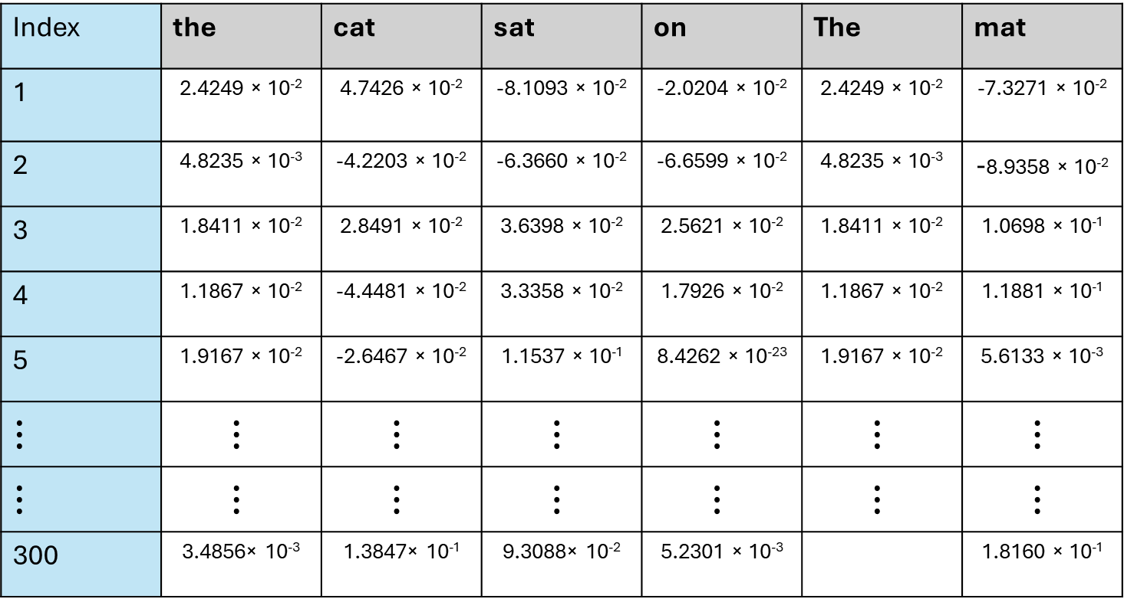
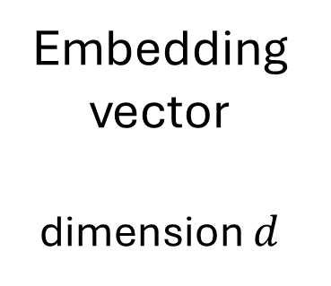
Word embeddings
Tokens
Index | the | cat | sat | on | The | mat
1 | 2.4249 × 10⁻² | 4.7426 × 10⁻² | -8.1093 × 10⁻² | -2.0204 × 10⁻² | 2.4249 × 10⁻² | -7.3271 × 10⁻²
2 | 4.8235 × 10⁻³ | -4.2203 × 10⁻² | -6.3660 × 10⁻² | -6.6599 × 10⁻² | 4.8235 × 10⁻³ | -8.9358 × 10⁻²
3 | 1.8411 × 10⁻² | 2.8491 × 10⁻² | 3.6398 × 10⁻² | 2.5621 × 10⁻² | 1.8411 × 10⁻² | 1.0698 × 10⁻¹
4 | 1.1867 × 10⁻² | -4.4481 × 10⁻² | 3.3358 × 10⁻² | 1.7926 × 10⁻² | 1.1867 × 10⁻² | 1.1881 × 10⁻¹
5 | 1.9167 × 10⁻² | -2.6467 × 10⁻² | 1.1537 × 10⁻¹ | 8.4262 × 10⁻²³ | 1.9167 × 10⁻² | 5.6133 × 10⁻³
$$⋮$$ | $$⋮$$ | $$⋮$$ | $$⋮$$ | $$⋮$$ | $$⋮$$ | $$⋮$$
$$⋮$$ | $$⋮$$ | $$⋮$$ | $$⋮$$ | $$⋮$$ | $$⋮$$ | $$⋮$$
300 | 3.4856× 10⁻³ | 1.3847× 10⁻¹ | 9.3088× 10⁻² | 5.2301 × 10⁻³ |  | 1.8160 × 10⁻¹
Embedding vector
dimension $d$
Word2Vec model = “fasttext-wiki-news-subwords-300”

Slide 36
Code example
Working with word embeddings

Slide 37
Code Example 1
Open up the Jupyter notebook ODSCEast2026_CodeExample1.ipynb in the github repository
https://github.com/dchoyle/ODSCEast2026_TransformerBootcamp/

Slide 38
Transformers
Creating context aware embeddings

Slide 39
Transforming embeddings
the | cat | sat | on | the
Predict the next word
?
Input vector from preceding token into multi-class classifier
Each token knows nothing about the broader context of the preceding words
Need new vectors for each token that take into account the preceding context
We will make a Transformer
For now, create new vectors that take into account the context of the whole sentence

Slide 40
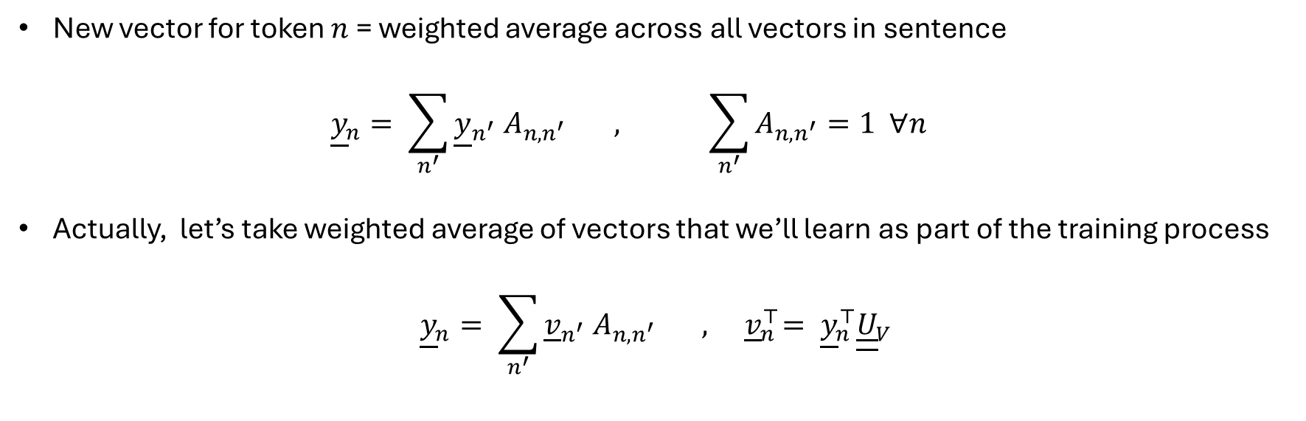
Attention
Input embeddings
Updated embeddings
the | cat | sat | on | the
the | cat | sat | on | the
New vector for token $n$ = weighted average across all vectors in sentence
$${\underline{y}}_{n}= \sum_{n^{′}}{{\underline{y}}_{n^{′}} A_{n,n^{′}} , \sum_{n^{′}}{A_{n,n^{′}}=1 ∀n}}$$
Actually, let’s take weighted average of vectors that we’ll learn as part of the training process
$${\underline{y}}_{n}= \sum_{n^{′}}{{\underline{v}}_{n^{′}} A_{n,n^{′}}} , { \underline{v}}_{n}^{⊤}= {{\underline{y}}_{n}^{⊤}\underline{\underline{U}}}_{V}$$

Slide 41
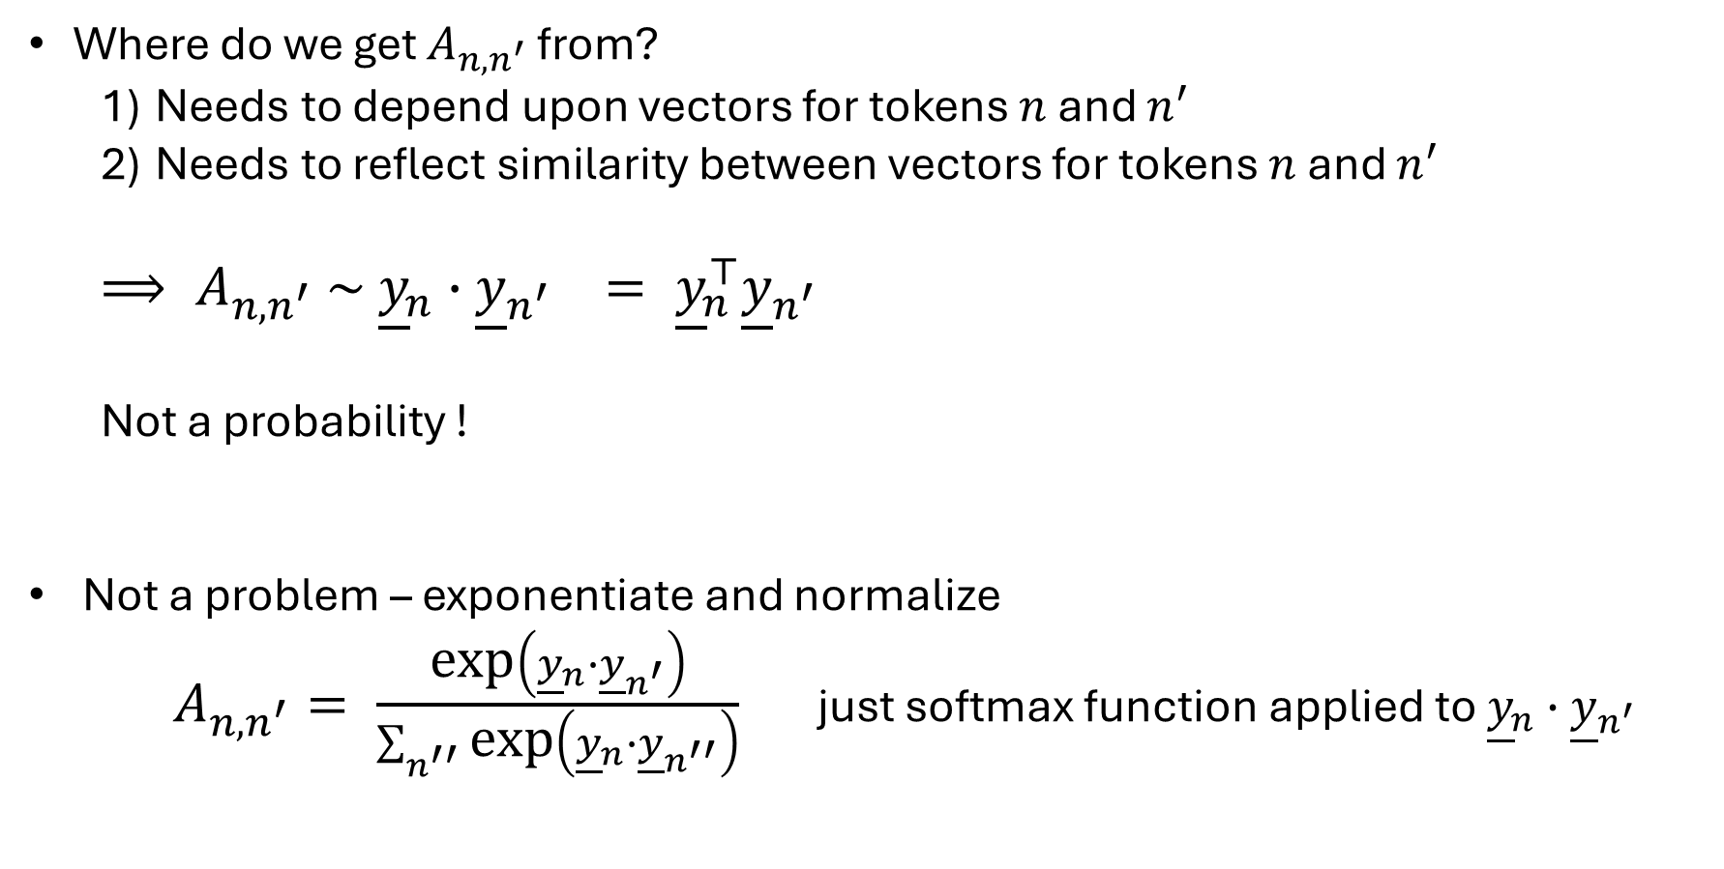
Self-Attention
Where do we get $A_{n,n^{′}}$ from?
Needs to depend upon vectors for tokens $n$ and $n^{′}$
Needs to reflect similarity between vectors for tokens $n$ and $n^{′}$
$⟹ A_{n,n^{′}} \sim {\underline{y}}_{n}∙{\underline{y}}_{n^{′}} = {\underline{y}}_{n}^{⊤}{\underline{y}}_{n^{′}}$
Not a probability !
Not a problem – exponentiate and normalize
$A_{n,n^{′}}= \frac{\text{exp}\left({\underline{y}}_{n}∙{\underline{y}}_{n^{′}}\right)}{\sum_{n^{′′}}{\text{exp}\left({\underline{y}}_{n}∙{\underline{y}}_{n^{′′}}\right)}}$ just softmax function applied to ${\underline{y}}_{n}∙{\underline{y}}_{n^{′}}$

Slide 42
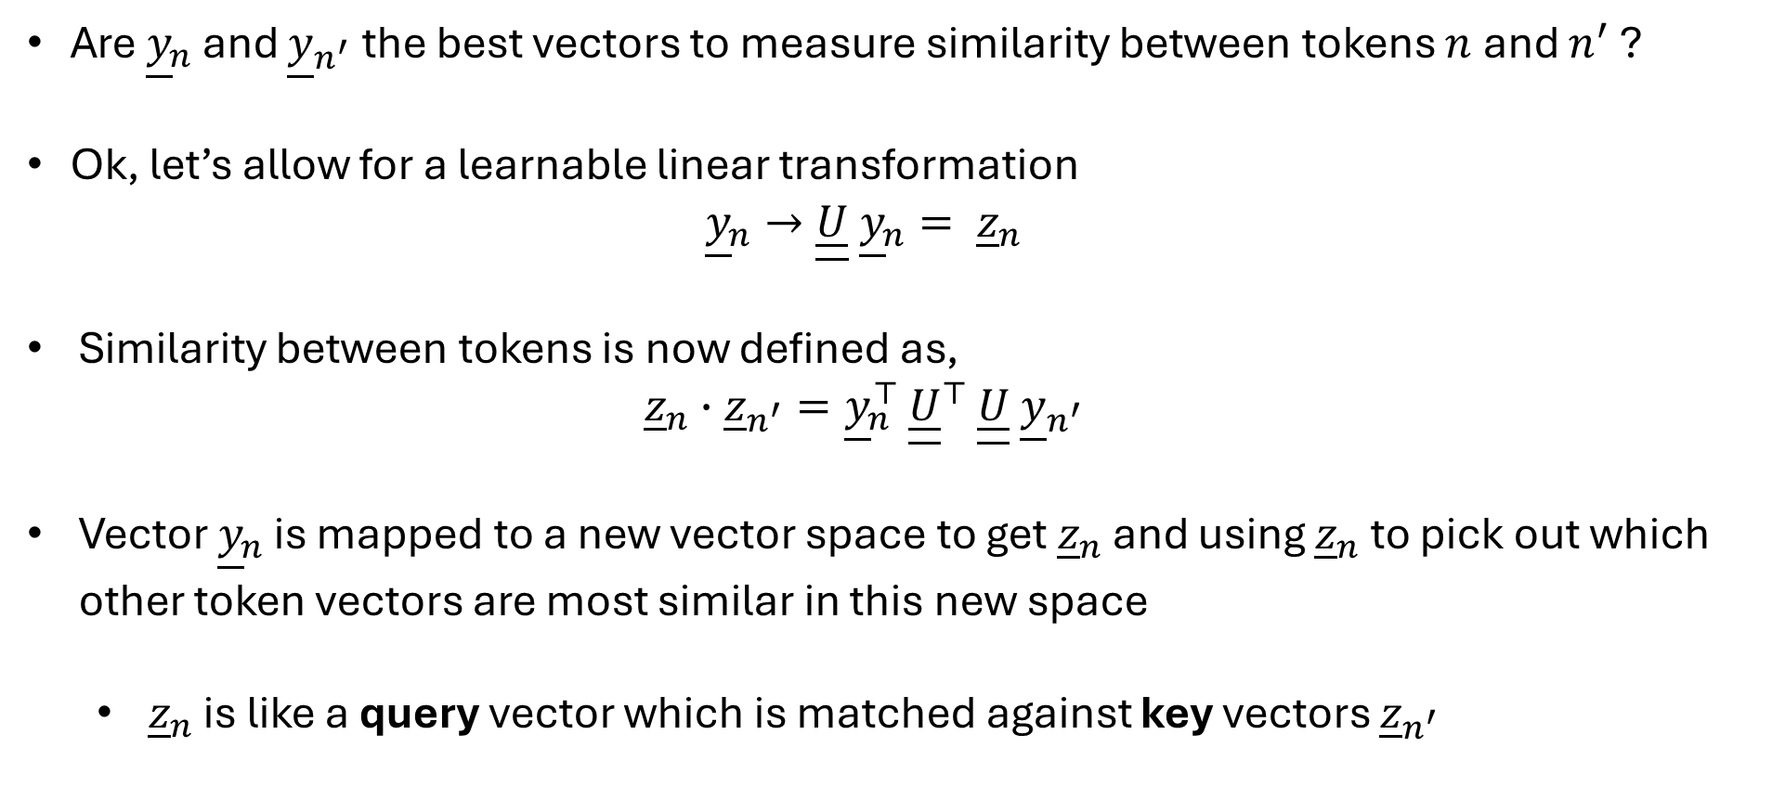
Self-Attention
Are ${\underline{y}}_{n}$ and ${\underline{y}}_{n^{′}}$ the best vectors to measure similarity between tokens $n$ and $n^{′}$ ?
Ok, let’s allow for a learnable linear transformation
$${\underline{y}}_{n}→\underline{\underline{U}} {\underline{y}}_{n}= {\underline{z}}_{n}$$
Similarity between tokens is now defined as,
$${\underline{z}}_{n}∙{\underline{z}}_{n^{′}}={\underline{y}}_{n}^{⊤ }{\underline{\underline{U}}}^{⊤ }\underline{\underline{U}} {\underline{y}}_{n^{′}}$$
Vector ${\underline{y}}_{n}$ is mapped to a new vector space to get ${\underline{z}}_{n}$ and using ${\underline{z}}_{n}$ to pick out which other token vectors are most similar in this new space
${\underline{z}}_{n}$ is like a query vector which is matched against key vectors ${\underline{z}}_{n^{′}}$

Slide 43
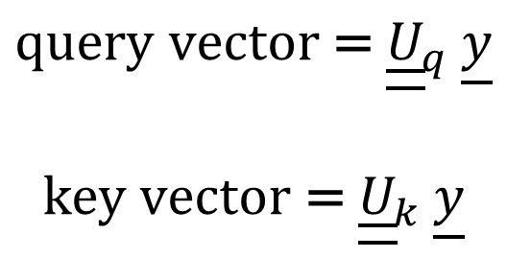
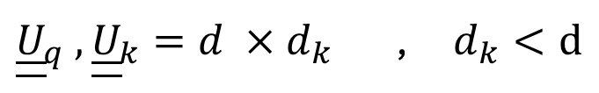
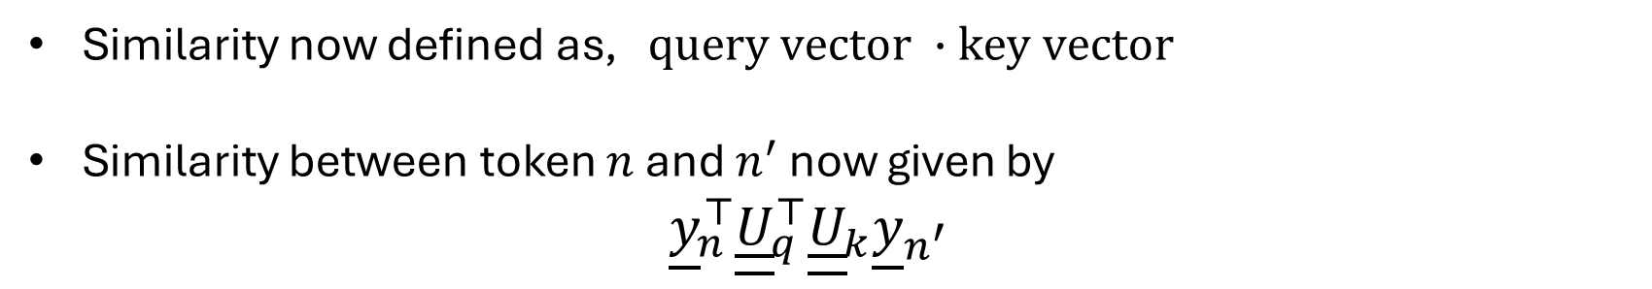
Self-Attention
We can add more flexibility to model.
Different linear mappings to create the query vectors and to create the key vectors
$$\text{query} \text{vector} \text{= }{\underline{\underline{U}}}_{q} \underline{y}$$
$$\text{k}\text{ey} \text{vector} \text{= }{\underline{\underline{U}}}_{k} \underline{y}$$
${\underline{\underline{U}}}_{q} , {\underline{\underline{U}}}_{k}=d ×d_{k}$ , $d_{k}<d$
Similarity now defined as, $\text{query} \text{vector} ∙\text{key} \text{vector}$
Similarity between token $n$ and $n^{′}$ now given by
${\underline{y}}_{n}^{⊤}{\underline{\underline{U}}}_{q}^{⊤}{\underline{\underline{U}}}_{k}{\underline{y}}_{n^{′}}$

Slide 44
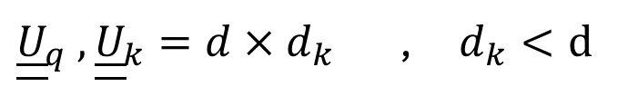
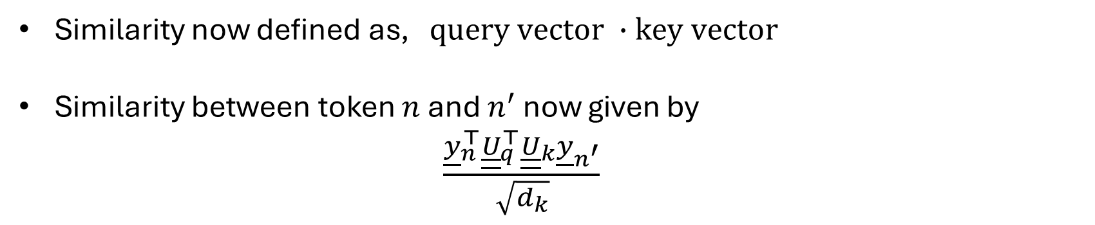
Self-Attention
We can add more flexibility to model.
Different linear mappings to create the query vectors and to create the key vectors
$$\text{query} \text{vector} \text{= }{\underline{\underline{U}}}_{q} \underline{y}$$
$$\text{k}\text{ey} \text{vector} \text{= }{\underline{\underline{U}}}_{k} \underline{y}$$
${\underline{\underline{U}}}_{q} , {\underline{\underline{U}}}_{k}=d×d_{k}$ , $d_{k}<d$
Similarity now defined as, $\text{query} \text{vector} ∙\text{key} \text{vector}$
Similarity between token $n$ and $n^{′}$ now given by
$\frac{{\underline{y}}_{n}^{⊤}{\underline{\underline{U}}}_{q}^{⊤}{\underline{\underline{U}}}_{k}{\underline{y}}_{n^{′}}}{\sqrt{d_{k}}}$

Slide 45
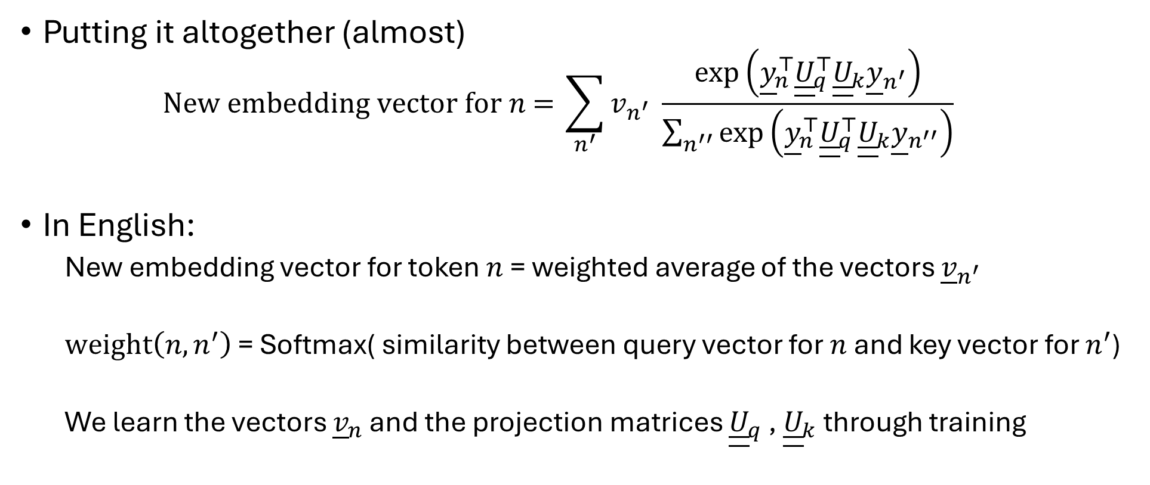
Self-Attention
Putting it altogether (almost)
$$\text{New} \text{embedding} \text{vector} \text{for} n\text{ = }\sum_{n^{′}}{v_{n^{′}} \frac{\text{exp}\left({\underline{y}}_{n}^{⊤}{\underline{\underline{U}}}_{q}^{⊤}{\underline{\underline{U}}}_{k}{\underline{y}}_{n^{′}}\right)}{\sum_{n^{′′}}{\text{exp}\left({\underline{y}}_{n}^{⊤}{\underline{\underline{U}}}_{q}^{⊤}{\underline{\underline{U}}}_{k}{\underline{y}}_{n^{′′}}\right)}}}$$
In English:
New embedding vector for token $n$ = weighted average of the vectors ${\underline{v}}_{n^{′}}$
$\text{weight}\left(n,n^{′}\right)$ = Softmax( similarity between query vector for $n$ and key vector for $n^{′}$)
We learn the vectors ${\underline{v}}_{n}$ and the projection matrices ${\underline{\underline{U}}}_{q}$ , ${\underline{\underline{U}}}_{k}$ through training

Slide 46
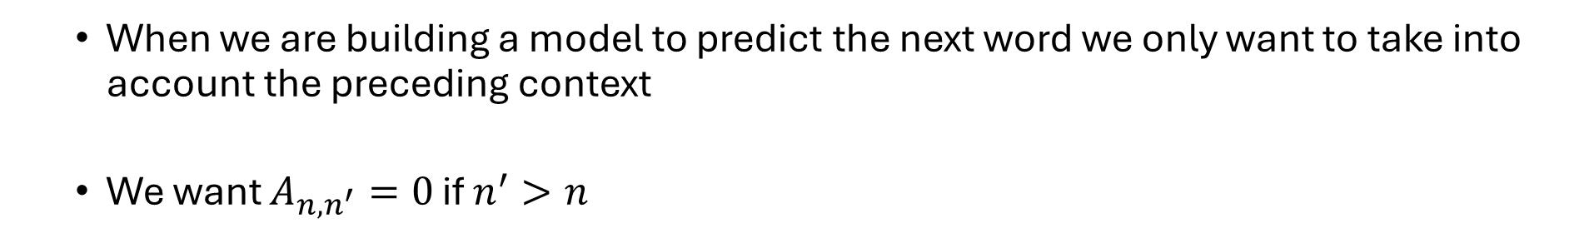
Attention: Masking
When we are building a model to predict the next word we only want to take into account the preceding context
We want $A_{n,n^{′}}=0$ if $n^{′}>n$
 | the | cat | sat | on | the
the | 1.0 | 0 | 0 | 0 | 0
cat | 0.2 | 0.8 | 0 | 0 | 0
sat | 0.35 | 0.15 | 0.5 | 0 | 0
on | 0.08 | 0.12 | 0.34 | 0.46 | 0
the | 0.2 | 0.25 | 0.30 | 0.05 | 0.2
We can easily achieve this by putting correspond ‘similarity’ values equal to $−∞$ before applying softmax operation

Slide 47
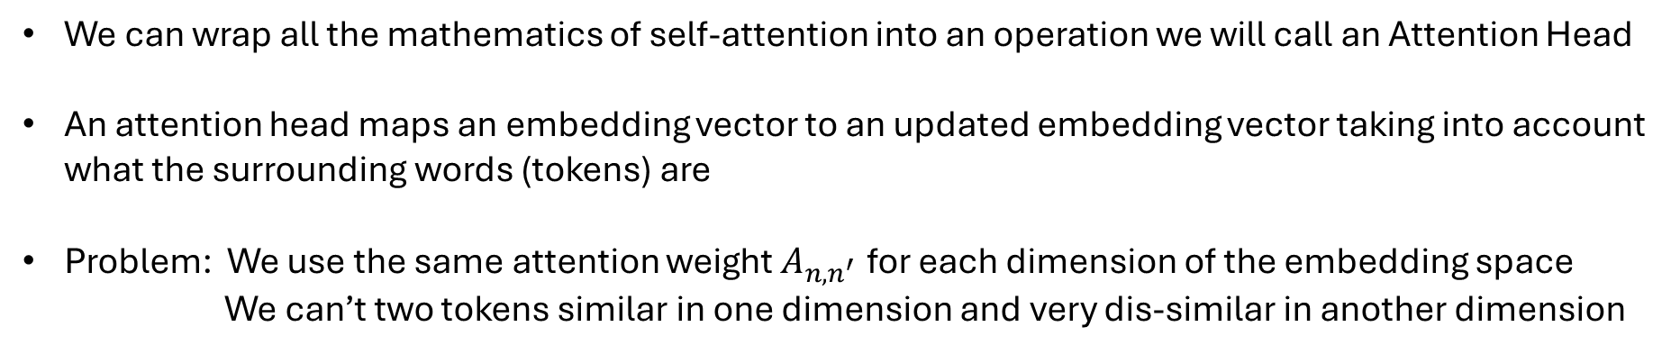
Attention Head
Input embedding vector for token
Output embedding vector for token
Attention Head
We can wrap all the mathematics of self-attention into an operation we will call an Attention Head
An attention head maps an embedding vector to an updated embedding vector taking into account what the surrounding words (tokens) are
Problem: We use the same attention weight $A_{n,n^{′}}$ for each dimension of the embedding space
We can’t two tokens similar in one dimension and very dis-similar in another dimension

Slide 48
Multi-headed Self-Attention
Output embedding vector for token
Input embedding vector for token
Attention Head
Concatenation Operator, e.g. stacking or take average
Attention Head
Attention Head
We solve this by having multiple (H) self-attention heads.
We combine the output vectors of all the attention heads into a single vector
Typically, we make output dimension of each attention head d/H

Slide 49
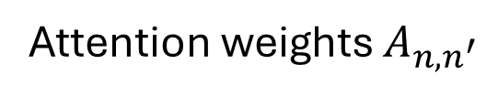
Neural Network Sub-Layer
Input embeddings
Output embeddings
the | cat | sat | on | the
the | cat | sat | on | the
Multi-headed attention
Attention weights $A_{n,n^{′}}$
Attention process is column-wise (token-to-token)
We haven’t allowed the different rows within a column to interact when producing the updated embedding

Slide 50
Neural Network Sub-Layer
Embedding vector
Output Embedding vector
Neural Network
Parameters of neural network are learnt as part of the overall model training

Slide 51
The Transformer Block
Transformer Block
Input embeddings
Output embeddings
Multi-headed attention
Neural Network
the | cat | sat | on | the
the | cat | sat | on | the
What are these gaps?

Slide 52
Technical transformations
We apply two main additional transformations to the data to improve efficiency and stability of the training process:
Layer-wise normalization – apply a standardization (location and scale) transformation before each sub-layer
We use the multi-headed attention and neural network transformations to model the residuals of the input-output relations
Output vector = Input vector + Transformation(Input vector)

Slide 53
The Transformer Block
Transformer Block
Input embeddings
Output embeddings
Layer Normalization
Multi-headed attention
Layer Normalization
Neural Network
the | cat | sat | on | the
the | cat | sat | on | the

Slide 54
The Transformer Model
Input embeddings
Output embeddings
the | cat | sat | on | the
Transformer Block
Transformer Block
Transformer Block
Transformer Block
Transformer Block
Transformer Block
the | cat | sat | on | the

Slide 55
Back to predicting the next word
Back to our goal

Slide 56
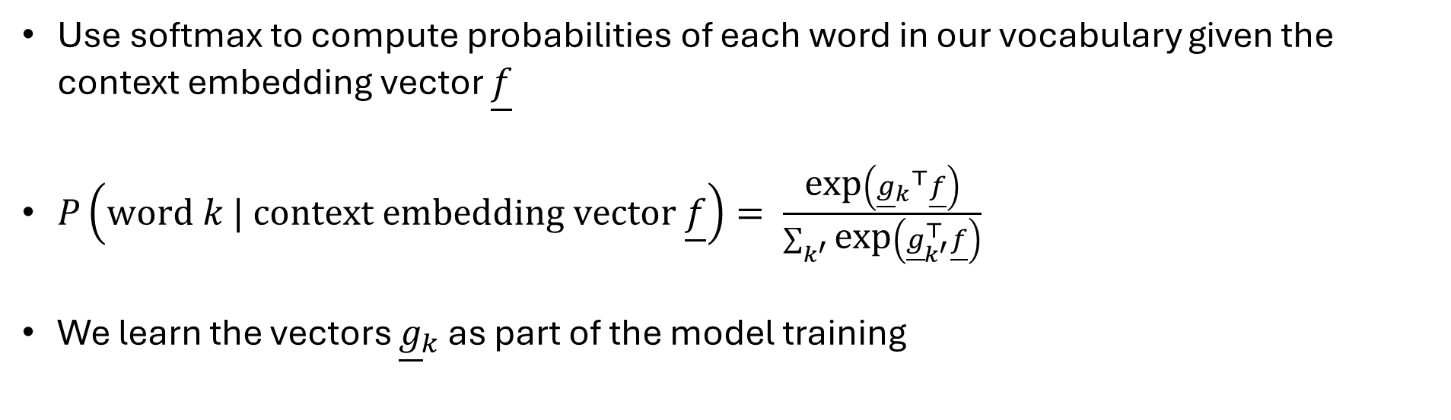
Predicting the next word from context embeddings
the | cat | sat | on | the
Predict the next word
?
Input vector from preceding token into multi-class classifier
Use softmax to compute probabilities of each word in our vocabulary given the context embedding vector $\underline{f}$
$P\left(\text{word} k | \text{context} \text{embedding} \text{vector} \underline{f}\right)= \frac{\text{exp}\left({{\underline{g}}_{k}}^{⊤}\underline{f}\right)}{\sum_{k^{′}}{\text{exp}\left({\underline{g}}_{k^{′}}^{⊤}\underline{f}\right)}}$
We learn the vectors ${\underline{g}}_{k}$ as part of the model training

Slide 57
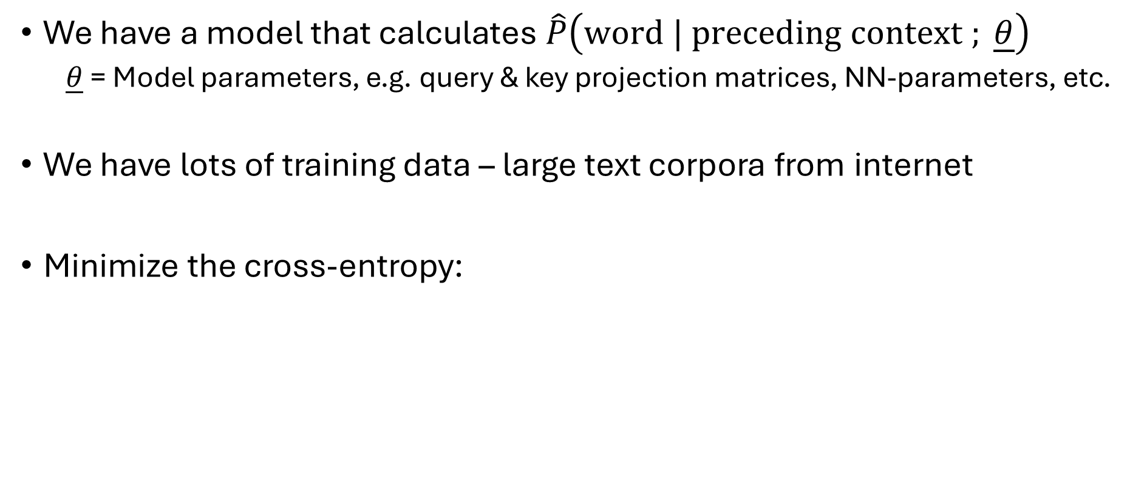
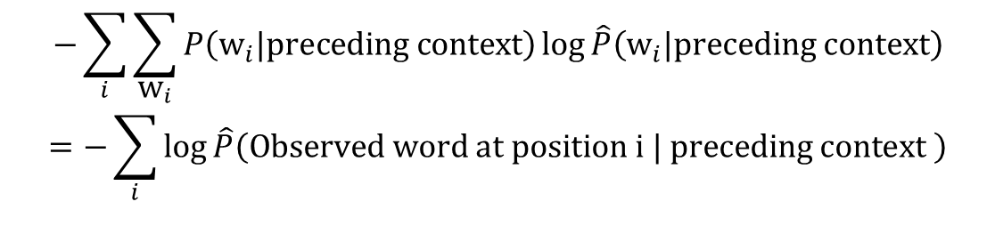
Training
We have a model that calculates $\hat{P}\left(\text{word}\text{ | }\text{preceding} \text{context} ; \underline{θ}\right)$
$\underline{θ}$ = Model parameters, e.g. query & key projection matrices, NN-parameters, etc.
We have lots of training data – large text corpora from internet
Minimize the cross-entropy:
$$−\sum_{i}{\sum_{{\text{w}}_{i}}{P\left({\text{w}}_{i}\text{|}\text{preceding} \text{context}\right)}\log{\hat{P}\left({\text{w}}_{i}|\text{preceding} \text{context}\right)}}$$
$$=−\sum_{i}{\log{\hat{P}\left(\text{Observed} \text{word} \text{at} \text{position} \text{i}\text{ | }\text{preceding} \text{context} \right)}}$$

Slide 58
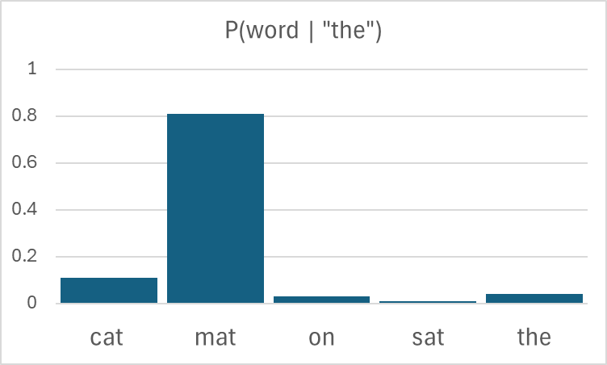
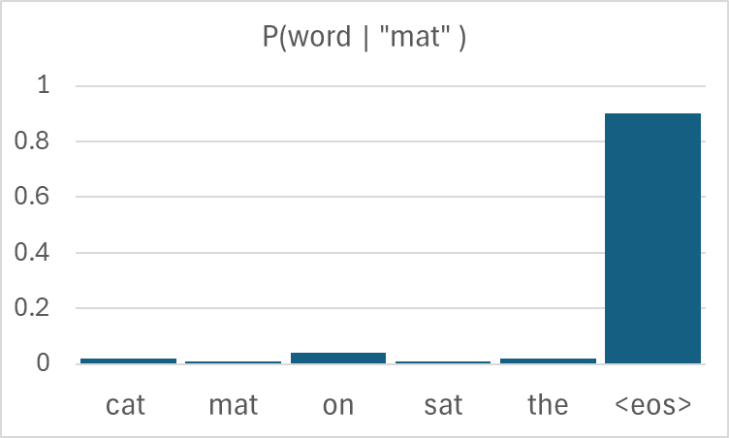
Predicting the next word from context embeddings
the | cat | sat | on | the
“mat”
cat | sat | on | the | mat
Transformer Model
cat | sat | on | the | mat
<eos>

Slide 59
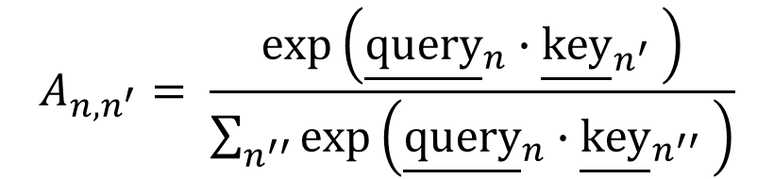
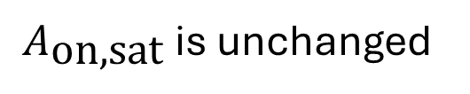
Positional encoding
Let’s look at our formula for the attention probabilities
$$A_{n,n^{′}}= \frac{\text{exp}\left({\underline{\text{query}}}_{n}∙{\underline{\text{key}}}_{n^{′}} \right)}{\sum_{n^{′′}}{\text{exp}\left({\underline{\text{query}}}_{n}∙{\underline{\text{key}}}_{n^{′′}} \right)}}$$
the | cat | sat | on | the
sat | cat | the | on | the
$A_{\text{on}\text{,}\text{sat}}$is unchanged
The input embeddings, and hence the context embeddings don’t take into account the position of the token in the context (other than through masking) !!

Slide 60



















Positional encoding
We solve by adding position dependent vectors to the input
$$i=1$$
$$i=2$$
$$i=3$$
$$i=4$$
$$i=5$$
$$i=1$$
$$i=2$$
$$i=3$$
$$i=4$$
$$i=5$$
the
cat
sat
on
the
$$p(1)$$
$$p(2)$$
$$p(3)$$
$$p(4)$$
$$p(5)$$
$$i=1$$
$$i=1$$
$$i=1$$
the
$$p(1)$$
the @ i=1
+
=

Slide 61




Positional encoding
We solve by adding position dependent vectors to the input
$$i=1$$
$$i=2$$
$$i=3$$
$$i=4$$
$$i=5$$
$$i=1$$
$$i=2$$
$$i=3$$
$$i=4$$
$$i=5$$
the
cat
sat
on
the
$$p(1)$$
$$p(2)$$
$$p(3)$$
$$p(4)$$
$$p(5)$$
$$i=2$$
$$i=2$$
$$i=2$$
cat
$$p(2)$$
cat @ i=2
+
=

Slide 62



Positional encoding
We solve by adding position dependent vectors to the input
$$i=1$$
$$i=2$$
$$i=3$$
$$i=4$$
$$i=5$$
$$i=1$$
$$i=2$$
$$i=3$$
$$i=4$$
$$i=5$$
the
cat
sat
on
the
$$p(1)$$
$$p(2)$$
$$p(3)$$
$$p(4)$$
$$p(5)$$
$$i=5$$
$$i=5$$
$$i=5$$
the
$$p(2)$$
the @ i=5
+
=

Slide 63
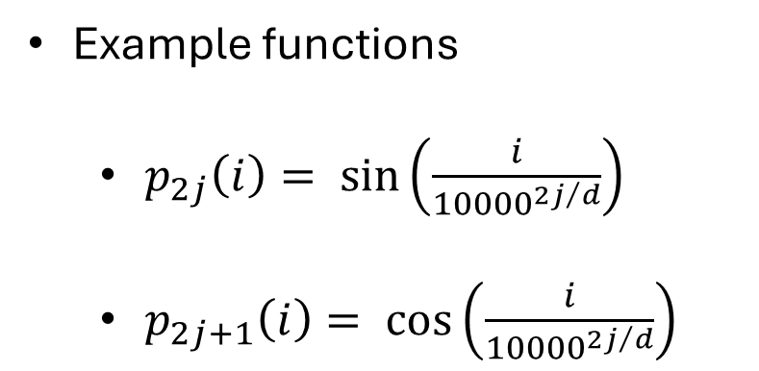

Positional encoding
Example functions
$p_{2j}\left(i\right)= \sin\left(\frac{i}{{10000}^{{2j}/d}}\right)$
$p_{2j+1}\left(i\right)= \cos\left(\frac{i}{{10000}^{{2j}/d}}\right)$
$$j=1,2,…,\left\lfloor d/2\right\rfloor$$

Slide 64
Positional encoding
Putting it all together (finally!)
Input embeddings
Output embeddings
the | cat | sat | on | the
Transformer Block
Transformer Block
Transformer Block
Transformer Block
Transformer Block
Transformer Block
the | cat | sat | on | the
Position encodings
i=1 | i=2 | i=3 | i=4 | i=5

Slide 65
Different types of transformers
Encoders, Decoders, Cross-attention

Slide 66
Different types of transformers
What we covered was embedding vector → token (word)
We ‘decoded’ the embedding vector
ChatGPT, Claude, etc are known as ‘decoder-only’ models
“mat”

Slide 67
Different types of transformers
We also have encoders: token → context embedding vector
“mat”
Encoders are useful where we have all the tokens (no prediction), we just need to map them to appropriate vectors
E.g. “the cat is on the table” → “le chat est sur la table”
Encoder model, without masking
Decoder model, with masking

Slide 68
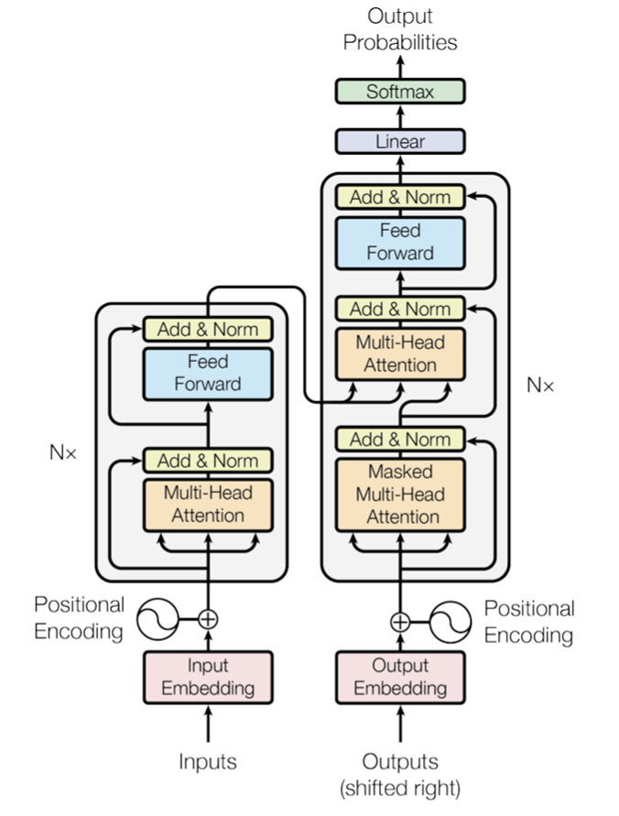
Different types of transformers
‘Attention is all you need’, Vaswani et al, 2017 , arXiv:1706.03762
“the cat is on the table” → “le chat est sur la table”
Encoder model, without masking
Decoder model, with masking

Slide 69
Different types of transformers
Encoder model
“the cat is on the table” → “le chat est sur la table”
Encoder model, without masking
Decoder model, with masking

Slide 70
Different types of transformers
Decoder model
“the cat is on the table” → “le chat est sur la table”
Encoder model, without masking
Decoder model, with masking

Slide 71
Different types of transformers
Cross attention
“the cat is on the table” → “le chat est sur la table”
Encoder model, without masking
Decoder model, with masking

Slide 72
Code example
Using PyTorch to build transformer layers

Slide 73
Code Example 2
Open up the Jupyter notebook ODSCEast2026_CodeExample2.ipynb in the github repository
https://github.com/dchoyle/ODSCEast2026_TransformerBootcamp/

Slide 74
Wrap up: What we learnt
Next token prediction is a powerful capability
To solve:
We map very large vocabularies to lower dimensional vectors
Each token in a sequence is initially represented by an embedding vector
We transform each token to a new vector that also encodes the surrounding context
The transformation model contains lots of parameters.
We learn the model parameters by training on very large datasets
Transformer models can be used to encode and/or decode tokens
We can have applications that use only decoder blocks, only encoder blocks, or both.

Slide 75
Wrap up: What to learn next
The hundred page language models book - Andriy Burkov
An introduction to Transformers – R. Turner, arXiv:2304.10557
Decoder-Only Transformers: The Workhorse of Generative LLMs
Cameron R. Wolfe. Substack article
Attention is all you need – Vaswani et al, arXiv:1706.03762
Paper Walkthrough: Attention Is All You Need
- Muhammad Ardi. Towards Data Science article

Slide 76
Wrap up: What I haven’t told you
The engineering challenges, scale, and costs associated with foundational model training are significant
Foundational models are general – but can be fine-tuned
Domain specific datasets
LoRA
Problem of hallucinations can be mitigated but not eliminated
RAG
CoT

Slide 77


Thank you for listening Questions?
github.com/dchoyle/ODSCEast2026_TransformerBootcamp
www.linkedin.com/in/davidchoyle/
www.hoyleanalytics.org

