Slide 1
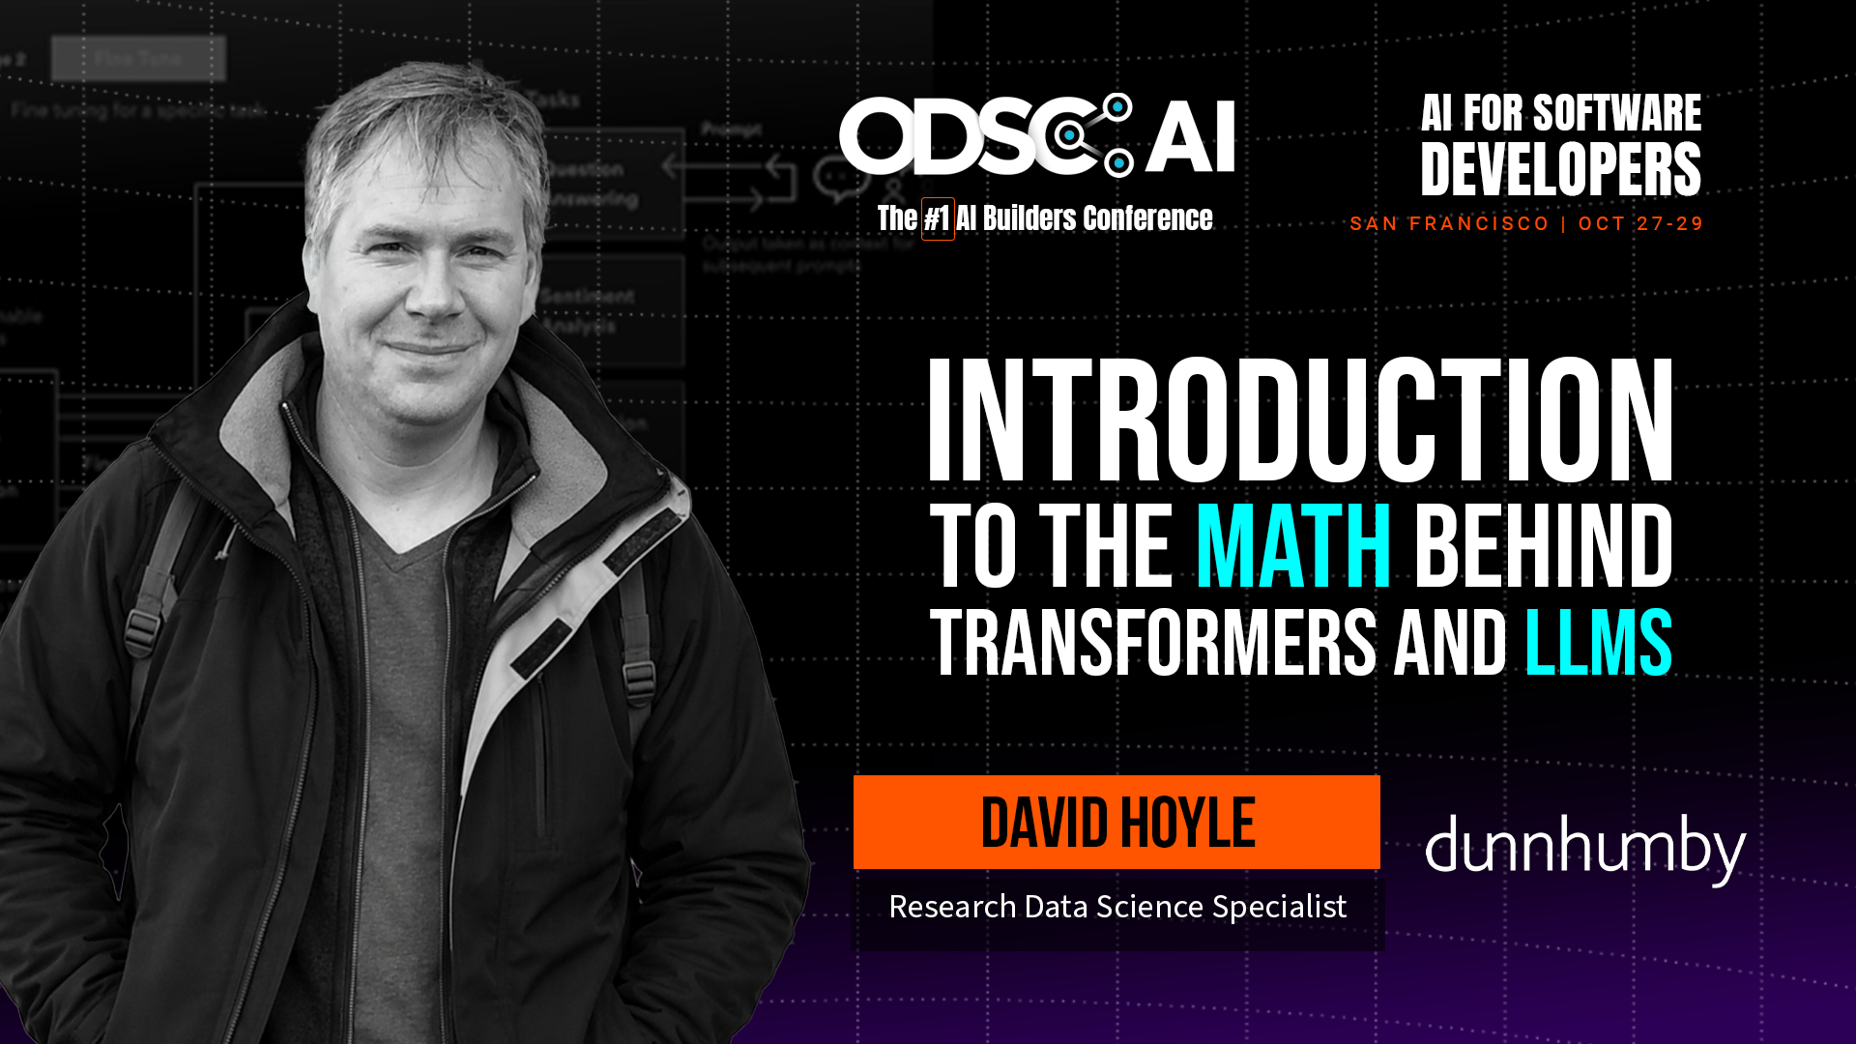
Notes:
Hello. My name is David Hoyle and I’m going to show you how not to be frightened of the mathematics inside Transformers and Large Language Models. Let’s begin.

Slide 2

Outline
github.com/dchoyle/ODSCWest2026_TransformerBootcamp
01 | What we will learn
02 | Predicting the next word
03 | Simple approaches
04 | Word embeddings
05 | Transformers
06 | Back to predicting the next word
07 | Different types of transformers
08 | Wrap-up
Notes:
So first an outline of what we are going to cover. We are going to start gentle and ramp up. We’ll briefly outline what we aim to learn from this session. Then we’ll move onto outlining what our actual modelling goal is here – that of next word prediction and why that is useful to be able to do. Next, we’ll walk through a simple but naïve approach to solving that goal, as it will highlight some key issues that any solution to next word prediction has to address. This will bring us onto word embeddings and transformers, where we’ll start to dig into the mathematical details. Having explained what word embeddings are and how transformers work mathematically, we’ll return to our task of next word prediction. Finally, we’ll end with a quick explanation of the different types of transformers and wrap-up what we have learnt. All the material for this tutorial session can be found in the public git hub repository at the link above

Slide 3
Outline
github.com/dchoyle/ODSCWest2026_TransformerBootcamp
01 | What we will learn
02 | Predicting the next word
03 | Simple approaches
04 | Word embeddings
05 | Transformers
06 | Back to predicting the next word
07 | Different types of transformers
08 | Wrap-up
Break
Notes:
Since this is a going to be a long session, we’ll take a short 5 minute comfort break in the middle.

Slide 4
Outline
github.com/dchoyle/ODSCWest2026_TransformerBootcamp
01 | What we will learn
02 | Predicting the next word
03 | Simple approaches
04 | Word embeddings
05 | Transformers
06 | Back to predicting the next word
07 | Different types of transformers
08 | Wrap-up
Code example
Code example
Notes:
We’ll also have two short code examples to illustrate things and help break up the session a bit. So let’s get started.

Slide 5

What we will learn
The mathematical challenges of next word prediction
The basic mathematical ideas behind Transformers
How Transformers predict words and sentences
To get comfortable at a high-level with how LLMs work at a mathematical level
To lose your fear of the science of LLMs
Notes:
What will we learn? Well, we’re obviously going to learn about some of the mathematics of predicting the next word in a sequence of words and why this is useful, but we’re also going to learn the basic mathematics behind what is called a Transformer that helps us do that next word prediction. Ultimately, the goal is to get you comfortable at a very high-level with how large language models works mathematically. And I will have done my job if by the end you have lost some of your fear of the science inside large language models.

Slide 6
What we will not learn
How to train foundational models
How to build transformer-based chatbots
How to prompt
Agentic AI
How to make $$$Millions from AI
Notes:
What we will not learn is how to train large foundational language models. In fact, I’m hardly going to mention training at all. I’m just going to assume you understand the concept of training a machine learning model using training data.
We’re not going to be building any chatbots, nor are we going to become expert prompters or start building agentic AI systems.
And I’m afraid this talk isn’t going to make you rich either

Slide 7

What I assume you know
Basic linear algebra, e.g. matrix multiplication as a transformation
Basic machine learning, e.g. training a model by minimizing a loss function
Notes:
But you are going to have to know some stuff already. I’m going to assume you know some basic linear algebra, you’re comfortable with vectors and matrices and matrix multiplication and what a matrix represents. Finally, I’m going to assume you’ve done some supervised machine learning before and you are familiar with the idea of training model parameters by minimizing some loss function.

Slide 8
Predicting the next word
What this enables, tokens and sequences
Notes:
Now we’ve got the pre-requisites out of the way we’re going to start with outlining our main goal, which is building a model that can predict the next word in a sequence. This will be our guiding aim throughout the whole process of learning about attention, transformers, decoders and so on.
I’ll explain why being able to predict the next word is extremely useful and leads to powerful AI systems such as ChatGPT and Claude that you may have already used, but for now let’s start simple.

Slide 9
Predicting the next word
What are we trying to achieve?
  The cat sat on …….
Notes:
Let’s look at a familiar phrase in the English language, “The cat sat on ….”

Slide 10
Predicting the next word
What are we trying to achieve?
  The cat sat on the
  The cat sat on the mat
Notes:
You’ll probably have predicted that the next word should be “the” given the start of that sentence.
We can then take the word “the” and append it to end of the partial sentence. We now make a prediction of the new next word that should follow given our new extended partial sentence.
And obviously, the most likely next word is “mat”. We’ve been able to extend the initial partial sentence by two extra words. We could continue and build up a whole new sentence if we so wished.
Why is this useful to me, unless I want to use AI to write a novel or some poetry? It’s to do with what words are in a sentence.

Slide 11
Words as tokens
Words are the natural units of a sentence.
We call these units “tokens”
Our modelling challenge is “predict the next token in given the preceding sequence of tokens”
Tokens don’t have to be complete words:
  quick brown fox jumped over → [quick, brown, fox, jump, ed, over]
Notes:
Sentences are made of words. So words are the natural units into which we can decompose a sentence. We call these units tokens. So a sentence is made up of a collection of tokens.
We could choose to use smaller tokens, for example sub-words or split off the ending of a word such as ‘ing’ or ‘ed’ to produce two tokens. So in this example the word “jumped” has been split into two tokens, “jump” and “ed”. In fact, it is more efficient to do this and modern LLMs use what is called byte-pair tokenization to construct the tokens. Typically, for English-language based LLMs the tokenization will be such that we have around 4 tokens for every 3 words, or 0.75 words per token.

Slide 12
Sequences
We find sequences of tokens everywhere, not just in language
Sequence can be structured code, including tool calls
{“tool_call”:{ “tool_name”: “flight_booking_api”, “arguments”: { “destination”: “LHR”, “max_price”: 400, “seat_preference”: “window”}
...}
Agentic AI:
Pre-trained model → Instruction following model → Agent
Today
Supervised Fine Tuning
RLHF
Output sequence of next tokens, train on token prediction accuracy
Output sequence of next tokens, train on token prediction accuracy
Output sequence of next tokens, train on action reward
Notes:
But a token is a just a thing and a sequence is just a collections of things. So we realise that many things in life are just sequences of tokens. For example, a movie is just a sequence of images. An image is just a collection of pixels with colour and hue attributes, a protein is just a sequence of amino-acids.
That sequence of tokens could also be a sequence of structured code statements, including API calls to tools that take actions. We now have the beginnings of AgenticAI.
Going from a language model that predicts the next token to an Agent requires some additional sophisticated training steps.
But in all the extra steps we are using model to output a sequence of next tokens. What differs is how we do the training.
We now see that if we can learn how to predict the next token, we will have developed a very powerful technology that has many many applications in very different areas. And understanding how LLMs predict the next word is just a means to understanding how to solve the more general problem of next token prediction. So for the rest of this presentation I’m going to focus on explaining just next word prediction.

Slide 13
Simple approaches
Naïve models that are wrong and what we can learn from that
Notes:
And to begin our journey into building a mathematical model that is capable of predicting the next word in a sentence, we are going to start by trying a very naïve approach. Because by getting it wrong to start with we’ll uncover which bits of the problem are hard to solve and why.

Slide 14
Simple approach:
Example: “The cat sat on the mat”
5 words in the vocabulary ⇒ represent each word as 5-dimensional vector
“the” = (1,0,0,0,0)
“cat” = (0,1,0,0,0)
“sat” = (0,0,1,0,0)
“on” = (0,0,0,1,0)
“mat” = (0,0,0,0,1)
Notes:
Let’s return to our simple example, “the cat sat on the mat”. There are five distinct words in that sentence. So, if that was the entirety of our training data we would have a vocabulary size of 5. And we could represent each word as a 5-dimensional vector.
For example, we can represent the word “cat” by the vector (0,1,0,0,0), and the 1 at position 2 in the vector tells us that the word cat is the second word in whole vocabulary.

Slide 15
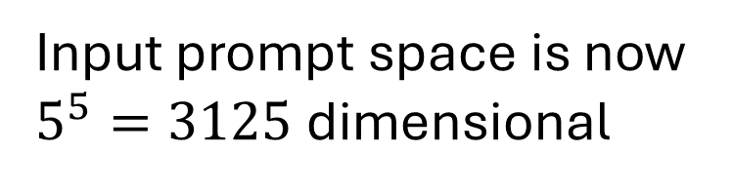
Simple approach:
Prompt: “The cat sat on the”
We could represent the 5-word initial prompt as combination of the individual word vectors
the | cat | sat | on | the
1 | 0 | 0 | 0 | 1
0 | 1 | 0 | 0 | 0
0 | 0 | 1 | 0 | 0
0 | 0 | 0 | 1 | 0
0 | 0 | 0 | 0 | 0
Input prompt space is now $5^{5}=3125$ dimensional
Prompt =
Notes:
Ok, so we have a simple way of numerically representing each word in our vocabulary, but what happens if we use the same approach to represent our partial sentence, our prompt “The cat sat on the” ?
We could just represent the prompt by combining the vectors from the individual words of the prompt. Doing so gives the table here. You can see that although we started with a small vocabulary, the size of the input prompt space is very large.
You can probably see where this simple approach is going wrong.

Slide 16
Simple approach: Issues
Problems:
Starting dimensionality is high
  Our vocabulary is large, e.g. 170000 – 700000 words
We need to work with long contexts → large prompt representation
Solution:
  Reduce the dimensionality
  Represent words using vectors that incorporate the preceding context
Use word embedding vectors
Create context-aware word embedding vectors
Notes:
Firstly, real language has much bigger vocabularies than just 5 words. For example, the English language is estimated to consist of between 170,000 and 700,000 words, depending on which dictionary you use. That would lead to very large vectors and a very large input prompt space, one that would be too big to build a model of. For more practical next-word prediction models we need to be working with much smaller dimensional vectors.
Secondly, we will want to work with long input prompts or contexts, as even in simple sentences the words 10 or more places back can influence the meaning of the sentence. Again, this would lead to very large numerical representations of the prompt. In machine learning we much prefer to use smaller vectors of features with fixed dimensionality. It would be a lot better if we could use a vector to not just represent a word, but the whole prompt. We would like to be able to construct vectors that incorporated information about the context that had occurred before the word the vector was representing. In other words, we need “context aware vectors” to represent each word.
And that is how we will solve the problem. We will reduce the dimensionality, by mapping our sparse vectors of ones and zeros into much shorter, denser vectors. We will do that using word embeddings.
We will then modify or “transform” each vector in our prompt to take into account the preceding words, to give us context aware embedding vectors.

Slide 17
Word embeddings
Reducing the dimensionality
Notes:
Clearly the next stop in our journey needs to be learning about word embeddings. What they are and how we can create them. And that is what we are going to do now.

Slide 18
Word embeddings
Reduce to a fixed lower dimensionality
3-dimensional
5-dimensional
cat
“the” = (1,0,0,0,0)
“cat” = (0,1,0,0,0)
“sat” = (0,0,1,0,0)
“on” = (0,0,0,1,0)
“mat” = (0,0,0,0,1)
the
Map
on
sat
mat
Notes:
Our simple approach had each of the five words in our vocabulary represented by a five-dimensional vector. We have five words, so we have five data points. We can map those five data points, into a 3-dimensional space. We can learn the mapping perhaps using a neural network auto-encoder approach, where we use the vectors in the 3-dimensional space to reconstruct or predict the words in the original 5-dimensional space using our neural network and we train the neural network by minimizing the reconstruction error. Once we have trained the auto-encoder we have mapped all five of our 5-dimensional vectors into five 3-dimensional vectors.

Slide 19
Word embeddings
Reduce to a fixed lower dimensionality
Word2Vec: 300-dimensional
GPT-3 (Davinci): 12288-dimensional
LlaMA 3.1-70B: 8192-dimensional
GPT-4.5: 3072-dimensional
170000 – 700000 dimensional
Map
All of English language
Notes:
For real-world word embeddings we follow the same principle, it is just we have much bigger vocabulary, a much bigger training set, and we map into a space bigger than just 3 dimensions. Modern English-language LLMs don’t use the full English vocabulary but still use something in the order of 30,000 to 50,000 words. One of the pioneering pieces of work on word embeddings, Word2Vec, mapped those English-language words into a 300-dimensional space. That is a huge reduction in dimensionality, but it still means that each word is represented by a 300-dimensional vector.
Modern LLMs also represent tokens using embedding vectors, but those embedding vectors are typically more than 300-dimensional but still represent a large reduction in dimensionality compared to the size of the vocabularies we are using. For many LLMs that embedding mapping is learnt as part of the overall model.

Slide 20
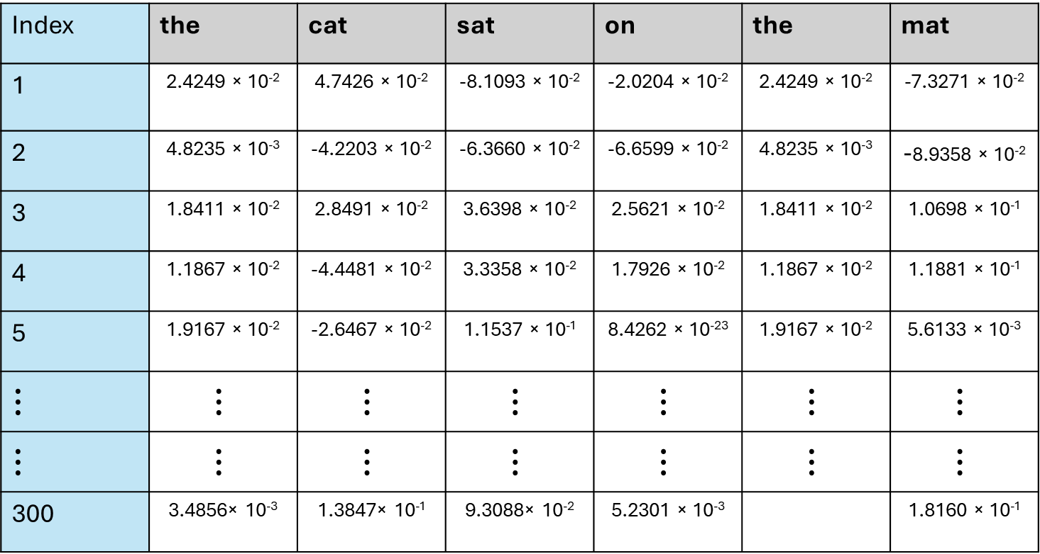
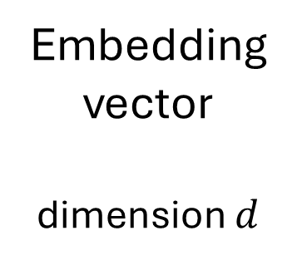
Word embeddings
Tokens
Index | the | cat | sat | on | the | mat
1 | 2.4249 × 10⁻² | 4.7426 × 10⁻² | -8.1093 × 10⁻² | -2.0204 × 10⁻² | 2.4249 × 10⁻² | -7.3271 × 10⁻²
2 | 4.8235 × 10⁻³ | -4.2203 × 10⁻² | -6.3660 × 10⁻² | -6.6599 × 10⁻² | 4.8235 × 10⁻³ | -8.9358 × 10⁻²
3 | 1.8411 × 10⁻² | 2.8491 × 10⁻² | 3.6398 × 10⁻² | 2.5621 × 10⁻² | 1.8411 × 10⁻² | 1.0698 × 10⁻¹
4 | 1.1867 × 10⁻² | -4.4481 × 10⁻² | 3.3358 × 10⁻² | 1.7926 × 10⁻² | 1.1867 × 10⁻² | 1.1881 × 10⁻¹
5 | 1.9167 × 10⁻² | -2.6467 × 10⁻² | 1.1537 × 10⁻¹ | 8.4262 × 10⁻²³ | 1.9167 × 10⁻² | 5.6133 × 10⁻³
$$⋮$$ | $$⋮$$ | $$⋮$$ | $$⋮$$ | $$⋮$$ | $$⋮$$ | $$⋮$$
$$⋮$$ | $$⋮$$ | $$⋮$$ | $$⋮$$ | $$⋮$$ | $$⋮$$ | $$⋮$$
300 | 3.4856× 10⁻³ | 1.3847× 10⁻¹ | 9.3088× 10⁻² | 5.2301 × 10⁻³ |  | 1.8160 × 10⁻¹
Embedding vector
dimension $d$
Word2Vec model = “fasttext-wiki-news-subwords-300”
Notes:
The table here shows Word2Vec embedding vectors for the words in our earlier phrase “the cat sat on the mat”. Each column represents the 300-dimensional embedding vector corresponding to the word (or token) at the top of the column. The embeddings vectors were constructed by training on a large subset of Wikipedia news articles. We can get access to those Wikipedia-based word embeddings through the genism python package.

Slide 21
Code example 1
Working with word embeddings
Notes:
This brings us neatly onto our first code example, where we will work with word embeddings.

Slide 22
Code Example 1
Open up the Jupyter notebook ODSCWest2026_CodeExample1.ipynb in the github repository
https://github.com/dchoyle/ODSCWest2026_TransformerBootcamp/
Notes:
The code example is in the Jupyter notebook, CodeExample1 in the github repository.

Slide 23
Transformers
Creating context aware embeddings
Notes:
So, we have solved our first issue, reducing the dimensionality of our vectors. But let’s see if our new word embeddings solve our second issue. Are embedding vectors aware of the preceding sentence? Let’s find out.

Slide 24
Transforming embeddings
the | cat | sat | on | the
Predict the next word
?
Input vector from preceding token into multi-class classifier
Each vector knows nothing about the broader context of the preceding words
Need new vectors for each token that take into account the preceding context
  We will make a Transformer
For now, create new vectors that take into account the context of the whole sentence
Notes:
Here, we have the embedding vectors of the words in our phrase represented by columns in a table. I’ve highlighted the embedding vector for the last word “the” in a darker shade of blue because what I’d like to be able to do is to be able predict the next word just using that dark blue embedding vector. In principle that is just a MachineLearning101 task. We could potentially do that using a standard off-the-shelf multi-class classifier which takes the dark blue embedding vector as an input feature vector. Once we got hold of a training data set we could train the classifier and then we’d be good to go.
The problem is that that dark blue embedding vector knows nothing about the preceding sentence. We just looked it up in the Word2Vec dataset. It contains information only about the word “the”. It contains no information about the preceding sentence, so there is no way it can accurately predict the next word.
We need to create a new dark blue embedding vector that takes into account the preceding context. We will need to transform those starting input embedding vectors.
We will need to build a Transformer, and that is what we are going to learn how to do.
Whilst we ultimately want to learn how to predict the next word given just the preceding sentence or context, to start with we’re going to learn how to predict a word given all of the surrounding context, and then later we’ll come back to learning how to make predictions just using the preceding sentence.

Slide 25
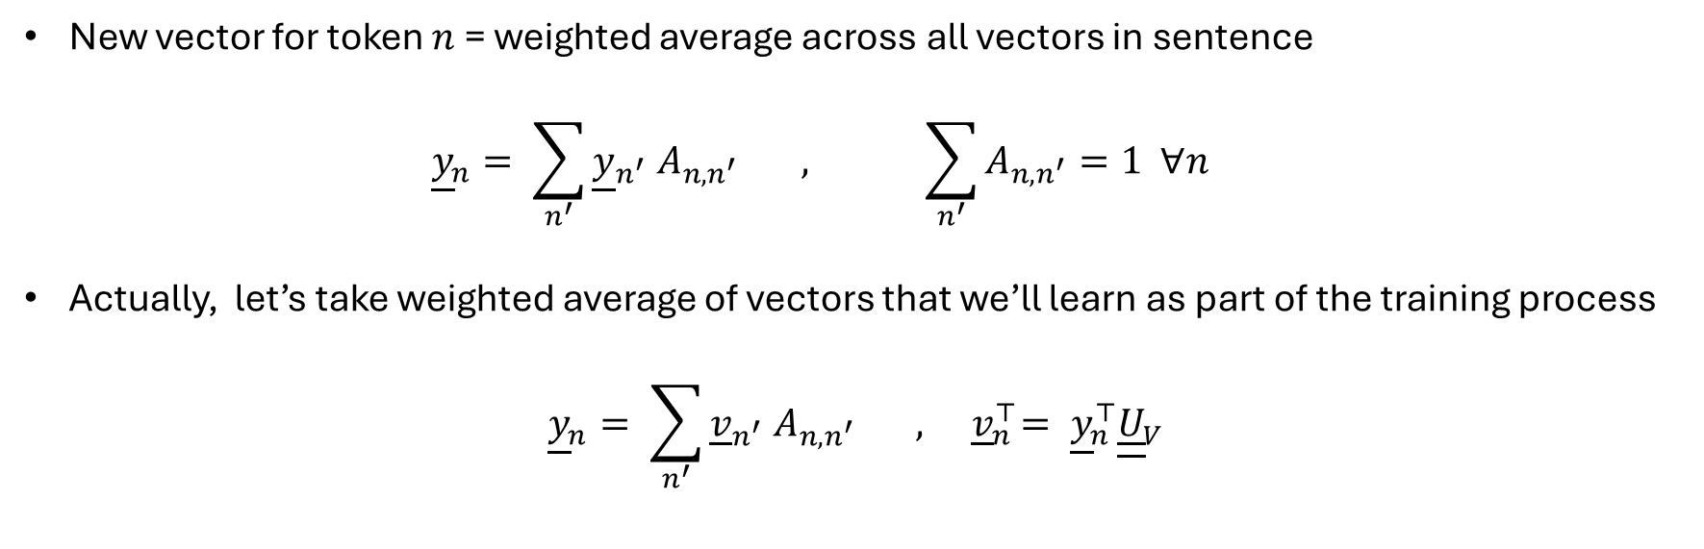
Attention
Input embeddings
Updated embeddings
the | cat | sat | on | the
the | cat | sat | on | the
New vector for token $n$ = weighted average across all vectors in sentence
  $${\underline{y}}_{n}= \sum_{n^{′}}{{\underline{y}}_{n^{′}} A_{n,n^{′}} , \sum_{n^{′}}{A_{n,n^{′}}=1 ∀n}}$$
Actually, let’s take weighted average of vectors that we’ll learn as part of the training process
$${\underline{y}}_{n}= \sum_{n^{′}}{{\underline{v}}_{n^{′}} A_{n,n^{′}}} , { \underline{v}}_{n}^{⊤}= {{\underline{y}}_{n}^{⊤}\underline{\underline{U}}}_{V}$$
Notes:
We said that we needed to transform the starting input embedding vectors into new embedding vectors that take into account the surrounding context, or in other words take into account the surrounding vectors, but how do we do that?
Easy. We just take a weighted average of the surrounding vectors. The weighs for that weighted average are stored in the matrix elements A n, n-dashed. The element A n, n-dashed tells us how much attention to the vector at n-dashed we should be paying when we construct the new embedding vector for token n. Hence, we call the matrix elements attention weights, and the whole method of constructing new embedding vectors is known as “Attention”.
Actually, we do something slightly different. We don’t take a weighted average of the existing input embedding vectors, we take a weighted average of a set of new vectors v, which we model as a linear transformation of the input embedding vectors. The transformation matrix U subscript v we consider to be a parameter of the transformer model and so we learn it through the training process. And so we’re good to go. Not quite. Where are we going to get the attention weights from. Where do the matrix elements A n, n-dashed come from?

Slide 26
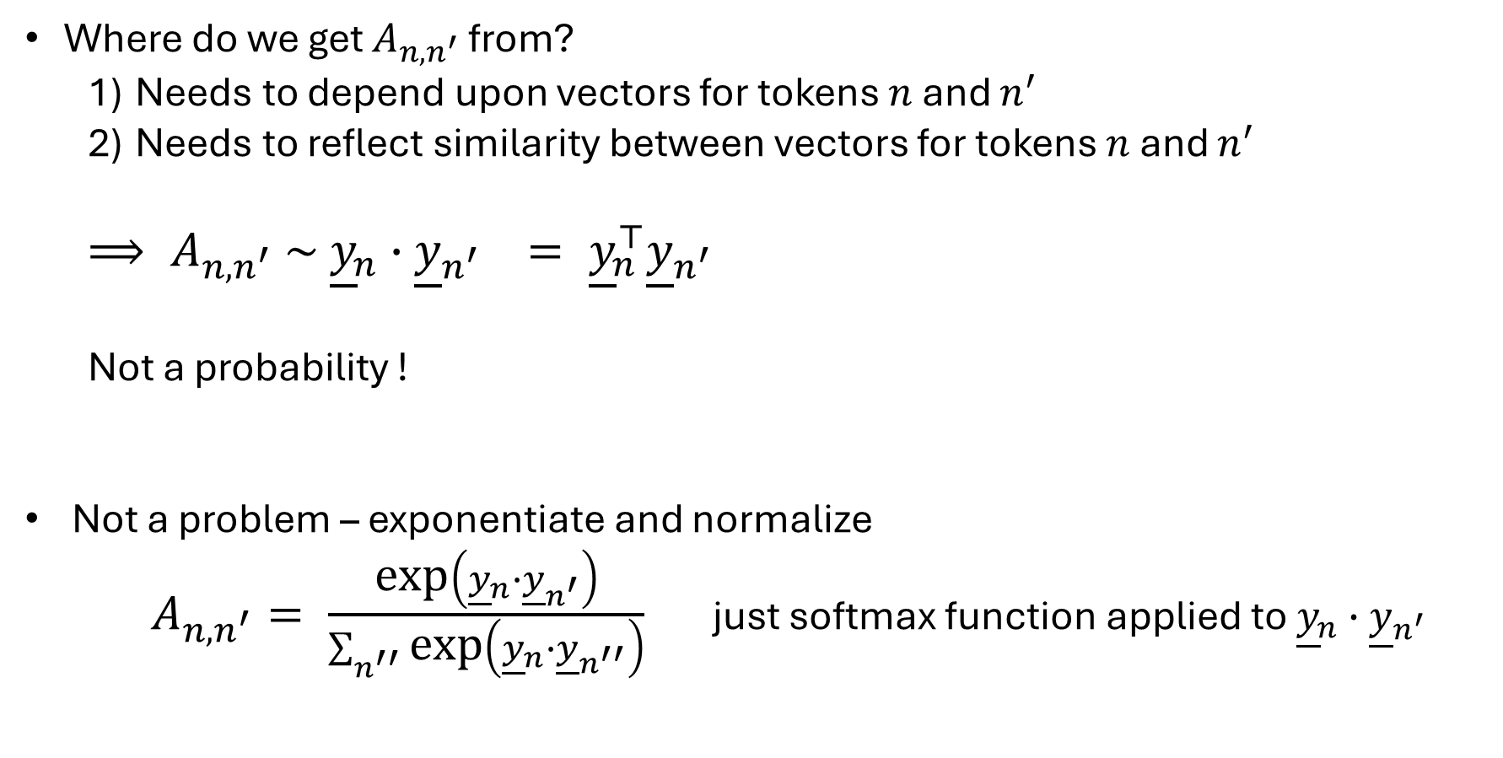
Self-Attention
Where do we get $A_{n,n^{′}}$ from?
  Needs to depend upon vectors for tokens $n$ and $n^{′}$
  Needs to reflect similarity between vectors for tokens $n$ and $n^{′}$
  $⟹ A_{n,n^{′}} \sim {\underline{y}}_{n}∙{\underline{y}}_{n^{′}} = {\underline{y}}_{n}^{⊤}{\underline{y}}_{n^{′}}$
  Not a probability !
Not a problem – exponentiate and normalize
  $A_{n,n^{′}}= \frac{\text{exp}\left({\underline{y}}_{n}∙{\underline{y}}_{n^{′}}\right)}{\sum_{n^{′′}}{\text{exp}\left({\underline{y}}_{n}∙{\underline{y}}_{n^{′′}}\right)}}$ just softmax function applied to ${\underline{y}}_{n}∙{\underline{y}}_{n^{′}}$
Notes:
What do we need mathematically from the attention weights? We’ll we need A n, n-dashed to depend upon the tokens at n and n-dashed. Secondly, we still want the updated embedding vector to represent the its token, and so if the updated vector at n pays a lot of attention to the token at n-dashed we want that to be because tokens n and n-dashed are similar.
How do we capture similarity between vectors in mathematics? We could use the inner-product between the input embedding vectors as a means of calculating the self-attention weights.
The only problem with that is that the inner product isn’t a probability. It can even be negative, if the two vectors are dis-similar.
Not problem. We just use another common machine learning trick – softmax. We just exponentiate the values and normalize. So now we have a mechanism to calculate self-attention weights. We’re done right ?

Slide 27
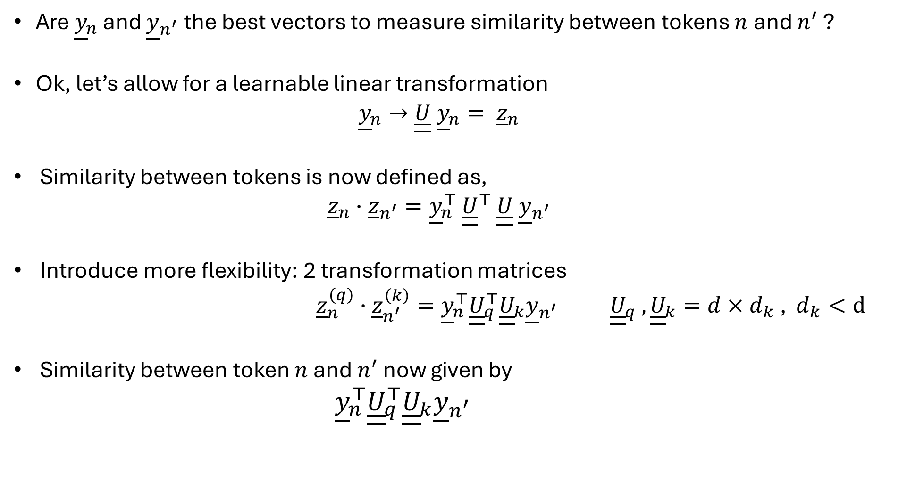
Self-Attention
Are ${\underline{y}}_{n}$ and ${\underline{y}}_{n^{′}}$ the best vectors to measure similarity between tokens $n$ and $n^{′}$ ?
Ok, let’s allow for a learnable linear transformation
  $${\underline{y}}_{n}→\underline{\underline{U}} {\underline{y}}_{n}= {\underline{z}}_{n}$$
Similarity between tokens is now defined as,
  $${\underline{z}}_{n}∙{\underline{z}}_{n^{′}}={\underline{y}}_{n}^{⊤ }{\underline{\underline{U}}}^{⊤ }\underline{\underline{U}} {\underline{y}}_{n^{′}}$$
Introduce more flexibility: 2 transformation matrices
${\underline{z}}_{n}^{\left(q\right)}∙{\underline{z}}_{n^{′}}^{\left(k\right)}={\underline{y}}_{n}^{⊤}{\underline{\underline{U}}}_{q}^{⊤}{\underline{\underline{U}}}_{k}{\underline{y}}_{n^{′}}{ \underline{\underline{U}}}_{q} , {\underline{\underline{U}}}_{k}=d×d_{k} \text{, }d_{k}<d$
Similarity between token $n$ and $n^{′}$ now given by
${\underline{y}}_{n}^{⊤}{\underline{\underline{U}}}_{q}^{⊤}{\underline{\underline{U}}}_{k}{\underline{y}}_{n^{′}}$
Notes:
Not quite. We want the self-attention weights to take into account similarity between the tokens, but are the input embedding vectors the best vectors to use in a similarity calculation?
If we transform the input vectors into new vectors z and make the transformation matrix U part of the model parameters which can be learnt through model training, then we allow the model to discover what is the best way to measure similarity between the input embedding vectors.
The similarity between tokens is now calculated as the inner product between these new z vectors.
We actually use two transformation matrices when calculating the similarity between these new z vectors, to give the transformer model more flexibility. For the sake of brevity, I’m not going to go into the reason for doing that here, other than to say that because we now have 2 transformation matrices Uq and Uk and we have two new transformed vectors zq and zk, which are called query and key vectors. Our similarity calculation is just the inner-product between the query vector for token n with the key vector for token n-dashed.
In mathematical form, that similarity is now given by the following equation, and it is this equation that we then stick into our softmax function to get actual self-attention probabilities or weights.

Slide 28
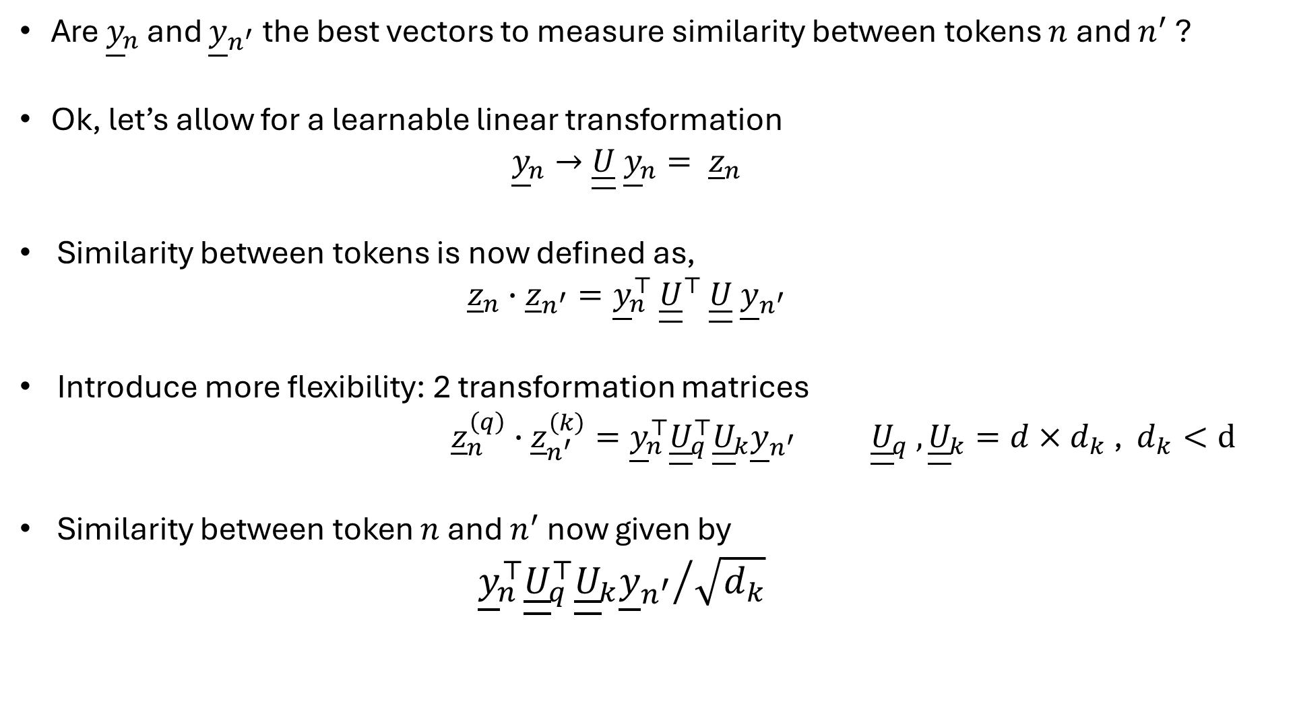
Self-Attention
Are ${\underline{y}}_{n}$ and ${\underline{y}}_{n^{′}}$ the best vectors to measure similarity between tokens $n$ and $n^{′}$ ?
Ok, let’s allow for a learnable linear transformation
  $${\underline{y}}_{n}→\underline{\underline{U}} {\underline{y}}_{n}= {\underline{z}}_{n}$$
Similarity between tokens is now defined as,
  $${\underline{z}}_{n}∙{\underline{z}}_{n^{′}}={\underline{y}}_{n}^{⊤ }{\underline{\underline{U}}}^{⊤ }\underline{\underline{U}} {\underline{y}}_{n^{′}}$$
Introduce more flexibility: 2 transformation matrices
${\underline{z}}_{n}^{\left(q\right)}∙{\underline{z}}_{n^{′}}^{\left(k\right)}={\underline{y}}_{n}^{⊤}{\underline{\underline{U}}}_{q}^{⊤}{\underline{\underline{U}}}_{k}{\underline{y}}_{n^{′}}{ \underline{\underline{U}}}_{q} , {\underline{\underline{U}}}_{k}=d×d_{k} \text{, }d_{k}<d$
Similarity between token $n$ and $n^{′}$ now given by
${{\underline{y}}_{n}^{⊤}{\underline{\underline{U}}}_{q}^{⊤}{\underline{\underline{U}}}_{k}{\underline{y}}_{n^{′}}}/{\sqrt{d_{k}}}$
Notes:
In a lot of the research literature you will see an additional factor of the square root of key vector dimension in the denominator of the query-key similarity calculation. This is done to help with the stability of the training process. It makes the variance of the query-key inner product an order 1 quantity. This is desirable from a training point of view. From a mathematical point of view we can just absorb that square root factor into the definition of the U matrices. Since I’m only teaching about the mathematics of Transformers, not the nitty-gritty details of how to get the model training to work I can and will absorb that square root factor into the U matrices. But don’t worry, the square root factor is there implicitly, I not teaching you something different to the research literature. It’s just that for writing and explaining about transformers it is easier and cleaner not to show the square root. Phew! That’s a lot of mathematical detail. So let’s put it altogether and summarize.

Slide 29
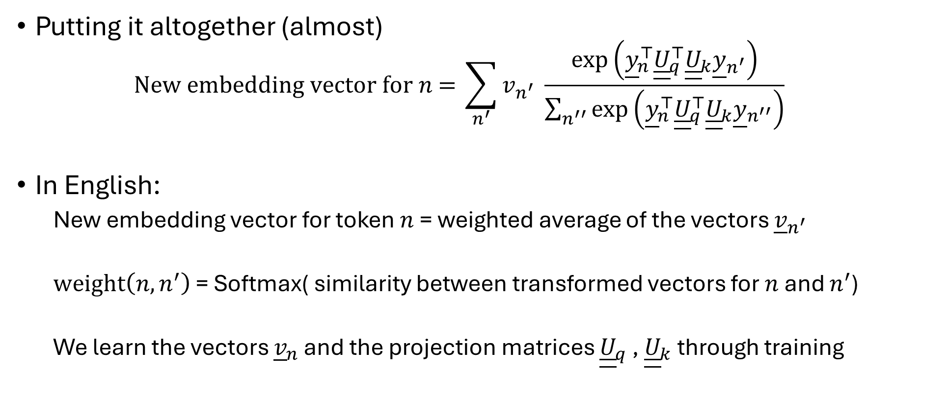
Self-Attention
Putting it altogether (almost)
  $$\text{New embedding vector for }n\text{ = }\sum_{n^{′}}{v_{n^{′}} \frac{\text{exp}\left({\underline{y}}_{n}^{⊤}{\underline{\underline{U}}}_{q}^{⊤}{\underline{\underline{U}}}_{k}{\underline{y}}_{n^{′}}\right)}{\sum_{n^{′′}}{\text{exp}\left({\underline{y}}_{n}^{⊤}{\underline{\underline{U}}}_{q}^{⊤}{\underline{\underline{U}}}_{k}{\underline{y}}_{n^{′′}}\right)}}}$$
In English:
  New embedding vector for token $n$ = weighted average of the vectors ${\underline{v}}_{n^{′}}$
  $\text{weight}\left(n,n^{′}\right)$ = Softmax( similarity between transformed vectors for $n$ and $n^{′}$)
  We learn the vectors ${\underline{v}}_{n}$ and the projection matrices ${\underline{\underline{U}}}_{q}$ , ${\underline{\underline{U}}}_{k}$ through training
Notes:
Given some input embedding vectors y_n that represent the tokens in a sentence, we construct new, context-aware, embedding vectors using the following formula.
In words, that formula is a lot simpler to understand. We calculate the new embedding vectors as a weighted average of vectors v. The weights are calculated from a softmax function applied to the similarity between the query and key vectors for the two tokens we are comparing. The query and key vectors are linear transformations applied to the input embedding vectors. The transformation matrices are just model parameters we learn through training the model. That’s it. It’s that simple. That famous self-attention mechanism that everyone talks about, that’s in a famous paper from Google, and is at the heart of LLM really is that simple. That verbal description is all I need you to remember and all you need to take away from this section of the slides. But I’m afraid we’re not finished yet.

Slide 30
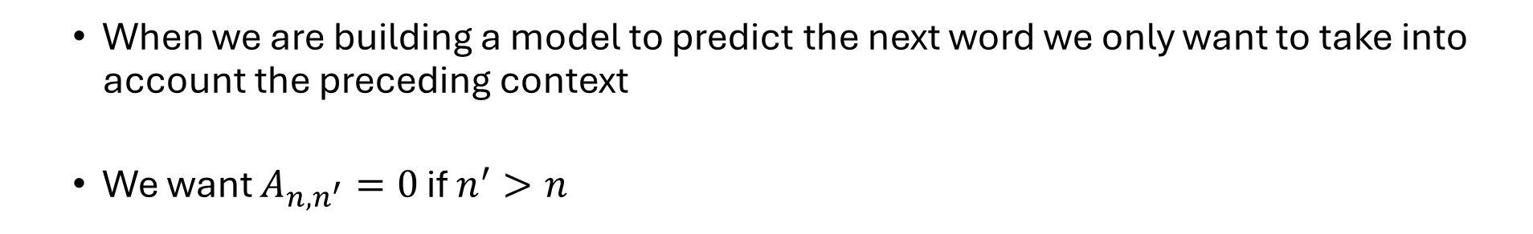
Attention: Masking
  When we are building a model to predict the next word we only want to take into account the preceding context
  We want $A_{n,n^{′}}=0$ if $n^{′}>n$
 | the | cat | sat | on | the
the | 1.0 | 0 | 0 | 0 | 0
cat | 0.2 | 0.8 | 0 | 0 | 0
sat | 0.35 | 0.15 | 0.5 | 0 | 0
on | 0.08 | 0.12 | 0.34 | 0.46 | 0
the | 0.2 | 0.25 | 0.30 | 0.05 | 0.2
We can easily achieve this by putting correspond ‘similarity’ values equal to $−∞$ before applying softmax operation
Notes:
I need to return something I mentioned earlier. I’ve said that we ultimately want to predict the next word given the preceding sentence. However, when explaining attention and self-attention we actually focused on how we could construct updated embedding vectors using all of the surrounding tokens, not just the preceding tokens. We’re going to modify that.
If we want to use just the preceding tokens when performing a self-attention calculation, we can just set the appropriate attention weights to zero. So our attention weight matrix would look like this. This is called masking. There are other patterns of masking we might want to use, but we always use the same simple idea – if we don’t want a token to be used in the vector update calculation we just set the corresponding attention weight to zero. We mask it out.
We can easily make an attention weight equal to zero when we apply the softmax calculation by simply setting the query-key inner product result to minus infinity. When we take the exponential of minus infinity in the softmax calculation we will automatically get a zero for the attention weight. Excellent, but I’m afraid there is more to learn about transformers. So let’s continue.

Slide 31
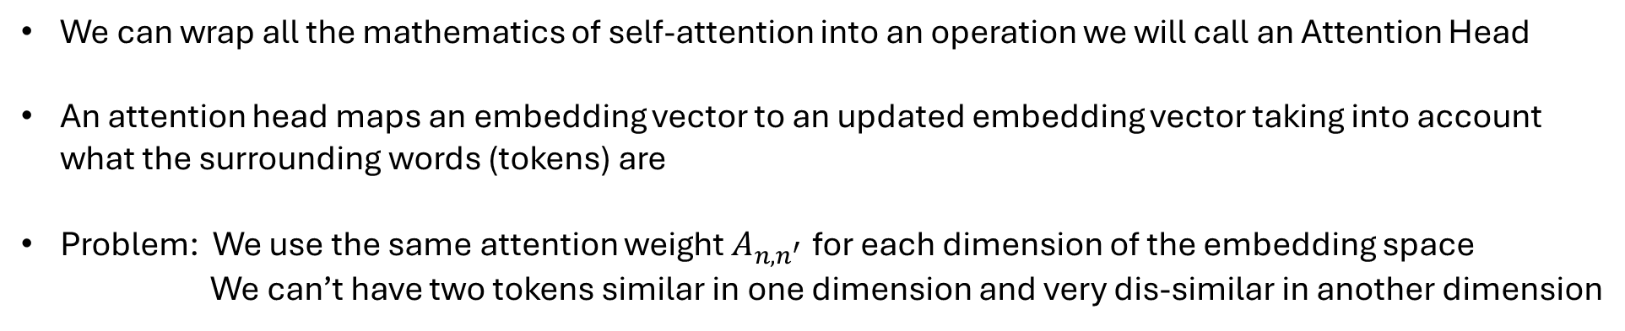
Attention Head
Input embedding vector for token
Output embedding vector for token
Attention Head
We can wrap all the mathematics of self-attention into an operation we will call an Attention Head
An attention head maps an embedding vector to an updated embedding vector taking into account what the surrounding words (tokens) are
Problem: We use the same attention weight $A_{n,n^{′}}$ for each dimension of the embedding space
      We can’t have two tokens similar in one dimension and very dis-similar in another dimension
Notes:
We can wrap up all those mathematical details about self-attention into single schematic box, which I’ll call an attention head. The attention head takes an embedding vector as input and outputs a transformed embedding vector that has taken into account the surrounding tokens, possibly with masking. The purpose of the transformed vector is to make the job of predicting the next token easier, more accurate. We need each element of that transformed embedding vector to be optimal for the purposes of next token prediction.
The problem we have is that we use the same attention weights when calculating all of the elements of the transformed vector. It may be that we want to consider two tokens to be very similar when calculating elements 1 to 20 of the output vector, but for elements 21 to 40 we may want to consider the two tokens as very dis-similar. Our single set of attention weights don’t give us that flexibility. What can we do?

Slide 32
Multi-headed Self-Attention
Output embedding vector for token
Input embedding vector for token
Attention Head
Concatenation Operator, e.g. stacking or take average
Attention Head
Attention Head
We solve this by having multiple (H) self-attention heads.
We combine the output vectors of all the attention heads into a single vector
Typically, we make output dimension of each attention head d/H
Notes:
Easy. We just use multiple of these attention heads and allow different attention heads to focus on transforming different elements of the input embedding vector. Again, we allow the model training to work out which attention head should focus on which parts of the input vector. We call this “multi-headed self-attention”, for obvious reasons.
Each attention head outputs a transformed vector, so we need to combine those output vectors into a single final output vector. We could do that by simply taking the average of the output vectors if they are all of the correct final dimension. More commonly, each attention head is set to output a smaller vector and we simply stack those smaller vectors to get our final vector of the required dimension. The advantage of having the attention heads output smaller length vectors is that moving to multi-attention head setup needn’t lead to a massive increase in the number of model parameters. Great! We’ve covered multi-headed self-attention, surely we’re done. There can’t be anything more to learn about Transformers. I’m afraid not.

Slide 33
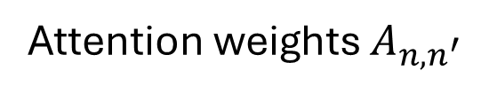
Neural Network Sub-Layer
Input embeddings
Output embeddings
the | cat | sat | on | the
the | cat | sat | on | the
Multi-headed attention
Attention weights $A_{n,n^{′}}$
Attention process is column-wise (token-to-token)
We haven’t allowed the different rows within a column to interact when producing the updated embedding
Notes:
Everything we discussed so far when transforming input embedding vectors to context-aware embedding vector has focused on column wise operations. The self-attention weights help us combine vectors from different tokens to produce an output vector that we hopefully be optimal to next token prediction.
But it can’t really be optimal for what we want because so far we haven’t been allowed to combine values from different rows. By combining different elements within a vector we may be able to produce an even better output vector.

Slide 34
Neural Network Sub-Layer
Embedding vector
Output Embedding vector
Neural Network
Parameters of neural network are learnt as part of the overall model training
Notes:
What we want to do is take an embedding vector, combine the different elements using possibly non-linear transformations and output a new vector.
That is precisely what a feed-forward neural network does. So we also include a feed-forward neural network in our transformer and simply treat the neural network parameters as just more transformer parameters to be learnt through model training.

Slide 35
Neural Network Sub-Layer: Mixture of Experts
Neural Network
Embedding vector
Output Embedding vector
Gating Router: decides TopK weights
TopK weighted average, e.g. top 2 experts
Neural Network
Neural Network
Notes:
Just like we used multiple attention heads to allow for specialization when do the column-wise interaction, we actually use multiple neural networks and take a weighted average to produce our output embedding vector. Each separate neural network is an expert that can specialize on processing certain input vectors. The weighted average is called a mixture of experts.

Slide 36
The Transformer Block
Transformer Block
Input embeddings
Output embeddings
Multi-headed attention
Neural Network
Layer
the | cat | sat | on | the
the | cat | sat | on | the
What are these gaps?
Notes:
We combine the multi-headed self-attention layer with the feed-forward neural network layer schematically into what we call a Transformer block. We refer to the multi-headed attention part and the neural network part as sub-layers of the block. As before the transformer block takes embedding vectors as input and creates output embedding vectors that are more suited to the task of next token prediction.
But wait. You’re suspicious by now. I’ve tricked you a couple of times and you’ve probably noticed some deliberate gaps in the transformer block. You’re right. There’s more. We need to some extra layers. These are technical layers which make the training process more stable and efficient, so I’m not going to explain them here.

Slide 37
The Transformer Block
Transformer Block
Input embeddings
Output embeddings
Layer Normalization
Multi-headed attention
Layer Normalization
Neural Network
Layer
the | cat | sat | on | the
the | cat | sat | on | the
Notes:
If we add those technical transformations to our transformer block schematic, we now have this. You can see the normalization sub-layers in green, one for the multi-headed self-attention sublayer and one for the neural network sublayer. You can also see the residual connection mechanism coming in through plus symbols in the schematic by combining the input into each sublayer with the output from that sublayer. As before, our finished transformer block provides a mechanism to transform input vectors into embedding vectors that also reflect the preceding context and so are suited to being used for next word or next token prediction. Since the transformer block is ideally suited to doing this transformation, there is only one way we can improve it any further.

Slide 38
The Transformer Model
Input embeddings
Output embeddings
the | cat | sat | on | the
Transformer Block
Transformer Block
Transformer Block
Transformer Block
Transformer Block
Transformer Block
the | cat | sat | on | the
Notes:
And that is to just stack multiple transformer blocks together. The more blocks we stack the bigger our model becomes and is part of the reason why LLMs have so many parameters. The downside to that is that we require bigger training datasets and longer, more compute intensive and expensive training runs. Surely, the output vectors are now suitable for predicting the next word at the end of the sentence!? Surely, there is nothing more to the transformer structure.

Slide 39
Back to predicting the next word
Back to our goal
Notes:
Yes, you are right. We are ready to return to our main goal. We have understood how transformers are constructed and we have context-aware embedding vectors fit for purpose. But that’s been a lot to take in, so this an ideal point to take a short break. We’ll take a short 5-minute comfort break. When we return we’ll return to the task of how we actually predict the next word given our context aware embedding vectors. So, I’ll see you back here in 5 minutes.

Slide 40
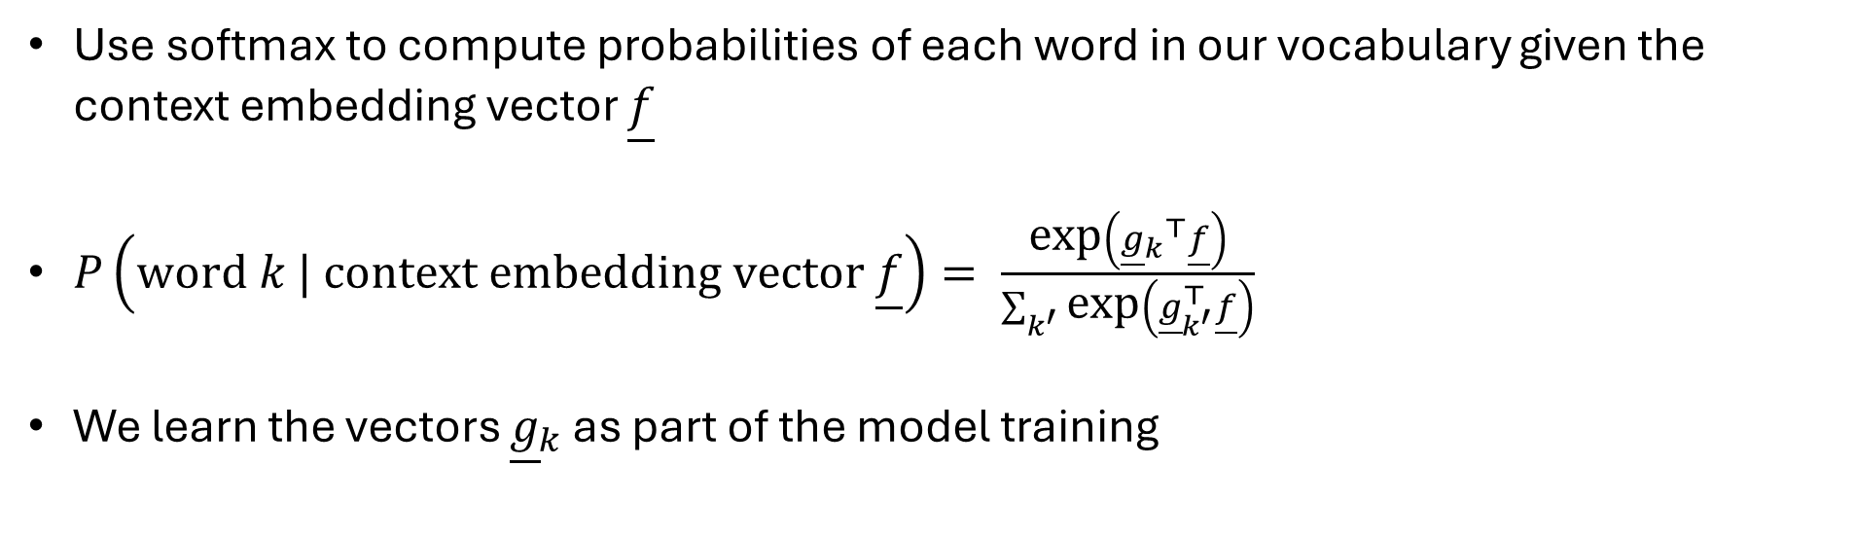
Predicting the next word from context embeddings
the | cat | sat | on | the
Predict the next word
?
Input vector from preceding token into multi-class classifier
Use softmax to compute probabilities of each word in our vocabulary given the context embedding vector $\underline{f}$
$P\left(\text{word }k | \text{context} \text{embedding vector }\underline{f}\right)= \frac{\text{exp}\left({{\underline{g}}_{k}}^{⊤}\underline{f}\right)}{\sum_{k^{′}}{\text{exp}\left({\underline{g}}_{k^{′}}^{⊤}\underline{f}\right)}}$
We learn the vectors ${\underline{g}}_{k}$ as part of the model training
Notes:
Thanks to transformers we now have a set of context-aware embedding vectors, where the last vector in the sequence is suitable for feeding into a multi-class classifier to predict the next word. But what classifier should we use?
We return to our old friend softmax.
Given an embedding vector f, we just feed f into the softmax function and it gives us the probability of each word in our full vocabulary given the vector f. So in our example, I would set f equal to the embedding vector for the last word “the” in the sentence and feed it into the softmax function to get the probabilities of each word in our vocabulary given that last word “the”. I can then, say select the most probable next word as my prediction, or even sample from the probability distribution if I wanted some novelty injected into my sentence.
The vectors g subscript k, are parameters in this softmax function, and so again we add them to the list of LLM parameters we need to learn when we train our LLM.

Slide 41
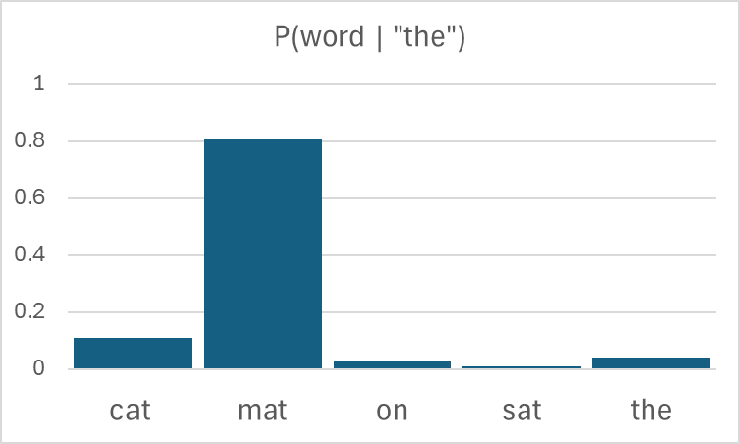
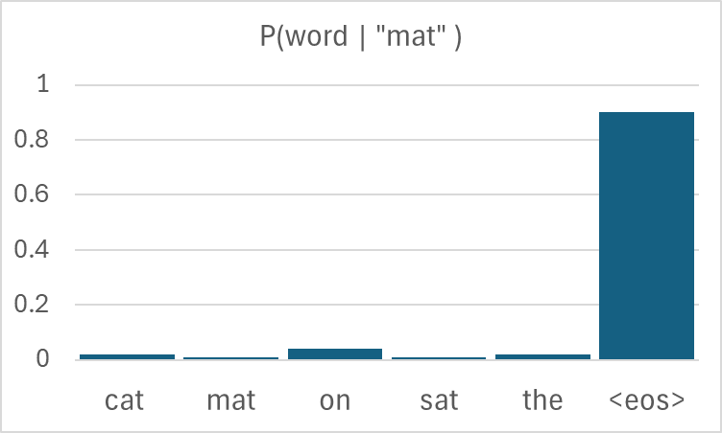
Predicting the next word from context embeddings
the | cat | sat | on | the
“mat”
cat | sat | on | the | mat
Transformer Model
cat | sat | on | the | mat
<eos>

Slide 42
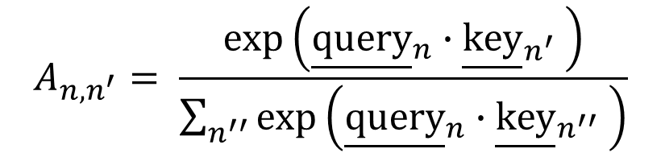
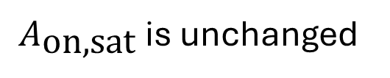
Positional encoding
Let’s look at our formula for the attention probabilities
$$A_{n,n^{′}}= \frac{\text{exp}\left({\underline{\text{query}}}_{n}∙{\underline{\text{key}}}_{n^{′}} \right)}{\sum_{n^{′′}}{\text{exp}\left({\underline{\text{query}}}_{n}∙{\underline{\text{key}}}_{n^{′′}} \right)}}$$
the | cat | sat | on | the
sat | cat | the | on | the
$A_{\text{on,sat}}$is unchanged
The input embeddings, and hence the context embeddings don’t take into account the position of the token in the context (other than through masking) !!
Notes:
If we got back and look at our softmax function for the self-attention weights we notice something strange. The numerator only depends on the two tokens n and n-dashed, and is an inner product so doesn’t depend upon the position order in which those two tokens occur in the sentence. Similarly, the denominator is just a sum over the tokens in the context window, so clearly the result of that sum can’t depend on position order of the tokens.
Oops! That means if I jumble up the order of the first three tokens in this context window, the attention weight between the word “on” and the word “sat” is unchanged.
This means when we construct the context-aware embedding vectors we don’t take into account the position of the word. But position of a word in a sentence is critically important for understanding meaning of a sentence and hence for accurately predicting the next word. How can we solve this problem? Well, we can clearly see that the problem arises because the starting input embedding vectors don’t depend upon position. The two occurrences of the word “the” in the sentence here have the same starting vector, but clearly we should distinguish them from one another somehow. That is easily solved using what are called positional embedding vectors.

Slide 43



















Positional encoding
We solve by adding position dependent vectors to the input
$$i=1$$
$$i=2$$
$$i=3$$
$$i=4$$
$$i=5$$
$$i=1$$
$$i=2$$
$$i=3$$
$$i=4$$
$$i=5$$
the
cat
sat
on
the
$$p(1)$$
$$p(2)$$
$$p(3)$$
$$p(4)$$
$$p(5)$$
$$i=1$$
$$i=1$$
$$i=1$$
the
$$p(1)$$
the @ i=1
+
=
Notes:
Put very simply, we create a separate set of vectors, one for each token, that only depend upon the position of the token i in the context window. These are called positional embedding vectors and each positional embedding vector is of the same dimension as our blue input embedding vectors. The positional embedding vectors are often constructed by inputting the token position i into some simple pre-chosen function, which I’ve denoted by p here. We now simply add the blue starting embedding vector and the corresponding orange positional embedding vector, token by token, to get the green embedding vector, thus. Our green vectors are word dependent and position dependent. So if we step through the process

Slide 44




Positional encoding
We solve by adding position dependent vectors to the input
$$i=1$$
$$i=2$$
$$i=3$$
$$i=4$$
$$i=5$$
$$i=1$$
$$i=2$$
$$i=3$$
$$i=4$$
$$i=5$$
the
cat
sat
on
the
$$p(1)$$
$$p(2)$$
$$p(3)$$
$$p(4)$$
$$p(5)$$
$$i=2$$
$$i=2$$
$$i=2$$
cat
$$p(2)$$
cat @ i=2
+
=

Slide 45




Positional encoding
We solve by adding position dependent vectors to the input
$$i=1$$
$$i=2$$
$$i=3$$
$$i=4$$
$$i=5$$
$$i=1$$
$$i=2$$
$$i=3$$
$$i=4$$
$$i=5$$
the
cat
sat
on
the
$$p(1)$$
$$p(2)$$
$$p(3)$$
$$p(4)$$
$$p(5)$$
$$i=5$$
$$i=5$$
$$i=5$$
the
$$p(5)$$
the @ i=5
+
=
Notes:
We realize that our green embedding vector for the second occurrence of the word “the” at the end of the context window, will be different from the green vector for the first occurrence of the word “the” at the start of the context window.

Slide 46
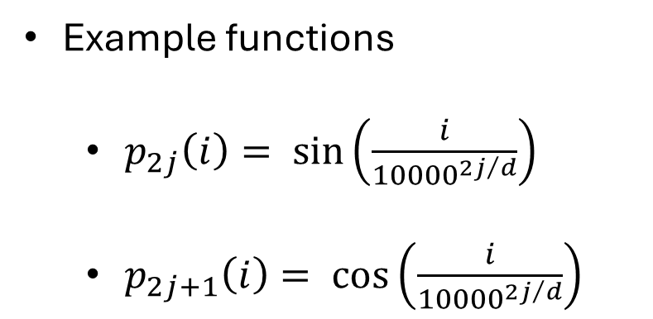

Positional encoding
Example functions
  $p_{2j}\left(i\right)= \sin\left(\frac{i}{{10000}^{{2j}/d}}\right)$
  $p_{2j+1}\left(i\right)= \cos\left(\frac{i}{{10000}^{{2j}/d}}\right)$
$$j=1,2,…,\left\lfloor d/2\right\rfloor$$
Notes:
So, what kind of positional embedding function do we use? As I said, earlier those functions are often simple. The function used in the original transformer paper from Google was this one. As LLM research has evolved, more sophisticated positional embeddings have been developed, but I’m not going to go into those here. The main lesson to take from this is that we differentiate the starting input embedding vectors that we input into our transformer model by adding in position dependent vectors.

Slide 47
Positional encoding
Putting it all together (finally!)
Input embeddings
Output embeddings
the | cat | sat | on | the
Transformer Block
Transformer Block
Transformer Block
Transformer Block
Transformer Block
Transformer Block
the | cat | sat | on | the
Position encodings
i=1 | i=2 | i=3 | i=4 | i=5
Notes:
Our transformer model now looks like this schematically. That’s it. We are now are finally done with our explanation of what is mathematically inside a transformer model. Honest.

Slide 48
Different types of transformers
Encoders, Decoders, Cross-attention
Notes:
Having explained mathematically how transformers work and how next word prediction works using transformers, we’re going to change tack slightly and widen our scope. That’s because the transformer structure we explained is a very specific type of transformer known as a decoder-only model. And unsurprisingly, there are other different types of transformer-based models around, so we’ll now highlight those different types of transformers.

Slide 49
Different types of transformers
What we covered was embedding vector → token (word)
We ‘decoded’ the embedding vector
ChatGPT, Claude, etc are known as ‘decoder-only’ models
“mat”
Notes:
The type of transformer we’ve be focusing on so far takes a word embedding vector and predicts the next word. We went from vector to word or token.
In other words we “decoded” the embedding vector. Consequently, LLMs that work in this way, such as ChatGPT and Claude, are known as “decoder-only” models.

Slide 50
Different types of transformers
We also have encoders: token → context embedding vector
“mat”
Encoders are useful where we have all the tokens (no prediction), we just need to map them to appropriate vectors
  E.g. “the cat is on the table” → “le chat est sur la table”
Encoder model, without masking
Decoder model, with masking
Notes:
But we can obviously also have encoders as well. An encoder goes from a word or token to a context embedding vector.
Encoders are useful when we just want to encode a sequence of tokens. There is no prediction to be done. We have all the tokens in the context window, we just want to map them context aware vectors.
This is useful for tasks such as language translation. Take this simple example. I’m wanting to translate the English sentence “the cat is on the table” into French. Essentially, we want to predict the words in the corresponding sentence one at a time based on what is in the English sentence. For predicting the French words, yes, I will want to use a decoder model. But for the English sentence I already know all the words. I just want to map them to vectors. So for the English sentence I want to use an encoder model. So we use the simple approach shown here.

Slide 51
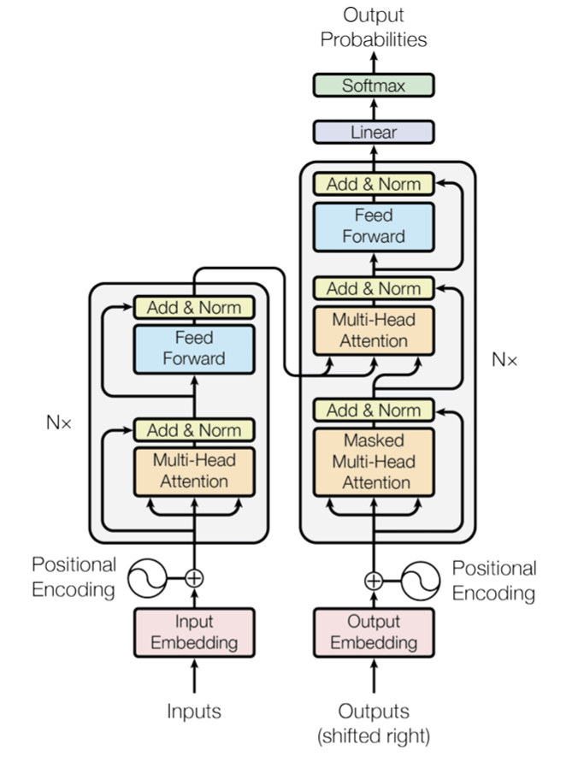
Different types of transformers
‘Attention is all you need’, Vaswani et al, 2017 , arXiv:1706.03762
“the cat is on the table” → “le chat est sur la table”
Encoder model, without masking
Decoder model, with masking
Notes:
In fact, language translation was the application demonstrated in the original famous “Attention is all you need” paper from Google and MIT, that started the whole transformer-based phase of generative AI. The model in this paper has an encoder model and a decoder model which are coupled together, as shown in the diagram on the right which is taken from the original paper. Every talk on explaining transformers and LLMs has to have a copy of this diagram in it, so I’m no different here. But I want to leave this diagram to the end of my talk, because I think it scares people and makes LLMs harder to understand than need be. The diagram on the right is just the same as the schematic on the left, which is simpler to understand. We can highlight the correspondence between the two diagrams.

Slide 52
Different types of transformers
Encoder model
“the cat is on the table” → “le chat est sur la table”
Encoder model, without masking
Decoder model, with masking
Notes:
Highlighted in red is the encoder model of the original paper. It converts the English sentence into context-aware embedding vectors

Slide 53
Different types of transformers
Decoder model
“the cat is on the table” → “le chat est sur la table”
Encoder model, without masking
Decoder model, with masking
Notes:
Next, in red is the decoder model, which predicts the words of the French sentence one word at a time in exactly the way we explained when we were learning about the mathematics inside transformers.

Slide 54
Different types of transformers
Cross attention
“the cat is on the table” → “le chat est sur la table”
Encoder model, without masking
Decoder model, with masking
Notes:
And here is where the two models are coupled together, where the output from the encoder model is fed into the input of the decoder model. You may notice the encoder output is fed into a multi-headed attention sub-layer in the decoder model. That means when the decoder model is creating its context-aware vectors to be used later to predict the next French word, it is paying attention to the English words. We call this “cross attention” for obvious reasons. And that’s it. That’s how simple the original “Attention is all you need” paper is. Yes, there is a huge amount of engineering challenges alongside that we haven’t gone into here, but transformers and LLMs are not as scary, mathematically, as they may seem. We’ll summarize what we have learnt about transformers and LLMs in moment, but next we’ll do a quick code example to further illustrate that transformers are not that scary once you unpack them at a high level.

Slide 55
Code example 2
Using PyTorch to build transformer layers

Slide 56
Code Example 2
Open up the Jupyter notebook ODSCWest2026_CodeExample2.ipynb in the github repository
https://github.com/dchoyle/ODSCWest2026_TransformerBootcamp/

Slide 57
Wrap up: What we learnt
Next token prediction is a powerful capability
To solve:
  We map very large vocabularies to lower dimensional vectors
  Each token in a sequence is initially represented by an embedding vector
  We transform each token to a new vector that also encodes the surrounding context
The transformation model contains lots of parameters.
We learn the model parameters by training on very large datasets
Transformer models can be used to encode and/or decode tokens
We can have applications that use only decoder blocks, only encoder blocks, or both.

Slide 58
Wrap up: What to learn next
The hundred page language models book - Andriy Burkov
An introduction to Transformers – R. Turner, arXiv:2304.10557
Decoder-Only Transformers: The Workhorse of Generative LLMs
  Cameron R. Wolfe. Substack article
Attention is all you need – Vaswani et al, arXiv:1706.03762
Paper Walkthrough: Attention Is All You Need
  - Muhammad Ardi. Towards Data Science article

Slide 59
Wrap up: What I haven’t told you
The engineering challenges, scale, and costs associated with foundational model training are significant
Foundational models are general – but can be fine-tuned
  Domain specific datasets
  LoRA
Problem of hallucinations can be mitigated (but not eliminated)
  RAG
  CoT

Slide 60
Wrap up: Wider reading
The Hitchhiker’s Guide to Agentic AI: From Foundations to Systems - Haggai Roitman, arXiv: 2606.24937
Welcome to the era of experience – David Silver, Richard Sutton
- Google DeepMind
The Infinity Machine: Demis Hassabis, DeepMind and the Quest for Superintelligence
  Sebastian Mallaby

Slide 61


Thank you for listening
Questions?
github.com/dchoyle/ODSCWest2026_TransformerBootcamp
www.linkedin.com/in/davidchoyle/
www.hoyleanalytics.org

