Slide 1

Ecommerce
Customer Analysis

Slide 2
Context
This is the largest retail e-commerce orders dataset from Pakistan. It contains a million transaction records from March 2016 to August 2018.
The dataset retrieved from Kaggle.
We analyze a dataset with 1.000.000 rows and 21 columns.
Table Of Content
Data Cleaning
Market Basket Analysis
Best selling Categories
RFM
Cohort Analysis

Slide 3
Data cleaning
We dropped 500k rows because they had N/A values.
We also dropped unneeded columns.
Changed wrong data types into correct ones.
Excluded the amount negative orders and kept orders with complete status
Transposed the Pakistani currency into dollars currency

Slide 4
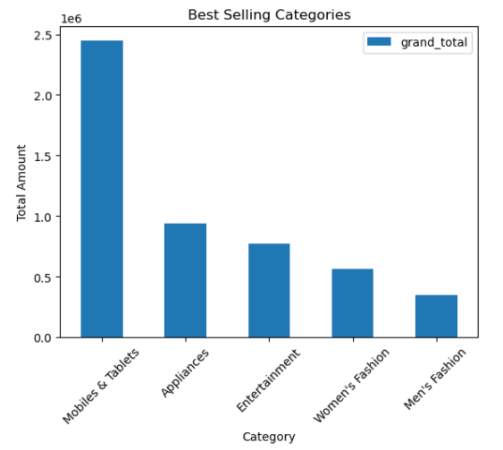
Best Selling Categories
Top 5 categories as for revenue amount. (in millions)
Seems that in Pakistani market technology products sells more that Fashion products.
Further Analysis:
Which months are the hottest for tech products to promote.
Which products are the best-selling ones

Slide 5
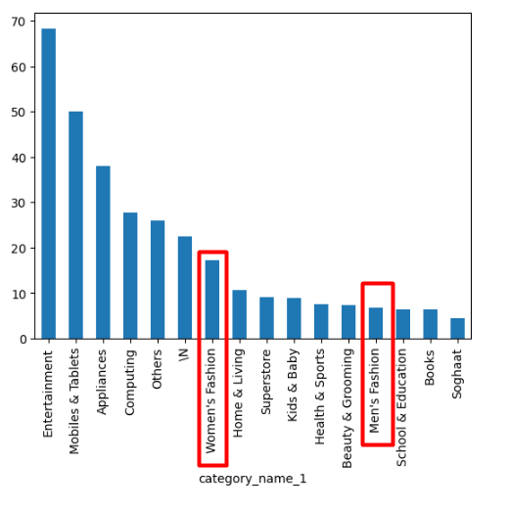
Market basket Analysis based on categories
Entertainment is an opportunity to expand. People that buys Entertainment products tend to spend much more than everything else.
Men's Fashion is crowded but with low average basket. (15$)
Top Categories
Entertainment : 143 $ per Customer per Basket
Mob. & Tablets: 112 $ per Customer per Basket
Further Analysis
Try to create bigger categories.
Example : Fashion, Tech , Entertainment
In order to do in depth analysis

Slide 6
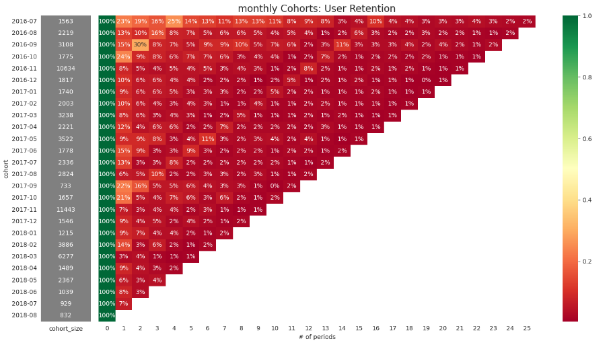
Cohort
seems like in November we have the highest retention rate from our customers. In November black Friday happens.
Its the best time of the year for online websites.
also, we have a pattern from months 2016-12 to 2017-03 where we have low retention rate at black Friday.
They are probably the best customers because the don't buy with discounts. Further analysis needed.

Slide 7
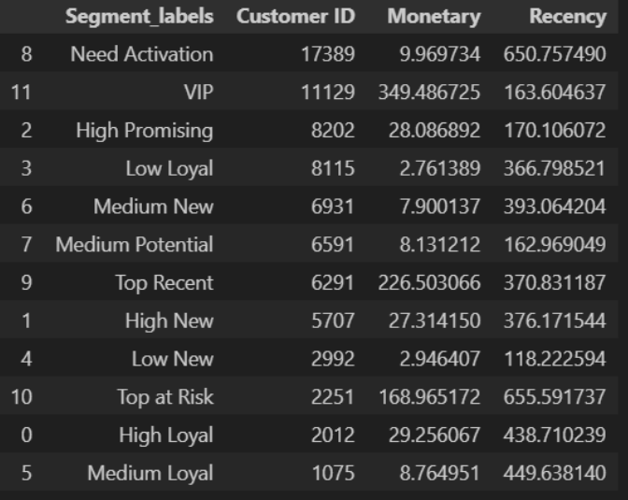
RFM
Implement RFM Analysis on the customer base and categorize the customers into 12 different categories
Further Analysis:
finding best clients,
the number of customers per segment, total Monetary value (Sales) per segment as well as Mean Recency and Mean Monetary Value per segment.

Slide 8
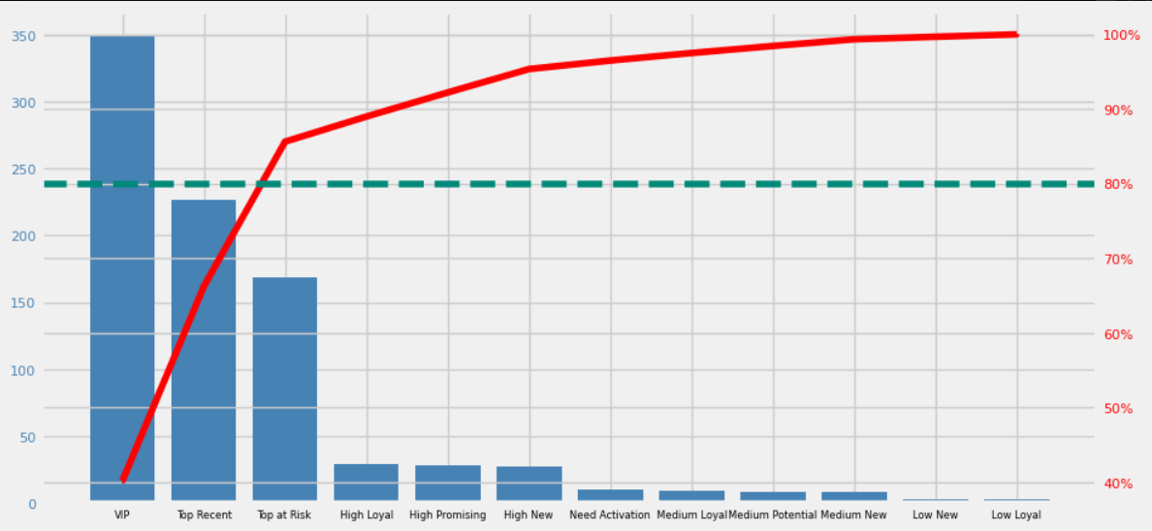
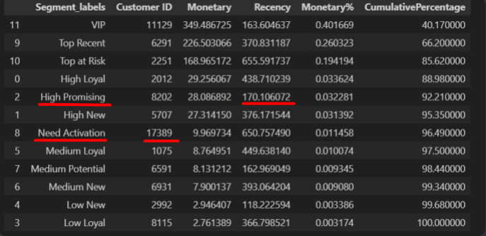
Pareto
The pool of the customers are 78.685
16% of the customers bring the 80% of the total revenue.
Further Analysis:
Categories to further investigate are ‘Need activation’ and ‘High Promising’ due to the volume of customers and the low recency.

