Slide 1

Hotels demand ------------- Cancellation’s causes ------------- prediction of cancellation

Slide 2
The dataset is about hotel’s bookings across the world for city and resort hotels • It contains bookings from 2015 until 2017 • the dataset retrieved from Kaggle • we analyzed 118k rows and 31 columns table of content 1. Data pre-process 2. visuals 3. PREDICTION MODEL & TECHNIQUES 4. Conclusion

Slide 3
Data pre-process
We had some columns containing to many null values (like company, agent) and removed 500 rows of with null values in multiple columns.
We did not have any significant outliers, so we do not use any similar technique
We did a normalization for the data (scaling)
We excluded columns that spoils cancellation

Slide 4
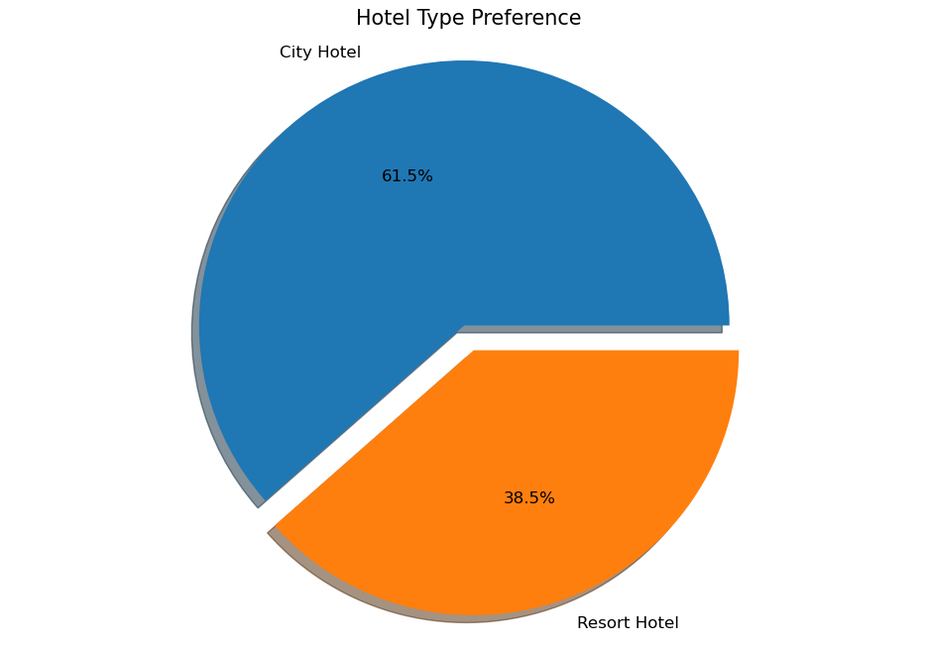
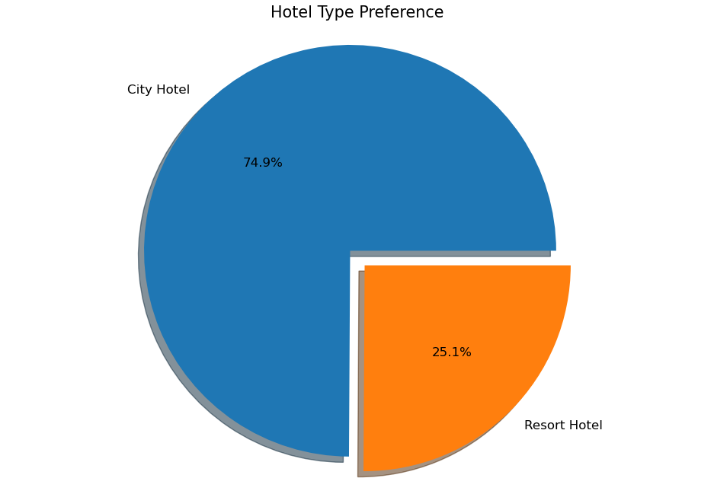
Distribution of non-cancelled bookings
Distribution of cancelled bookings
Most of cancellation happens in City Hotels

Slide 5
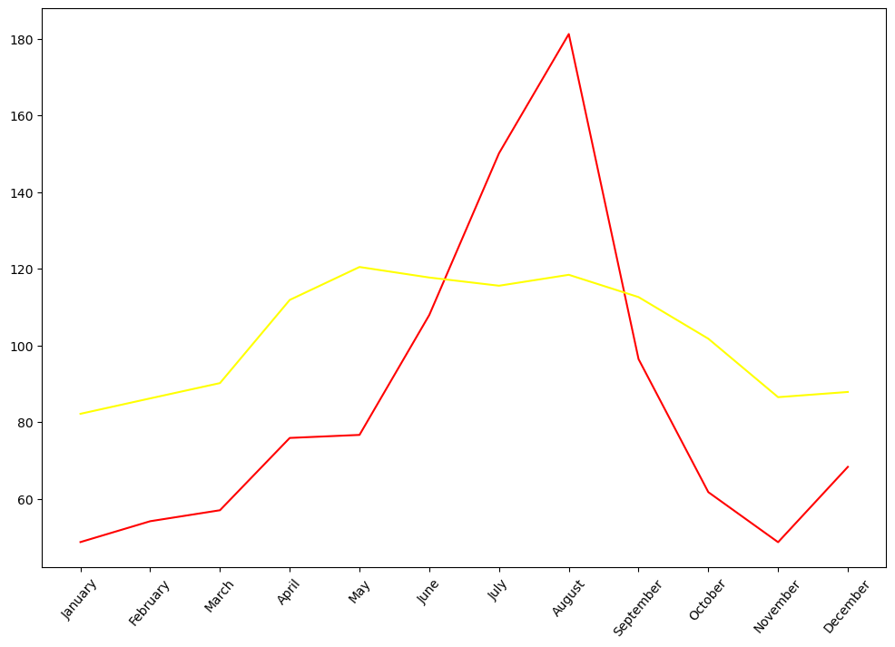
ARRIVALS PER MONTH – NON CANCELLED BOOKINGS
Visuals – Insights
Resorts = red
High season: May until August
City hotels = yellow
High season: April until September

Slide 6
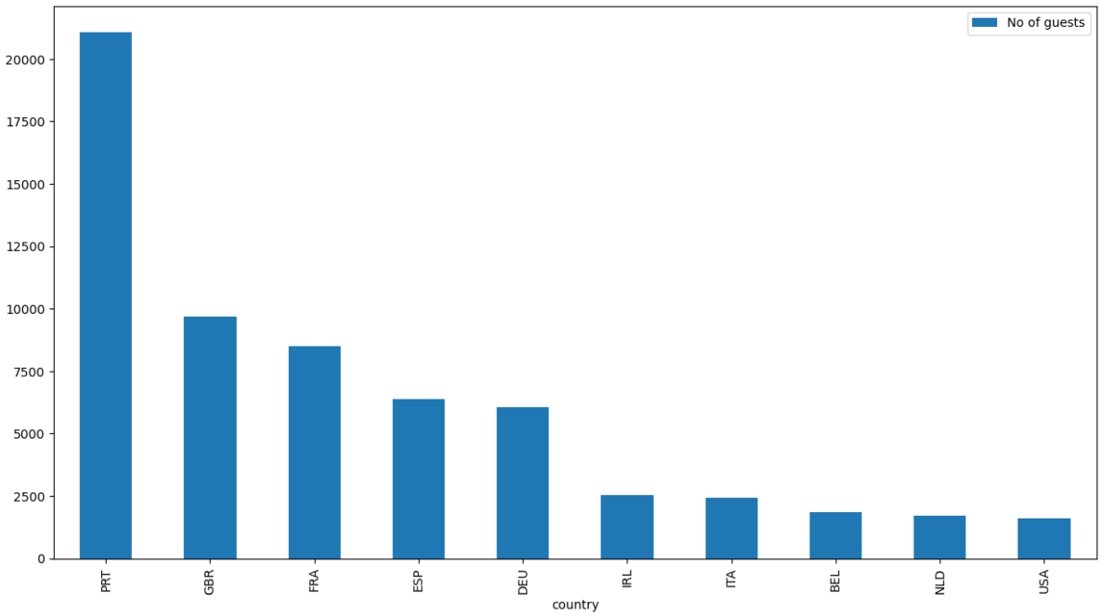
Visuals – Insights
Number of guest per country of origin
Visitors from Portugal, Great Britain, France, Spain and Germany were the majority of our sample.

Slide 7
Visitors from countries with cancellation percentage under 20%
Visuals – Insights
country | Total bookings | cancelations | percentage of cancelation
12 | CN | 1279 | 254 | 19.86
2 | FRA | 10415 | 1934 | 18.57
9 | NLD | 2104 | 387 | 18.39
13 | AUT | 1263 | 230 | 18.21
4 | DEU | 7287 | 1218 | 16.71
53 | LVA | 55 | 9 | 16.36
43 | BGR | 75 | 12 | 16.00
21 | FIN | 447 | 69 | 15.44
74 | JOR | 21 | 3 | 14.29
30 | JPN | 197 | 28 | 14.21
38 | MEX | 85 | 10 | 11.76
68 | MYS | 28 | 3 | 10.71
41 | LTU | 81 | 7 | 8.64
44 | NZL | 74 | 6 | 8.11
51 | ISL | 57 | 4 | 7.02
36 | SRB | 101 | 3 | 2.97
Countries with over 1000 bookings have over 15% percentages of cancellation. Best countries are German, Austria, Netherland France, Netherland and Canada.
Best visitors with low total bookings came from Serbia, Israel and Nea Zealand and had low cancellation percentages.

Slide 8
Where the cancellations came from?
Visuals – Insights
country | Total bookings | cancelations | percentage of cancelation
0 | PRT | 48586 | 27515 | 56.63
24 | AGO | 362 | 205 | 56.63
15 | CHN | 999 | 462 | 46.25
26 | MAR | 259 | 109 | 42.08
33 | KOR | 133 | 55 | 41.35
27 | TUR | 248 | 102 | 41.13
25 | LUX | 287 | 109 | 37.98
18 | RUS | 632 | 239 | 37.82
8 | BRA | 2224 | 830 | 37.32
5 | ITA | 3766 | 1333 | 35.40
28 | HUN | 230 | 77 | 33.48
People from Portugal, Angola, China, Morocco, South Korea and Turkey had more than 40% percentage of cancellation on their bookings.

Slide 9
Where the cancellations came from?
Visuals – Insights
market_segment | Total bookings | cancelations | percentage of cancelation
0 | Online TA | 56402 | 20738 | 56.63
1 | Offline TA/TO | 24160 | 8278 | 20.22
2 | Groups | 19806 | 12097 | 18.57
3 | Direct | 12448 | 1920 | 25.41
4 | Corporate | 5111 | 978 | 16.71
5 | Complementary | 734 | 90 | 35.40
6 | Aviation | 237 | 52 | 24.65
The 56.63% of bookings via Online Travel Agents were cancelled!
Complementary also have high percentage in cancellation of the bookings.

Slide 10
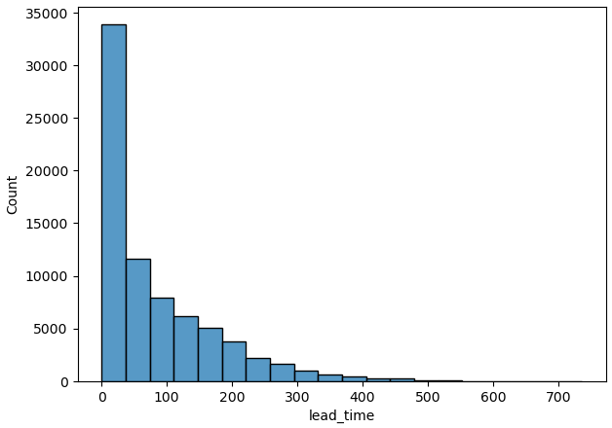
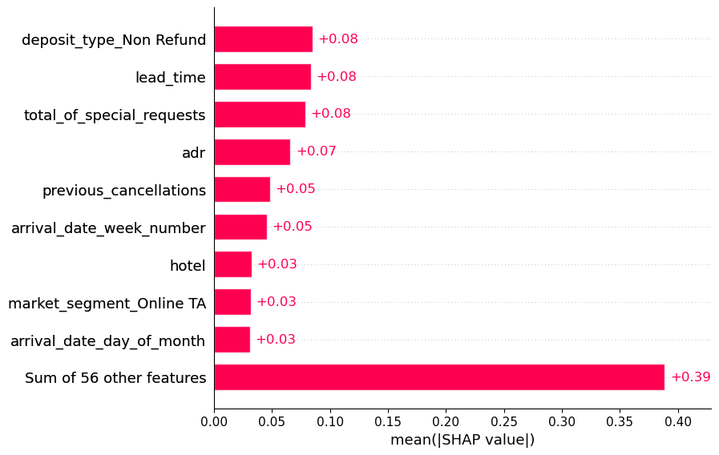
Visuals – Insights
Lead time had significant affection in our model
These are top 10 most significant factors that affect most our model.
Most of the visitors made their bookings one month before their arrival.

Slide 11
Prediction model & accuracy
Random forest
Lightgbm
Xgboost
AdaBoost
83,43% accuracy
84,2% accuracy
85,7% accuracy
81,45% accuracy

Slide 12
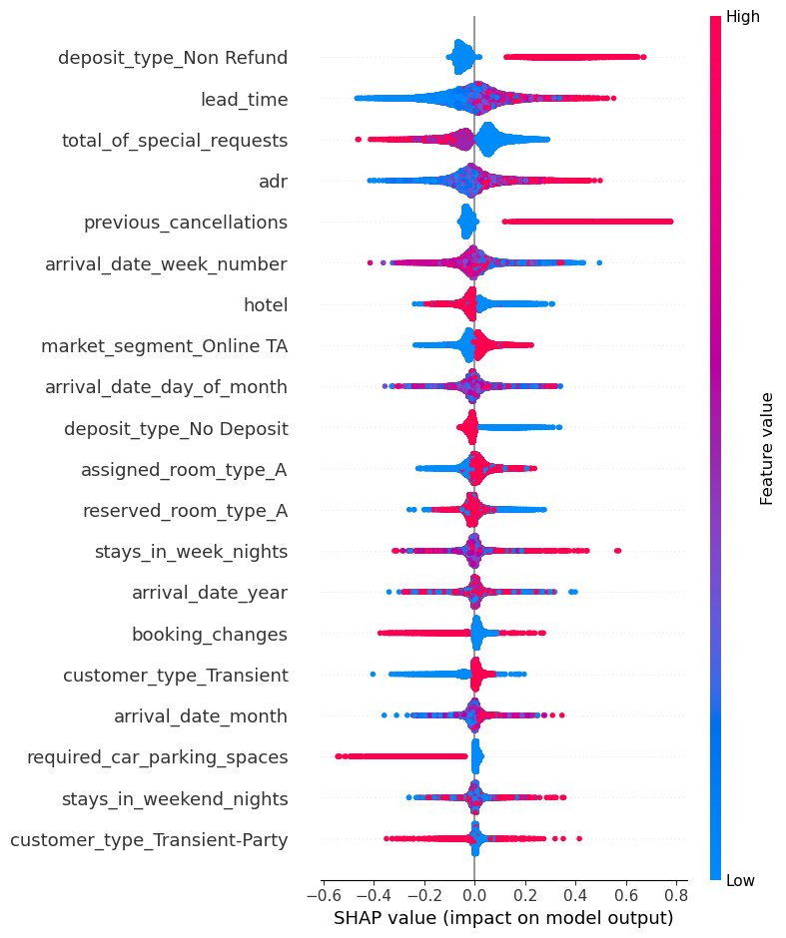
Feature importance – Shap technique
Hotels that demand deposits that cover total stay cost to guarantee the booking increased cancellations.
Low values of lead time decrease cancellations.
High number of special requests made by the customer decrease cancellations and low number of special requests increased cancellations.
High Average daily rate increased cancellations and low average daily rate decrease cancellations.
People that had previous cancellations, increased cancellations.
Online Travel Agents bookings increased cancellations.

Slide 13
Conclusions
Our prediction model had 85,7% accuracy in prediction for cancellations.
After consideration,
we propose not to have deposits that cover total stay cost to guarantee the booking
We should consider to not close the availability of rooms for bookings with advanced booking window after 2-3 or 4 months.
Prefer customers with special requests.
Revisit their partnerships with online Travel Agents.
Flag previous customers, where they cancelled their last booking and let them only pay by card and not in person.

