Slide 1


Animals As Sentinels of Human Environmental Health Hazards: Linking Animal and Human Health
Peter Rabinowitz MD MPH
Yale University School of Medicine
Occupational & Environmental Medicine Program
Colorado State University
February 3, 2006

Slide 2
What is Occupational and Environmental Medicine?
Medical specialty concerned with the prevention and treatment of illness caused by hazardous exposures in the workplace or environment
  Chemical Hazards
    Asbestos, lead, etc.
  Physical Hazards
    Noise, heat, radiation, etc.
  Biological Hazards
    TB, West Nile, Lyme, SARS etc.

Slide 3
Should Human Health Professionals Use Animal Disease Data in Assessing Human Environmental Health Risks?

Slide 4
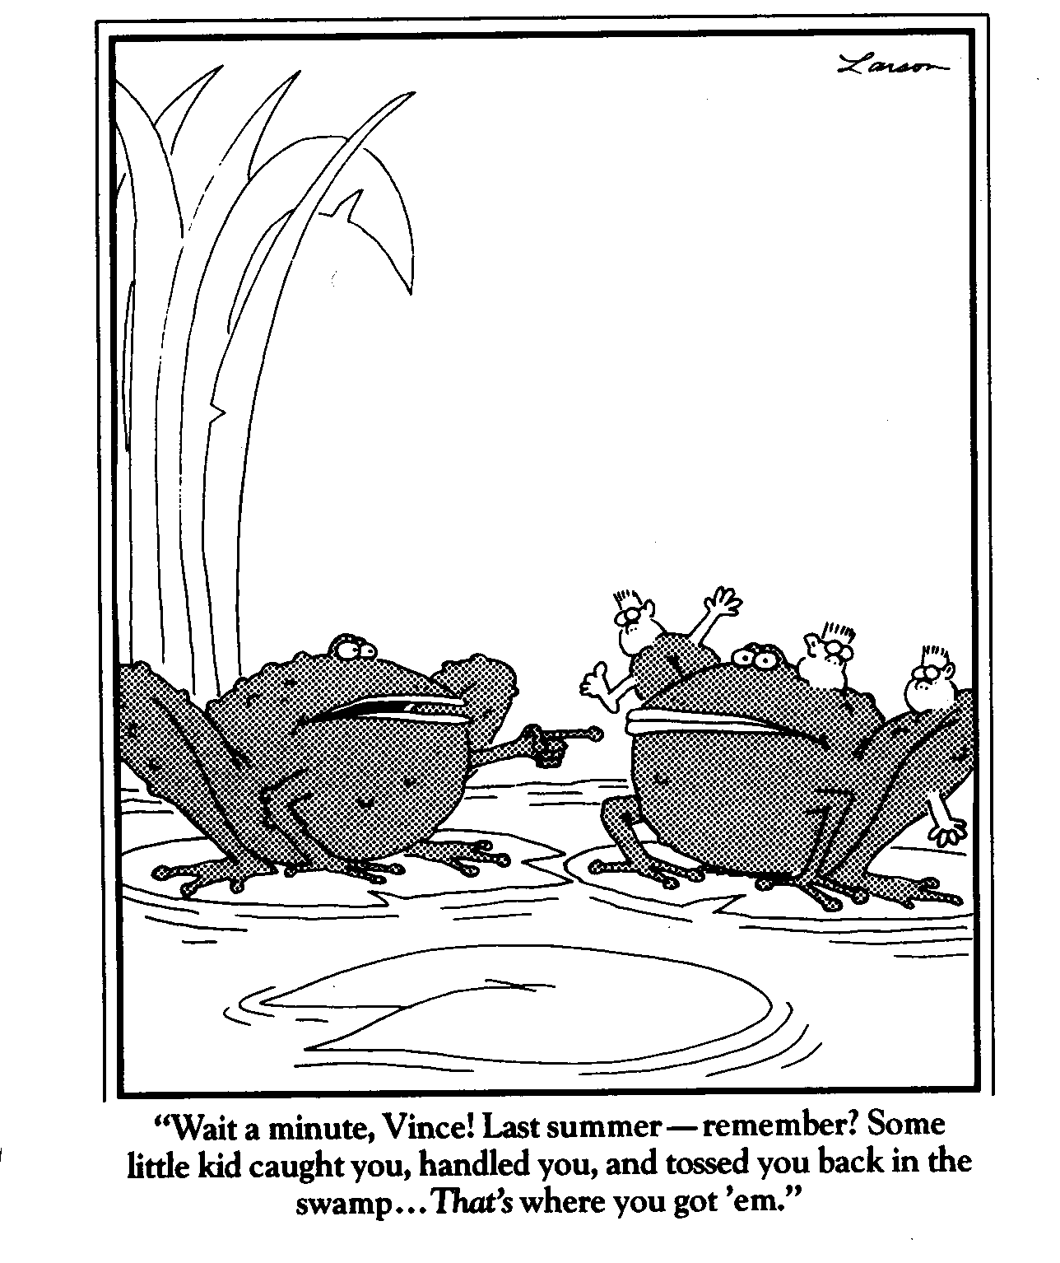

Slide 5
Overview
Environmental health and animals as sentinels
The explosion of animal sentinel data
An evidence-based approach to animal sentinels
The Canary Database
The need for better “Sentinel Science”

Slide 6
Definition of “Animal Sentinel”
Refers directly to human health
“Organisms in which changes in known characteristics can be measured to assess the extent of environmental contamination and its implication for human health and to provide early warning of those implications” (O’Brien 1993)

Slide 7
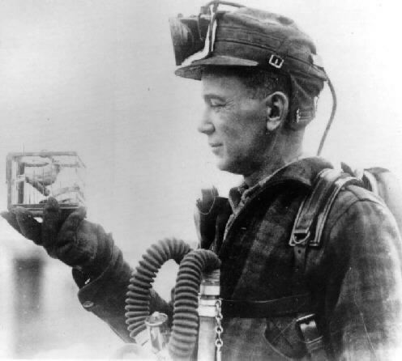

Examples of Animal Sentinels- toxic hazards
Canaries in coal mines- intentional use of birds for surveillance
  Greater susceptibility to CO effects
Dancing cats in Minamata- naturally occurring event
  Higher exposure to methylmercury from fish

Slide 8
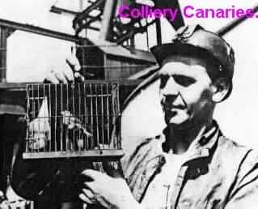
The Sentinel Canary- A Relic?

Slide 9
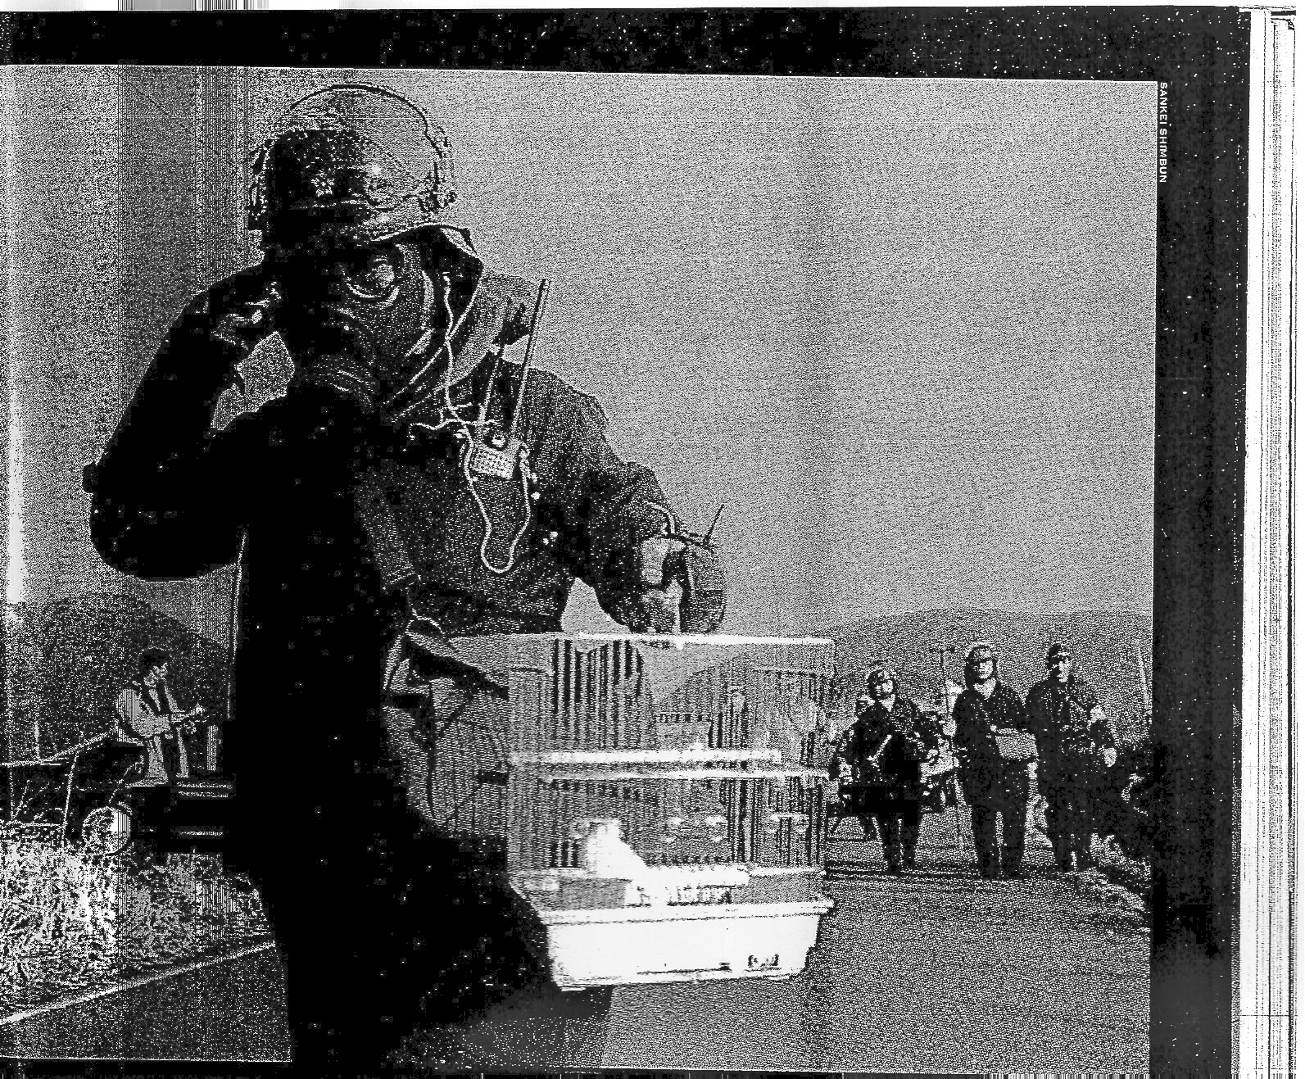
Tokyo Sarin Attack

Slide 10
Potential Advantages of Animal Sentinels
Animals may be more susceptible than humans
Animals are often exposed at higher level than humans to environmental hazards
Shorter lifespan, intergenerational period to see effects of chronic exposures

Slide 11
Animal Populations: Potential Sentinels
Wildlife
  Ongoing environmental exposures
  Species diversity
Domestic
  Ongoing surveillance, food safety etc.
  Sentinel flocks
Companion
  Shared exposures with humans

Slide 12
Animal Sentinels for Human Health Hazards?
Amphibian limb deformities
Endocrine disruption in wildlife populations
Pets with cancer
But is there a definite…

Slide 13
Linkage to Human Health?
How to assess the evidence provided by animal sentinel data

Slide 14
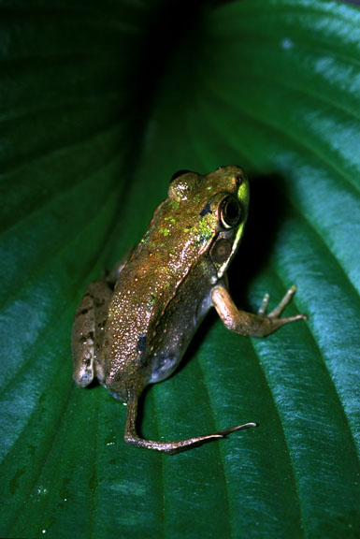
Example: Amphibian Malformation
What is the causative agent? Infectious? Toxic?
Is agent also a hazard to humans?
Is there shared exposure with humans?
What is the human corollary of amphibian malformation?

Slide 15
Animals as Sentinels of Human Infectious Disease Threats
Many emerging infectious diseases are zoonotic in origin
Can animal populations provide early warning?
  Greater exposure
  Greater susceptibility
Intentional surveillance (ex. Sentinel chickens) vs. naturally occurring disease events (wild bird mortality)
Surveillance of asymptomatic reservoirs- value to humans

Slide 16
Traditional Use of Animal Data re: Infectious Hazards
Rabies surveillance and control
Herd health
Flavivirus monitoring in vectors and sentinel flocks

Slide 17
West Nile Virus
US epidemic began with observation of event in wildlife population (dead birds)
Organized avian surveillance
Enhanced vector surveillance
Sentinel flocks

Slide 18
CDC Guidelines for WNV Surveillance
Avian
  Avian morbidity/mortality surveillance
    “most sensitive early detection system for WNV activity”
    Utility seems to fluctuate
  Live bird surveillance
    Captive sentinel surveillance
    Free-ranging bird surveillance
    Sensitivity variable

Slide 19
CDC Guidelines for WNV Surveillance
Equine
  Important in some regions
  In some areas cases do not precede humans
Mosquito
  “Remains the primary tool for quantifying the intensity of virus transmission in an area”
  Labor intensive

Slide 20
WNV Questions
Why does the predictive ability of avian surveillance for human risk fluctuate?
Is mosquito surveillance better?
What other species should be routinely included in surveillance systems?
  Pets, wild mammals, etc.?
What are temporal/spatial relationships between environmental risk factors for animal sentinel events and also human health risk?

Slide 21
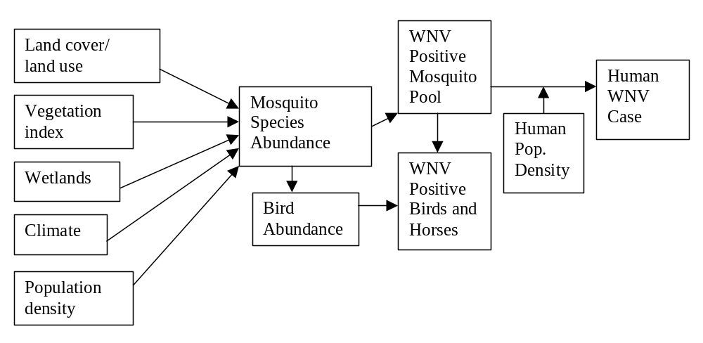
Animal Sentinel Events
Environmental Factors
Vector/Reservoir Abundance
Human Health

Slide 22
WNV-Strength of Evidence that:
Can animal data provide meaningful early warning for humans?
  Sensitivity
  Specificity
  Time lag for ‘early warning’
  Over what geographic area?

Slide 23
Avian Influenza
Development of HPAI strain heralded by mortality in wild birds
“Spillback” into domestic birds
“Spillover” into wild bird populations, some migratory
Can wild birds serve as sentinels for AI risk?

Slide 24
Proposed AI Early Detection System for HPAI in Wild Migratory Birds
Investigation of wild bird mortality/morbidity events
Surveillance in live wild birds
Surveillance in hunter-killed birds
Captive sentinel species

Slide 25
AI Sentinel Questions
Where to test
What species to track?
Environmental Risk factors
What other pathogens to test for in asymptomatic reservoirs?
Relationship between animal sentinel event and human health risk

Slide 26
Explosion of ‘Animal Sentinel’ Data
Veterinary surveillance at local, state, and national levels
Arbonet
Avian Influenza National Surveillance System
USDA/CEAH
  National Surveillance Unit
WHO OIE
Outbreaks: SARS, Monkeypox, AI, Nipah
Comparative genomics

Slide 27
Growing Awareness of Animal-Human Health Linkages
“One Medicine” initiative
Consortium for Conservation Medicine
One World One Health

Slide 28
Need for Rapid Development of “Sentinel Science”
Reduce data gaps for linkages between animal and human health disease risk
  Animal/human exposure pathways and relationships
  Interspecies susceptibility differences, genomic overlap
  Environmental risk factors for sentinel events
Evidence-based analysis of linkages between animal and human epidemiology
Practical analysis of surveillance systems
Remote sensing, information visualization, time series analysis, and other methods to improve analytic capability

Slide 29
Evidence-Based Medicine (EBM)
Movement to replace empiric dogma of clinical medicine with explicit, evidence based approaches.
For a particular clinical question, assemble relevant studies to answer
Systematic reviews of the medical literature
Grading the level of evidence

Slide 30
Animal Sentinel Studies from EBM Point of View
What is the evidence that animals:
  Are experiencing disease related to environmental risk factors?
    Causation
  Are providing reliable early warning of human health risk?
    Sensitivity
    Specificity
    Time lag
  Share exposure with humans?
  Are more susceptible than humans to the hazard?
  Experience health effects that can be linked to human outcomes?
How good are the studies?
Is there consistency across studies?

Slide 31
Challenges to Assembling the Evidence for Animal Sentinels
Difficult to locate “animal sentinel studies” in medical databases (Medline)
  Lack of search terms (nothing for ‘animal sentinel’)
  Limited species capture (gambian rat, dunlin)
  Journal limitations (Jl of Animal Ecology, Intl Jl Poultry Sci, etc.)
Lack of communication between animal and human health professionals
Differences in study techniques between animal and human health researchers
Funding for animal sentinel research-cracks

Slide 32
The Sentinel Studies Project at Yale
Canary Database Project
Animal Sentinel Research

Slide 33
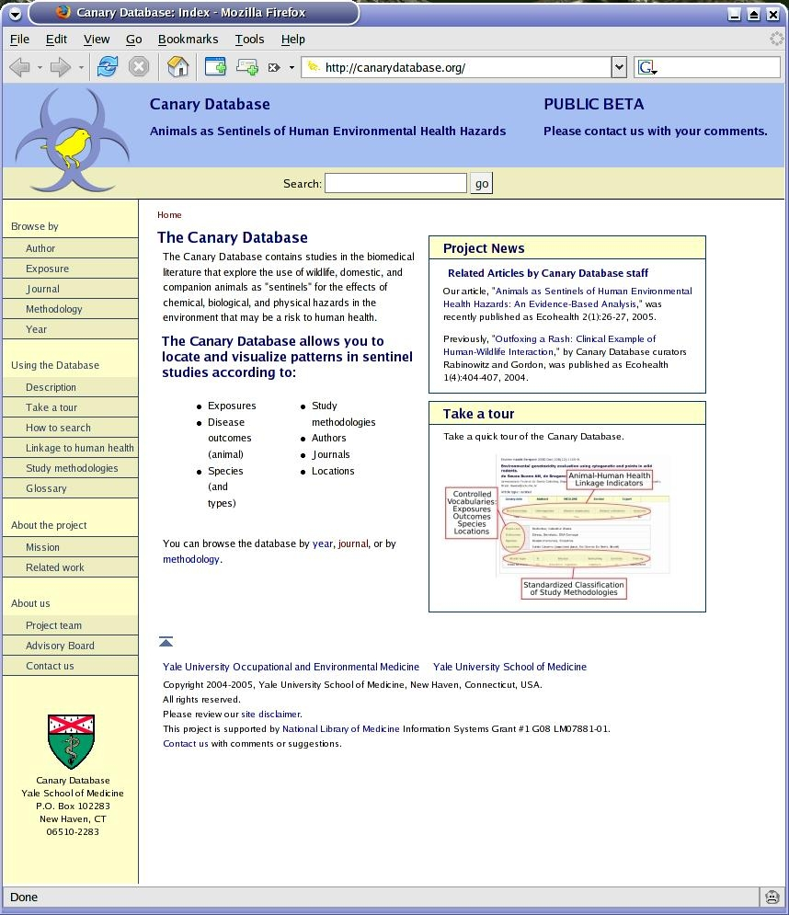
The Canary Database (canarydatabase.org)
National Library of Medicine: Communication Systems Grant
Goals:
Assemble evidence for human health relevance of animal sentinel data
Facilitate evidence-based reviews
Make scientific literature on sentinels more accessible
Promote interdisciplinary communication
  Epidemiology as common language

Slide 34
What Data are in the Canary Database?
Peer-reviewed studies of non-traditional animal species with exposures and/or outcomes relevant to human health:
  biological, chemical, physical hazards
Searches of Medline, CAB, Agricola, etc
Curation of studies by trained curators according to protocol

Slide 35
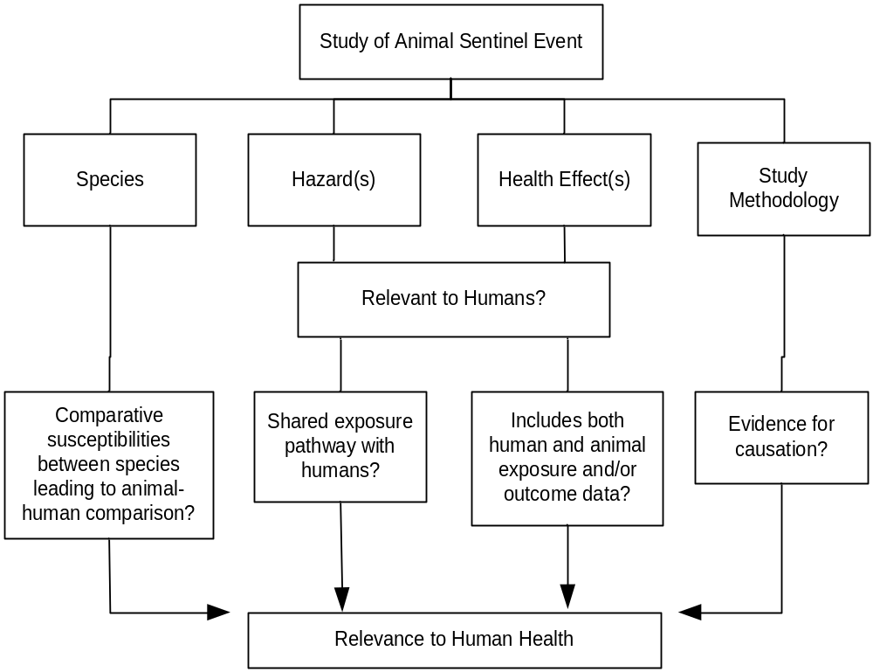
Identifying Relevant Animal Sentinel Studies and Linkages to Human Health

Slide 36
Curation Protocol
Developed by national advisory board with expertise in:
  Epidemiology/human health
  Animal health
  Environmental health
  Infectious disease ecology
  Toxicology
  Medical informatics
  Ecology
  Zoology

Slide 37
Canary Database Advisory Board
Anne Fairbrother DVM, EPA
Peter Daszak PhD, Consortium for Conservation Medicine
Henry Gardner DrPh: Colorado State U.
Joanna Burger PhD, Rutgers
Durland Fish PhD, Yale
Mark Cullen MD, Yale
Judy Zelikoff PhD, NYU
Constance Rinaldo MS, Harvard
Mark Pokras DVM, Tufts School of Vet Med
Perry Miller MD, Yale

Slide 38
Database Project Team
  Peter Rabinowitz, MD, MPH ( PI)
  Joshua Dein VMD, USGS National Wildlife Health Ctr. (Co-I)
  Prakash Nadkarni MD (Co-I)
  Zimra Gordon DVM, MPH
  Lynda Odofin DVM, MPH
  Dan Chudnov MS, Informatics
  Matt Wilcox MS, Library Science

Slide 39
Curation of Studies in Database
Linkages to human health:
  Does study present evidence about:
    Cause and effect in animals?
    Shared exposure with humans?
    Interspecies susceptibility?
    Animal and human outcome data?
    Inclusion of genomic data?

Slide 40
Curation of Studies (cont.)
Hazard (s) studied
Health Outcome(s)
Species (NCBI, ITIS, MeSH taxonomies)
Environmental and Host Factors
Geographic location (gazetteer)
Epidemiological Study Methodology(ies)

Slide 41
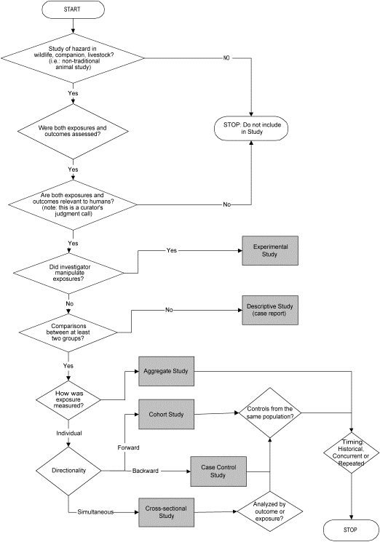
Study Methodology Classification

Slide 42
Canary Database User Community
Public health professionals
Clinicians
Toxicologists
Veterinary professionals/librarians
Ecologists
Medical librarians
Infectious Disease Biologists
Zoologists

Slide 43
Current Status of Canary Database
Website and database construction complete
Curation: >1500 studies to date
Public release of site: April 2005
Approximately 10,000 website hits/month

Slide 44
On Line Demonstration
Search “anthrax” in Canary Database

Slide 45
Current Projects: Evidence-Based Reviews
Example: Animals as Sentinels of Bioterrorism Agents

Slide 46
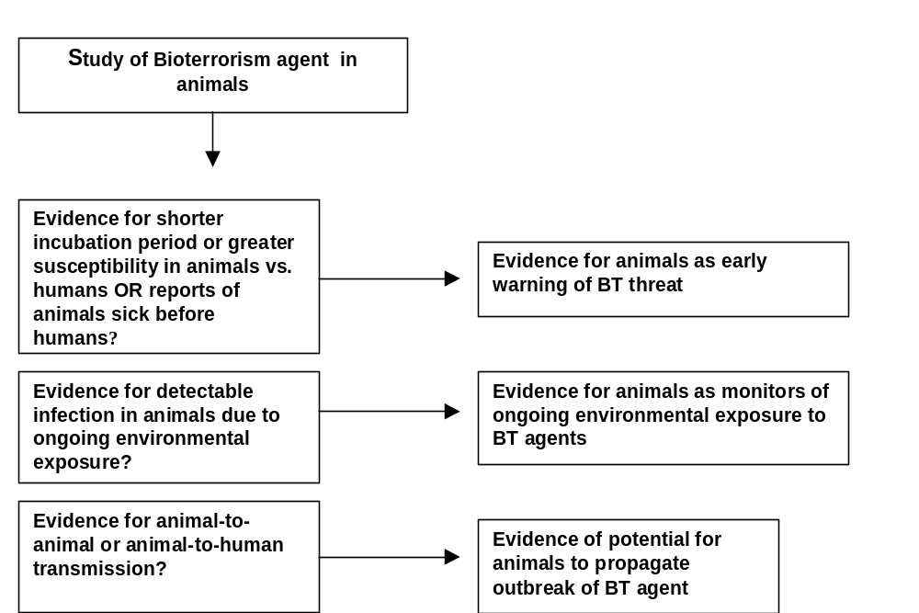
Evidence: BT Agents

Slide 47
Levels of Evidence (based on CEBM/SORT Taxonomeis)
LEVEL 1:
  Experimental studies
  Cohort Studies
LEVEL 2:
  Cross sectional, ecologic, case-control studies
LEVEL 3:
  Case reports/series, expert opinion/consensus

Slide 48


Slide 49
Conclusion
Some animals can provide early warning
Many species can warn of ongoing exposure risk
For certain diseases, risk of propagation in animal populations
Many data gaps: species susceptibility, exposures, study limitations

Slide 50
Current sentinel research work
Use of information visualization and spatial analysis of remote sensing data and sentinel events to determine environmental risk factors for WNV emergence
  (in cooperation with Durland Fish PhD, Yale Center for Ecoepidemiology, and Pacific Northwest Laboratories)

Slide 51
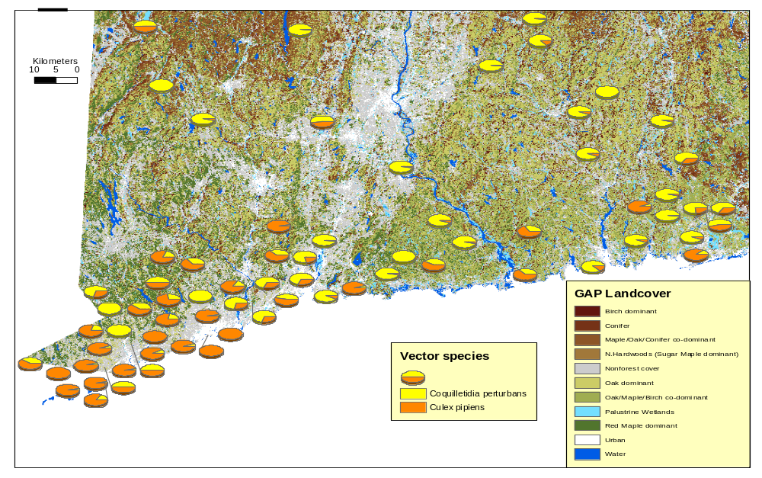
Use of Remote Sensing Data

Slide 52
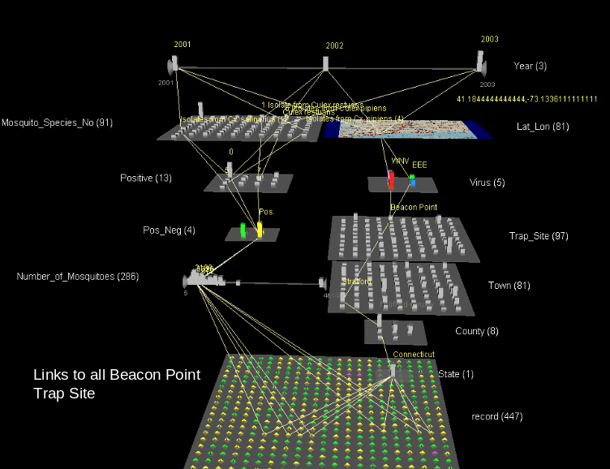
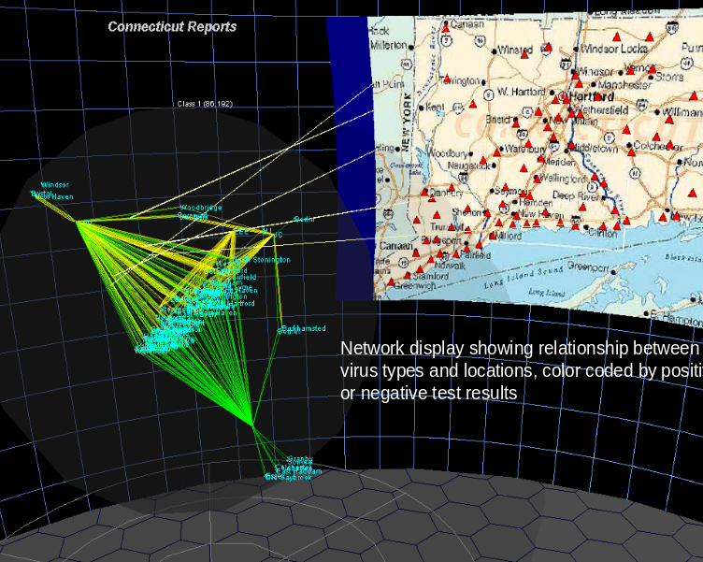
Starlight Information Visualization of CT WNV Mosquito Data

Slide 53
Other Sentinel Research/Projects
Spatial/temporal analysis of animals as sentinels of AI (Using Promed Reports)
Animals as sentinels of chemical terrorism agents
Integration of Canary Database with Comparative Genomics databases
Cross-training of veterinary and medical students in sentinel issues

Slide 54
Summary
Animal sentinel data can provide data for environmental health decision making
But: evidence gaps must be addressed
Need for greater communication between animal and human health professionals
Canary Database can be resource for evidence-based decision-making
Need for interdisciplinary development of “Sentinel Science”

Slide 55
Thank You!

