Slide 1

ATMS 597: Neural Networks
Randy Chase, Divyansh Chug, Rose Miller

Slide 2
OVERVIEW
Can we predict the intraseasonal precipitation over Central east Brazil (aka SACZ region) in the wet season (NDJFM) with a lead time of 30 days?
We will use commonly referenced predictors such as:
ENSO
MJO
Past precipitation
Soil Moisture (not so common)
How important is soil moisture for this prediction (relatively)?

Slide 3
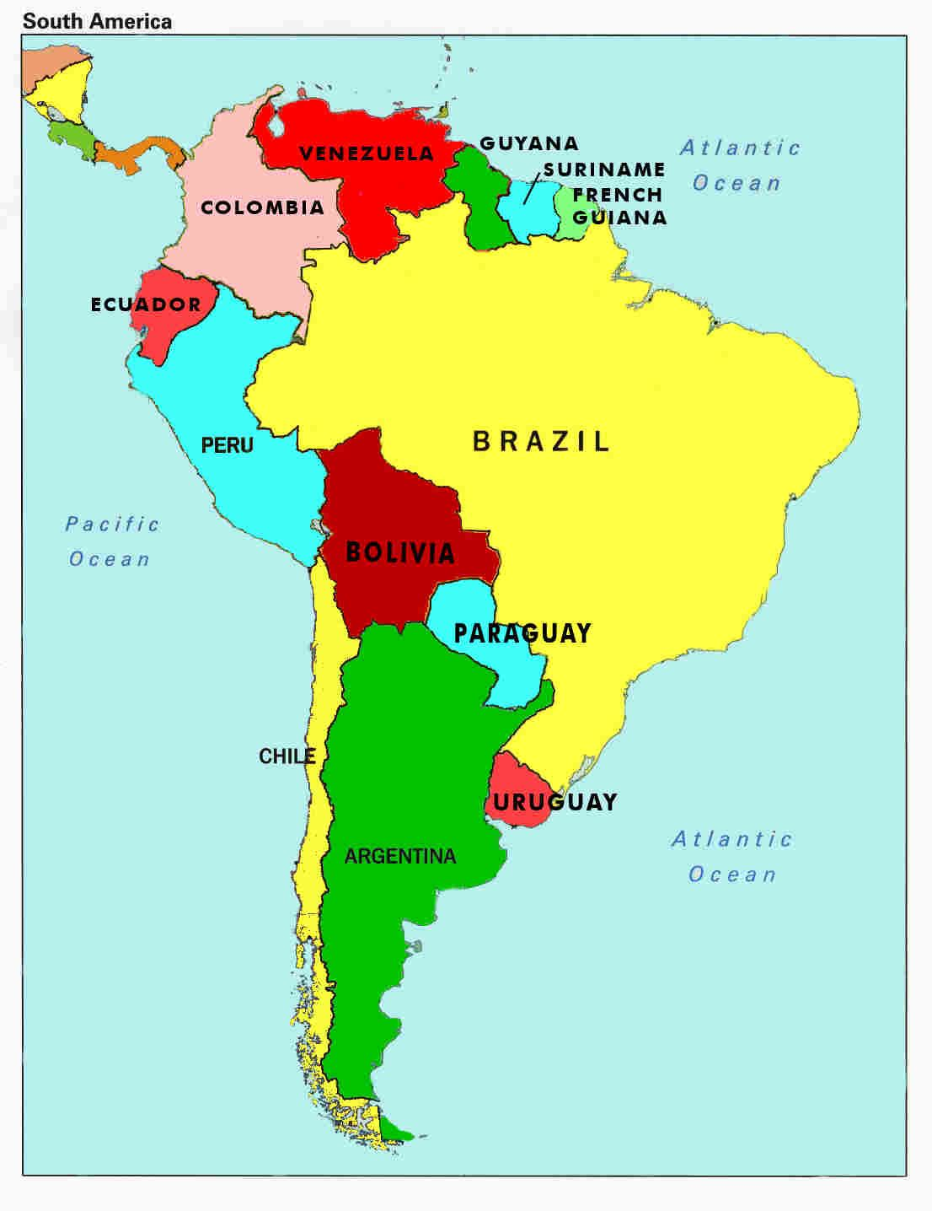
Predictors (standardized)
1. ENSO - Daily Nino 3.4 index, from SST OI v2 dataset (1981-now)
2. MJO - Daily amplitude and phase, Daily PC values of RMM1 and RMM2 modes
3. Soil Moisture - Daily SM data from GLEAM, averaged over SACZ
4. Precipitation - Daily IMERG data, averaged over SACZ
5. Synthetic - Day of year, Years since start
SACZ
A 30-day rolling mean was applied to soil moisture, precipitation, nino3.4 and MJO amplitude.
We used 10% data for testing, and same random state.

Slide 4
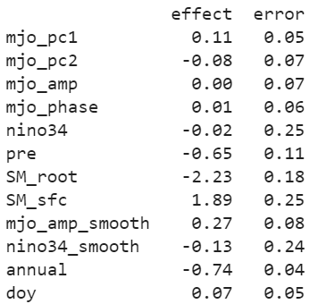
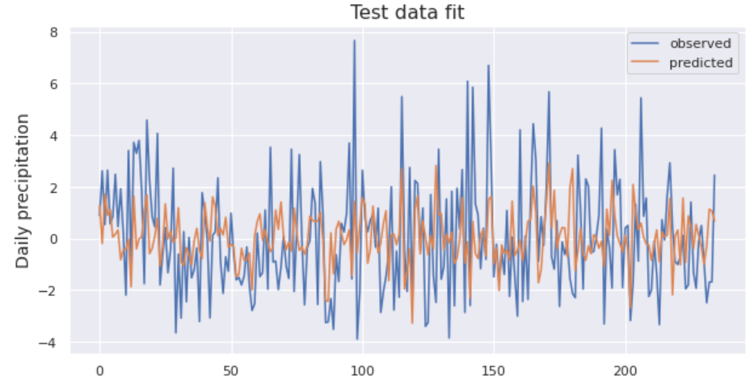
Baseline: Linear Regression
RMSE
Training | Testing
2.01 | 2.07
% correct prediction of sign of anomaly = 59.1%
Does not see extreme values

Slide 5
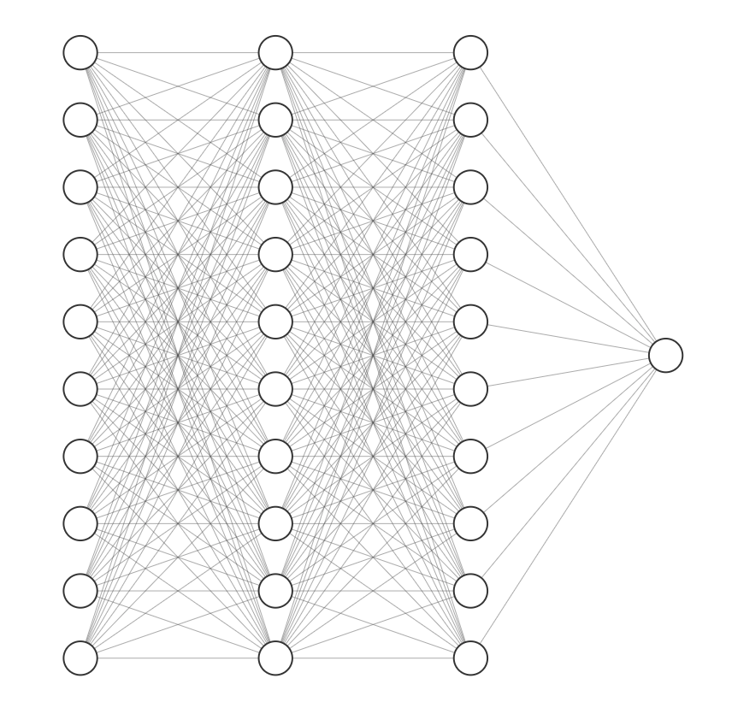
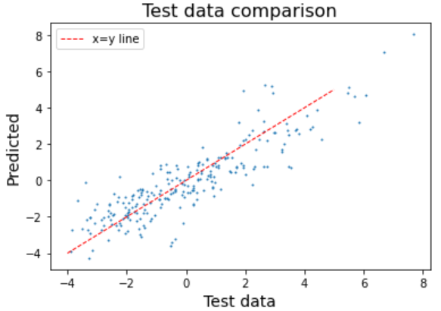
Simple Neural Network
10x10, Relu activation function, RMSprop, 500 epochs

Slide 6
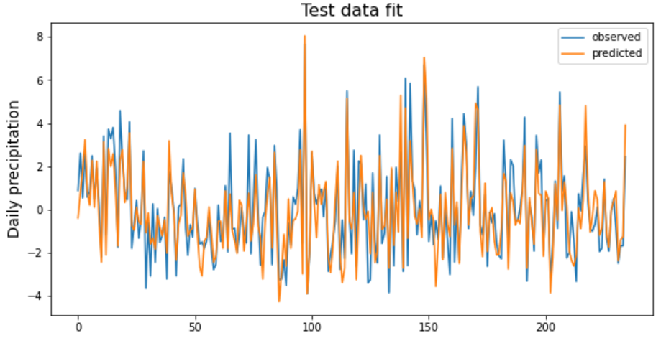
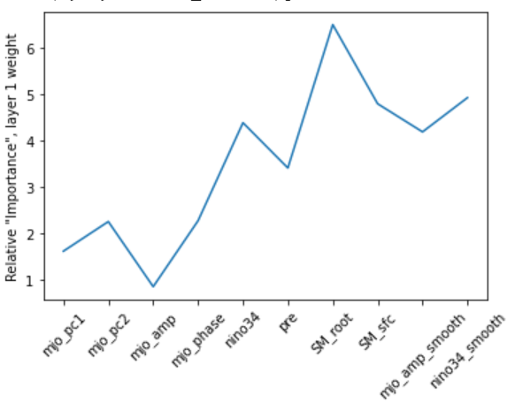
Simple Neural Network
RMSE
Training | Testing
0.84 | 1.06
% correct prediction of sign of anomaly = 86.38%
Relative importance from Layer 1

Slide 7
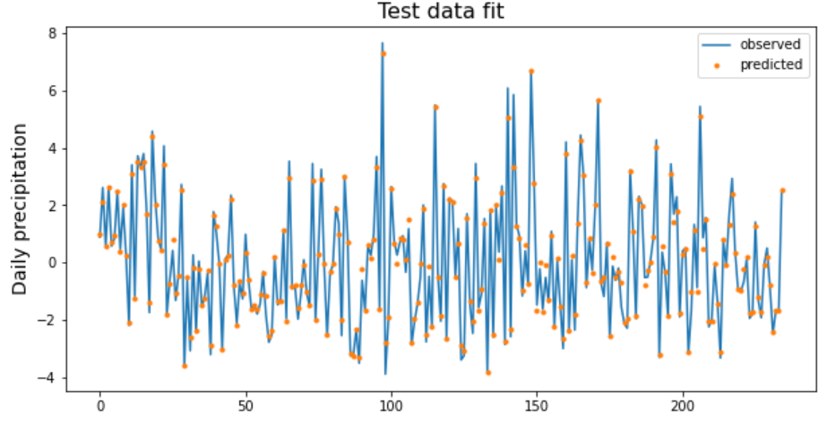
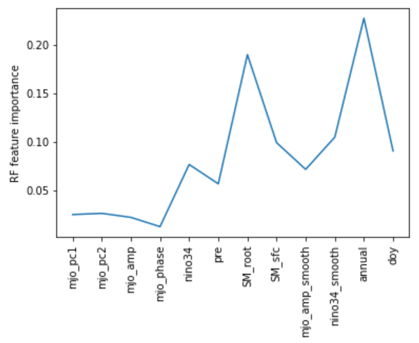
Random Forest
Because we also planted 500 Decision trees
RMSE
Training | Testing
10e-5 | 0.31
% correct prediction of sign of anomaly = 97.4%
Slight underfitting for extremes

Slide 8
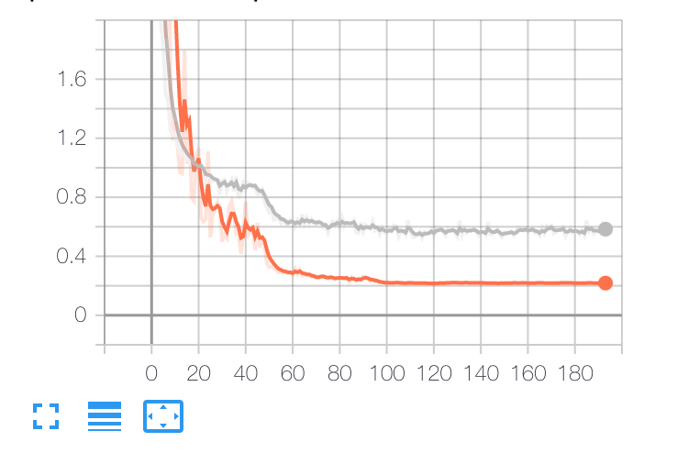
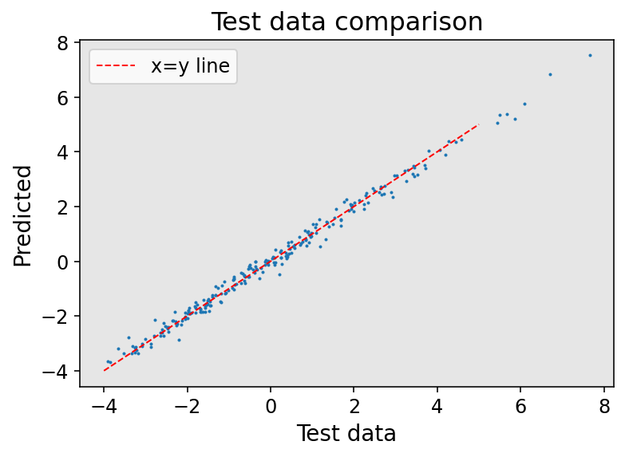
Deep Neural Network
6x1024, Relu activation function, RMSprop, ~200 epochs
Regularization: Dropout (0.2), BatchNorm after each layer
Training
Validation

Slide 9
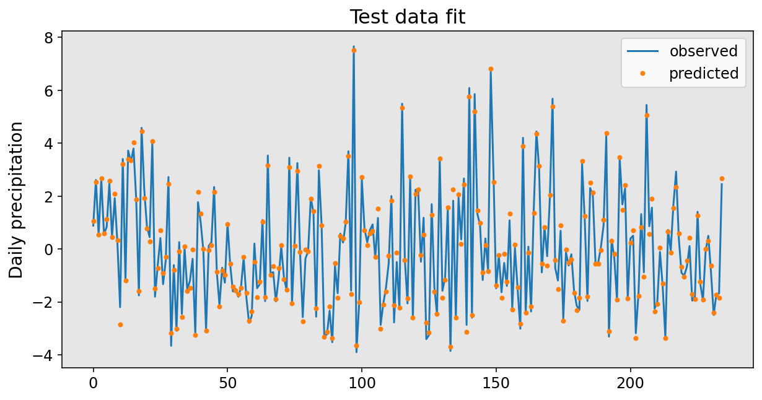
Deep Neural Network
RMSE
Training | Testing
0.22 | 0.21
% correct prediction of sign of anomaly = 97%

Slide 10

Conclusions
Random forests outperforms a simple NN
A Deep NN does the best (without overfitting), but offers the least in terms of which variables are most important.
We learned a lot.
We repeated the experiments after removing SM_sfc, since it is highly correlated to SM_root. Similar results.
We repeated experiments with 20% test data. Similar results.
So yes, soil moisture is important for accurate prediction of subseason rainfall over central east Brazil!
Doing all 3 for Steve’s Class

