Slide 1
Programming
Merit Badge

Slide 2
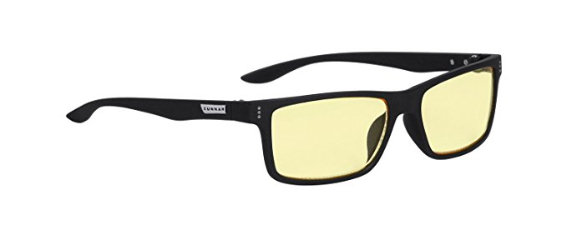
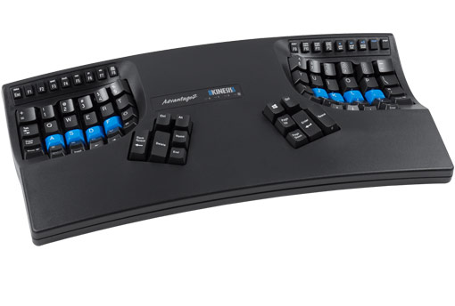
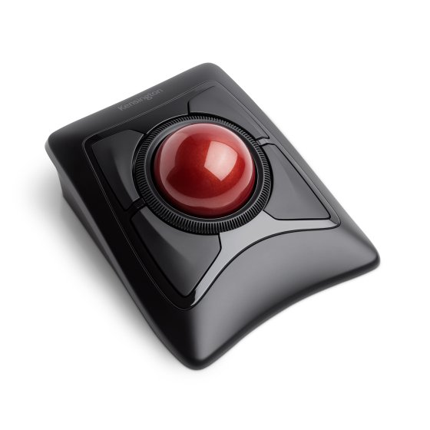
Safety
Yes, programming has some occupational hazards. But only just barely.
Eyestrain
Use tinted glasses
Get up and take walks
Ensure good lighting in the room
Repetitive Stress Injury
Use different mice and keyboards
Good posture

Slide 3
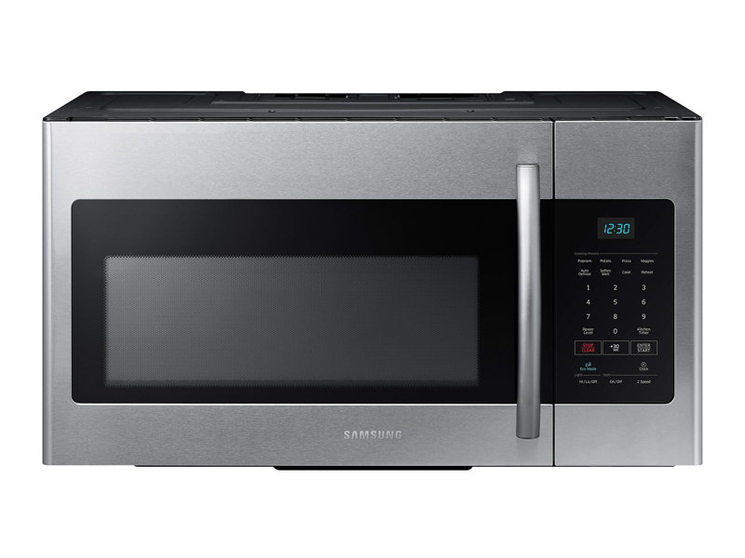
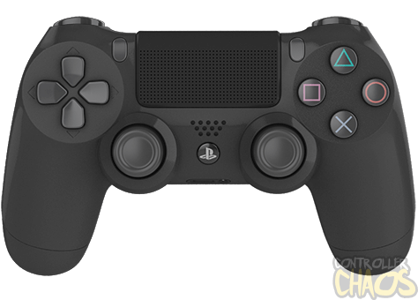
Lets talk about software
Can you name 3 devices that you use every day, that require software? (Besides a computer)
Did someone have to write a program to make it work?
Examples:
Smartphone
Game Console
Keyboard
Microwave

Slide 4
How are programs made?
Programs are written in a language that both the computer and person writing the program understand.
These programs are then compiled into machine code.
Often, the person writing the program will make mistakes.
Sometimes, the computer can catch them. These are called compilation errors. The computer cannot run a program with these kind of errors.
When the computer cannot catch them, the programmer will have to debug the program to find his mistakes.
Do you know any examples of programming languages?

Slide 5
History
Programming is a relatively new field. It has really only existed as a job for the last 70 years! Other kinds of engineering are hundreds of years older.
Every industry needs programmers. Programmers can be found in Art, Science, Math, Education, and more!

Slide 6
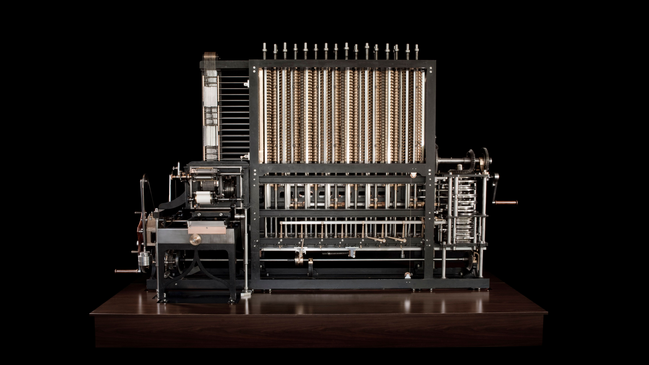
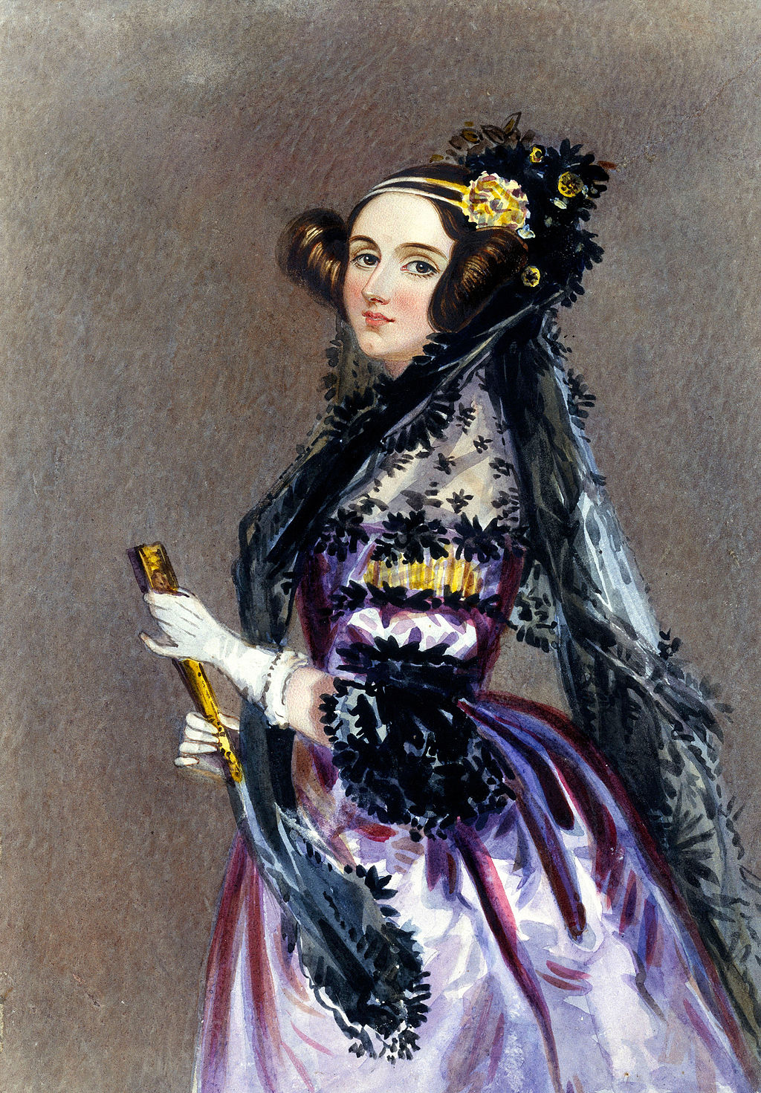
More History
Which came first – the program or the computer?
The program! It was written for a mechanical computer called the “Babbage Analytical Engine” in 1840 by a woman named Ada Lovelace.
The computer it was written for had no electronics, and was meant to be cranked by hand.

Slide 7
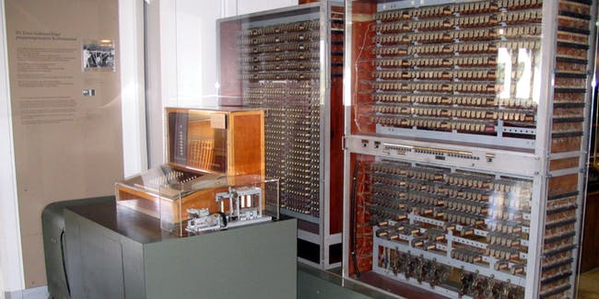
Even More History
It was many, many years before an electronic computer would be invented.
In 1941, Konrad Zuse invented the first programmable electric computer.
Programs were written on tape and fed into the machine, which would then print out a result.
There was no screen

Slide 8
Yet More History
A few years later in 1946, the first general purpose computer was created.
This means that it could run any program, and could be configured to do any kind of computation.
This computer was named ENIAC. (Electronic Numerical Integrator and Computer)
This computer was programmed by hand. It would take many days to do this, because it required rewiring the whole thing!
It filled an entire room and took many people to operate.

Slide 9
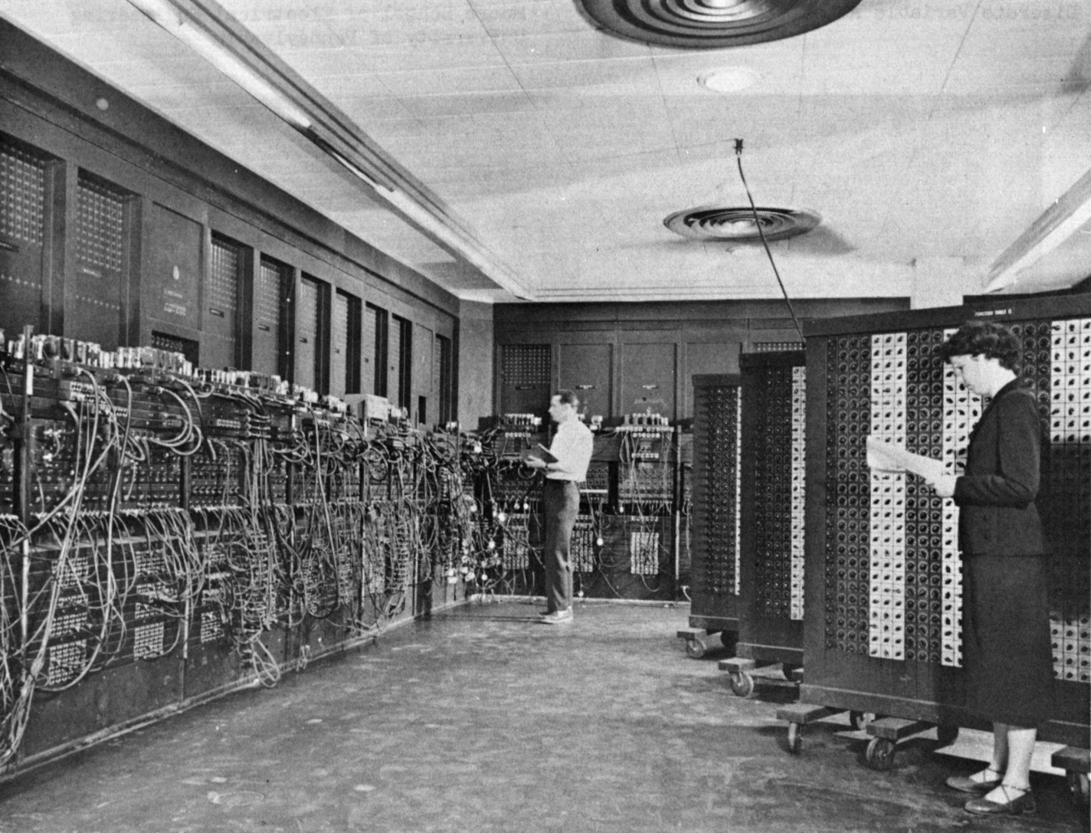
ENIAC

Slide 10
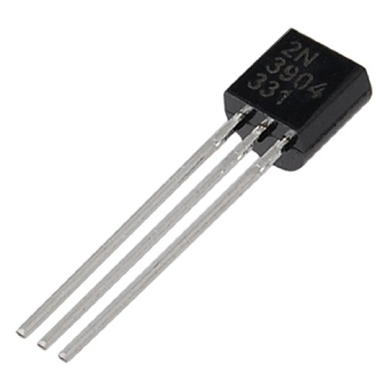
History Again
In the 1950s, computers based on Transistors began to appear.
Transistors are really tiny light switches, but work with electricity instead.
If you have a LOT of transistors, you can use them to make the different parts of a computer. Things like memory, hard drives, and processors.
These were much smaller than other methods. They were also faster, and more reliable.
The latest Processors these days contain 19.2 billion transistors.
Transistors can represent two values – 1 (on) and 0 (off).

Slide 11
The Last History Slide
As computers became more widespread, more people wanted to write programs for them.
At the time, programs were written on pieces of paper, by punching holes in the paper.
These programs were represented in binary, a pattern of 1s and 0s
Later, people used a language called Assembler to write programs.
This was better, but only a little bit
High level languages were invented in the 1960’s. This means that you write a program in one language, and the computer converts it to binary for you.
This conversion is called compilation.

Slide 12
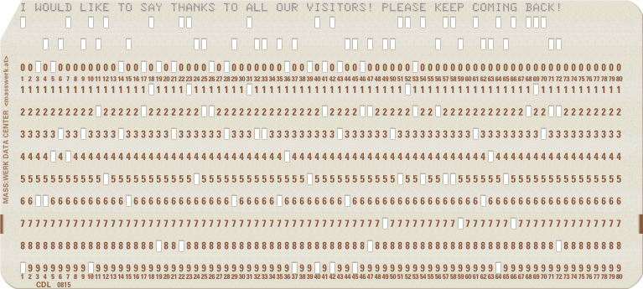
Punch Cards

Slide 13
Intellectual Property
Because programs are just information, it is easy to steal (pirate) software. Even on accident!
Here are some terms you should know:
Freeware – Software which is distributed freely.
Commercial – Software which you need to pay for.
Open Source – Software which is often free, and you also have access to the source code for the application.
Sometimes, if you make changes to the source code of Open Source, you are also required to share those changes.

Slide 14
More Intellectual Property
There are 4 kinds of property you need to be careful that you do not steal.
Patents – These protect ideas and processes. It’s the way a program does something.
Trademark – These are the words, colors, and graphics of the program.
Copyright – These protect how the program expresses ideas. This could include the code itself, or any writing that appears in the program.
Trade Secret – These are proprietary formulas and strategies.

Slide 15
Careers
Programming can be very different depending on what kind of job you have.
Here are some careers you can choose to follow as a programmer:
Software Engineer
Graphics Programmer (video games)
DevOps Engineer
Data Scientist
Researcher
Teacher
Can you think of any other ideas?

Slide 16
Lets Make A Game!

