Slide 1
NON-PROFIT EVENT MANAGEMENT · FIRST MODULE: MEDICAL CAMP
The dcica Platform
One phone-first system for registration, check-in, patient
flow, payments, and volunteers — replacing the forms-and-spreadsheets stack.
Committee demo · working software, real data

Slide 2
WHY WE BUILT IT
From forms & spreadsheets to one live system
▸ Today's pain. Registration in Google Forms, payments tracked by hand, day-of routing on paper, volunteers in email threads.
▸ One system, camp to discharge. Register → pay → QR badge → check-in → stations → labs — all connected.
▸ Phone-first, no app to install. Every volunteer screen works on a 6” phone. Tablets just show it larger.
▸ Built for 300–500 patients in a half-day. Pre-register online (80%) and walk-in on-site (20%) in the same flow.
▸ Privacy by design. No medical records ever stored. Patient data is purged after each camp.
WHAT THE CAMP DAY LOOKS LIVE
5
modules live today
9
role-based access levels
2
payment paths — Stripe + cash
0
medical records stored
dcica platform · committee demo
2

Slide 3
HOW IT WORKS
The patient journey
1
2
3
4
5
Register
Check-In
Vitals
Doctor
Labs / Vision / Dental
Online or walk-in. Pay by card or cash.
Scan QR badge. Sign waiver. Print badge.
Queue in, queue out.
Consult — can add services on the spot.
Routed by the services they paid for.
If a doctor adds a paid service mid-visit, the patient is flagged needs payment, sent to the desk, then routed on.
Every patient carries a printed badge: QR code + color-coded service dots + a station checklist.
dcica platform · committee demo
3

Slide 4
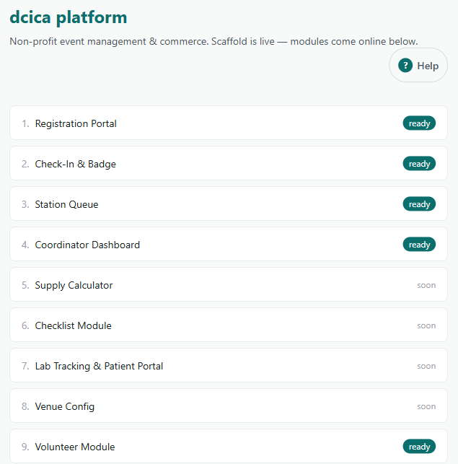
SCOPE
What's built — and what's next
▸ Live now (5). Registration, Check-In & Badge, Station Queue, Coordinator Dashboard, Volunteer Module.
▸ Coming next (4). Supply Calculator, Operations Checklist, Lab Tracking & Patient Portal, Venue Config.
▸ The core flow is done. Everything needed to run camp day end-to-end is working today.
dcica platform · committee demo
4

Slide 5
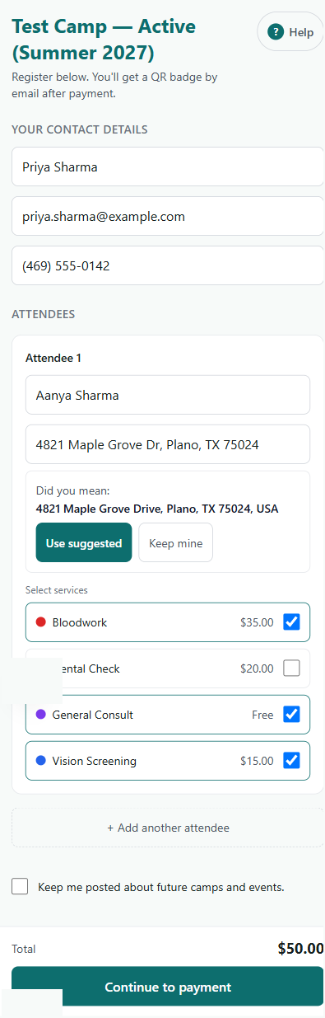
MODULE 1
Registration Portal
▸ One registrant, many attendees. Add a row per family member; each gets their own badge.
▸ Pick paid services live. Color-coded menu, sold-out items disabled, total updates as you tap.
▸ Capacity caps enforced. Registration stops selling a service once it hits the camp's cap.
▸ Address validation built in. Suggests a standardized mailing address for lab results — accept or keep your own.
▸ Pay, then you're in. Stripe card payment confirms the spot; cash handled at the desk on-site.
dcica platform · committee demo
5

Slide 6
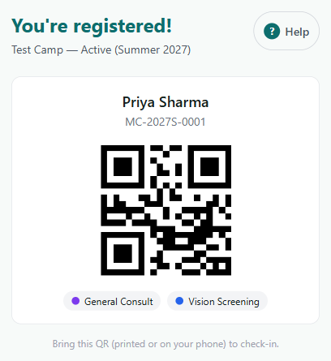
MODULE 1
Instant QR confirmation
▸ Emailed the moment payment clears. No waiting for a staff member to send anything.
▸ Unique camp ID per attendee. Format MC-YYYY·season·number, e.g. MC-2027S-0001.
▸ Scannable QR badge. Bring it on a phone or printed — it's the check-in key.
▸ Service dots at a glance. Color tags show exactly what was paid for.
dcica platform · committee demo
6

Slide 7
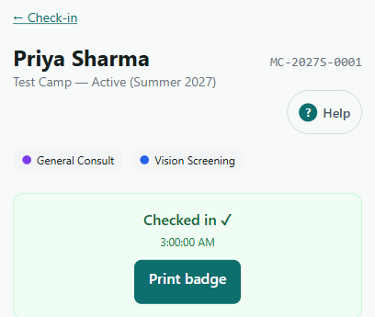
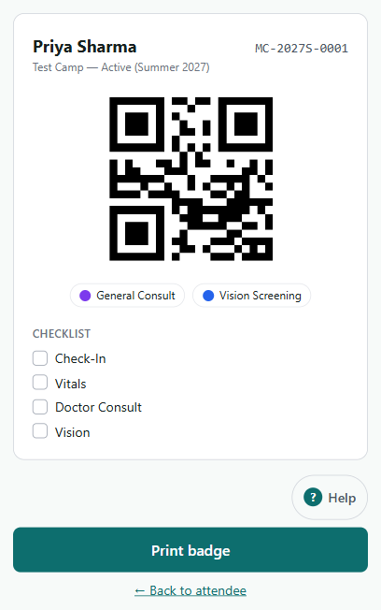
MODULE 2
Check-In & Badge
▸ Scan the QR, or type the camp ID. Camera scan at the desk; manual lookup as a fallback.
▸ Digital waiver gate. Check-in records consent before the patient enters the flow.
▸ One-tap badge print. Sends to the shared WiFi label printer from any phone.
▸ The badge is the wayfinding tool. QR + service color-dots + a checklist of stations to visit.
dcica platform · committee demo
7

Slide 8
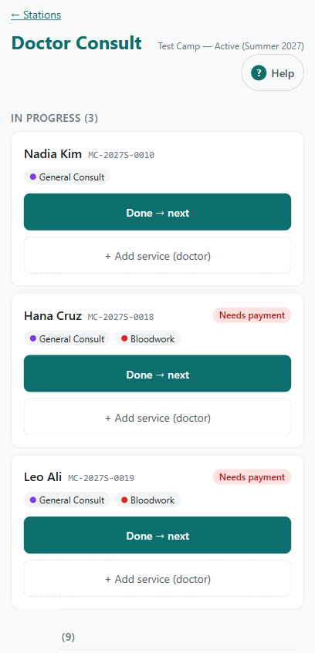
MODULE 3
Station Queue — the routing engine
▸ A focused queue per station. Volunteer sees only their station: who's waiting, who's in progress.
▸ Start → Done → next. Big tap targets move patients along and route them to the next stop.
▸ Doctors add services on the spot. “+ Add service” flags the patient and reroutes after payment.
▸ Payment alerts inline. A red “needs payment” badge shows before the patient moves on.
▸ Works on the volunteer's own phone. No special hardware required at any station.
dcica platform · committee demo
8

Slide 9
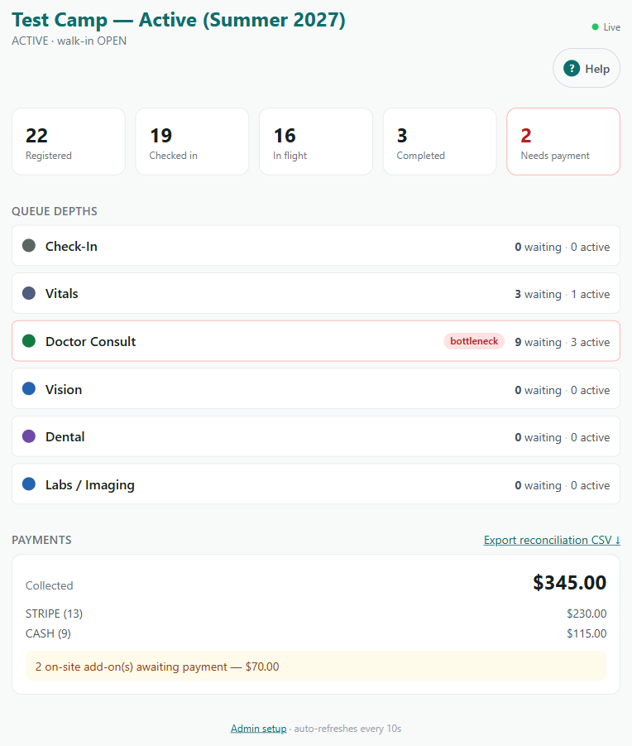
MODULE 4
Coordinator Dashboard — the god view
▸ Whole camp at a glance. Registered, checked-in, in-flight, completed, needs-payment — live.
▸ Bottleneck detection. A station that's backing up is flagged red so help can be moved.
▸ Money reconciled in real time. Stripe vs cash totals, plus add-ons still awaiting payment.
▸ Treasurer's export. One click for the reconciliation CSV.
▸ Auto-refreshes every 10 seconds. Readable on a phone, expands on a TV display.
dcica platform · committee demo
9

Slide 10
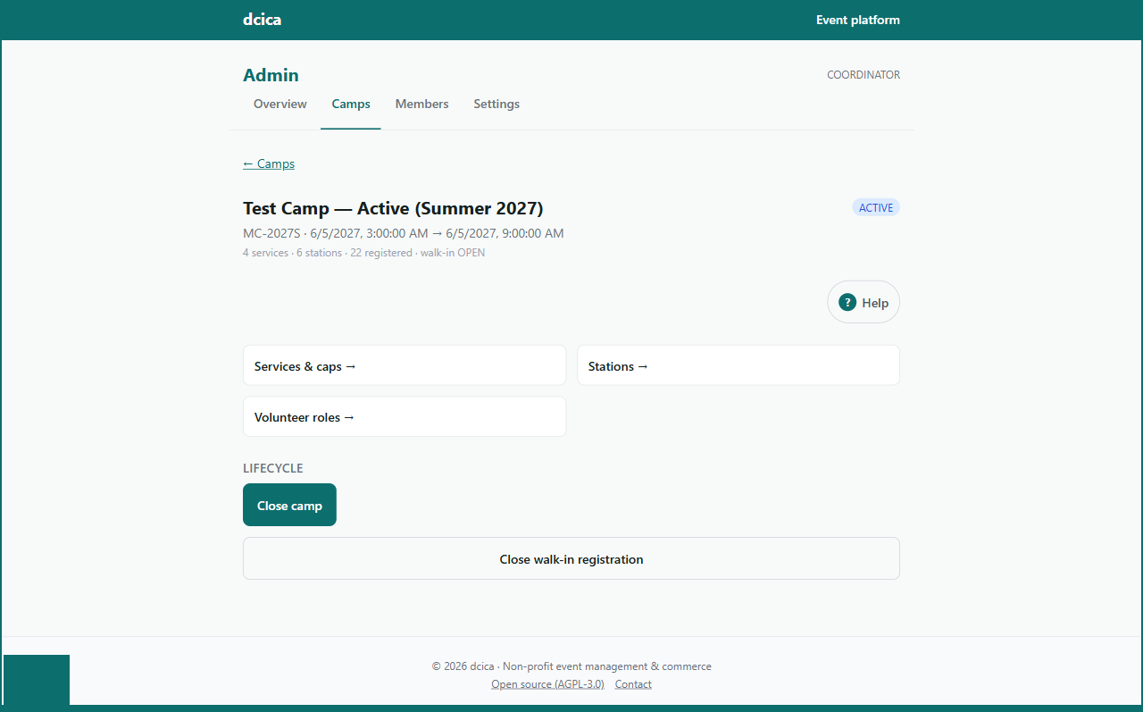
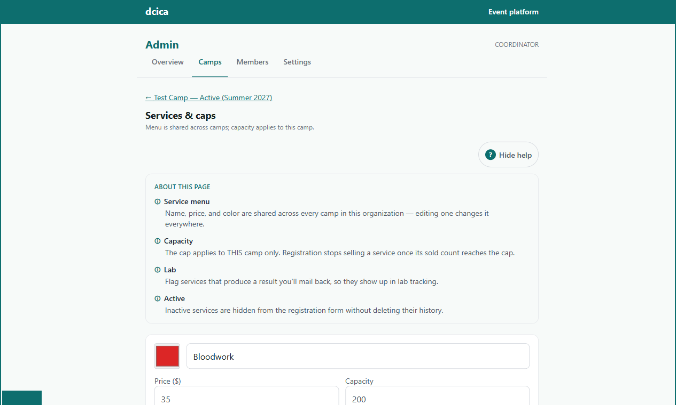
SETUP
Configuration over code
▸ Coordinators set up camps — no developer. Services, prices, capacity caps, stations and volunteer roles are all settings.
▸ Shared service menu, per-camp caps. Edit a service once; set how many seats this camp sells.
▸ Color = the badge dot. The color you pick here is what volunteers see on badges and queues.
▸ Lifecycle with a built-in purge. Draft → Open → Active → Closed → Purged removes patient data after the camp.
dcica platform · committee demo
10

Slide 11
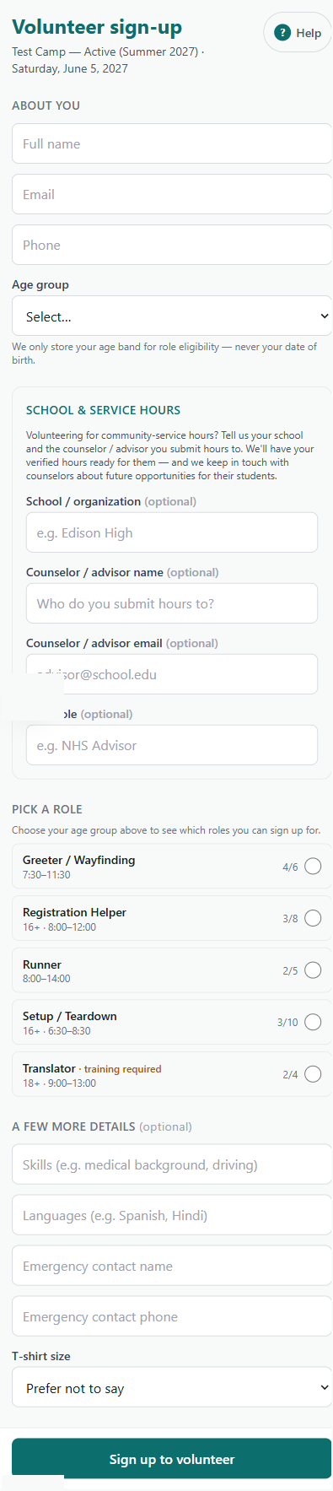
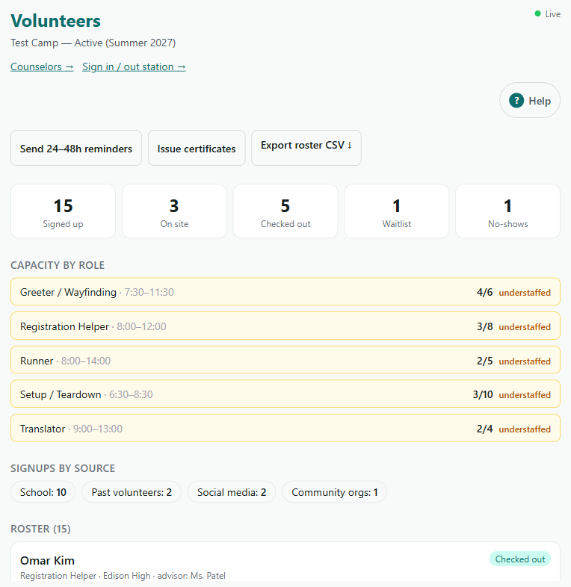
MODULE 9
Volunteer Module
▸ Self-serve signup. Roles with capacity, age limits, and shifts.
▸ Student service hours. Captures school + counselor to verify hours.
▸ Live staffing view. Understaffed roles flagged for the coordinator.
▸ Day-of QR sign in/out. Tracks hours automatically.
▸ Reminders & certificates. 24–48h nudge; certificates after.
▸ Privacy-safe. Age band only — never a date of birth.
dcica platform · committee demo
11

Slide 12
TRUST
Privacy & safeguards
No medical records. Ever.
Data purged after each camp.
We store name, phone, and the services paid for — nothing clinical. No diagnoses, results, or insurance data.
Patient records are camp-scoped and removed when the camp closes — enforced by the camp lifecycle.
Role-based access.
Cash handled safely.
Nine roles, from coordinator to station volunteer. People see only what their job needs.
Only assigned till-holders see the cash option; everyone else is Stripe-only. Cash is reconciled separately.
dcica platform · committee demo
12

Slide 13
UNDER THE HOOD
Built to last — and already live
▸ Modern, proven stack. Next.js web app, PostgreSQL database, hosted on Vercel.
▸ Stripe for payments. Card online and on-site; each org connects its own account.
▸ Open source (AGPL-3.0). Self-hostable; no vendor lock-in; reusable by other non-profits.
▸ Multi-tenant ready. dcica is the first org; the platform is built to host more.
▸ Secure sign-in. Google / Microsoft / GitHub login with tenant-scoped roles.
LIVE TEST ENVIRONMENT
medcamp-sigma
.vercel.app
Running now with seeded demo data — every screen in this deck is real, not a mockup.
COST POSTURE
Free-tier hosting today. Non-profit Stripe rate at go-live. No per-seat licensing.
dcica platform · committee demo
13

Slide 14
WHAT WE'D LIKE FROM THE COMMITTEE
Next steps
Try it. Open the live link and run a registration end-to-end.
Confirm the service menu & prices. So we can lock capacity caps for the next camp.
Name the coordinators & till-holders. We assign roles before camp day.
Green-light modules 5–8. Supply calculator, checklist, lab tracking, venue config.
Approve go-live items. Live Stripe keys + non-profit rate, and a custom domain.
dcica platform · medcamp-sigma.vercel.app

