Slide 1

http://RandomTest.net
Random Integration Tests For Your Continuous Integration Toolchain
By
Dariusz Cieslak
dc at aplikacja.info

Slide 2
Unit Tests?
I strongly believe in Unit Tests efficiency
Are great for automation, but:
Are hard to implement properly
Requires architectural changes (deps!)
Integration issues not visible there: performance, resources, …
So then … ?

Slide 3
QA Team Activity
I do appreciate our QA teams effort – it's important part of any project and cannot be omitted
But: any human activity (including mine) is expensive – we would like to use them as effectively as possible
How to minimize the effort?
→ AUTOMATION!

Slide 4
Record'n'Play Integration Tests?
Simple idea: record events in application and reply them automatically
Have you seen big 100% working UI scripts after 1 year of development? Me: NOT
Fragile due to changes in application
Fragile due to environment state
→ Requires big effort to maintain

Slide 5
Contracts!
An Idea from Eiffell language:
1. Embed assertions in your code
2. Supply runtime coverage somehow (run the stuff)
3. App will crash on unmet assertion when found
4. Fix the issue then goto 2

Slide 6
Code Coverage – How?
Manual tests are important but expensive (boring?)
Scripted automation – requires big effort for maintenance
Solution: RANDOMISATION! – cheaper method to deliver runtime codebase coverage

Slide 7
Results Verification – How?
Do not try to verify output of the randomised input – it won't work
Assert / Require / Expect / @pre / @post / … are your friends
Replace static test cases (data – dependant) with contracts (data – independant)
Collect any failed assertion for aggregations in central repository

Slide 8
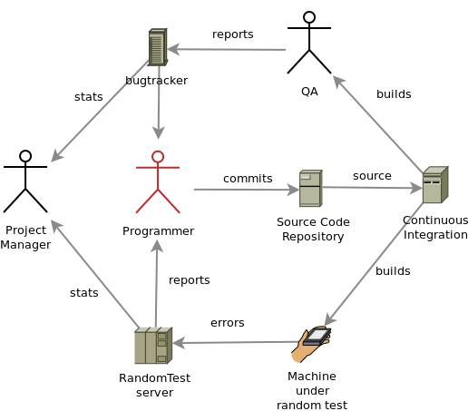
QA + RandomTest setup

Slide 9
About Us
Aplikacja.info delivers software consulting services
We're The Continuous Integration Freaks
RandomTest.net supports C/C++, Java, PHP at the moment, more to come!
Need more information? Please visit randomtest.net for full source code (LGPL-ed) and documentation

