Slide 1
Containers and Microservices
Project : Refactor Udagram App into Microservices and Deploy

Slide 2
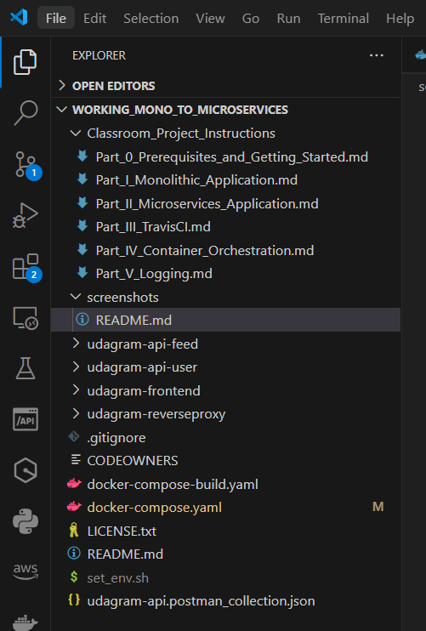
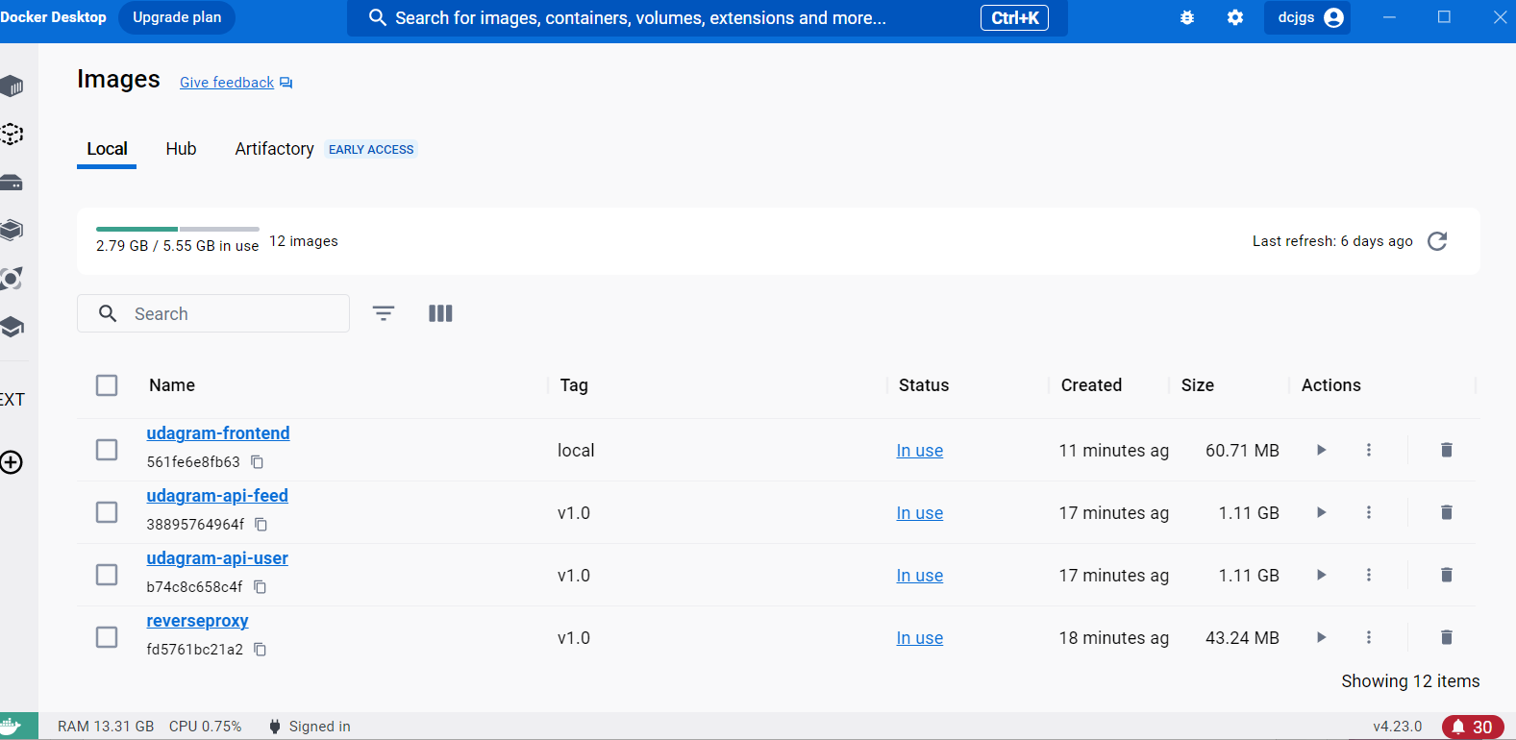
Project: Refactor Monolith to Microservices
/feed, /user backends are
separated into independent projects
Docker images created

Slide 3
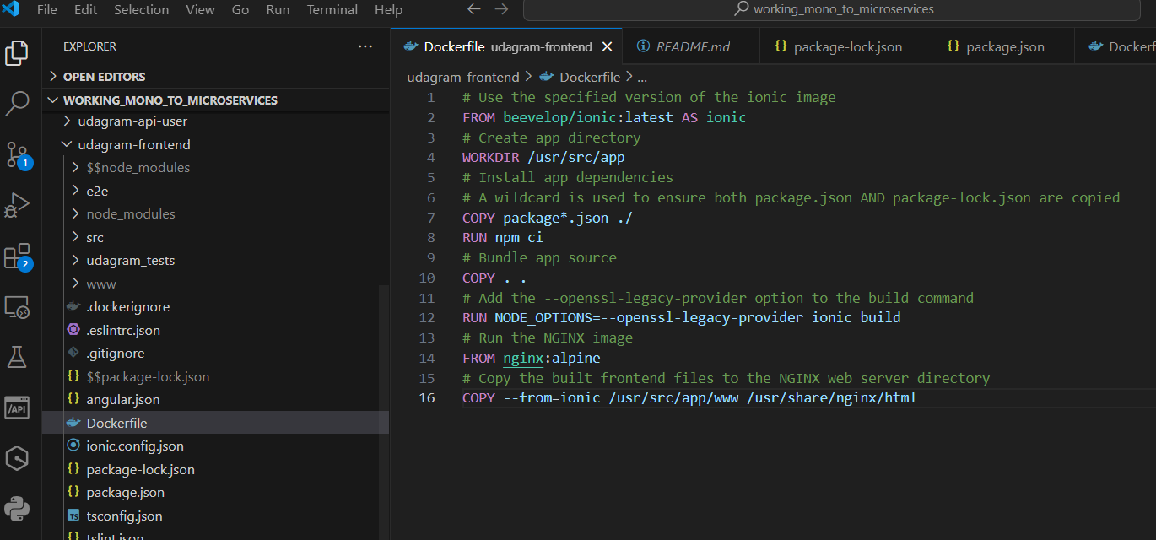
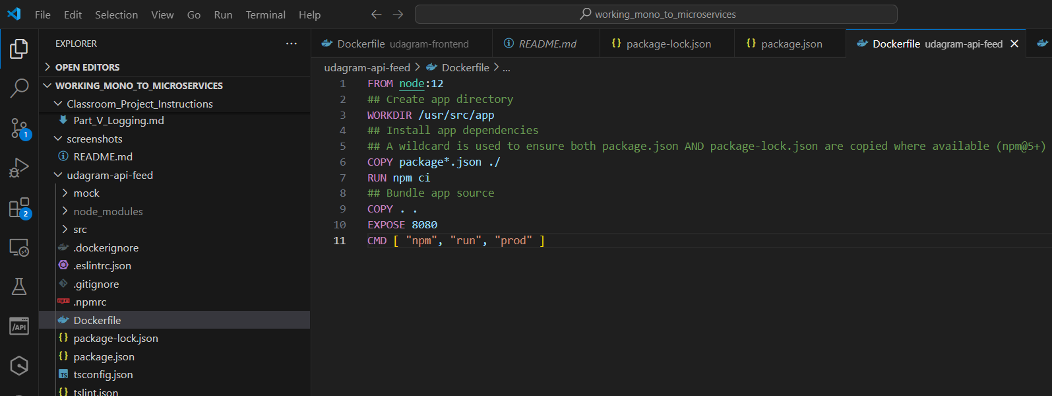
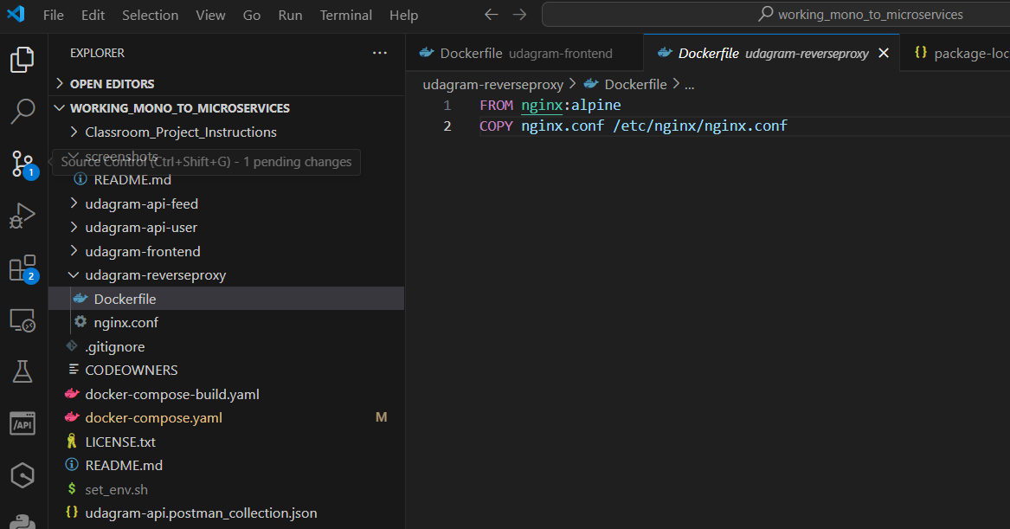
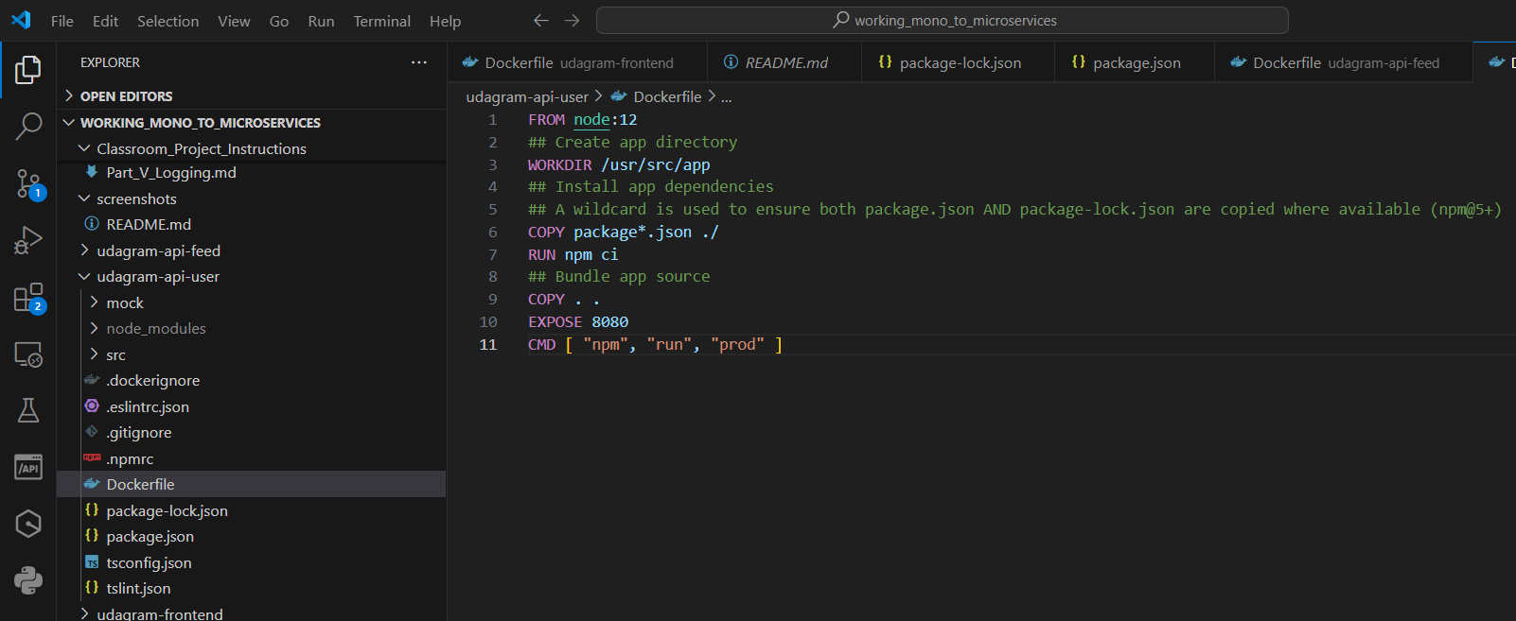
Project: Refactor Monolith to Microservices
Docker files to successfully create Docker Images for /feed,/user backends,frontend and reverse proxy

Slide 4
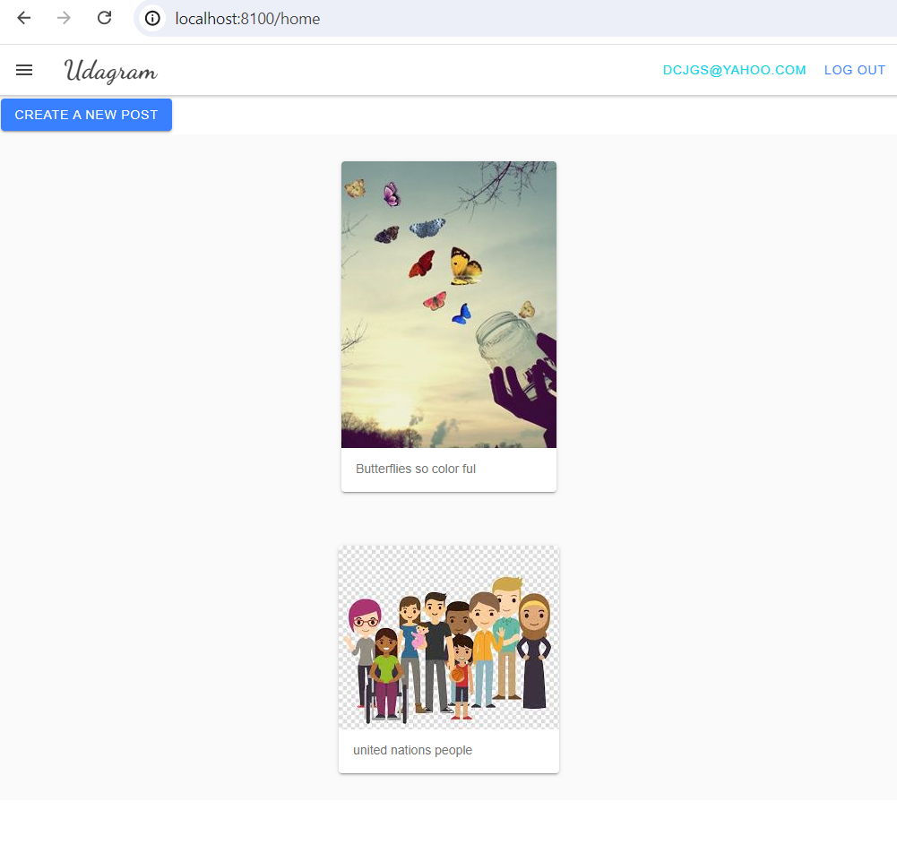
Project: Refactor Monolith to Microservices
http://localhost:8100/home

Slide 5
Independent Releases and Deployments

Slide 6
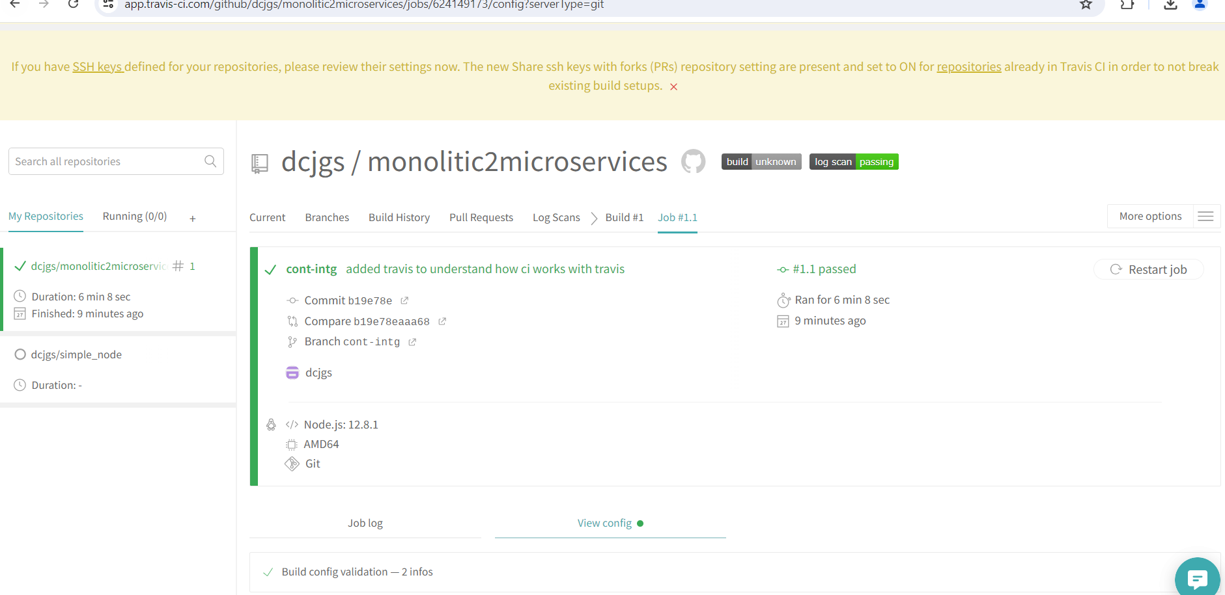
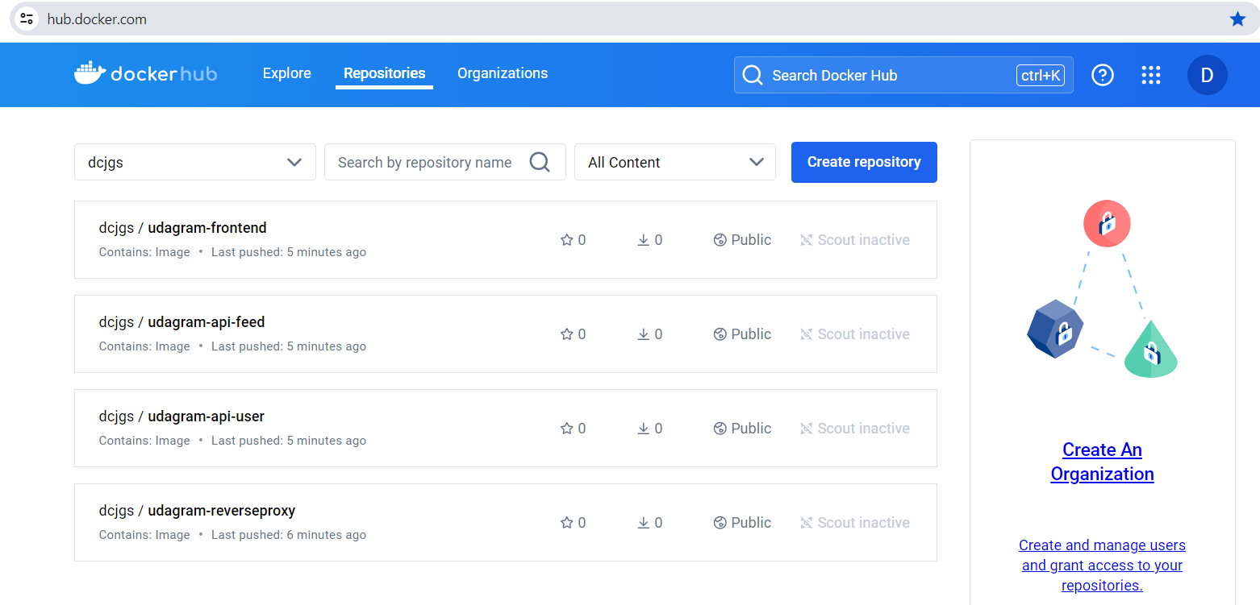
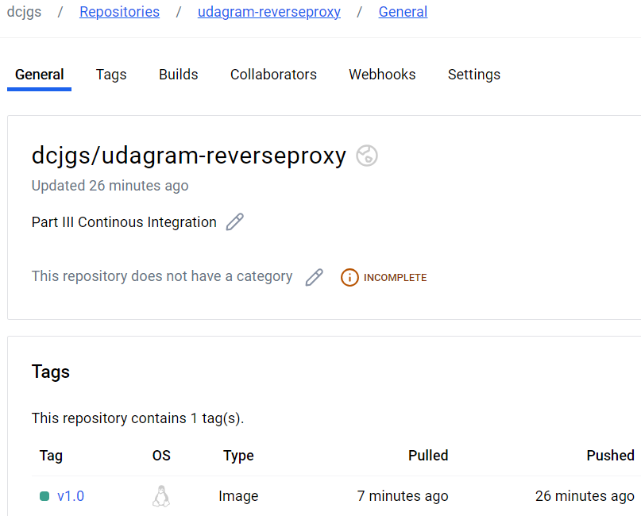
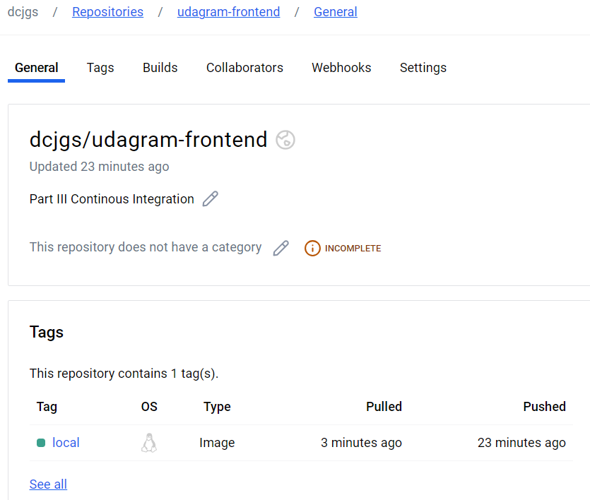
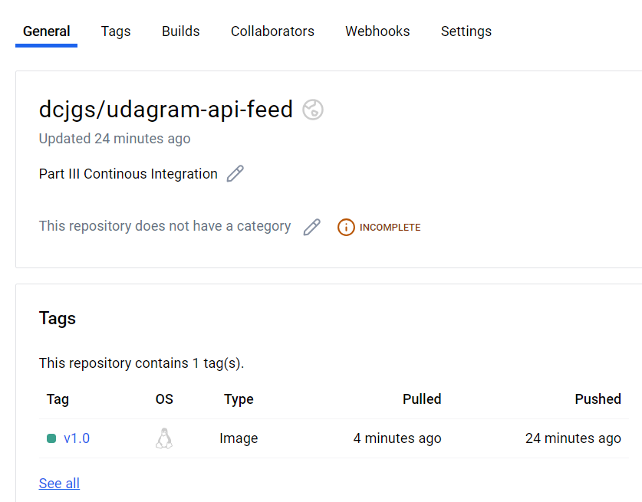
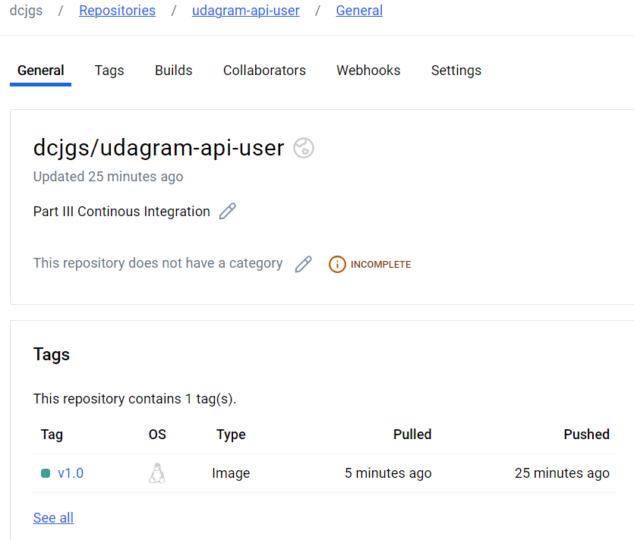
TravisCI build pipeline showing successful build jobs

Slide 7
Service Orchestration with Kubernetes
Deploy microservices using a Kubernetes cluster on AWS

Slide 8
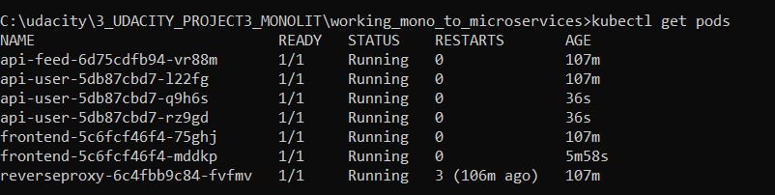
Kubernetes kubectl get pods output

Slide 9
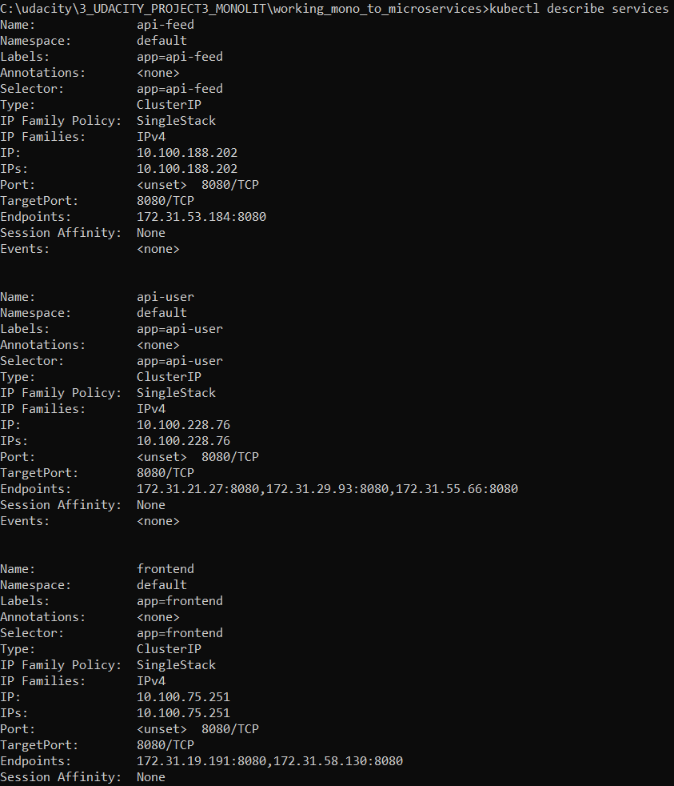
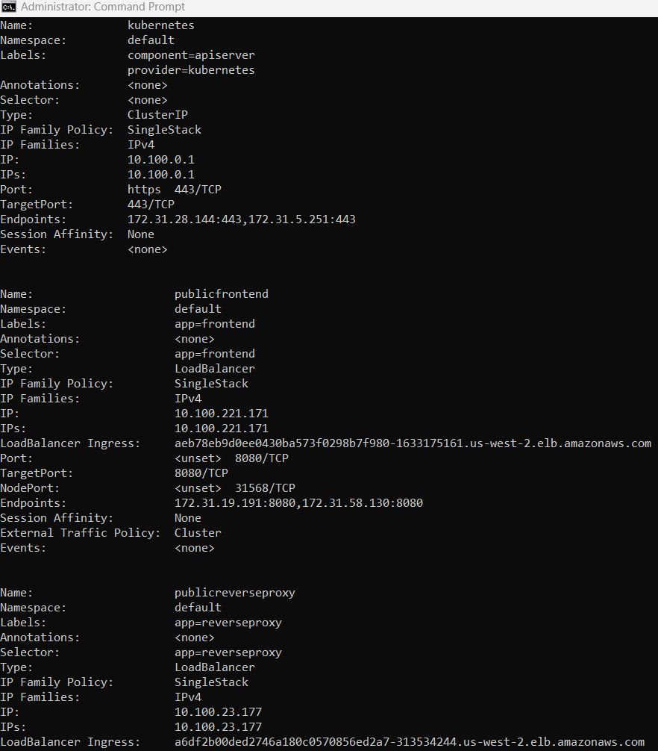
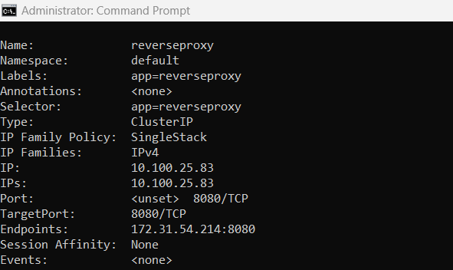
Kubernetes kubectl describe services output

Slide 10
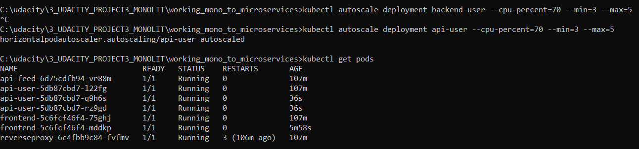
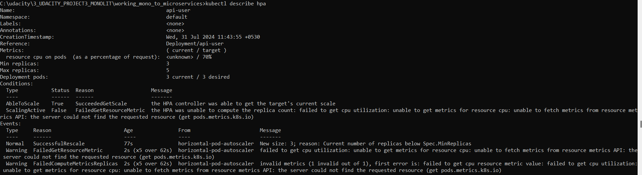
Kubernetes kubectl describe hpa output

Slide 11
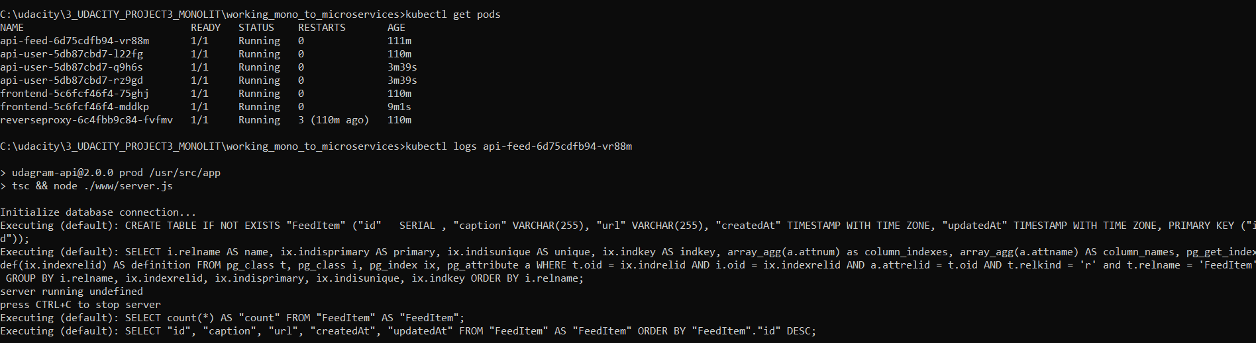
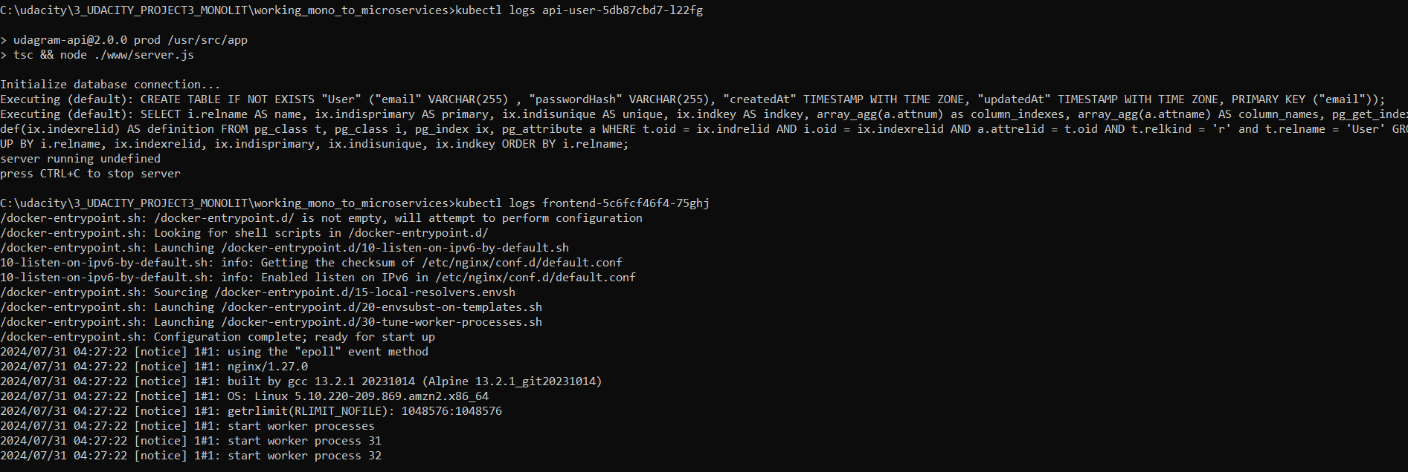
Kubernetes kubectl logs <your pod name> output

Slide 12
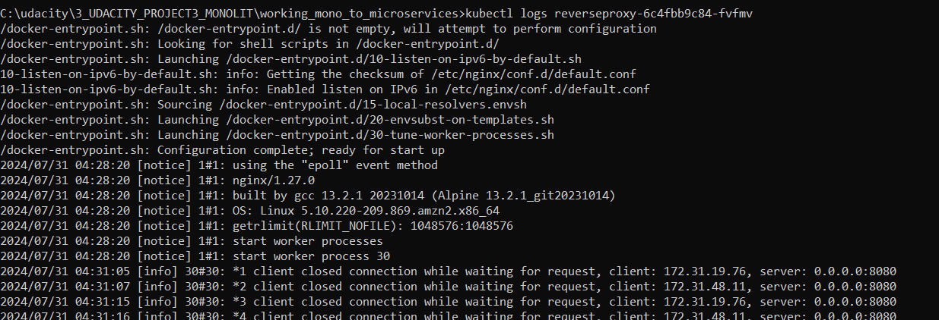
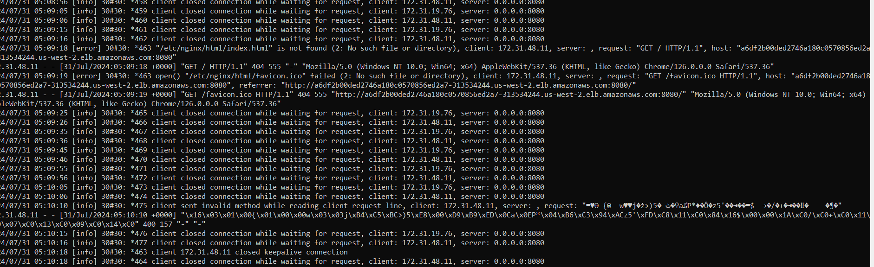
Kubernetes kubectl logs <your pod name> output

Slide 13
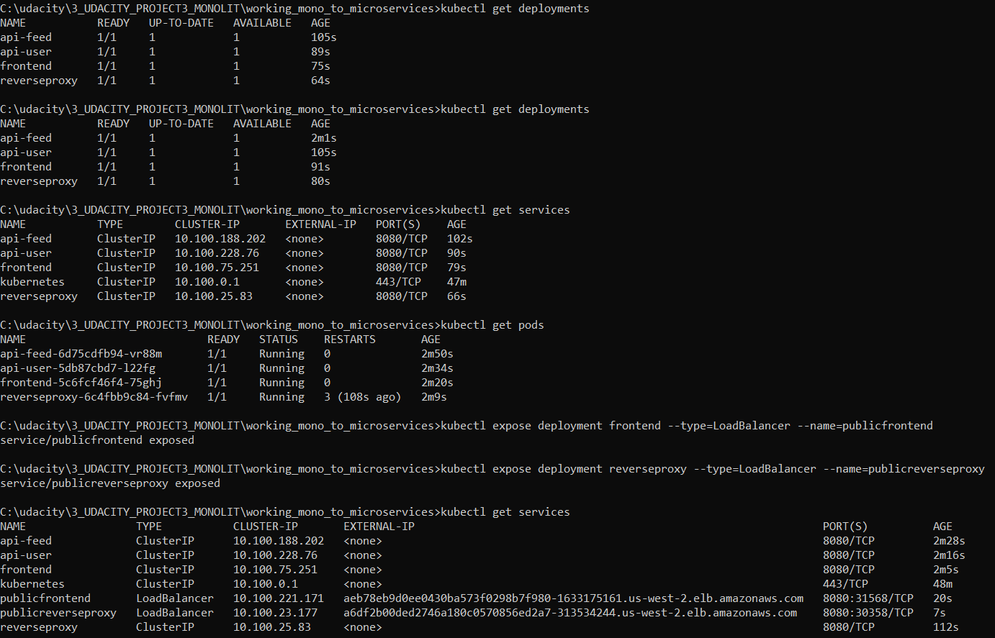
Misc

