Slide 1
jQuery Tic-Tac-Toe
Danny Lopez: mysql database + passportjs
Michael Greg Kilmer: all things front-end
Habeeb Olawin:
Darshak Surti:

Slide 2
Motivation
Had to scale back from original project idea
Knew group availability was limited
Wanted to get a robust, polished, and working application

Slide 3
Uses
Game to kill time
Shows record of games played
Logs in using your Facebook account, effectively a Facebook App

Slide 4
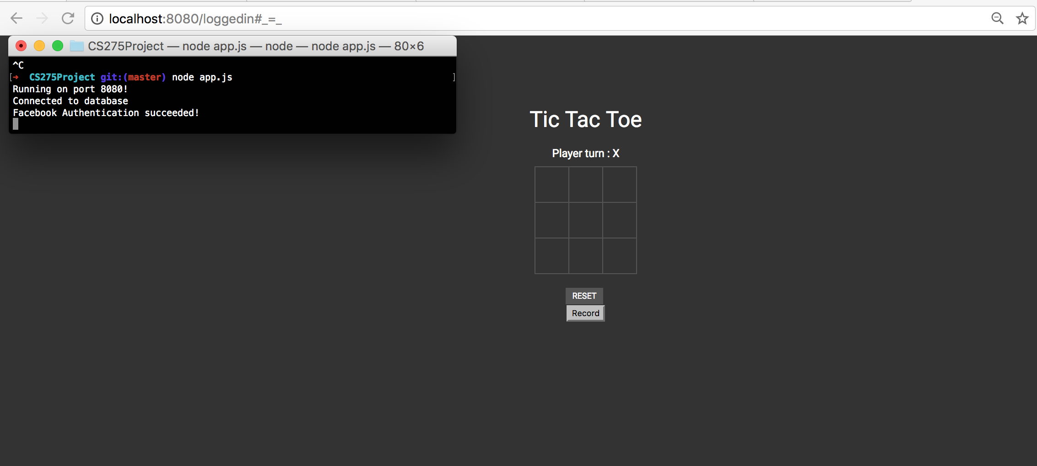

Dataflow + nodejs
→

Slide 5
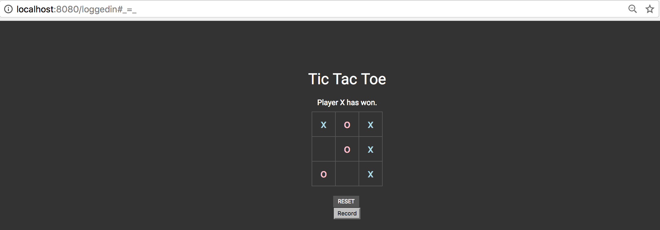
SQL insert called using Ajax upon every round completed. User logged in + winner, X or O, included

Slide 6
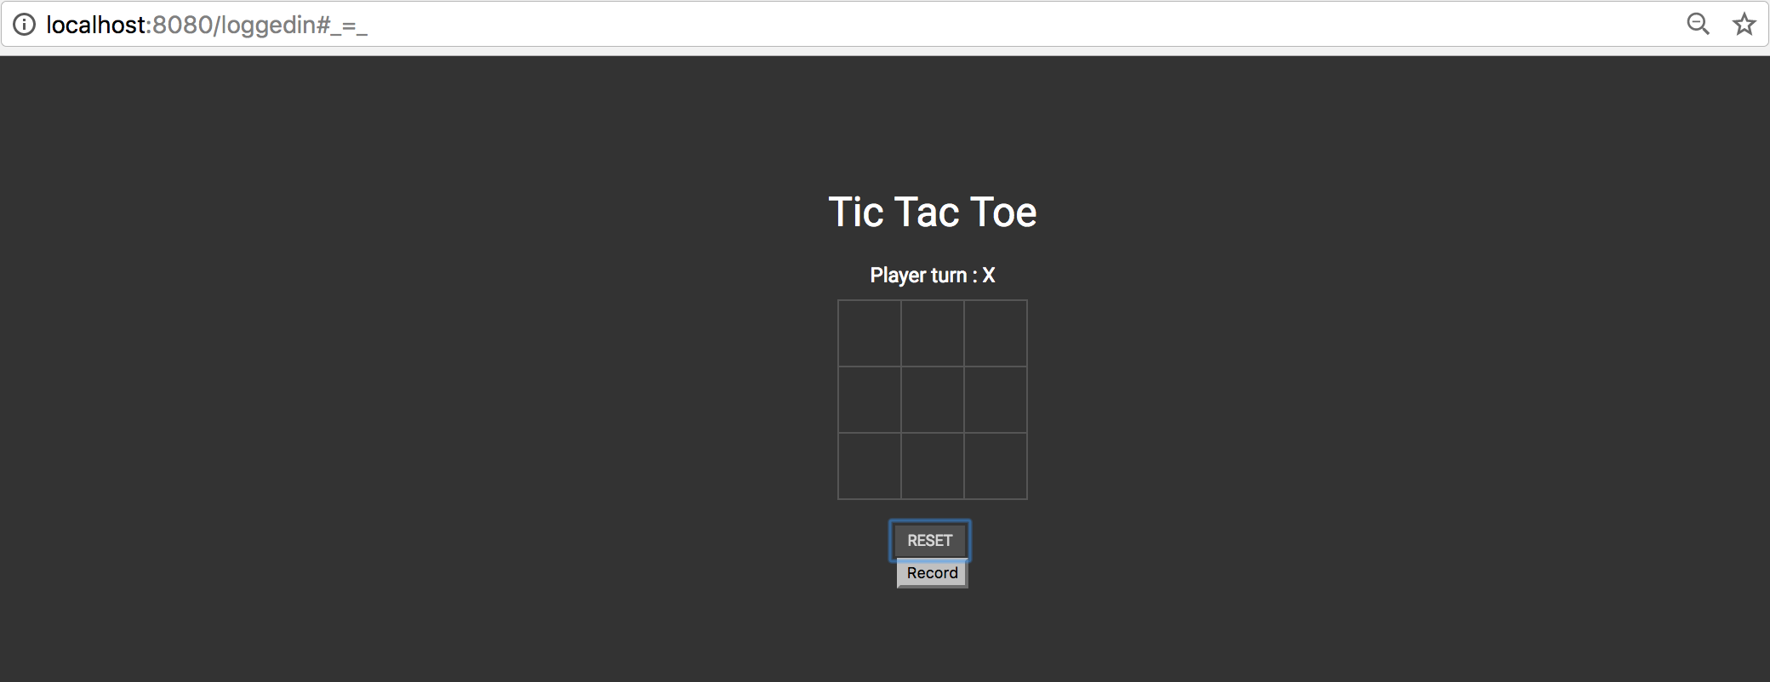

Slide 7
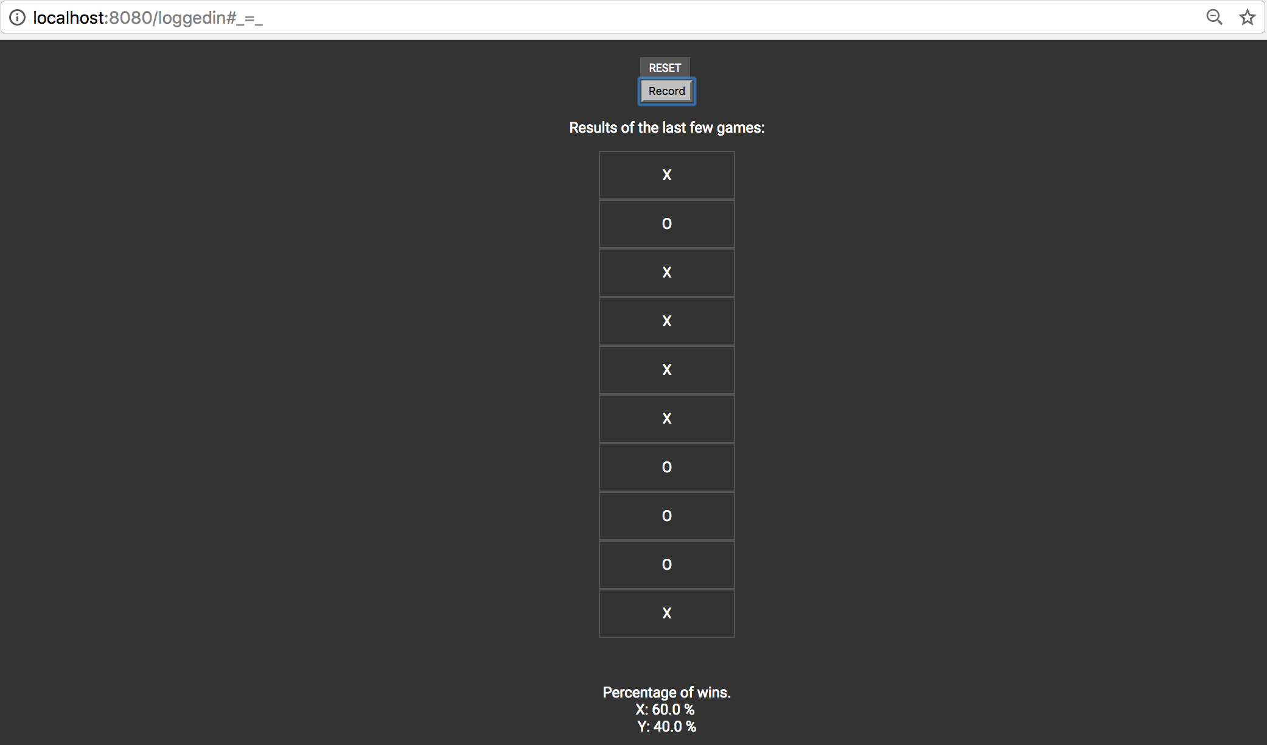
Table is populated by an Ajax call to NodeJS file, which makes a SQL select statement

Slide 8
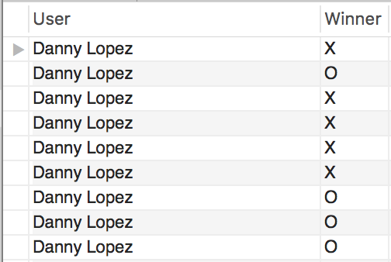
MySQL Database

Slide 9
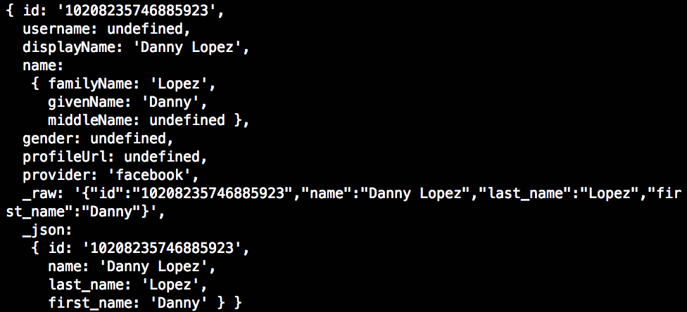
Passport.js + JSON

Slide 10
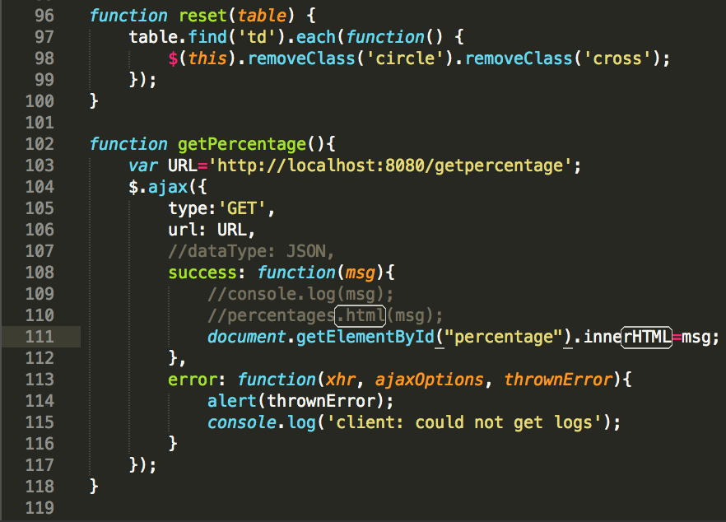
Ajax + jquery
Ajax used to make calls to connect with MySQL database
jQuery used in tictactoe.js file

Slide 11
Expansions…when allotted extra time
New levels, selectors with different themes
AI
More games: Checkers, chess, pong, snake?

Slide 12
Challenges and lessons learned
Coordination with group members
PassportJS: Issues with creating a login page with href to login through Facebook, then for Facebook to redirect to the app
After more research, our implementation was blocked as a phishing prevention mechanism
Suggestions for this?
Over-ambitious project initially, then working around other projects

Slide 13
Questions?

