Slide 1
Covid-19 Forecasts: US and Arizona
Exploratory data analysis by Daniel clark and gavin hudgeons

Slide 2
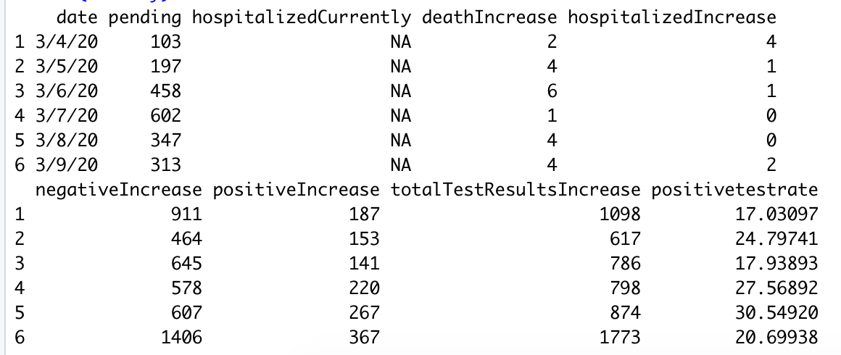
Data source
Sourced from John’s Hopkins Research Lab that covers US and Global cases
Arizona State-wide Data and U.S. National Data
Date Range: 3/4/2020 – 7/21/2020
* Positive Percentage reflects the percent of tests that come out positive

Slide 3
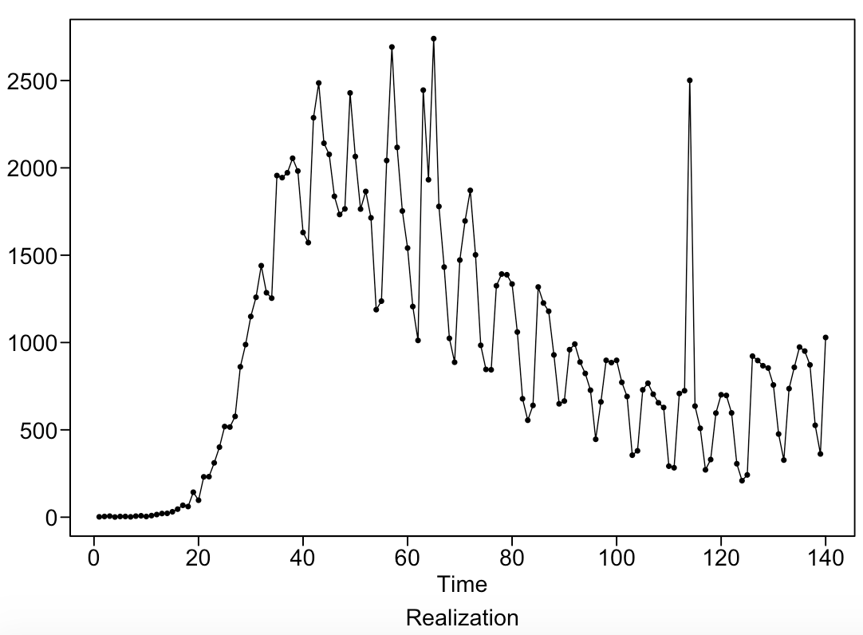
US Data detail
Key Features: Date, New Deaths per Day, New Hospitalizations Per Day, New Positive Tests Per Day, New Negative Tests Per Day, Total Test Results Per Day, and Positive Percentage*
US Daily dataset: 140 Rows, captured from John’s Hopkins Research Lab
Started on March 4th, as the data is very flat in the weeks before
US Daily Deaths: Mar. 4 – Jul 21

Slide 4
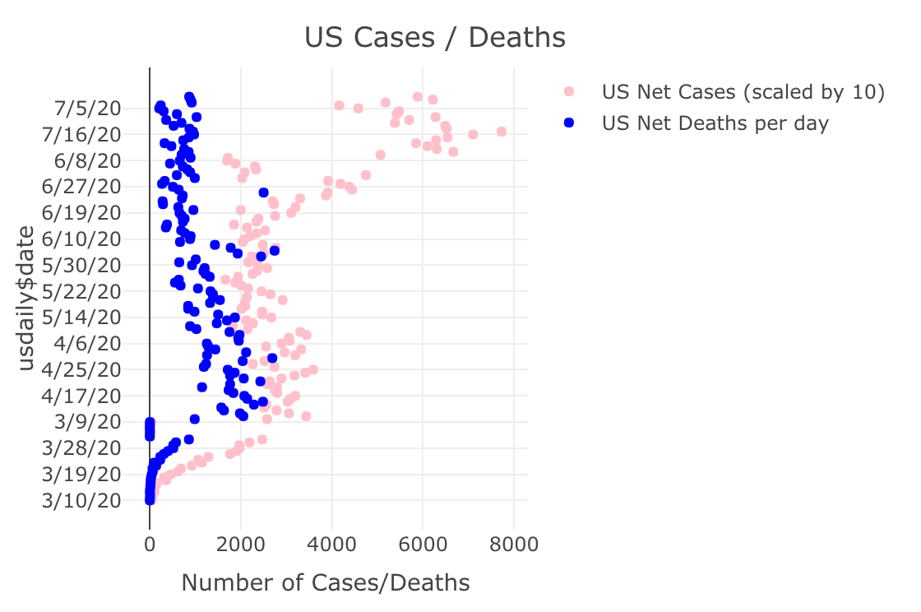
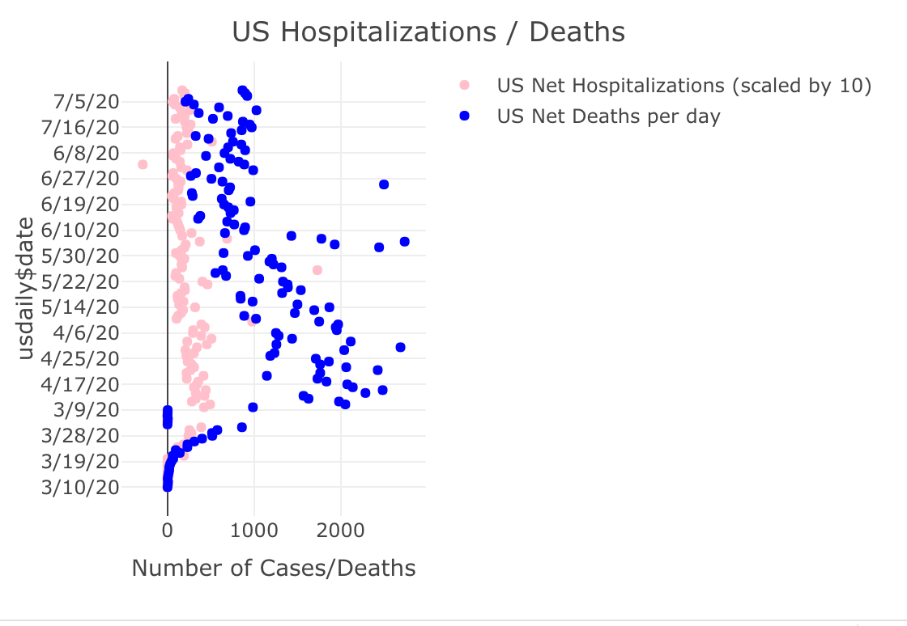
EDA
Reviewing both a comparison of hospitalizations and cases over time with deaths, we have not seen a that deaths and hospitalizations have not spiked with the influx of new cases since June.

Slide 5
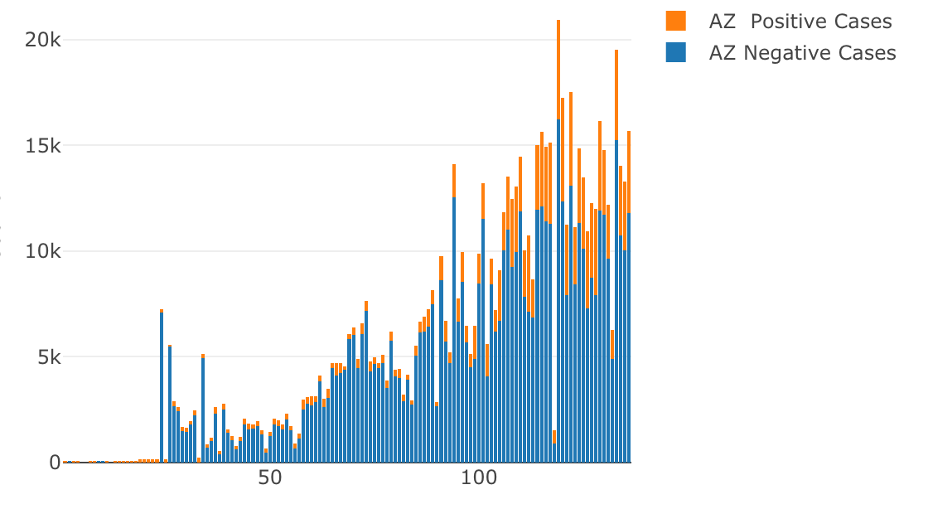
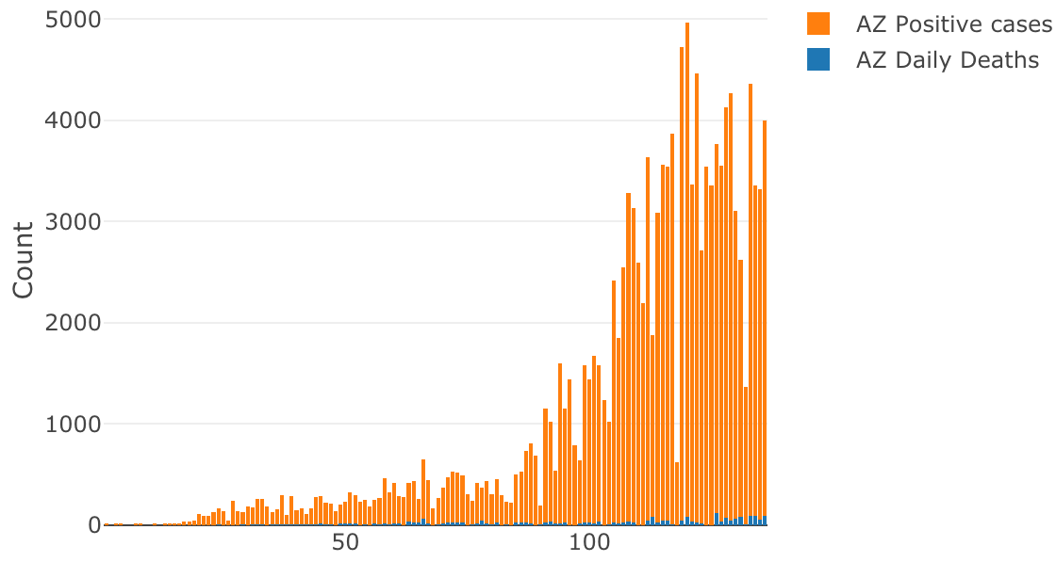
EDA
Looking specifically at the Arizona data, we have a couple of interesting findings.
The amount of testing that took place grew exponentially.
The percentage of positive tests also seemed to increase over time, which suggests that around mid-may is when the virus started to spread in AZ.
While the positive cases have been high, the percent of deaths significantly decreased (meaning the number of deaths remained low.)

Slide 6
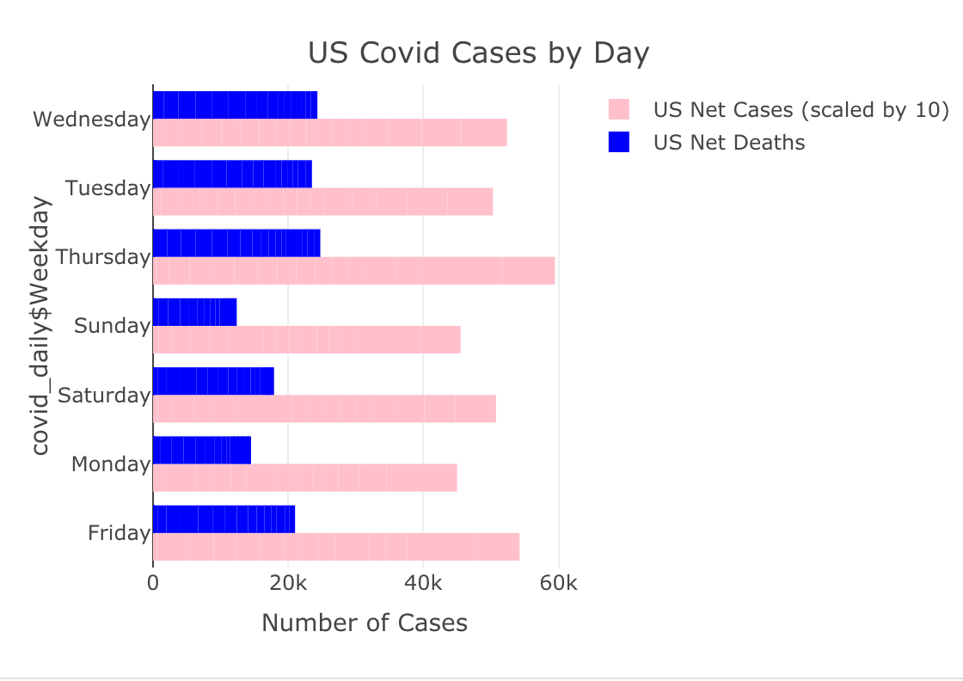
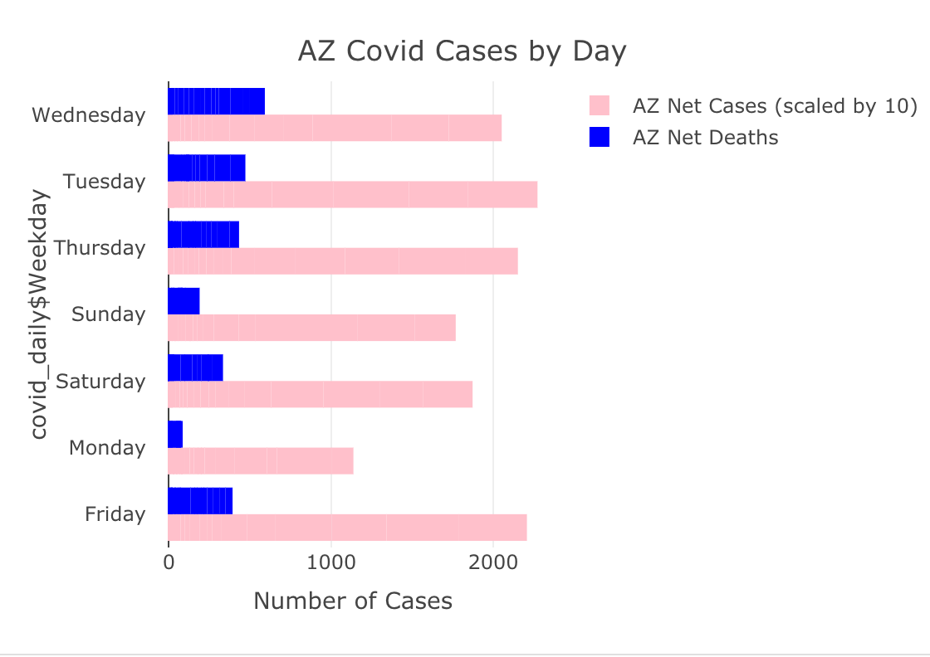
EDA
Similar themes emerge with both the US and AZ data that positive cases and deaths are less reported on Sat-Mon. This may possibly explain any cyclic behavior with our findings.

Slide 7
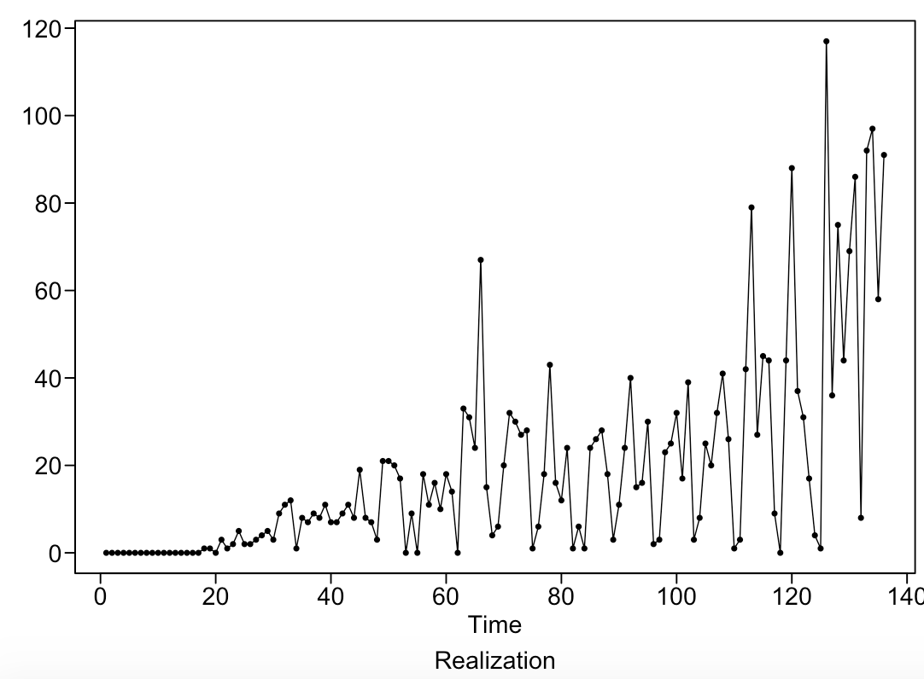
AZ data detail
AZ Daily Deaths: Mar. 4 – Jul. 17
Key Features: Date, New Tests Daily, Daily Positive Cases, Daily Negative Cases, Daily Hospitalized Patients, Daily Deaths and Positive Test Percentage
Arizona State-Wide Covid Case Data from John’s Hopkins
Date Range: March 4 – July 17

Slide 8
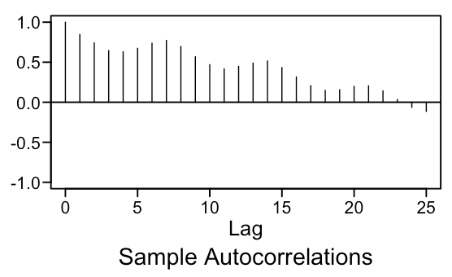
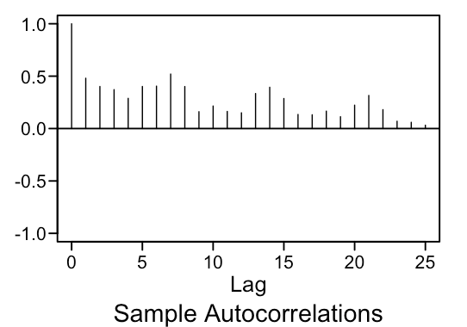
Data Stationarity
US Daily Deaths: Mar. 4 – Jul 21
AZ Daily Deaths: Mar. 4 – Jul. 17
We looked at the stationarity of our key features of interest across the US and Arizona
* Consistent Mean – All of our US and AZ charts show wandering behavior around the mean
* Constant Variance – As time went on, we saw dramatic spikes in our data day over day
* ACFs do not depend on time – We see through our autocorrelations that our ACFs change with time
All of this is evidence against stationarity for all of our key features.

Slide 9
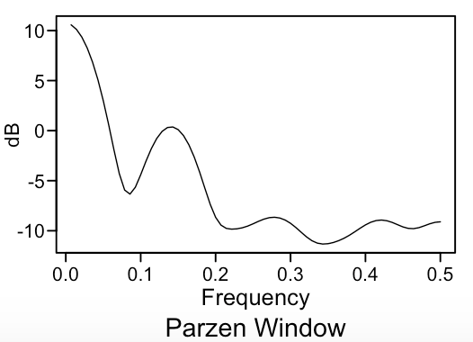
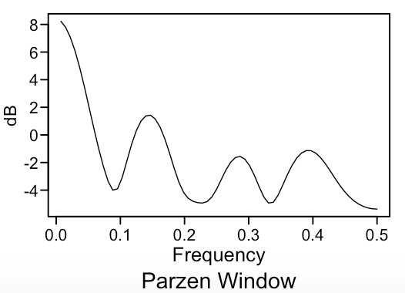
Spectral densities and ACFs
US Daily Deaths - Spectral Density
AZ Daily Deaths - Spectral Density
Reviewing each Spectral Density, we can see a general spike at around .14 which indicates a 7 day cycle, as well as smaller spikes 0.27 and 0.43, which suggest that we may be getting lags for every 9 times and 13 days a month.
The ACFs are dampening with a oscillating behavior which suggests an AR2 model.

Slide 10
Forecasts

