Slide 1
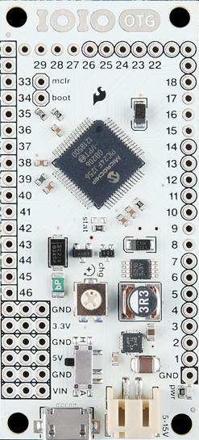
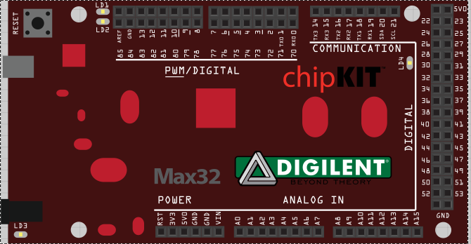
Key pos 3
Key pos 2
Key pos 1
Key pos 0
Z Pul
Z Dir
Y Pul
Y Dir
X Pul
X Dir
Home sensors
Flow
Meters
Solenoids

Slide 2
