Slide 1


DKube at a Glance
Implementing Private AI Infra at Scale for Enterprise
Based in Silicon Valley
Founded and funded by serial entrepreneurs and engineers
Experiencing rapid growth in customer demand for secure, private GenAI
Providing enterprise-grade end-to-end GenAI and agentic solutions deployed on-prem, private cloud or multi-cloud
dkube.io

Slide 2
Core Team
We are an 80 people GenAI company HQ out of Silicon Valley
Experienced delivering complex infrastructure at Scale to Enterprises.
Vinai Kolli
Rajendra Singh
CEO
Chief Architect
D-Link, TeamF1, Wind River
USC, NIT-S
Skiva Technologies, Deep Cognition, TeamF1, IIT-G
Sireesha Mandava
Ajay Tyagi
Director - Engineering
Senior Director
Mahindra Satyam, Motorola
Intel, Dell, Broadcom
IIT-K
dkube.io

Slide 3
Who we are
An AIaaS company specializing in agentic solutions along with providing AI infrastructure with our highly reliable private AI platforms.
Our Platforms
FMOPs
Agentic AI
Our Solutions
DKube QueriLynx
DKube AI Research Lab
DKube CompliQuik
DKube DocMind
AskX
Virtual Teaching Assistant
dkube.io

Slide 4
Privacy and Security
Scalability
Our Approach to Enterprise Needs
All workflows run on-prem or on private VPC, making sure no data leaves the environment.
Scalable infra with option to integrate enterprise storage, helping user or resource-intensive workflows run smoothly.
Cost Efficiency
Observability
Automated scaling, distilled models, minimal footprint, and ultra-low token costs.
End-to-end visibility with lineage, traces, req/resp monitoring, feedback capture, and experiment evaluation.
dkube.io

Slide 5





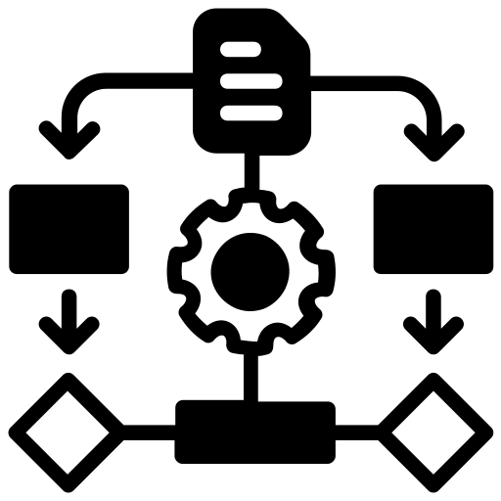

Discovery and Brainstorming
Private GenAI Infra Setup
Solution Design
Our AI Solutions Lifecycle
Pilot and Iteration
Finetuning and Training
Workflow Orchestration
Production Rollout
dkube.io

Slide 6
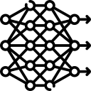

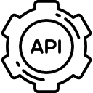

Fine-Tune
Fine-Tune models on domain-specific data for precise, contextual AI
Design Persona
How We Build Our AI Agents
Design agents as specialized personas using prompt engineering
Deploy API
Deploy agents as scalable, secure APIs for real-time integration
Integrate and Monitor
Integrate agents seamlessly into automated workflows for coordinated execution and monitor performance.
dkube.io

Slide 7

Ingest and Index Data
Collect domain-specific data
Preprocess, chunk and embed
Store in a vector database for retrieval
How We Build Our RAG workFlow
Optimize retrieval strategy (e.g. dense, hybrid search)
Tune relevance and ranking
Configure Retriever
Connect retriever to LLM
Apply prompt templates for contextual grounding
Orchestrate with LLM
Expose via API
Monitor retrieval quality, latency and performance
Deploy and Monitor
dkube.io

Slide 8
Our Solutions
Unified, multi-agent platform that lets users explore data from various sources using no code.
Multi agent workflow that lets users to generate hypothesis over a certain topic while refining it, using the elo scores and re-ranking agents.
RAG-native AI copilot that streamlines teaching tasks, personalizes learning, and enhances student engagement in higher education.
QueriLynx
AI Research Lab
Virtual Teaching Assistant
A multi-agent assistant that streamlines workplace processes with intelligent automation, powered by RAG for document retrieval and knowledge querying.
An AI-driven document assistant that streamlines workflows through intelligent sorting, key field extraction, and deep document analysis.
An AI-powered assistant that leverages RAG to quickly retrieve, query, and simplify OSHA compliance documents, ensuring faster, safer, and more efficient workplace decisions.
AskX
DocMind
CompliQuik
dkube.io

Slide 9
What we offer - Your Private AI Advantage
Retrieval Augmented Generation for AI Apps
Securely Fine-tune LLMs with your data
Train & Deploy your models on-prem or cloud
Custom ML Pipelines and Workflow
Reliable Autoscaled Production Serving
Maintain full control over your data & models
Self-serve on your private infrastructure
Seamless integration with your workflows
Tracing & observability of infrastructure resources, model usage, applications
Create your own AI agentic apps and deploy & maintain it at ease
Creation and seamless integration of agentic workflows
dkube.io

Slide 10
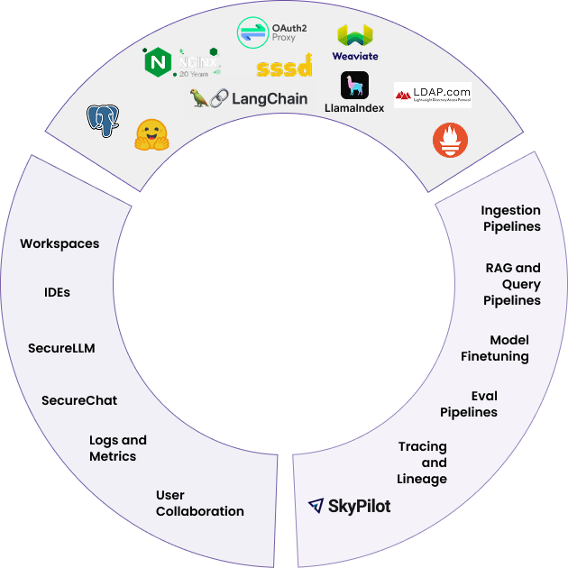


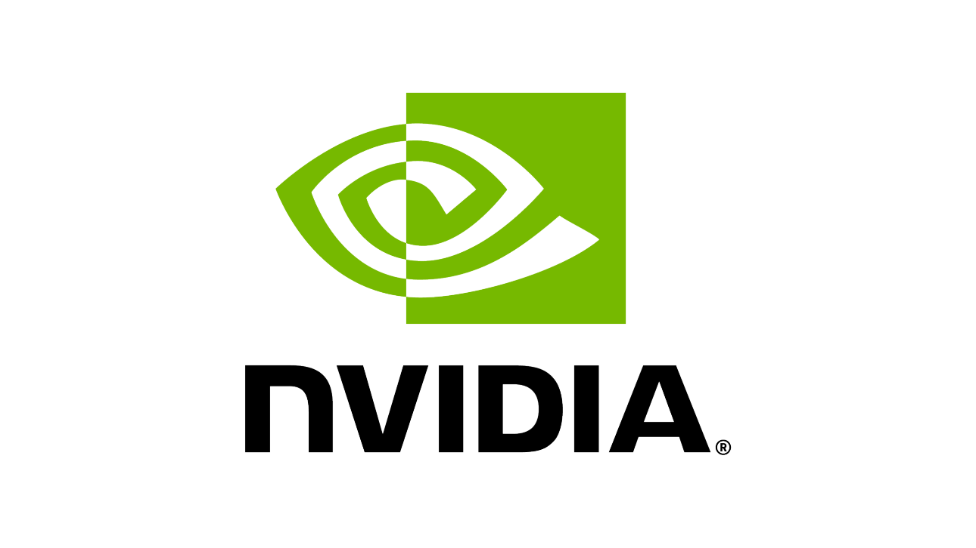

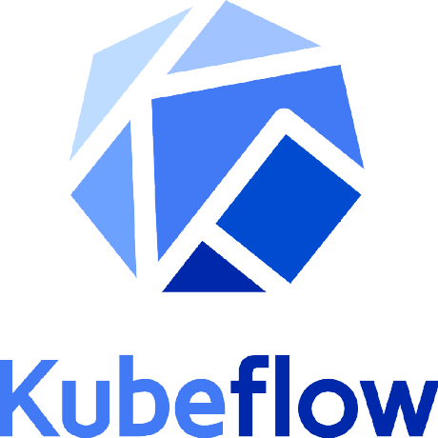

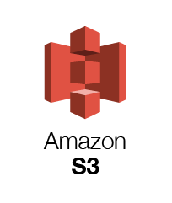
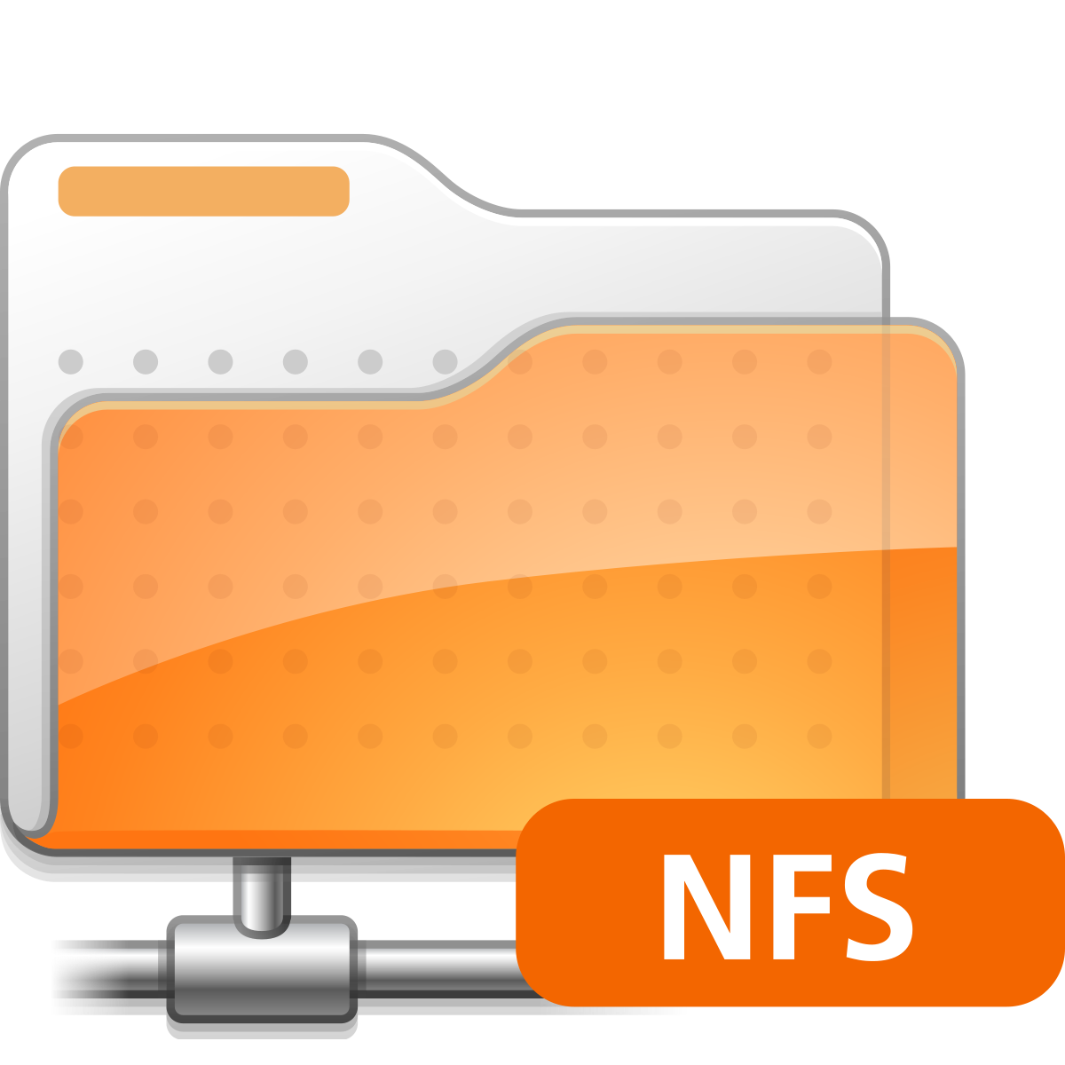
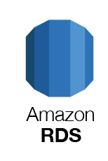
Development tools & Infra Services
Supported External Services
LLM Providers
Our Private AI Platform
The Key Building Blocks
Controllers
DKubeX
FM/LLM
Sky
Private AI Platform Services
LLM Catalog
UI Services
Storage Providers
User Apps & Services
GenAI Apps & Services
dkube.io
Supported Base Distro Infra

Slide 11
Your requirements
What You Have
Your Data
Bridging The Gap
Building and Operating Private AI for your Enterprise
Your On-Prem, Private, Multi-Cloud Infra
Gen AI Tool Chain Build Application
What We Add
Fine-tune
Scalable Compute/
GPU Infra
Security & Observability
dkube.io

Slide 12






Who we serve
dkube.io

Slide 13






Private AI Software
Resellers & Private Cloud Services
Hardware Infra Provider
Strategic Partnerships
dkube.io

Slide 14
Thank You!
dkube.io

