Slide 1


Empowering Enterprise AI on Kubernetes
Backed by 7+ years of Kubernetes expertise, DKube has delivered multiple customer solutions and built robust in-house products for AI and MLOps.
DKubeX is our flagship enterprise-grade private AI platform to build, deploy, and scale Generative AI and ML securely within your infrastructure.
Designed for Kubernetes, it simplifies AI operations while ensuring enterprise-grade security, governance, and cost efficiency.
dkube.io

Slide 2
DKubeX - A Kubernetes Based Platform
DKubeX runs seamlessly on any Kubernetes environment, offering flexibility and portability that align perfectly with AWS strategy.
Supported Environments:
On-Prem / Private Clouds: RKE2, and other Kubernetes distributions for organizations running within their own datacenters or private infrastructure.
Public Clouds: AWS EKS, Azure AKS - offering multi-cloud support and cloud-agnostic deployment across major providers.
dkube.io
Empowering Enterprise AI on Kubernetes

Slide 3

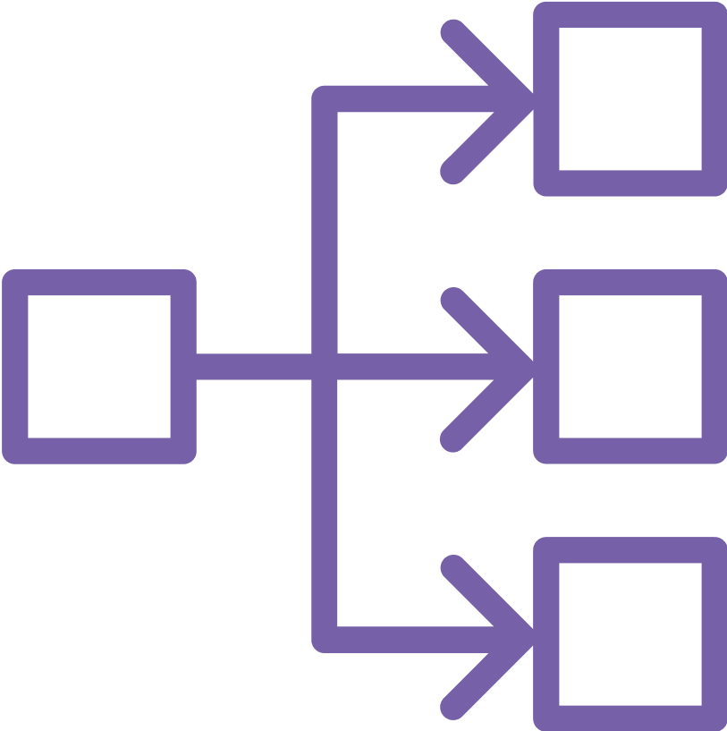
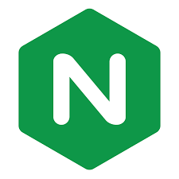



DKubeX on AWS
NLB
NGINX
Auth
Application Interface
SecureChat
API Endpoints
CLI/UI
Security Group
D3X K8S Service
User Interface
FM Controller
D3X Controller
Workspace
LLM Controller
SKY Controller
Feedback
Vector Store
Deployments
MLFlow
KubeFlow
SecureLLM
Databases
Datasets
KServe/vLLM
Model Store
Jobs
Monitoring
Postgres
Cache
LLM/EMB Models
Lineage
Pipelines
Reports
Prometheus/Grafana
Loki
Storage
CPU Nodes
GPU Nodes
EFS
dkube.io
Empowering Enterprise AI on Kubernetes

Slide 4
DKubeX – Features
Robust Security and User Management
Comprehensive User Workspaces
ML Training
ML Serving and Management
MLOps Integration
LLMOps: Powering Generative AI
LLM Fine-Tuning
Generative AI and Agentic Solutions
Simplified Installation
dkube.io
Empowering Enterprise AI on Kubernetes

Slide 5







Customers
dkube.io
Empowering Enterprise AI on Kubernetes
Notes:
altos
thermofischer
roche
cisco
nutanix
stackpath
fungible

Slide 6
Customer Use Cases
Accelerating Research with Compute Platform
Agentic AI Solution
CNI Plugin for Kubernetes
Cloud Native Platform (K8S) Services
Virtual PCIe Fabric management using Kubernetes
App Feedback Input and Analysis
dkube.io
Empowering Enterprise AI on Kubernetes

Slide 7

Build. Scale. Innovate.
Bring GenAI and ML to life securely on AWS Kubernetes – Powered by DKubeX
dkube.io
Empowering Enterprise AI on Kubernetes

Slide 9
Robust Security and User Management
Enterprise-grade access control and identity management are built in.
Supported OAuth Providers:
Git · Okta · Keycloak · Google · Microsoft ADFS
Value to AWS Enterprises:
Seamless integration with corporate identity systems
Role-based access and audit trails for every user action
Meets security and compliance standards expected in regulated industries
dkube.io
Empowering Enterprise AI on Kubernetes

Slide 10
Comprehensive User Workspaces
Pre-configured environments for data scientists and MLOps teams
IDEs: RStudio, JupyterLab, VS Code
Integrated File Browser and Terminal access
Consistent, ready-to-use setup across teams and projects
Accelerates experimentation and collaboration
dkube.io
Empowering Enterprise AI on Kubernetes

Slide 11
ML Training
Provides environments like Jupyter, Vscode, R
Integrates with tools like Ray, Kubeflow and flyte
Tools for training and serving traditional machine learning models.
Run distributed ML jobs on Kubernetes using Ray and submit ML training jobs on cloud (AWS, GCP)
Supports GPU/CPU resource allocation
Ensures reproducible and efficient training workflows
Uses Mlflow for tracking experiments and training runs including the parameters. metrics, artifacts of the training runs.
dkube.io
Empowering Enterprise AI on Kubernetes

Slide 12
ML Model Serving and Management
DKubeX provides flexible model-serving options designed for scalability and performance across environments.
Serving Options:
On Kubernetes: via Ray for containerized inference
In Cloud: via Skypilot for managed GPU/compute utilization
Business Advantage:
Choose deployment method based on workload size and cost profile
Unified management for training, serving, and monitoring ML models
dkube.io
Empowering Enterprise AI on Kubernetes

Slide 13
MLOps Integration
Record parameters, metrics, and artifacts
Reproduce and compare runs
Manage model versioning and lifecycle stages
MLFlow - Experiment Tracking
Design and execute complex ML pipelines on Kubernetes
Ensure consistency and scalability across teams
KubeFlow - Orchestration
Automate tuning to improve accuracy and reduce iteration time
Optuna - Hyperparameter Optimization
Real-time insights into model performance and training behavior
Tensorboard - Visualization
dkube.io
Empowering Enterprise AI on Kubernetes

Slide 14
LLMOps: Powering Generative AI
Purpose-built for modern Generative AI workloads on Kubernetes– providing seamless management of LLMs and embedding models across training, deployment, and inference pipelines - both on-prem and across cloud environments.
Core Components:
LLM/Embedding Model Catalog: Ready-to-deploy open-source and NVIDIA NIM models (LLMs and embeddings)
Deployment: KServe (local) or Skypilot (AWS, GCP)
Inference: Run on local GPUs or cloud GPU nodes
Scaling: Auto-optimization for cost and performance
API Access: Standardized endpoints for application integration
dkube.io
Empowering Enterprise AI on Kubernetes

Slide 15
LLM Fine-Tuning
Key Features:
DKubeX simplifies the complex process of fine-tuning LLMs and embedding models
Axolotl Framework: human-readable configuration for fine-tuning jobs
Simplify fine-tuning with intuitive, YAML-based workflows.
Methods Supported: LoRA and QLoRA for efficient tuning
Embeddings: Flag Embedding for performance gains
Synthetic Data Generation: automatic positive/negative example creation
Value:
Accelerated LLM customization for domain-specific applications without infrastructure overhead.
dkube.io
Empowering Enterprise AI on Kubernetes

Slide 16
Generative AI and Agentic Solutions
Enables enterprise-grade Generative AI and multi-agent systems on Kubernetes, accelerating innovation and simplifying rapid GenAI deployment
Retrieval-Augmented Generation (RAG): Build chatbots that understand and respond using enterprise data
Agentic AI: Develop secure, scalable, and cost-efficient end-to-end AI workflows
Framework Proficiency: LangChain · LlamaIndex · LangFlow · MCP Server · LangGraph
dkube.io
Empowering Enterprise AI on Kubernetes

Slide 17
Simplified Installation
DKubeX’s installation process, powered by Terraform and Helm, enables rapid deployment across both AWS, other clouds or on-prem environments.
Terraform-based installation provisions and configures all necessary AWS infrastructure — including EKS clusters, networking, storage, and IAM roles — ensuring a fully integrated and production-ready environment within minutes.
RKE2 installation using Helm charts for simplified on-prem deployments
Consistent configuration across environments ensures repeatability and compliance
dkube.io
Empowering Enterprise AI on Kubernetes

Slide 18
Accelerating Research with Compute Platform
High-speed compute platform enabling on-demand infrastructure provisioning and reduced time-to-experiment.
Diverse Resources: Quick access to EKS Containers (K8s), EC2 VMs, AWS Parallel Clusters (HPC), and Ray Clusters (AI/ML)
Bridges local development with cloud compute for maximum productivity. Dedicated Desktop App and CLI Commands connect local tools directly to cloud resources
Integrated Workflows: Pre-bundled software for day to day development by users, easy access to dataset using S3 bucket mounting, and simplified Authentication and Authorization
Observability & monitoring of all user & system resources
Cost Optimization: Auto-shutdown of idle nodes, workspaces to reduce spend.Integrated with slack alerts to intimate users.
dkube.io
Empowering Enterprise AI on Kubernetesc

Slide 19
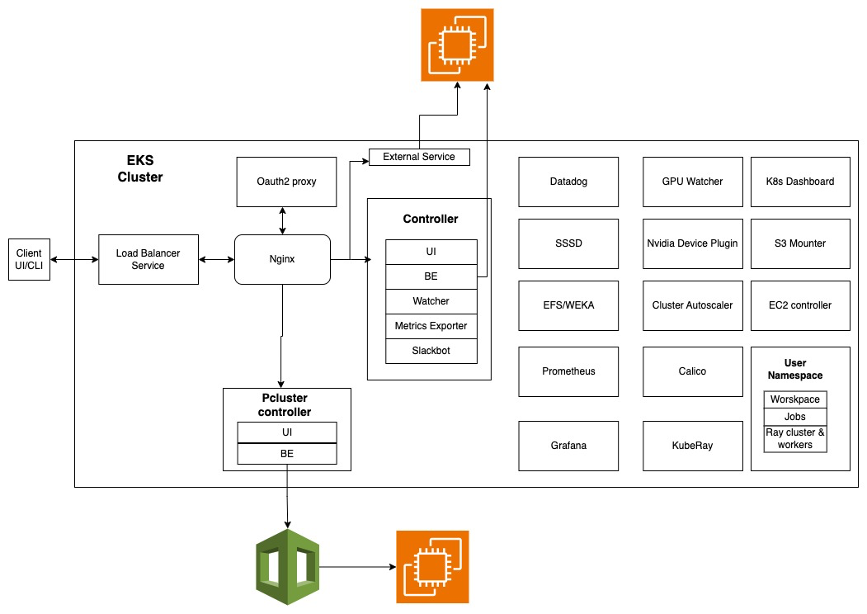
Use Case : Accelerating Research with Compute Platform
dkube.io
Empowering Enterprise AI on Kubernetesc

Slide 20
Use Case : Agentic AI Solution
Developed an intelligent research agent platform leveraging AWS and Bedrock to enhance scientific discovery.
Reasoning & Generation: Integrated Bedrock (Claude) as the core LLM for advanced research insights.
Agent Framework: Built using the Strands Agent SDK to enable autonomous, agentic workflows.
Infrastructure: Deployed on AWS ECS (Fargate) for scalable, containerized services.
Security & Access: Secured via AWS CloudFront + ALB stack and AWS Cognito for identity management.
dkube.io
Empowering Enterprise AI on Kubernetes

Slide 21
Use Case : CNI Plugin for Kubernetes
Built Container Network interface(CNI) for Kubernetes for ACI fabric.
CNI enables containers and pods running in Kubernetes to directly leverage ACI’s policy, segmentation and visibility capabilities.
The plugin provides all networking and security requirements for OpenShift cluster.
Involved in end-to-end automation and verification of CNI plugin in different releases and eco systems (RKE, K8s, OpenShift)
Verification on bare metal, OpenStack VMs, ESX VMs
Optimized some of the features of ACI CNI like SNAT, Network Policies
dkube.io
Empowering Enterprise AI on Kubernetes

Slide 22
Use Case : Cloud-Native Platform (K8s) Services
Worked for Edge Computing Platform provider and implemented cloud native platform(K8s) services to manage
Compute resources(VM and container workloads)
GPU enablement and monitoring for both VM and container workloads
IPv4, IPv6 and dual-network stack support for workload networking using CNI plugins and OVS + SmartNIC on compute hosts.
SmartNIC Open vSwitch integration.
Telemetry
dkube.io
Empowering Enterprise AI on Kubernetes

Slide 23
Use Case : Virtual PCIe Fabric management using Kubernetes
Core objective was to virtualize PCIe connections, enabling remote devices to appear as locally attached to the host system via the PCIe protocol.
Multiple microservices were developed to manage the orchestration, network tunneling and monitoring the virtual PCIe fabric.
Microservices are run as Kubernetes workloads
dkube.io
Empowering Enterprise AI on Kubernetes

Slide 24
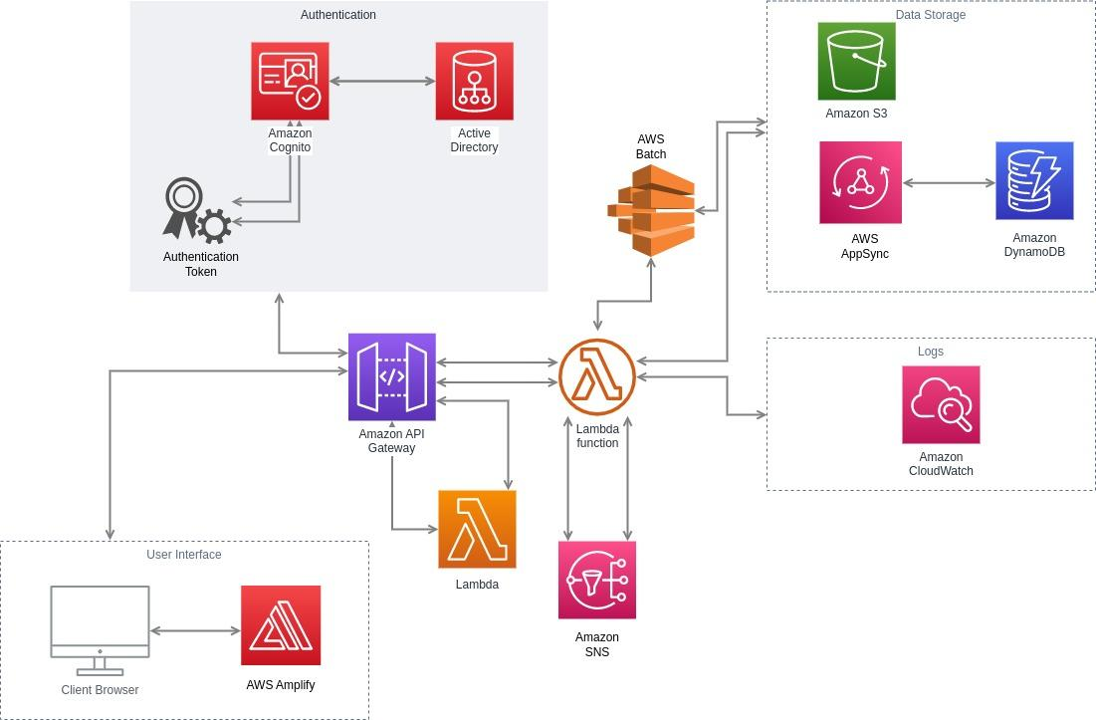
Use Case : App Feedback Input and Analysis
dkube.io
Empowering Enterprise AI on Kubernetes

